Slide 1
Ch. 8: Validation and Using DTDs
Seoul National University, Internet Database Laboratory
July, 2011
Jee-bum Park

Slide 2
Contents
Creating an External DTD
Declaring an External DTD
Declaring and Creating an Internal DTD
Validating XML Documents Against a DTD
Naming a Public External DTD
Declaring a Public External DTD
Pros and Cons of DTDs

Slide 3
Creating an External DTD
You can create an external file that contains the DTD
team.dtd
map_reduce.xml
tagging.xml
ontology.xml

Slide 4
Creating an External DTD
You can create an external file that contains the DTD
<!ELEMENT wonder (name, location, height)>
<!ELEMENT name (#PCDATA)>
<!ELEMENT location (#PCDATA)>
<!ELEMENT height (#PCDATA)>
08-01.dtd

Slide 5
Declaring an External DTD
You need to refer to the external DTD within your XML document
Corresponds to the name of the root element in this XML document
This tells the XML parser that the document will rely on an external file
<?xml version="1.0" standalone="no"?>
<!DOCTYPE wonder SYSTEM "08-01.dtd">
<wonder>
<name>Colossus of Rhodes</name>
<location>Greece</location>
<height>107</height>
</wonder>
xml
The location URI of the DTD content file

Slide 6
Declaring and Creating an Internal DTD
It is simplest to declare and create the DTD within the XML
Corresponds to the name of the root element in this XML document
<?xml version="1.0"?>
<!DOCTYPE wonder [
<!ELEMENT wonder (name, location, height)>
<!ELEMENT name (#PCDATA)>
<!ELEMENT location (#PCDATA)>
<!ELEMENT height (#PCDATA)>
]>
<wonder>
<name>Colossus of Rhodes</name>
<location>Greece</location>
<height>107</height>
</wonder>
xml

Slide 7
Declaring and Creating an Internal DTD
Combining both an internal and external DTD
Corresponds to the name of the root element in this XML document
<?xml version="1.0"?>
<!DOCTYPE wonder SYSTEM "08-01.dtd"[
<!ATTLIST height units CDATA #REQUIRED>
]>
<wonder>
<name>Colossus of Rhodes</name>
<location>Greece</location>
<height units="feet">107</height>
</wonder>
xml
The location URI of the DTD content file

Slide 8
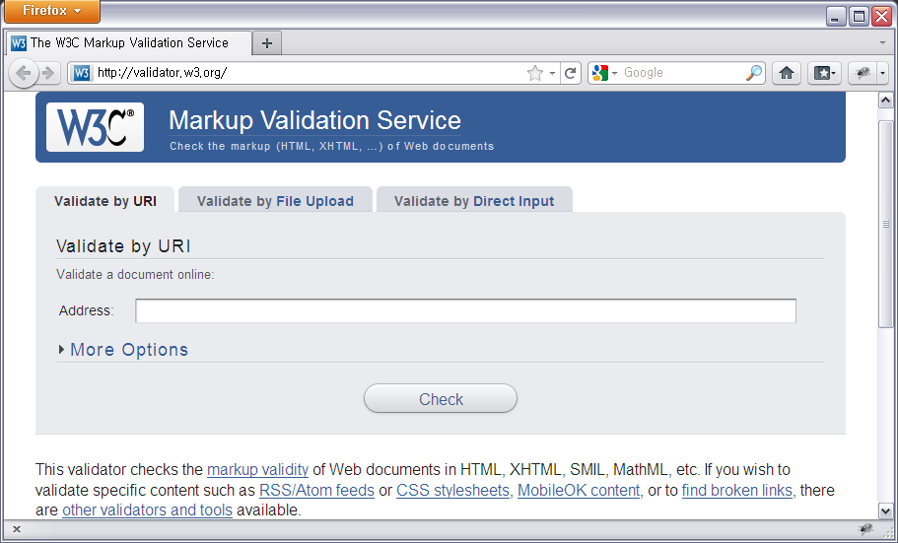
Validating XML Documents Against a DTD
http://validator.w3.org/

Slide 9
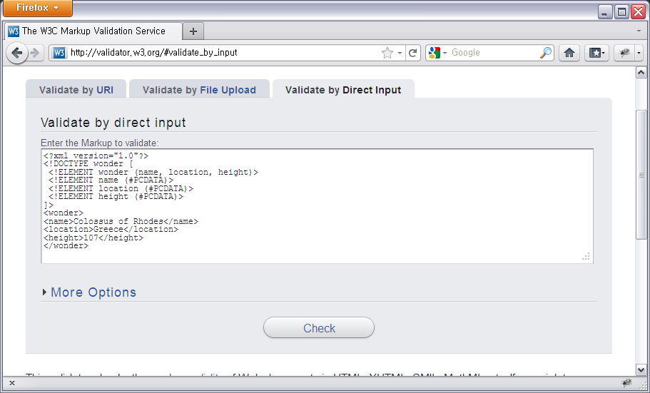
Validating XML Documents Against a DTD
http://validator.w3.org/

Slide 10
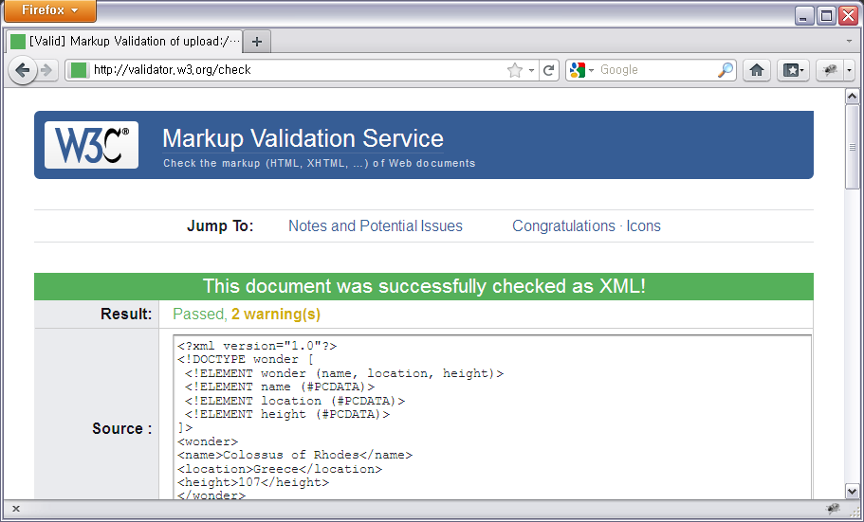
Validating XML Documents Against a DTD
http://validator.w3.org/

Slide 11
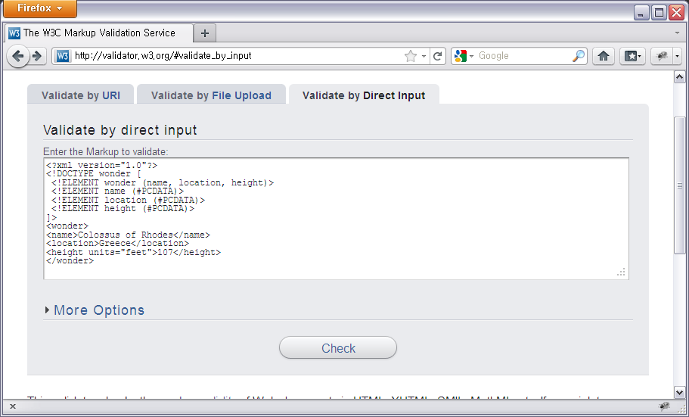
Validating XML Documents Against a DTD
http://validator.w3.org/

Slide 12
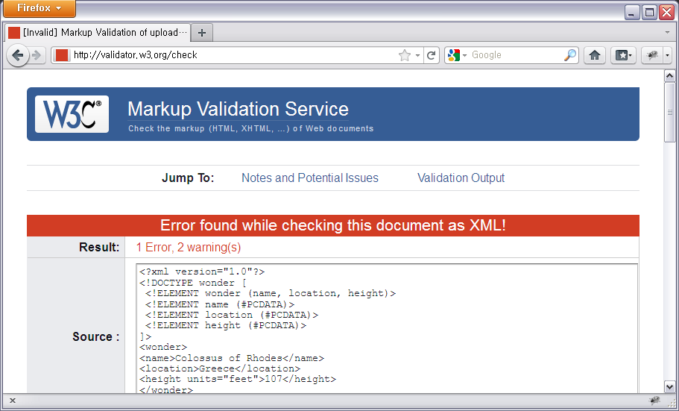
Validating XML Documents Against a DTD
http://validator.w3.org/

Slide 13
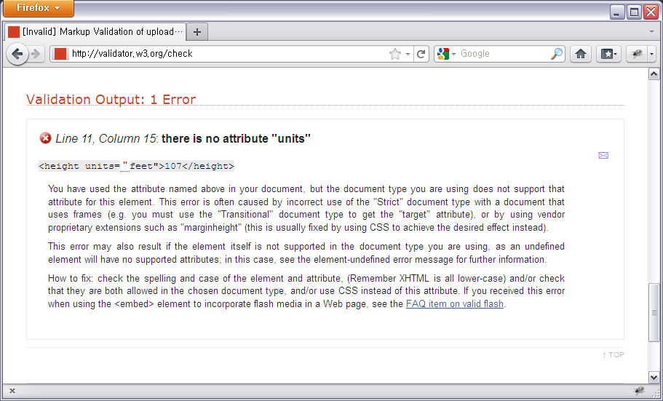
Validating XML Documents Against a DTD
http://validator.w3.org/

Slide 14
Naming a Public External DTD
If your DTD will be used by others, you should name your DTDs in STANDARD WAY
Using a formal public identifier (FPI)
An XML parser could use the FPI to find the latest version of the DTD on a public Web server

Slide 15
Naming a Public External DTD
Formal public identifier (FPI)
-: if your DTD is not a standard (this is most common)
+: if your DTD is an approved non-ISO standard
ISO: if your DTD is an approved ISO standard
Language
-//okbem//DTD okbemML 3.0//EN
Owner who wrote and will maintain the DTD
DTD Description
(should contain a unique element)

Slide 16
Declaring a Public External DTD
To declare a public external DTD:
Corresponds to the name of the root element in this XML document
Formal public identifier
<?xml version="1.0"?>
<!DOCTYPE ancient_wonders PUBLIC
"-//kehogo//DTD WowML 2.0//EN"
"http://www.kehogo.com/dtd/wonders-master.dtd">
<ancient_wonders>
...
</ancient_wonders>
xml
The location URI of the DTD content file

Slide 17
Pros and Cons of DTDs
Some pros of using DTDs
They are compact and easily comprehended with a little direction
They can be defined inline (internal DTDs) for quick development
They can define entities (see Ch. 7)
They are the most widely accepted and are supported by most XML parsers
Some cons of using DTDs
They are not written using XML syntax, and require parsers to support an additional language
They do not support Namespaces (see Ch. 12 and 13)
They do not have data type, thereby decreasing the strength of the validation
They have limited capacity to define how many child elements can nest within a given parent element

