Slide 1
Relationship between the level of intimacy and lurking in online social network services
Pei-Luen Patrick Rau, Qin Gao, Yinan Ding
Computers in Human Behavior 24, 2008
18 Dec 2015
Hyewon Lim

Slide 2
Table of Content
Introduction
Research Framework and Questions
Methodology
Results
Discussion

Slide 3
Introduction
Intimacy
An essential aspect of the social network tie and interpersonal relationship
Active posting is desired
Users’ active and public participance is critical to the success of SNSs
Understand the reasons behind lurking in SNS
Difference from traditional online communities

Slide 4
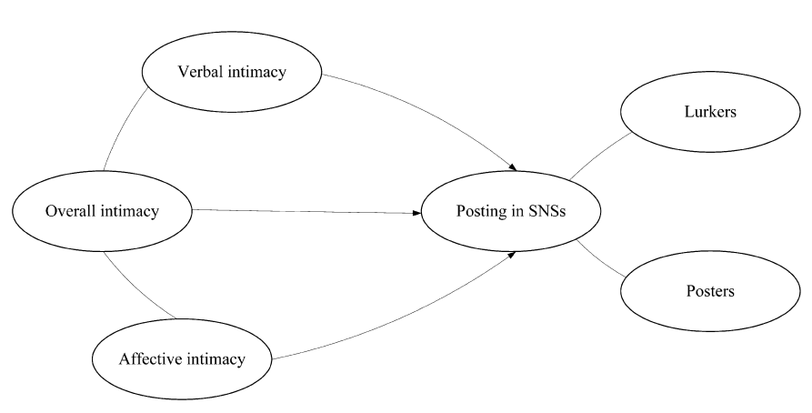
Research Framework and Questions
“Just browsing/reading is enough.”
In information-seeking orientated communities
The level of interpersonal intimacy
Hypothesize to influence user posting behavior

Slide 5
Research Framework and Questions
Verbal intimacy
An important ingredient of tie strength or intimacy
People sharing an intimate relationship communicate more frequently
Discussing topics of a wider breadth
The depth of self-disclosure is deep
Affective intimacy
The presence of emotional closeness and affective feelings
Sharing each others innermost emotional worlds

Slide 6
Research Framework and Questions
Research Question 1
Does the level of verbal intimacy in a SNS have an influence on posting frequency in that SNS?
The need and the possibility for self-disclosure are low, which leads to lurking behaviors
Research Question 2
Does the level of affective intimacy in a SNS have an influence on posting frequency in the SNS?
People feeling affectively intimate will post more because they seek more emotional supports and the possibility that they can receive satisfactory supports is high

Slide 7
Research Framework and Questions
Research Question 3
: How lurkers and posters differ in terms of their verbal and affective intimacy levels?
Both verbal and affective intimacy levels influence posting behaviors, and consequently influence whether a user becomes a lurker or a poster

Slide 8
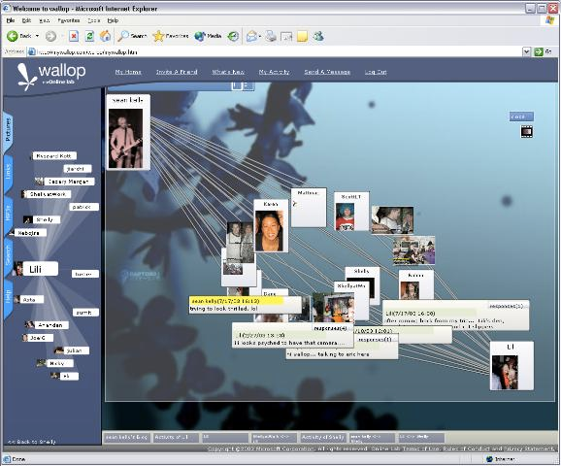
Methodology
Wallop
768 invitations, 102 responses

Slide 9
Methodology
Questionnaire design
Section A
Measures of the posting frequency and lurking level in Wallop
Section B (verbal intimacy)
Measured by the depth and thebreadth of interactions
Section C (affective intimacy)
The feeling of closeness and emotional bonding
Include Parks and Floyd’s scale (Parks & Floyd, 1996)
Overall intimacy = verbal intimacy + affective intimacy

Slide 10
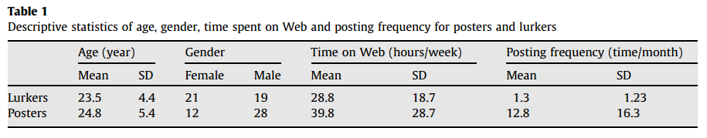
Results
Descriptive statistics
40 lurkers, 40 posters
48 males, 34 females (age: 18-49)
64 students (46 undergraduate)
Almost had a college or above level education
The average amount of computer use = 34.3 hours/week

Slide 11
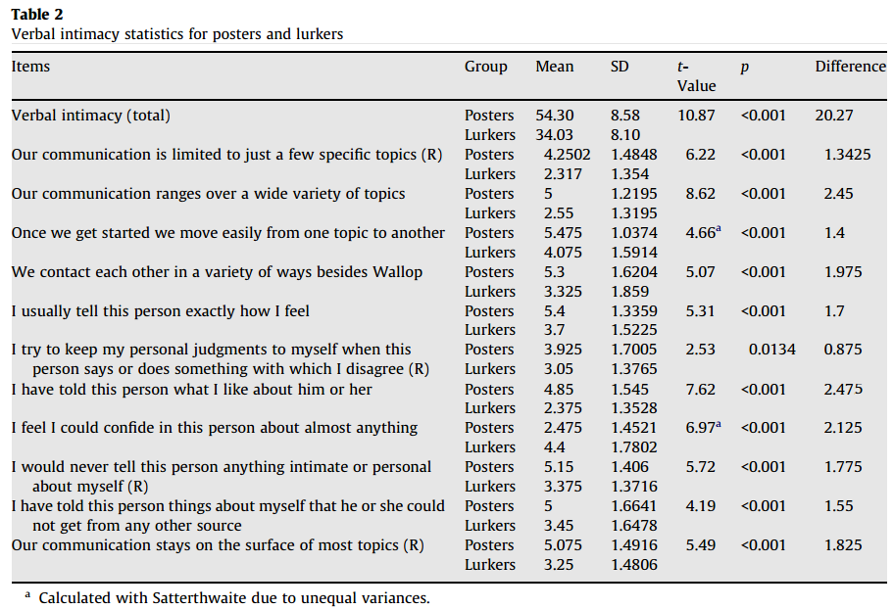
Results
Descriptive statistics

Slide 12
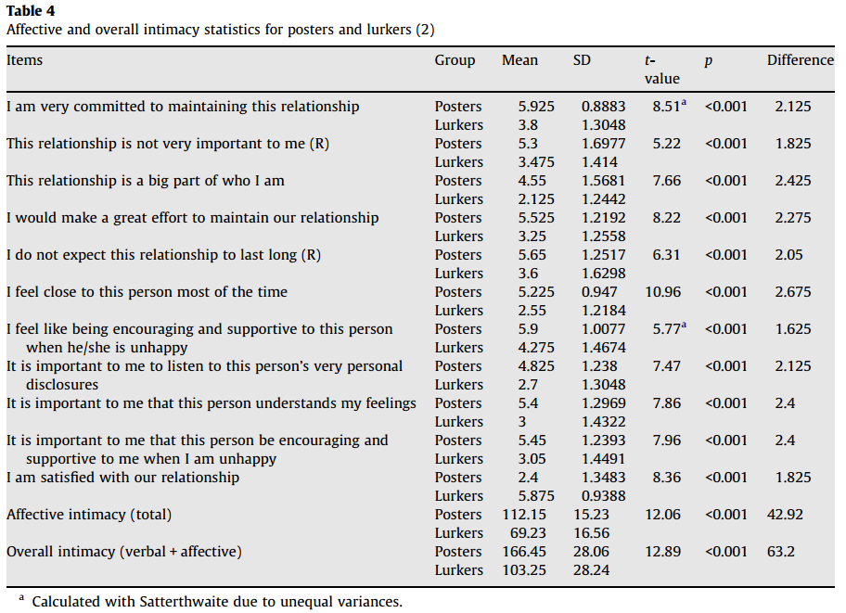
Results
Descriptive statistics

Slide 13
Results
Intimacy and posting
Pearson correlation coefficients
Both the verbal and the affective intimacy levels are positively correlated with posting frequency
Discriminant analysis!

Slide 14
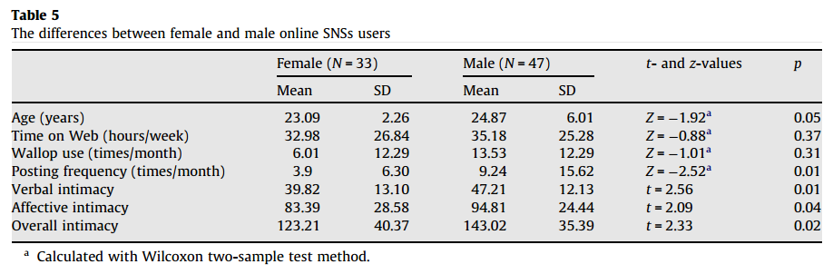
Results
The influence of gender
Verbal and affective intimacy: male > female
Posting frequency: male > female

Slide 15
Discussion
People lurk on SNSs
they believe that their social-emotional needs may not be satisfied even if they post
People in SNSs are connected in a person-to-person manner
Changes people’s expectations for potential audience and possible responses
Forums vs. SNSs
Relevant expertise vs. friends

Slide 16
Discussion
Higher verbal intimacy
People feel free with various topics and in-depth disclosure
Affective intimacy
Correlated with posting frequency
The strength of the emotional support is often weak due to the limited affective intimacy
Gender
Influence the perceived intimacy and the posting behavior of users

