Slide 1
Chapter 12 – Cluster Analysis
Data Mining for Business Intelligence
Shmueli, Patel & Bruce
© Galit Shmueli and Peter Bruce 2008

Slide 2
Clustering: The Main Idea
Goal: Form groups (clusters) of similar records
Used for segmenting markets into groups of similar customers
Example: Claritas segmented US neighborhoods based on demographics & income: “Furs & station wagons,” “Money & Brains”, …

Slide 3
Other Applications
Periodic table of the elements
Classification of species
Grouping securities in portfolios
Grouping firms for structural analysis of economy
Army uniform sizes

Slide 4
Example: Public Utilities
Goal: find clusters of similar utilities
Data: 22 firms, 8 variables
  Fixed-charge covering ratio
  Rate of return on capital
  Cost per kilowatt capacity
  Annual load factor
  Growth in peak demand
  Sales
  % nuclear
  Fuel costs per kwh

Slide 5
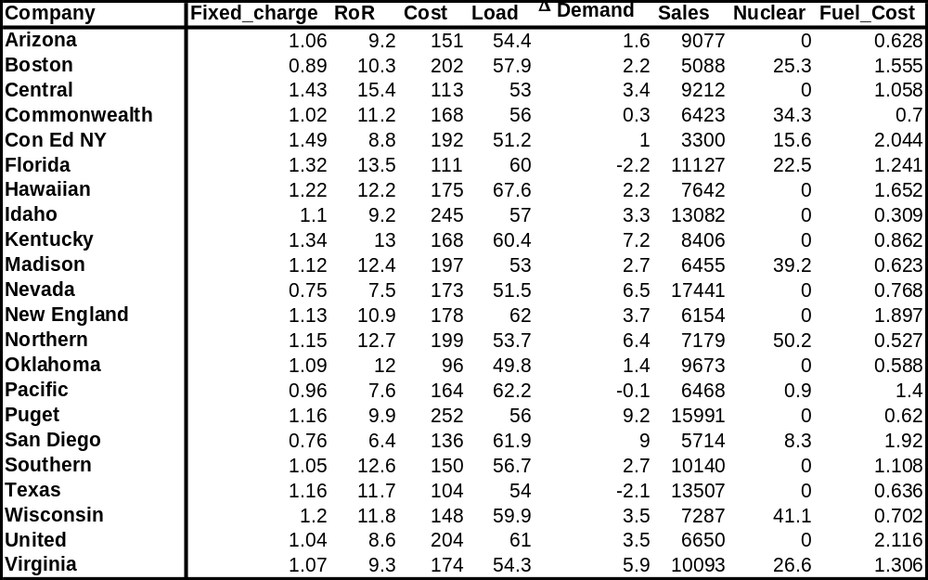

Slide 6
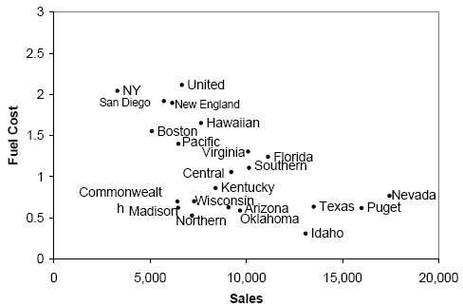
Sales & Fuel Cost:
3 rough clusters can be seen
High fuel cost, low sales
Low fuel cost, high sales
Low fuel cost, low sales

Slide 7
Extension to More Than 2 Dimensions
In prior example, clustering was done by eye
Multiple dimensions require formal algorithm with
  A distance measure
  A way to use the distance measure in forming clusters
We will consider two algorithms: hierarchical and non-hierarchical

Slide 8
Hierarchical Clustering

Slide 9
Hierarchical Methods
Agglomerative Methods
  Begin with n-clusters (each record its own cluster)
  Keep joining records into clusters until one cluster is left (the entire data set)
  Most popular
Divisive Methods
  Start with one all-inclusive cluster
  Repeatedly divide into smaller clusters

Slide 10
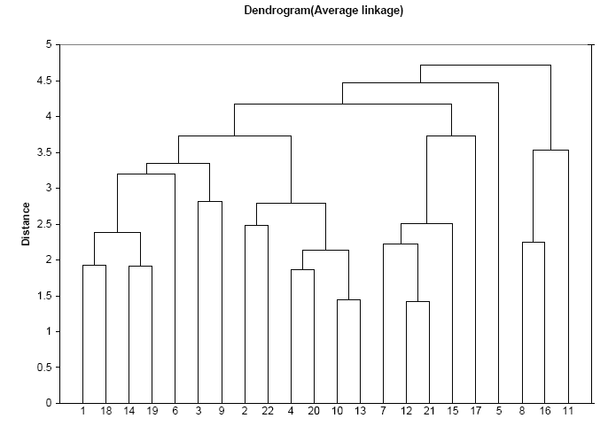
A Dendrogram shows the cluster hierarchy

Slide 11
Measuring Distance
Between records
Between clusters

Slide 12
Measuring Distance Between Records

Slide 13
Distance Between Two Records
Euclidean Distance is most popular:

Slide 14
Normalizing
Problem: Raw distance measures are highly influenced by scale of measurements
Solution: normalize (standardize) the data first
  Subtract mean, divide by std. deviation
  Also called z-scores

Slide 15
Example: Normalization
For 22 utilities:
Avg. sales = 8,914
Std. dev. = 3,550
Normalized score for Arizona sales:
  (9,077-8,914)/3,550 = 0.046

Slide 16
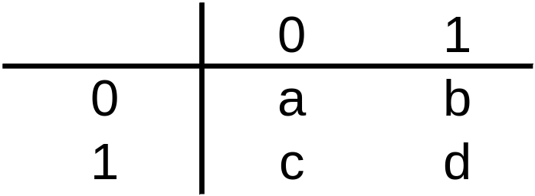
For Categorical Data: Similarity
To measure the distance between records in terms of two 0/1 variables, create table with counts:
Similarity metrics based on this table:
Matching coef. = (a+d)/p
Jaquard’s coef. = d/(b+c+d)
  Use in cases where a matching “1” is much greater evidence of similarity than matching “0” (e.g. “owns Corvette”)

Slide 17
Other Distance Measures
Correlation-based similarity
Statistical distance (Mahalanobis)
Manhattan distance (absolute differences)
Maximum coordinate distance
Gower’s similarity (for mixed variable types: continuous & categorical)

Slide 18
Measuring Distance Between Clusters

Slide 19
Minimum Distance
(Cluster A to Cluster B)
Also called single linkage
Distance between two clusters is the distance between the pair of records A_{i} and B_{j} that are closest

Slide 20
Maximum Distance
(Cluster A to Cluster B)
Also called complete linkage
Distance between two clusters is the distance between the pair of records A_{i} and B_{j} that are farthest from each other

Slide 21
Average Distance
Also called average linkage
Distance between two clusters is the average of all possible pair-wise distances

Slide 22
Centroid Distance
Distance between two clusters is the distance between the two cluster centroids.
Centroid is the vector of variable averages for all records in a cluster

Slide 23
The Hierarchical Clustering Steps (Using Agglomerative Method)
Start with n clusters (each record is its own cluster)
Merge two closest records into one cluster
At each successive step, the two clusters closest to each other are merged
Dendrogram, from bottom up, illustrates the process

Slide 24
Records 12 & 21 are closest & form first cluster

Slide 25
Reading the Dendrogram
See process of clustering: Lines connected lower down are merged earlier
  10 and 13 are merged next
Determining number of clusters: For a given “distance between clusters”, a horizontal line intersects the clusters that are that far apart, to create clusters
  E.g., at distance of 4.6 (red line in next slide), data can be reduced to 2 clusters -- The smaller of the two is circled
  At distance of 3.6 (green line) data can be reduced to 6 clusters, including the circled cluster

Slide 27
Validating Clusters

Slide 28
Interpretation
Goal: obtain meaningful and useful clusters
Caveats:
  (1) Random chance can often produce apparent clusters
  (2) Different cluster methods produce different results
Solutions:
Obtain summary statistics
Also review clusters in terms of variables not used in clustering
Label the cluster (e.g. clustering of financial firms in 2008 might yield label like “midsize, sub-prime loser”)

Slide 29
Desirable Cluster Features
Stability – are clusters and cluster assignments sensitive to slight changes in inputs? Are cluster assignments in partition B similar to partition A?
Separation – check ratio of between-cluster variation to within-cluster variation (higher is better)

Slide 30
Nonhierarchical Clustering:
K-Means Clustering

Slide 31
K-Means Clustering Algorithm
Choose # of clusters desired, k
Start with a partition into k clusters
  Often based on random selection of k centroids
At each step, move each record to cluster with closest centroid
Recompute centroids, repeat step 3
Stop when moving records increases within-cluster dispersion

Slide 32
K-means Algorithm:
Choosing k and Initial Partitioning
Choose k based on the how results will be used
  e.g. “How many market segments do we want?”
Also experiment with slightly different k’s
Initial partition into clusters can be random, or based on domain knowledge
  If random partition, repeat the process with different random partitions

Slide 33
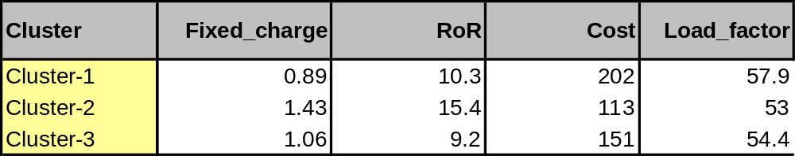
XLMiner Output: Cluster Centroids
We chose k = 3
4 of the 8 variables are shown

Slide 34
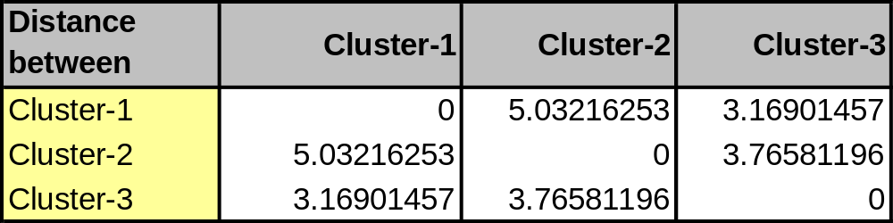
Distance Between Clusters
Clusters 1 and 2 are relatively well-separated from each other, while cluster 3 not as much

Slide 35
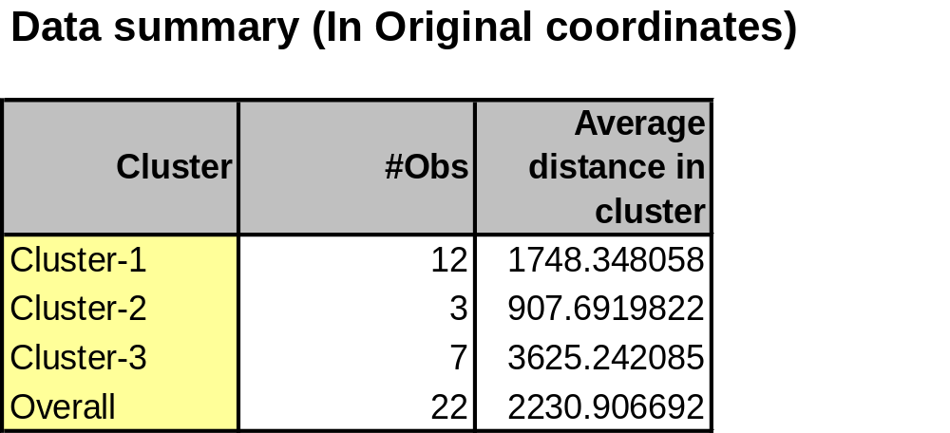
Within-Cluster Dispersion
Clusters 1 and 2 are relatively tight, cluster 3 very loose
Conclusion: Clusters 1 & 2 well defined, not so for cluster 3
Next step: try again with k=2 or k=4

Slide 36
Summary
Cluster analysis is an exploratory tool. Useful only when it produces meaningful clusters
Hierarchical clustering gives visual representation of different levels of clustering
  On other hand, due to non-iterative nature, it can be unstable, can vary highly depending on settings, and is computationally expensive
Non-hierarchical is computationally cheap and more stable; requires user to set k
Can use both methods
Be wary of chance results; data may not have definitive “real” clusters

