Slide 1
Multiple Linear Regression
Data Mining for Business Intelligence
Shmueli, Patel & Bruce
© Galit Shmueli and Peter Bruce 2008

Slide 2
Topics
Explanatory vs. predictive modeling with regression
Example: prices of Toyota Corollas
Fitting a predictive model
Assessing predictive accuracy
Selecting a subset of predictors

Slide 3
Explanatory Modeling
Goal: Explain relationship between predictors (explanatory variables) and target
Familiar use of regression in data analysis
Model Goal: Fit the data well and understand the contribution of explanatory variables to the model
“goodness-of-fit”: R², residual analysis, p-values

Slide 4
Predictive Modeling
Goal: predict target values in other data where we have predictor values, but not target values
Classic data mining context
Model Goal: Optimize predictive accuracy
Train model on training data
Assess performance on validation (hold-out) data
Explaining role of predictors is not primary purpose (but useful)

Slide 5
Example: Prices of Toyota Corolla
ToyotaCorolla.xls
Goal: predict prices of used Toyota Corollas based on their specification
Data: Prices of 1442 used Toyota Corollas, with their specification information

Slide 6
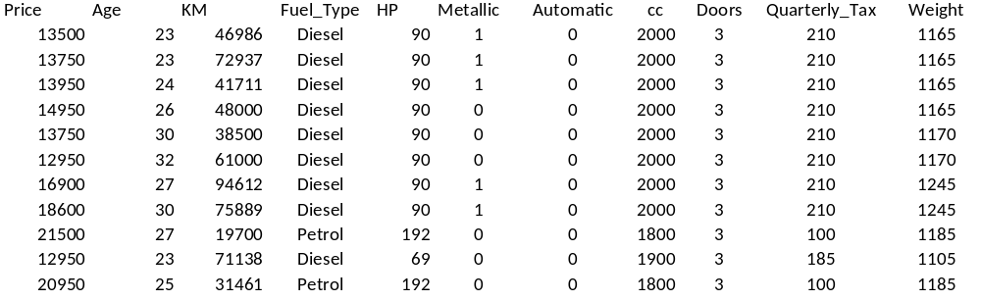
Data Sample
(showing only the variables to be used in analysis)

Slide 7
Variables Used
Price in Euros
Age in months as of 8/04
KM (kilometers)
Fuel Type (diesel, petrol, CNG)
HP (horsepower)
Metallic color (1=yes, 0=no)
Automatic transmission (1=yes, 0=no)
CC (cylinder volume)
Doors
Quarterly_Tax (road tax)
Weight (in kg)

Slide 8
Preprocessing
Fuel type is categorical, must be transformed into binary variables
  Diesel (1=yes, 0=no)
  CNG (1=yes, 0=no)
  None needed for “Petrol” (reference category)

Slide 9
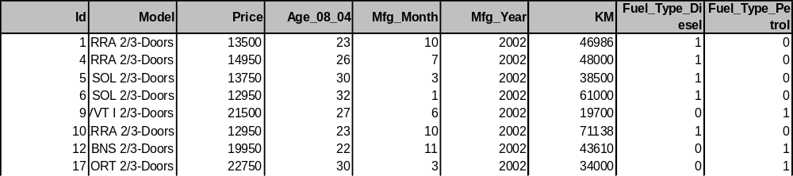
Subset of the records selected for training partition (limited # of variables shown)
60% training data / 40% validation data

Slide 10
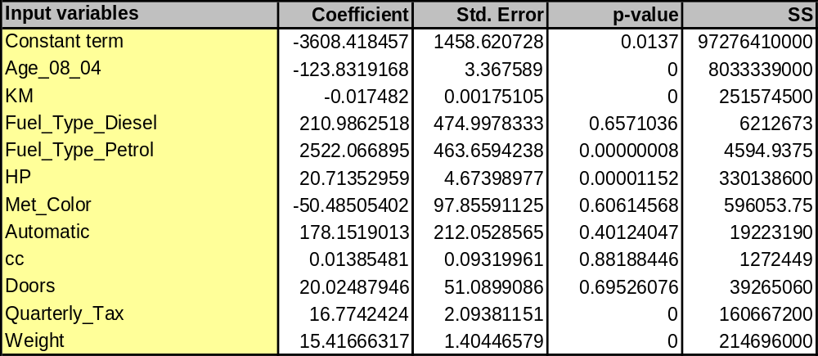
The Fitted Regression Model

Slide 11
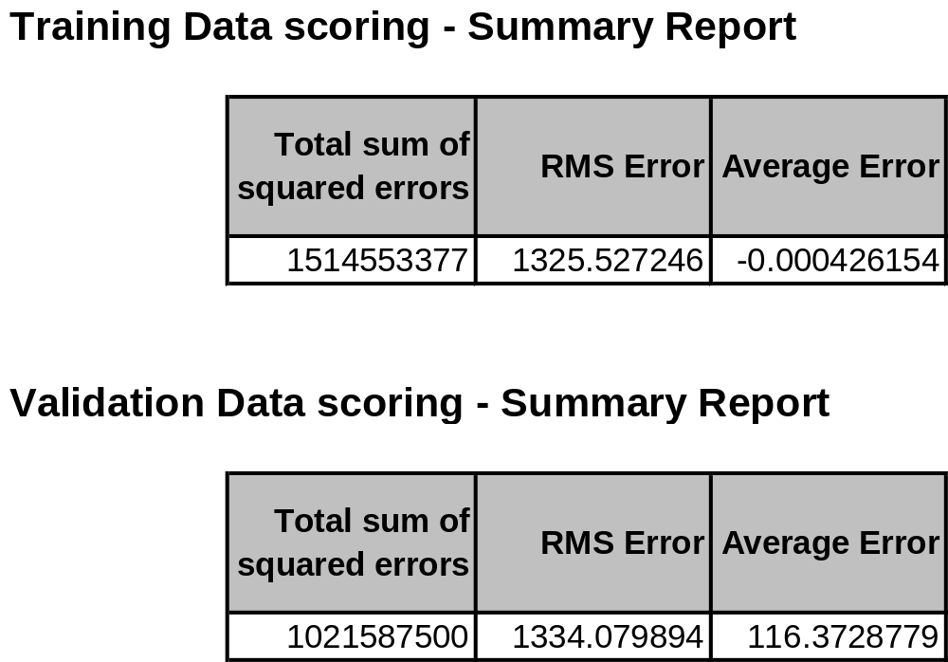
Error reports

Slide 12
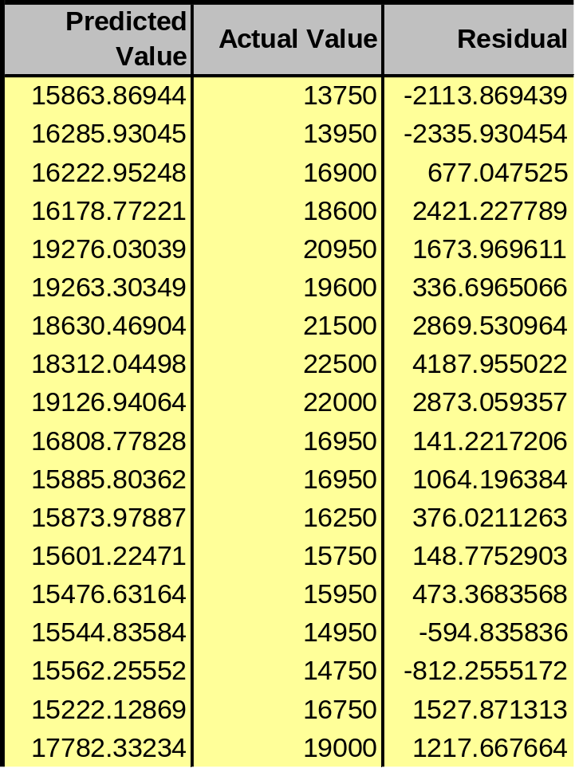
Predicted Values
Residuals = difference between actual and predicted prices
Predicted price computed using regression coefficients

Slide 13
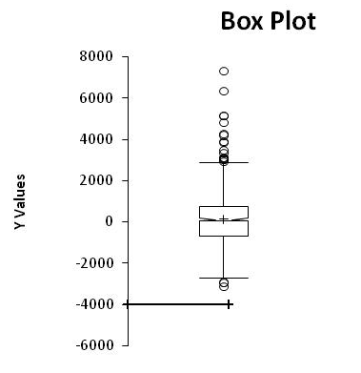
Distribution of Residuals
Symmetric distribution
Some outliers

Slide 14
Selecting Subsets of Predictors
Goal: Find parsimonious model (the simplest model that performs sufficiently well)
  More robust
  Higher predictive accuracy
Exhaustive Search
Partial Search Algorithms
  Forward
  Backward
  Stepwise

Slide 15
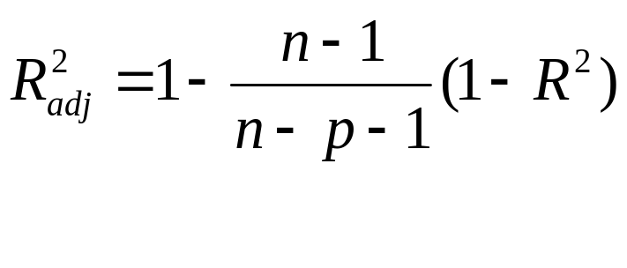
Exhaustive Search
All possible subsets of predictors assessed (single, pairs, triplets, etc.)
Computationally intensive
Judge by “adjusted R²”
Penalty for number of predictors

Slide 16
Forward Selection
Start with no predictors
Add them one by one (add the one with largest contribution)
Stop when the addition is not statistically significant

Slide 17
Backward Elimination
Start with all predictors
Successively eliminate least useful predictors one by one
Stop when all remaining predictors have statistically significant contribution

Slide 18
Stepwise
Like Forward Selection
Except at each step, also consider dropping non-significant predictors

Slide 19
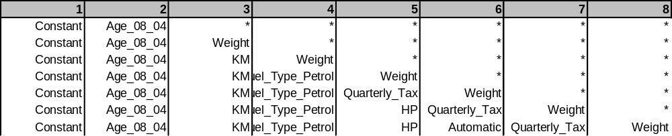
Backward elimination (showing last 7 models)
Top model has a single predictor (Age_08_04)
Second model has two predictors, etc.

Slide 20
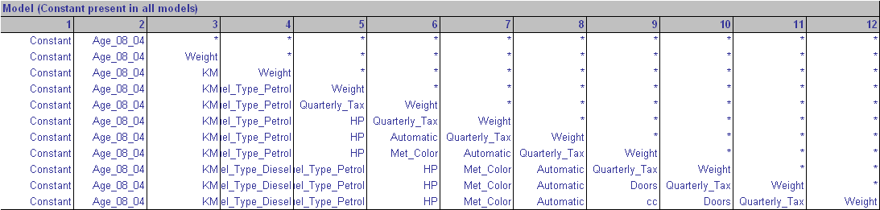
All 12 Models

Slide 21
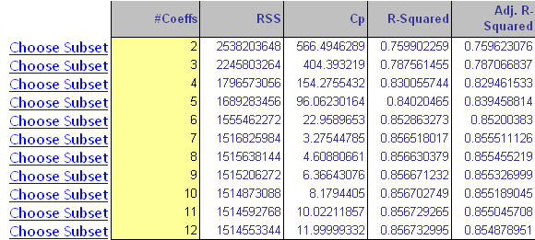
Diagnostics for the 12 models
Good model has:
High adj-R², Cp = # predictors

Slide 22
Next step
Subset selection methods give candidate models that might be “good models”
Do not guarantee that “best” model is indeed best
Also, “best” model can still have insufficient predictive accuracy
Must run the candidates and assess predictive accuracy (click “choose subset”)

Slide 23
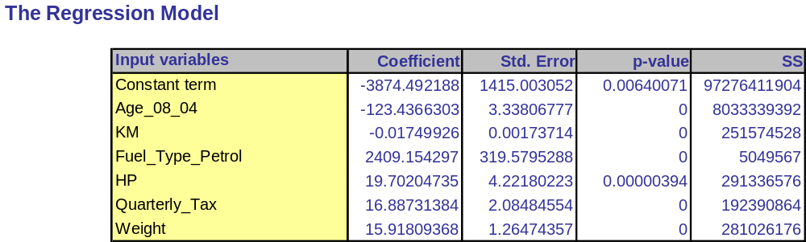
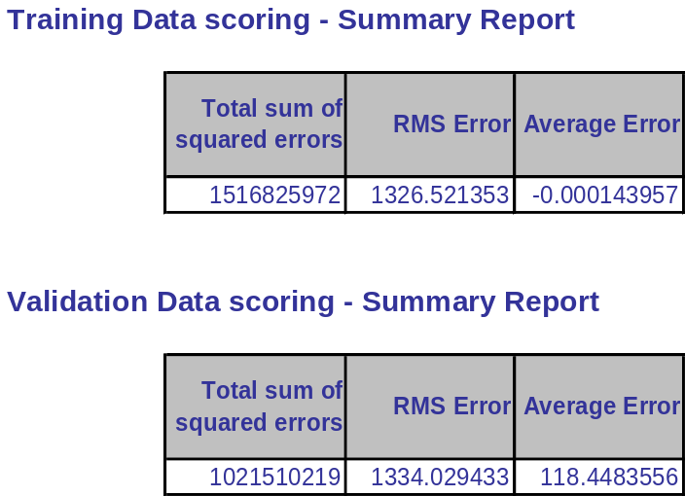
Model with only 6 predictors
Model Fit
Predictive performance
(compare to 12-predictor model!)

Slide 24
Summary
Linear regression models are very popular tools, not only for explanatory modeling, but also for prediction
A good predictive model has high predictive accuracy (to a useful practical level)
Predictive models are built using a training data set, and evaluated on a separate validation data set
Removing redundant predictors is key to achieving predictive accuracy and robustness
Subset selection methods help find “good” candidate models. These should then be run and assessed.

