Slide 1
CHAPTER 8 – Jena:RDF in Java
박형우
SNU OOPSLA Lab.
August 27, 2004

Slide 2
목차
Introduction
Jena Architecture
Writing RDF
Reading RDF
Navigating a Model
Querying a Model
Operations on Models
Containers
Creating and Using Wrapper Class
Persistent Model Storage

Slide 3
Introduction
A Java Framework for RDF, DAML and OWL
Developed by Brian McBride of HP Labs
Derived from SiRPAC
Can create, parse, navigate and search RDF, DAML and OWL model
Easy to use
Current Jena release: 2.1
Available at http://jena.sourceforge.net

Slide 4
Jena Architecture
Network API
Joseki
Sesame
Query
RDQL
SesameEngine
Inference
Readers
RDFS API
DAML API
OWL API
Writers
ARP
ARP
N3
Ontology API
N3
n-triple
Storages
n-triple
Memory
RDBMS
Berkeley
DB

Slide 5
Writing RDF(1/3)
model.write(System.out); ➔ model을 화면에 출력
model.write(System.out, “RDF/XML-ABBREV”); ➔ model을 축약된 형태로 출력
model.write(System.out, “N-TRIPLE”); ➔ model을 N-Triples 형식으로 출력

Slide 6
Writing RDF(2/3)
예제(1/2)
Model model=ModelFactory.createDefaultModel();
Resource res=model.createResource(“http://somewhere/root.htm”);
Property prop=model.createProperty(“http://someplace/”,“related”);
res.addProperty(prop, “child”);
<rdf:RDF
xmlns:rdf=“http://www.w3.org/1999/02/22-rdf-syntax-ns#”
xmlns:phw=“http://someplace/”>
<rdf:Description rdf:about=“http://somewhere/root.htm">
<phw:related>child</phw:related>
</rdf:Description>
</rdf:RDF>

Slide 7
Writing RDF(3/3)
예제(2/2)
http://somewhere/root.htm
http://someplace/related
child

Slide 8
Reading RDF
public class MyClass{
…
Model model = ModelFactory.createDefaultModel();
InputStream in = MyClass.class.getClassLoader().getResourceAsStream(“myrdf.rdf”);
model.read(new InputStreamReader(in), “”);
…
}

Slide 9
Navigating a Model(1/5)
model.getResource(uri : String) : Resource
➔ URI가 uri인 resource를 리턴(존재할 경우)하거나 새로 생성하여 리턴(존재하지 않는 경우)
resource.getProperty(p : Property) : Statement
➔ resource가 속성 p를 가지면 진술 (resource, p, O) 를 리턴하고, 속성 p를 갖지 않으면 null을 리턴
※ Property를 리턴하지 않고 Statement를 리턴한다는 점에 주의

Slide 10
Navigating a Model(2/5)
statement.getObject( ) : RDFNode
➔ statement의 object node를 리턴
statement.getResource() : Resource
➔ statement의 object가 Resource이면 그것을 리턴, Resource가 아니면 exception 발생
statement.getString() : String
➔ statement의 object가 Literal이면 그것을 리턴, Literal이 아니면 exception 발생
※ RDFNode는 Resource, Literal의 상위 인터페이스임

Slide 11
Navigating a Model(3/5)
resource.listProperties(p : Property) : StmtIterator
➔ getProperty(p)는 단 하나의 진술을 리턴하는 반면 이 함수는 해당되는 속성 p를 갖는 진술들 전체의 iterator 리턴

Slide 12
Navigating a Model(4/5)
예제(1/2)
Resource vcard = model.getResource(“http://somewhere/JohnSmith”);
Resource name = vcard.getProperty(VCARD.N).getResource( );
StmtIterator iter = vcard.listProperties(VCARD.NICKNAME);
Statement st;
while(iter.hasNext()){
st = iter.nextStatement();
if(st instanceof Literal){
System.out.println(“ ” + st.getString());
}
}

Slide 13
Navigating a Model(5/5)
예제(2/2)
출력결과
Smithy Adman
http://somewhere/JohnSmith
vcard:N
vcard:NICKNAME
vcard:NICKNAME
Smithy
Adman
John Smith

Slide 14
Querying a Model(1/2)
SimpleSelector(s : Resource, p : Property, o : RDFNode)
➔ subject가 s이고 predicate가 p이며 object가 o인 진술만 선택
selects(s : Statement) : boolean
➔ SimpleSelector는 subject가 s이고 predicate가 p이며 object가 o인지 검사한 뒤 selects(s)의 리턴값이 참인지 검사한다. 따라서 이 함수는 추가적인 필터링을 수행한다.

Slide 15
Querying a Model(2/2)
예제
StmtIterator iter = model.listStatements(
new SimpleSelector(null, VCARD.FN, (RDFNode) null) {
public boolean selects(Statement s)
{return s.getString().endsWith("Smith");}
});
➔ predicate가 VCARD.FN이고 object가 Smith로 끝나는 문자열(리터럴)인 진술들만 iterate

Slide 16
Operations on Models(1/2)
model1.union(model2 : Model) : Model
➔ model1 과 model2 를 merge한 결과를 리턴

Slide 17
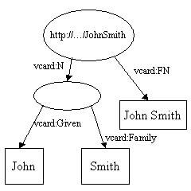
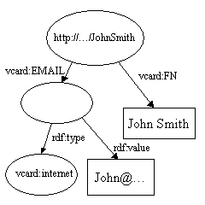
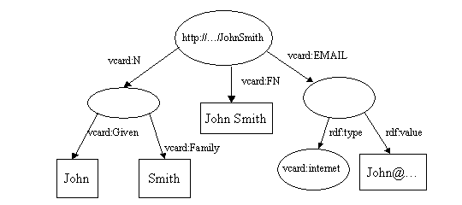
Operations on Models(2/2)
예제
model1
model2
model1.union(model2)

Slide 18
Containers(1/3)
model.createBag( ) : Bag ➔ Bag을 생성
model.createSeq( ) : Seq ➔ Seq을 생성
model.createAlt( ) : Alt ➔ Alt를 생성
bag.add(r : RDFNode) : Container
➔ Bag에 항목 추가
seq.add(index : int, r : Object) : Seq
➔ Seq에 항목 추가
alt.add(r : RDFNode) : Container
➔ Alt에 항목 추가

Slide 19
Containers(2/3)
예제
model.createBag()
.add(model.createResource(“http://somewhere/Peter”))
.add(model.createResource(“http://somewhere/John”));

Slide 20
Containers(3/3)
출력결과
<rdf:RDF xmlns:rdf="http://www.w3.org/1999/02/22-rdf-syntax-ns#">
<rdf:Description rdf:nodeID="A3">
<rdf:type rdf:resource="http://www.w3.org/1999/02/22-rdf-syntax-ns#Bag"/>
<rdf:_1 rdf:resource="http://somewhere/Peter"/>
<rdf:_2 rdf:resource="http://somewhere/John"/>
</rdf:Description>
</rdf:RDF>
rdf:type
rdf:_2
rdf:_1
rdf:Bag
http://somewhere/Peter
http://somewhere/John

Slide 21
Creating and Using Wrapper Class
예제
  wrapper class 구현
    package com.hp.hpl.jena.vocabulary;
    …
    public class VCARD{
    protected static final String uri ="http://www.w3.org/2001/vcard-rdf/3.0#";
    …
    public static final Property FN = m.createProperty(uri, "FN" );
    …
    }
  wrapper class 이용
    import com.hp.hpl.jena.vocabulary.VCARD;
    …
    resource.addProperty(VCARD.FN, “John Smith”);
    …

Slide 22
Persistent Model Storage
예제
  RDF/XML 을 데이터베이스에 저장
    …
    Class.forName(“com.mysql.jdbc.Driver”);
    IDBConnection conn = new DBConnection(“jdbc:mysql://localhost/test”, “test”, “”, “MySQL”);
    Model m = ModelRDB.createModel(conn, “one”);
    …
  데이터베이스에서 RDF/XML 읽기
    …
    Class.forName(“com.mysql.jdbc.Driver”);
    IDBConnection conn = new DBConnection(“jdbc:mysql://localhost/test”, “test”, “”, “MySQL”);
    Model m = ModelRDB.open(conn, “one”);
    …

