Slide 1
Processing a Trillion Cells per Mouse Click
Alexander Hall, Olaf Bachmann, Robert Bussow, Silviu Gănceanu, Marc Nunkesser
Google, Inc.
VLDB 2012
January 2, 2015
Heymo Kou

Slide 2
Outline
Introduction
Basic Approach
Key Optimizations
Distributed Execution
Conclusion

Slide 3



Introduction
Company’s data is getting bigger
Data analysis is harder as data increases
Column-oriented database system is getting more attention
RDB is too slow for OLAP
Google’s PowerDrill project
Developed for enhancing interactive Web UI performance
Notes:
MonetDB – 네덜란드 Column-oriented database 선두주자
Netezza – IBM에 인수된 Column based architecture database를 주로 다룸
qlik – 스위덴 기업으로 마찬가지 column based DB 개발기업

Slide 4
Introduction RDB vs Column-oriented database
RDB | Column-oriented database
Row0 | Row0 | Row0 | Row0
Row1 | Row1 | Row1 | Row1
Row2 | Row2 | Row2 | Row2
Row3 | Row3 | Row3 | Row3
Col0 | Col1 | Col2 | Col3
Col0 | Col1 | Col2 | Col3
Col0 | Col1 | Col2 | Col3
Col0 | Col1 | Col2 | Col3
Low Compression Rate | High Compression Rate
Stored continuously | Partitioned by column
Suitable for OLTP | Better for OLAP

Slide 5
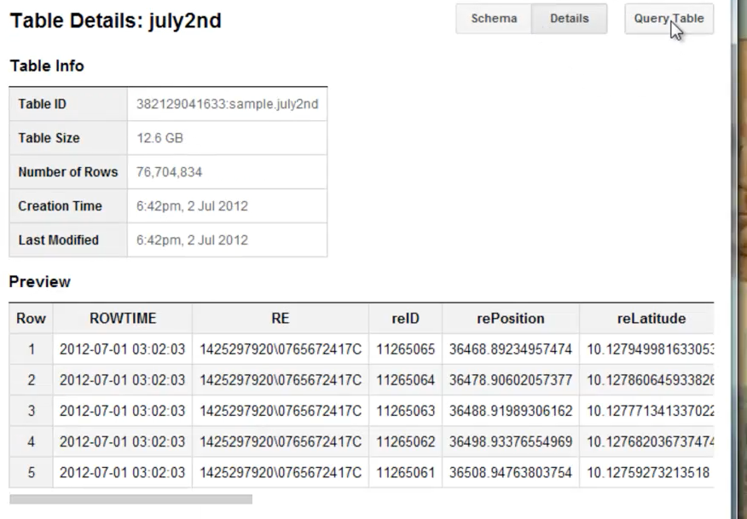
Introduction PowerDrill [1/2]
Google’s data analysis service
Heavy use on AJAX for an interactive Web UI

Slide 6
Introduction PowerDrill [2/2]
Since user can drill down to values of interest
Aggregation, Summation, etc.
Thus, pre-aggregation or indexing does not help
Need to query the raw data directly.
4 million SQL queries per month
Now part of Apache drill(Sep, 2014)
http://drill.apache.org/

Slide 7
Introduction Problems
Current-oriented database systems are vulnerable to thousands column data
OLAP should be faster
Since we do not know user’s demand
Indexing or pre-aggregation is meaningless
Full scan is always required

Slide 8
Introduction Contributions
Data is partitioned and organized in an important phase
Enables skipping and caching large parts of the data
Successive “algorithmic” engineering
Improves key data-structures
Computing queries in a distributed system

Slide 9
Introduction Assumptions
Importing and processing data from single tables
Log files at Google in “protocol buffers” format
Denormalized relational tables

Slide 10
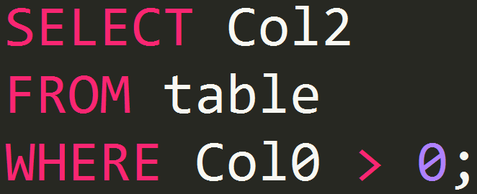
Basic Approach Main advantage of column-oriented stores
Only need to access a fraction of data
Row0 | Row0 | Row0 | Row0
Row1 | Row1 | Row1 | Row1
Row2 | Row2 | Row2 | Row2
Row3 | Row3 | Row3 | Row3
Col0 | Col1 | Col2 | Col3
Col0 | Col1 | Col2 | Col3
Col0 | Col1 | Col2 | Col3
Col0 | Col1 | Col2 | Col3

Slide 11
Basic Approach Power of Full Scans vs Skipping Data
Most column-oriented systems are highly optimized for full scans
However, Google’s customers’ case
Indices are not efficient
Partition is performed when importing
Not only by columns
Data is also partitioned into chunks
Skipping data saves tons of time

Slide 12
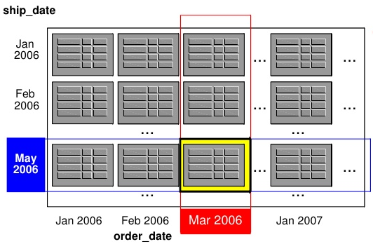
Basic Approach Partitioning the Data
Performs a composite range partitioning
User chooses an ordered set of fields
Iteratively split data into smaller chunks
Stops when no chunk has more rows than a given threshold
Notes:
주어진 개체수(threshold) 보다 row수가 적어지면 멈춘다

Slide 13
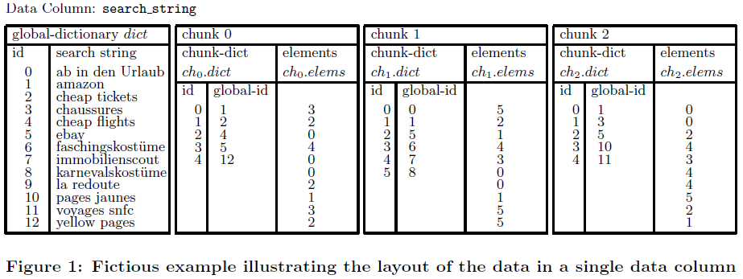
Basic Approach Basic Data-Structures
Order of data for all columns should be same
Global-dictionary contains every distinct values
Chunk-dictionary contains enumeration of value

Slide 14
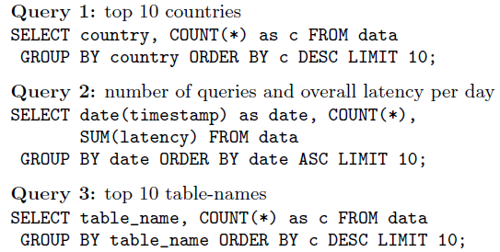
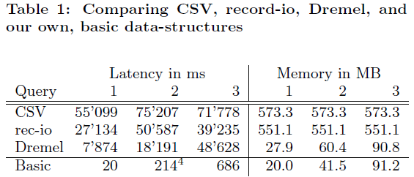
Basic Approach Basic Experiments

Slide 15
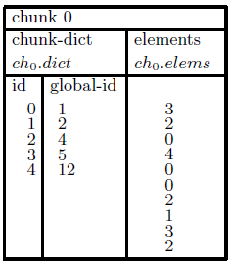
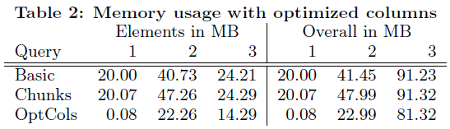
Key Optimization Optimize Encoding of Elements in Columns
Use encryption for id
Instead of using 32bit integer for id
byte encode
32bit int

Slide 16
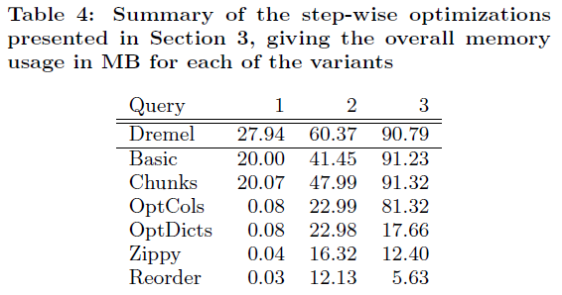
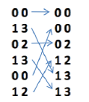

Key Optimization
Optimize Global-Dictionaries
Use trie data-structure
Generic Compression Algorithm using Zippy
Snappy is externally available
Reordering Rows

Slide 17

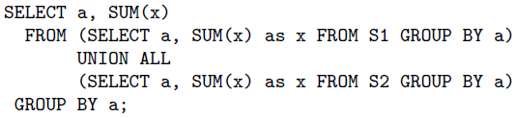
Distributed Execution
Distribute queries
Given query
Divide query for distributed system
SELECT SUM
SELECT S1
SELECT S2

Slide 18
Conclusion
On average
92.41% records were skipped
5.02% served from cached results
only 2.66% of whole data were scanned
On most real cases, full scan is not used in OLAP
Indexing and pre-aggregation is inefficient
PowerDrill Rocks!

