Slide 1
빅데이터 팀 세미나 2주차 #맵리듀스 기반 조인 알고리즘
Some slides from vldb 2012 tutorial

Slide 2
Outline
일반 조인 연산 소개
병렬 조인 소개
맵리듀스 기반 조인 소개
All Pair Partitioning 조인
Repartition Equi-Join
Theta Join
멀티웨이 조인 소개

Slide 3
일반 조인
Several different algorithms to implement joins
Nested-loop join
Block nested-loop join
Indexed nested-loop join
Merge-join
Hash-join
Choice based on cost estimate
Examples use the following information
Number of records of student: 5,000 takes: 10,000
Number of blocks of student: 100 takes: 400

Slide 4
Nested-loop join
Borrower relation: N = 16, B = 4
Customer name | Loan number
Jones | L - 170
Bahn | L – 82
Kim | L – 42
Lee | L – 48
Jane | L – 112
Smith | L – 34
Hwang | L – 321
Choi | L – 109
Pedro | L – 90
Sammy | L – 112
Jun | L – 31
Jung | L – 62
Shin | L – 99
Koh | L – 70
Mark | L – 221
Harry | L - 116
Loan relation : N = 12, B = 3
Loan number | Branch name | amount
L- 170 | Downtown | 300
L – 42 | Redwood | 400
L – 48 | Redwood | 1500
L – 112 | Perryridge | 2300
L – 321 | Redwood | 3100
L – 90 | Downtown | 800
L – 112 | Perryridge | 2300
L – 31 | Redwood | 200
L - 70 | Perryridge | 600
L - 221 | Downtown | 1000
L – 155 | Redwood | 800
L - 320 | Downtown | 2500

Slide 5
Nested-loop join
Borrower relation
Loan relation
Customer name | Loan number
Jones | L - 170
Bahn | L – 82
Kim | L – 42
Lee | L – 48
Jane | L – 112
Smith | L – 34
Hwang | L – 321
Choi | L – 109
Pedro | L – 90
Sammy | L – 112
Jun | L – 31
Jung | L – 62
Shin | L – 99
Koh | L – 70
Mark | L – 221
Harry | L - 116
Loan number | Branch name | amount
L- 170 | Downtown | 300
L – 42 | Redwood | 400
L – 48 | Redwood | 1500
L – 112 | Perryridge | 2300
L – 321 | Redwood | 3100
L – 90 | Downtown | 800
L – 112 | Perryridge | 2300
L – 31 | Redwood | 200
L - 70 | Perryridge | 600
L - 221 | Downtown | 1000
L – 155 | Redwood | 800
L - 320 | Downtown | 2500

Slide 6
Nested-loop join
Borrower relation
Loan relation
Customer name | Loan number
Jones | L - 170
Bahn | L – 82
Kim | L – 42
Lee | L – 48
Jane | L – 112
Smith | L – 34
Hwang | L – 321
Choi | L – 109
Pedro | L – 90
Sammy | L – 112
Jun | L – 31
Jung | L – 62
Shin | L – 99
Koh | L – 70
Mark | L – 221
Harry | L - 116
Loan number | Branch name | amount
L- 170 | Downtown | 300
L – 42 | Redwood | 400
L – 48 | Redwood | 1500
L – 112 | Perryridge | 2300
L – 321 | Redwood | 3100
L – 90 | Downtown | 800
L – 112 | Perryridge | 2300
L – 31 | Redwood | 200
L - 70 | Perryridge | 600
L - 221 | Downtown | 1000
L – 155 | Redwood | 800
L - 320 | Downtown | 2500

Slide 7
Nested-loop join
Borrower relation
Customer name | Loan number
Jones | L - 170
Bahn | L – 82
Kim | L – 42
Lee | L – 48
Jane | L – 112
Smith | L – 34
Hwang | L – 321
Choi | L – 109
Pedro | L – 90
Sammy | L – 112
Jun | L – 31
Jung | L – 62
Shin | L – 99
Koh | L – 70
Mark | L – 221
Harry | L - 116
Loan relation
Loan number | Branch name | amount
L- 170 | Downtown | 300
L – 42 | Redwood | 400
L – 48 | Redwood | 1500
L – 112 | Perryridge | 2300
L – 321 | Redwood | 3100
L – 90 | Downtown | 800
L – 112 | Perryridge | 2300
L – 31 | Redwood | 200
L - 70 | Perryridge | 600
L - 221 | Downtown | 1000
L – 155 | Redwood | 800
L - 320 | Downtown | 2500

Slide 8
Nested-loop join
Borrower relation
Loan relation
Customer name | Loan number
Jones | L - 170
Bahn | L – 82
Kim | L – 42
Lee | L – 48
Jane | L – 112
Smith | L – 34
Hwang | L – 321
Choi | L – 109
Pedro | L – 90
Sammy | L – 112
Jun | L – 31
Jung | L – 62
Shin | L – 99
Koh | L – 70
Mark | L – 221
Harry | L - 116
Loan number | Branch name | amount
L- 170 | Downtown | 300
L – 42 | Redwood | 400
L – 48 | Redwood | 1500
L – 112 | Perryridge | 2300
L – 321 | Redwood | 3100
L – 90 | Downtown | 800
L – 112 | Perryridge | 2300
L – 31 | Redwood | 200
L - 70 | Perryridge | 600
L - 221 | Downtown | 1000
L – 155 | Redwood | 800
L - 320 | Downtown | 2500
borrower relation을 outer relation으로 하면
16*3 + 4(borrower) = 52회의 disk access가 필요
Loan relation을 outer relation으로 했을 경우
12*4 + 3(loan) = 51회의 disk access가 필요

Slide 9
Block nested-loop join
Borrower relation
Loan relation
Customer name | Loan number
Jones | L - 170
Bahn | L – 82
Kim | L – 42
Lee | L – 48
Jane | L – 112
Smith | L – 34
Hwang | L – 321
Choi | L – 109
Pedro | L – 90
Sammy | L – 112
Jun | L – 31
Jung | L – 62
Shin | L – 99
Koh | L – 70
Mark | L – 221
Harry | L - 116
Loan number | Branch name | amount
L- 170 | Downtown | 300
L – 42 | Redwood | 400
L – 48 | Redwood | 1500
L – 112 | Perryridge | 2300
L – 321 | Redwood | 3100
L – 90 | Downtown | 800
L – 112 | Perryridge | 2300
L – 31 | Redwood | 200
L - 70 | Perryridge | 600
L - 221 | Downtown | 1000
L – 155 | Redwood | 800
L - 320 | Downtown | 2500

Slide 10
Block nested-loop join
Borrower relation
Customer name | Loan number
Jones | L - 170
Bahn | L – 82
Kim | L – 42
Lee | L – 48
Jane | L – 112
Smith | L – 34
Hwang | L – 321
Choi | L – 109
Pedro | L – 90
Sammy | L – 112
Jun | L – 31
Jung | L – 62
Shin | L – 99
Koh | L – 70
Mark | L – 221
Harry | L - 116
Loan relation
Loan number | Branch name | amount
L- 170 | Downtown | 300
L – 42 | Redwood | 400
L – 48 | Redwood | 1500
L – 112 | Perryridge | 2300
L – 321 | Redwood | 3100
L – 90 | Downtown | 800
L – 112 | Perryridge | 2300
L – 31 | Redwood | 200
L - 70 | Perryridge | 600
L - 221 | Downtown | 1000
L – 155 | Redwood | 800
L - 320 | Downtown | 2500

Slide 11
Block nested-loop join
Borrower relation
Customer name | Loan number
Jones | L - 170
Bahn | L – 82
Kim | L – 42
Lee | L – 48
Jane | L – 112
Smith | L – 34
Hwang | L – 321
Choi | L – 109
Pedro | L – 90
Sammy | L – 112
Jun | L – 31
Jung | L – 62
Shin | L – 99
Koh | L – 70
Mark | L – 221
Harry | L - 116
Loan relation
Loan number | Branch name | amount
L- 170 | Downtown | 300
L – 42 | Redwood | 400
L – 48 | Redwood | 1500
L – 112 | Perryridge | 2300
L – 321 | Redwood | 3100
L – 90 | Downtown | 800
L – 112 | Perryridge | 2300
L – 31 | Redwood | 200
L - 70 | Perryridge | 600
L - 221 | Downtown | 1000
L – 155 | Redwood | 800
L - 320 | Downtown | 2500

Slide 12
Block nested-loop join
Loan relation
Borrower relation
Loan number | Branch name | amount
L- 170 | Downtown | 300
L – 42 | Redwood | 400
L – 48 | Redwood | 1500
L – 112 | Perryridge | 2300
L – 321 | Redwood | 3100
L – 90 | Downtown | 800
L – 112 | Perryridge | 2300
L – 31 | Redwood | 200
L - 70 | Perryridge | 600
L - 221 | Downtown | 1000
L – 155 | Redwood | 800
L - 320 | Downtown | 2500
Customer name | Loan number
Jones | L - 170
Bahn | L – 82
Kim | L – 42
Lee | L – 48
Jane | L – 112
Smith | L – 34
Hwang | L – 321
Choi | L – 109
Pedro | L – 90
Sammy | L – 112
Jun | L – 31
Jung | L – 62
Shin | L – 99
Koh | L – 70
Mark | L – 221
Harry | L - 116
borrower relation을 outer relation으로 하면
4*3 + 4 = 16회의 disk access가 필요
Loan relation을 outer relation으로 했을 경우
3*4 + 3 = 15회의 disk access가 필요

Slide 13
Indexed nested-loop join
Customer name | Loan number
Jones | L - 170
Bahn | L – 82
Kim | L – 42
Lee | L – 48
Jane | L – 112
Smith | L – 34
Hwang | L – 321
Choi | L – 109
Pedro | L – 90
Sammy | L – 112
Jun | L – 31
Jung | L – 62
Shin | L – 99
Koh | L – 70
Mark | L – 221
Harry | L - 116
Loan number | Branch name | amount
L- 170 | Downtown | 300
L – 42 | Redwood | 400
L – 48 | Redwood | 1500
L – 112 | Perryridge | 2300
L – 321 | Redwood | 3100
L – 90 | Downtown | 800
L – 112 | Perryridge | 2300
L – 31 | Redwood | 200
L - 70 | Perryridge | 600
L - 221 | Downtown | 1000
L – 155 | Redwood | 800
L - 320 | Downtown | 2500
B+ tree
Index
Borrower relation의 16개의 tuple에 대해 각각 그 tuple과 join할 수 있는 loan relation의 tuple을 B+tree로 검색 (3회의 disk access)
Tree의 height가 2, 그리고, 실제의 data access를 위한 1회, 따라서, 3회의 disk access 필요
따라서, 총 cost는 4 block access +16*3 block access = 43회의 disk access필요

Slide 14
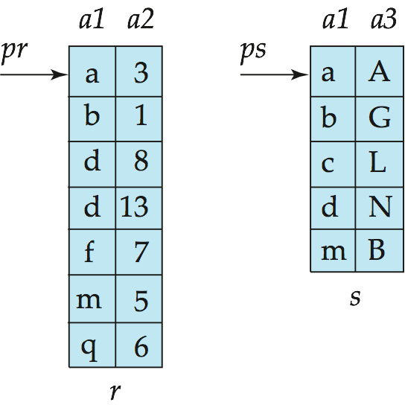
Merge-Join
Sort both relations on their join attribute (if not already sorted on the join attributes).
Merge the sorted relations to join them
Join step is similar to the merge stage of the sort-merge algorithm.
Main difference is handling of duplicate values in join attribute — every pair with same value on join attribute must be matched
Detailed algorithm in book

Slide 15
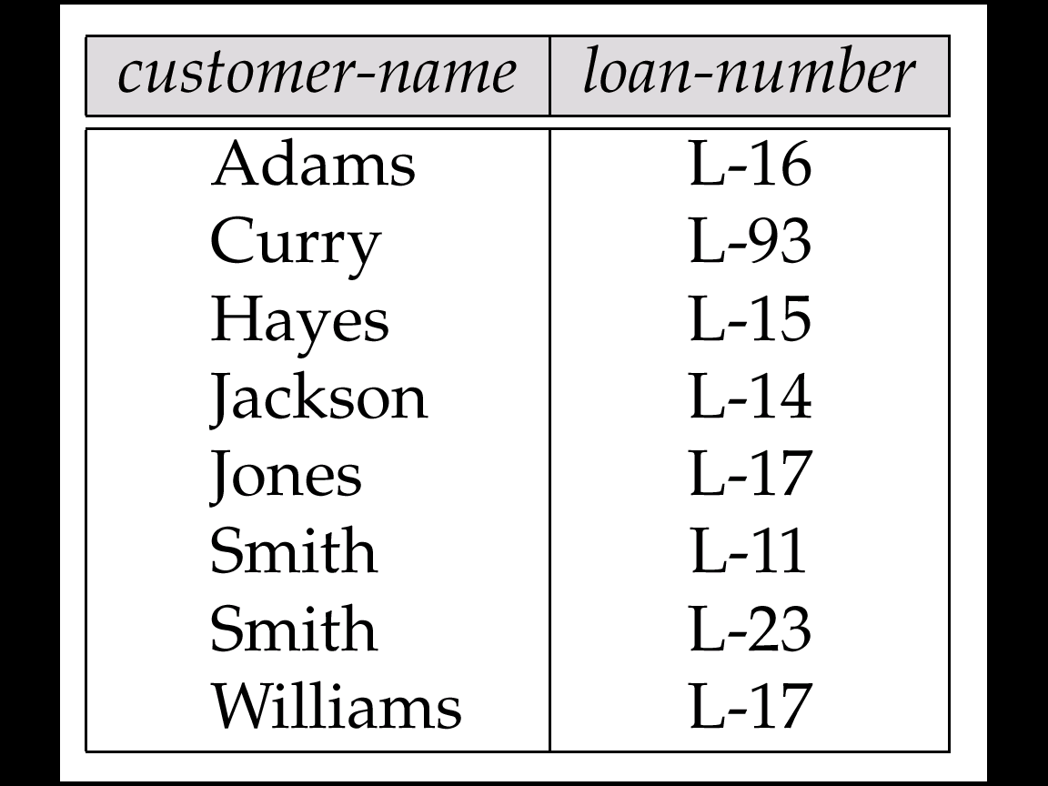
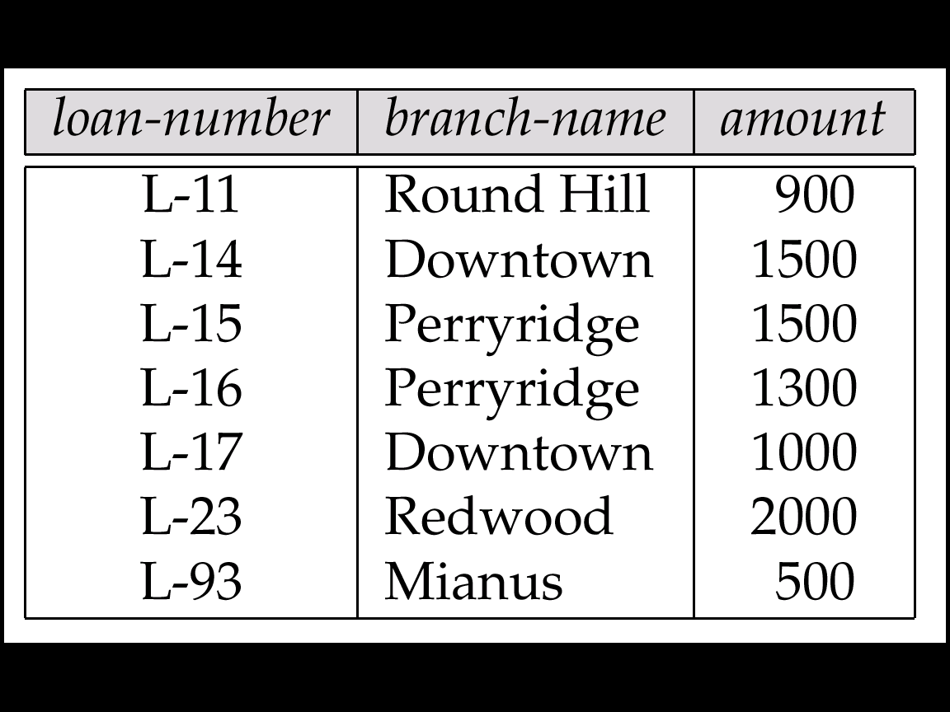
Merge-Join
Custom-name | Loan -number | Loan-number | Branch-name | amount
Smith | L-11 | L-11 | Round Hill | 900
Jackson | L-14 | L-14 | Downtown | 1500
Hayes | L-15 | L-15 | Perryridge | 1500
Adams | L-16 | L-16 | Perryridge | 1300
Jones | L-17 | L-17 | Downtown | 1000
Williams | L-17
Smith | L-23 | L-23 | Redwood | 2000
Curry | L-93 | L-93 | Mianus | 500

Slide 16
Hash-Join
Applicable for equi-joins and natural joins.
A hash function h is used to partition tuples of both relations
h maps JoinAttrs values to {0, 1, ..., n}, where JoinAttrs denotes the common attributes of r and s used in the natural join.
r₀, r₁, . . ., r_{n} denote partitions of r tuples
Each tuple t_{r} ∈ r is put in partition r_{i} where i = h(t_{r} [JoinAttrs]).
r₀,, r₁. . ., r_{n} denotes partitions of s tuples
Each tuple t_{s} ∈s is put in partition s_{i}, where i = h(t_{s} [JoinAttrs]).
Note: In book, r_{i} is denoted as H_{ri,} s_{i} is denoted as H_{si} and n is denoted as n_{h.}

Slide 17
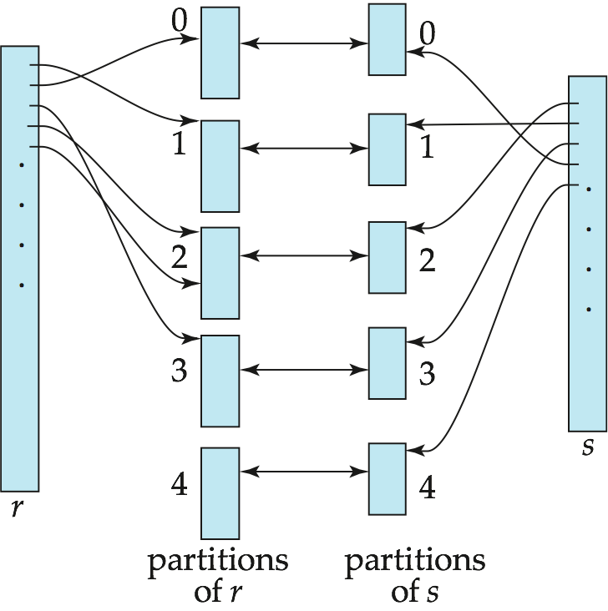
Hash-Join (Cont.)

Slide 18
Hash-Join (Cont.)
r tuples in r_{i} need only to be compared with s tuples in s_{i}
Need not be compared with s tuples in any other partition, since:
an r tuple and an s tuple that satisfy the join condition will have the same value for the join attributes.
If that value is hashed to some value i, the r tuple has to be in r_{i} and the s tuple in s_{i}.

Slide 19
Hash-Join (Cont.)
Custom-name | Loan -number | 해시집합 (R) | 해시집합 (S) | Loan-number | Branch-name | amount
Adams | L-16 | 3 | 0 | L-11 | Round Hill | 900
Curry | L-93 | 6 | 1 | L-14 | Downtown | 1500
Hayes | L-15 | 2 | 2 | L-15 | Perryridge | 1500
Jackson | L-14 | 1 | 3 | L-16 | Perryridge | 1300
Jones | L-17 | 4 | 4 | L-17 | Downtown | 1000
Smith | L-11 | 0 | 5 | L-23 | Redwood | 2000
Smith | L-23 | 5 | 6 | L-93 | Mianus | 500
Williams | L-17 | 4
Custom-name | Loan -number | 해시집합 (R) | 해시집합 (S) | Loan-number | Branch-name | amount
Smith | L-11 | 0 | 0 | L-11 | Round Hill | 900
Jackson | L-14 | 1 | 1 | L-14 | Downtown | 1500
Hayes | L-15 | 2 | 2 | L-15 | Perryridge | 1500
Adams | L-16 | 3 | 3 | L-16 | Perryridge | 1300
Jones | L-17 | 4 | 4 | L-17 | Downtown | 1000
Williams | L-17 | 4
Smith | L-23 | 5 | 5 | L-23 | Redwood | 2000
Curry | L-93 | 6 | 6 | L-93 | Mianus | 500

Slide 20
Hash-Join Algorithm
1. Partition the relation s using hashing function h. When partitioning a relation, one block of memory is reserved as the output buffer for each partition.
2. Partition r similarly.
3. For each i:
(a) Load s_{i} into memory and build an in-memory hash index on it using the join attribute. This hash index uses a different hash function than the earlier one h. (why??)
(b) Read the tuples in r_{i} from the disk one by one. For each tuple t_{r} locate each matching tuple t_{s} in s_{i} using the in-memory hash index.
Output the concatenation of their attributes.
The hash-join of r and s is computed as follows.
Relation s is called the build input and r is called the probe input. (s<<r)

Slide 21
Hash Join Example
Original
Relation
OUTPUT
Partitions
1
1
INPUT
2
hash
function
h
2
. . .
B-1
B-1
Disk
main memory
Disk
Partitions
of R & S
Join Result
Hash table for partition
Si (k < B-1 pages)
hash
fn
S : build input
S : build input
R : probe input
h2
h2
Input buffer
For Ri
Output
buffer
Disk
main memory
Disk

Slide 22
병렬조인
The join operation requires pairs of tuples to be tested to see if they satisfy the join condition, and if they do, the pair is added to the join output.
Parallel Join algorithms
Split the pairs to be tested over several processors
Each processor then computes part of the join locally
In a final step, the results from each processor can be collected together to produce the final result
Partitioned Join
Fragment-and-Replicate Join
Partitioned Parallel Hash-Join
Parallel Nested-Loop Join

Slide 23
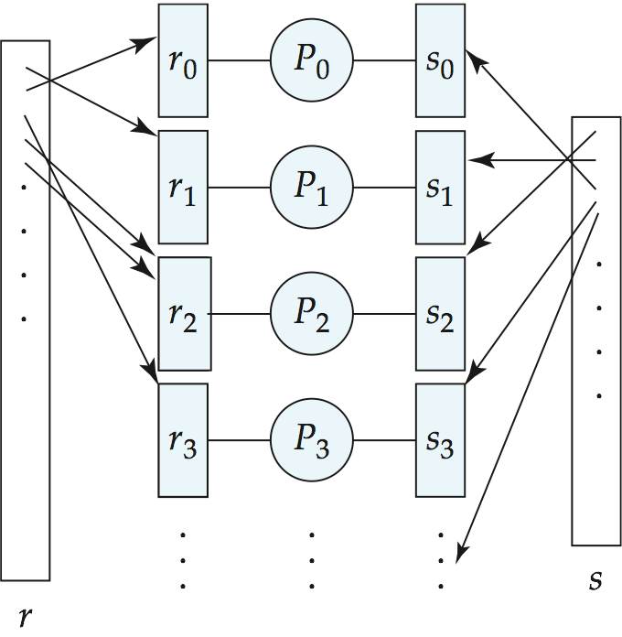
Partitioned Join (Cont.)
Range partitioning
or Hash partitioning
on join attributes

Slide 24
Fragment-and-Replicate Join
Partitioned join is not possible for some join conditions
e.g., non-equijoin conditions, such as r.A > s.B.
For joins where partitioning is not applicable, parallelization can be accomplished by fragment and replicate technique
Depicted on next slide
Special case – asymmetric fragment-and-replicate:
One of the relations, say r, is partitioned
any partitioning technique can be used.
The other relation, s, is replicated across all the processors
Processor P_{i} then locally computes the join of r_{i} with all of s using any join technique.

Slide 25
Fragment-and-Replicate Join (Cont.)
General case: reduces the sizes of the relations at each processor
r is partitioned into n partitions,r₀, r₁, ..., r _{n-1}
s is partitioned into m partitions, s₀, s₁, ..., s_{m-1}
Any partitioning technique may be used.
There must be at least m * n processors
Label the processors as P_{0,0}, P_{0,1}, ..., P_{0,m-1}, P_{1,0}, ..., P_{n-1m-1}
P_{i,j} computes the join of r_{i} with s_{j}
In order to do so, r_{i} is replicated to P_{i,0}, P_{i,1}, ..., P_{i,m-1}, while s_{i} is replicated to P_{0,i}, P_{1,i}, ..., P_{n-1,i}
Any join technique can be used at each processor P_{i,j}.

Slide 26
Fragment-and-Replicate Join (Cont.)
Both versions of fragment-and-replicate work with any join condition, since every tuple in r can be tested with every tuple in s.
Usually has a higher cost than partitioned join, since one of the relations (for asymmetric fragment-and-replicate) or both relations (for general fragment-and-replicate) have to be replicated.
Sometimes asymmetric fragment-and-replicate is preferable even though partitioning could be used.
E.g., Suppose s is small and r is large, and already partitioned
It may be cheaper to replicate s across all processors, rather than repartition r and s on the join attributes.

Slide 27
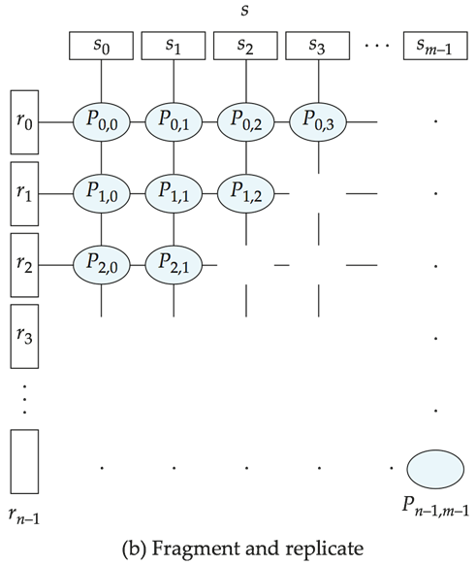
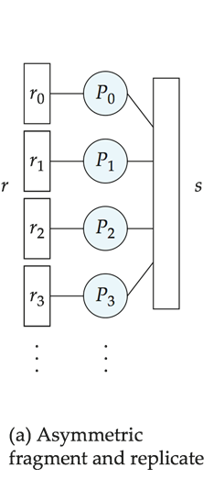
Depiction of Fragment-and-Replicate Joins
S replicated
r0 replicated
s0 replicated
When partitioned join is not possible!

Slide 28
Partitioned Parallel Hash-Join
Relation R
OUTPUT
Partitions
1
Pr₁
R₁
INPUT
2
hash
function
h1
Pr₂
. . .
R₂
i
Pr₃
R_{i}
Partition both
relations using
hash function h1
Relation S
OUTPUT
Partitions
1
Ps₁
S₁
INPUT
2
hash
function
h1
S₂
Ps₂
. . .
i
Ps₃
S_{i}
main memory buffers

Slide 29
Partitioned Parallel Hash-Join
P_{i}
Partitions
of S
Hash table for partition
S_{i}
Partitions
of R
h2
h2
Read in a
partition of R,
hash it using h2
Input buffer
R_{i}
Output
buffer
main memory buffers
P_{n}
Disk
Disk
Join Result
Disk

Slide 30
Parallel Nested-Loop Join
Join attribute A
Partitions
P₁
Replicate of S
R
S
INPUT
R₁
S
INPUT
R₁
1
R₂
S
2
. . .
. . .
i
R_{i}
S
Disk
Disk
Output
buffer
Disk
Disk
A..Z
P_{i}
Index nested loop join
Join Result
Asymmetric fragment + replicate join
Disk

Slide 31
맵리듀스 기반 조인
Equi-Join Algorithm
All Pair Partitioning Join
Repartition Equi-Join
Standard repartition
Improved repartition
Repartition with pre-partitioning
Broadcast join algorithm
Semi-join algorithm
Semi-join
Per-split semi join
Theta Join

Slide 32
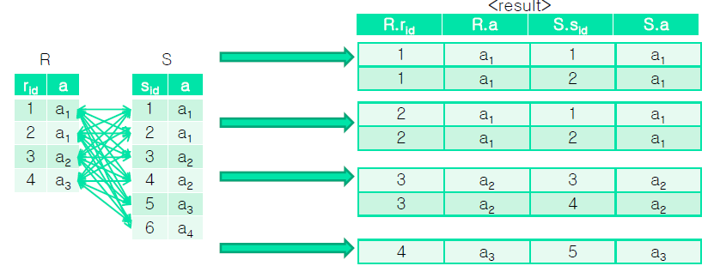
Equi-Join

Slide 33
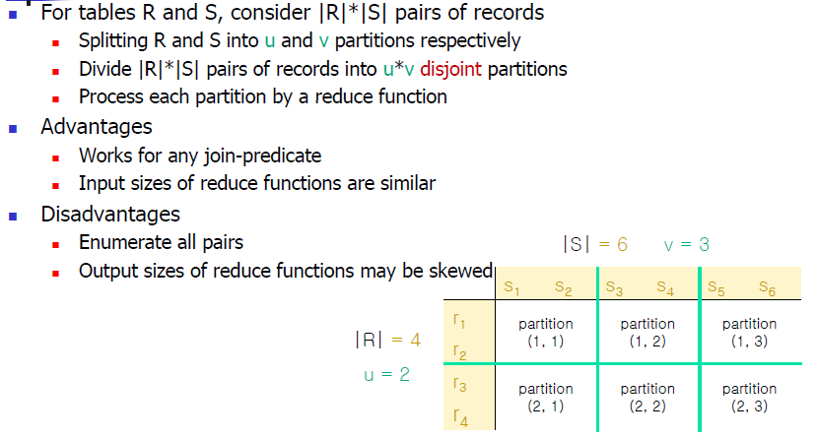
All Pair Partitioning Algorithm

Slide 34
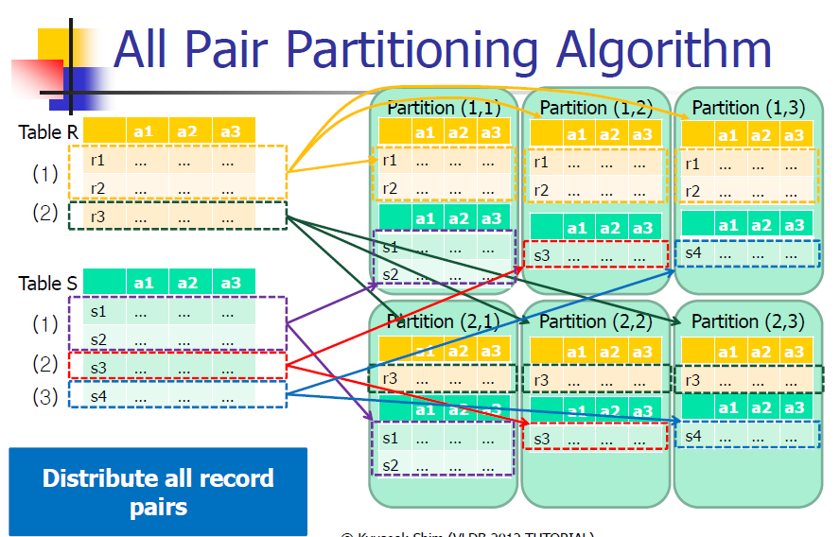
Example

Slide 35
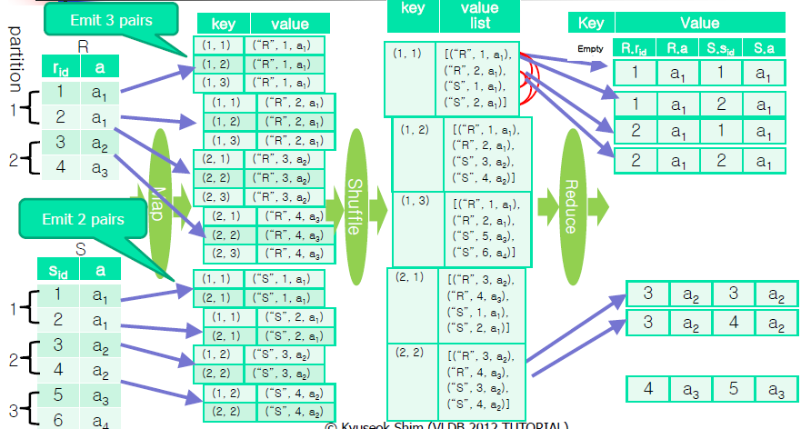
An Illustration of All Pair Partitioning using MapReduce

Slide 36

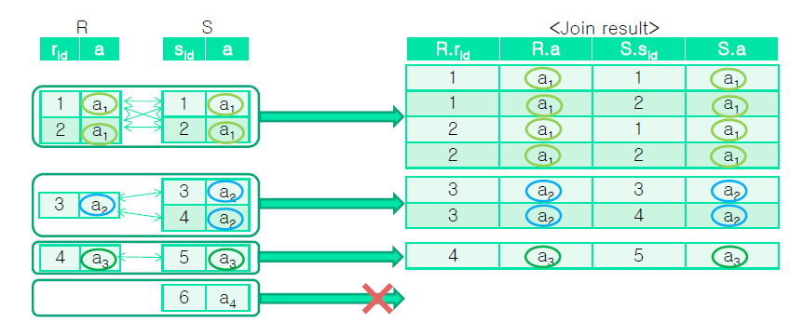
Remember Hash Joins!

Slide 37
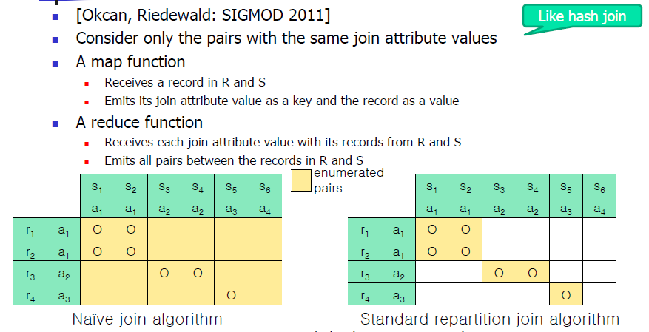
Standard Repartition Equi-Join Algorithm

Slide 38
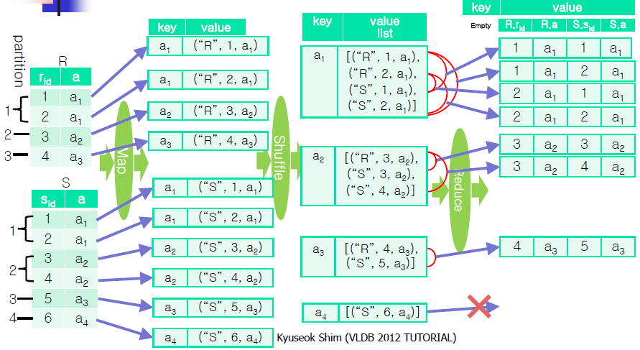
An Illustration of Standard Repartition Equi-Join Algorithm

Slide 39
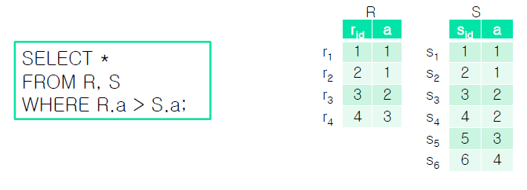
Theta Joins
Use primitive comparison operators (<, >, ≤, ≥, ≠, =) in the join-predicate

Slide 40
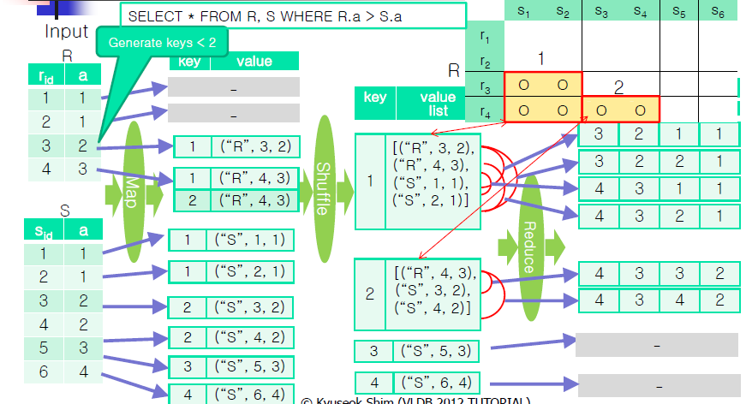
An Illustration of Standard Repartition Theta-Join Algorithm
맵 함수가 S 릴레이션의 값 분포를 알아야 함 : 그래야 R 릴레이션의 복사본을 보낼 수 있음 (단점 : 많은 복사본과 숫자가 아닌 데이터에 대해서는 적용하기 힘듬)

Slide 41
Analysis of Join Algorithms with MapReduce
[Okcan, Riedewald: SIGMOD 2011]
Execution times of map and reduce functions increase monotonically with their input and output sizes
Job complete time depends on the slowest map and reduce functions
Balancing the workloads of map functions is easy and thus we ignore map functions
Balance the workloads of reduce functions as evenly as possible

Slide 42
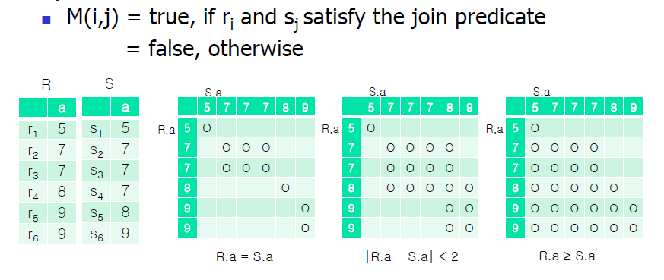
Join-Matrix M of R and S
Equi-join
Similarity-join
inequality-join

Slide 43
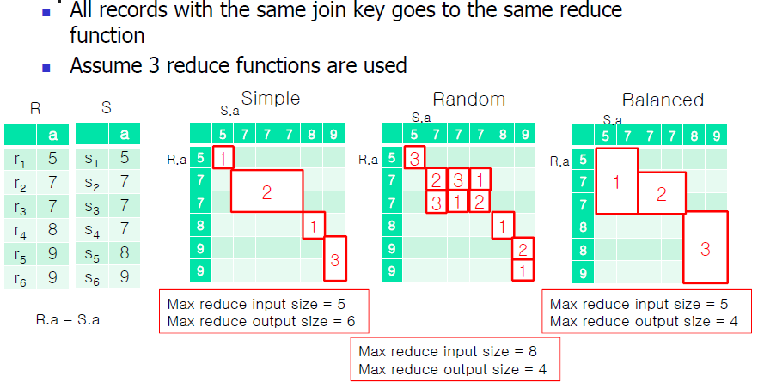
Reduce Allocations for Standard Repartition Equi-Joins

Slide 44
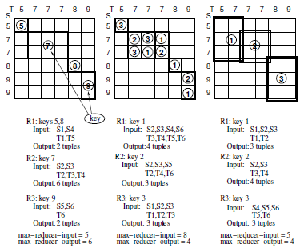
Matrix-to-reducer mapping
Standard equi-join (left), random(center), and balanced (right)

Slide 45
Comparisons of Reduce Allocation Methods
Simple allocation
Minimize the maximum input size of reduce functions
Output size may be skewed
Random allocation
Minimize the maximum output size of reduce functions
Input size may be increased due to duplication
Balances allocation
Minimize both maximum input and output sizes

Slide 46
How to Balance Reduce Allocation
[Okan, Riedewald: SIGMOD 2011]
Assume r is desired number of reduce functions
Partition join-matrix M into r regions
A map function sends each records in R and S to mapped regions
A reduce function outputs all possible (r, s) pairs satisfying the join predicates in its value-list
Propose M-Bucket-I algorithm

Slide 47
1-Bucket Theta
MapReduce Algorithm
“Computes” cross-product
Goals:
Tuples matched at exactly one reducer
Minimal input to a reducer
Minimal output from each reducer
“1-Bucket” refers to no statistics about data distribution

Slide 48
Algorithm
Precompute regions of cross-product SxT
Use size of S (|S|) and T (|T|)
Regions are disjoint
Union of regions covers cross-product
Each region assigned to single reducer
1 | 1 | 1 | 1 | 2 | 2 | 2 | 2
1 | 1 | 1 | 1 | 2 | 2 | 2 | 2
1 | 1 | 1 | 1 | 2 | 2 | 2 | 2
1 | 1 | 1 | 1 | 2 | 2 | 2 | 2
3 | 3 | 3 | 3 | 4 | 4 | 4 | 4
3 | 3 | 3 | 3 | 4 | 4 | 4 | 4
3 | 3 | 3 | 3 | 4 | 4 | 4 | 4
3 | 3 | 3 | 3 | 4 | 4 | 4 | 4
|S|=8; |T|=8; #reducers =4
Rows are tuples in s; columns are tuples in t
Value is region for the <s,t> pair

Slide 49
Algorithm : Mapper
Each row in S
Randomly assign value (x) from 1 to size(S)
Output <region, row + ‘S’> for each region containing x
Example: Assume x=3. Output <1,row+’S’> and <2,row+’S’>
Each row in T
Same, except output <region, row+’T’>
ExampleL Assume x=3. Output <1, row+’T’> and <3,row+’T’>

Slide 50
Algorithm: Reducer
Joins all S rows with all T rows
Can use any join algorithm appropriate for join value
Output cross-product, theta join or equi-join

Slide 51
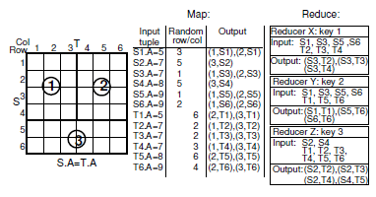
Example
Matrix-to-reducer mapping for equi-join
The join matrix is partitioned into 3 regions
S의 row가 3이면 가질 수 있는 파티션은 1, 2
T의 column이 6이면 가질 수 있는 파티션은 2, 3

Slide 52
맵리듀스 기반 조인 : 기타 방법
Improved Repartition Join
Repartition Join with Pre-partitioning
Broadcast Join
Semi-Join Algorithm

Slide 53
Improved Repartition Join
In reduce functions (한 릴레이션을 메모리에 보관)
Only records from R are kept in main memory
Records from S are streamed to generate the join output
In shuffling phase, redefine partitioning scheme by changing Partitioner and Comparator classes so that
Sorting is done with (join attribute value, relation id) in the keys output by map functions
Key-value pairs are assigned to reduce functions by join attribute value in the keys

Slide 54
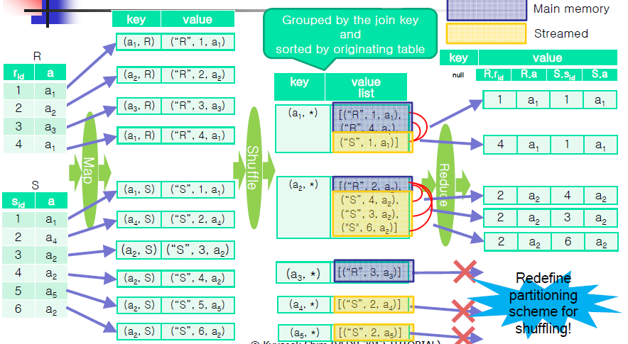
An Illustration of Improved Repartition Join Algorithm

Slide 55
Repartition Join with Pre-partitioning
Do not use reduce functions
To decrease the shuffling overhead in the repartition join
Split both S and R into partitions, S_{i}s and R_{i}s, in DFS based on the join attribute values before the join operation
The size of R_{i} is decided to be put in main memory of a map function
Before the map functions are called with records in S_{i}, build a hash table in main-memory using R_{i} in DFS
The map function emit the pairs of the input record (from S) and records in hash table (from R)

Slide 56
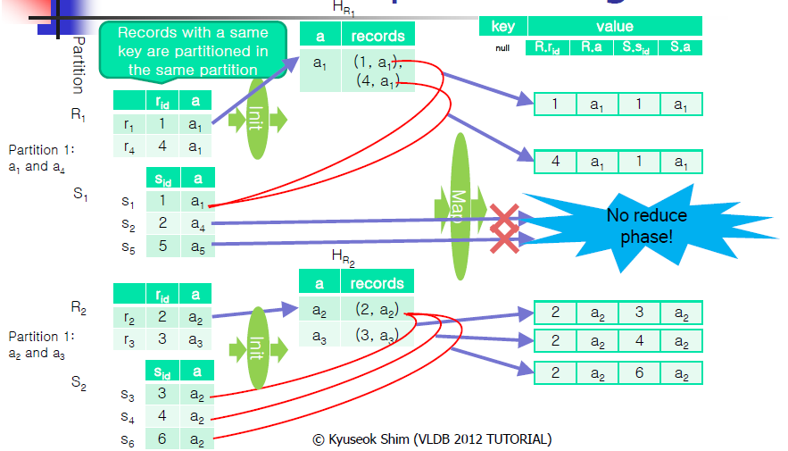
An Illustration of Repartition Join with Pre-partitioning

Slide 57
Broadcast Join
Broadcast Join
In most applications, |R| << |L|
Instead of moving both R and L across the network,
To broadcast the smaller table R to avoids the network overhead
A map-only job
Each map task uses a main-memory hash table for either L or R

Slide 58
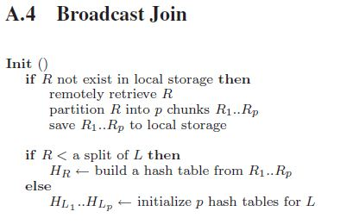
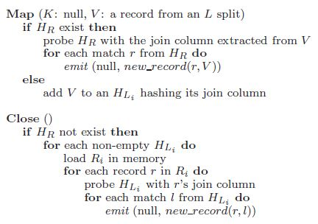
Broadcast Join
Broadcast Join
If R < a split of L
To build the hash table on R
If R > a split of L
To build the hash table on a split of L
Preprocessing for Broadcast Join
Most nodes in the cluster
have a local copy of R in advance
To avoid retrieving R
from the DFS in its init() function

Slide 59
Semi-Join
Original semi-join
r₁ r₂
temp1
(R₁[A])
Site 2
Site 1
R₁
1
R₂
1. projection
2
2. Ship(3)
A
B
C
3
A
D
1
4
7
3
10
2
5
8
4
11
3
6
9
5
12
4. Ship(2)
5. r₁ temp2
temp2
3. r₂ temp1
3
10
3
6
9
10
join result
Shipping cost savings = 9 –(3+2) = 4

Slide 60
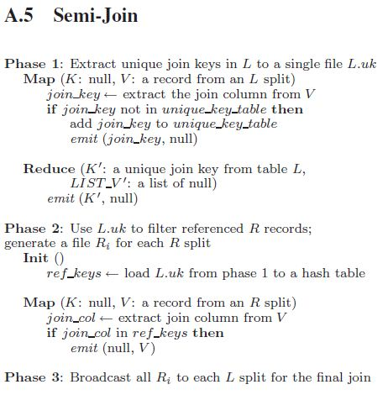
Semi-Join in MapReduce
Semi-Join
Some applications, |R| << |L|
In Facebook, user table has hundreds of millions of records
A few million unique active users per hour
To avoid sending the records in R over the network that will not join with L
(오리지널 semi 조인과 마찬가지로 해당되지 않는 레코드를 맵리듀스 과정에 참여시키지 않음)
Preprocessing for Semi-Join
First two phases of semi-join can preprocess

Slide 61
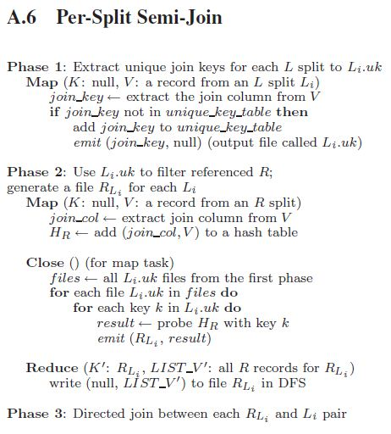
Per-Split Semi-Join
Per-Split Semi-Join
The problem of Semi-join : All records of extracted R will not join L_{i}
L_{i} can be joined with R_{i} directly
Preprocessing for Per-split Semi-join
Also benefit from moving its first two phases

Slide 62
Two-Way Join and Map-Reduce
R
A
B
(b, (a, R))
Map
Hash
Bad feature
h(b)
sorted pair
(a, b, c)
Reduce
S
(b, (c, S))
h(b)
B
C
Map
Hash
k - buckets

Slide 63
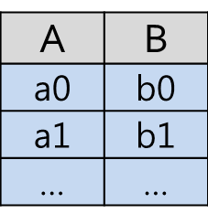
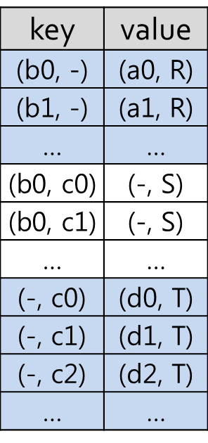
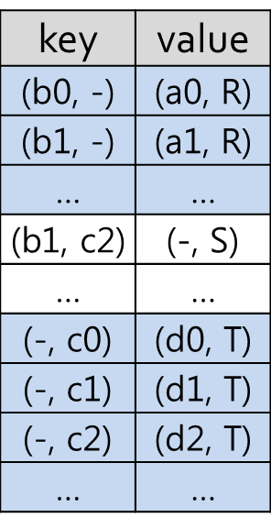
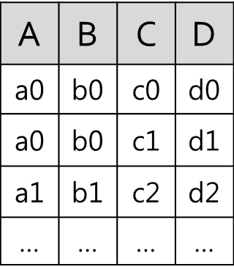
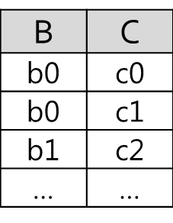
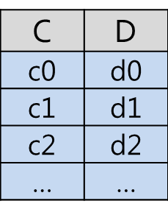
Three-Way Join
R(A,B) S(B,C) T(C,D)
Input
Reduce input
R
Final output
S
Map
Reduce
T

Slide 64
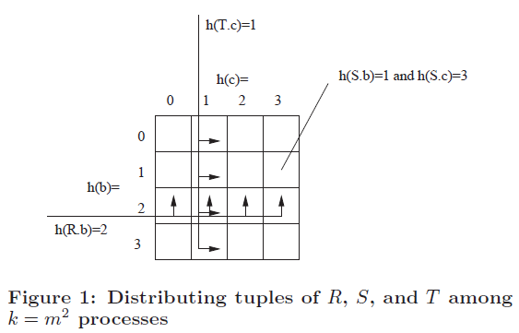

Three-Way Join
Joining Several Relations at Once
k( = $m^{2} )$ reduce processes
S(b,c) -> (h(b), h(c)), R(a, b) -> (h(b), x) where 0 <= x <= m, T(c, d) -> (y, h(c)) where 0 <= y <= m
h is hash function with range 1,2,…,m

