Slide 1
Building Java Programs
Chapter 14
Graphical User Interfaces

Slide 2
Graphical input and output with JOptionPane

Slide 3
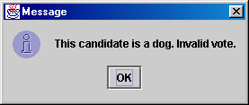
JOptionPane
An option pane is a simple dialog box for graphical input/output
advantages:
  simple
  flexible (in some ways)
  looks better than the black box of death
disadvantages:
  created with static methods;
  not very object-oriented
  not very powerful (just simple dialog boxes)

Slide 4
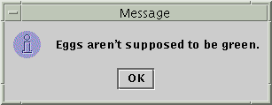

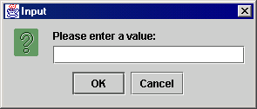
Types of JOptionPanes
showMessageDialog(<parent>, <message>)
Displays a message on a dialog
with an OK button.
showConfirmDialog(<parent>, <message>)
Displays a message and list of
choices Yes, No, Cancel;
returns user's choice as an int with one
of the following values:
  JOptionPane.YES_OPTION
  JOptionPane.NO_OPTION
  JOptionPane.CANCEL_OPTION
showInputDialog(<parent>, <message>)
Displays a message and text
field for input; returns the user's
value entered as a String.
  can pass null for the parent to all methods

Slide 5
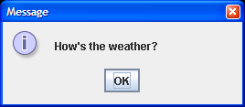
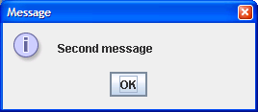
JOptionPane examples 1
showMessageDialog analogous to System.out.println to display a message
import javax.swing.*;
public class MessageDialogExample {
public static void main(String[] args) {
JOptionPane.showMessageDialog(null,"How's the weather?");
JOptionPane.showMessageDialog(null, "Second message");
}
}

Slide 6
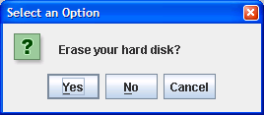
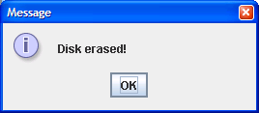
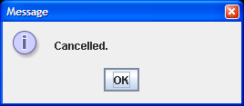
JOptionPane examples 2
showConfirmDialog analogous to a System.out.print that prints a question, then reading an input value from the user (can only be one of the provided choices)
import javax.swing.*;
public class ConfirmDialogExample {
public static void main(String[] args) {
int choice = JOptionPane.showConfirmDialog(null, "Erase your hard disk?");
if (choice == JOptionPane.YES_OPTION) {
JOptionPane.showMessageDialog(null, "Disk erased!");
} else {
JOptionPane.showMessageDialog(null, "Cancelled.");
}
}
}

Slide 7
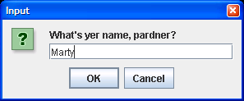
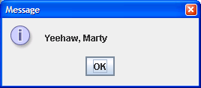
JOptionPane examples 3
showInputDialog analogous to a System.out.print that prints a question, then reading an input value from the user (can be any value)
import javax.swing.*;
public class InputDialogExample {
public static void main(String[] args) {
String name = JOptionPane.showInputDialog(null,
"What's yer name, pardner?");
JOptionPane.showMessageDialog(null, "Yeehaw, " + name);
}
}

Slide 8

Onscreen GUI elements
Most GUIs are not composed of option panes; they are too limited. Instead, complex GUIs contain the following elements:
  frame: A graphical window on the screen.
  components: GUI widgets such as buttons or text fields.
  containers: Logical groups of components.

Slide 9

JFrame example 1
A simple program that creates and shows a JFrame:
  import javax.swing.*;
  public class SimpleFrame {
  public static void main(String[] args) {
  JFrame frame = new JFrame();
  frame.setVisible(true);
  }
  }
Graphical output:

Slide 10
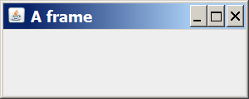
JFrame example 2
  import java.awt.*;
  import javax.swing.*;
  public class SimpleFrame2 {
  public static void main(String[] args) {
  JFrame frame = new JFrame();
  frame.setForeground(Color.WHITE);
  frame.setDefaultCloseOperation(JFrame.EXIT_ON_CLOSE);
  frame.setLocation(new Point(10, 50));
  frame.setSize(new Dimension(300, 120));
  frame.setTitle("A frame");
  frame.setVisible(true);
  }
  }
Graphical output:

Slide 11
JFrame properties
JFrames have the following properties that you can get/set:
name | type | description | methods
default close operation | int | what should happen when frame is closed | getDefaultCloseOperation, setDefaultCloseOperation
icon image | Image | icon in the window's title bar | getIconImage, setIconImage
layout | LayoutManager | how the frame should position its components | getLayout, setLayout
resizable | boolean | whether the window can be resized | isResizable, setResizable
title | String | window's title bar text | getTitle, setTitle

Slide 12
Component properties
name | type | description | methods
background | Color | background color | getBackground, setBackground
enabled | boolean | whether the component can be interacted with | isEnabled, setEnabled
font | Font | font used to display any text on the component | getFont, setFont
foreground | Color | foreground color | getForeground, setForeground
location | Point | (x, y) position of component on screen | getLocation, setLocation
size | Dimension | width, height of component | getSize, setSize
preferred size | Dimension | width, height that the component wants to be | getPreferredSize, setPreferredSize
visible | boolean | whether the component can be seen on screen | isVisible, setVisible

Slide 13
Swing component hierarchy
Graphical components in Java form an inheritance hierarchy:
java.lang.Object
+--java.awt.Component
+--java.awt.Container
|
+--javax.swing.JComponent
| +--javax.swing.JButton
| +--javax.swing.JLabel
| +--javax.swing.JMenuBar
| +--javax.swing.JOptionPane
| +--javax.swing.JPanel
| +--javax.swing.JTextArea
| +--javax.swing.JTextField
|
+--java.awt.Window
+--java.awt.Frame
+--javax.swing.JFrame
When doing GUI programming, always import these packages:
import java.awt.*;
import javax.swing.*;

Slide 14
Java GUI: AWT and Swing
Sun's initial idea: create a set of classes/methods that can be used to write a multi-platform GUI (Abstract Windowing Toolkit, or AWT)
  problem: not powerful enough; limited; a bit clunky to use
Second edition (JDK v1.2): Swing
  a newer library written from the ground up that allows much more powerful graphics and GUI construction
Drawback: Both exist in Java now; easy to get them mixed up; still have to use both sometimes!

Slide 15
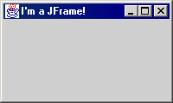
JFrame
A frame is a graphical window that can
be used to hold other components
public JFrame()
public JFrame(String title)
Creates a frame with an optional title.
public void setTitle(String text)
Puts the given text in the frame’s title bar.
public void setDefaultCloseOperation(int op)
Makes the frame perform the given action when it closes. Common value: JFrame.EXIT_ON_CLOSE
public void add(Component comp)
Places the given component or container inside the frame.
  How would we add more than one component to the frame?
NOTE: Call setVisible(true) to make a frame appear on screen after creating it.

Slide 16
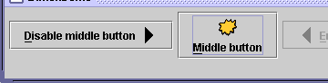
JButton, JLabel
The most common component—
a button is a clickable onscreen
region that the user interacts with
to perform a single command
A text label is simply a string of text
displayed on screen in a graphical
program. Labels often give infor-
mation or describe other components
public JButton(String text)
public JLabel(String text)
Creates a new button / label with the given string as its text.
public String getText()
Returns the text showing on the button / label.
public void setText(String text)
Sets button / label's text to be the given string.

Slide 17
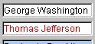

JTextField, JTextArea
A text field is like a label, except that the text
in it can be edited and modified by the user.
Text fields are commonly used for user input,
where the user types information in the field
and the program reads it
A text area is a multi-line text field
public JTextField(int columns)
public JTextArea(int lines, int columns)
Creates a new text field the given number of columns (letters) wide.
public String getText()
Returns the text currently in the field.
public void setText(String text)
Sets field's text to be the given string.

Slide 18
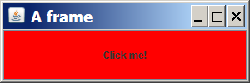
Components example
This program attempts to show 2 buttons:
  import java.awt.*;
  import javax.swing.*;
  public class ComponentsExample1 {
  public static void main(String[] args) {
  JFrame frame = new JFrame();
  frame.setDefaultCloseOperation(JFrame.EXIT_ON_CLOSE);
  frame.setSize(new Dimension(300, 100));
  frame.setTitle("A frame");
  JButton button1 = new JButton();
  button1.setText("I'm a button.");
  button1.setBackground(Color.BLUE);
  frame.add(button1);
  JButton button2 = new JButton();
  button2.setText("Click me!");
  button2.setBackground(Color.RED);
  frame.add(button2);
  frame.setVisible(true);
  }
  }

Slide 19
Layout problems
The preceding program added two buttons to the frame, but only one appeared on the screen.
layout manager: An object contained inside frames and other graphical containers that decides the position and size of the components inside the container.
The default layout manager sizes each component added to occupy the full window space.

Slide 20
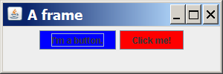
Changing layouts
We can correct the program's appearance by changing the frame's layout manager .
Change the layout by calling the setLayout method on the frame and passing a layout manager object.
  We will see several layout managers later.
  We'll use one called a FlowLayout, which sizes each component to its preferred size and positions them in left-to-right rows.
  If the following line is added to the preceding program just before calling setVisible(true), its appearance will be:
  frame.setLayout(new FlowLayout());

Slide 21
Action events with
ActionListener

Slide 22
Event-driven programming
program's execution is indeterminate
on-screen components cause events to occur when they are clicked / interacted with
events can be handled, causing the program to respond, driving the execution thru events (an "event-driven" program)

Slide 23
Java Event Hierarchy
java.lang.Object
+--java.util.EventObject
+--java.awt.AWTEvent
+--java.awt.event.ActionEvent
+--java.awt.event.TextEvent
+--java.awt.event.ComponentEvent
+--java.awt.event.FocusEvent
+--java.awt.event.WindowEvent
+--java.awt.event.InputEvent
+--java.awt.event.KeyEvent
+--java.awt.event.MouseEvent
import java.awt.event.*;

Slide 24
Action events: ActionEvent
most common / simple event type in Swing
represent an action occurring on a GUI component
created by:
  button clicks
  check box checking / unchecking
  menu clicks
  pressing Enter in a text field
  etc.

Slide 25

Listening for events
attach a listener to the component
listener’s appropriate method will be called when event occurs (e.g. when the button is clicked)
for Action events, use ActionListener

Slide 26
Writing an ActionListener
// part of Java; you don't write this
public interface ActionListener {
public void actionPerformed(ActionEvent event);
}
// Prints a message when the button is clicked.
public class MyActionListener
implements ActionListener {
public void actionPerformed(ActionEvent event){
JOptionPane.showMessageDialog(null,
"An event occurred!");
}
}

Slide 27
Attaching an ActionListener
JButton button = new JButton("button 1");
ActionListener listener = new MyActionListener();
button.addActionListener(listener);
now button will print "Event occurred!" when clicked
  addActionListener method exists in many Swing components

Slide 28
Laying out components

Slide 29
Problem: position, resize
How does the programmer specify where each component sits in the window, how big each component should be, and what the component should do if the window is resized/moved/maximized/etc?
Absolute positioning (C++, C#, others):
Specify exact pixel coordinates for every component
Layout managers (Java):
Have special objects that decide where to position each component based on some criteria
  What are benefits or drawbacks to each approach?

Slide 30
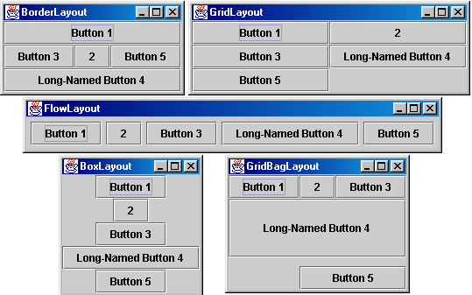
Layout managers
Here are several common Java layout managers:

Slide 31
Containers
container: An object that holds components; it also governs their positions, sizes, and resizing behavior.
Containers have the following public methods:
  public void add(Component comp)
  public void add(Component comp, Object info)
  Adds a component to the container, possibly giving extra information about where to place it.
  public void remove(Component comp)
  Removes the given component from the container.
  public void setLayout(LayoutManager mgr)
  Uses the given layout manager to position the components in the container.
  public void validate()
  You should call this if you change the contents of a container that is already on the screen, to make it re-do its layout.

Slide 32
JPanel
A panel is our container of choice; it provides the methods from the previous slide and defines these additional methods (among others):
  public JPanel()
  Constructs a panel with a default flow layout.
  public JPanel(LayoutManager mgr)
  Constructs a panel that uses the given layout manager.

Slide 33

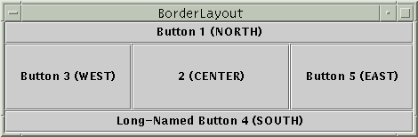
Preferred size
Swing component objects each have a certain size they would "like" to be--just large enough to fit their contents (text, icons, etc.)
This is called the preferred size of the component
Some types of layout managers (e.g. FlowLayout) choose to size the components inside them to the preferred size; others (e.g. BorderLayout, GridLayout) disregard the preferred size and use some other scheme
Buttons at preferred size: Not preferred size:

Slide 34
FlowLayout
public FlowLayout()
treats container as a left-to-right, top-to-bottom "page" or "paragraph"
components are given their preferred size both horizontally and vertically
components are positioned in order added
if too long, components wrap around to next line
Container panel = new JPanel(new FlowLayout());
panel.add(new JButton("Button 1"));

Slide 35
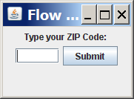

FlowLayout example
  import java.awt.*;
  import javax.swing.*;
  public class FlowLayoutExample {
  public static void main(String[] args) {
  JFrame frame = new JFrame();
  frame.setDefaultCloseOperation(JFrame.EXIT_ON_CLOSE);
  frame.setSize(new Dimension(320, 75));
  frame.setTitle("Flow layout");
  frame.setLayout(new FlowLayout());
  frame.add(new JLabel("Type your ZIP Code: "));
  frame.add(new JTextField(5));
  frame.add(new JButton("Submit"));
  frame.setVisible(true);
  }
  }

Slide 36
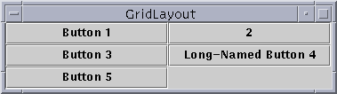
GridLayout
public GridLayout(int rows, int columns)
treats container as a grid of equally-sized rows and columns
components are given equal horizontal / vertical size, disregarding preferred size
can specify 0 rows or columns to indicate expansion in that direction as needed

Slide 37
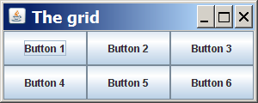
GridLayout example
  import java.awt.*;
  import javax.swing.*;
  public class GridLayoutExample {
  public static void main(String[] args) {
  JFrame frame = new JFrame();
  frame.setDefaultCloseOperation(JFrame.EXIT_ON_CLOSE);
  frame.setSize(new Dimension(300, 120));
  frame.setTitle("The grid");
  // 2 rows, 3 columns
  frame.setLayout(new GridLayout(2, 3));
  for (int i = 1; i <= 6; i++) {
  JButton button = new JButton();
  button.setText("Button " + i);
  frame.add(button);
  }
  frame.setVisible(true);
  }
  }

Slide 38
BorderLayout
public BorderLayout()
divides container into five regions: NORTH, SOUTH, WEST, EAST, CENTER
  NORTH and SOUTH regions expand to fill region horizontally, and use preferred size vertically
  WEST and EAST regions expand to fill region vertically, and use preferred size horizontally
  CENTER uses all space not occupied by others
Container panel = new JPanel(new BorderLayout());
panel.add(new JButton("Button 1 (NORTH)", BorderLayout.NORTH);

Slide 39
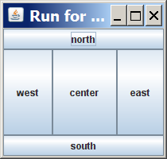
BorderLayout example
  import java.awt.*;
  import javax.swing.*;
  public class BorderLayoutExample {
  public static void main(String[] args) {
  JFrame frame = new JFrame();
  frame.setDefaultCloseOperation(JFrame.EXIT_ON_CLOSE);
  frame.setSize(new Dimension(210, 200));
  frame.setTitle("Run for the border");
  frame.setLayout(new BorderLayout());
  frame.add(new JButton("north"), BorderLayout.NORTH);
  frame.add(new JButton("south"), BorderLayout.SOUTH);
  frame.add(new JButton("west"), BorderLayout.WEST);
  frame.add(new JButton("east"), BorderLayout.EAST);
  frame.add(new JButton("center"),
  BorderLayout.CENTER);
  frame.setVisible(true);
  }
  }

Slide 40
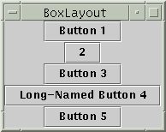
BoxLayout
Box.createHorizontalBox()
Box.createVerticalBox()
aligns components in container in a single row or column
components use preferred sizes and align based on their preferred alignment
preferred way to construct a container with box layout:
Box.createHorizontalBox(); or Box.createVerticalBox();

Slide 41

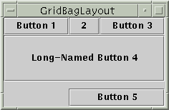
Other layouts
CardLayout
layers of "cards" stacked
on top of each other;
one visible at a time
GridBagLayout
very complicated;
recommendation: avoid

Slide 42
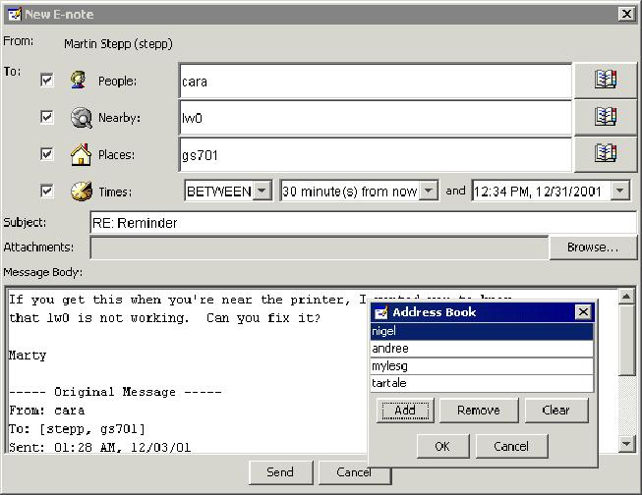
Complex layouts
How would you create a complex window like this, using the layout managers shown?

Slide 43
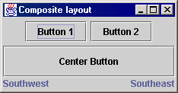
Solution: composite layout
create panels within panels
each panel has a different layout, and by combining the layouts, more complex / powerful layout can be achieved
example:
  how many panels?
  what layout in each?

Slide 44
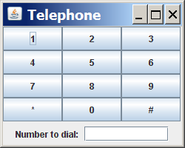
Composite layout example
  import java.awt.*;
  import javax.swing.*;
  public class Telephone {
  public static void main(String[] args) {
  JFrame frame = new JFrame();
  frame.setDefaultCloseOperation(JFrame.EXIT_ON_CLOSE);
  frame.setSize(new Dimension(250, 200));
  frame.setTitle("Telephone");
  frame.setLayout(new BorderLayout());
  JPanel centerPanel = new JPanel(new GridLayout(4, 3));
  for (int i = 1; i <= 9; i++) {
  centerPanel.add(new JButton("" + i));
  }
  centerPanel.add(new JButton("*"));
  centerPanel.add(new JButton("0"));
  centerPanel.add(new JButton("#"));
  frame.add(centerPanel, BorderLayout.CENTER);
  JPanel southPanel = new JPanel(new FlowLayout());
  southPanel.add(new JLabel("Number to dial: "));
  southPanel.add(new JTextField(10));
  frame.add(southPanel, BorderLayout.SOUTH);
  frame.setVisible(true);
  }
  }

Slide 45
Additional components

Slide 46
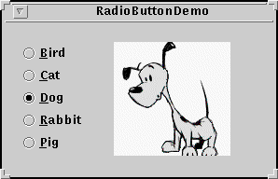
JCheckBox, JRadioButton
A check box is a toggleable button with two states:
checked and unchecked
A radio button is a button that can be selected; usually part of a group of mutually-exclusive radio buttons (1 selectable at a time)
public JCheckBox / JRadioButton(String text)
public JCheckBox(String text, boolean isChecked)
Creates checked/unchecked check box with given text.
public boolean isSelected()
Returns true if check box is checked.
public void setSelected(boolean selected)
Sets box to be checked/unchecked.

Slide 47
ButtonGroup
A logical group of radio buttons that ensures
that only one is selected at a time
public ButtonGroup()
public void add(JRadioButton button)
The ButtonGroup is not a graphical component, just a logical group; the RadioButtons themselves are added to the container, not the ButtonGroup

Slide 48

ImageIcon
Allows you to put a picture on a button, label or other component
public class ImageIcon implements Icon
  public ImageIcon(String filename)
  public ImageIcon(URL address)
in JButton, JRadioButton, JCheckBox, JLabel, etc...
  constructor that takes an Icon
  public void setIcon(Icon)
  public void setSelectedIcon(Icon)
  public void setRolloverIcon(Icon)

Slide 49

JScrollPane
A special container that holds a component,
using scrollbars to allow that component to be seen
public JScrollPane(Component comp)
Wraps the given component with scrollbars.
After constructing the scroll pane, add the scroll pane to the container, not the original component.
frame.add(new JScrollPane(area), BorderLayout.CENTER);

Slide 50
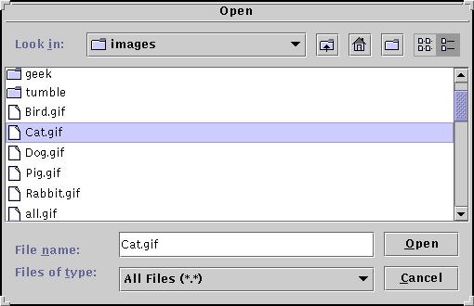
JFileChooser
A special dialog box that
allows the user to select
one or more files/folders
public JFileChooser()
public JFileChooser(String currentDir)
public int showOpenDialog(Component parent)
public int showSaveDialog(Component parent)
public File getSelectedFile()
public static int APPROVE_OPTION, CANCEL_OPTION
Possible result values from showXxxDialog(..).
JFileChooser chooser = new JFileChooser();
int result = chooser.showSaveDialog(this);
if (result == JFileChooser.APPROVE_OPTION)
this.saveData(chooser.getSelectedFile().getName());

Slide 51
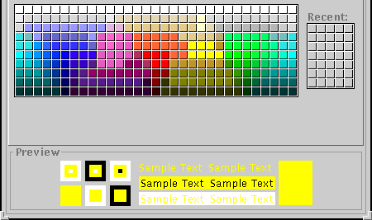
JColorChooser
Another special dialog that
lets the user pick from a
palette of colors
public JColorChooser()
public JColorChooser(Color initial)
public Color showDialog(Component parent,
String title, Color initialColor)
  returns null if user chose Cancel option

Slide 52

JMenuBar
The top-level container that holds menus;
can be attached to a frame
public JMenuBar()
public void add(JMenu menu)
Usage: in JFrame, the following method exists:
  public void setJMenuBar(JMenuBar bar)

Slide 53


JMenu
A menu to hold menu items; menus can contain other menus
public JMenu(String text)
public void add(JMenuItem item)
public void addSeparator()
public void setMnemonic(int mnemonic)

Slide 54

JMenuItem
An entry in a frame's Menu bar, which
can be clicked to perform commands
public JMenuItem(String text)
public JMenuItem(String text, Icon icon)
public JMenuItem(String text, int mnemonic)
public void addActionListener(
ActionListener al)
public void setAccelerator(KeyStroke ks)
public void setEnabled(boolean b)
public void setMnemonic(int mnemonic)

Slide 55

JCheckBoxMenuItem, JRadioButtonMenuItem
Radio button and checkbox-like menu items
public J_____MenuItem(String text)
public J_____MenuItem(String text, boolean select)
public J_____MenuItem(String text, Icon icon)
public J_____MenuItem(String text,
Icon icon, boolean selected)
public void addActionListener(ActionListener al)
public boolean isSelected()
public void setSelected(boolean b)
Recall: in a ButtonGroup, the following method exists:
  public void add(AbstractButton button)
These two classes extend AbstractButton!

Slide 56
Mnemonics
mnemonic: menu hotkey assigned to a button or component
  usually visible as an underlined key, activated by pressing:
    Ctrl+key (buttons) or Alt+key (menus)
  only work when input focus is on the component
    (affects menus)
usage: call setMnemonic(char) method
  menu items also have constructor that takes mnemonic
myQuitButton.setMnemonic('Q');
JMenuItem myNewItem = new JMenuItem("New", 'N');
myNewItem.setMnemonic('N'); // or this

Slide 57
Accelerators
accelerator: global hotkey combination that performs an action (ex: Alt-X to exit program) even on components that aren't in focus / visible
  can be run at any time in the application
  can optionally include modifiers like Shift, Alt
  created by calling the getKeyStroke method of the KeyStroke class, and passing this to setAccelerator method of various components (buttons, menus)
menuItem.setAccelerator(
KeyStroke.getKeyStroke('T', KeyEvent.ALT_MASK));

Slide 58
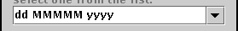
JComboBox
public JComboBox()
public JComboBox(Object[] items)
public JComboBox(Vector items)
public JComboBox(ComboBoxModel model)
Constructs a combo box. Can optionally pass a vector or model of items. (See DefaultComboBoxModel for a model implementation.)
public void addActionListener(
ActionListener al)
Causes an action event to be sent to listener al when the user selects or types a new item in the combo box.

Slide 59
JComboBox: Managing Items
public void addItem(Object item)
public Object getItemAt(int index)
public void removeAllItems()
public void removeItem(Object item)
public void removeItemAt(int index)

Slide 60
JComboBox: Selected Item
public int getSelectedIndex()
public Object getSelectedItem()
public void setSelectedItem(Object item)
public void setSelectedIndex(int index)
public void setEnabled(boolean enabled)
public void setEditable(boolean editable)
If editable, the user can type new arbitrary values into the combo box.

Slide 61
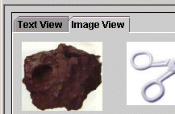
JTabbedPane
A container that can hold many "tab"
subcontainers, each with components in it
public JTabbedPane()
public JTabbedPane(int tabAlignment)
Constructs a new tabbed pane. Defaults to having the tabs on top; can be set to JTabbedPane.BOTTOM, LEFT, RIGHT, etc.
public void addTab(String title, Component comp)
public void addTab(String title, Icon icon,
Component comp)
public void addTab(String title, Icon icon,
Component comp, String tooltip)
Adds the given component as a tab in this tabbed pane. Can optionally use an icon and/or tool tip.

Slide 62
JTabbedPane methods
public void insertTab(String title,
Icon icon, Component comp,
String tooltip, int index)
public void remove(Component comp)
public void remove(int index)
public void removeAll()
public void setSelectedComponent(Component c)
public void setSelectedIndex(int index)

Slide 63

JSplitPane
A container that can hold two components,
divided by a movable separator
public JSplitPane()
public JSplitPane(int orientation)
Constructs a new tabbed pane. Defaults to having a horizontal split; can be set to JSplitPane.HORIZONTAL_SPLIT, VERTICAL_SPLIT, etc.
public void setBottomComponent(Component comp)
public void setLeftComponent(Component comp)
public void setRightComponent(Component comp)
public void setTopComponent(Component comp)
Sets the given component to occupy the desired region of the split pane.

Slide 64
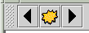
JToolBar
A movable container to hold
common buttons, commands, etc
public JToolBar()
public JToolBar(int orientation)
public JToolBar(String title)
public JToolBar(String title, int orientation)
Constructs a new tool bar, optionally with a title and orientation; can be JToolBar.HORIZONTAL or VERTICAL, defaults to horizontal
public void add(Component comp)
Adds the given component to this tool bar's flowing layout.

Slide 65
JToolBar: Usage
construct toolbar
add items (usually buttons) to toolbar
add toolbar to edge of BorderLayout of content pane (usually NORTH)
  don't put anything in other edges (N/S/E/W)!

Slide 66

JList
A list of selectable
pre-defined items
public JList()
Constructs an empty JList.
public JList(ListModel model)
public JList(Object[] data)
public JList(Vector data)
Constructs a JList that displays the given data.
public void addListSelectionListener(
ListSelectionListener lsl)
Adds the given listener to be informed when the selected index / indices change for this list.

Slide 67
JList: more methods
public void clearSelection()
public int getSelectedIndex()
public int[] getSelectedIndices()
public Object getSelectedValue()
public Object[] getSelectedValues()
public void setSelectedIndex(int index)
public void setSelectedIndices(int[] indices)
Methods for getting / setting the selected item and index in the list.

Slide 68



JList: even more methods
public ListModel getModel()
public void setListData(Object[] data)
public void setListData(Vector data)
public void setModel(ListModel model)
Causes this list to now display the given collection of data.
public int getSelectionMode()
public void setSelectionMode(int mode)
Get / set selection mode for the list. For example, set
to ListSelectionModel.SINGLE_SELECTION to only allow one item in the list to be chosen at once.
SINGLE_INTERVAL_SELECTION
SINGLE_SELECTION MULTIPLE_INTERVAL_SELECTION

Slide 69
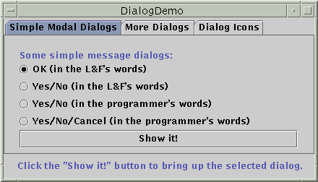
JDialog
A window that is a child of the
overall JFrame; used for popup
windows, option/config boxes, etc.
public JDialog(Dialog parent, boolean modal)
public JDialog(Frame parent, String title,
boolean modal)
Constructs a new dialog with the given parent and title. If the modal flag is set, this dialog is a child of the parent and the parent will be locked until the dialog is closed.
public void show()
Shows this dialog on screen. If the dialog is modal, calling show() will lock the parent frame/dialog.
JDialog has most all JFrame methods: getContentPane(), setJMenuBar(JMenuBar), setResizable(boolean), setTitle(String), ...

Slide 70
Some eye candy...
making a Java Swing GUI look like the native operating system:
    try {
    UIManager.setLookAndFeel(
    UIManager.getSystemLookAndFeelClassName());
    } catch Exception e) {}
adding borders to components:
    whateverComponent.setBorder(
    BorderFactory.createLineBorder(Color.BLUE, 3));

Slide 71
Mouse and keyboard events

Slide 72

Mouse events
Uses of mouse events:
  listen to clicks and movement of mouse within a GUI component (usually a panel)
  respond to mouse activity with appropriate actions
  create interactive programs that are driven by mouse activity

Slide 73
Listening to clicks: MouseListener
package java.awt.event;
public interface MouseListener {
public void mouseClicked(MouseEvent event);
public void mouseEntered(MouseEvent event);
public void mouseExited(MouseEvent event);
public void mousePressed(MouseEvent event);
public void mouseReleased(MouseEvent event);
}

Slide 74
MouseListener example
public class MyMouseListener implements MouseListener {
public void mouseClicked(MouseEvent event) {}
public void mouseEntered(MouseEvent event) {}
public void mouseExited(MouseEvent event) {}
public void mousePressed(MouseEvent event) {
System.out.println("User pressed mouse button!");
}
public void mouseReleased(MouseEvent event) {}
}

Slide 75
MouseListener usage
// assumes some custom panel class named MyPanel
MyPanel panel = new MyPanel();
panel.addMouseListener(new MyMouseListener());
Problem: Tedious to implement entire interface when only partial behavior is wanted/needed

Slide 76
MouseAdapter
an abstract class with empty implementations of all MouseListener methods
usage: extend MouseAdapter and override the methods you want to do something
removes need for you to type in empty methods for all the ones you don’t want
an example of the Adapter design pattern

Slide 77
MouseAdapter usage
public class MyMouseAdapter extends MouseAdapter {
public void mousePressed(MouseEvent event) {
System.out.println("User pressed mouse button!");
}
}
...
// using the MyMouseAdapter
MyPanel panel = new MyPanel();
panel.addMouseListener(new MyMouseAdapter());

Slide 78

MouseEvent objects
InputEvent
  public static int BUTTON1_MASK,
  BUTTON2_MASK, BUTTON3_MASK,
  CTRL_MASK, ALT_MASK, SHIFT_MASK
MouseEvent
  public int getClickCount()
  public Point getPoint()
  public int getX(), getY()
  public Object getSource()
  public int getModifiers()
  (use the above button masks with this)
SwingUtilities
  isLeftMouseButton(MouseEvent event)
  isRightMouseButton(MouseEvent event)

Slide 79
MouseEvent: usage
public class MyMouseAdapter extends MouseAdapter {
public void mousePressed(MouseEvent event) {
Point p = event.getPoint();
Object source = event.getSource();
if (source == this.panel && p.getX() < 10) {
JOptionPane.showMessageDialog(null,
"You clicked the left side of myPanel!");
}
}
}

Slide 80
Mouse movement: MouseMotionListener
package java.awt.event;
public interface MouseMotionListener {
public void mouseDragged(MouseEvent event);
public void mouseMoved(MouseEvent event);
}
abstract MouseMotionAdapter class provides empty implementations of both methods if you just want to override one

Slide 81
MouseMotionAdapter example
public class MyMouseMotionAdapter extends MouseMotionAdapter {
public void mouseMoved(MouseEvent event) {
Point p = event.getPoint();
double x = event.getX();
double y = event.getY();
System.out.println("Mouse is at " + p);
System.out.println("x is " + x);
System.out.println("y is " + y);
}
}
// using the listener
myPanel.addMouseMotionListener(new MyMouseMotionAdapter());

Slide 82
MouseInputListener
package javax.swing.event;
public interface MouseInputListener
extends MouseListener, MouseMotionListener {}
more importantly: MouseInputAdapter class includes empty implementations for ALL methods from both mouse input interfaces, allowing same listener to listen to mouse clicks and movement

Slide 83
MouseInputAdapter: Example
public class MyMouseInputAdapter extends MouseInputAdapter {
public void mousePressed(MouseEvent event) {
System.out.println("Mouse was pressed");
}
public void mouseMoved(MouseEvent event) {
Point p = event.getPoint();
System.out.println("Mouse is at " + p);
}
}
...
// using the listener
MyMouseInputAdapter adapter = new MyMouseInputAdapter();
myPanel.addMouseListener(adapter);
myPanel.addMouseMotionListener(adapter);

Slide 84

Keyboard Events
Usage of keyboard events:
  listen to keyboard activity within a GUI component
  (usually a panel)
  respond to keyboard activity with appropriate actions
  control onscreen drawn characters and simulate text input

Slide 85
Key Presses: KeyListener
package java.awt.event;
public interface KeyListener {
public void keyPressed(KeyEvent event);
public void keyReleased(KeyEvent event);
public void keyTyped(KeyEvent event);
}
abstract class KeyAdapter implements all KeyListener methods

Slide 86
KeyEvent objects
InputEvent
  public static int CTRL_MASK,
  ALT_MASK, SHIFT_MASK
KeyEvent
  public static int VK_A .. VK_Z,
  VK_0 .. VK_9,
  VK_F1 .. VK_F10,
  VK_UP, VK_LEFT, ..,
  VK_TAB, VK_SPACE, VK_ENTER, ...
  (one for every key)
  public char getKeyChar()
  public int getKeyCode()
  public Object getSource()
  public int getModifiers()
  (use masks with this)

Slide 87
KeyAdapter example
class PacManKeyListener extends KeyAdapter {
public void keyPressed(KeyEvent event) {
char keyChar = event.getKeyChar();
int keyCode = event.getKeyCode();
if (keyCode == KeyEvent.VK_RIGHT) {
pacman.setX(pacman.getX() + 1);
pacpanel.repaint();
} else if (keyChar == 'Q') {
System.exit(0);
}
}
}
// assumes some custom panel class named PacPanel
PacPanel panel = new PacPanel();
panel.addKeyListener(new PacKeyListener());

Slide 88
Other kinds of events
WindowListener/Adapter/Event:
Responds to events in a top-level window (JFrame). Useful to catch windowClosing event and respond, e.g. prompt to save current file
FocusListener/Event:
Responds to when the keyboard focus changes to a different component. Useful to validate input format on a text field.
ListSelectionListener, HyperlinkListener, ItemListener:
Event listeners for specific Swing components (JList, JEditorPane, JComboBox respectively)

Slide 89
2D Graphics

Slide 90
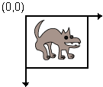
A drawing panel
extend JPanel and override paintComponent method to use a panel as a drawing surface
  public void paintComponent(Graphics g)
coordinate system: (0, 0) at top-left,
x-axis increases rightward, y-axis downward
panel surface is transparent unless drawn on

Slide 91
Some details
JPanel's paintComponent does important things that we don't want to lose, so call the method super.paintComponent first thing!
paintComponent's Graphics g argument represents "graphical context" object that can be told to draw things on the panel
Guaranteed for every JPanel that actual object passed in is a Graphics2D (can cast)
panel has small preferred size, so it will be tiny when put into some layouts; use setPreferredSize(Dimension) to make it bigger!
refreshing panel: can't call paintComponent, so call repaint()

Slide 92
Basic panel painting syntax
public class MyPanel extends JPanel {
public void paintComponent(Graphics g) {
super.paintComponent(g); // important!
// put your painting code here
}
}

Slide 93
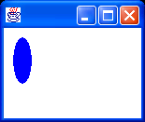
Quick drawing example
public class MyPanel extends JPanel {
public MyPanel() {
this.setBackground(Color.WHITE);
}
public void paintComponent(Graphics g) {
super.paintComponent(g);
g2.setColor(Color.BLUE);
g.fillOval(10, 10, 20, 50);
}
}

Slide 94
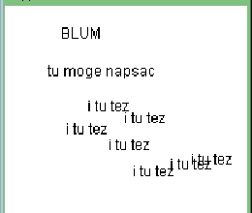
Drawing text strings
Graphics
public void drawString(String s, int x, int y)
Draws a string with its first letter's bottom-left corner at the given location.
  The string is drawn using the Graphics' current color and font settings.
  Before drawing the string, you can set the font, color, and other attributes.

Slide 95
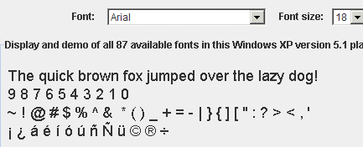
Fonts
Graphics
  public void setFont(Font f)
  Sets this Graphics context to start writing text in the given font. (Forgotten at end of paintComponent call!)
java.awt.Font
Text styles used when drawing Strings on the panel
  public Font(String name, int style, int size)
  some predefined font names:
    "Serif", "SansSerif", "Monospaced"
  font styles (can be combined with + operator):
    Font.BOLD
    Font.ITALIC
    Font.PLAIN

Slide 96
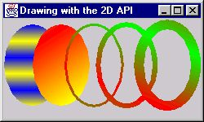
Colors and paints
java.awt.Color
(a simple single-colored paint)
  public Color(int r, int g, int b)
  public Color(int r, int g, int b, int alpha)
    a partially-transparent color (range 0-255, 0=transparent)
  public Color brighter(), darker()
  public static Color BLACK, BLUE, CYAN, DARK_GRAY, GRAY, GREEN, LIGHT_GRAY, MAGENTA, ORANGE, PINK, RED, WHITE, YELLOW

Slide 97






Drawing shapes
Graphics
public void drawLine(int x1, int y1, int x2, int y2)
public void drawOval(int x, int y, int w, int h)
public void fillOval(int x, int y, int w, int h)
public void drawPolygon(int[] xpoints, int[] ypoints, int len)
public void fillPolygon(int[] xpoints, int[] ypoints, int len)
public void drawRect(int x, int y, int w, int h)
public void fillRect(int x, int y, int w, int h)
public void drawArc(...)
public void fillArc(...)
...

Slide 98
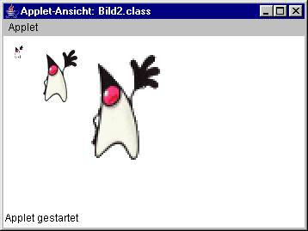
Drawing images
Graphics
public void drawImage(Image i, int x, int y, ImageObserver io)
public void drawImage(Image i, int x, int y, int width,
int height, ImageObserver io)
Draws given image with this Graphics pen with its top-left corner at given location (pass the panel as the ImageObserver).

Slide 99
Classes for imaging
java.awt.Toolkit
Gets images from disk or internet
  public static Toolkit getDefaultToolkit()
  public Image getImage(String filename)
  public Image getImage(URL address)
java.awt.MediaTracker
Ensures that images are loaded fully
  public MediaTracker(Component comp)
  public void addImage(Image img, int id)
  public void waitForAll()
  throws InterruptedException
java.awt.Image
Represents a graphic image (BMP, GIF, ...)
  public int getWidth(ImageObserver obs)
  public int getHeight(ImageObserver obs)
java.awt.image.BufferedImage
A blank graphic image surface onto which you can draw
  public BufferedImage(int w, int h, int type)
  public Graphics getGraphics()

Slide 100
Images, continued
Code to load an image:
Toolkit tk = Toolkit.getDefaultToolkit();
Image img = tk.getImage("myimage.jpg");
MediaTracker mt = new MediaTracker(this);
mt.addImage(img, 0); // any ID will do
try {
mt.waitForAll();
} catch (InterruptedException ie) {}
This is tedious!
  suggest making a helper method to load and return one image
  public Image loadImage(String filename)

Slide 101
Animation with Timers

Slide 102
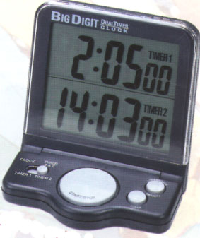
Timers—Why?
execute an action multiple times
at given intervals
create animations in our GUI programs
add delays and pauses when required / desired
a Timer is an example of a "callback" -- your code starts the timer, then later at a specified time, the timer activates, causing an event in your system

Slide 103
javax.swing.Timer
public Timer(int ms_delay, ActionListener al)
Causes al to fire an actionPerformed every ms_delay milliseconds.
public void start()
Causes timer to begin ticking; the first tick happens after the initial delay, and the rest occur separated by the timer's delay.
public void stop()
Stops timer from ticking.
public void restart()
Restarts timer, causing it to wait its initial delay and then begin firing at its delay rate.

Slide 104
Timer: more methods
public void addActionListener(ActionListener a)
Adds additional listeners to be fired as the timer ticks.
public boolean isRunning()
Returns true when timer is ticking (has been started).
public void setDelay(int delay)
Changes the delay between timer ticks.
public void setInitialDelay(int delay)
Sets a one-time delay to occur before ticking starts.
public void setRepeats(boolean b)
Set to false to make timer fire only once.

Slide 105
Timer example
// This code could be used to move a shape to the right
// across the screen.
int DELAY = 100;
ActionListener updater = new ActionListener() {
public void actionPerformed(ActionEvent event) {
x++;
myPanel.repaint();
}
}
Timer tim = new Timer(DELAY, updater);
tim.start();

