Slide 1
Defining Classes and Methods
Chapter 5

Slide 2
Objectives
Describe concepts of class, class object
Create class objects
Define a Java class, its methods
Describe use of parameters in a method
Use modifiers public, private
Define accessor, mutator class methods
Describe information hiding, encapsulation
Write method pre- and postconditions

Slide 3
Objectives
Describe purpose of javadoc
Draw simple UML diagrams
Describe references, variables, parameters of a class type
Define boolean-valued methods such as equals
In applets use class Graphics, labels, init method

Slide 4
Class and Method Definitions: Outline
Class Files and Separate Compilation
Instance Variables
Methods
The Keyword this
Local Variables
Blocks
Parameters of a Primitive Type

Slide 5
Class and Method Definitions
Java program consists of objects
  Objects of class types
  Objects that interact with one another
Program objects can represent
  Objects in real world
  Abstractions

Slide 6
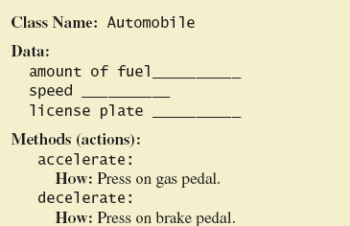
Class and Method Definitions
Figure 5.1 A class as a blueprint

Slide 7
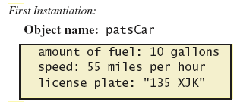
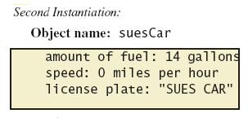
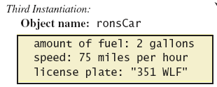
Class and Method Definitions
Figure 5.1 ctd.
Objects that are instantiations of the class Automobile

Slide 8
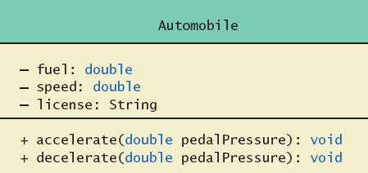
Class and Method Definitions
Figure 5.2 A class outline as a UML class diagram

Slide 9
Class Files and Separate Compilation
Each Java class definition usually in a file by itself
  File begins with name of the class
  Ends with .java
Class can be compiled separately
Helpful to keep all class files used by a program in the same directory

Slide 10
Instance Variable
View sample program, listing 5.1
class SpeciesFirstTry
Note class has
  Three pieces of data (instance variables)
  Three behaviors
Each instance of this type has its own copies of the data items
Use of public
  No restrictions on how variables used

Slide 11
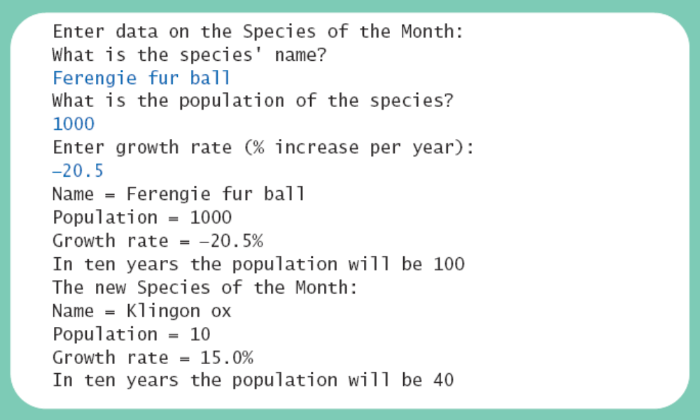
Using a Class and Its Methods
View sample program, listing 5.2
class SpeciesFirstTryDemo
Sample
screen output

Slide 12
Methods
When you use a method you "invoke" or "call" it
Two kinds of Java methods
  Return a single item
  Perform some other action – a void method
The method main is a void method
  Invoked by the system
  Not by the application program

Slide 13
Methods
Calling a method that returns a quantity
  Use anywhere a value can be used
Calling a void method
  Write the invocation followed by a semicolon
  Resulting statement performs the action defined by the method

Slide 14
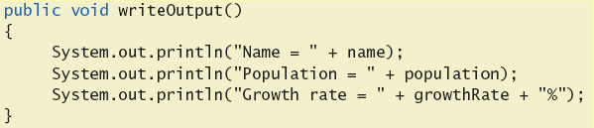
Defining void Methods
Consider method writeOutput from
Listing 5.1
Method definitions appear inside class definition
  Can be used only with objects of that class

Slide 15
Defining void Methods
Most method definitions we will see as public
Method does not return a value
  Specified as a void method
Heading includes parameters
Body enclosed in braces { }
Think of method as defining an action to be taken

Slide 16
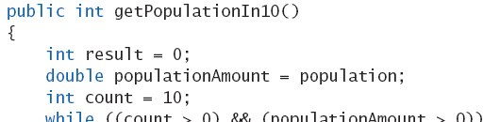
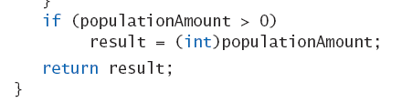
Methods That Return a Value
Consider method getPopulationIn10( )
Heading declares type of value to be returned
Last statement executed is return
. . .

Slide 17
The Keyword this
Referring to instance variables outside the class – must use
  Name of an object of the class
  Followed by a dot
  Name of instance variable
Inside the class,
  Use name of variable alone
  The object (unnamed) is understood to be there

Slide 18
The Keyword this
Inside the class the unnamed object can be referred to with the name this
Example
this.name = keyboard.nextLine();
The keyword this stands for the receiving object
We will seem some situations later that require the this

Slide 19
Local Variables
Variables declared inside a method are called local variables
  May be used only inside the method
  All variables declared in method main are local to main
Local variables having the same name and declared in different methods are different variables

Slide 20

Local Variables
View sample file, listing 5.3A
class BankAccount
View sample file, listing 5.4B
class LocalVariablesDemoProgram
Note two different variables newAmount
  Note different values output
Sample
screen output

Slide 21
Blocks
Recall compound statements
  Enclosed in braces { }
When you declare a variable within a compound statement
  The compound statement is called a block
  The scope of the variable is from its declaration to the end of the block
Variable declared outside the block usable both outside and inside the block

Slide 22
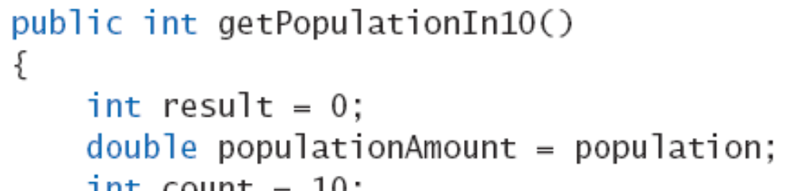
Parameters of Primitive Type
Recall method
declaration
in listing 5.1
  Note it only works for 10 years
  We can make it more versatile by giving the method a parameter to specify how many years
Note sample program, listing 5.4
class SpeciesSecondTry

Slide 23
Parameters of Primitive Type
Note the declaration
public int predictPopulation(int years)
  The formal parameter is years
Calling the method
int futurePopulation =
speciesOfTheMonth.predictPopulation(10);
  The actual parameter is the integer 10
View sample program, listing 5.5
class SpeciesSecondClassDemo

Slide 24
Parameters of Primitive Type
Parameter names are local to the method
When method invoked
  Each parameter initialized to value in corresponding actual parameter
  Primitive actual parameter cannot be altered by invocation of the method
Automatic type conversion performed
byte -> short -> int ->
long -> float -> double

Slide 25
Information Hiding,
Encapsulation: Outline
Information Hiding
Pre- and Postcondition Comments
The public and private Modifiers
Methods Calling Methods
Encapsulation
Automatic Documentation with javadoc
UML Class Diagrams

Slide 26
Information Hiding
Programmer using a class method need not know details of implementation
  Only needs to know what the method does
Information hiding:
  Designing a method so it can be used without knowing details
Also referred to as abstraction
Method design should separate what from how

Slide 27
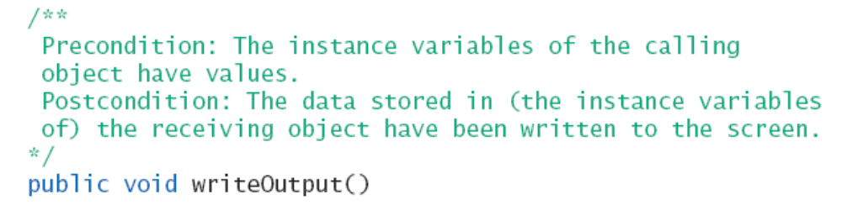
Pre- and Postcondition Comments
Precondition comment
  States conditions that must be true before method is invoked
Example

Slide 28
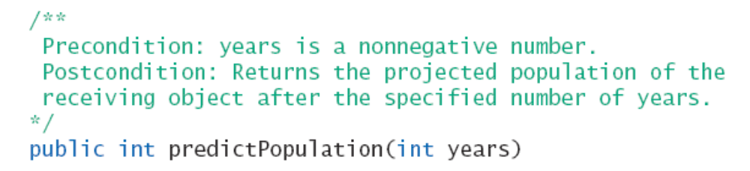
Pre- and Postcondition Comments
Postcondition comment
  Tells what will be true after method executed
Example

Slide 29
The public and private Modifiers
Type specified as public
  Any other class can directly access that object by name
Classes generally specified as public
Instance variables usually not public
  Instead specify as private
View sample code, listing 5.6
class SpeciesThirdTry

Slide 30
Programming Example
Demonstration of need for private variables
View sample code, listing 5.7
Statement such as
box.width = 6;
is illegal since width is private
  Keeps remaining elements of the class consistent in this example

Slide 31
Programming Example
Another implementation of a Rectangle class
View sample code, listing 5.8
class Rectangle2
Note setDimensions method
  This is the only way the width and height may be altered outside the class

Slide 32
Accessor and Mutator Methods
When instance variables are private must provide methods to access values stored there
  Typically named getSomeValue
  Referred to as an accessor method
Must also provide methods to change the values of the private instance variable
  Typically named setSomeValue
  Referred to as a mutator method

Slide 33
Accessor and Mutator Methods
Consider an example class with accessor and mutator methods
View sample code, listing 5.9
class SpeciesFourthTry
Note the mutator method
  setSpecies
Note accessor methods
  getName, getPopulation, getGrowthRate

Slide 34
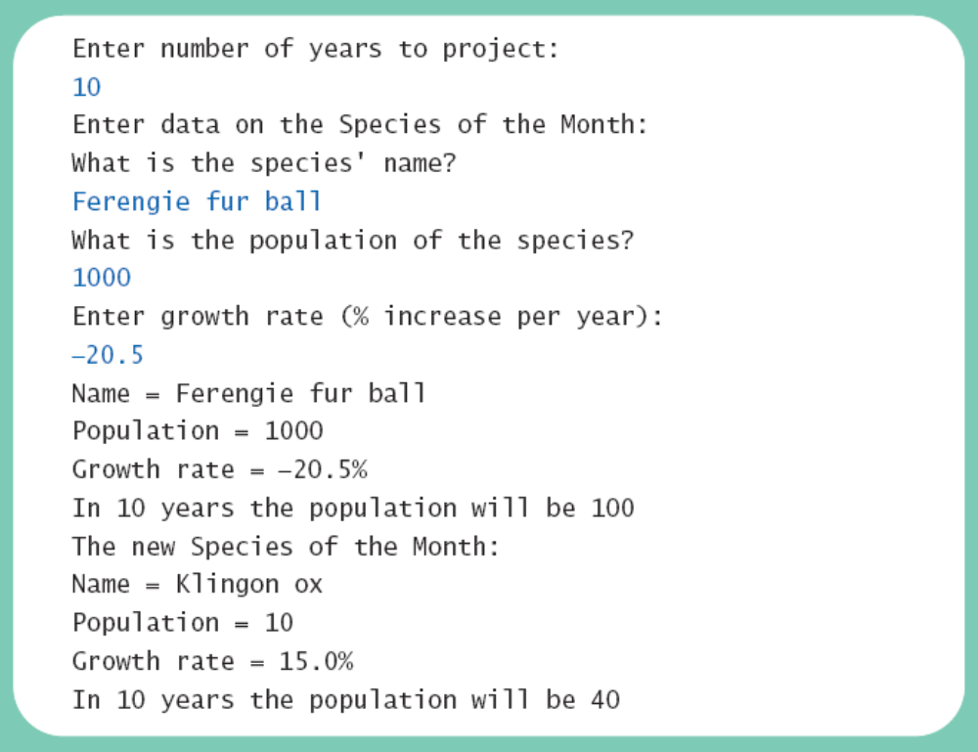
Accessor and Mutator Methods
Using a mutator method
View sample program, listing 5.10
classSpeciesFourthTryDemo
Sample
screen output

Slide 35
Programming Example
A Purchase class
View sample code, listing 5.11
class Purchase
  Note use of private instance variables
  Note also how mutator methods check for invalid values
View demo program, listing 5.12
class purchaseDemo

Slide 36
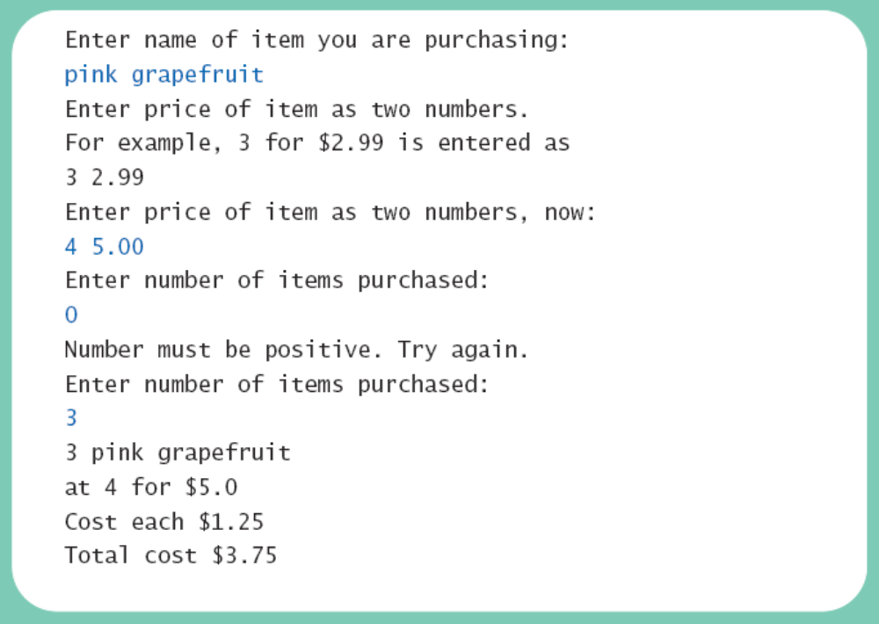
Programming Example
Sample
screen output

Slide 37
Methods Calling Methods
A method body may call any other method
If the invoked method is within the same class
  Need not use prefix of receiving object
View sample code, listing 5.13
class Oracle
View demo program, listing 5.14
class OracleDemo

Slide 38
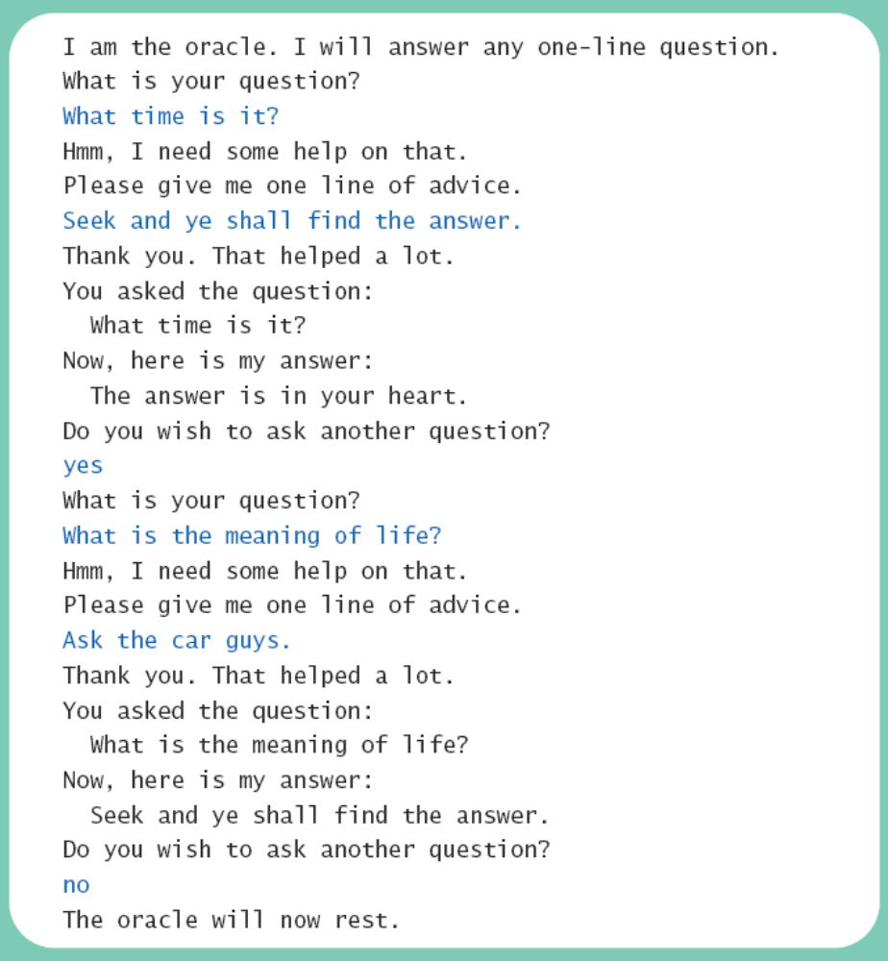
Methods Calling Methods
Sample
screen output

Slide 39
Encapsulation
Consider example of driving a car
  We see and use break pedal, accelerator pedal, steering wheel – know what they do
  We do not see mechanical details of how they do their jobs
Encapsulation divides class definition into
  Class interface
  Class implementation

Slide 40
Encapsulation
A class interface
  Tells what the class does
  Gives headings for public methods and comments about them
A class implementation
  Contains private variables
  Includes definitions of public and private methods

Slide 41
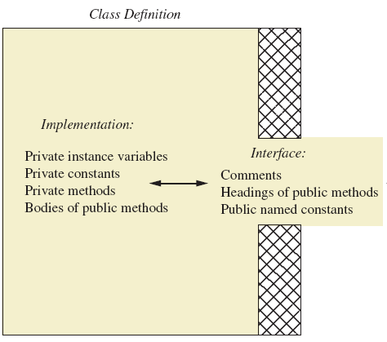
Encapsulation
Figure 5.3 A well encapsulated class definition
Programmer who uses the class

Slide 42
Encapsulation
Preface class definition with comment on how to use class
Declare all instance variables in the class as private.
Provide public accessor methods to retrieve data Provide public methods manipulating data
  Such methods could include public mutator methods.
Place a comment before each public method heading that fully specifies how to use method.
Make any helping methods private.
Write comments within class definition to describe implementation details.

Slide 43
Automatic Documentation javadoc
Generates documentation for class interface
Comments in source code must be enclosed in /** */
Utility javadoc will include
  These comments
  Headings of public methods
Output of javadoc is HTML format

Slide 44
UML Class Diagrams
Recall Figure 5.2 A class outline as a UML class diagram

Slide 45
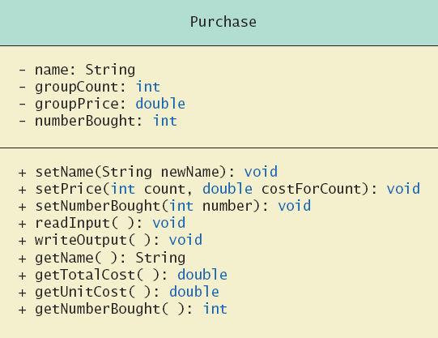
UML Class Diagrams
Note
Figure 5.4
for the
Purchase
class
Minus signs imply private methods
Plus signs imply public methods

Slide 46
UML Class Diagrams
Contains more than interface, less than full implementation
Usually written before class is defined
Used by the programmer defining the class
  Contrast with the interface used by programmer who uses the class

Slide 47
Objects and References: Outline
Variables of a Class Type
Defining an equals Method for a Class
Boolean-Valued Methods
Parameters of a Class Type

Slide 48
Variables of a Class Type
All variables are implemented as a memory location
Data of primitive type stored in the memory location assigned to the variable
Variable of class type contains memory address of object named by the variable

Slide 49
Variables of a Class Type
Object itself not stored in the variable
  Stored elsewhere in memory
  Variable contains address of where it is stored
Address called the reference to the variable
A reference type variable holds references (memory addresses)
  This makes memory management of class types more efficient

Slide 50
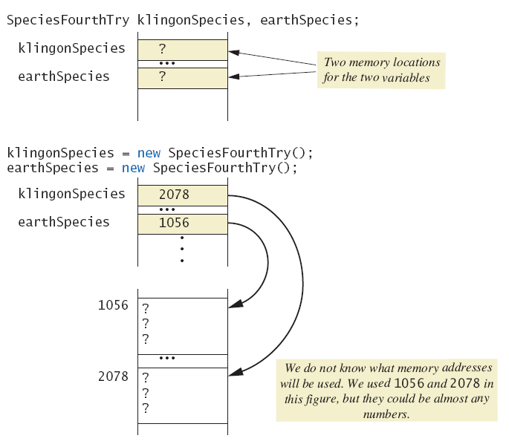
Variables of a Class Type
Figure
5.5a
Behavior
of class
variables

Slide 51
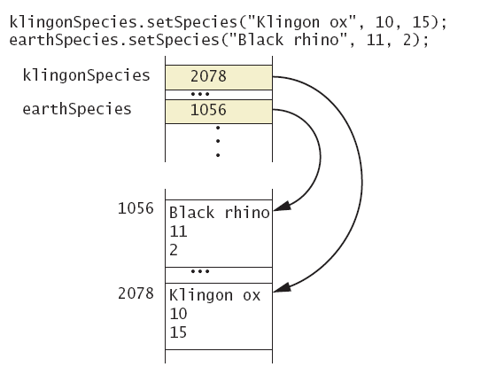
Variables of a Class Type
Figure
5.5b
Behavior
of class
variables

Slide 52
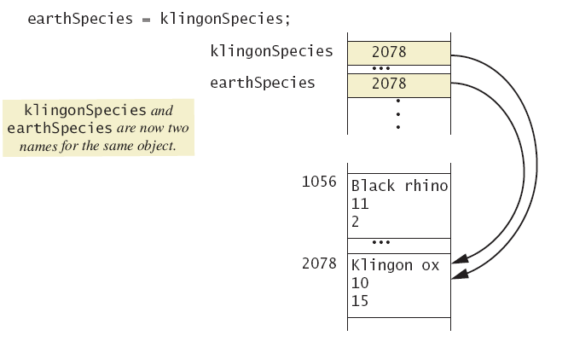
Variables of a Class Type
Figure
5.5c
Behavior
of class
variables

Slide 53
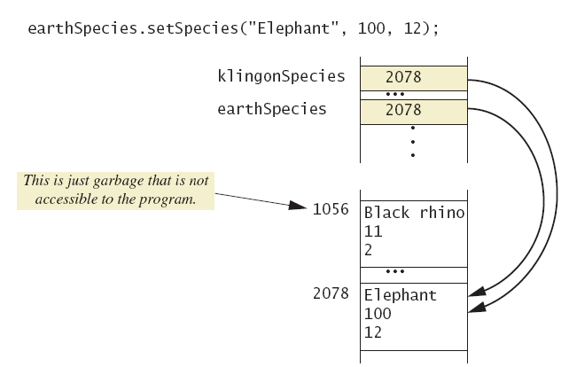
Variables of a Class Type
Figure
5.5d
Behavior
of class
variables

Slide 54
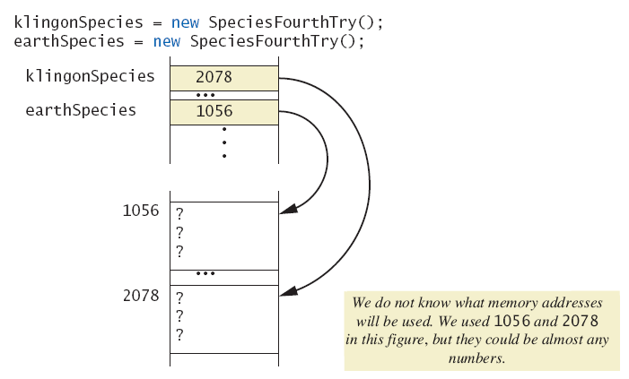
Variables of a Class Type
Figure
5.6a
Dangers of
using ==
with objects

Slide 55
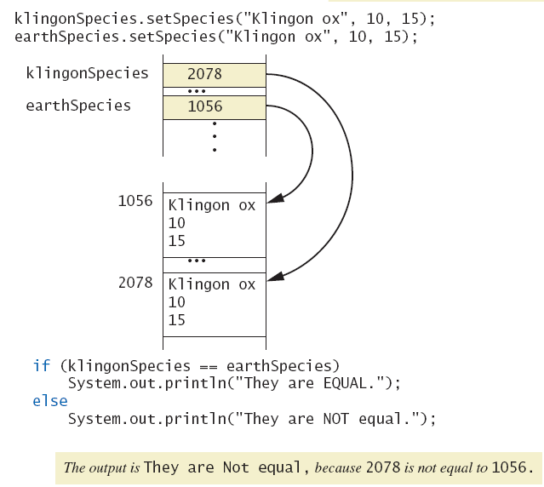
Variables of a Class Type
Figure
5.6b
Dangers of
using ==
with objects

Slide 56
Defining an equals Method
As demonstrated by previous figures
  We cannot use == to compare two objects
  We must write a method for a given class which will make the comparison as needed
View sample code, listing 5.15
class Species
The equals for this class method used same way as equals method for String

Slide 57
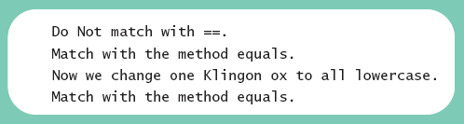
Demonstrating an equals Method
View sample program, listing 5.16
class SpeciesEqualsDemo
Note difference in the two comparison methods == versus .equals( )
Sample
screen output

Slide 58
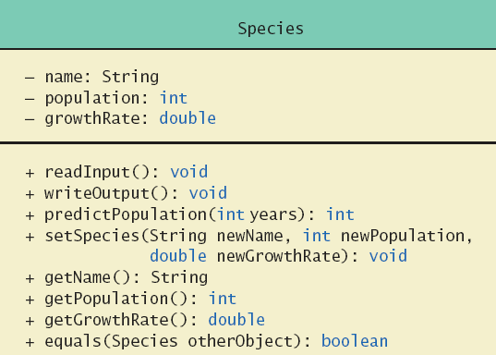
Programming Example
View sample code, listing 5.17
class Species
Figure 5.7
Class Diagram
for the class
Species
in listing 5.17

Slide 59
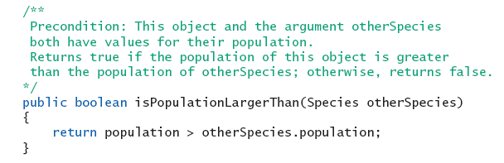
Boolean-Valued Methods
Methods can return a value of type boolean
Use a boolean value in the return statement
Note method from listing 5.17

Slide 60
Parameters of a Class Type
When assignment operator used with objects of class type
  Only memory address is copied
Similar to use of parameter of class type
  Memory address of actual parameter passed to formal parameter
  Formal parameter may access public elements of the class
  Actual parameter thus can be changed by class methods

Slide 61
Programming Example
View sample code, listing 5.18
class DemoSpecies
  Note different parameter types and results
View sample program, listing 5.19
  Parameters of a class type versus parameters of a primitive type
  class ParametersDemo

Slide 62
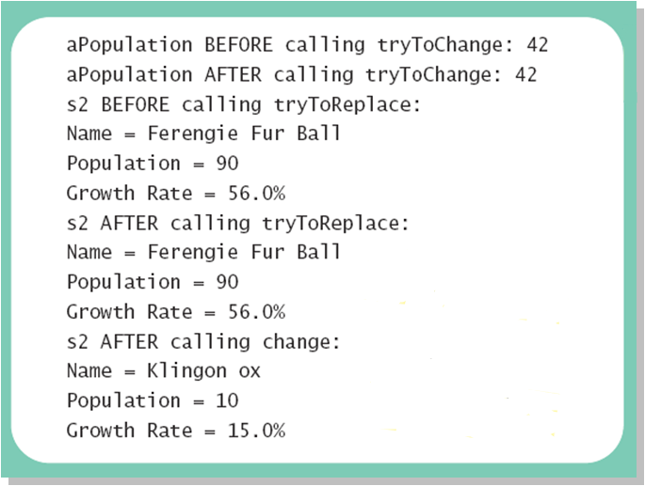
Programming Example
Sample
screen output

Slide 63
Graphics Supplement: Outline
The Graphics Class
The init Methods
Adding Labels to an Applet

Slide 64
The Graphics Class
An object of the Graphics class represents an area of the screen
Instance variables specify area of screen represented
When you run an Applet
  Suitable Graphics object created automatically
  This object used as an argument in the paint method

Slide 65
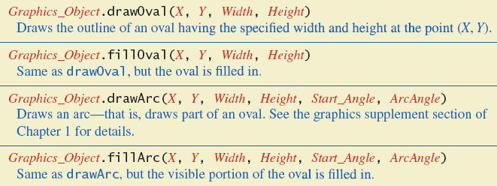
The Graphics Class
Figure 5.8a Some methods in class Graphics

Slide 66
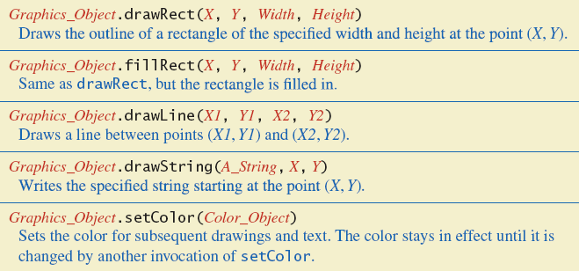
The Graphics Class
Figure 5.8b Some methods in class Graphics

Slide 67
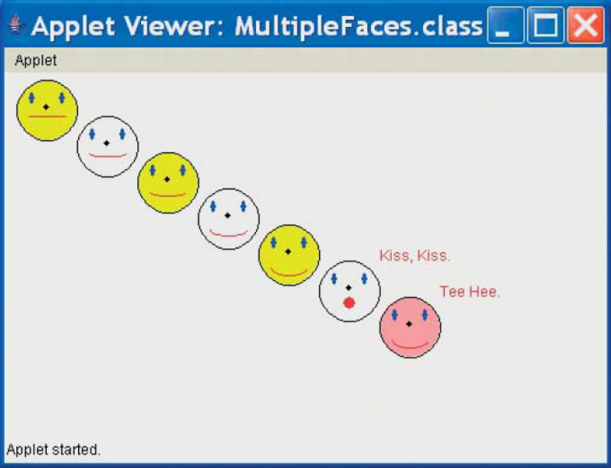
Programming Example
Multiple faces – using a Helping method
View sample code, listing 5.20
class MultipleFaces
Sample
screen output

Slide 68
The init Method
Method init may be defined for any applet
Like paint, method init called automatically when applet is run
Method init similar to method main in an application program

Slide 69
Adding Labels to Applet
Provides a way to add text to an applet
When component (such as a label) added to an applet
  Use method init
  Do not use method paint

Slide 70
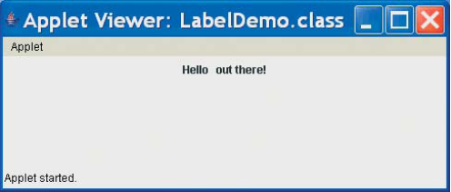
Adding Labels to Applet
View sample applet, listing 5.21
class LabelDemo
Sample
screen output

Slide 71
Summary
Classes have
  Instance variables to store data
  Method definitions to perform actions
Instance variables should be private
Class needs accessor, mutator methods
Methods may be
  Value returning methods
  Void methods that do not return a value

Slide 72
Summary
Keyword this used within method definition represents invoking object
Local variables defined within method definition
Formal arguments must match actual parameters with respect to number, order, and data type
Formal parameters act like local variables

Slide 73
Summary
Parameter of primitive type initialized with value of actual parameter
  Value of actual parameter not altered by method
Parameter of class type initialized with address of actual parameter object
  Value of actual parameter may be altered by method calls
A method definition can include call to another method in same or different class

Slide 74
Summary
Precondition comment states conditions that must be true before method invoked
Postcondition comment describes resulting effects of method execution
Utility program javadoc creates documentation
Class designers use UML notation to describe classes
Operators = and == behave differently with objects of class types (vs. primitive types)

Slide 75
Summary
Designer of class should include an equals method
Graphics drawn by applet normally done from within paint
  Other applet instructions placed in init
Parameter of paint is of type Graphics
Method setBackground sets color of applet pane
Labels added to content pane within the init method

