Slide 1

Practical RDF Ch.10
Querying RDF: RDF as Data
Taewhi Lee
SNU OOPSLA Lab.
Shelley Powers, O’Reilly
August 27, 2004

Slide 2
Contents
RDF and the Relational Data Model
The RDF Query Language Issue
Roots: rdfDB QL
Inkling and SquishQL
RDQL
Jena’s RDQL
Sesame

Slide 3
RDF and the Relational Data Model
Storing RDF in a relational DB
  Need to persistently store and manipulate (large amounts of) RDF data
  To use the relational database technology
  Basically store the model as triples
    A table for storing statements
    Secondary tables storing literals, resources, and namespaces
  Options
    Multiple models support
    Use of a hash to generate the identifiers for the resources

Slide 4
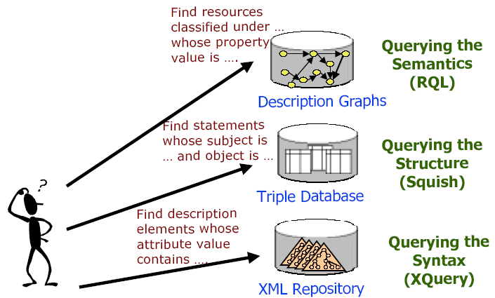
The RDF Query Language Issue

Slide 5
Roots: RDFDB QL
R. V. Guha’s RDFDB
  One of the earliest persistent data stores for RDF
  Written in C, primarily tested within a Linux environment
  Uses a specialized language derived form SQL
    RDF triple in the format of arc-source-target, not source-arc-target
Query example
- insert into test1 (type DanB Person), (name DanB 'Dan Brickley') </>
- select ?x from test1 where (worksFor ?x W3C) (name ?x ?y) </>
?x = DanC ?y = 'Dan Connolly'
?x = DanB ?y = 'Dan Brickley'

Slide 6
Inkling and SquishQL(1/3)
Inkling DB
  Written in Java, originally on Linux and Solaris and most recently hosted and tested on Mac OS X, using Java JDBC classes
  PostgreSQL required to use this DB for persistent storage
  Data structure loaded into the PostgreSQL
    One table containing pointers(hashed value) to the actual values in a second table
SquishQL
  Based on Guha’s RDFDB QL

Slide 7
Inkling and SquishQL(2/3)
SquishQL – basic structure
SELECT variables
FROM source
WHERE (triple clause)
USING namespace mapping
Query example
SELECT ?subject
FROM http://burningbird.net/articles/monsters1.rdf
WHERE (dc::subject ?x ?subject)
USING dc FOR http://purl.org/dc/elements/1.1/

Slide 8
Inkling and SquishQL(3/3)
SquishQL – query constraints
  less than(<), greater than(>)
  equality(=), string equality(~)
Query example
SELECT ?resource
FROM http://burningbird.net/articles/monsters1.rdf
WHERE (rdf::type ?resource http://burningburd.net/postcon/elements/1.0/Movement)
(dc::date ?resource ?date)
AND ?date ~ “1999-10-31:T00:00:00-05:00”
USING pstcn FOR http://burningbird.net/postcon/elements/1.0/
rdf FOR http://www.w3.org/1999/02/22-rdf-syntax-ns#
dc FOR http://purl.org/dc/elements/1.1/

Slide 9
RDQL
Based on the earlier work of Guha’s RDFDB QL and SquishQL, with some relatively minor differences
more comparison semantics support
  OR operator(|||), bitwise operators(& and |), negation(!)
Implementations
  Jena (java)
  Sesame (java)
  PHPxmlclasses (PHP)
  RDFStore (Perl)

Slide 10
Jena’s RDQL(1/2)
Specialized classes for use with RDQL
  Query – to build or parse the query
  QueryEngine – for processing
  QueryExecution
  QueryResults
  ResultBinding
    Bounds the data to program variables, to access individual items in the results

Slide 11
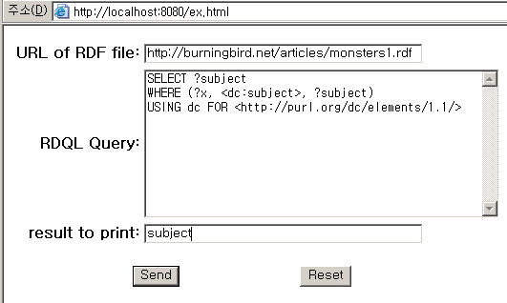
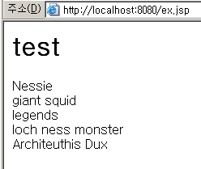
Jena’s RDQL(2/2)
The Query-O-Matic – a two-page application
  First HTML page containing a form
  Second JSP page processing the form contents

Slide 12
Sesame
“…an Open Source RDF Schema-Based Repository and Querying Facility.”
Can be used on PostgreSQL, MySQL and Oracle 9i.
RDQL, RQL, SeRQL support

Slide 13
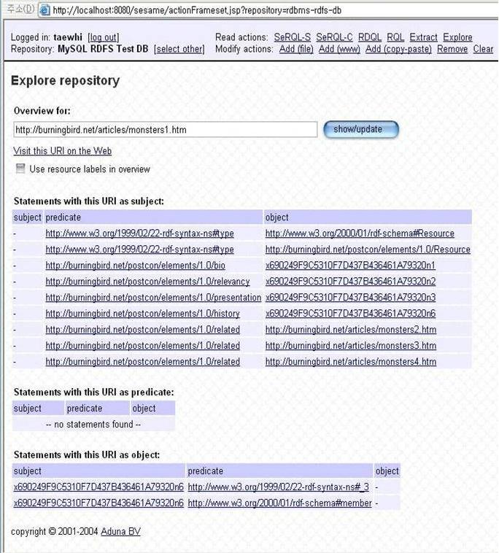
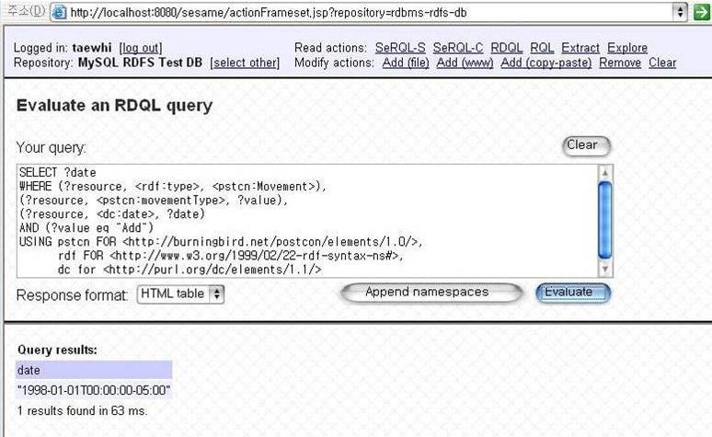

Sesame’s RDQL
SELECT ?date
WHERE (?resource, <rdf.type>, <pstcn:Movement>),
(?resource, <pstcn:movementType>, ?value),
(?resource, <dc:date>, ?date)
AND (?value eq “Add”)
USING pstcn FOR <http://burningbird.net/postcon/elements/1.0>,
rdf FOR <http://www.w3.org/1999/02/22-rdf.syntax-ns#>,
dc FOR <http://purl.org/dc/elements/1.1/>

Slide 14
RQL
RQL
  Querying at the semantic level
  Adopts the syntax of OQL
  A functional language
  Queries
    Access to the RDF Schema specific contents of an RDF triple store
    The structure of the subclass hierarchy
    Match patterns along entire paths in RDF/RDF Schema graphs
select Y
from FamousWriter{X}.hasWritten{Y}

Slide 15
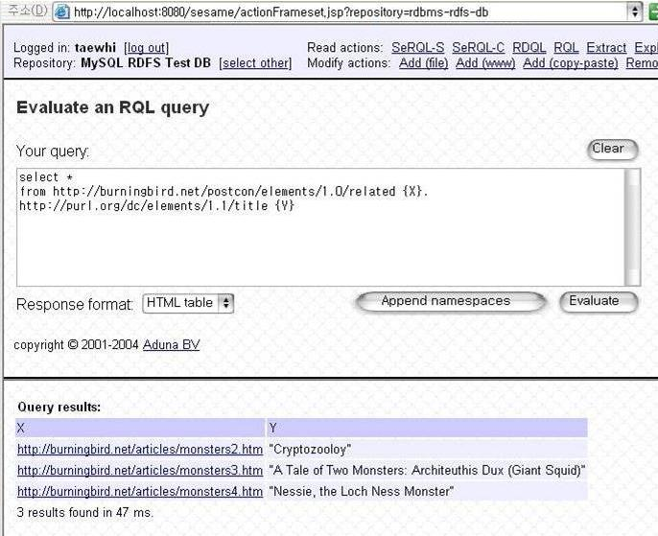
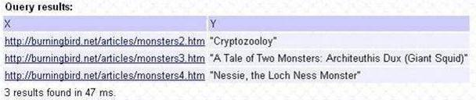
Sesame’s RQL
SELECT *
FROM http://burningbird.net/postcon/elements/1.0/related {X} .
http://purl.org/dc/elements/1.1/title {Y}

Slide 16
SeRQL(1/4)
SeRQL
  “Sesame RDF Query Language”
  combines the best features of other (query) languages (RQL, RDQL, N-Triples, N3) and adds some of its own
  most important features:
    Graph transformation
    Schema awareness – RDF Schema support
    Datatyping – XML Schema data type support
    Optional path matching
    Expressive path expression syntax
  SeRQL-S, SeRQL-C

Slide 17
SeRQL(2/4)
SeRQL-S
  Select queries
SELECT O, S
FROM {S} <rdfs:label> {O}
SeRQL-C
  Construct queries
CONSTRUCT
{Artist} <rdf:type> {<art:Painter>};
<art:hasPainted> {Painting}
FROM
{Artist} <rdfs:type> {<art:Artist>};
<art:hasCreated> {Painting} <rdf:type> {<art:Painting>}

Slide 18
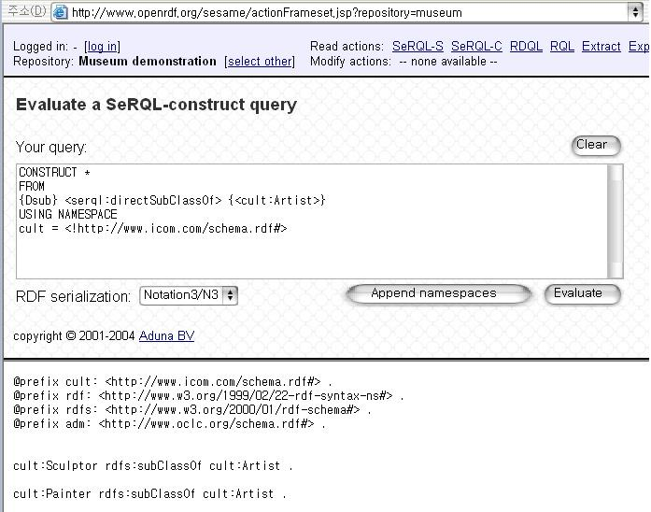
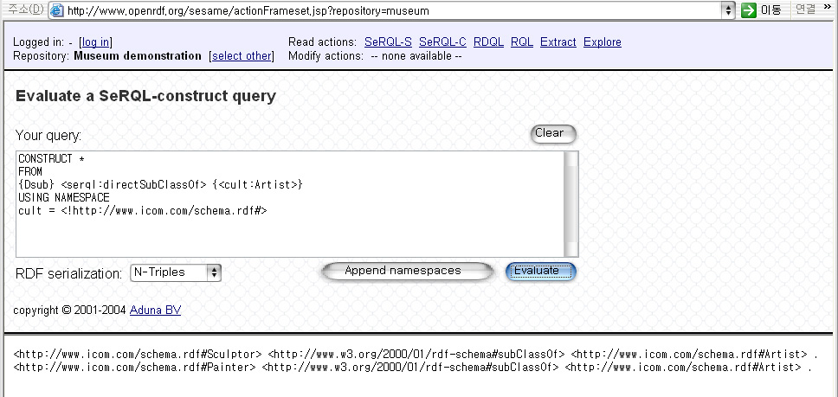
SeRQL(3/4)
CONSTRUCT *
FROM
{Dsub} <serql:directSubClassOf> {<cult:Artist>}
USING NAMESPACE
cult = <!http://www.icom.com/schema.rdf#>
@prefix cult: <http://www.icom.com/schema.rdf#Sculptor> .
@prefix rdf: <http://www.w3.org/1999/02/22-rdf-syntax-ns#> .
@prefix rdfs: <http://www.w3.org/2000/01/rdf-schema#> .
@prefix adm: <http://www.oclc.org/schema.rdf#> .
cult:Sculptor rdfs:SubClassOf cult:Artist .
cult:Painter rdfs:SubClassOf cult:Artist .
<http://www.icom.com/schema.rdf#Sculptor> <http://www.w3.org/2000/01/rdf-schema#SubClassOf> <http://www.icom.com/schema.rdf#Artist> .
<http://www.icom.com/schema.rdf#Painter> <http://www.w3.org/2000/01/rdf-schema#SubClassOf> <http://www.icom.com/schema.rdf#Artist> .

Slide 19
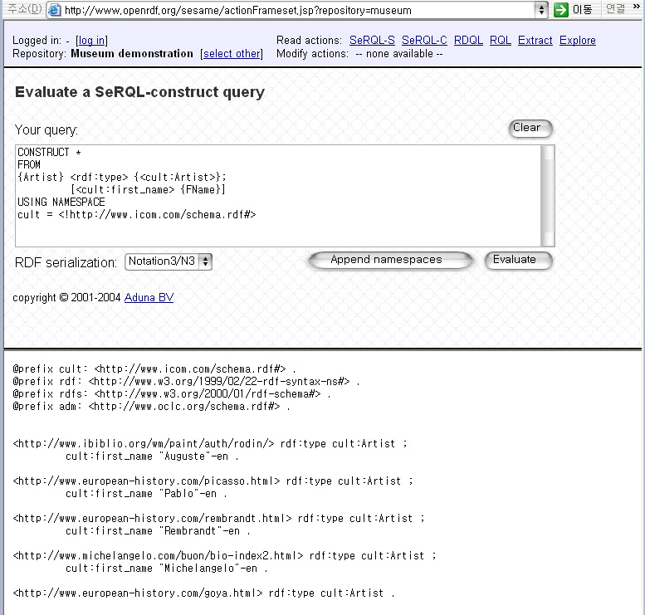
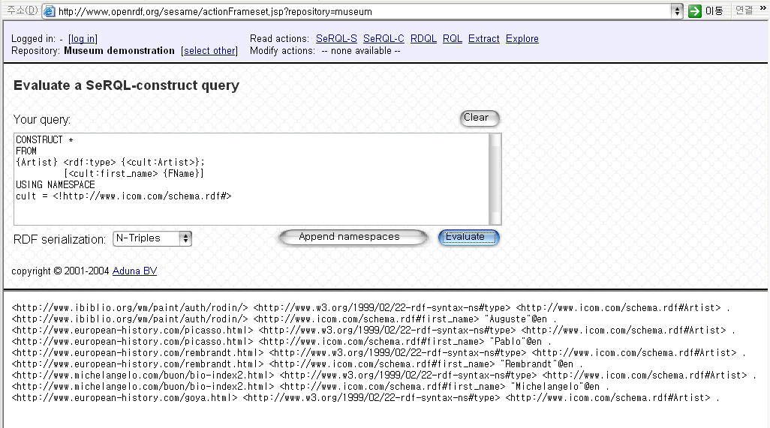
SeRQL(4/4)
CONSTRUCT *
FROM
{Artist} <rdf:type> {<cult:Artist>};
[<cult:first_name> <FName>]
USING NAMESPACE
cult = <!http://www.icom.com/schema.rdf#>
<http://www.ibiblio.org/wm/paint/auth/rodin/> <http://www.w3.org/1999/02/22-rdf-syntax-ns#type> <http://www.icom.com/schema.rdf#Artist> .
<http://www.ibiblio.org/wm/paint/auth/rodin/> <http://www.icom.com/schema.rdf#first_name> “Auguste”@en .
…
<http://www.european-history.com/goya.html> <http://www.w3.org/1999/02/22-rdf-syntax-ns#type> <http://www.icom.com/schema.rdf#Artist> .

