Slide 1
Chapter 19: Distributed Databases

Slide 2
Database System Concepts
Chapter 1: Introduction
Part 1: Relational databases
  Chapter 2: Introduction to the Relational Model
  Chapter 3: Introduction to SQL
  Chapter 4: Intermediate SQL
  Chapter 5: Advanced SQL
  Chapter 6: Formal Relational Query Languages
Part 2: Database Design
  Chapter 7: Database Design: The E-R Approach
  Chapter 8: Relational Database Design
  Chapter 9: Application Design
Part 3: Data storage and querying
  Chapter 10: Storage and File Structure
  Chapter 11: Indexing and Hashing
  Chapter 12: Query Processing
  Chapter 13: Query Optimization
Part 4: Transaction management
  Chapter 14: Transactions
  Chapter 15: Concurrency control
  Chapter 16: Recovery System
Part 5: System Architecture
  Chapter 17: Database System Architectures
  Chapter 18: Parallel Databases
  Chapter 19: Distributed Databases
Part 6: Data Warehousing, Mining, and IR
  Chapter 20: Data Mining
  Chapter 21: Information Retrieval
Part 7: Specialty Databases
  Chapter 22: Object-Based Databases
  Chapter 23: XML
Part 8: Advanced Topics
  Chapter 24: Advanced Application Development
  Chapter 25: Advanced Data Types
  Chapter 26: Advanced Transaction Processing
Part 9: Case studies
  Chapter 27: PostgreSQL
  Chapter 28: Oracle
  Chapter 29: IBM DB2 Universal Database
  Chapter 30: Microsoft SQL Server
Online Appendices
  Appendix A: Detailed University Schema
  Appendix B: Advanced Relational Database Model
  Appendix C: Other Relational Query Languages
  Appendix D: Network Model
  Appendix E: Hierarchical Model

Slide 3
Chapter 19: Distributed Databases
19.1 Heterogeneous and Homogeneous Databases
19.2 Distributed Data Storage
19.3 Distributed Transactions
19.4 Commit Protocols
19.5 Concurrency Control in Distributed Databases
19.6 Availability
19.7 Distributed Query Processing
19.8 Heterogeneous Distributed Databases
19.9 Cloud-Based Databases
19.10 Directory Systems

Slide 4
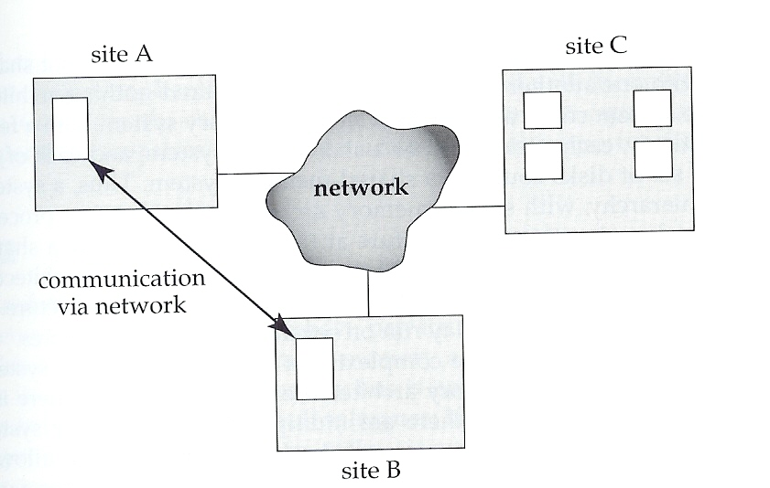
Distributed Database System
A distributed database system consists of loosely coupled sites that share no physical component
  Database systems that run on each site are independent of each other
  Transactions may access data at one or more sites

Slide 5
Distributed Database System (cont.)
In a homogeneous distributed database
  All sites have identical software
  Are aware of each other and agree to cooperate in processing user requests.
  Each site surrenders part of its autonomy in terms of right to change schemas or software
  Appears to user as a single system
In a heterogeneous distributed database
  Different sites may use different schemas and software
    Difference in schema is a major problem for query processing
    Difference in software is a major problem for transaction processing
  Sites may not be aware of each other and may provide only limited facilities for cooperation in transaction processing

Slide 6
Chapter 19: Distributed Databases
19.1 Heterogeneous and Homogeneous Databases
19.2 Distributed Data Storage
19.3 Distributed Transactions
19.4 Commit Protocols
19.5 Concurrency Control in Distributed Databases
19.6 Availability
19.7 Distributed Query Processing
19.8 Heterogeneous Distributed Databases
19.9 Cloud-Based Databases
19.10 Directory Systems

Slide 7
Distributed Data Storage
Assume relational data model
Replication
  System maintains multiple copies of data, stored in different sites, for faster retrieval and fault tolerance.
Fragmentation
  Relation is partitioned into several fragments stored in distinct sites
Replication and fragmentation can be combined
  Relation is partitioned into several fragments: system maintains several identical replicas of each such fragment.

Slide 8
Data Replication
A relation or fragment of a relation is replicated if it is stored redundantly in two or more sites.
  Full replication of a relation is the case where the relation is stored at all sites.
  Fully redundant DB means every site contains a copy of the entire DB.
Advantages of Replication
  Availability: failure of site containing relation r does not result in unavailability of r is replicas exist.
  Parallelism: queries on r may be processed by several nodes in parallel.
  Reduced data transfer: relation r is available locally at each site containing a replica of r.
Disadvantages of Replication
  Increased cost of updates: each replica of relation r must be updated.
  Increased complexity of concurrency control: concurrent updates to distinct replicas may lead to inconsistent data unless special concurrency control mechanisms are implemented.
    One solution: choose one copy as primary copy and apply concurrency control operations on primary copy

Slide 9
Data Fragmentation
Division of relation r into fragments r₁, r₂, …, r_{n} which contain sufficient information to reconstruct relation r.
Horizontal fragmentation: each tuple of r is assigned to one or more fragments
Vertical fragmentation: the schema for relation r is split into several smaller schemas
  All schemas must contain a common candidate key (or superkey) to ensure lossless join property.
  A special attribute, the tuple-id attribute may be added to each schema to serve as a candidate key.
Example : relation account with following schema
Account = (branch_name, account_number, balance )
Employee_Info = ( employee_id, name, destination, salary)

Slide 10
Horizontal Fragmentation of account Relation
Account = (branch_name, account_number, balance )
account₁ = σ_{branch_name=“Hillside”} (account )
branch_name
account_number
balance
Hillside
Hillside
Hillside
A-305
A-226
A-155
500
336
62
account₂ = σ_{branch_name=“Valleyview”} (account )
branch_name
account_number
balance
Valleyview
Valleyview
Valleyview
Valleyview
A-177
A-402
A-408
A-639
205
10000
1123
750

Slide 11
Vertical Fragmentation of employee_info Relation
Employee_Info = ( branch_name, customer_name, account_number, balance)
deposit₁ = Πbranch_name, customer_name, tuple_id (employee_info )
branch_name
customer_name
tuple_id
Hillside
Hillside
Valleyview
Valleyview
Hillside
Valleyview
Valleyview
Lowman
Camp
Camp
Kahn
Kahn
Kahn
Green
1
2
3
4
5
6
7
deposit₂ = Πaccount_number, balance, tuple_id (employee_info )
account_number
balance
tuple_id
A-305
A-226
A-177
A-402
A-155
A-408
A-639
500
336
205
10000
62
1123
750
1
2
3
4
5
6
7

Slide 12
Advantages of Fragmentation
Horizontal fragmentation:
  allows parallel processing on fragments of a relation
  allows a relation to be split so that tuples are located where they are most frequently accessed
Vertical fragmentation:
  allows tuples to be split so that each part of the tuple is stored where it is most frequently accessed
  tuple-id attribute allows efficient joining of vertical fragments
  allows parallel processing on a relation
Vertical and horizontal fragmentation can be mixed.
  Fragments may be successively fragmented to an arbitrary depth.

Slide 13
Data Transparency
Data transparency: Degree to which system user may remain unaware of the details of how and where the data items are stored in a distributed system
Consider transparency issues in relation to:
  Fragmentation transparency
  Replication transparency
  Location transparency
Naming of Data Items - Criteria
1. Every data item must have a system-wide unique name.
2. It should be possible to find the location of data items efficiently.
3. It should be possible to change the location of data items transparently.
4. Each site should be able to create new data items autonomously.

Slide 14
Naming Schemes
Central Name Server Scheme
  Structure:
    name server assigns all names
    each site maintains a record of local data items
    sites ask name server to locate non-local data items
  Advantages:
    satisfies naming criteria 1-3
  Disadvantages:
    does not satisfy naming criterion 4
    name server is a potential performance bottleneck
    name server is a single point of failure

Slide 15
Naming Schemes (cont.)
Site-Id Prefix Scheme
  each site prefixes its own site identifier to any name that it generates i.e., site 17.account.
  Fulfills having a unique identifier, and avoids problems associated with central control.
  However, fails to achieve network transparency.
Solution:
  Create a set of aliases for data items;
  Store the mapping of aliases to the real names at each site.
The user can be unaware of the physical location of a data item, and is unaffected if the data item is moved from one site to another.

Slide 16
Chapter 19: Distributed Databases
19.1 Heterogeneous and Homogeneous Databases
19.2 Distributed Data Storage
19.3 Distributed Transactions
19.4 Commit Protocols
19.5 Concurrency Control in Distributed Databases
19.6 Availability
19.7 Distributed Query Processing
19.8 Heterogeneous Distributed Databases
19.9 Cloud-Based Databases
19.10 Directory Systems

Slide 17
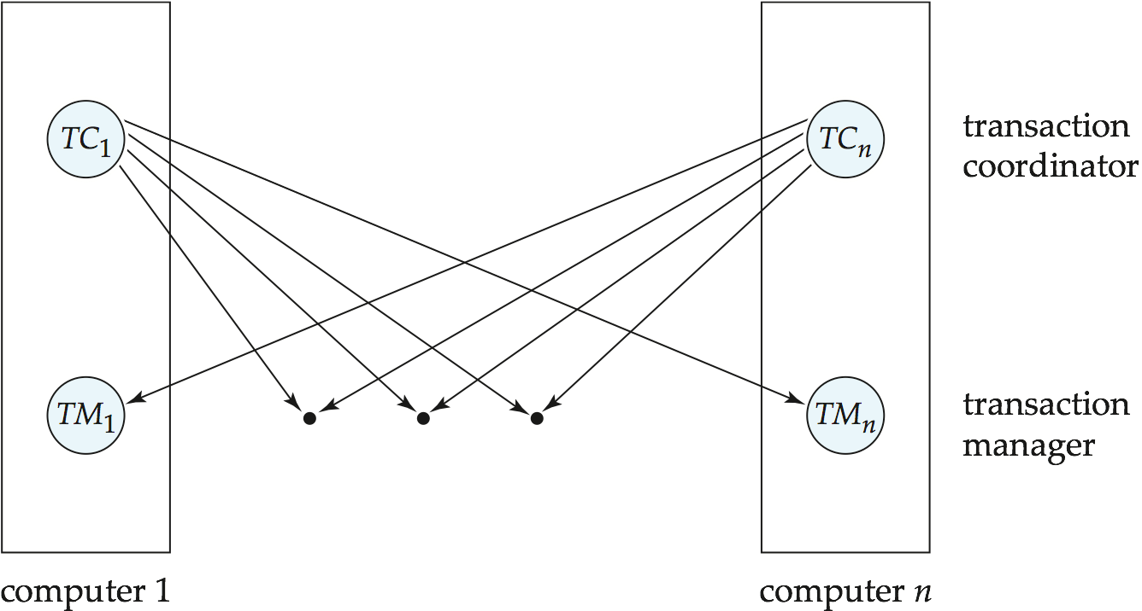
Distributed Transactions
Transaction may access data at several sites.
Each site has a local transaction manager responsible for:
  Maintaining a log for recovery purposes
  Participating in coordinating the concurrent execution of the transactions executing at that site.
Each site has a transaction coordinator, which is responsible for:
  Starting the execution of transactions that originate at the site.
  Distributing subtransactions at appropriate sites for execution.
  Coordinating the termination of each transaction that originates at the site, which may result in the transaction being committed at all sites or aborted at all sites.

Slide 18
System Failure Modes
Failures unique to distributed systems:
  Failure of a site
  Loss of massages
    Handled by network transmission control protocols such as TCP-IP
  Failure of a communication link
    Handled by network protocols, by routing messages via alternative links
  Network partition
    A network is said to be partitioned when it has been split into two or more subsystems that lack any connection between them
      Note: a subsystem may consist of a single node
Network partitioning and site failures are generally indistinguishable.

Slide 19
Chapter 19: Distributed Databases
19.1 Heterogeneous and Homogeneous Databases
19.2 Distributed Data Storage
19.3 Distributed Transactions
19.4 Commit Protocols
19.5 Concurrency Control in Distributed Databases
19.6 Availability
19.7 Distributed Query Processing
19.8 Heterogeneous Distributed Databases
19.9 Cloud-Based Databases
19.10 Directory Systems

Slide 20
Commit Protocols
Commit protocols are used to ensure atomicity across sites
  a transaction which executes at multiple sites must either be committed at all the sites, or aborted at all the sites.
  not acceptable to have a transaction committed at one site and aborted at another
The two-phase commit (2PC) protocol is widely used
The three-phase commit (3PC) protocol is more complicated and more expensive, but avoids some drawbacks of two-phase commit protocol.
  This protocol is not used in practice.

Slide 21
Two Phase Commit Protocol (2PC)
Assumes fail-stop model
  failed sites simply stop working,
  and do not cause any other harm, such as sending incorrect messages to other sites.
Execution of the protocol is initiated by the coordinator after the last step of the transaction has been reached.
The protocol involves all the local sites at which the transaction executed
Let T be a transaction initiated at site S_{i}, and let the transaction coordinator at S_{i} be C_{i}

Slide 22
Phase 1 of 2PC: Obtaining a Decision
Coordinator asks all participants to prepare to commit transaction T_{i}.
  C_{i} adds the records <prepare T> to the log and forces log to stable storage
  sends prepare T messages to all sites at which T executed
Upon receiving message, transaction manager at site determines if it can commit the transaction
  if not, add a record <no T> to the log and send abort T message to C_{i}
  if the transaction can be committed, then:
  add the record <ready T> to the log
  force all records for T to stable storage
  send ready T message to C_{i}

Slide 23
Phase 2 of 2PC: Recording the Decision
T can be committed if C_{i} received a ready T message from all the participating sites: otherwise T must be aborted.
Coordinator adds a decision record, <commit T> or <abort T>, to the log and forces record onto stable storage.
  Once the record stable storage it is irrevocable (even if failures occur)
Coordinator sends a message to each participant informing it of the decision (commit or abort)
Participants take appropriate action locally.

Slide 24
2PC – Finite State Machine
Prepare-commit
Local-abort
INIT
INIT
Execute-done
Prepare-commit
Prepare-commit
Ready-commit
WAIT
READY
Local-abort
Global-abort
Ready-commit
Global-commit
Global-abort
ACK
Global-commit
ACK
ABORT
COMMIT
ABORT
COMMIT
coordinator
participant

Slide 25
2PC – Commit
Assume the coordinator received a global transaction T_{g,}
which is composed of local transaction T₁ and T₂.
Site A
Site B
Site C
Participant 1 Coordinator Participant 2
Execute Execute
Execution Execution
Done
Done
Prepare to Commit Prepare to Commit
Ready to Commit Ready to Commit
Commit Commit
Execute Commit Execute Commit
Ack Ack
T₁
INIT
T₂
INIT
INIT
READY
WAIT
READY
COMMIT
COMMIT
COMMIT
T_{g} Commit

Slide 26
2PC – Abort
Assume the coordinator received a global transaction T_{g,}
which is composed of local transaction T₁ and T₂.
Site A
Site B
Site C
Participant 1 Coordinator Participant 2
Execute Execute
Execution Execution
Done
Done
Prepare to Commit Prepare to Commit
Abort Ready to Commit
Abort Abort
Undo Execution Undo Execution
Ack Ack
T₁
INIT
T₂
INIT
INIT
ABORT
WAIT
READY
ABORT
ABORT
T_{g} Abort

Slide 27
Handling of Failures in 2PC - Site Failure
When site S_{i} recovers, it examines its log to determine the fate of
transactions active at the time of the failure.
Log contain <commit T> record: site executes redo (T)
Log contains <abort T> record: site executes undo (T)
Log contains <ready T> record: site must consult C_{i} to determine the fate of T.
  If T committed, redo (T)
  If T aborted, undo (T)
The log contains no control records concerning T replies that S_{k} failed before responding to the prepare T message from C_{i}
  since the failure of S_{k} precludes the sending of such a response C₁ must abort T
  S_{k} must execute undo (T)

Slide 28
Handling Site Failure in 2PC (1)
CASE 1: Participant 2 dies during commit execution
Participant 2 knew the commit before it dies.
→ During recovery, Participant 2 must redo T₂.
Site A
Site B
Site C
Participant 1 Coordinator Participant 2
Execute Execute
Execution Execution
Done
Done
Prepare to Commit Prepare to Commit
Ready to Commit Ready to Commit
Commit Commit
Execute Commit Execute Commit
Ack
T₁
INIT
T₂
INIT
INIT
READY
WAIT
READY
COMMIT
COMMIT
DIE
T_{g} Commit

Slide 29
Handling Site Failure in 2PC (2)
CASE 2: Participant 2 dies during undo execution
Participant 2 knew the abort before it dies.
→ During recovery, Participant 2 must undo T₂.
Site A
Site B
Site C
Participant 1 Coordinator Participant 2
Execute Execute
Execution Execution
Done
Done
Prepare to Commit Prepare to Commit
  Abort Ready to Commit
Abort Abort
Undo Execution Undo Execution
Ack
T₁
INIT
T₂
INIT
INIT
ABORT
WAIT
READY
ABORT
ABORT
DIE
T_{g} Abort

Slide 30
Handling Site Failure in 2PC (3)
CASE 3: Participant 2 dies during ready state, before receiving commit/abort message
Participant 2 don’t know the fate of the transaction.
→ During recovery, Participant 2 must consult the coordinator. In this case, redo T₂.
(redo T₂ if T_{g} is commited, undo T₂ if T_{g} is aborted.)
Site A
Site B
Site C
Participant 1 Coordinator Participant 2
Execute Execute
Execution Execution
Done
Done
Prepare to Commit Prepare to Commit
Ready to Commit Ready to Commit
Commit Commit
Execute Commit
Ack
T₁
INIT
T₂
INIT
INIT
READY
WAIT
READY
DIE
COMMIT
COMMIT
T_{g} Commit

Slide 31
Handling Site Failure in 2PC (4)
CASE 4: Participant 2 dies before it responds to the prepare to commit message
T_{g} cannot be commited because Participant 2 didn’t send a ready to commit message.
→ During recovery, Participant 2 must undo T₂ without consulting with the coordinator
Site A
Site B
Site C
Participant 1 Coordinator Participant 2
Execute Execute
Execution Execution
Done
Done
Prepare to Commit Prepare to Commit
  Ready to Commit
Abort
Undo Execution
Ack
T₁
INIT
T₂
INIT
INIT
READY
WAIT
DIE
ABORT
ABORT
T_{g} Abort

Slide 32
Handling of Failures in 2PC - Coordinator Failure
If coordinator fails while the commit protocol for T is executing then participating sites must decide on T’s fate:
  If an active site contains a <commit T> record in its log, then T must be committed.
  If an active site contains an <abort T> record in its log, then T must be aborted.
  If some active participating site does not contain a <ready T> record in its log, then the failed coordinator C_{i} cannot have decided to commit T. Can therefore abort T.
  If none of the above cases holds, then all active sites must have a <ready T> record in their logs, but no additional control records (such as <abort T> of <commit T>). In this case active sites must wait for C_{i} to recover, to find decision.
Blocking problem : active sites may have to wait for failed coordinator to recover.

Slide 33
Handling Coordinator Failure in 2PC (1)
CASE 1: Coordinator dies while it sends commit messages
(i.e., an active site is in COMMIT state)
When coordinator fails, Participant 2 asks Participant 1.
→ No recovery process is required: Participant 2 just commit T₂.
Site A
Site B
Site C
Participant 1 Coordinator Participant 2
Execute Execute
Execution Execution
Done
Done
Prepare to Commit Prepare to Commit
Ready to Commit Ready to Commit
Commit
Execute Commit
Ack
T₁
INIT
T₂
INIT
INIT
WAIT
READY
READY
COMMIT
DIE
T_{g} Commit

Slide 34
Handling Coordinator Failure in 2PC (2)
CASE 2: Coordinator dies while it sends abort messages
(i.e., an active site is in ABORT state)
When coordinator fails, Participant 2 asks Participant 1.
→ No recovery process is required: Participant 2 just abort T₂.
Site A
Site B
Site C
Participant 1 Coordinator Participant 2
Execute Execute
Execution Execution
Done
Done
Prepare to Commit Prepare to Commit
  Abort Ready to Commit
Abort
Undo Execution
Ack
T₁
INIT
T₂
INIT
INIT
WAIT
ABORT
READY
DIE
ABORT
T_{g} Abort

Slide 35
Handling Coordinator Failure in 2PC (3)
CASE 3: Coordinator dies while it sends prepare to commit messages
(i.e., some active sites are in INIT state)
T_{g} cannot be commited because Participant 2 didn’t receive a prepare to commit message.
→ All participants must abort the transactions.
Site A
Site B
Site C
Participant 1 Coordinator Participant 2
Execute Execute
Execution Execution
Done
Done
Prepare to Commit
Ready to Commit
T₁
INIT
T₂
INIT
INIT
READY
DIE
T_{g} Abort

Slide 36
Handling Coordinator Failure in 2PC (4-1)
CASE 4: Coordinator dies and all active sites are in READY state
(some dead parts may be in INIT, READY, ABORT, or COMMIT state,
or coordinator may not have received all votes before crash.)
When coordinator fails, All participants don’t know the fate of the transaction.
→ Blocking – All participants cannot proceed until either the coordinator are available.
Site A
Site B
Site C
Participant 1 Coordinator Participant 2
Execute Execute
Execution Execution
Done
Done
Prepare to Commit Prepare to Commit
  Ready to Commit
T₁
INIT
T₂
INIT
INIT
DIE
READY
WAIT
Blocked
DIE
T_{g} ?

Slide 37
Handling Coordinator Failure in 2PC (4-2)
CASE 4: Coordinator dies and all active sites are in READY state
(some dead parts may be in INIT, READY, ABORT, or COMMIT state,
or coordinator may not have received all votes before crash.)
When coordinator fails, All participants don’t know the fate of the transaction.
→ Blocking – All participants cannot proceed until either the coordinator are available.
Site A
Site B
Site C
Participant 1 Coordinator Participant 2
Execute Execute
Execution Execution
Done
Done
Prepare to Commit Prepare to Commit
  Ready to Commit
T₁
INIT
T₂
INIT
INIT
READY
WAIT
READY
DIE
Blocked
DIE
T_{g} ?

Slide 38
Handling Coordinator Failure in 2PC (4-3)
CASE 4: Coordinator dies and all active sites are in READY state
(some dead parts may be in INIT, READY, ABORT, or COMMIT state,
or coordinator may not have received all votes before crash.)
When coordinator fails, All participants don’t know the fate of the transaction.
→ Blocking – All participants cannot proceed until either the coordinator are available.
Site A
Site B
Site C
Participant 1 Coordinator Participant 2
Execute Execute
Execution Execution
Done
Done
Prepare to Commit Prepare to Commit
  Abort Ready to Commit
Abort
Undo Execution
Ack
T₁
INIT
T₂
INIT
INIT
ABORT
WAIT
READY
DIE
DIE
Blocked
ABORT
T_{g} ?

Slide 39
Handling Coordinator Failure in 2PC (4-4)
CASE 4: Coordinator dies and all active sites are in READY state
(some dead parts may be in INIT, READY, ABORT, or COMMIT state,
or coordinator may not have received all votes before crash.)
When coordinator fails, All participants don’t know the fate of the transaction.
→ Blocking – All participants cannot proceed until either the coordinator are available.
Site A
Site B
Site C
Participant 1 Coordinator Participant 2
Execute Execute
Execution Execution
Done
Done
Prepare to Commit Prepare to Commit
  Ready to Commit Ready to Commit
Commit
Execute Commit
Ack
T₁
INIT
T₂
INIT
INIT
READY
WAIT
READY
DIE
DIE
Blocked
COMMIT
T_{g} ?

Slide 40
Handling of Failures in 2PC - Network Partition
If the coordinator and all its participants remain in one partition, the failure has no effect on the commit protocol.
If the coordinator and its participants belong to several partitions:
  Sites that are not in the partition containing the coordinator think the coordinator has failed, and execute the protocol to deal with failure of the coordinator.
    No harm results, but sites may still have to wait for decision from coordinator.
  The coordinator and the sites are in the same partition as the coordinator think that the sites in the other partition have failed, and follow the usual commit protocol.
    Again, no harm results
Site 4
Site 1
Coordinator
Site 3
C
Site 5

Slide 41
Recovery and Concurrency Control in 2PC
In-doubt transactions have a <ready T>, but neither a <commit T>, nor an <abort T> log record.
The recovering site must determine the commit-abort status of such transactions by contacting other sites
  this can slow and potentially block recovery.
Recovery algorithms can note lock information in the log.
  Instead of <ready T>, write out <ready T, L> L = list of locks held by T when the log is written (read locks can be omitted).
  For every in-doubt transaction T, all the locks noted in the <ready T, L> log record are reacquired.
After lock reacquisition, transaction processing can resume
  the commit or rollback of in-doubt transactions is performed concurrently with the execution of new transactions.

Slide 42
2PC vs. 3PC
2PC may cause blocking when coordinator fails.
3PC chooses “abort” instead of the blocking process
After aborting, the participants can resume the normal activity
Basic idea of 3PC:
By having PRECOMMIT state, there is no single state from which it is possible to make a transition directly to either a COMMIT or an ABORT state.
By having PRECOMMIT state, there is no state (i.e., blocking state) in which it is not possible to make a final decision, and from which a transition to a COMMIT state can be made.
When coordinator dies and all active sites are in READY state
Coordinator
Site 3
2PC ➔ Participants go to “blocking”
3PC ➔ Participants go to “abort” state
by having “precommit” state
Site 1
Site 2
INIT?
READY?
ABORT?
COMMIT?
READY
READY

Slide 43
Three Phase Commit Protocol (3PC)
Three phases
  Phase 1 :
    Coordinator check if T can commit, participants send their choice to coordinator
  Phase 2 : Coordinator makes decision
    If commit, send precommit message to participants
    If abort, send abort message to participants
  Phase 3 :
    If commit, final commit decision is broadcast and everyone commits

Slide 44
3PC – Finite State Machine
Prepare-commit
Local-abort
INIT
INIT
Execute-done
Prepare-commit
Prepare-commit
Ready-precommit
WAIT
READY
Local-abort
Global-abort
Ready-precommit
Global-precommit
Global-abort
ACK
Global-precommit
Ready-commit
ABORT
PRECOMMIT
ABORT
PRECOMMIT
Ready-commit
Global-commit
Global-commit
ACK
COMMIT
COMMIT
coordinator
participant

Slide 45
3PC – Commit
Assume the coordinator received a global transaction T_{g,}
which is composed of local transaction T₁ and T₂.
Site A
Site B
Site C
Participant 1 Coordinator Participant 2
Execute Execute
Execution Execution
Done
Done
Prepare to Commit Prepare to Commit
Ready to Precommit Ready to Precommit
Precommit Precommit
Ready to Commit Ready to Commit
Commit Commit
Execute Commit Execute Commit
Ack Ack
INIT
INIT
INIT
READY
WAIT
READY
PRECOMMIT
PRECOMMIT
PRECOMMIT
COMMIT
COMMIT
COMMIT
T_{g} Commit

Slide 46
3PC – Abort
Assume the coordinator received a global transaction T_{g,}
which is composed of local transaction T₁ and T₂.
Site A
Site B
Site C
Participant 1 Coordinator Participant 2
Execute Execute
Execution Execution
Done
Done
Prepare to Commit Prepare to Commit
Abort Ready to Precommit
Abort Abort
Undo Execution Undo Execution
Ack Ack
T₁
INIT
T₂
INIT
INIT
ABORT
WAIT
READY
ABORT
ABORT
T_{g} Abort

Slide 47
Handling of Failures in 3PC - Site Failure
When site S_{i} recovers, it examines its log to determine the fate of
transactions active at the time of the failure.
Log contain <commit T> record: site executes redo (T)
Log contains <abort T> record: site executes undo (T)
Log contains <ready T> or <precommit T> record: site must consult C_{i} to determine the fate of T.
  If T committed, redo (T)
  If T aborted, undo (T)
The log contains no control records concerning T replies that S_{k} failed before responding to the prepare T message from C_{i}
  since the failure of S_{k} precludes the sending of such a response C₁ must abort T
  S_{k} must execute undo (T)

Slide 48
Handling Site Failure in 3PC (1)
CASE 1: Participant 2 dies during commit execution
Participant 2 knew the commit before it dies → During recovery, Participant 2 must redo T₂.
Site A
Site B
Site C
Participant 1 Coordinator Participant 2
Execute Execute
Execution Execution
Done
Done
Prepare to Commit Prepare to Commit
Ready to Precommit Ready to Precommit
Precommit Precommit
Ready to Commit Ready to Commit
Commit Commit
Execute Commit Execute Commit
Ack
INIT
INIT
INIT
READY
WAIT
READY
PRECOMMIT
PRECOMMIT
PRECOMMIT
COMMIT
COMMIT
DIE
T_{g} Commit

Slide 49
Handling Site Failure in 3PC (2)
CASE 2: Participant 2 dies during undo execution
Participant 2 knew the abort before it dies. → During recovery, Participant 2 must undo T₂.
Site A
Site B
Site C
Participant 1 Coordinator Participant 2
Execute Execute
Execution Execution
Done
Done
Prepare to Commit Prepare to Commit
  Abort Ready to Precommit
Abort Abort
Undo Execution Undo Execution
Ack
T₁
INIT
T₂
INIT
INIT
ABORT
WAIT
READY
ABORT
ABORT
DIE
T_{g} Abort

Slide 50
Handling Site Failure in 3PC (3)
CASE 3: Participant 2 dies during ready or precommit state
Participant 2 don’t know the fate of the transaction.
→ During recovery, Participant 2 must consult the coordinator. In this case, redo T₂.
(redo T₂ if T_{g} is commited, undo T₂ if T_{g} is aborted.)
Site A
Site B
Site C
Participant 1 Coordinator Participant 2
Execute Execute
Execution Execution
Done
Done
Prepare to Commit Prepare to Commit
Ready to Precommit Ready to Precommit
Precommit Precommit
Ready to Commit Ready to Commit
Commit Commit
Execute Commit
Ack
INIT
INIT
INIT
READY
WAIT
READY
PRECOMMIT
PRECOMMIT
PRECOMMIT
DIE
COMMIT
COMMIT
T_{g} Commit

Slide 51
Handling Site Failure in 3PC (4)
CASE 4: Participant 2 dies before it responds to the prepare to commit message
T_{g} cannot be commited because Participant 2 didn’t send a ready to commit message.
→ During recovery, Participant 2 must undo T₂.
Site A
Site B
Site C
Participant 1 Coordinator Participant 2
Execute Execute
Execution Execution
Done
Done
Prepare to Commit Prepare to Commit
  Ready to Commit
Abort
Undo Execution
Ack
T₁
INIT
T₂
INIT
INIT
READY
WAIT
DIE
ABORT
ABORT
T_{g} Abort

Slide 52
Handling of Failures in 3PC - Coordinator Failure
If coordinator fails while the commit protocol for T is executing then participating sites must decide on T’s fate:
  If an active site contains a <commit T> record in its log, then T must be committed.
  If an active site contains a <abort T> record in its log, then T must be aborted.
  If some active participating site does not contain a <ready T> record in its log (i.e., if some participant is still in INIT state), then the failed coordinator C_{i} cannot have decided to precommit T. Can therefore abort T.
  If none of the above cases holds, then all active sites must have a <ready T> record or a <precommit T> record in their logs.
    If some active sites have a <ready T> record and some active sites have a <precommit T> record, then T must be committed since all must have voted commit.
    If all active sites have a <ready T> record, then T must be aborted since some dead parts may have voted abort, or coordinator C_{i} may not have received all votes before crash. If all active sites voted commit before crash, it cannot do any harm to still abort the transaction T.

Slide 53
Handling Coordinator Failure in 3PC (1)
CASE 1: Coordinator dies while it sends commit messages
(i.e., an active site is in COMMIT state)
When coordinator fails, Participant 2 can learn of the commit from Participant 1.
→ Participant 2 must commit T₂.
Site A
Site B
Site C
Participant 1 Coordinator Participant 2
Execute Execute
Execution Execution
Done
Done
Prepare to Commit Prepare to Commit
Ready to Precommit Ready to Precommit
Precommit Precommit
Ready to Commit Ready to Commit
Commit
Execute Commit
Ack
INIT
INIT
INIT
READY
WAIT
READY
PRECOMMIT
PRECOMMIT
PRECOMMIT
DIE
COMMIT
T_{g} Commit

Slide 54
Handling Coordinator Failure in 3PC (2)
CASE 2: Coordinator dies while it sends abort messages
(i.e., an active site is in ABORT state)
When coordinator fails, Participant 2 can learn of the abort from Participant 1.
→ Participant 2 must abort T₂.
Site A
Site B
Site C
Participant 1 Coordinator Participant 2
Execute Execute
Execution Execution
Done
Done
Prepare to Commit Prepare to Commit
  Abort Ready to Preommit
Abort
Undo Execution
Ack
T₁
INIT
T₂
INIT
INIT
ABORT
WAIT
READY
DIE
ABORT
T_{g} Abort

Slide 55
Handling Coordinator Failure in 3PC (3)
CASE 3: Coordinator dies while it sends prepare to commit messages
(i.e., some active sites are in INIT state)
T_{g} cannot be commited because Participant 2 didn’t receive a prepare to commit message.
→ All participants must abort the transactions.
Site A
Site B
Site C
Participant 1 Coordinator Participant 2
Execute Execute
Execution Execution
Done
Done
Prepare to Commit
Ready to Precommit
T₁
INIT
T₂
INIT
INIT
READY
DIE
T_{g} Abort

Slide 56
Handling Coordinator Failure in 3PC (4)
CASE 4a: Coordinator dies while it sends precommit messages
(i.e., some active sites are in PRECOMMIT state)
All site must have voted commit if some active sites are in precommit state.
→ All participant must commit the transactions.
Site A
Site B
Site C
Participant 1 Coordinator Participant 2
Execute Execute
Execution Execution
Done
Done
Prepare to Commit Prepare to Commit
Ready to Precommit Ready to Precommit
Precommit
Ready to Commit
INIT
INIT
INIT
READY
WAIT
READY
PRECOMMIT
DIE
T_{g} Commit

Slide 57
Handling Coordinator Failure in 3PC (5)
CASE 4b: Coordinator dies and all active sites are in READY state
(some dead parts may be in INIT, READY, ABORT, or PRECOMMIT state,
or coordinator may not have received all votes before crash.)
We cannot sure whether all participants voted commit.
→ All participant must abort the transactions.
Site A
Site B
Site C
Participant 1 Coordinator Participant 2
Execute Execute
Execution Execution
Done
Done
Prepare to Commit Prepare to Commit
Ready to Precommit Ready to Precommit
Precommit
Ready to Commit
INIT
INIT
INIT
READY
WAIT
READY
DIE
PRECOMMIT
Abort
(NOT Blocked)
DIE
T_{g} Abort

Slide 58
Pros and Cons of 3PC
No blocking problem
Network partition problem – All precommit sites may reside in one section
Adds another set of messages to be exchanged between the coordinator
and participants
Not widely used
Coordinator
Communication
link goes down
commit
Site 4
abort
Partitioning
containing
three sites
Site 1
Site 2
Site 3
Precommit
Ready
Ready
Precommit
Site 5
Partitioning
containing
two sites
Ready

Slide 59
Alternative Models of Transaction Processing
Notion of a single transaction spanning multiple sites is inappropriate for many applications
  E.g. transaction crossing an organizational boundary
  No organization would like to permit an externally initiated transaction to block local transactions for an indeterminate period
Alternative models carry out transactions by sending messages
  Code to handle messages must be carefully designed to ensure atomicity and durability properties for updates
    Isolation cannot be guaranteed, in that intermediate stages are visible, but code must ensure no inconsistent states result due to concurrency
  Persistent messaging systems are systems that provide transactional properties to messages
    Messages are guaranteed to be delivered exactly once
    Will discuss implementation techniques later

Slide 60
Alternative Models (Cont.)
Motivating example: Fund transfer between two banks
  Two phase commit would have the potential to block updates on the accounts involved in fund transfer
  Alternative solution:
    Debit money from source account and send a message to other site
    Site receives message and credits destination account
  Messaging has long been used for distributed transactions (even before computers were invented!)
Atomicity issue
  Once transaction sending a message is committed, message must guaranteed to be delivered
    Guarantee as long as destination site is up and reachable, code to handle undeliverable messages must also be available
      e.g. credit money back to source account.
  If sending transaction aborts, message must not be sent

Slide 61
Persistent Messaging: Error Conditions
Code to handle messages has to take care of variety of failure situations (even assuming guaranteed message delivery)
  If destination account does not exist, failure message must be sent back to source site
  When failure message is received from destination site, or destination site itself does not exist, money must be deposited back in source account
    Problem if source account has been closed
      get humans to take care of problem
User code executing transaction processing using 2PC does not have to deal with such failures
There are many situations where extra effort of error handling is worth the benefit of absence of blocking
  E.g. pretty much all transactions across organizations

Slide 62
Persistent Messaging and Workflows
Workflows provide a general model of transactional processing involving multiple sites and possibly human processing of certain steps
  E.g. when a bank receives a loan application, it may need to
    Contact external credit-checking agencies
    Get approvals of one or more managers
    and then respond to the loan application
  We study workflows in Chapter 25
  Persistent messaging forms the underlying infrastructure for workflows in a distributed environment

Slide 63
Persistent Messaging: Implementation
Sending site protocol
Sending transaction writes message to a special relation messages-to-send The message is also given a unique identifier.
  Writing to this relation is treated as any other update, and is undone if the transaction aborts.
  The message remains locked until the sending transaction commits
A message delivery process monitors the messages-to-send relation
  When a new message is found, the message is sent to its destination
  When an acknowledgment is received from a destination, the message is deleted from messages-to-send
  If no acknowledgment is received after a timeout period, the message is resent
    This is repeated until the message gets deleted on receipt of acknowledgement, or the system decides the message is undeliverable

Slide 64
Persistent Messaging: Implementation (cont.)
Receiving site protocol
  When a message is received
  It is written to a received-messages relation
    if it is not already present (the message id is used for this check).
  The transaction performing the write is committed
  An acknowledgement is then sent to the sending site
There may be very long delays in message delivery coupled with repeated messages
    Could result in processing of duplicate messages if we are not careful
  Option 1: messages are never deleted from received-messages
  Option 2: messages are given timestamps
    Messages older than some cut-off are deleted from received-messages
    Received messages are rejected if older than the cut-off

Slide 65
Persistent Messaging
  Guarantee successful message delivery for enhancing the robustness of
  distributed transaction processing instead of “coordinator”
3) Delivery
Sending
Site
1) Send
Receiving
Site
Message
server
4) ACK
2) Message is saved
before delivery
Persistent store
5) Message is removed
after acknowledgment

Slide 66
Persistent Messaging – Error Handling (1)
  Case 1: Message Failure
3) Delivery
Sending
Site
1) Send
Receiving
Site
Message
server
2) Message is saved
before delivery
4) No ACK
6) Delivery failure
Server sends failure message & removes message
Sending site must abort the transaction
Persistent store
5) No ACK → delivery again

Slide 67
Persistent Messaging – Error Handling (2)
Example: Fund transfer between two banks (A = A – 20, B = B + 20)
  Case 2: If the account B does not exist in the destination site,
  failure message must be sent back to source site having the account A.
B = B + 20
3) Delivery
Sending
Site
1) Send
Receiving
Site
Message
server
A
B
A = A – 20
4) Failure
2) Message saved
before delivery
If no such destination account
6) Delivery failure message
Sending site must abort the transaction
Persistent store
5) Message removed
after failure message

Slide 68
Chapter 19: Distributed Databases
19.1 Heterogeneous and Homogeneous Databases
19.2 Distributed Data Storage
19.3 Distributed Transactions
19.4 Commit Protocols
19.5 Concurrency Control in Distributed Databases
19.6 Availability
19.7 Distributed Query Processing
19.8 Heterogeneous Distributed Databases
19.9 Cloud-Based Databases
19.10 Directory Systems

Slide 69
Concurrency Control
Modify concurrency control schemes for use in distributed environment.
We assume that each site participates in the execution of a commit protocol to ensure global transaction automicity.
We assume all replicas of any item are updated
  Will see how to relax this in case of site failures later
Single-Lock-Manager Approach
Distributed-Lock-Manager Approach
  Primary Copy
  Majority Protocol
  Bias Protocol
  Quorum Consensus Protocol
Time Stamping Approach
Replication Approach

Slide 70
Single-Lock-Manager Approach
System maintains a single lock manager that resides in a single chosen site, say S_{i}
When a transaction needs to lock a data item, it sends a lock request to S_{i} and lock manager determines whether the lock can be granted immediately
  If yes, lock manager sends a message to the site which initiated the request
  If no, request is delayed until it can be granted, at which time a message is sent to the initiating site
The transaction can read the data item from any one of the sites at which a replica of the data item resides.
Writes must be performed on all replicas of a data item
Advantages of single-lock manager scheme:
  Simple implementation
  Simple deadlock handling
Disadvantages of single-lock manager scheme:
  Bottleneck: lock manager site becomes a bottleneck
  Vulnerability: system is vulnerable to lock manager site failure.

Slide 71
Single-Lock Manager Distributed CC – Example (1)
  Assume Site A is the single lock manager, and
  Site B, C, D contains a replica of data item Q
Site A
  Single lock manager
T₁: Start
… Write(Q)...
Commit
1) Request & Response Lock-X(Q)
2) Request Lock-S(Q) & Delayed
T₂: Start
… Read(Q)...
Commit
Site B
Site C
Site D
2) Write(Q) to all replicas

Slide 72
Single-Lock Manager Distributed CC – Example (2)
  Assume Site A is the single lock manager, and
  Site B, C, D contains a replica of data item Q
Site A
  Single lock manager
T₁: Start
… Write(Q)...
Commit
3) Release Lock-X(Q)
4) Response Lock-S(Q)
T₂: Start
… Read(Q)...
Commit
Site B
Site C
Site D
5) Read(Q) from any one of the sites

Slide 73
Distributed Lock Manager
In this approach, functionality of locking is implemented by lock managers at each site
  Lock managers control access to local data items
    But special protocols may be used for replicas
Advantage: work is distributed and can be made robust to failures
Disadvantage: deadlock detection is more complicated
  Lock managers cooperate for deadlock detection (More on this later)
Several variants of distributed locking
  Primary copy
  Majority protocol
  Biased protocol
  Quorum consensus

Slide 74
Primary Copy Distributed Locking
Choose one replica of data item to be the primary copy.
  Site containing the replica is called the primary site for that data item
  Different data items can have different primary sites
When a transaction needs to lock a data item Q, it requests a lock at the primary site of Q.
  Implicitly gets lock on all replicas of the data item
Benefit
  Concurrency control for replicated data handled similarly to unreplicated data - simple implementation.
Drawback
  If the primary site of Q fails, Q is inaccessible even though other sites containing a replica may be accessible.

Slide 75
Primary Copy Distributed Locking– Example
  When T₁ needs to lock a data item R
  It requests a lock at the primary site of R.
  Concurrency control for replicated data handled like unreplicated data.
T₁: Start
… Write(R) ...
Commit
1) Request Lock-X(R)
2) Request Lock-X(R)
Q R
Q R
4) Response Lock-X(R)
3) Response Lock-X(R)
Site 1
Primary copy of Q
Secondary of R
Site 2
Primary copy of R
Secondary of Q
  If the site fails, T1 cannot proceed

Slide 76
Majority-based Distributed Locking Protocol
Local lock manager at each site administers lock and unlock requests for data items stored at that site.
When a transaction wishes to lock an unreplicated data item Q residing at site S_{i}, a message is sent to S_{i} ‘s lock manager.
  If Q is locked in an incompatible mode, then the request is delayed until it can be granted.
  When the lock request can be granted, the lock manager sends a message back to the initiator indicating that the lock request has been granted.
In case of replicated data Q
  If Q is replicated at n sites, then a lock request message must be sent to more than half of the n sites in which Q is stored.
  The transaction does not operate on Q until it has obtained a lock on a majority of the replicas of Q.
  When writing the data item, transaction performs writes on all replicas

Slide 77
Majority Protocol (Cont.)
Benefit
  Can be used even when some sites are unavailable
    details on how handle writes in the presence of site failure later
Drawback
  Requires 2(n/2 + 1) messages for handling lock requests, and (n/2 + 1) messages for handling unlock requests.
  Potential for deadlock even with single item
    e.g., each of 3 transactions may have locks on 1/3rd of the replicas of a data.

Slide 78
Majority-based Distributed Locking Protocol – Example (1)
  Key idea : locks from more than one-half sites required for read or write
Assume 12 sites(A~L) containing a replica of Q → 7 locks required for read / write
Request Lock-X(Q)
& Response Lock-X(Q)
Request
Lock-X(Q)
T₁: Start
… Write(Q)...
Commit
A
B
C
D
Execute T₁
E
F
G
H
Request Lock-S(Q) & delayed
T₂: Start
… Read(Q)...
Commit
I
J
K
L
T₂ must wait
Request Lock-S(Q)
& Response Lock-S(Q)

Slide 79
Majority-based Distributed Locking Protocol – Example (2)
  Key idea : locks from more than one-half sites required for read or write
Assume 12 sites(A~L) containing a replica of Q → 7 locks required for read / write
T₃: Start
… Write(Q)...
Commit
(Lock request & response processes are omitted)
T₁: Start
… Write(Q)...
Commit
A
B
C
D
E
F
G
H
DEADLOCK
T₂: Start
… Read(Q)...
Commit
I
J
K
L

Slide 80
Biased Distributed Locking Protocol
Local lock manager at each site as in majority protocol, however, requests for shared locks are handled differently than requests for exclusive locks.
Shared locks
  When a transaction needs to lock data item Q, it simply requests a lock on Q from the lock manager at one site containing a replica of Q.
Exclusive locks
  When transaction needs to lock data item Q, it requests a lock on Q from the lock manager at all sites containing a replica of Q.
Advantage - imposes less overhead on read operations.
Disadvantage - additional overhead on writes

Slide 81
Biased Distributed Locking Protocol – Example
  Key idea : only one lock is required for read while locks from all sites is required for write
Assume 12 sites(A~L) containing a replica of Q
(Lock request & response processes are omitted)
T₁: Start
… Write(Q)...
Commit
A
B
C
D
T₁ : all 12 locks required
E
F
G
H
T₂ : only one lock required
T₂: Start
… Read(Q)...
Commit
I
J
K
L

Slide 82
Quorum Consensus Protocol
A generalization of both majority and biased protocols
Each site is assigned a weight.
  Let S be the total of all site weights
Choose two values read quorum Q_{r} and write quorum Q_{w}
  Such that Q_{r} + Q_{w} > S and 2 * Q_{w} > S
  Quorums can be chosen (and S computed) separately for each item
Each read must lock enough replicas that the sum of the site weights is ≥ Q_{r}
Each write must lock enough replicas that the sum of the site weights is ≥ Q_{w}
For now we assume all replicas are written
  Extensions to allow some sites to be unavailable described later
  Quorum: 정원, 정족수

Slide 83
Quorum Consensus Distributed Locking Protocol - Example
  Key idea : Q_{r} + Q_{w} > S and 2 * Q_{w} > S (Q_{r} : read quorum, Q_{w} : write quorum, S: # of sites)
Assume 12 sites(A~L) containing a replica of Q
Case 1: Q_{r} = 3, Q_{w} = 10
T₂: Start
… Read(Q)...
Commit
3 + 10 > 12, 2 * 10 > 12 → correct choice
T₁: Start
… Write(Q)...
Commit
T₂ : 3 locks
required
A
B
C
D
T₁ : 10 locks
required
E
F
G
H
(Lock request & response processes are omitted)
I
J
K
L

Slide 84
Quorum Consensus Distributed Locking Protocol - Example
Case 2: Q_{r} = 7, Q_{w} = 6
7 + 6 > 12, but 2 * 6 > 12 → incorrect choice
Case 3: Q_{r} = 1, Q_{w} = 12 (ROWA: Read-One, Write-All = Biased protocol)
1 + 12 > 12, 2 * 12 > 12 → correct choice
T₁: Start
… Write(Q)...
Commit
A
B
C
D
T₁ : all 12 locks
required
(Lock request & response processes are omitted)
E
F
G
H
T₂ : only one lock required
T₂: Start
… Read(Q)...
Commit
I
J
K
L

Slide 85
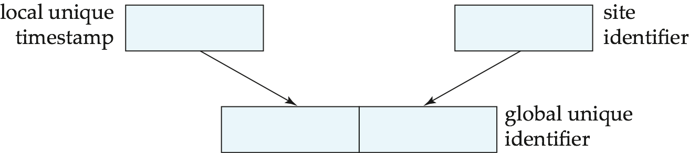
Timestamping Distributed CC
Timestamp based concurrency-control protocols can be used in distributed systems
Read of T_{i} is allowed If TS(T_{i}) ≥ W-timestamp(Q)
Write of T_{i} is allowed If (TS(T_{i}) ≥ R-timestamp(Q) and TS(T_{i}) ≥ W-timestamp(Q))
Each transaction must be given a unique timestamp
Main problem: how to generate a timestamp in a distributed fashion
  Each site generates a unique local timestamp using either a logical counter or the local clock.
  Global unique timestamp is obtained by concatenating the unique local timestamp with the unique identifier.

Slide 86
Timestamping Distributed CC (Cont.)
A site with a slow clock will assign smaller timestamps
  Still logically correct: serializability not affected
  But: “disadvantages” transactions
To fix this problem
  Define within each site S_{i} a logical clock (LC_{i}), which generates the unique local timestamp
  Require that S_{i} advance its logical clock whenever a request is received from a transaction Ti with timestamp <x,y> and x is greater that the current value of Lc_{i} and y is a site id
  In this case, site S_{i} advances its logical clock to the value x + 1.

Slide 87
Timestamping Distributed CC – Example (1)
Assume Site 1 contains a data item X and logical clock “4”,
Site 2 contains a data item Y and logical clock “3”.
Assume R-Timestamp(X) = W-Timestamp(X) = <3,1>
R-Timestamp(Y) = W-Timestamp(Y) = <2,2>
T₁
T₂
Site 1
Site 2
X
Y
read(X)
T₂
write(X)
T₁
4
3
read(Y)
Timestamp of T₁ ⬅ <4,1>
Timestamp of T₂ ⬅ <3,2>
read(Y)
write(Y)
read(X)
write(X)
T₁ is younger than T₂

Slide 88
Timestamping Distributed CC – Example(2)
Assume Site 1 contains a data item X and logical clock “4”,
Site 2 contains a data item Y and logical clock “3”.
Assume R-Timestamp(X) = W-Timestamp(X) = <3,1>
R-Timestamp(Y) = W-Timestamp(Y) = <2,2>
T₁
T₂
Site 1
Site 2
Timestamp of T₂ = <3,2>
Timestamp of T₁ = <4,1>
X
Y
read(X)
T₂
T₁
write(X)
3
4
read(Y)
read(X)
read(Y)
write(X)
R-Timestamp(Y) ⬅ <3,2>
read(Y)
R-Timestamp(X) ⬅ <4,1>
W-Timestamp(X) ⬅ <4,1>
write(Y)
read(X)
write(X)
T₂
T₁ is younger than T₂

Slide 89
Timestamping Distributed CC – Example(3)
Assume Site 1 contains a data item X and logical clock “4”,
Site 2 contains a data item Y and logical clock “3”.
Assume R-Timestamp(X) = W-Timestamp(X) = <3,1>
R-Timestamp(Y) = W-Timestamp(Y) = <2,2>
T₁
T₂
Site 1
Site 2
Timestamp of T₂ = <3,2>
Timestamp of T₁ = <4,1>
X
Y
read(X)
T₂
T₁
write(X)
3
4
read(Y)
read(X)
read(Y)
write(X)
R-Timestamp(Y) ⬅ <3,2>
read(Y)
R-Timestamp(X) ⬅ <4,1>
W-Timestamp(X) ⬅ <4,1>
write(Y)
read(X)
read(Y)
T₁
5
write(X)
write(Y)
R-Timestamp(Y) ⬅ <4,1>
W-Timestamp(Y) ⬅ <4,1>
T₂
Abort!
T₁ is younger than T₂

Slide 90
Replication-based Distributed CC with Weak Consistency
Many commercial databases support replication of data with weak degrees of consistency (I.e., without guarantee of serializability)
  Neither distributed locks nor distributed timestamping
  Two kinds of sites: Master site (master copy) and Slave site (replicas)
  Useful for running read-only queries to slave sites
Master-slave replication distributed concurrency control
  Updates are allowed only in a “master” site, and propagated to “slave” sites.
    There could be inconsistency between Master site and Slave sites
  Single-Master vs. Multi-Master
Replicas should see a transaction-consistent snapshot of the database
  That is, a state of the database reflecting all effects of all transactions up to some point in the serialization order, and no effects of any later transactions.
E.g. Oracle provides a create snapshot statement to create a snapshot of a relation or a set of relations at a remote site
  Snapshot refresh either by recomputation or by incremental update
  Automatic refresh (continuous or periodic) or manual refresh

Slide 91
Master-Slave Replication Distributed CC
Master-Slave Replication Distributed CC
  Updates are performed at a single “master” site, and propagated to “slave” sites.
  Propagation is not part of the update transaction: its is decoupled
    May be immediately after transaction commits & May be periodic
  Data may only be read at slave sites, not updated
    No need to obtain locks at any remote site
  Particularly useful for distributing information
    E.g. from central office to branch-office
  Also useful for running read-only queries offline from the main database

Slide 92
Master-Slave Replication Distributed CC– Example
The database allows updates at a primary site,
and propagates updates to replicas at other sites.
Useful case: 1) replication from a central office to branch offices
2) run large read-only queries without interferences
Master
Site
Updates can be occurred at master site only
Updates may be propagated periodically
replicate
Read-only queries are allowed only in slave sites
Slave
Site 1
Slave
Site 2
Slave
Site 3

Slide 93
Multimaster Replication Distributed CC with Lazy Propagation
With multimaster replication (also called update-anywhere replication) updates are permitted at any replica, and are automatically propagated to all replicas
  Basic model in distributed databases, where transactions are unaware of the details of replication, and database system propagates updates as part of the same transaction
    Coupled with 2 phase commit
Many systems support lazy propagation where updates are transmitted after transaction commits
  Allows updates to occur even if some sites are disconnected from the network, but at the cost of consistency

Slide 94
Multimaster Replication Distributed CC with Lazy Propagation (example)
Master
Site 1
Master
Site 2
Master
Site 3
Lazy propagation – two approaches
  Updates at replicas are translated into updates at a primary site, which are then propagated lazily to all replicas.
  Updates are performed at any replica and propagated to all other replicas.
  → The above schemes should be used with care. (resolving conflict required)

Slide 95
Deadlock Handling in Distributed DB
Consider the following two transactions and history, with item X and transaction T₁ at site 1, and item Y and transaction T₂ at site 2:
T₁: write (X)
write (Y)
T₂: write (Y)
write (X)
X-lock on X
write (X)
X-lock on Y
write (Y)
wait for X-lock on X
Wait for X-lock on Y
Result: deadlock which cannot be detected locally at either site

Slide 96
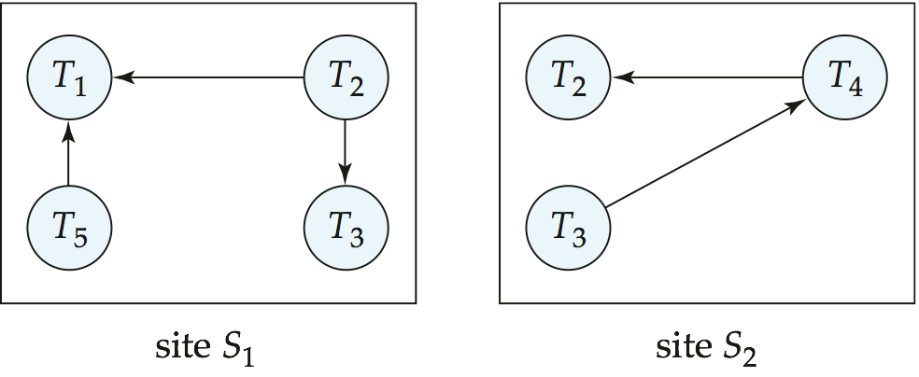
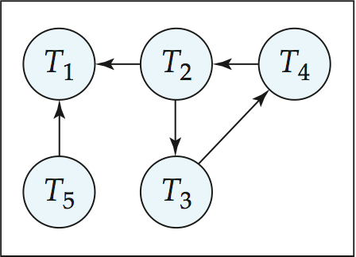
Centralized Approach for Deadlock Handling
A global wait-for graph is constructed and maintained in a single site (i.e., the deadlock-detection coordinator)
  Real graph: Real, but unknown, state of the system.
  Constructed graph: Approximation generated by the controller during the execution of its algorithm .
The global wait-for graph can be constructed when:
  a new edge is inserted in or removed from one of the local wait-for graphs.
  a number of changes have occurred in a local wait-for graph.
  the coordinator needs to invoke cycle-detection.
If the coordinator finds a cycle, it selects a victim and notifies all sites.
  The sites roll back the victim transaction.
Global
Local

Slide 97
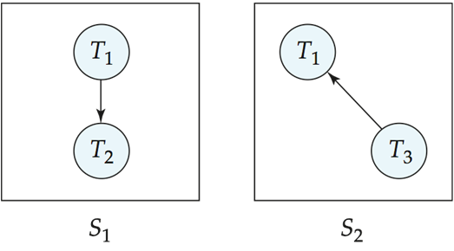
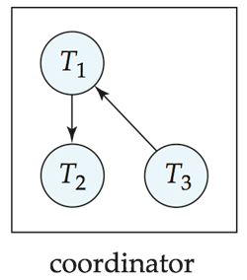
False Cycles in Global Wait-For Graph
Initial state:
Suppose that starting from the state shown in figure.
1. T₂ releases resources at S₁
    send “remove T₁ → T₂ “ message from S₁ to the coordinator
2. And then T₂ requests a resource held by T₃ at site S₂
    send “insert T₂ → T₃ “ message from S₂ to the coordinator
Suppose further that the insert message reaches before the delete message
  this can happen due to network delays

Slide 98
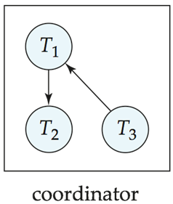
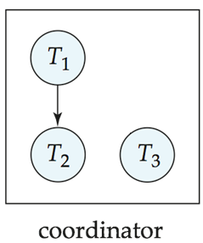
Unnecessary Rollbacks
False Cycle:
Reality:
The coordinator would then find a false cycle: T₁ → T₂ → T₃ → T₁
  The false cycle above never existed in reality.
  False cycles cannot occur if two-phase locking is used.
Unnecessary rollbacks can result from false cycles in the global wait-for graph; however, likelihood of false cycles is low.
Unnecessary rollbacks may also result
  when deadlock has indeed occurred and a victim has been picked,
  and meanwhile one of the transactions was aborted for reasons unrelated to the deadlock.

Slide 99
Chapter 19: Distributed Databases
19.1 Heterogeneous and Homogeneous Databases
19.2 Distributed Data Storage
19.3 Distributed Transactions
19.4 Commit Protocols
19.5 Concurrency Control in Distributed Databases
19.6 Availability
19.7 Distributed Query Processing
19.8 Heterogeneous Distributed Databases
19.9 Cloud-Based Databases
19.10 Directory Systems

Slide 100
Availability
High availability: time for which system is not fully usable should be extremely low (e.g. 99.99% availability)
Robustness: ability of system to function spite of failures of components
Failures are more likely in large distributed systems
To be robust, a distributed system must
  Detect failures
  Reconfigure the system so computation may continue
  Recovery / Reintegration when a site or link is repaired
Failure detection: distinguishing link failure from site failure is hard
  (partial) solution: have multiple links, multiple link failure is likely a site failure

Slide 101
Reconfiguration
Reconfiguration:
  Abort all transactions that were active at a failed site
    Making them wait could interfere with other transactions since they may hold locks on other sites
    However, in case only some replicas of a data item failed, it may be possible to continue transactions that had accessed data at a failed site (more on this later)
  If replicated data items were at failed site, update system catalog to remove them from the list of replicas.
    This should be reversed when failed site recovers, but additional care needs to be taken to bring values up to date
  If a failed site was a central server for some subsystem, an election must be held to determine the new central server
    E.g. name server, concurrency coordinator, global deadlock detector

Slide 102
Reconfiguration (Cont.)
Since network partition may not be distinguishable from site failure, the following situations must be avoided
  Two ore more central servers elected in distinct partitions
  More than one partition updates a replicated data item
Updates must be able to continue even if some sites are down
Solution: majority based approach
  Alternative of “read one write all available” is tantalizing but causes problems
Tantalize: bother
Tantalizing: 안타까운

Slide 103
Reconfiguration:
Majority-Based Approach (High Available)
The majority protocol for distributed concurrency control can be modified to work even if some sites are unavailable
  Each replica of each item has a version number which is updated when the replica is updated, as outlined below
  A lock request is sent to at least ½ the sites at which item replicas are stored and operation continues only when a lock is obtained on a majority of the sites
  Read operations look at all replicas locked, and read the value from the replica with largest version number
    May write this value and version number back to replicas with lower version numbers (no need to obtain locks on all replicas for this task)

Slide 104
Reconfiguration:
Majority-Based Approach (High Available) (cont.)
Majority protocol (Cont.)
  Write operations
    find highest version number like reads, and set new version number to old highest version + 1
    Writes are then performed on all locked replicas and version number on these replicas is set to new version number
  Failures (network and site) cause no problems as long as
    Sites at commit contain a majority of replicas of any updated data items
    During reads a majority of replicas are available to find version numbers
    Subject to above, 2 phase commit can be used to update replicas
  Note: reads are guaranteed to see latest version of data item
  Reintegration is trivial: nothing needs to be done
Quorum consensus distributed CC algorithm can be similarly extended

Slide 105
Majority Based Approach (High Available) – Read
  Key idea : read the highest version among replicas in more than one-half sites
  write (the highest version + 1) to replicas in more than one-half sites
Assume 12 sites(A~L) containing a replica of Q → 7 locks required for read / write
Request Lock-S(Q)
& Response Lock-S(Q)
Request
Lock-S(Q)
T₁: Start
… Read(Q)...
Commit
A
B
C
D
Q3
Q3
Q3
Q3
Response
Lock-S(Q)
the highest version
of Q = Q4
E
F
G
H
Q4
Q4
Q4
Q4
I
J
K
L
Q4
Q4
Q4
Q4
Failures (network and site) cause no problems as long as more than one-half sites are alive
Reintegration is trivial: nothing needs to be done

Slide 106
Majority Based Approach (High Available) – Write
  Key idea : read the highest version among replicas in more than one-half sites
  write (the highest version + 1) to replicas in more than one-half sites
Assume 12 sites(A~L) containing a replica of Q → 7 locks required for read / write
Request Lock-X(Q)
& Response Lock-X(Q)
Request
Lock-X(Q)
T₂: Start
… Write(Q)...
Commit
Q5
Q5
Q5
D
A
B
C
Q3
Q3
Q3
Q3
Response
Lock-S(Q)
Q5
Q5
Q5
Q5
(the highest version
of Q) + 1= Q5
E
F
G
H
Q4
Q4
Q4
Q4
I
J
K
L
Q4
Q4
Q4
Q4
Failures (network and site) cause no problems as long as more than one-half sites are alive
Reintegration is trivial: nothing needs to be done

Slide 107
Reconfiguration:
Read One Write All (High Available)
Biased protocol is a special case of quorum consensus
  Allows reads to read any one replica but updates require all replicas to be available at commit time (called read one write all)
Read one write all available (ignoring failed sites) is attractive, but incorrect
  If failed link may come back up, without a disconnected site ever being aware that it was disconnected
  The site then has old values, and a read from that site would return an incorrect value
  If site was aware of failure reintegration could have been performed, but no way to guarantee this
  With network partitioning, sites in each partition may update same item concurrently
    believing sites in other partitions have all failed

Slide 108
Read One Write All (High Available) – Read
  Key idea : read any replica from any site.
  write (the version + 1) to replicas of all sites.
Assume 12 sites(A~L) containing a replica of Q
In ROWA, all sites has the same version.
only one lock
required
Request
Lock-S(Q)
A
B
C
D
T₁: Start
… Read(Q)...
Commit
Q3
Q3
Q3
Q3
Response
Lock-S(Q)
E
F
G
H
Q3
Q3
Q3
Q3
the version of Q = Q3
I
J
K
L
Q3
Q3
Q3
Q3
Temporary communication failures ➔ no write & no reintegration actions are performed
Network partition ➔ each partition may independently update the same data item

Slide 109
Read One Write All (High Available) – Write
  Key idea : read any replica from any site.
  write (the version + 1) to replicas of all sites.
Assume 12 sites(A~L) containing a replica of Q
In ROWA, all sites has the same version.
all 12 locks required
Q4
Q4
Q4
Q4
A
B
C
D
T₂: Start
… Write(Q)...
Commit
Q3
Q3
Q3
Q3
(Lock request & response processes are omitted)
Q4
Q4
Q4
Q4
E
F
G
H
Q3
Q3
Q3
Q3
(the previous version of Q) + 1 = Q4
Q4
Q4
Q4
Q4
I
J
K
L
Q3
Q3
Q3
Q3
Temporary communication failures ➔ no write & no reintegration actions are performed
Network partition ➔ each partition may independently update the same data item

Slide 110
Site Reintegration
When a failed site recovers, it must catch up with all updates that it missed while it was down
  Problem: updates may be happening to items whose replica is stored at the site while the site is recovering
  Solution 1: halt all updates on system while reintegrating a site
    Unacceptable disruption
  Solution 2: lock all replicas of all data items at the site, update to latest version, then release locks
    Other solutions with better concurrency also available

Slide 111
Distributed DB vs. Remote Backup
Remote backup (hot spare) systems (Section 17.10) are also designed to provide high availability
  Remote backup systems are simpler and have lower overhead
  All actions performed at a single site, and only log records shipped
  No need for distributed concurrency control, or 2 phase commit
Using distributed databases with replicas of data items can provide higher availability by having multiple (> 2) replicas and using the majority protocol
  Also avoid failure detection and switchover time associated with remote backup systems

Slide 112
Coordinator Selection in Distributed DB
Backup coordinators
  site which maintains enough information locally to assume the role of coordinator if the actual coordinator fails
  executes the same algorithms and maintains the same internal state information as the actual coordinator fails executes state information as the actual coordinator
  allows fast recovery from coordinator failure but involves overhead during normal processing.
Election algorithms
  used to elect a new coordinator in case of failures
  Example: Bully Algorithm - applicable to systems where every site can send a message to every other site.

Slide 113
Coordinator Selection in Distributed DB:
The Bully Algorithm
If site S_{i} sends a request that is not answered by the coordinator within a time interval T, assume that the coordinator has failed S_{i} tries to elect itself as the new coordinator.
S_{i} sends an election message to every site with a higher identification number, S_{i} then waits for any of these processes to answer within T.
If no response within T, assume that all sites with number greater than i have failed, S_{i} elects itself the new coordinator.
If answer is received S_{i} begins time interval T’, waiting to receive a message that a site with a higher identification number has been elected.
If no message is sent within T’, assume the site with a higher number has failed; S_{i} restarts the algorithm.
After a failed site recovers, it immediately begins execution of the same algorithm.
If there are no active sites with higher numbers, the recovered site forces all processes with lower numbers to let it become the coordinator site, even if there is a currently active coordinator with a lower number.
Bully: 골목대장, 조폭

Slide 114
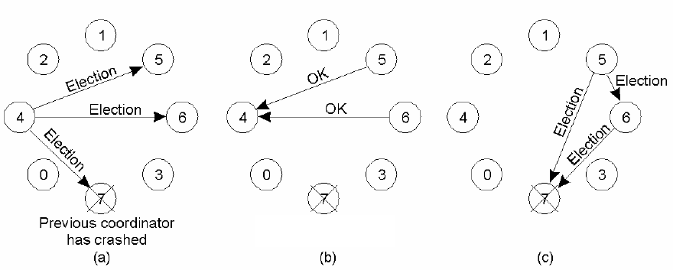
Bully Algorithm – Example
Suppose Site 4 notices the crash of coordinator site 7.
Site rank: site 7, site 6, site 5, ……, site 0
- Site 4 initiates an election
- Sends an Election message
to all sites with higher #
- Site 5 and 6 respond
- Site 4’s job is over
- Both 5 and 6 hold elections
- Send Election messages to
those sites with higher #
than itself

Slide 115
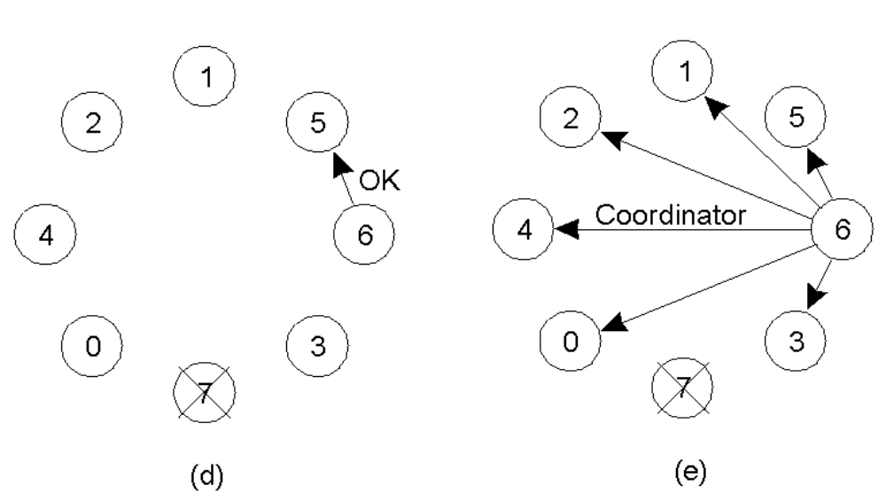
Bully Algorithm – Example (cont.)
- Site 6 announces the takeover
by sending a Coordinator message
to all sites
- Site 6 tells site 5 that
it will take over
* When the original coordinator (ie. 7) comes back on-line, it simply sends out a
COORDINATOR message, as it is the highest numbered process (and it knows it.)
* Site 7 takes over the coordinator position after receiving Oks from all sites.

Slide 116
Chapter 19: Distributed Databases
19.1 Heterogeneous and Homogeneous Databases
19.2 Distributed Data Storage
19.3 Distributed Transactions
19.4 Commit Protocols
19.5 Concurrency Control in Distributed Databases
19.6 Availability
19.7 Distributed Query Processing
19.8 Heterogeneous Distributed Databases
19.9 Cloud-Based Databases
19.10 Directory Systems

Slide 117
Distributed Query Processing
For centralized systems, the primary criterion for measuring the cost of a particular strategy is the number of disk accesses.
In a distributed system, other issues must be taken into account:
  The cost of a data transmission over the network
  The potential gain in performance from having several sites process parts of the query in parallel
Primary Concerns
  Transforming queries on fragments
  Reducing data transmission for joining relations in distributed sites (semijoin)
  Parallel Inter-join strategy exploiting distributed sites

Slide 118
Query Transformation in Distributed DB
Translating algebraic queries on fragments
  It must be possible to construct relation r from its fragments
  Replace relation r by the expression to construct relation r from its fragments
Consider the horizontal fragmentation of the account relation into
  account₁ = σ _{branch_name = “Hillside”} (account )
  account₂ = σ _{branch_name = “Valleyview”} (account )
The query σ _{branch_name = “Hillside”} (account ) becomes
  σ _{branch_name = “Hillside”} (account₁ ∪ account₂) which is again optimized into
  σ _{branch_name = “Hillside”} (account₁) ∪ σ _{branch_name = “Hillside”} (account₂)
  Since account₁ has only tuples pertaining to the Hillside branch, we can eliminate the selection operation.
  Apply the definition of account₂ to obtain
σ _{branch_name = “Hillside”} (σ _{branch_name = “Valleyview”} (account )
  This expression is the empty set regardless of the contents of the account relation.
Final strategy is for the Hillside site to return account₁ as the result of the query.

Slide 119

Simple Join Processing
Consider the following relational algebra expression in which the three relations are neither replicated nor fragmented
account depositor branch
suppose account is stored at site S₁ & depositor at S₂ & branch at S₃
For a query issued at site S_{I}, the system needs to produce the result at site S_{I}
Strategy 1: Ship copies of all three relations to site S_{I} and choose a strategy for processing the entire locally at site S_{I.}
Strategy 2:
  Ship a copy of the account relation to site S₂ and compute temp₁ = account depositor at S₂
  Ship temp₁ from S₂ to S₃, and compute temp₂ = temp₁ branch at S₃.
  Ship the result temp₂ to S_{I}.
  Devise similar strategies, exchanging the roles S₁, S₂, S₃
Must consider following factors:
  amount of data being shipped
  cost of transmitting a data block between sites
  relative processing speed at each site

Slide 120
Semijoin Strategy
Let r₁ be a relation with schema R₁ stores at site S₁
Let r₂ be a relation with schema R₂ stores at site S₂
Evaluate the expression r₁ r₂ and obtain the result at S₁.
1. Compute temp₁ ← ∏_{R1 ∩ R2} (r1) at S1.
2. Ship temp₁ from S₁ to S₂.
3. Compute temp₂ ← r₂ temp1 at S₂
4. Ship temp₂ from S₂ to S₁.
5. Compute r₁ temp₂ at S₁. This is the same as r₁ r₂.
The semijoin of r₁ with r₂, is denoted by: r₁ r₂ = ∏_{R1} (r₁ r₂)
Thus, r₁ r₂ selects those tuples of r₁ that contributed to r₁ r₂.
In step 3 above, temp₂ = r₂ r₁.
For joins of several relations, the above strategy can be extended to a series of semijoin steps.

Slide 121
Semi Join – Example
r₁ r₂
temp1
(R₁[A])
Site 2
Site 1
R₁
1
R₂
1. projection
2
2. Ship(3)
A
B
C
3
A
D
1
4
7
3
10
2
5
8
4
11
3
6
9
5
12
4. Ship(2)
5. r₁ temp2
temp2
3. r₂ temp1
3
10
3
6
9
10
join result
Shipping cost savings = 9 –(3+2) = 4

Slide 122
Join Strategies that Exploit Parallelism
Consider r₁ r₂ r₃ r₄ where relation r_{i} is stored at site S_{i}.
The result must be presented at site S₁.
r₁ is shipped to S₂ and r₁ r₂ is computed at S₂
Simultaneously r₃ is shipped to S₄ and r₃ r₄ is computed at S₄
S₂ ships tuples of (r₁ r₂) to S₁ as they produced;
S₄ ships tuples of (r₃ r₄) to S₁
Once tuples of (r₁ r₂) and (r₃ r₄) arrive at S₁:
(r₁ r₂) (r₃ r₄) is computed in parallel with the computation of (r₁ r₂) at S₂ and the computation of (r₃ r₄) at S₄.
r1
S1: r1
S2: r2
r1 ▷◁ r2
S1
r1 ▷◁ r2 ▷◁ r3 ▷◁ r4
r2
S3: r3
S4: r4
r3 ▷◁ r4

Slide 123
Chapter 19: Distributed Databases
19.1 Heterogeneous and Homogeneous Databases
19.2 Distributed Data Storage
19.3 Distributed Transactions
19.4 Commit Protocols
19.5 Concurrency Control in Distributed Databases
19.6 Availability
19.7 Distributed Query Processing
19.8 Heterogeneous Distributed Databases
19.9 Cloud-Based Databases
19.10 Directory Systems

Slide 124
Heterogeneous Distributed Databases
Many database applications require data from a variety of preexisting databases located in a heterogeneous collection of hardware and software platforms
  Data models may differ (hierarchical, relational , etc.)
  Transaction commit protocols may be incompatible
  Concurrency control may be based on different techniques (locking, timestamping, etc.)
  System-level details almost certainly are totally incompatible.
A multidatabase system is a software layer on top of existing database systems, which is designed to manipulate information in heterogeneous databases
  Creates an illusion of logical database integration without any physical database integration

Slide 125
Advantages of Heterogeneous DB
Preservation of investment in existing
  Hardware
  System software
  Applications
Local autonomy and administrative control
Allows use of special-purpose DBMSs
Step towards a unified homogeneous DBMS
  Full integration into a homogeneous DBMS faces
    Technical difficulties and cost of conversion
    Organizational / Political difficulties
      Organizations do not want to give up control on their data
      Local databases wish to retain a great deal of autonomy

Slide 126
Unified View of Data in Heterogeneous DB
Agreement on a common data model
  Typically the relational model
Agreement on a common conceptual schema
  Different names for same relation/attribute
  Same relation/attribute name means different things
Agreement on a single representation of shared data
  E.g. data types, precision,
  Character sets
    ASCII vs EBCDIC
    Sort order variations
Agreement on units of measure
Variations in names
  E.g. Köln vs Cologne, Mumbai vs Bombay

Slide 127
Query Processing in Heterogeneous DB
Several issues in query processing in a heterogeneous database
Schema translation
  Write a wrapper for each data source to translate data to a global schema
  Wrappers must also translate updates on global schema to updates on local schema
Limited query capabilities
  Some data sources allow only restricted forms of selections
    E.g. web forms, flat file data sources
  Queries have to be broken up and processed partly at the source and partly at a different site
Removal of duplicate information when sites have overlapping information
  Decide which sites to execute query
Global query optimization

Slide 128
Mediator Systems in Heterogeneous DB
Mediator systems are systems that integrate multiple heterogeneous data sources by providing an integrated global view, and providing query facilities on global view
  Unlike full fledged multidatabase systems, mediators generally do not bother about transaction processing
  But the terms mediator and multidatabase are sometimes used interchangeably
  The term virtual database is also used to refer to mediator/multidatabase systems
User/Application
Provide an integrated global view of the data
Provide query facilities on the global view
query
Mediator
Translate queries on the global schema into
queries on the local schema
Translate results back into the global schema
Wrapper 1
Wrapper 2
Data
source 1
Data
source 2

Slide 129
Chapter 19: Distributed Databases
19.1 Heterogeneous and Homogeneous Databases
19.2 Distributed Data Storage
19.3 Distributed Transactions
19.4 Commit Protocols
19.5 Concurrency Control in Distributed Databases
19.6 Availability
19.7 Distributed Query Processing
19.8 Heterogeneous Distributed Databases
19.9 Cloud-Based Databases
19.10 Directory Systems

Slide 130
Directory Systems
Typical kinds of directory information
  Employee information such as name, id, email, phone, office addr, ..
  Even personal information to be accessed from multiple places
    e.g. Web browser bookmarks
White pages
  Entries organized by name or identifier
    Meant for forward lookup to find more about an entry
Yellow pages
  Entries organized by properties
  For reverse lookup to find entries matching specific requirements
When directories are to be accessed across an organization
  Alternative 1: Web interface. Not great for programs
  Alternative 2: Specialized directory access protocols
    Coupled with specialized user interfaces

Slide 131
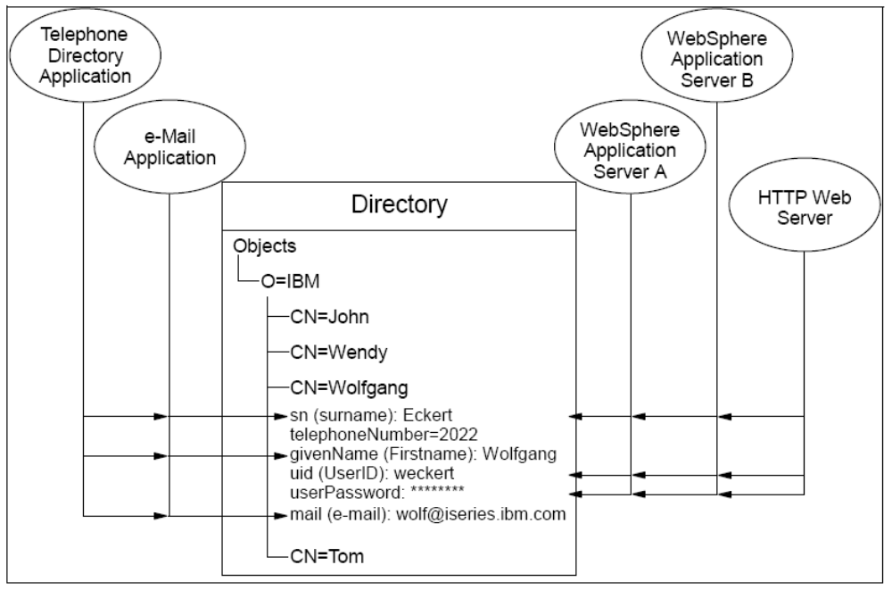
Directory Systems – Example
Several applications using attributes of the same entry

Slide 132
DBMS vs LDAP
Question: Why not use database protocols like ODBC/JDBC?
Answer:
  Simplified protocols for a limited type of data access, evolved parallel to ODBC/JDBC
  Can be optimized to economically provide more applications with rapid access to directory data in large distributed environments (Because directories are not intended to provide as many functions as general-purpose relational databases.)
  Provide a nice hierarchical naming mechanism similar to file system directories
    Data can be partitioned amongst multiple servers for different parts of the hierarchy, yet give a single view to user
      E.g. different servers for Bell Labs Murray Hill and Bell Labs Bangalore
  Directories may use databases as storage mechanism

Slide 133
Directory Access Protocols
Most commonly used directory access protocol:
  LDAP (Lightweight Directory Access Protocol)
  Simplified from earlier X.500 protocol
LDAP
  LDAP Data Model
  Data Manipulation
  Distributed Directory Trees

Slide 134
LDAP Data Model
LDAP directories store entries
  Entries are similar to objects
Each entry must have unique distinguished name (DN)
DN made up of a sequence of relative distinguished names (RDNs)
Example of a DN
  cn = Silberschatz, ou = Bell Labs, o = Lucent, c = USA
  Standard RDNs (can be specified as part of schema)
    cn: common name
    ou: organizational unit
    o: organization
    c: country
  Similar to paths in a file system but written in reverse direction

Slide 135
LDAP Data Model (Cont.)
Entries can have attributes
  Attributes are multi-valued by default
  LDAP has several built-in types
    Binary type, String type, Time type
    Tel type: telephone number PostalAddress type: postal address
LDAP allows definition of object classes
  Object classes specify attribute names and types
  Can use inheritance to define object classes
  Entry can be specified to be of one or more object classes
    No need to have single most-specific type

Slide 136
Directory Information Tree (DIT)
Entries organized into a directory information tree (DIT) according to their DNs
  Leaf level usually represent specific objects
  Internal node entries represent objects such as organizational units, organizations or countries
  Children of a node inherit the DN of the parent, and add on RDNs
    E.g. internal node with DN c=USA
      Children nodes have DN starting with c=USA and further RDNs such as o or ou
    DN of an entry can be generated by traversing path from root
  Leaf level can be an alias pointing to another entry
    Entries can thus have more than one DN
      E.g. person in more than one organizational unit

Slide 137
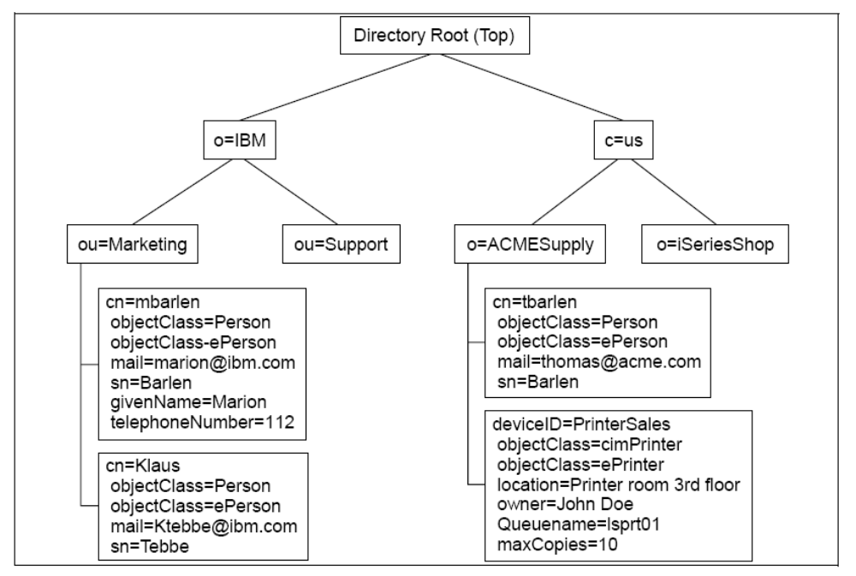
Directory Information Tree – Example
Application programs can connect to DIT via LDAP Query, LDIF, URL and API

Slide 138
LDAP Data Manipulation
Unlike SQL, LDAP does not define DDL or DML
Instead, it defines a network protocol for DDL and DML
  Users use an API or vendor specific front ends
  LDAP also defines a file format
    LDAP Data Interchange Format (LDIF)
Querying mechanism is very simple: only selection & projection
# e.g., adding single attribute
# The add directive follows a changetype: modify directive and
# defines the name of the attribute(s) to be added to an existing entry.
dn: cn=Robert Smith,ou=people,dc=example,dc=com
changetype: modify
add: telephonenumber
telephonenumber: 123-111

Slide 139
LDAP Queries
LDAP query must specify
  Base: a node in the DIT from where search is to start
  A search condition
    Boolean combination of conditions on attributes of entries
      Equality, wild-cards and approximate equality supported
  A scope
    Just the base, the base and its children, or the entire subtree from the base
  Attributes to be returned
  Limits on number of results and on resource consumption
  May also specify whether to automatically dereference aliases
LDAP URLs are one way of specifying query
LDAP API is another alternative

Slide 140
LDAP Query by LDAP URLs
First part of LDAL URL specifies server and second part is DN of base
  ldap:://aura.research.bell-labs.com/o=Lucent,c=USA
Optional further parts separated by ? symbol
  ldap:://aura.research.bell-labs.com/o=Lucent,c=USA??sub?cn=Korth
  Optional parts specify
    ? ➔ attributes to return (empty means all)
    ?sub ➔ Scope (sub indicates entire subtree)
    ?cn=korth ➔ Search condition (cn=Korth)

Slide 141
LDAP Query by LDAP C-API
LDAP API also has functions to create, update and delete entries
Each function call behaves as a separate transaction
  LDAP does not support atomicity of updates
  #include <stdio.h>
  #include <ldap.h>
  main( ) {
  LDAP *ld;
  LDAPMessage *res, *entry;
  char *dn, *attr, *attrList [ ] = {“telephoneNumber”, NULL};
  BerElement *ptr;
  int vals, i;
// Open a connection to server
ld = ldap_open(“aura.research.bell-labs.com”, LDAP_PORT);
ldap_simple_bind(ld, “avi”, “avi-passwd”);
… actual query (next slide) …
ldap_unbind(ld);
}

Slide 142
C Code using LDAP API (Cont.)
ldap_search_s(ld, “o=Lucent, c=USA”, LDAP_SCOPE_SUBTREE,
“cn=Korth”, attrList, /* attrsonly */ 0, &res);
/*attrsonly = 1 ➔ return only schema not actual results*/
printf(“found%d entries”, ldap_count_entries(ld, res));
for (entry = ldap_first_entry(ld, res); entry != NULL; entry = ldap_next_entry(id, entry)) {
dn = ldap_get_dn(ld, entry);
printf(“dn: %s”, dn); /* dn: DN of matching entry */
ldap_memfree(dn);
for(attr = ldap_first_attribute(ld, entry, &ptr); attr != NULL;
attr = ldap_next_attribute(ld, entry, ptr)) // for each attribute
{ printf(“%s:”, attr); // print name of attribute
vals = ldap_get_values(ld, entry, attr);
for (i = 0; vals[i] != NULL; i ++)
printf(“%s”, vals[i]); // since attrs can be multivalued
ldap_value_free(vals);
}
}
ldap_msgfree(res);

Slide 143
Distributed Directory Information Trees
Organizational information may be split into multiple directory information trees (DITs)
  Suffix of a DIT gives RDN to be tagged onto to all entries to get an overall DN
    E.g. two DITs, one with suffix o=Lucent, c=USA
    and another with suffix o=Lucent, c=India
  Organizations often split up DITs based on geographical location or by organizational structure
  Many LDAP implementations support replication (master-slave or multi-master replication) of DITs (not part of LDAP 3 standard)
A node in a DIT may be a referral to a node in another DIT
  E.g. “ou= Bell Labs” may have a separate DIT, and DIT for “o=Lucent” may have a leaf with “ou=Bell Labs” containing a referral to the Bell Labs DIT
  Referrals are the key to integrating a distributed collection of directories
  When a server gets a query reaching a referral node, it may either
    Forward query to referred DIT and return answer to client, or
    Give referral back to client, which transparently sends query to referred DIT (without user intervention)

Slide 144
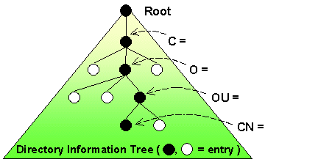
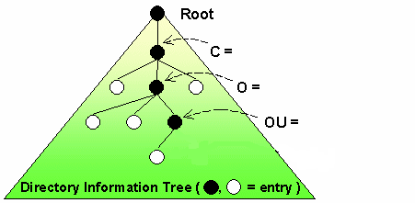
Distributed Directory Tree – Example
E.g., Suppose Frank in Bell Labs, USA is transferred to India for some time.
USA
India
Lucent
Lucent
Bell Labs
Bell Labs
Frank
referral

Slide 145
End of Chapter

Slide 146
Three Phase Commit (3PC)
Assumptions:
  No network partitioning
  At any point, at least one site must be up.
  At most K sites (participants as well as coordinator) can fail
Phase 1: Obtaining Preliminary Decision: Identical to 2PC Phase 1.
  Every site is ready to commit if instructed to do so
Phase 2 of 2PC is split into 2 phases, Phase 2 and Phase 3 of 3PC
  In phase 2 coordinator makes a decision as in 2PC (called the pre-commit decision) and records it in multiple (at least K) sites
  In phase 3, coordinator sends commit/abort message to all participating sites,
Under 3PC, knowledge of pre-commit decision can be used to commit despite coordinator failure
  Avoids blocking problem as long as < K sites fail
Drawbacks:
  higher overheads
  assumptions may not be satisfied in practice

Slide 147
Figure 19.02

Slide 148
Figure 19.03

Slide 149
Figure 19.04

Slide 150
Figure 19.05

Slide 151
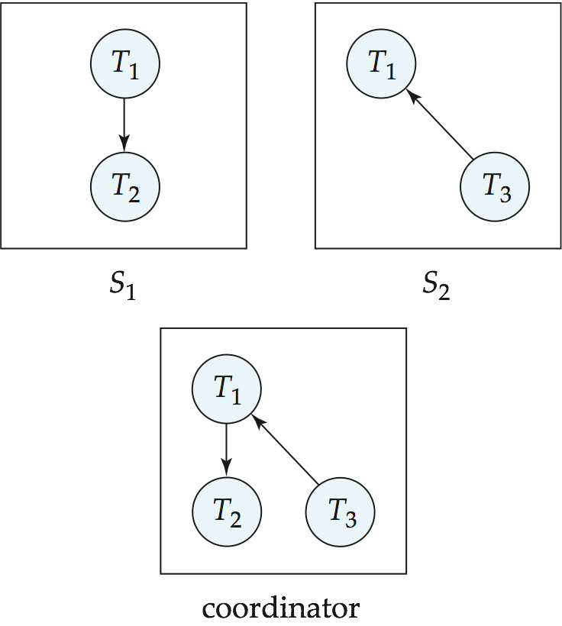
Figure 19.06

Slide 152
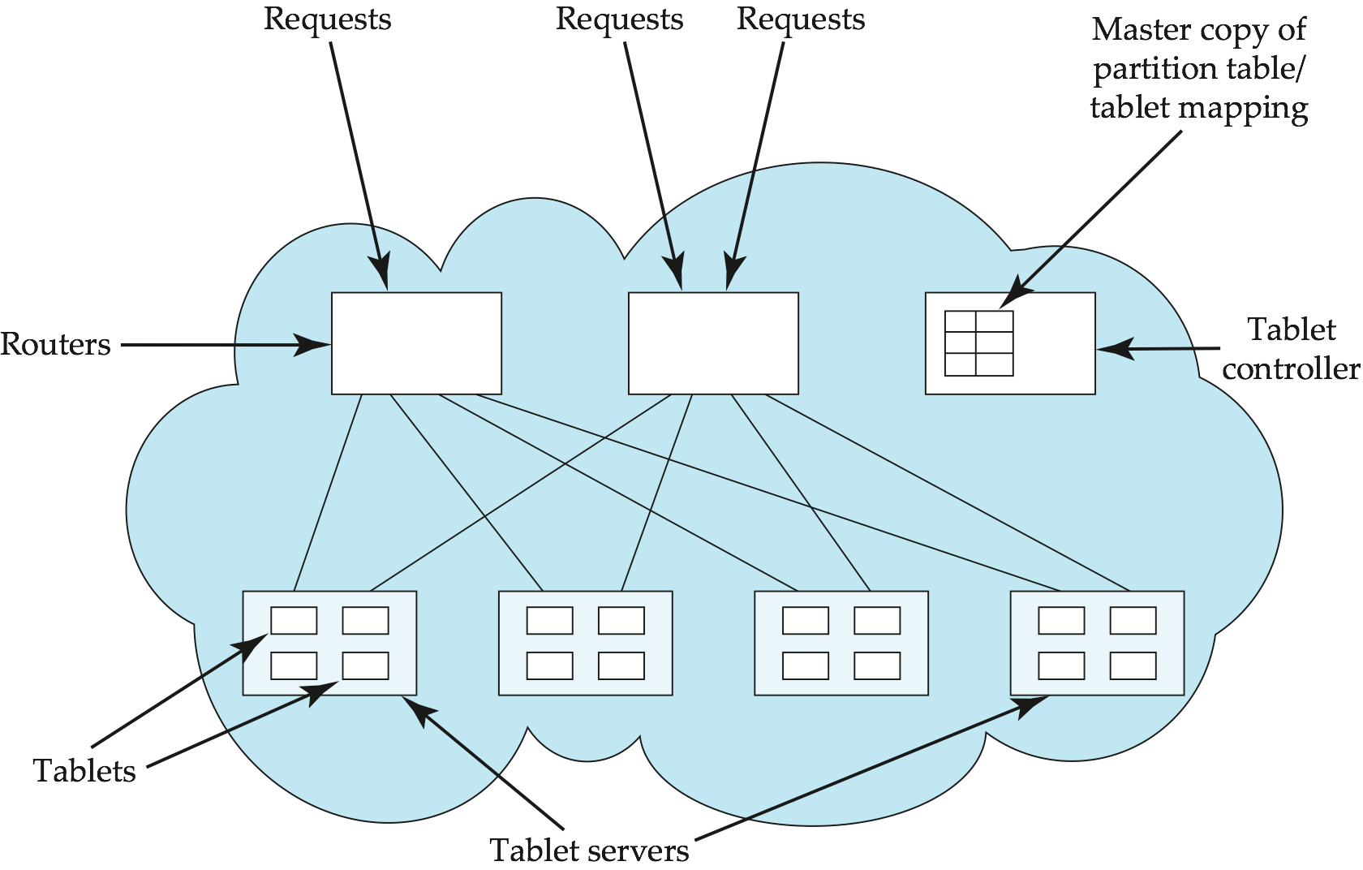
Figure 19.07

