Slide 1
On Labeling Schemes for the Semantic Web
Vassilis Christophides¹, Dimitris Plexousakis¹
Michel Scholl²
Sotirios Tourtounis³
1 Institute of Computer Science, FORTH, Greece
2 CNAM and INRIA-Futurs, France
3 Department of Computer Science, Univ. of Crete, Greece
WWW2003
iDB Lab., SNU
Junseok Yang
2008-07-25

Slide 2
Introduction [1/4]
Web Portals require advanced tools for managing metadata i.e., descriptions about the meaning, usage, accessibility or quality of information resources (e.g., data, documents, services)
They employ descriptive schemas, such as structured vocabularies or thematic taxonomies, which represent nowadays an important part of the hierarchical data available on the Web

Slide 3
Introduction - RDF [2/4]
In such context, Resource Description Framework (RDF) is increasingly gaining acceptance for metadata creation and exchange by providing
i) a Standard Representation Language for descriptions based on directed labeled graphs
ii) a Schema Definition Language (RDFS) for modeling user thesauri or taxonomies as class/property subsumption hierarchies (i.e., trees or DAGs)
iii) an XML syntax for both schemas and resource descriptions

Slide 4
Introduction [3/4]
In this paper, we are interested in labeling schemes for such hierarchical data exported by Web Portals, in order to optimize complex queries on their catalogs
Catalog is created according to one or more topic hierarchies (schemas)
Catalog is actually published on the Web as a set of statically interlinked Html pages : Each page contains the information resources (objects) classified under a specific topic (class), as well as various kinds of relationship between topics

Slide 5
Introduction [4/4]
In this paper, we focus on the optimization of such queries by avoiding costly transitive closure computations over voluminous class hierarchies
We are interested in labeling schemes for RDF/S class hierarchies allowing us to efficiently evaluate descendant/ancestor, adjacent/sibling queries, as well as, finding nearest common ancestors (nca) by using only the generated lables

Slide 6
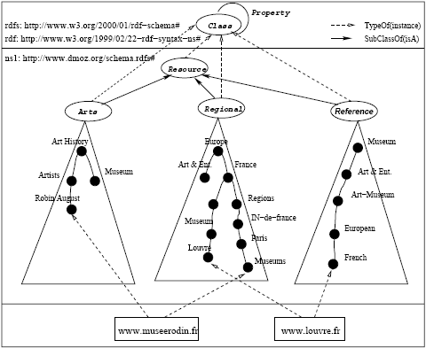
Motivating Example: ODP [1/3]
Part of the RDFS schema employed by Netscape Open Directory Portal (ODP)
Nodes denote class names/topics
Solid edges denote subsumption relationships
The ODP schema designers partially replicate terms in the various topic hierarchies in order to denote all the valid combinations of terms
RDF Catalog of Open Directory Portal

Slide 7
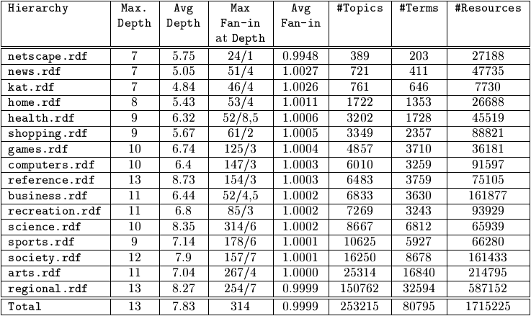
Motivating Example: ODP [2/3]
Complete statistics of 16 ODP hierarches (version of 2001-01-16)
Statistics of the ODP Topic Hierarchies

Slide 8
Motivating Example: ODP [3/3]
The total number of distinct terms used by all topics is 80795 while 14355 of them (17.77%) are replicated in more than one topic name
A totla number of 1715225 resources are classfied with 118925 (6.93%) of them multiply classified unter more than on e topic
Relatively deep (the average depth is 7.3 and the maximum is 13) with a varying fan-in at each level (the maximum fan-in degree is 314 while the average is only 0.9999)

Slide 9
Labeling Schemes : Bit-Vector [1/3]
Breadth First Traversal
current node
ancestor : inherit the bits identifying ancestors
descendant
0 | … | 0 | 0 | 1 | 0 | 1 | … | 1
n bits : number of nodes
current node
is ancestor?
0 | 0 | 1 | 0 | 1
&
0 | 0 | 1 | 0 | 1
|
0 | 1 | 1 | 0 | 1
…
0 | 1 | 1 | 0 | 1
is descendant?
current node

Slide 10
Labeling Schemes : Bit-Vector [2/3]
0 | 0 | 0 | 0 | 0 | 1 | 1
Support subsumption checking and Greatest Lower Bound (Nearest Common Descendant) operations in constant time by comparing two bit vectors
0 | 0 | 0 | 0 | 1 | 1 | 1
0 | 0 | 0 | 1 | 0 | 1 | 1
0 | 0 | 1 | 0 | 1 | 1 | 1
0 | 1 | 0 | 0 | 1 | 1 | 1
1 | 0 | 0 | 0 | 0 | 1 | 1
&
Least Upper Bound
(Nearest Common Ancestor)
0 | 0 | 0 | 0 | 0 | 1 | 1

Slide 11
Labeling Schemes : Bit-Vector [3/3]
All labels have fixed size n bits
Labels can be constructed in time linear in the size n
Storage required for the labels is exactly n²
Drawback
ancestor/descendent/sibling queries are O(n)
No O(logn) data structure can be used to accelerate the evaluation of the queries
The fixed size of the produced labels heavily depends on the size of the input class hierarchies
Inappropriate for incremental updates

Slide 12
Labeling Schemes : Prefix [1/4]
Depth First Traversal
1
The labels for a tree T can be computed in time linear in the number of nodes in T
1 | 1
1 | 2
1 | 3
1 | 1 | 1
1 | 1 | 2
1 | 3 | 1
1 | 3 | 2
Dewey Decimal Coding (DDC)

Slide 13
Labeling Schemes : Prefix [2/4]
ancestor(v, u) : label(v) ∈ prefixes(label(u))
Lexicographic order
The labels of nodes u in a subtree with root v are greater than those of its left sibling subtrees
prev(lable(v)) < label(v) < label(u) < next(label(v))
Index structures based on the key’s domain order, such as the B-tree, can be used to speed-up

Slide 14
Labeling Schemes : Prefix [3/4]
father/children/sibling queries rely purely on string matching functions
father(u) : mprefix(u) (the greatest prefix of u)
nca(v, w) : common prefix of maximum length
Maximum label size (in bytes) depends only on the maximum depth of T
For fan-in degrees greater than 10, larger alphabets should be used (e.g. UTF-8)

Slide 15
Labeling Schemes : Prefix [4/4]
Advantages
Production of Labels with variable size
→ Incremental updates
Disadvantages
Evaluation of queries on variable size labels relies on string manipulation functions
Reducing the optimization opportunities of existing SQL query engines because the evaluation cost of user-defined functions is unknown by the optimizers
When extended for DAGs, produce inflationary labels

Slide 16
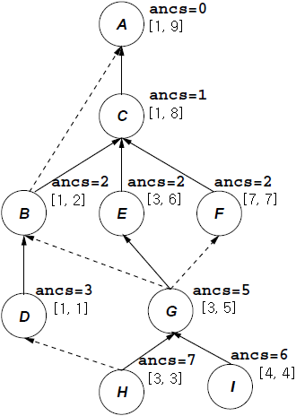
Labeling Schemes : Interval [1/4]
[index, post]
Dietz is original scheme
Node is labeled with [pre, post]
ancestor(v, u)
pre(v) < pre(u) and post(v) > post(u)
Agrawal et al.
Introduce a (optimal) spanning tree to distinguish between tree and non-tree edges
Agrawal et al.

Slide 17
Labeling Schemes : Interval [2/4]
Agrawal et al. (cont’d)
A node in the spanning tree T of the graph is labeled with [index, post]
post is the postorder number
index is the lowest postorder number of it’s descendants
If node v is the source of a non spanning tree edge with target u, then u as well as all its ancestors in the graph replicate the label of v
To support incremental updates without node relabeling, leave gaps between the intervals (e.g. [index, c * post])

Slide 18
Labeling Schemes : Interval [3/4]
Modified schemes of Li and Moon
For encoding XML data
[pre(u), size(u)] (size(u) : the size of the subtree rooted at u)
Advantages of Agrawal et al.
Smaller index volumes (and update costs)
Allows for more efficient query evaluation by standard SQL engines
Interval compression opportunities for graphs either by absorbing subsumed intervals or by merging adjacent intervals coming from non-tree edge

Slide 19
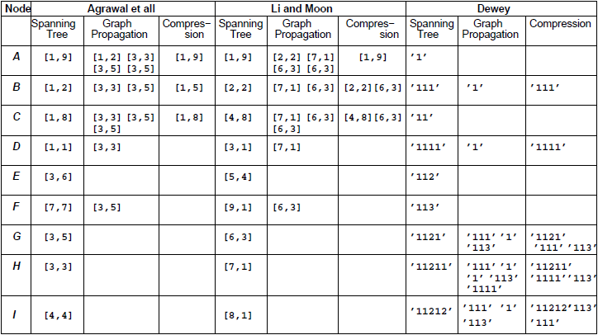
Labeling Schemes : Interval [4/4]
Label Compression for Graphs

Slide 20
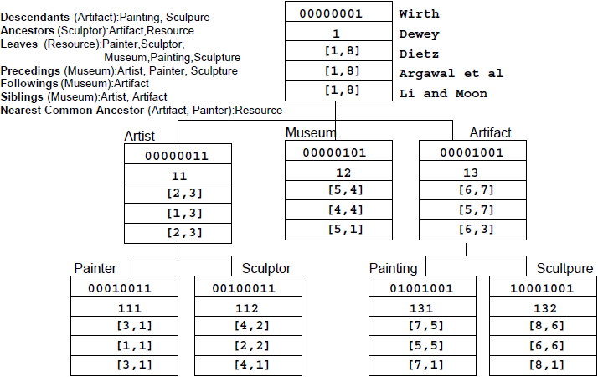
Labeling Schemes

Slide 21
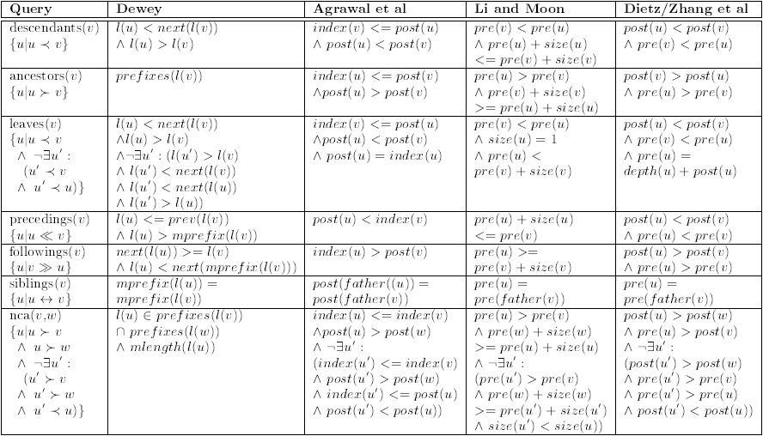
Labeling Schemes
Core Query Expressions for Trees

Slide 22
Labeling Schemes : Summary
Bit-Vector based schemes
Do not efficiently support all testbed queries when implemented by SQL engines
Prefix-based schemes
Provide simple expressions for ancestor/descendant queries based on string matching operators
Allow for simple increment updates
Optimization opportunities are reduced
Interval-based scheme proposed by Agrawal et al.
Compactness for DAG hierarchies
Efficient query evaluation by standard SQL engines

Slide 23
Evaluation of Labeling Schemes
Compare the storage and query performance of two labeling schemes
Unicode Dewey prefix-based schemes (Uprefix)
Extended postorder interval-based scheme by Agrawal et al. (PInterval)
Use as a testbed the RDF dump of the ODP Catalog (version of 2001-01-16)

Slide 24
Evaluation : Case of Trees [1/4]
Database Representation and Size
label in UPrefix is determined by the maximum depth of the ODP class hierarchy plus one (for the root class Resource)
post in PInterval is determined by the total number of the ODP classes
Utilize the father in order to reconstruct the class hierarchy and efficiently support direct parent/children/sibling queries
Class(id : int4, name : varchar(256))
SubClass(id : int4, father : int4)
since labels are unique
UPrefix(label : varchar(15), father : varchar(15))
PInterval(index : int4, post : int4, father : int4)

Slide 25
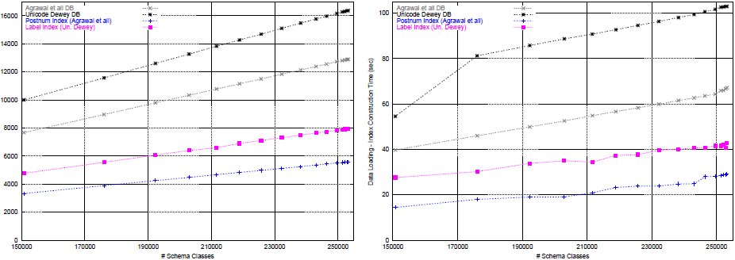
Evaluation : Case of Trees [2/4]
UPrefix is 21.2% bigger than PInterval
Size of the index on attribute label is 29.8% larger than that of post
Data loading (index construction) time of UPrefix is 34.75% (32.21%) larger than of PInterval
Database/Index Size and Construction Time for ODP Subclass Trees

Slide 26
Evaluation : Case of Trees [3/4]
Core Query Evaluation
Most query expressions can be directly translated into SQL
The only queries for UPrefix needing to be implemented by SQL stored procedures are ancestors (function prefixes) and nca (functions prefixes and mlength)
The main performance limitation of SQL queries for UPrefix is due to the presence of user-defined functions (next, prev, and mprefix) in the selection conditions involving label
The only problem for the interval based scheme is related to the following query which relies on the value of the attribute index for which no index was constructed

Slide 27
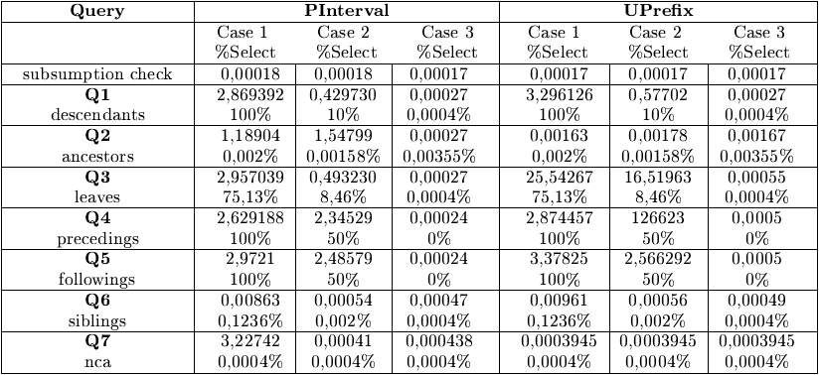
Evaluation : Case of Trees [4/4]
In all queries except leaves, ancestors and nca, PInterval exhibits slightly smaller execution times than UPrefix since for the same number of returned tuples, a smaller number of disk pages need to be accessed
Execution Time of Core Queries for the ODP Subclass Tree

Slide 28
Evaluation : Case of DAGs [1/4]
Database Representation and Size
When label compression in PInterval, do not consider merging of adjacent intervals since DAG nodes are not anymore identified using their postorder number of merged interval
UPrefix(label : varchar(15), father : varchar(15))
PInterval(index : int4, post : int4, father : int4)
siblings (and father/children) queries can be easily evaluated
DUprefix(label : varchar(15), ancestor : varchar(15))
DPInterval(index : int4, post : int4, ancestor : int4)
label ancestor propagates downwards its label to the node identified by label
label [index, post] propagates its label upwards to the node identified by the post value ancestor

Slide 29
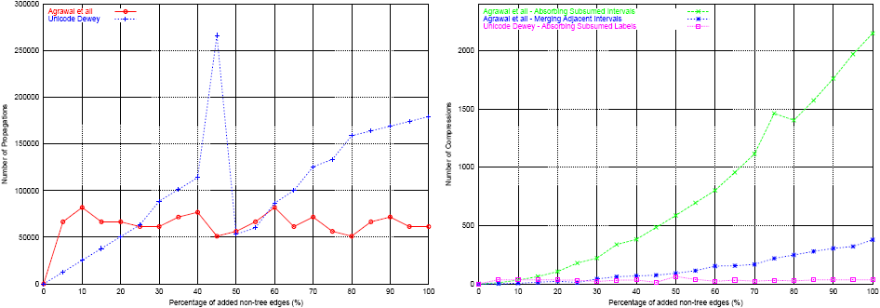
Evaluation : Case of DAGs [2/4]
Since the tables UPrefix and PInterval hold all the edges of the DAG, the extra storage space is exactly the size of tables DUPrefix and DPInterval
Label Propagation and Compression for ODP Subclass DAGs

Slide 30
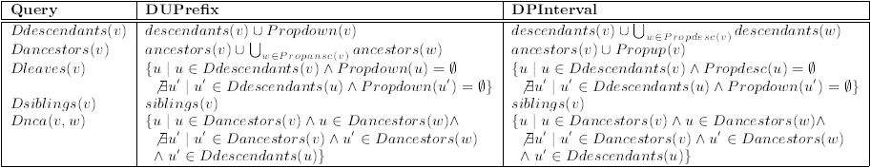
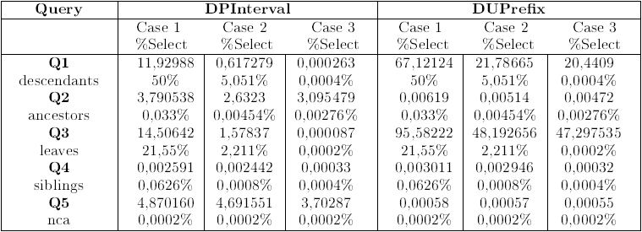
Evaluation : Case of DAGs [3/4]
Core Query Evaluation
Core Query Expressions for DAGs
Execution Time of Core Queries for the ODP Subclass DAG

Slide 31
Evaluation : Case of DAGs [4/4]
Core Query Evaluation (cont’d)
DPInterval outperfoms DUPrefix by up to 5 orders of magnitude for descendants and leaves queries especially for cases with high selectivity
ancestors and nca in DUPrefix run in practically constant time

Slide 32
Summary
For voluminous class subsumption hierarchies, labeling schemes bring significant performance gains (3-4 orders of magnitude) in query evaluation as compared to transitive closure computations
This gain comes with no significant increase in storage requirements

Slide 33
END

