Slide 1
Apache SAMOA Scalable Advanced Massive Online Analytics Gianmarco De Francisci Morales (WWW 2013) Yahoo! Research
Heymo Kou
Dec 28th, 2016

Slide 2
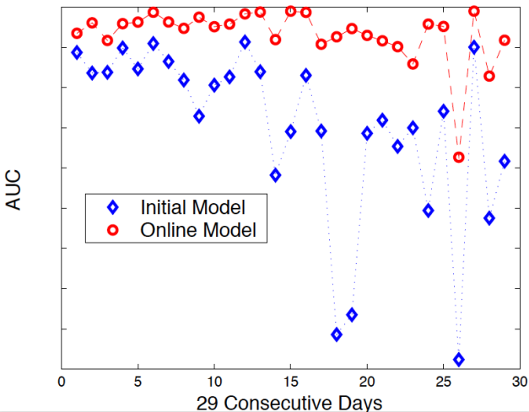
Importance of Online Model
Spam detection in comments on Yahoo News
Trends and Spam styles change in time
Should retrain model w/ new data

Slide 3
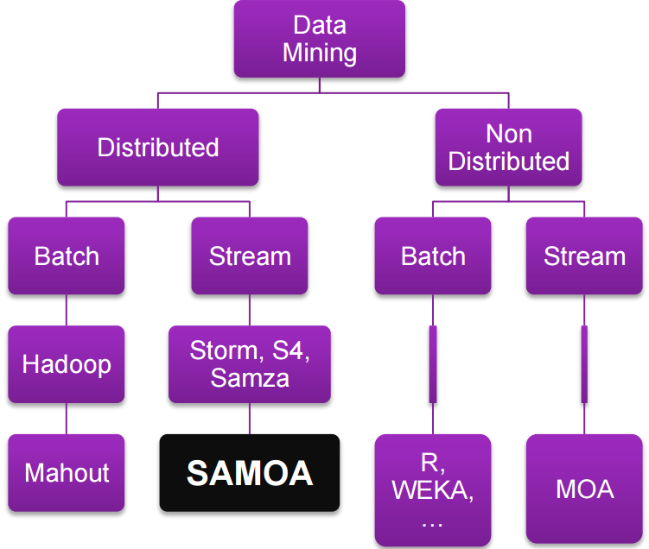
Taxonomy
Mining Big Data Streams : Better Algorithms or Faster Systems? By Gianmarco De Francisci Morales

Slide 4
Apache SAMOA
Distributed streaming machine learning framework
Programing abstraction for distributed streaming ML alg.
Enables development of new ML algorithms w/o directly dealing with the complexity of underlying distributed stream processing engines (DPSE : Storm, Flink, and Samza)
Develop once execute them on multiple DPSEs

Slide 5
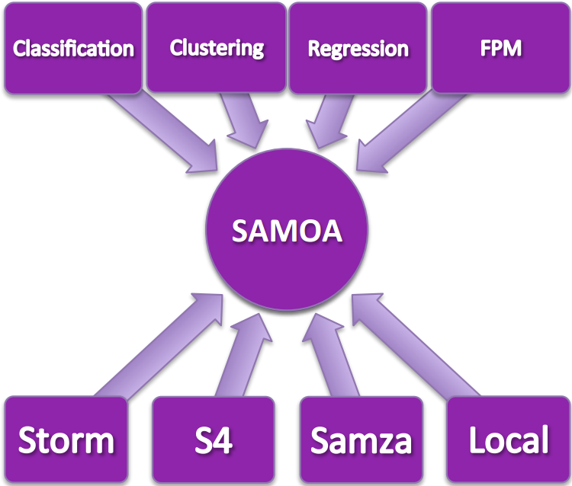
Architecture
Mining Big Data Streams : Better Algorithms or Faster Systems? By Gianmarco De Francisci Morales

Slide 6



Features status (0.4.0-incubating)
Parallel algorithms
Classification (Vertical Hoeffding Tree)
Clustering (CluStream)
Regression (Adaptive Model Rules)
Execution engines
Apache Storm
Apache S4
Apache Samza

Slide 7
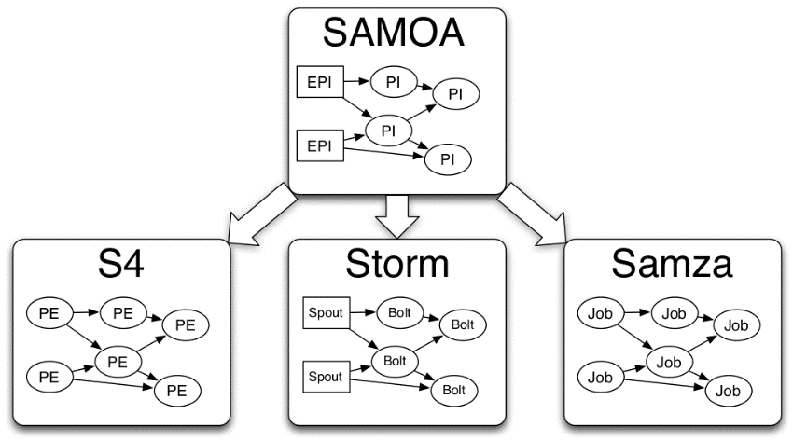
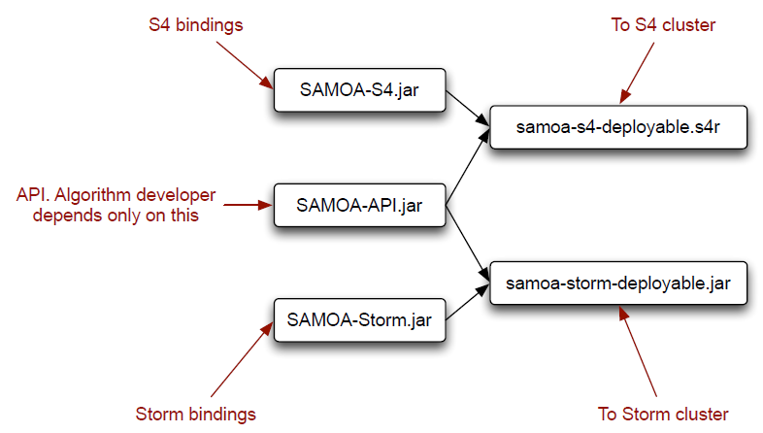
SAMOA Deployment
Develop once
Deploy to multiple DSPEs
Storm, S4, SAMZA

Slide 8

Roadmap
Triggers
API for event triggering that can be used at the ML level to describe actions to be taken upon conditions
Distributed Naive Bayes
Feature Extraction Pipeline
Stochastic Gradient Descent in Java
Classical optimization algorithm used in many machine learning algorithms
Some parallel implementations of the algorithm
But either they are in C or C++ or they work only for shared memory systems (or both)
MapReduce and Hadoop are not suitable to deal with streams of data
Adaptive + Boosting Vertical Hoeffding Tree (Very Fast Decision Trees)
Decision trees for streaming data.
Parallel algorithm that works on distributed streaming environments.
Extend the current implementation of the VHT to handle “concept drift”
Boosting is a meta-algorithm that trains an ensemble of classifiers
Regression Tree + Parallel Gradient Boosted Decision Tree (GBDT)
Classification by simple thresholding
Basic building block of one of the most successful modern algorithms for classification
Distributed Data Stream Mining using Coresets
Data storage handling in Big Data
Compression or sampling
Distributed Data Stream Mining using Sketches
Implement streaming structures called sketches to reduce the resources used in stream mining
https://cwiki.apache.org/confluence/display/SAMOA/Roadmap Last edit : 2015 / 05 / 07

