Slide 1
Reverse Nearest Neighbors in Large Graphs
Man Lung Yiu¹, Dimitris Papadias², Nikos Mamoulis¹, and Yufei Tao³
Univ. of Hong Kong¹, Hong Kong Univ. of Science and Technology(HKUST)²
City Univ. of Hong Kong³
TKDE ’06
13 Oct 2011
Taewhi Lee

Slide 2
Outline
Introduction
Preliminaries and Basic Algorithms
Optimizations
Experimental Evaluation
Conclusion

Slide 3
Reverse Nearest Neighbor(RNN) Query
RNN(q): returns a set of data points that have the query point q as the nearest neighbor(NN)
Asymmetrical property of RNN queries
NN(q) = p ⇒ NN(p) = q
RNN problems are not solved with efficient NN alg.
Naïve solution: check for each point if it has q as its NN
Not suitable for large data set
p
r
q
s

Slide 4
Applications of the RNN Queries
Applications
Decision support
Resource allocation
Profile-based marketing
Example: traffic allocation in P2P networks
p₂
p₁
q

Slide 5
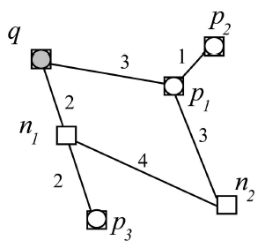
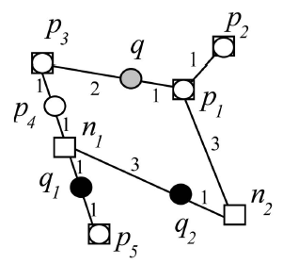
Types of RNN Queries
Restricted network: the query and data points can reside only on the nodes (e.g., P2P network)
Unrestricted network: the query and data points can reside anywhere on the edges (e.g., road network)
Reverse k nearest neighbor query RkNN(q)
Retrieves all the points that have q as one of their k nearest neighbors
Notes:
Node graph와 data point가 서로 분리되어 있는 형태를 가정. (flexible하기 때문)

Slide 6
Contributions
There is no previous work in the context of large graphs
Extensively studied only in Euclidean spaces
Two RNN methods are proposed
Eager algorithm: prune nodes as soon as they are visited
Lazy algorithm: prune the search space when a data point is discovered

Slide 7
Outline
Introduction
Preliminaries and Basic Algorithms
Optimizations
Experimental Evaluation
Conclusion

Slide 8
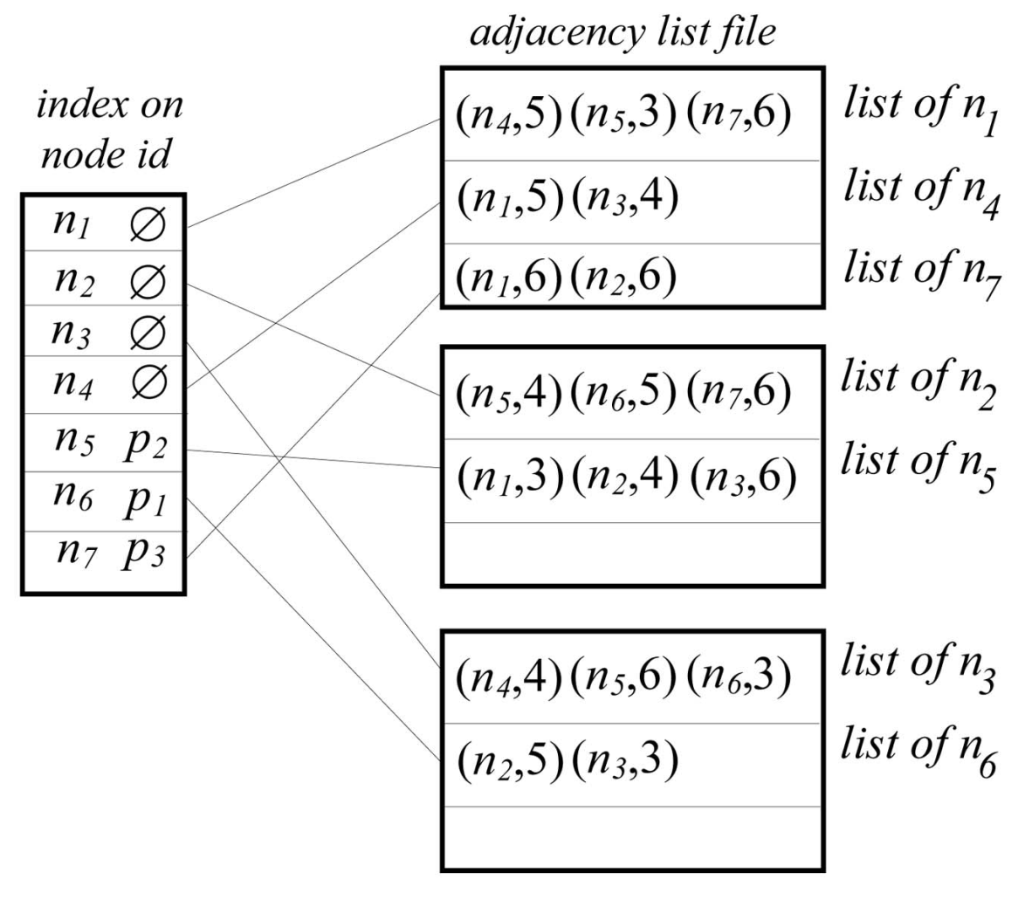
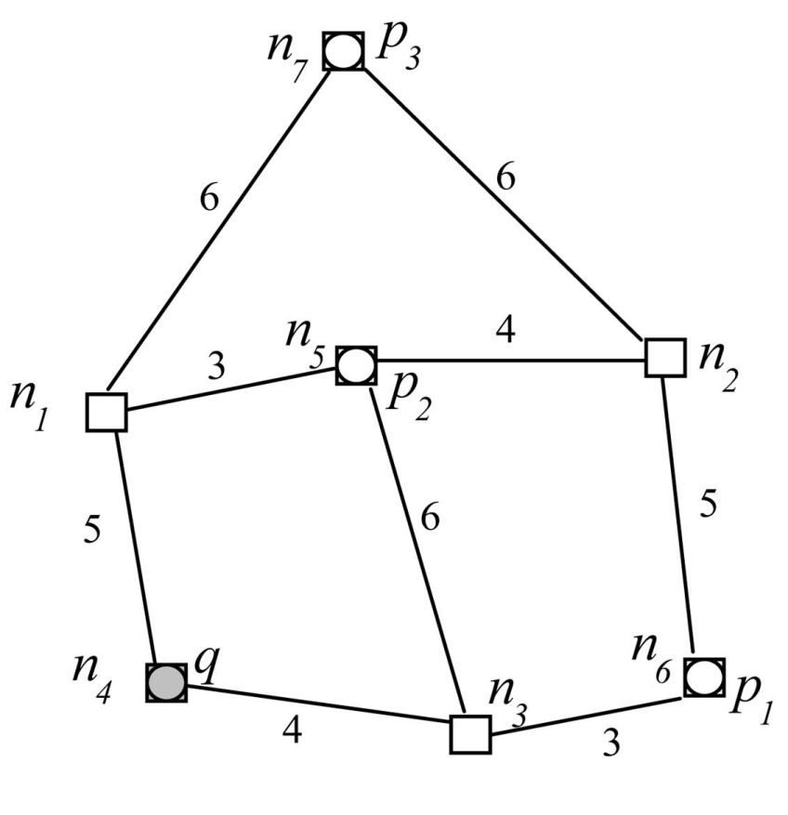
Graph Storage Scheme
Neighboring nodes (for I/O cost reduction)
Node ID
The data point contained by the node (if any)
disk page
Notes:
어떻게 그래프를 나누고 디스크 기반으로 저장하는지에 대해서는 다른 논문 인용.

Slide 9
Straightforward Algorithm
Naïve solution: check for each point if it has q as its NN
1. Traverse the network from q
2. Issue a NN query for each point p encountered
3. Verify whether p ∈ RNN(q)
Problems
RNN(q) does not have a fixed size
RNN(q) may contain points which are far from q

Slide 10
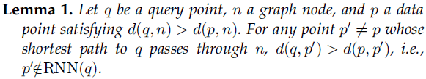
Fundamental Lemma
q
5
4
n
p'
3
p
We can minimize the extent of network traversal!

Slide 11
Eager Algorithm
Basic procedures
range-NN(n, k, e): retrieves the k nearest data points with dist. < e
verify(p, k, q): checks whether q is among the kNNs of a data point p
Example: k = 1
Heap content
< n₃, 4 >
< n₁, 5 >
range-NN(n₁, 1, 5)
q
4
verify(p₂, 1, q)
n₃
p₂
3
p₁
verify(p₁, 1, q)
No more expansion!
range-NN(n₃, 1, 4)
RNN(q) = { p₁, p₂ }
Notes:
RkNN의 경우라면, NN으로 확인된 data point의 개수가 k개가 되어야 expansion을 멈출 수 있음.

Slide 12
Eager Algorithm (cont’d)
1. Initialize a heap H by inserting the node containing q
2. De-heap a node n & execute range-NN query
3-1. ∃data point with dist. < d(n,q) → verify whether p ∈ RNN(q) (expansion stops if |kNN(q)| < k)
3-2. ￢∃ data point with dist. < d(n,q) → enheap the adjacent nodes of n
4. Repeat 2 & 3 until the heap is empty

Slide 13
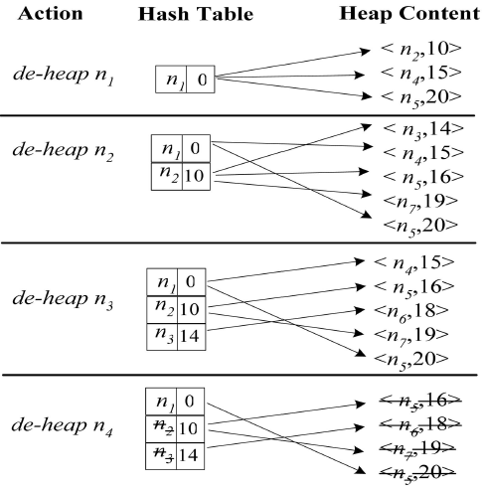
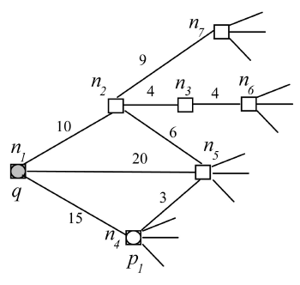
Lazy Algorithm
Eager algorithm may perform numerous local network expansions
For retrieving the nearest point p of a deheaped node
For verifying whether p ∈ RNN(q)
Example: k = 1
d(p₁, n₂) = 9 < d(q, n₂) = 10
verify(p₁, 1, q)
Notes:
RkNN의 경우라면, NN으로 확인된 data point의 개수에 따라
- 한 노드를 여러 번 방문하는 경우도 발생. (최대 k번)
- Data point를 포함하는 노드라도 expansion 필요.

Slide 14
Lazy Algorithm (cont’d)
1. Initialize a heap H by inserting the node containing q
2. De-heap a node n
3-1. The deheaped node n contains a data point → verify whether p ∈ RNN(q) (expansion stops if |kNN(q)| < k) prune the nodes encountered during verification if d(n_{i}, p) < d(n_{i}, q)
3-2. The deheaped node n does not contain a data point → enheap the adjacent nodes of n
4. Repeat 2 & 3 until the heap is empty

Slide 15
Outline
Introduction
Preliminaries and Basic Algorithms
Optimizations
Experimental Evaluation
Conclusion

Slide 16
Materialization for Eager Algorithm
Materializes the KNNs of each node to avoid local expansions
Each entry in the materialized list for node n: < p_{i}, d(p_{i}, n) >
In range-NN & verify, each node retrieves its KNNs directly
Naïve solution
Computes the K closest data points of all nodes
Proposed algorithm: all-NN
Expands the network only once
Worst-case time complexity: O(K·|E|·log(K·|E|))

Slide 17
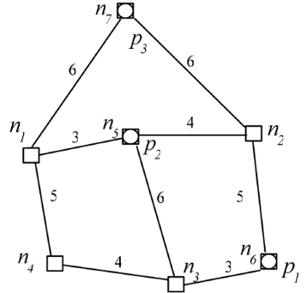
all-NN Materialization Algorithm
Example: k = 1
NN(n₇) = {p₃}
Heap content
< n₆, p₁, 0 >
< n₅, p₂, 0 >
< n₇, p₃, 0 >
< n₃, p₁, 3 >
< n₁, p₂, 3 >
NN(n₅) = {p₂}
< n₂, p₂, 4 >
< n₂, p₁, 5 >
NN(n₁) = {p₂}
NN(n₂) = {p₂}
< n₃, p₂, 6 >
< n₂, p₃, 6 >
< n₁, p₃, 6 >
< n₄, p₁, 7 >
< n₄, p₂, 8 >
NN(n₄) = {p₁}
NN(n₆) = {p₁}
NN(n₃) = {p₁}

Slide 18
Maintenance of Materialized Information
Insertion of a new data point p
Run a variation of all-NN algorithm that initializes H to <n, p, 0>, where n is the node containing p
Update the materialized NN if the new dist. < existing NN dist.
Deletion of a data point
More complex: all influenced nodes have to be modified
1st step: expands the network around p, removing p from the materialized lists of all nodes n for which p ∈ KNN(n)
The expansion stops at some border nodes, whose KNNs do not change
2nd step: completes the KNN list of all affected nodes using another expansion with 2nd heap H’

Slide 19
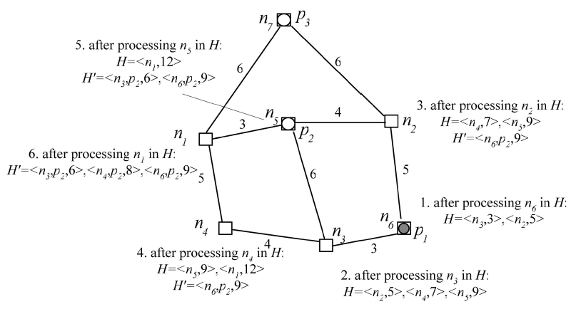
Deletion of a Data Point – 1st Step
Maintain another heap H’ for 2nd step
Border nodes
NN(n_{i}) = {p₁}

Slide 20
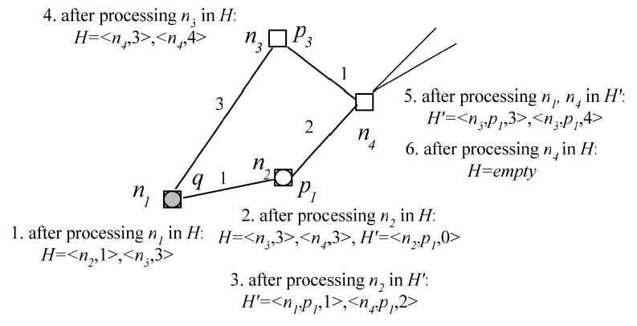
Extended Pruning for Lazy Algorithm
Example: k = 1
H: the distances between each node and the query point
H’: the distances between each node and other data points

Slide 21
Outline
Introduction
Preliminaries and Basic Algorithms
Optimizations
Experimental Evaluation
Conclusion

Slide 22
Experiment Settings
Dataset | # of nodes | # of edges
DBLP (co-authorship) | 4,260 | 13,199
BRITE (P2P network, simulation) | 90K~360K | avg. degree = 4
SF (grid maps) | 174,956 | 223,001
Avg. cost of workloads containing 50 random queries is measured
Pentium 4 CPU (2.3GHz)
Page size: 4Kb, LRU buffer size: 1Mb (256 pages)

Slide 23
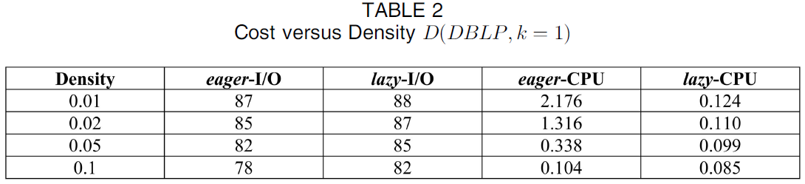
Experiment – DBLP
(unit: sec)
Low I/O cost
Low CPU cost
Density = (# of nodes) / (# of data points)
High density → low processing cost

Slide 24
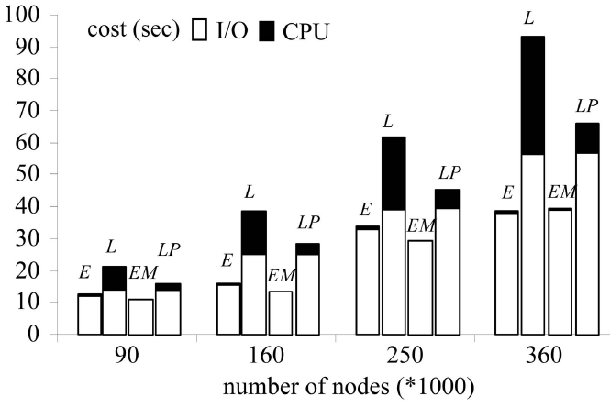
Experiment – BRITE (1)
* BRITE – http://www.cs.bu.edu/brite/

Slide 25
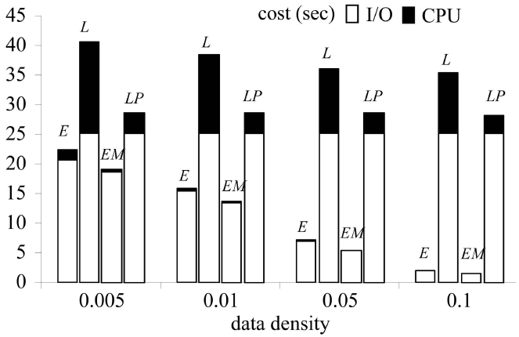
Experiment – BRITE (2)
Lazy & Lazy-EP visit most of the network
→ No pruning effect

Slide 26
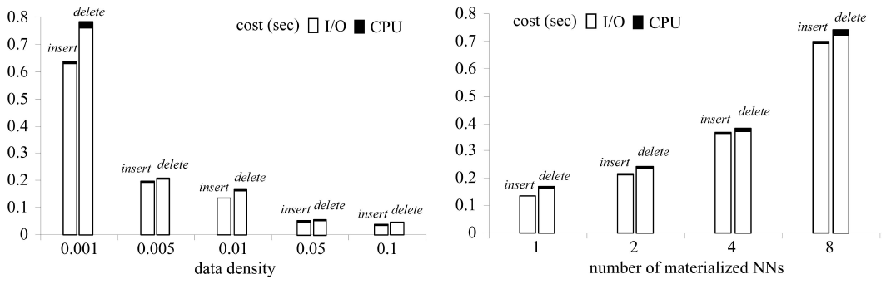
Experiment – SF (Materialization Update)
Increasing
update cost (but feasible)
Decreasing update cost

Slide 27
Outline
Introduction
Forward Processing
Backward Processing
Experimental Results
Conclusion

Slide 28
Conclusion
The first work that deals with RNN queries in large networks
Proposed techniques: Eager, Lazy, Eager-M, Lazy-EP
Eager-M is the best and most robust algorithm
Eager: low I/O cost vs. Lazy: low CPU cost
Future Work
Extensions to directed networks (asymmetric neighborhood relation)
Estimation of the cost and selectivity of RNN queries in large graphs

Slide 29
Thank You!
Any questions or comments?

