Slide 1
MapReduce Online
Tyson Condie, Neil Conway, Peter Alvaro, Joseph M.Hellerstein
UC Berkelery
Khaled Elmeleegy, Russell Sears
Yahoo! Research
NSDI 2010
13 April 2012
SNU IDB Lab.
Min Sup Lee

Slide 2
Outline
Introduction
Hadoop background
HOP Architecture
Online Aggregation
Stream Processing
Performance (blocking vs. pipelining)
Future work
Conclusion
Discussion

Slide 3

MapReduce?
A Popular framework for data-intensive distributed computing of batch jobs
Simple, strong fault tolerance model
Critical for large clusters

Slide 4
MapReduce Programming Model
Map step: Map(k1, v1) ‐> list(k2, v2)
Apply map function to input records
Assign output records to groups
Reduce step: Reduce(k2, list(v2)) ‐> list(v3)
Consolidate groups from the map step
Apply reduce function to each group

Slide 5
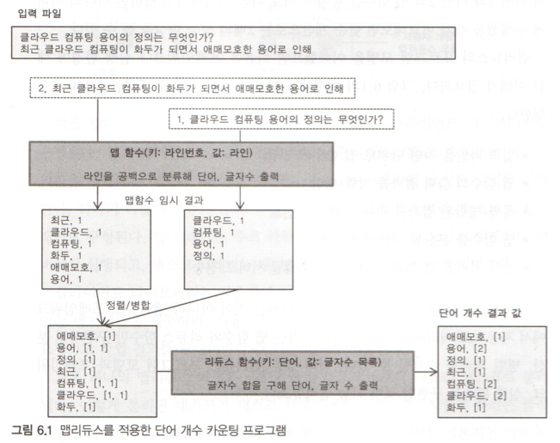
MapReduce Programming Model

Slide 6
MapReduce Programming Model
Shared-nothing architecture
Tuned for massive data parallelism
Many maps operate on portions of the input
Many reduces, each assigned specific groups
Batch-oriented computations over massive data
Execute on tens to thousands of machines
Runtimes range in minutes to hours

Slide 7
Isn’t it enough?
High latency
Hard to use for real-time analysis
Final answers only
No infinite streams

Slide 8
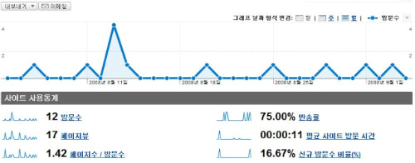
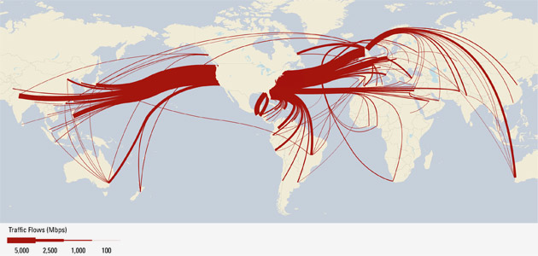
Beyond Batch
MapReduce often used for analytics on streams of data that arrive continuously
Click streams, Network traffic, web crawl data, …

Slide 9
MapReduce Online
Pipeline data between operators as it is produced
Decoupled computation schedule (logical) from data transfer schedule (physical)
Hadoop Online Prototype (HOP): Hadoop with pipelining support
Preserving the Hadoop interfaces and APIs
Challenge: retain elegant fault tolerance model
Enables approximate answers and stream processing
Can also reduce the response times of jobs
Notes:
파이프라이닝 가능하다.
실시간 가까이 비슷한 답을 얻는 것을 가능하게 함.

Slide 10
Outline
Introduction
Hadoop background
HOP Architecture
Online Aggregation
Stream Processing
Performance (blocking vs. pipelining)
Future work
Conclusion
Discussion

Slide 11
Hadoop Architecture
Hadoop MapReduce
Single master node, many worker nodes
Client submits a job to master node
Master splits each job into tasks (map/reduce), and assigns tasks to worker nodes
Hadoop Distributed File System (HDFS)
Single name node, many data nodes
Files stored as large, fixed-size (e.g. 64MB) blocks
HDFS typically holds map input and reduce output

Slide 12
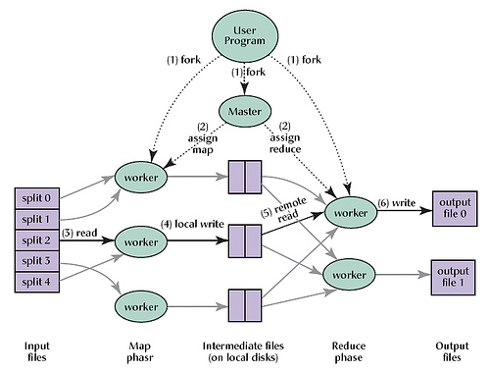
Hadoop Architecture

Slide 13
Job Scheduling
One map task for each block of the input file
Applies user-defined map function to each record in the block
Record = <key, value>
User-defined number of reduce tasks
Each reduce task is assigned a set of record groups
Record group = all records with same key
For each group, apply user-defined reduce function to the record values in that group
Reduce tasks read from every map task
Each read returns the record groups for that reduce task

Slide 14
Job Scheduling

Slide 15
Dataflow in Hadoop
Map tasks write their output to local disk
Output available after map task has completed
Reduce tasks write their output to HDFS
Once job is finished, next job’s map tasks can be scheduled, and will read input from HDFS
Therefore, fault tolerance is simple: simply re-run tasks on failure
No consumers see partial operator output

Slide 16
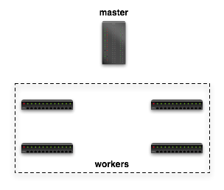

Dataflow in Hadoop
Submit job
map
schedule
reduce
map
reduce

Slide 17
Dataflow in Hadoop
Read
Input File
map
reduce
Block 1
HDFS
Block 2
map
reduce

Slide 18
Dataflow in Hadoop
Finished
Finished + Location
map
Local FS
reduce
map
Local FS
reduce

Slide 19
Dataflow in Hadoop
map
Local FS
reduce
HTTP GET
map
Local FS
reduce

Slide 20
Dataflow in Hadoop
Write Final Answer
reduce
HDFS
reduce

Slide 21
Outline
Introduction
Hadoop background
HOP Architecture
Online Aggregation
Stream Processing
Performance (blocking vs. pipelining)
Future work
Conclusion
Discussion

Slide 22
Hadoop Online Prototype
HOP supports pipelining within and between MapReduce jobs: push rather than pull
Preserve simple fault tolerance scheme
Improved job completion time (better cluster utilization)
MapReduce programming model unchanged
Clients supply same job parameters
Notes:
HOP는 파이프라이닝 지원가능하다.
Reduce 함수에서 map 함수의 결과를 pull하는 방식이 아니고,
Map함수에서 reduce함수로 결과를 바로 push하는 방식.
Fault tolerance는 그대로 유지.
수행시간은 짧게

Slide 23
Pipelining in Batch job
Initial design: pipeline eagerly (for each row)
Prevents use of combiner
Moves more sorting work to mapper
Map function can block on network I/O
Revised design: map writes into buffer
Spill thread: sort & combine buffer, spill to disk
Send thread: pipeline spill files => reducers
Notes:
저장하는 스레드와 보내는 스레드를 다른놈을 쓴다.

Slide 24
Fault Tolerance
Fault tolerance in MR is simple and elegant
Simply recompute on failure, no state recovery
Initial design for pipelining Fault tolerance:
Reduce treats in-progress map output as tentative
Revised design:
Pipelining maps periodically checkpoint output
Reducers can consume output <= checkpoint
Bonus: improved speculative execution

Slide 25
Dataflow in HOP
Schedule
Schedule + Location
map
reduce
Pipeline request
map
reduce

Slide 26
Outline
Introduction
Hadoop background
HOP Architecture
Online Aggregation
Stream Processing
Performance (blocking vs. pipelining)
Future work
Conclusion
Discussion

Slide 27
Online Aggregation
Pipelining means that data is available at consumers “early”
Can be used to compute and refine an approximate answer
Often sufficient for interactive data analysis, developing new MapReduce jobs, ...
Within a single job: periodically invoke reduce function at each reduce task on available data
Between jobs: periodically send a “snapshot” to consumer jobs

Slide 28
Single-job Online Aggregation
Approximate answers published to HDFS by each reduce task
Based on job progress: e.g. 10%, 20%, …
Challenge: providing statistically meaningful approximations
How close is an approximation to the final answer?
How do you avoid biased samples?

Slide 29

Online Aggregation in HOP
Read
Input File
map
reduce
Block 1
HDFS
HDFS
Block 2
map
reduce
Write Snapshot
Answer

Slide 30
Multi-job Online Aggregation
Like Single-job OA, but approximate answers are pipelined to map tasks of next job
Requires co-scheduling a sequence of jobs
Consumer job computes an approximation
Can be used to feed an arbitrary chain of consumer jobs with approximate answers
Challenge: how to avoid redundant work

Slide 31
Multi-job Online Aggregation
Write Answer
reduce
map
HDFS
reduce
map
Job 1 Reducers
Job 2 Mappers

Slide 32
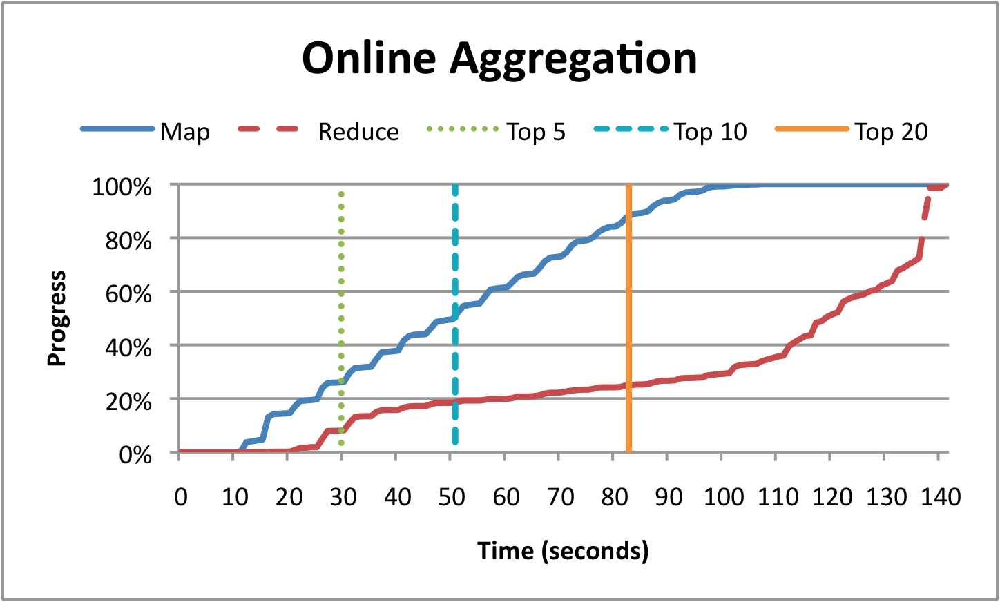
Evaluation in Online Aggregation
Top K most-frequent-words in 5.5GB Wikipedia corpus (implemented as 2 MR jobs)
60 node EC2 cluster

Slide 33
Outline
Introduction
Hadoop background
HOP Architecture
Online Aggregation
Stream Processing
Performance (blocking vs. pipelining)
Future work
Conclusion
Discussion

Slide 34

Stream Processing
MapReduce is often applied to streams of data that arrive continuously
Click streams, network traffic, web crawl data,…

Slide 35
Why?
Why use MapReduce for stream processing?
Many existing MR use cases are a good fit
Ability to run user-defined code
Massive scale + low-latency analysis
Use existing MapReduce tools and libraries
Notes:
이미 사용하고 있는 맵리듀스들의 방법들이 잘 맞을수 있다라는 것.
대용량 처리 + 지연이 적은 분석 필요!!
기존의 맵리듀스 툴, 라이브러리 사용 가능.

Slide 36
Stream Processing with HOP
Map and reduce tasks run continuously
Map tasks stream spill files
Input taken from arbitrary source
MapReduce job, TCP socket, log files, etc.
Window management done at reducer
Reduce output is an infinite series of windowed results
Window boundary based on time, record counts, etc.
Notes:
Continuous 맵리듀스 잡 구현은 그리 어렵지 않았다.
Flush API만 추가!

Slide 37
Real-time Monitoring System
Agents monitor machines
Implemented as a continuous map task
Record statistics of interest
Aggregators group agent-local statistics
Implemented as reduce tasks
Aggregate statistics along machine, datacenter
Reduce windows : 1, 5, and 15 second load averages

Slide 38
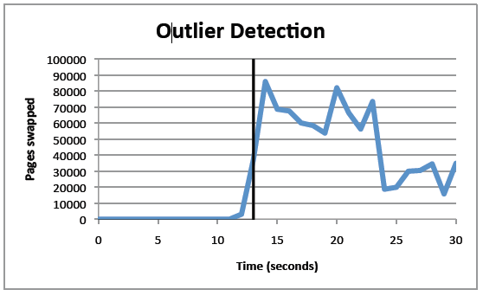
Real-time Monitoring System
Alert reported around a second after passing threshold
Notably faster than the 5-second TaskTracker reporting interval

Slide 39
Stream Processing Challenges
How to store stream input?
HDFS is not ideal
Fault tolerance for long-running tasks
Operator restart increasingly expensive
Elastic scale-up / scale-down during MR job

Slide 40
Outline
Introduction
Hadoop background
HOP Architecture
Online Aggregation
Stream Processing
Performance (blocking vs. pipelining)
Future work
Conclusion
Discussion

Slide 41
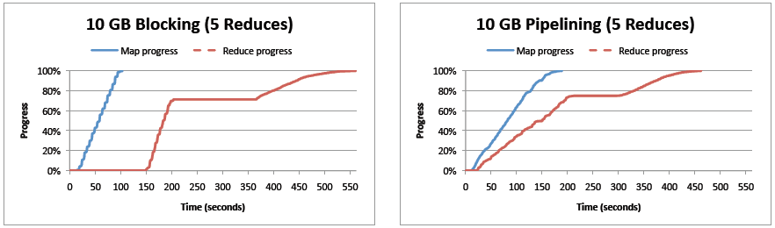
Performance comparison
A 10GB wordcount job using 20map tasks, 5 reduce tasks
(512MB block size)
561 seconds VS. 462 seconds

Slide 42
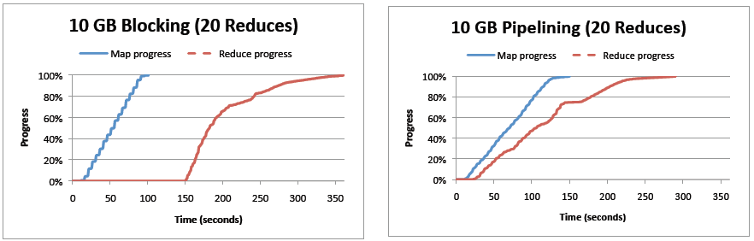
Performance comparison
A 10GB wordcount job using 20map tasks, 20 reduce tasks
(512MB block size)
361 seconds VS. 290 seconds

Slide 43
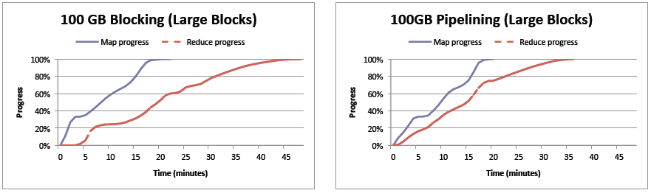
Performance comparison
A 100GB wordcount job using 240 map tasks, 60 reduce tasks
(512MB block size)
48 minutes VS. 36 minutes

Slide 44
Outline
Introduction
Hadoop background
HOP Architecture
Online Aggregation
Stream Processing
Performance (blocking vs. pipelining)
Future work
Conclusion
Discussion

Slide 45
Future work
Basic pipelining
Performance analysis at scale (e.g. PetaSort)
Job scheduling is much harder
Online Aggregation
Statically-robust estimation
Better UI for approximate results
Stream Processing
Develop into full-fledged stream processing engine
Stream support for high-level query languages

Slide 46
Outline
Introduction
Hadoop background
HOP Architecture
Online Aggregation
Stream Processing
Performance (blocking vs. pipelining)
Future work
Conclusion
Discussion

Slide 47
Conclusion
Designed HOP(Hadoop Online Prototype)
Implement pipelining on MapReduce programming model
Shorter job completion time
“Early returns” on long-running jobs

Slide 48
Outline
Introduction
Hadoop background
HOP Architecture
Online Aggregation
Stream Processing
Performance (blocking vs. pipelining)
Future work
Conclusion
Discussion

Slide 49
Discussion
Strong points
Showed the possibility of real-time processing
Weak points
Supposed to be Peta bytes

Slide 50
Thank you

