Slide 1
Social Tagging-Based Exploratory Search Management System
Last Update on September 29, 2011
Kang-Pyo Lee
IDB Tagging Team, School of CSE, SNU
Co-work with Prof. H. G. Kim & Dr. S. S. Choi

Slide 2
Main Theme
How to improve exploratory search
by leveraging the collective intelligence
from social tagging
in a metacognitive framework

Slide 3

What is exploratory search?
A search that requires user’s exploratory investigation and active learning
Motivated by circumstances that
The user wants to know around a topic, not looking for a single answer
The user does not know appropriate keywords as queries
The answers are usually not found in a single document
Users need to iteratively refine their search activities and integrate the information they collected
VIPS가 몇 시까지
하더라?
기상이변으로 세계 곳곳에서 어떤 일들이 일어나고 있지?
Vs.
이번 월트디즈니 특별전에서 할인 받으려면?
정치권의 보수와 진보 세력간의 갈등의 역사가 궁금하네.

Slide 4
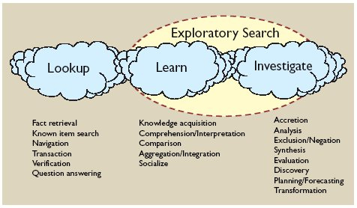
Learning and investigative search require strong human participation in a more continuous and exploratory process
To support the full range of search activities
CHI developments for bringing humans more actively into search
Interactive IR views the search problem from the vantage of an active human with
information needs
information skills
powerful digital library resources
situated in global and locally connected communities
all of which evolve over time
Highly interactively user interfaces that continuously engage human control over the information seeking process
[Marchionini, CACM’06]

Slide 5
Fields around the exploratory search
Cognitive
IR
Traditional IR
CHI
Interactive
IR

Slide 6
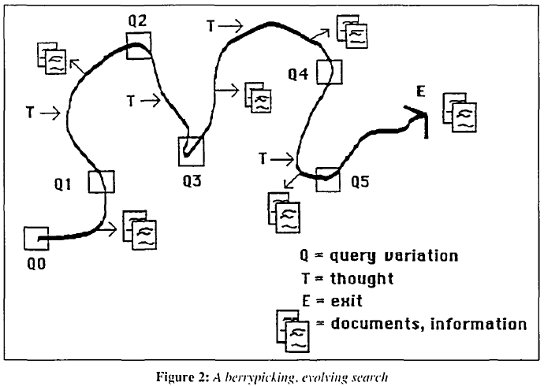
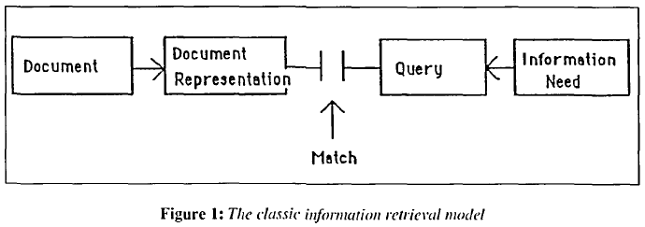
Berrypicking model
By Marcia Bates in 1989
Previous models were strictly linear and did not incorporate cognitive questions (e.g. a simple linear match between a query & a document)
A bit-at-a-time retrieval like picking huckleberries or blueberries in the forest
The focus is the match between
the document and query representations
The focus is the sequence
of searcher behaviors

Slide 7
An example scenario from [Qu & Funas, IPM’08]
Ying, a newly arrived student, wants to choose a bottle of wine (fairly new to her) for her friend’s birthday
turns to a Web search engine, starting with a general query, “wine”
discovers there are various interrelated subtopics of interest
e.g. the history of wine, the wine making process, the paring of food with wines, etc.
makes a list of subtopics she wants to learn more about, then formulates more specific queries
proceeds to make sense of each in turn
finds some wines appropriate as birthday gifts
⇒ Her explorations continue in search-understanding-decision-making cycles until she feels she has enough knowledge

Slide 8
Initial query formulation
Usually consists of a target term (mandatory) plus its features (optional)
E.g., q₀: “nice wine gifts”
Query reformulation (refinement) types
Term addition (for topic specification or generalization)
E.g., q₁: “nice french wine gifts”
Term switch
E.g., q₂: “popular french wine gifts”
Term removal
E.g., q₃: “popular wine gifts”
Term regression (for returning to the previous results)
E.g., q₄: “popular french wine gifts”
target
features

Slide 9

I want to find some nice wines as birthday gifts
The initial state of
information need
q₀: nice wine gifts
Oh, there are a lot of French wines! >.<
Term addition
q₁: nice french wine gifts
I’d better look for popular French wines.
Term switch
q₂: popular french wine gifts
My previous query result was the best!
Term removal &
regression
q₃: nice french wine gifts
Ok, now I’m happy to get enough information about wines!
The goal state of
resolution

Slide 10
Information Search Process (ISP) in [Kuhlthau, JASIS’91]
Stages in ISP | Task | Thoughts
1. (Task) Initiation | Merely recognize a need for information | Contemplating the problem, comprehending the task, and relating the problem to prior experience and knowledge
2. (Topic) Selection | Identify and select the general topic to be investigated or the approach to be pursued | Weighing perspective topics against the criteria of personal interest, assignment requirements, information available, and time allotted
3. (Prefocus) Exploration | Investigate information on the general topic in order to extend personal understanding | Becoming oriented and sufficiently informed about the topic to form a focus or a personal point of view
4. (Focus) Formulation | Form a focus from the information encountered | Identifying and selecting ideas in the information from which to form a focused perspective of the topic
5. (Information) Collection | Gather information related to the focused topic | Defining, extending, and supporting the focus
6. Presentation (Search Closure) | Complete the search and prepare to present or otherwise use the findings | Culminating the search with a personalized synthesis of the topic or problem

Slide 11
Exploratory Information Search Process (EISP)
1. Initiation
2. Selection
3. Exploration
4. Formulation
Iterative
Cycle
5. Collection
6. Presentation

Slide 12
Tagging-based EISP
1. Initiation
2. Selection
3. Exploration
4. Formulation
Iterative
Cycle
5. Collection
Tagging
6. Presentation
Conceptual Tag Cloud

Slide 13
Tagging-based EISP
Information
Need
Iterative Cycle
Querying
Investigation & Learning
Tagging
Constructing a Conceptual
Tag Cloud
Resolution

Slide 14
What is metacognition?
Thinking about thinking
“deliberate, planned, intentional, goal-directed, and future-oriented mental behavior that can be used to accomplish cognitive goals” (Flavell, 79)
“thinking that enables students to know themselves, the task at hand and the strategies to employ” (Haycock, 04)
Students who can thus control and monitor their activities are more likely to be successful in their learning
Much of the foundational research on metacognition has been in the area of children and education
Specifically in reading, writing, math, and science

Slide 15
Two distinct, albeit interrelated, aspects to metacognition: control process and metacognitive knowledge
Control process
Referred to as executive control, self-monitoring, and self-regulation
Reflects the application of strategies to control and coordinate aspects of metacognitive knowledge
Metacognitive knowledge
The knowing that certain strategies work better than others or that certain tasks might be easier to perform
Three interrelated components
Self-knowledge (awareness of one’s own cognition, including knowledge of one’s strengths & weaknesses and the awareness of one’s motivational beliefs)
Task knowledge (knowledge about the cognitive demands of the task)
Strategic knowledge (procedural knowledge of cognitive strategies to employ when unsuccessful)

Slide 16
Roles of metacognition in EISP [Liu & Chong, ASIST’11]
There may be two counteracting forces at play throughout the process of interactive searching
1) “Conceptual drifting”
the natural tendency of drifting away from the initial search focus
2) “Metacognitive behavior”
the user’s conscious effort of keeping the interactive search process on course in relation to the initial search question or information need

Slide 17
Classification of metacognitive skills for web searching in [Gorrell et al., JD’09]
 | Memory | Comprehension | Search task | Search Technology
Schema training | The subject has a variety of methods available to them to help them recall the information and where they found it. | The subject has methods to help them understand the information they find, monitor comprehension and correct comprehension failures. | The subject knows methods for finding information, assessing relevance and assessing task completion/thoroughness of topic exploration. | The subject understands the technology and has a good mental model of the internet.
Planning | The subject plans how they will record the results of their information search and any useful tricks they learn along the way | The subject plans to use methods such as summarization in order to monitor and improve their comprehension | The subject plans what information they need to find and assesses task completion on that basis. They might plan to check particular factual information with a number of sites to verify reliability | The subject plans use of search technology. They plan which sources they might use, and can explain their choice. They know which search engines are appropriate to the task
Monitoring | The subject assesses their note-taking/similar for its efficacy during task execution and changes if necessary. Are they remembering everything they need to? Are they recording the information in a useful form? | The subject is aware of the extent to which they are understanding what they read, and invokes correction strategies if necessary. The subject correctly determines document relevance | The subject is aware of their progress in completing the task and the reliability and relevance of the information they have found. They switch strategies if necessary to correct any issues | The subject assesses the efficacy of the technology/sources/search strategies they are using and switches if necessary. The subject detects and determines the cause of errors and low efficacy, and takes corrective action
Evaluation (Criticality) | The subject critically evaluates their note-taking and use of memory strategies and draws conclusions for future use | The subject critically evaluates their comprehension and the comprehensibility of the sources they find and draws conclusions for future use | The subject critically evaluates their search, the relevance of what they found and the usefulness of the sources, and draws conclusions for future use | The subject critically evaluates their search method and use of technology/sources and draws conclusions for future use
Transfer | The subject carries learning from other tasks into their decisions regarding how they will remember information. The subject carries learning from this task into other tasks in the future. | The subject carries learning from other tasks into their decisions regarding how they will monitor and improve their comprehension. The subject carries learning from this task into other tasks in the future. | The subject carries learning from other tasks into their decisions regarding how they will monitor and improve their search task success. The subject carries learning from this task into other tasks in the future | The subject carries learning from other tasks into their use of sources and technology. The subject carries learning from this task into other tasks in the future

Slide 18
Main Idea
System should be able to aid
users’ metacognitive activities
during exploratory search

Slide 19
Three Questions
1. How can our search management system
support users’ metacognition during the exploratory search process?
2. How can users present their knowledge
structures learned from searching?
3. How can we evaluate the efficacy of our search management system?

Slide 20
Assumption about querying & tagging
Querying & tagging are basically the same activity
Both are using keywords to describe something
Querying can be considered a special form of tagging aimed at web resources that may be relevant but unidentified yet
The difference is that the searcher does not know about the content of the resource while the tagger knows about it
 | Query terms (in exploratory search) | Tag terms
Word usage | General & vague words | Specific & clear words
 | All terms are essential | Not all terms are essential
# of terms | Small (less than 4 or 5) | Depends on person & resource

Slide 21
Social tagging & exploratory search
“Social tags are arguably more important in exploratory search, in which the users may engage in iterative cycles of goal refinement and exploration of new information (as opposed to simple fact retrievals), and interpretation of information contents by others will provide useful cues for people to discover topics that are relevant” [Fu et al., IUI’10]
Intuition
It is beneficial for the searcher (who does not know the answer) to be guided to follow the keyword usage patterns, rather than keywords themselves, of the taggers (who already know the answer)
⇒ following the footprints left by the others who have walked the road to the summit
Based on collective intelligence on the web

Slide 22
Assumption
An overall process of querying
is heading towards a perfect query,
though there might be some trial and error halfway

Slide 23
In normal search circumstances, we have very limited clues during a search process
1. a series of queries
2. a set of documents clicked by user
Additionally, our system possesses two more clues
3. a set of user’s tag assignments
4. a Conceptual Tag Cloud
With these four clues, we should be able to
identify the target and feature query terms
measure the coherency of user’s search process
evaluate the efficacy of our metacognitive supports

Slide 24
Tag Cloud
A cloud of top-k popular tags
Tags are sorted by alphabet or frequency
The font size of each tag is determined by its frequency
Each tag refers to the resources that are annotated with the tag
No relationship between tags
Conceptual Tag Cloud
A tag cloud that represents user’s knowledge structure
Two tags are linked by user like topic map, mind map, or concept map
Possible to provide not only user’s bookmarks but also the user’s knowledge structures
A novel information management system that integrates the information on the web with user’s knowledge structure

Slide 25
Tag Cloud vs. Conceptual Tag Cloud
business education food franchise history howto pregnancy shop safe tasting wine
wine
food
howto
tasting
pregnancy
safe
business
franchise
shop
history
education

Slide 26
Thank You!
Any Questions or Comments?

