Slide 1
An Effective Recommendation Method for Cold Start New Users using Trust and Distrust Networks
Chien Chin Chen et al., National Taiwan Univ.
Information Sciences 2013
13 February 2013
Hyunwoo Kim

Slide 2
Outline
Introduction
Methodology
Experiments
Conclusion
Discussion

Slide 3



Introduction [1/3]
Cold start problem in recommender systems
User-item rating matrix
Items
1
2
3
4
5
6
7
8
9
10
User 1
 | 4 | 1 | 3 | 2 | 5
 | 4 | 2 | 3 | 1 |  | 4
 |  |  |  |  |  |  |  | 5
User 2
User 3
User
User 4
Rating matrix
Recommendation
Similar users
item
item
item

Slide 4
Introduction [2/3]
Definition of trust
“A subjective expectation an agent has about another’s future behavior based on the history of their encounters”
USER SIMILARITY
No direction, symmetric
TRUST RELATIONSHIP
Asymmetric relationship, propagation
* Mui et al. “A computational model of trust and reputation” HICSS 2002

Slide 5

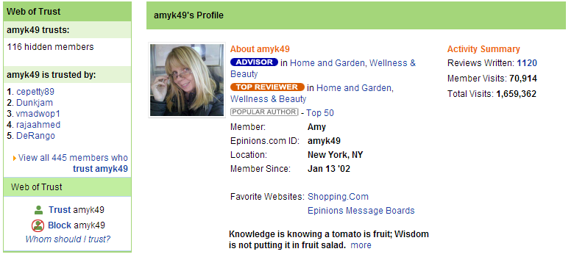
Introduction [3/3]
Epinions.com
Web of Trust

Slide 6
Outline
Introduction
Methodology
Experiments
Conclusion
Discussion

Slide 7

Methodology [1/6]
Identify trustworthy users
Cold start users
Trustworthy users

Slide 8
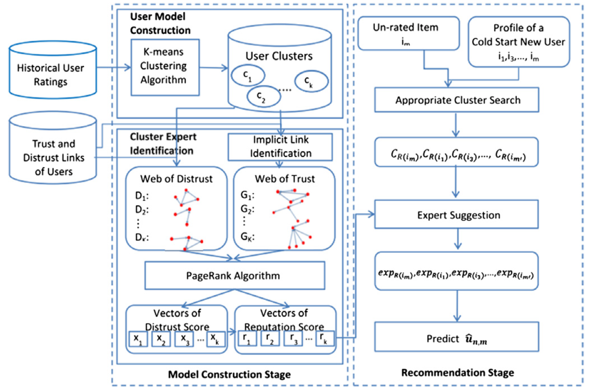
Methodology [2/6]
System architecture

Slide 9
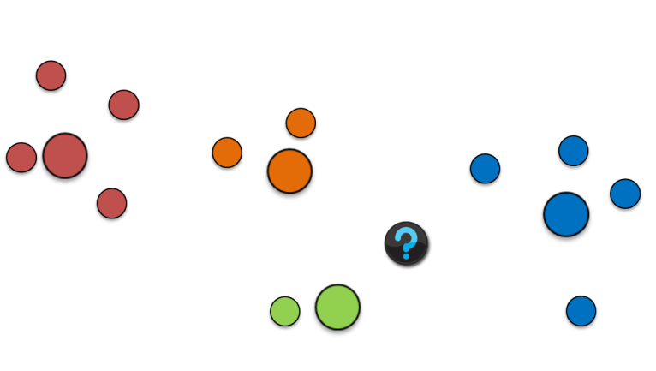
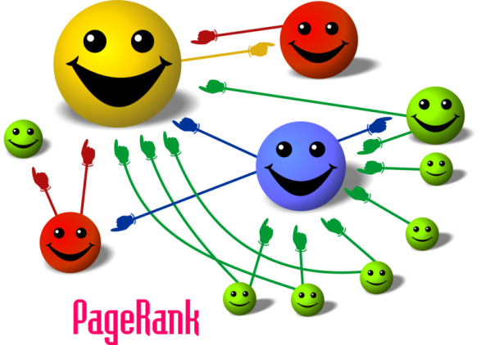
Methodology [3/6]
Model construction stage
Trust
Distrust
User Model Construction
Implicit Link Identification
K-means clustering
Cluster Expert Identification
PageRank Algorithm

Slide 10
Methodology [4/6]
Implicit link identification
?
item
item
5
item
# of rated items > threshold
Average ratings > threshold
item
4
item
trust!
item

Slide 11

Methodology [5/6]
Recommendation stage

Slide 12
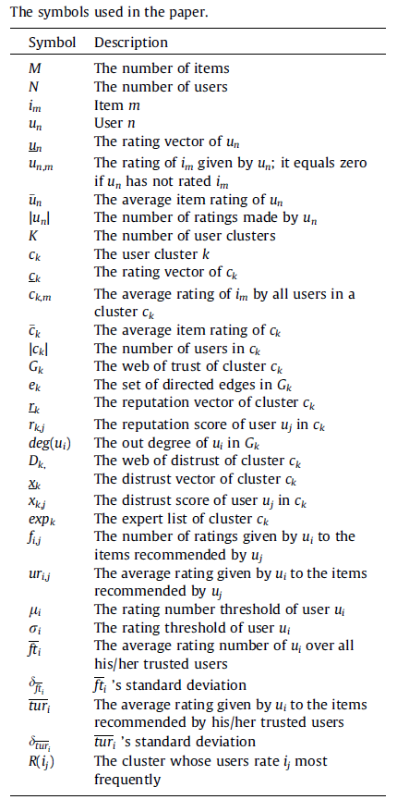



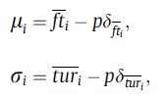


Methodology [6/6]

Slide 13
Outline
Introduction
Methodology
Experiments
Conclusion
Discussion

Slide 14
Experiments [1/3]
Dataset
Epinions
132,000 users
1,560,144 reviews
13,668,319 review ratings
717,667 trust relations
120,718 distrust relations
71,073 cold start new users (less than 5 ratings)
Method
Leave-one-out procedure

Slide 15
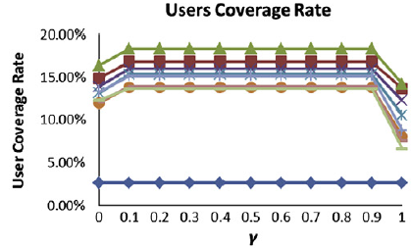
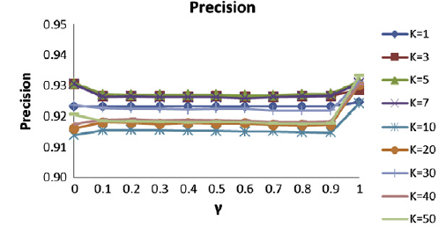
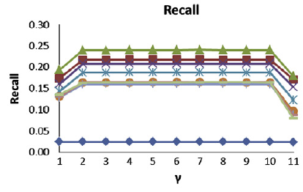
Experiments [2/3]
Overall system performance
γ weights the experts of the item
and the experts of the user’s profile
High precision
Low users coverage rate and recall

Slide 16
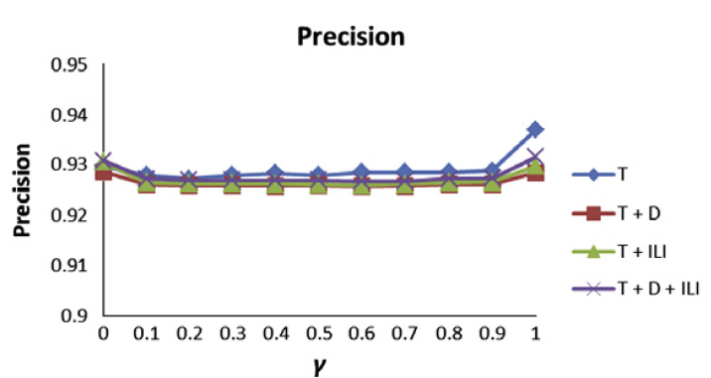
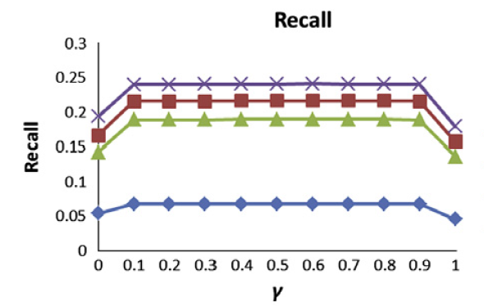
Experiments [3/3]
The web of distrust and implicit link identification
Implicit link identification discovers meaningful relationships between users
The web of distrust is effective in improving the selection of cluster experts
Two techniques have little effect on the precision rate and MAE
Our method identifies trustworthy experts

Slide 17
Outline
Introduction
Methodology
Experiments
Conclusion
Discussion

Slide 18
Conclusion
Research on new user cold start recommendation
The key to the success of e-services and e-commerce systems
A new user cold start recommendation method
Analyzing the social relationships of e-commerce users
Identifying trustworthy experts
Providing useful recommendation
Future work
Online user studies
Implicit feedback patterns will be analyzed

Slide 19
Outline
Introduction
Methodology
Experiments
Conclusion
Discussion

Slide 20
Discussion
Strong point
Well-organized paper
Weak point
Mathematical analysis
Experimental results

