Slide 1
The YouTube Video Recommendation System
James Davidson
Benjamin Liebald
Junning Liu
Palash Nandy
Taylor Van Vleet
@Google
ACM RecSys 2010
26 Dec. 2013
SNU IDB Lab.
Lee, Inhoe

Slide 2
Outline
Introduction
System Design
Input Data
Related Videos
Generating Recommendation Candidates
Ranking
System Implementation
Evaluation
Results
Conclusions

Slide 3
Introduction
Personalized recommendations are key method
Information retrieval
Content discovery in information-rich environment
YouTube is world’s most popular video site
Video recommendation system
Signed in user
Previous activity
Notes:
Personalized recommendations are a key method for information retrieval and content discovery in today’s information-rich environment.

Slide 4
Goal
Help users find high quality videos relevant to their interest
Top-N recommender rather than a predictor
How we evaluate success of this system
Maintain user privacy and provide explicit control

Slide 5
Challenges
No or very poor metadata
Short form (under 10mins)
User interaction short and noisy
Compare to interaction with Netflix or Amazon
Short life cycle

Slide 6
System Design
Recent and fresh
Diverse and relevant to user’s recent action
Why a video was recommended
Personal activity
Watched, favorited, liked

Slide 7
Input Data
Content data
Raw video streams and video metadata
Title, description
User activity data
Explicit: rating, favoriting, liking, subscribing
Implicit: how large portion of video watched
Notes:
But data is quite noisy.
Long-watch 받기 전에 browser close하는 경우도 있고함

Slide 8
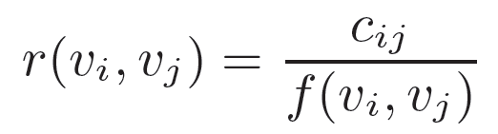
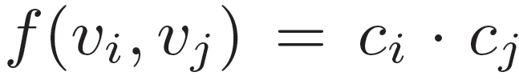
Related Videos
Mapping from a video (vi) to a set of related videos(Ri)
Association rule or co-visitation counts
Directed graph (vi, vj)
Notes:
how often they were co-watched within sessions (24h)
ci and cj are the total occurrence counts across all sessions
f(vi, vj) is a normalization function
simplest normalization functions
impose a minimum score threshold.

Slide 9
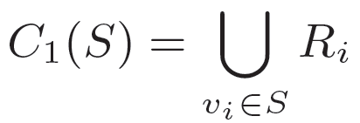
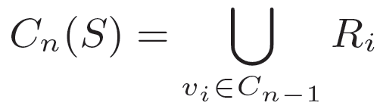
Generating Recommendation Candidates
Combine the related videos association rules with a user’s personal activity
seed set S,
Notes:
To compute personalized recommendations
we Combine the related videos association rules with a user’s personal activity
seed set S, (watched, liked, rated, favorited, added)
we expand it along the edges of the related videos graph For each video vi in the seed set consider its related videos Ri.
We denote the union of these related video sets as C1:
C1 is sufficient
reachable within a distance of n from any video in the seed set:
high branching factor of the related videos graph

Slide 10
Ranking
1) Video quality
View count, rating, commeting, favoriting, sharing activity
2) User specificity
User’s unique taste, user’s watch history
3) Diversification
Using a linear combination of these signals we generate a ranked list of candidate videos
Notes:
After the generation step has produced a set of candidate videos they are scored and ranked using a variety of signals.
Most relevant videos 고르기보단, balance btw relevancy and diversity across categories 고려하여 optimize해서 display
Since user는 보통 multiple different topic에 흥미가 있기 때문에
이렇게 하기 위해서 한 single seed로부터 나올 수 있는 recommendation의 숫자를 제한 하거나 same channel에서 나오는 거를 제한하거나. Topic clustering 을 해서

Slide 11
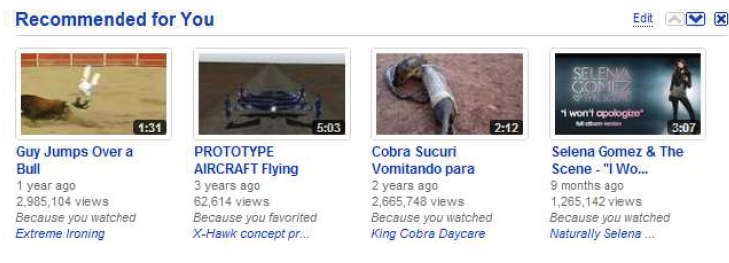
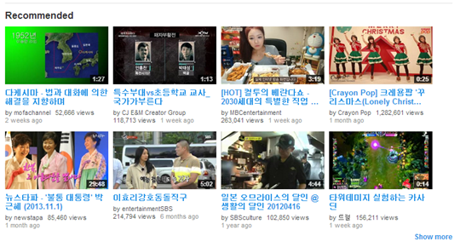
User Interface

Slide 12
System Implementation
batch-oriented pre-computation approach
1) Data collection
2) Recommendation generation
3) Recommendation serving
Input data stored in a Bigtable
Recommendation are generated through a series of MapReduces computations
Notes:
batch-oriented pre-computation approach rather than on-demand calculation of recommendations.
significant downside of this approach is the delay between generating and serving a particular rec-ommendation data set. We mitigate this by pipelining the recommendation generation, updating the data sets several times per day.
These logs are processed, signals extracted, and then stored on a per user basis in a Bigtable
Recommendations are generated through a series of MapReduces computations

Slide 13
Evaluation
A/B testing
Metric
Click through rate (CTR)
Long CTR (watches of substantial fraction of the videos)
Notes:
A/B testing
diverted into distinct groups where one group acts as the control or baseline and
the other group is exposed to a new feature,
swapped for another period of time to eliminate other factors.
Click-through rate (CTR) is a way of measuring the success of an online advertising campaign for a particular website as well as the effectiveness of an email campaign by the number of users that clicked on a specific link
The click-through rate is the number of times a click is made on the advertisement divided by the total impressions (the times an advertisement was served):

Slide 14
Results
60% of all video clicks from the home page
Notes:
measured CTR for these sections over a period of 21days.
we find that co-visitation based recommendation performs at 207% of the baseline Most Viewed page when averaged over the entire period,

Slide 15
Conclusions
Video recommendation system in use at YouTube
Users based on their activity on the site
Very successful
Other normalization functions
E. Spertus, M. Sahami, and O. Buyukkokten. Evaluating similarity measures: a large-scale study in the orkut social network. In KDD ’05, pages 678–684, New York, NY, USA, 2005. ACM.

