Slide 1
Chapter 10 – Discriminant Analysis
Data Mining for Business Intelligence
Shmueli, Patel & Bruce
© Galit Shmueli and Peter Bruce 2008

Slide 2
Discriminant Analysis: Background
A classical statistical technique
Used for classification long before data mining
  Classifying organisms into species
  Classifying skulls
  Fingerprint analysis
And also used for business data mining (loans, customer types, etc.)
Can also be used to highlight aspects that distinguish classes (profiling)

Slide 3
Small Example: Riding Mowers
Goal: classify purchase behavior (buy/no-buy) of riding mowers based on income and lot size
Outcome: owner or non-owner (0/1)
Predictors: lot size, income

Slide 4
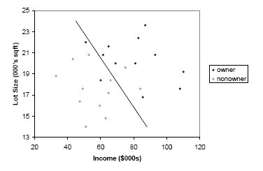
Can we manually draw a line that separates owners from non-owners?

Slide 5
Example: Loan Acceptance
In the prior small example, separation is clear
In data mining applications, there will be more records, more predictors, and less clear separation
Consider Universal Bank example with only 2 predictors:
Outcome: accept/don’t accept loan
Predictors:
  Annual income (Income)
  Avg. monthly credit card spending (CCAvg)

Slide 6
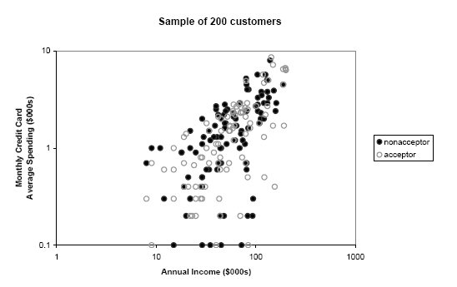
Sample of 200 customers

Slide 7
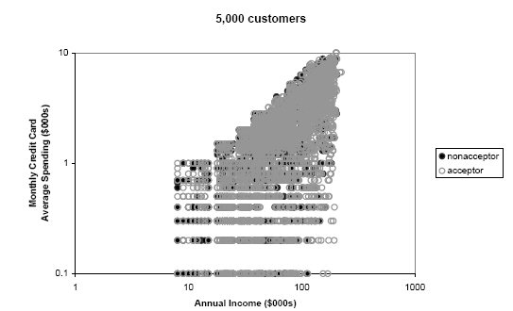
5000 customers

Slide 8
Algorithm for Discriminant Analysis

Slide 9
The Idea
To classify a new record, measure its distance from the center of each class
Then, classify the record to the closest class

Slide 10
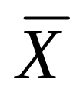
Step 1: Measuring Distance
Need to measure each record’s distance from the center of each class
The center of a class is called a centroid
The centroid is simply a vector (list) of the means of each of the predictors. This mean is computed from all the records that belong to that class.

Slide 11

Step 1: Measuring Distance – cont.
A popular distance metric is Euclidean Distance (used with KNN). We can use it to measure the distance of a record from a class centroid:
Drawbacks:
  Sensitive to scale, variance (can normalize to correct)
  Ignores correlation between variables

Slide 12

Instead, use
“Statistical (Mahalanobis) Distance”
transpose (convert column to row)
inverse of covariance matrix S
(p-dimension extension of division)
For a single predictor (p=1), this reduces to a z-score
When p > 1, statistical distance takes account of correlations among predictors (z-score doesn’t)

Slide 13
Step 2: Classification Functions
The idea is to create classification score that reflects the distance from each class
This is done by estimating “classification functions”, that are a function of the statistical distances.
The estimation maximizes the ratio of between-class to within-class variability
Fisher’s linear classification functions: one for each class. Used to compute a classification score.
Classify a record to class with highest score

Slide 14
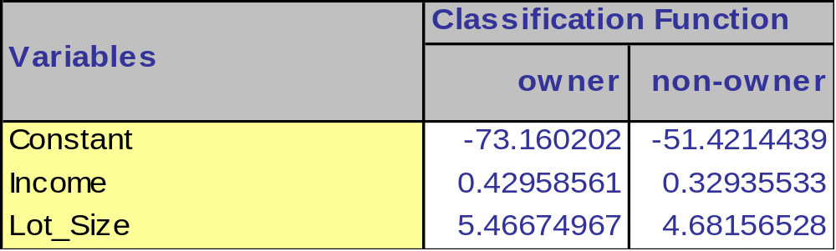
Classification Functions
(XLMiner output)
record #1: income = $60K, lot size = 18.4K
Owner score = -73.16 + (0.43)(60) + (5.47)(18.4) = 53.2
Non-owner score= -51.42+(0.33)(60)+(4.68)(18.4)= 54.48
“Non-owner” score is higher → (mis)classify as non-owner

Slide 15
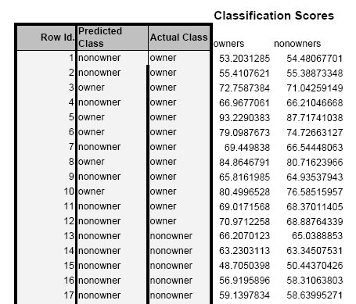
Classification scores for part of Mowers data

Slide 16

Step 3: Converting to Probabilities
It is possible to convert classification scores to probabilities of belonging to a class:
The probability is then compared to the cutoff value in order to classify a record
Probability that record i (with predictor values x1, x2, …xp) belongs to class k

Slide 17
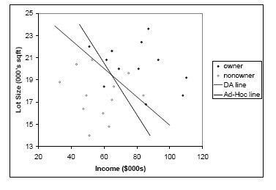
Line from model (plus ad-hoc line)
model
Ad-hoc

Slide 18
Assumptions & Caveats of Discriminant Analysis
Assumes multivariate normality of predictors
  When this condition is met, DA is more efficient than other methods (i.e. needs less data to obtain similar accuracy)
  Even when it is not met, DA is robust when we have enough cases in smallest class (> 20) . This means it can be used with dummy variables!
Assumes correlation among predictors within a class is the same across all classes. (Compare correlation tables of each class by eye.)
Sensitive to outliers

Slide 19
Assessing Predictive Performance
As in other classification methods:
Confusion matrix
Lift
Based on validation data

Slide 20
Improving Classifications

Slide 21
Prior Probabilities
If classes are not equally frequent, or their frequency in the sample does not reflect reality, then classification functions can be improved
How?
Incorporate prior (or real) probabilities of class membership:
Add log(p_{j}) to the classification function for class j
  P_{j} is probability a case belongs to class j

Slide 22
Example - Mowers
Sample contains 50% owners, but suppose in population only 15% are owners (i.e. 0.15 probability of being an owner)
Existing classification function constants
  Owners: -73.16
  Nonowners: -51.42
Adjusted for prior probabilities:
  Owners: -75.06 + log(0.15) = -75.06
  Nonowners: -51.42 + log(0.85) = -50.58

Slide 23
Unequal Misclassification Costs
For the two-class (buyer/non-buyer) case, we can account for asymmetric costs of misclassification (C₁, C₂) in same fashion as for unequal prior probabilities
How?
Add log(C₁) and log (C₂) to constants
Often absolute costs are unknown. Instead, use cost ratio:
Set C₁ = 1, C₂ = ratio
Add log (C₂/C₁) to class 2’s constant

Slide 24
Multiple Classes
Same procedure is used for multiple classes
One classification function for each class
Whichever function has highest value, case is assigned to that class

Slide 25
Example: Auto Accidents
Outcome: (3 classes)
  No injury
  Non-fatal injury
  Fatal injury
Predictors: Time of day, day of week, weather, type of road, road surface conditions, …

Slide 26
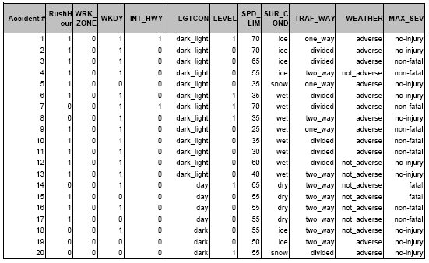
Accident Example: Data Sample

Slide 27
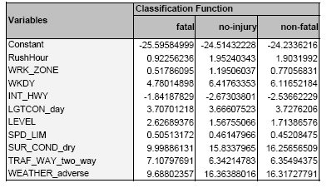
Classification Functions

Slide 28
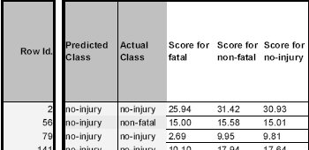
Scores for first few records
For row #2, “non-fatal” score is highest, so record is classified as non-fatal
Next slide shows these scores plus the estimated probabilities

Slide 29
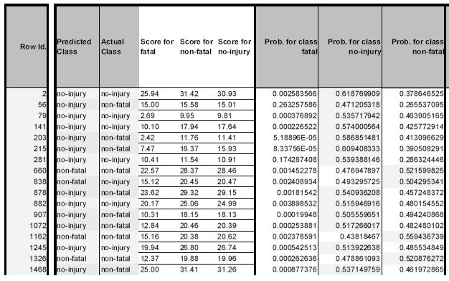
XLMiner output: scores & probabilities

Slide 30
Summary
Discriminant analysis is based on measuring the distance of a record from the class centers
The distance metric used is statistical distance, which takes into account the correlations between predictors
Suitable for small datasets
Assumptions: equal correlations within each class, and normality (but fairly robust to violation of normality)
Sensitive to outliers (explore the data!)
Classification functions useful for profiling: can order predictors in terms of separating the classes

