Slide 1
Hadoop: The Definitive Guide Chap. 4 Hadoop I/O
Kisung Kim

Slide 2
Contents
Integrity
Compression
Serialization
File-based Data Structure

Slide 3
Data Integrity
When the volumes of data flowing through the system are as large as the ones Hadoop is capable of handling, the chance of data corruption occurring is high
Checksum
Usual way of detecting corrupted data
Technique for only error detection (cannot fix the corrupted data)
CRC-32 (cyclic redundancy check)
Compute a 32-bit integer checksum for input of any size

Slide 4
Data Integrity in HDFS
HDFS transparently checksums all data written to it and by default verifies checksums when reading data
io.bytes.per.checksum
Data size to compute checksums
Default is 512 bytes
Datanodes are responsible for verifying the data they receive before storing the data and its checksum
If it detects an error, the client receives a ChecksumException, a subclass of IOException
When clients read data from datanodes, they verify checksums as well, comparing them with the ones stored at the datanode
Checksum verification log
Each datanode keeps a persistent log to know the last time each of its blocks was verified
When a client successfully verifies a block, it tells the datanode who sends the block
Then, the datanode updates its log

Slide 5
Data Integrity in HDFS
DataBlockScanner
Background thread that periodically verifies all the blocks stored on the datanode
Guard against corruption due to “bit rot” in the physical storage media
Healing corrupted blocks
If a client detects an error when reading a block, it reports the bad block and the datanode to the namenode
Namenode marks the block replica as corrupt
Namenode schedules a copy of the block to be replicated on another datanode
The corrupt replica is deleted
Disabling verification of checksum
Pass false to the setVerifyCheckSum() method on FileSystem
-ignoreCrc option

Slide 6
Data Integrity in HDFS
LocalFileSystem
Performes client-side checksumming
When you write a file called filename, the FS client transparently creates a hidden file, .filename.crc, in the same directory containing the checksums for each chunk of the file
RawLocalFileSystem
Disable checksums
Use when you don’t need checksums
ChecksumFileSystem
Wrapper around FileSystem
Make it easy to add checksumming to other (nonchecksummed) FS
Underlying FS is called the raw FS
FileSystem rawFs = ...
FileSystem checksummedFs = new ChecksumFileSystem(rawFs);

Slide 7
Compression
Two major benefits of file compression
Reduce the space needed to store files
Speed up data transfer across the network
When dealing with large volumes of data, both of these savings can be significant, so it pays to carefully consider how to use compression in Hadoop

Slide 8
Compression Formats
Compression formats
“Splittable” column
Indicates whether the compression format supports splitting
Whether you can seek to any point in the stream and start reading from some point further on
Splittable compression formats are especially suitable for MapReduce
Compression Format | Tool | Algorithm | Filename Extension | Multiple Files | Splittable
DEFLATE | N/A | DEFLATE | .deflate | NO | NO
gzip | gzip | DEFLATE | .gz | NO | NO
ZIP | zip | DEFLATE | .zip | YES | YES, at file boundaries
bzip2 | bzip2 | bzip2 | .bz2 | NO | YES
LZO | lzop | LZO | .lzo | NO | NO

Slide 9
Codes
Implementation of a compression-decompression algorithm
The LZO libraries are GPL-licensed and may not be included in Apache distributions
CompressionCodec
createOutputStream(OutputStream out): create a CompressionOutputStream to which you write your uncompressed data to have it written in compressed form to the underlying stream
createInputStream(InputStream in): obtain a CompressionInputStream, which allows you to read uncompressed data from the underlying stream
Compression Format | Hadoop Compression Codec
DEFLATE | org.apache.hadoop.io.compression.DefaultCodec
gzip | org.apache.hadoop.io.compression.GzipCodec
Bzip2 | org.apache.hadoop.io.compression.BZip2Codec
LZO | com.hadoop.compression.lzo.LzopCodec

Slide 10
Example
finish()
Tell the compressor to finish writing to the compressed stream, but doesn’t close the stream
public class StreamCompressor {
public static void main(String[] args) throws Exception {
String codecClassname = args[0];
Class<?> codecClass = Class.forName(codecClassname);
Configuration conf = new Configuration();
CompressionCodec codec = (CompressionCodec)
ReflectionUtils.newInstance(codecClass, conf);
CompressionOutputStream out = codec.createOutputStream(System.out);
IOUtils.copyBytes(System.in, out, 4096, false);
out.finish();
}
}
% echo "Text" | hadoop StreamCompressor org.apache.hadoop.io.compress.GzipCodec \
| gunzip -
Text

Slide 11
Compression and Input Splits
When considering how to compress data that will be processed by MapReduce, it is important to understand whether the compression format supports splitting
Example of not-splitable compression problem
A file is a gzip-compressed file whose compressed size is 1 GB
Creating a split for each block won’t work since it is impossible to start reading at an arbitrary point in the gzip stream, and therefore impossible for a map task to read its split independently of the others

Slide 12
Serialization
Process of turning structured objects into a byte stream for transmission over a network or for writing to persistent storage
Deserialization is the reverse process of serialization
Requirements
Compact
To make efficient use of storage space
Fast
The overhead in reading and writing of data is minimal
Extensible
We can transparently read data written in an older format
Interoperable
We can read or write persistent data using different language

Slide 13
Writable Interface
Writable interface defines two methods
write() for writing its state to a DataOutput binary stream
readFields() for reading its state from a DataInput binary stream
Example: IntWritable
public interface Writable {
void write(DataOutput out) throws IOException;
void readFields(DataInput in) throws IOException;
}
IntWritable writable = new IntWritable();
writable.set(163);
public static byte[] serialize(Writable writable) throws IOException {
ByteArrayOutputStream out = new ByteArrayOutputStream();
DataOutputStream dataOut = new DataOutputStream(out);
writable.write(dataOut);
dataOut.close();
return out.toByteArray();
}
byte[] bytes = serialize(writable);
assertThat(bytes.length, is(4));
assertThat(StringUtils.byteToHexString(bytes), is("000000a3"));

Slide 14
WritableComparable and Comparator
IntWritable implements the WritableComparable interface
Comparison of types is crucial for MapReduce
Optimization: RawComparator
Compare records read from a stream without deserializing them into objects
WritableComparator is a general-purpose implementation of RawComparator
Provide a default implementation of the raw compare() method
Deserialize the objects and invokes the object compare() method
Act as a factory for RawComparator instances
public interface WritableComparable<T> extends Writable, Comparable<T> {
}
RawComparator<IntWritable> comparator = WritableComparator.get(IntWritable.class);
IntWritable w1 = new IntWritable(163);
IntWritable w2 = new IntWritable(67);
assertThat(comparator.compare(w1, w2), greaterThan(0));
byte[] b1 = serialize(w1); byte[] b2 = serialize(w2);
assertThat(comparator.compare(b1, 0, b1.length, b2, 0, b2.length), greaterThan(0));

Slide 15
Writable Classes
Writable class hierarchy
Primitives
Others
BooleanWritable
NullWritable
<<interface>>
Writable
org.apache.hdaoop.io
<<interface>>
WritableComparable
ByteWritable
Text
IntWritable
BytesWritable
VIntWritable
MD5Hash
FloatWritable
ObjectWritable
LongWritable
GenericWritable
ArrayWritable
VLongWritable
TwoDArrayWritable
DoubleWritable
AbstractMapWritable
MapWritable
SortedMapWritable

Slide 16
Writable Wrappers for Java Primitives
There are Writable wrappers for all the Java primitive types except shot and char(both of which can be stored in an IntWritable)
get() for retrieving and set() for storing the wrapped value
Variable-length formats
If a value is between -122 and 127, use only a single byte
Otherwise, use first byte to indicate whether the value is positive or negative and how many bytes follow
Java Primitive | Writable Implementation | Serialized Size (bytes)
boolean | BooleanWritable | 1
byte | ByteWritable | 1
int | IntWritable | 4
 | VIntWritable | 1~5
float | FloatWritable | 4
long | LongWritable | 8
 | VLongWritable | 1~9
double | DoubleWritable | 8
163
VIntWritable: 8fa3
1000 1111 1010 0011
-123
(2’s complement)
163

Slide 17
Text
Writable for UTF-8 sequences
Can be thought of as the Writable equivalent of java.lang.String
Replacement for the org.apache.hadoop.io.UTF8 class (deprecated)
Maximum size is 2GB
Use standard UTF-8
org.apache.hadoop.io.UTF8 used Java’s modified UTF-8
Indexing for the Text class is in terms of position in the encoded byte sequence
Text is mutable (like all Writable implementations, except NullWritable)
You can reuse a Text instance by calling one of the set() method
Text t = new Text("hadoop");
t.set("pig");
assertThat(t.getLength(), is(3));
assertThat(t.getBytes().length, is(3));

Slide 18
Etc.
BytesWritable
Wrapper for an array of binary data
NullWritable
Zero-length serialization
Used as a placeholder
A key or a value can be declared as a NullWritable when you don’t need to use that position
ObjectWritable
General-purpose wrapper for Java primitives, String, enum, Writable, null, arrays of any of these types
Useful when a field can be of more than one type
Writable collections
ArrayWritable
TwoDArrayWritable
MapWritable
SortedMapWritable

Slide 19
Serialization Frameworks
Using Writable is not mandated by MapReduce API
Only requirement
Mechanism that translates to and from a binary representation of each type
Hadoop has an API for pluggable serialization frameworks
A serialization framework is represented by an implementation of Serialization (in org.apache.hadoop.io.serializer package)
A Serialization defines a mapping from types to Serializer instances and Deserializer instances
Set the io.serializations property to a comma-separated list of classnames to register Serialization implementations

Slide 20
SequenceFile
Persistent data structure for binary key-value pairs
Usage example
Binary log file
Key: timestamp
Value: log
Container for smaller files
The keys and values stored in a SequenceFile do not necessarily need to be Writable
Any types that can be serialized and deserialized by a Serialization may be used

Slide 21
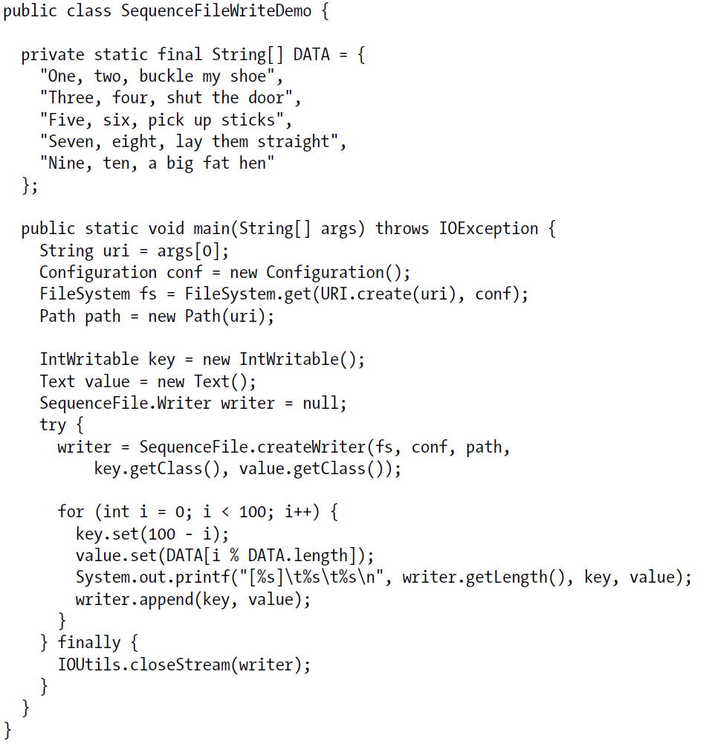
Writing a SequenceFile

Slide 22
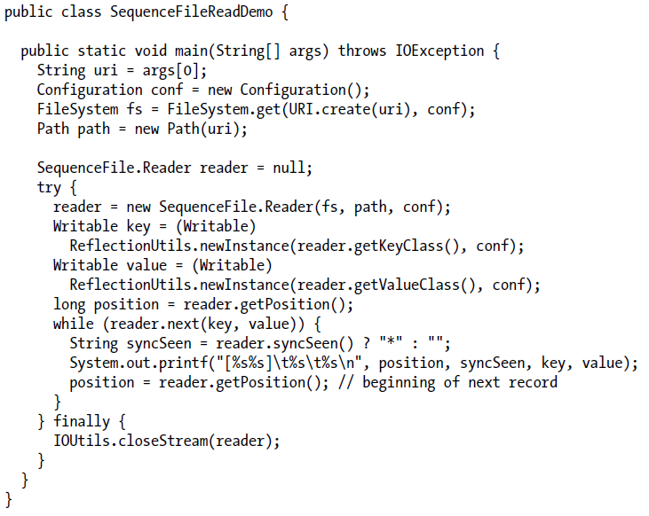
Reading a SequenceFile

Slide 23


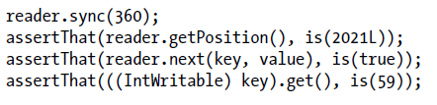
Sync Point
Point in the stream which can be used to resynchronize with a record boundary if the reader is “lost”—for example, after seeking to an arbitrary position in the stream
sync(long position)
Position the reader at the next sync point after position
Do not confuse with sync() method defined by the Syncable interface for synchronizing buffers to the underlying device

Slide 24
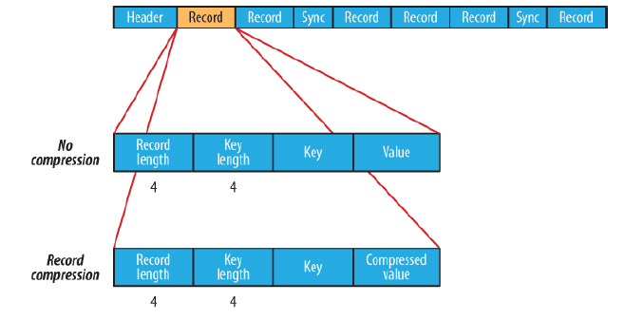
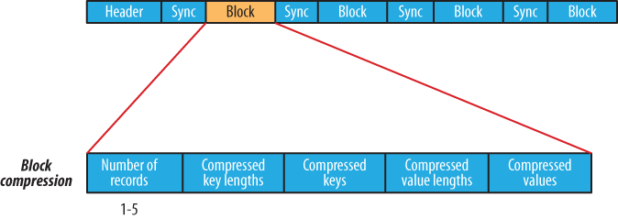
SequenceFile Format
Header contains the version number, the names of the key and value classes, compression details, user-defined metadata, and the sync marker
Record format
No compression
Record compression
Block compression

Slide 25
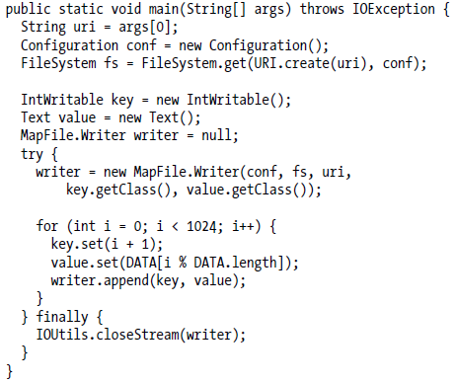

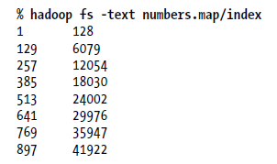
MapFile
Sorted SequenceFile with an index to permit lookups by key
Keys must be instances of WritableComparable and values must be Writable

Slide 26

Reading a MapFile
Call the next() method until it returns false
Random access lookup can be performed by calling the get() method
Read the index file into memory
Perform a binary search on the in-memory index
Very large MapFile index
Reindex to change the index interval
Load only a fraction of the index keys into memory by setting the io.map.index.skip property

