Slide 1
Recursion
Chapter 11

Slide 2
Objectives
Describe the concept of recursion
Use recursion as a programming tool
Describe and use recursive form of binary search algorithm
Describe and use merge sort algorithm

Slide 3
Basics of Recursion: Outline
Case Study: Digits to Words
How Recursion Works
Infinite Recursion
Recursive versus Iterative Methods
Recursive Methods that Return a Value

Slide 4
Basics of Recursion
A recursive algorithm will have one subtask that is a small version of the entire algorithm's task
A recursive algorithm contains an invocation of itself
Must be defined correctly else algorithm could call itself forever or not at all

Slide 5
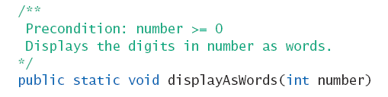
Case Study
Digits to Words – consider a method which receives an integer parameter
  Then it prints the digits of the number as words
Heading

Slide 6

Case Study
Consider this useful private method

Slide 7
Case Study
If number has multiple digits, decompose algorithm into two subtasks
  Display all digits but the last as words
  Display last digit as a word
First subtask is smaller version of original problem
  Same as original task, one less digit

Slide 8
Case Study
Algorithm for displayAsWords(number)
displayAsWords (number after deleting last digits)
System.out.print (getWordFromDigit(last digit of number + " ")

Slide 9
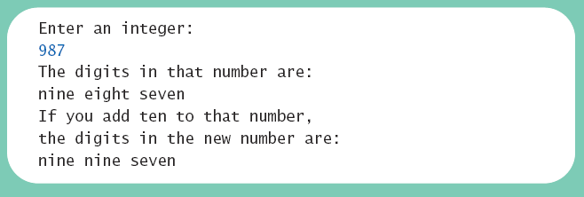
Case Study
View demonstration, listing 11.1
class RecursionDemo
Sample
screen output

Slide 10
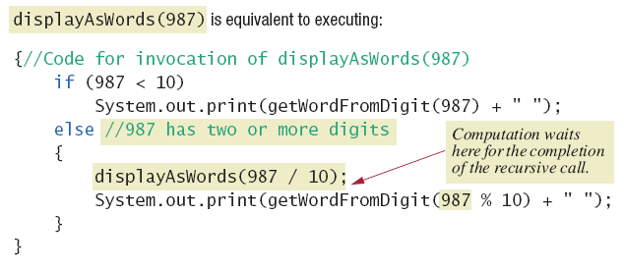
How Recursion Works
Figure 11.1a Executing recursive call

Slide 11
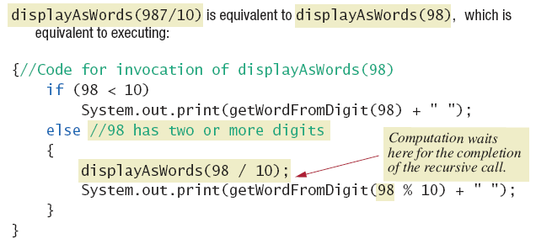
How Recursion Works
Figure 11.1b Executing recursive call

Slide 12
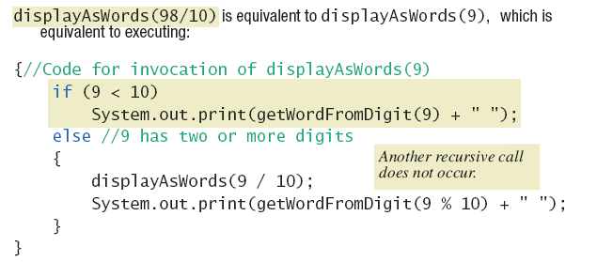
How Recursion Works
Figure 11.1c Executing recursive call

Slide 13
Keys to Successful Recursion
Must have a branching statement that leads to different cases
One or more of the branches should have a recursive call of the method
  Recursive call must us "smaller" version of the original argument
One or more branches must include no recursive call
  This is the base or stopping case

Slide 14
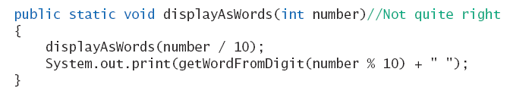
Infinite Recursion
Suppose we leave out the stopping case
Nothing stops the method from repeatedly invoking itself
  Program will eventually crash when computer exhausts its resources (stack overflow)

Slide 15
Recursive Versus Iterative
Any method including a recursive call can be rewritten
  To do the same task
  Done without recursion
Non recursive algorithm uses iteration
  Method which implements is iterative method
Note iterative version of program, listing 11.2
class IterativeDemo

Slide 16
Recursive Versus Iterative
Recursive method
  Uses more storage space than iterative version
  Due to overhead during runtime
  Also runs slower
However in some programming tasks, recursion is a better choice, a more elegant solution

Slide 17
Recursive Methods that Return a Value
Follow same design guidelines as stated previously
Second guideline also states
  One or more branches includes recursive invocation that leads to the returned value
View program with recursive value returning method, listing 11.3
class RecursionDemo2

Slide 18

Recursive Methods that Return a Value
Sample
screen output
Note recursive method NumberOfZeros
  Has two recursive calls
  Each returns value assigned to result
  Variable result is what is returned

Slide 19
Programming with Recursion: Outline
Programming Example: Insisting that User Input Be Correct
Case Study: Binary Search
Programming Example: Merge Sort – A Recursive Sorting Method

Slide 20
Programming Example
Insisting that user input be correct
  Program asks for a input in specific range
  Recursive method makes sure of this range
  Method recursively invokes itself as many times as user gives incorrect input
View program, listing 11.4
class CountDown

Slide 21
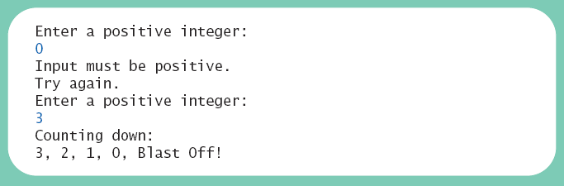
Programming Example
Sample
screen output

Slide 22
Case Study
Binary Search
  We design a recursive method to tell whether or not a given number is in an array
  Algorithm assumes array is sorted
First we look in the middle of the array
  Then look in first half or last half, depending on value found in middle

Slide 23
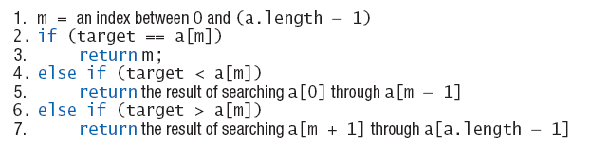
Binary Search
Draft 1 of algorithm
  Algorithm requires additional parameters

Slide 24
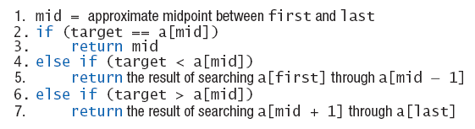
Binary Search
Draft 2 of algorithm to search a[first] through a[last]
  What if target is not in the array?

Slide 25
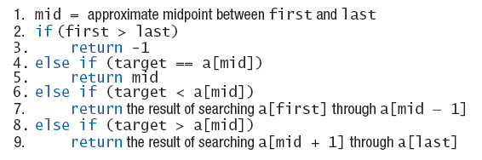
Binary Search
Final draft of algorithm to search a[first] through a[last] to find target

Slide 26
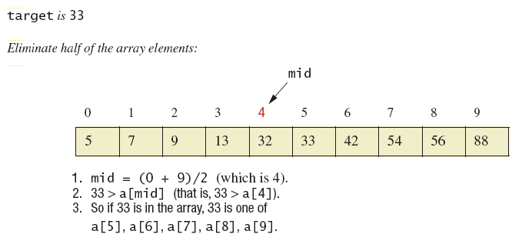
Binary Search
Figure 11.2a Binary search example

Slide 27
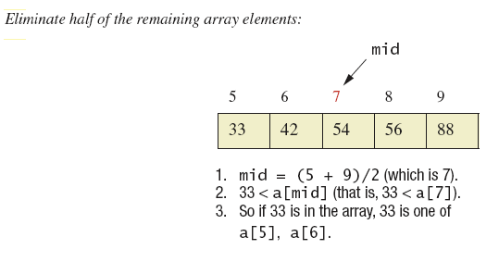
Binary Search
Figure 11.2b Binary search example

Slide 28
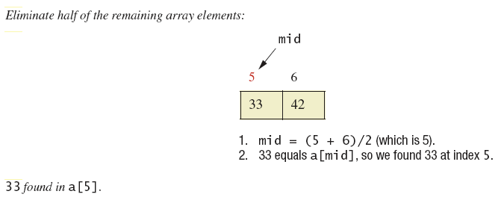
Binary Search
Figure 11.2c Binary search example

Slide 29
Binary Search
View final code, listing 11.5
class ArraySearcher
Note demo program, listing 11.6
class ArraySearcherDemo

Slide 30
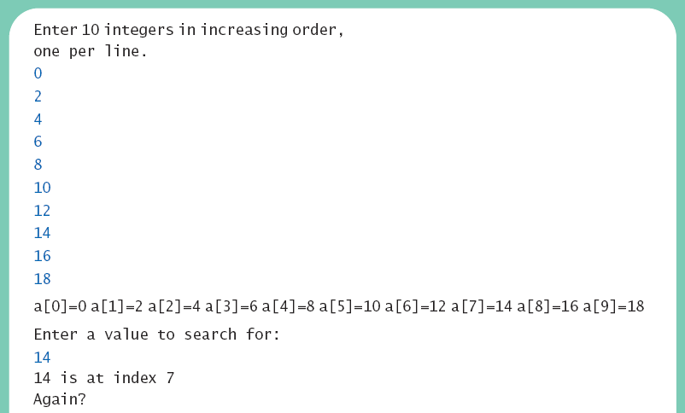
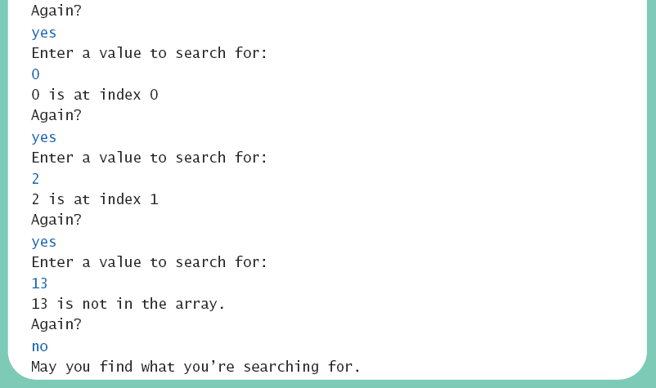
Binary Search
Sample
screen output

Slide 31
Programming Example
Merge sort – A recursive sorting method
A divide-and-conquer algorithm
  Array to be sorted is divided in half
  The two halves are sorted by recursive calls
  This produces two smaller, sorted arrays which are merged to a single sorted array

Slide 32
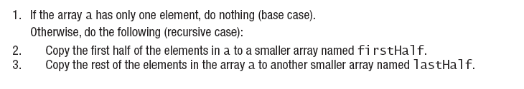

Merge Sort
Algorithm to sort array a
View Java implementation, listing 11.7
class MergeSort

Slide 33
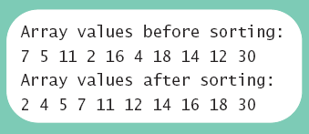
Merge Sort
View demo program, listing 11.8
class MergeSortDemo
Sample
screen output

Slide 34
Summary
Method with self invocation
  Invocation considered a recursive call
Recursive calls
  Legal in Java
  Can make some method definitions clearer
Algorithm with one subtask that is smaller version of entire task
  Algorithm is a recursive method

Slide 35
Summary
To avoid infinite recursion recursive method should contain two kinds of cases
  A recursive call
  A base (stopping) case with no recursive call
Good examples of recursive algorithms
  Binary search algorithm
  Merge sort algorithm

