Slide 1
Chapter 4
The Rise and Rise of Topic Maps
Sam Hunting

Slide 2
Table of Contents
Milestones in the topic map
Milestones in Standards and Specifications
XTM 1.0 versus ISO 13250
OASIS & ISO Activities
Modeling Layer
Syntax Layer
Constraints and Queries Layer
Milestones in Software
Future of Topic Maps

Slide 3
Milestones in Topic Map
Success of TopicMaps.org’s XTM 1.0
Release of ISO standard 13250
Rapid proliferation of software
ISO(for standards work)
OASIS(for application work)

Slide 4
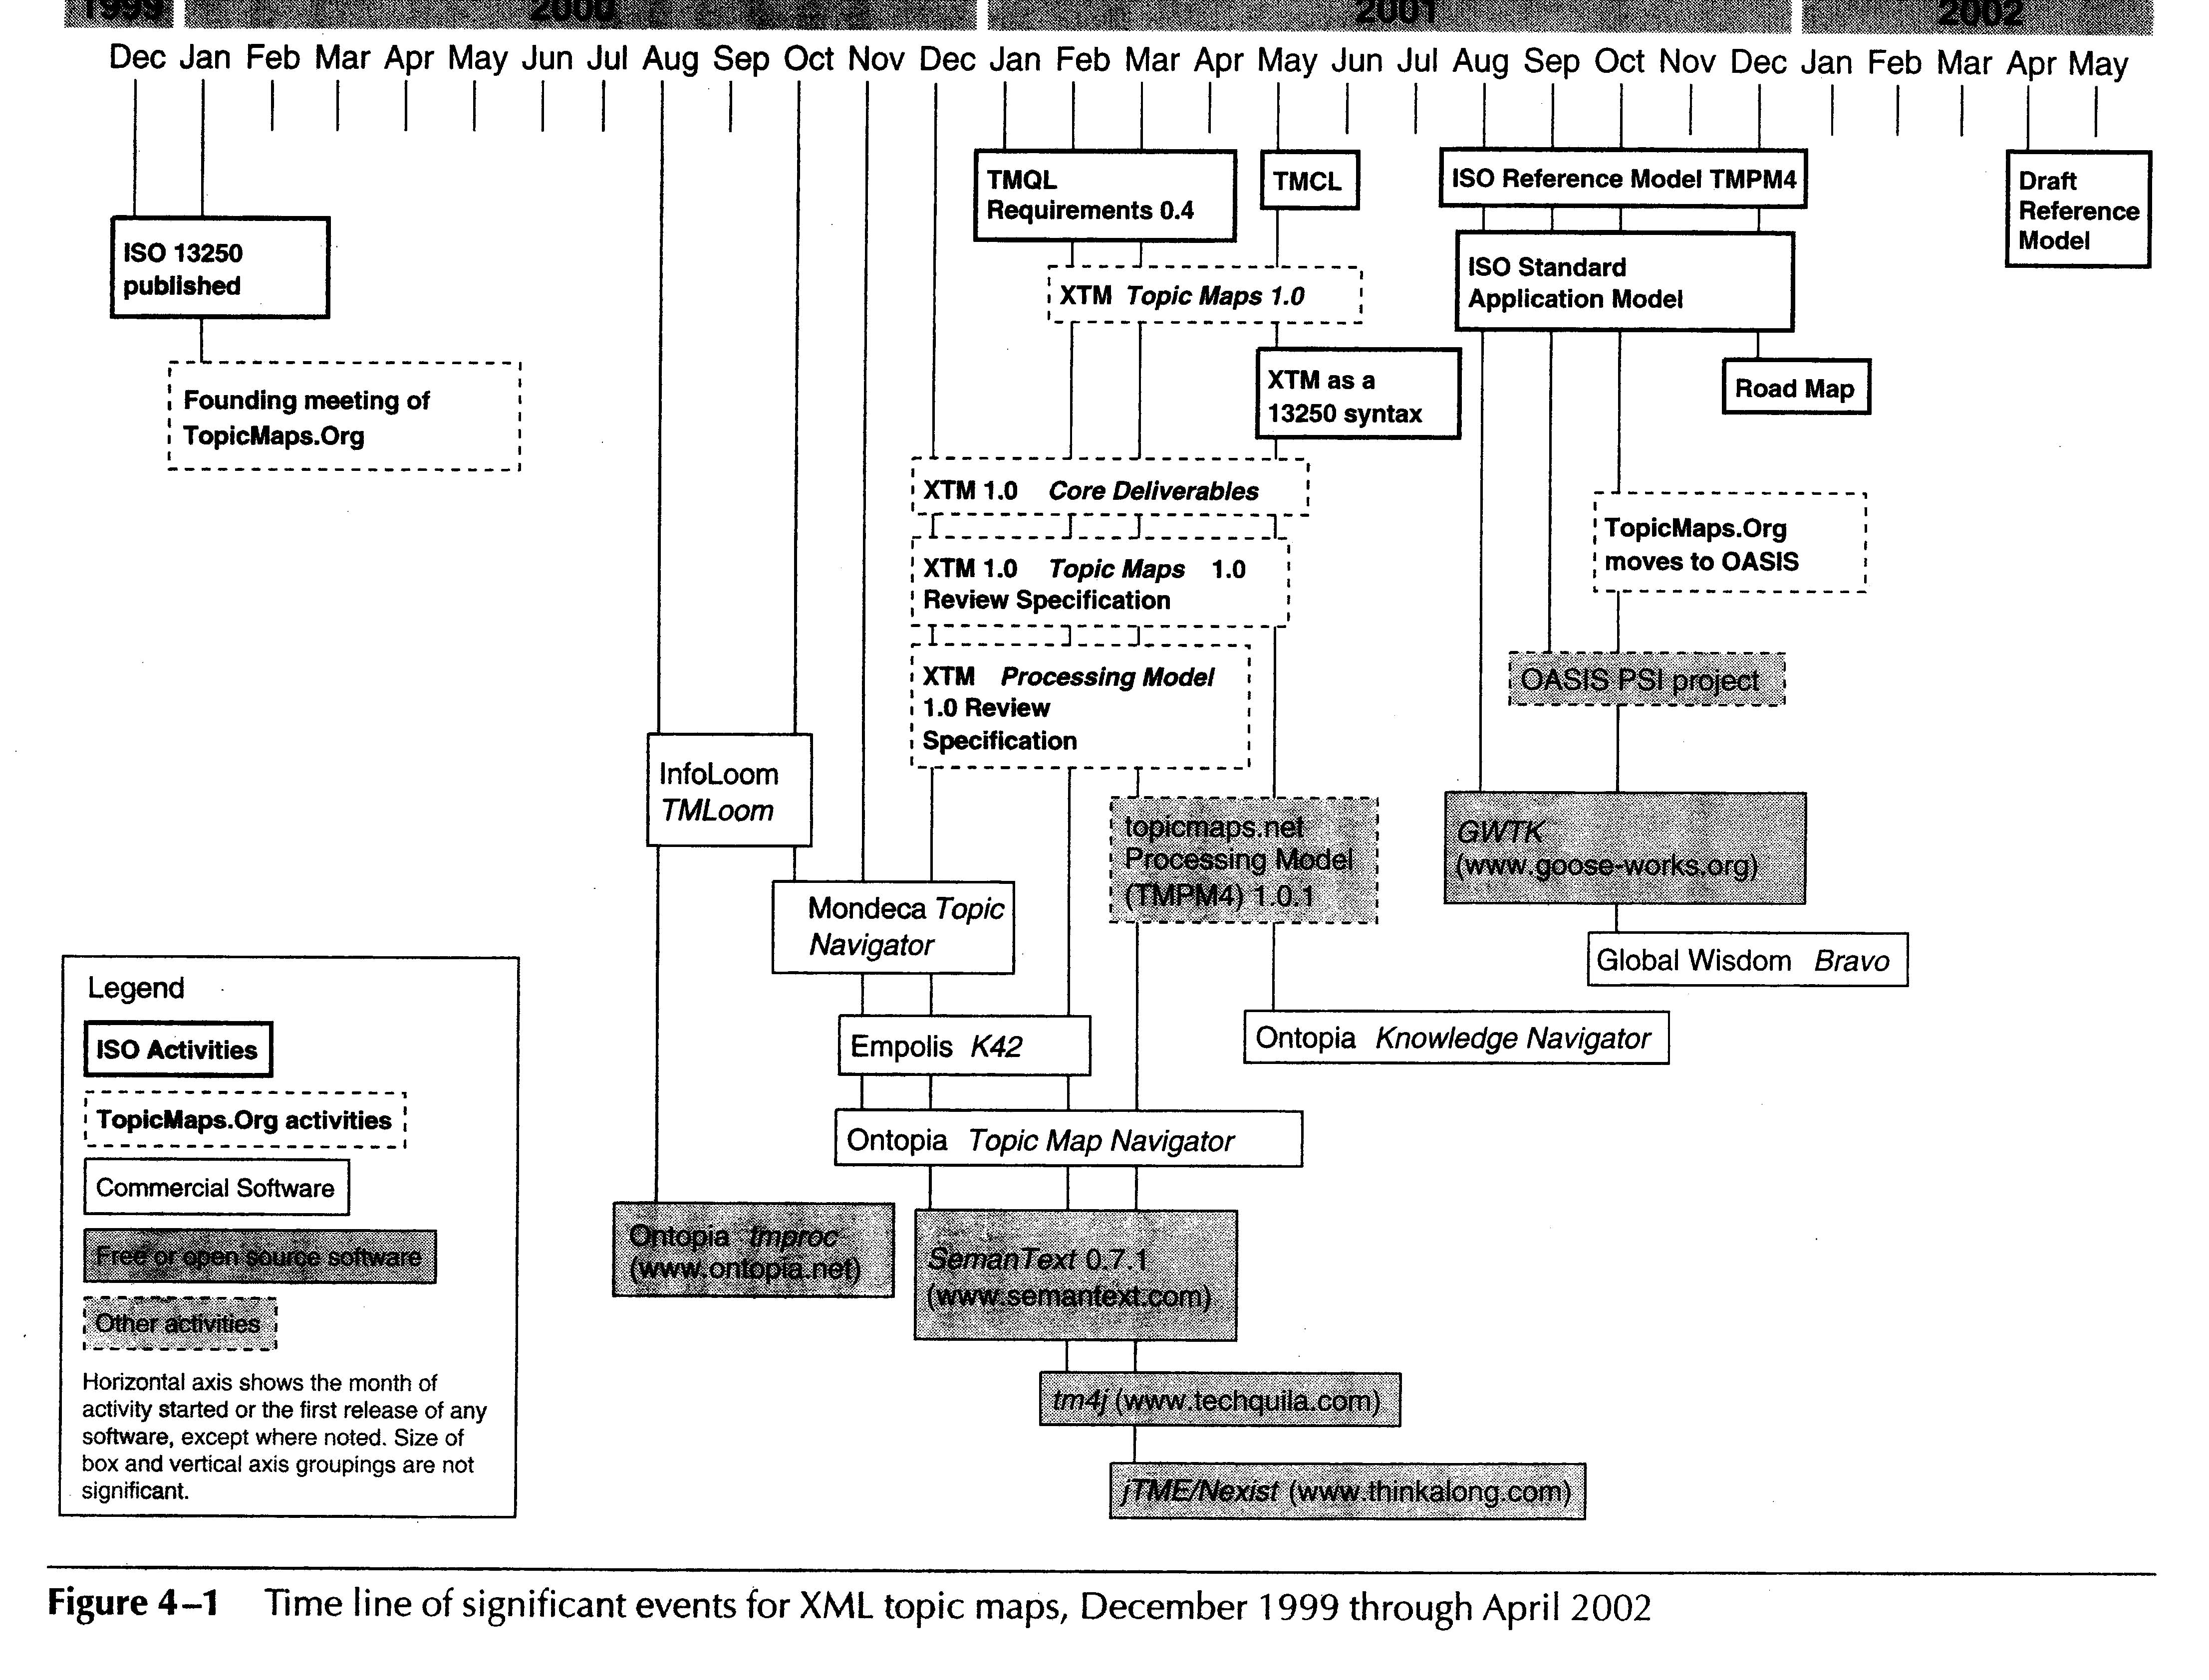

Slide 5
Standards and Specification
Three organization
  ISO
  TopicMaps.org
  OASIS
ISO Standard 13250 in December 1999
Release of HyTM
  Bringing the topic map to the Web as XTM

Slide 6
HyTM
HyTM was specified in SGML
HyTM used a technique called
SGML architectures
(not a single syntax with a DTD)
ISO and the Web were in some way
foreign to each other

Slide 7
XTM 1.0 Vs ISO 13250
XTM 1.0
  Use XML
  Define a single DTD
  Eleminate the facet element type of ISO 13250
  Generalize the sortName and dispName of HyTM
  into variant while preserving the semantics of HyTM
  Distinction between resources
  Use Xlink URI
  Use pleasing XML-style long tag name
  Use element type

Slide 8
OASIS
TopicMaps.org dissolved in Oct 2001
into OASIS
(Organization for the advancement of Structure Information Standards)
Work on applications of XTM 1.0
Committee members have diverse backgrounds
(ex. Library science, intelligent agents, software engeneering
agriculture)

Slide 9
Current ISO Activities
Topic Map Community has returned to
its root in ISO and refine the models
Topic map standards efforts at ISO
  The modeling layer
  The syntax layer
  The constraints and queries layer

Slide 10
The Modeling Layer
Reference Model (RM)
  Minimum number of ontological commitments needed to merge knowledge about subject
  regardless of the diversity of the ontologies.
Standard Application Model (SAM)
  Additional ontological commitments include
  familiar topic map features like topic names,
  occurrences and scope.

Slide 11
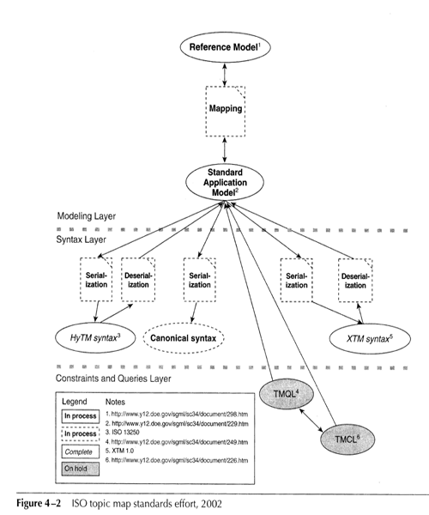


Slide 12
The Reference Model
TMPM4
  Graph theory
  Not directed, connected, symmetrical
  Arcs are typed
  Nodes are characterized as the end of arcs
  Assertion area nodes connected with arcs
dRM
  Simpler than TMPM4

Slide 13
TMPM4 (1)
Simplicity
Three type of nodes
  A-node (association node)
  T-node (Topic node)
  S-node (Scope node)
Four type of arcs
  AM, AX, AS, SC

Slide 14
TMPM4 (2)
AM arc could be optionally “labeled”
AM arc into “hyperedge”
  One endpoints was the a-node
  The second endpoint the member node
  The third endpoint the role-specifying “label”

Slide 15
dRM
Abandon hyperedge
Four arc types
  AC, Cx, CR and AP
  Arc names are concatenations of endpoints
Construction Rule
  A node that appears at the P endpoint of an
  AP are may not appear at the A end of any
  other arc.

Slide 16
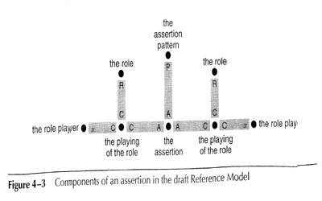
Reference Model
Three arc
endpoints

Slide 17
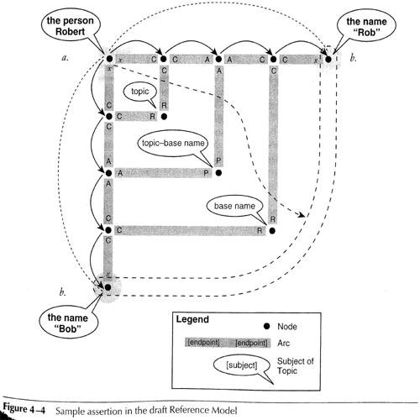
Two traversal
One traversal

Slide 18
Sample assertion
How to get from point a to point b
  Two traversals to finish at points b
  Cx1, AC2, AC3, Cx4
Each CR arc was playing the topic role
Each AP arc was being patterned on the
topic-base name assertion type.
Single traversal : dash arrow

Slide 19
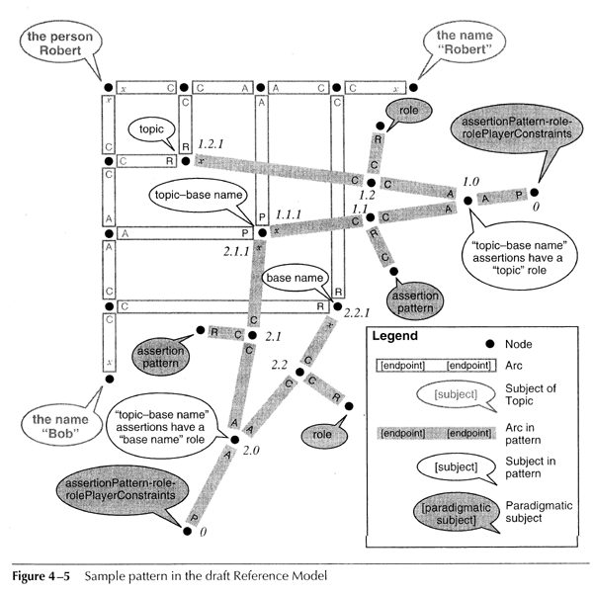

Slide 20
Sample pattern
Abandon hyperedge
Four arc types
  AC, Cx, CR and AP
  Arc names are concatenations of endpoints
Construction Rule
  A node that appears at the P endpoint of an
  AP are may not appear at the A end of any
  other arc.

Slide 21
Standard Application Model
RM focuses on the nature of assertion
itself
SAM takes assertion as given and focuses
on defining the semantics of privileged
assertion types

Slide 22
Syntax Layer
DTDs and documentation for HyTM’s
constructs
Two instances of the SAM will be considered
semantically equivalent if they produce
instance of the canonical syntax that are
byte-for-byte

Slide 23
Constraints and Queries Layer
TMQL(Topic Map Query Language)
TMQL general requirements
  Concise and human-readable syntax
  Defined on Abstract data model
  instance of abstract TMQL data model
  Support all natural language
  Two parts
  - one with querying only
  - one adding support for modifications

Slide 24
Constraints and Queries Layer
  TMQL standard shall not unduly constrain
  TMQL standard shall be formal, fully define
  TMQL shall be usable over an extended lifetime
TMCL (Topic map Constraint Language)
  TMCL is still in the early draft stage
  User requirements are needed
  TMCL shall permit the definition of classes
  of topic maps

Slide 25
Milestones in Software
Empolis K42
  Application in Java using RMI,Jini and SSL
Mondeca Knowledge Manager
  Application in Java for J2EE using EJBs
Ontopia Knowledge Suite
  Java SDKs for J2EE using Java servlets and
  JSP

Slide 26
Future of Topic Maps Constraints and Queries Layer
Topic map community has entered period
of consolidation
Mark up language is solution to solve
interchange problem
“TAO” of topic maps
  Topics, associations and occurrences

Slide 27
Near Future
Topic maps will remain stable
XTM DTD 1.0 will be accepted
HyTM and XTM interchange syntax will
reinforce as will OASIS applications
On model developed at ISO
  Topic map queries and constraints
  Validation of association
  Extension of Paradigm across XML syntax

Slide 28
Near Future
RDF and Topic maps will attain a degree
of convergence
  Both RDF and the Reference Model use
  a graph-based formalism
  Convergence is “a simple matter” of mapping

