Slide 1
A Sentimental Education: Sentiment Analysis Using Subjectivity Summarization Based on Minimum Cuts
04 10, 2014
Hyun Geun Soo
Bo Pang and Lillian Lee (2004) ACL-04
Notes:
영화 흥행 실적 예측을 위한 Big Data Mining: pre-processing of big data

Slide 2
Outline
Introduction
Method
Evaluation Framework
Experimental Results
Conclusions
Notes:
경시대회 영화데이터쪽 데이터로 관객을 예측하는 빅데이터작업 과정과 결과를 보여드리고
이를 데이터를 바탕으로 어떤것들을 더 연구할수 있는지 생각중인것을 이어서 설명

Slide 3
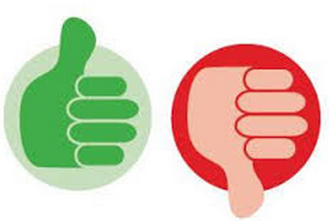
Intro
Sentiment analysis
Identify the view point underlying a text span
Sentiment polarity
E.g. classifying a movie review “thumbs up” “thumbs down”
In this paper,
Novel maching learning method
Minimum cuts in graphs

Slide 4
Intro
Previous
Document polarity classification focused on selecting indicative lexical feature(e.g. good), classifying the number of such features
In this paper,
1) label the sentences in the document as either subjective or objective and discarding latter
2) apply a standard machine learning classifier to the resulting extract
Prevent, irrelevant or potentially misleading text
E.g. “The protagonist tries to protect her good name”
Summary of the sentiment-oriented content of the document

Slide 5
Outline
Introduction
Method
Evaluation Framework
Experimental Results
Conclusions
Notes:
경시대회 영화데이터쪽 데이터로 관객을 예측하는 빅데이터작업 과정과 결과를 보여드리고
이를 데이터를 바탕으로 어떤것들을 더 연구할수 있는지 생각중인것을 이어서 설명

Slide 6
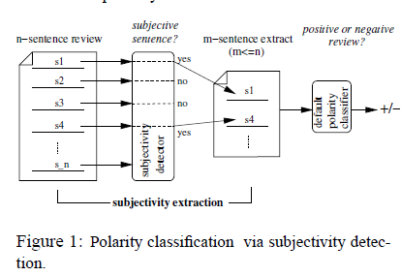
Architecture
SVM( Support vector machines )… – default polarity classifiers
Removing objective sentence (e.g. plot summaries) – subjectivity detector

Slide 7
Context and Subjectivity Detection
Standard classification algorithm apply on each sentence in isolation
Naïve Bayes or SVM classifiers label each test item in isolation
to specify that two particular sentences should ideally receive the same subjectivity label but not state which label this should be
Modeling proximity relationships
Share the same subjectivity status, other things being equal
Our method, minimum cuts
Concerned with physical proximity between the items to be classified
Notes:
Text spans occurring near each other(within discourse boundaries) may

Slide 8

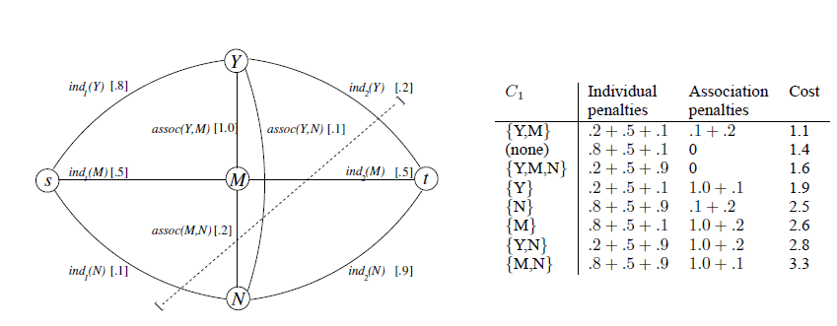

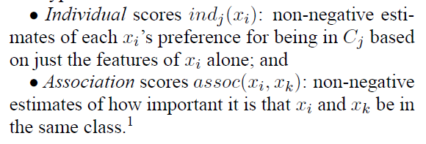

Cut-based classification

Slide 9
Cut-based classification
Minimum-cut practical advantages
Model item specific and pair-wise information independently
Can use maximum-flow algorithms with polynomial asymptotic running times
Other graph-partitioning problems are NP-complete

Slide 10
Outline
Introduction
Method
Evaluation Framework
Experimental Results
Conclusions
Notes:
경시대회 영화데이터쪽 데이터로 관객을 예측하는 빅데이터작업 과정과 결과를 보여드리고
이를 데이터를 바탕으로 어떤것들을 더 연구할수 있는지 생각중인것을 이어서 설명

Slide 11
Evaluation Framework
Classifying movie reviews as either positive or negative
Providing polarity information about reviews is a useful service
Movie reviews are apparently harder to classify than reviews of other product
The correct label can be extracted automatically from rating information
Polarity dataset
1000 positive and 1000 negative reviews
Default polarity classifiers – SVMs, NB
Subjectivity dataset
5000 movie review snippets and 5000 sentences from plot summaries
Subjectivity detectors
Basic sentence level subjectivity detector
Cut based subjectivity detector

Slide 12
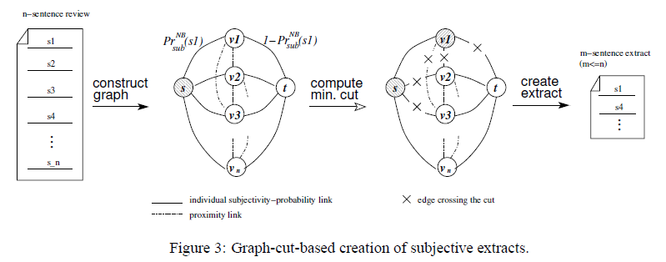
Evaluation Framework
Subjectivity detectors
Source s , sink t = class of subjective and objective
Ind(s) =
(denote Naïve Bayes’ estimate of the probility that sentence s is subjective)
.

Slide 13
Outline
Introduction
Method
Evaluation Framework
Experimental Results
Conclusions
Notes:
경시대회 영화데이터쪽 데이터로 관객을 예측하는 빅데이터작업 과정과 결과를 보여드리고
이를 데이터를 바탕으로 어떤것들을 더 연구할수 있는지 생각중인것을 이어서 설명

Slide 14
Experimental results
Ten fold cross validation
Subjectivity extraction produces effective summaries of document sentiment
Basic subjectivity extraction
Naïve Bayes and SVMs
Incorporating context information
Naïve Bayes + min-cut and SVMs + min-cut

Slide 15
Basic subjectivity extraction
Naïve Bayes and SVMs can be trained on our subjectivity dataset
Naïve Bayes subjectivity detector + Naïve Bayes polarity classifier
82% -> 86% improve than no extraction
N most subjective sentences
Last N sentences
First N sentences
Least subjective N sentences
Notes:
These findings indicate10 that the extracts preserve
(and, in the NB polarity-classifier case, apparently
clarify) the sentiment information in the originating
documents, and thus are good summaries
from the polarity-classification point of view.

Slide 16
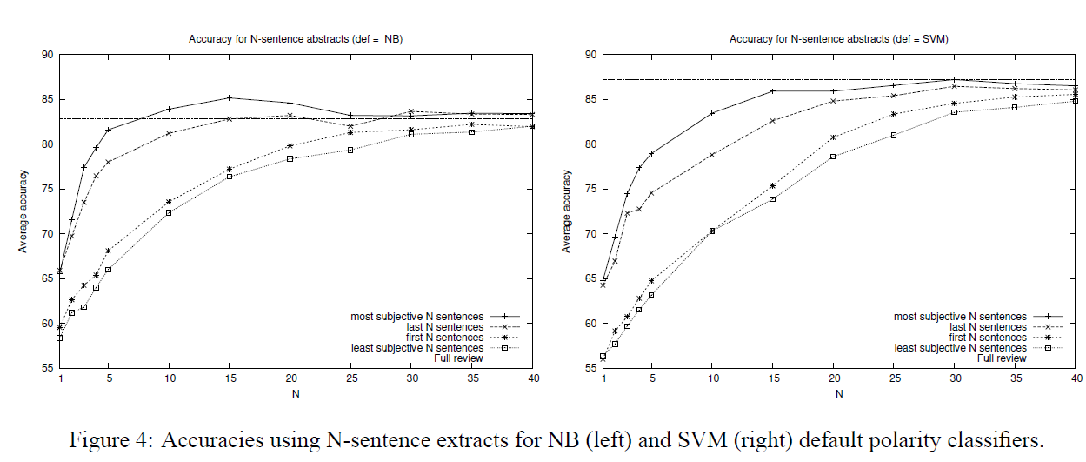
Experimental results

Slide 17
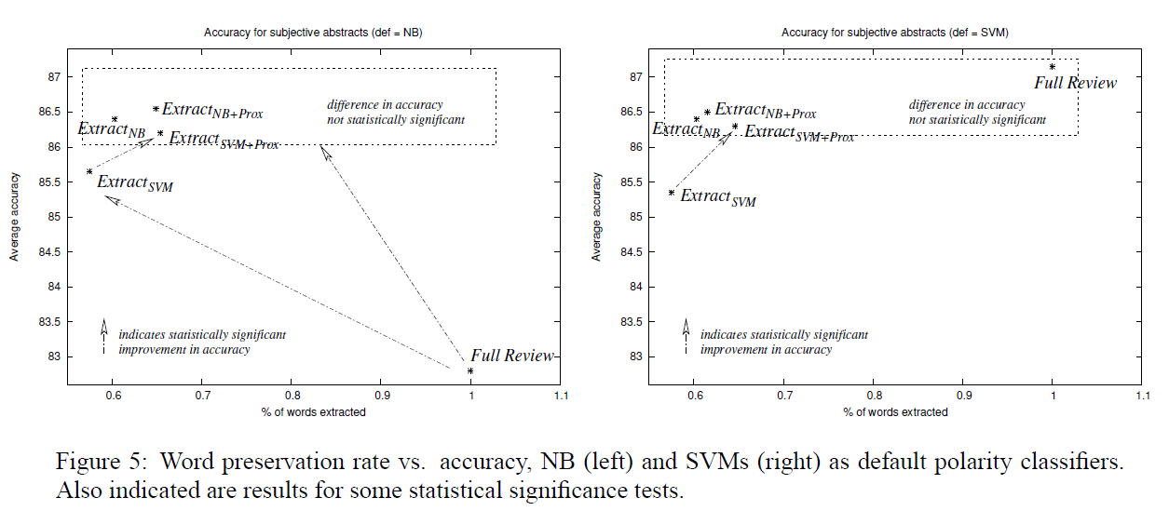
Experimental results

Slide 18
Outline
Introduction
Method
Evaluation Framework
Experimental Results
Conclusions
Notes:
경시대회 영화데이터쪽 데이터로 관객을 예측하는 빅데이터작업 과정과 결과를 보여드리고
이를 데이터를 바탕으로 어떤것들을 더 연구할수 있는지 생각중인것을 이어서 설명

Slide 19
Conclusion
Showing that subjectivity detection can compress reviews into much shorter extracts that still retain polarity information at a level comparable to that of the full review
For NB classifier, Extraction is not only shorter but also cleaner representations
Utilizing contextual information via this framework can lead to statistically significant improvement in polarity classification accuracy

