Slide 1
The Role of Information Diffusion in the Evolution of Social Networks
Lilian Weng et al.
KDD’13
26 Nov 2014
Hyewon Lim

Slide 2
OUtline
Introduction
Meme Dataset
Link Creation Mechanisms
Rules of Network Evolution
User Behavior
Conclusion

Slide 3
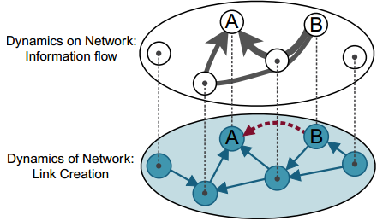
Introduction
Interactions
generate an unprecedented amount of data
Shed light on the mechanisms of human communication
Main themes on social media research
Communication and its social network substrate
Models
Dynamics of the network
Structural growth of the system
Dynamics on the network
Information diffusion processes
→ Present work: A feedback loop between two dynamics

Slide 4
Introduction
Triadic closure
A simple but powerful principle to model the evolution of social network based on shared friends
Social micro-blogging networks
Designed for information sharing
Most existing models do not take user activity of how information spreads on the network into consideration
In this paper
Role of information diffusion in shaping the evolution of the network structure
Individual strategies to create social links

Slide 5
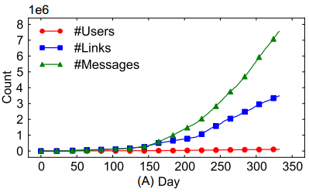
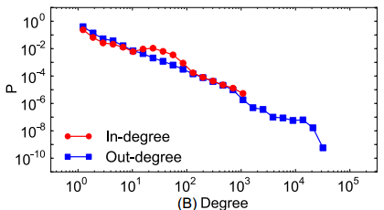
Meme Dataset
Yahoo! Meme
Full records of every message propagation and link creation event from 2009.04 ~ 2010.03
128,199 users, 3,485,361 edges
General statistics
i
Edge weight
= # msgs reposted/seen by j
j

Slide 6
OUtline
Introduction
Meme Dataset
Link Creation Mechanisms
Rules of Network Evolution
User Behavior
Conclusion

Slide 7
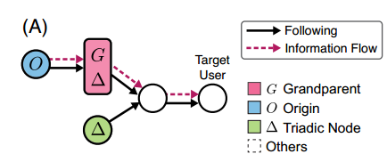
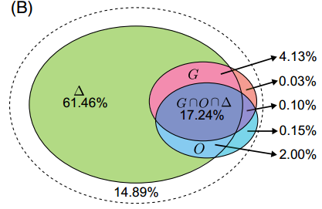
Link Creation Mechanisms
(A) Link creation mechanisms
(B) Proportions of links of different types
A large overlap between triadic closure links and traffic-based shortcuts
Traffic-based link creation mechanisms are an important complement to the triadic closure in modeling network evolution

Slide 8
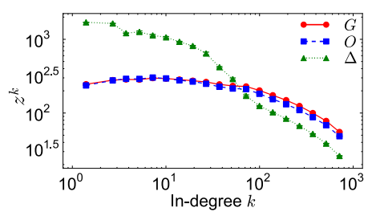
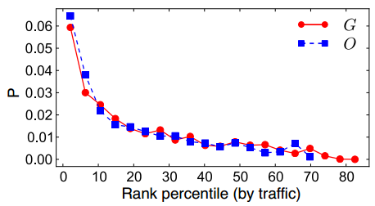
Link Creation Mechanisms
User preference (left) and traffic Bias (right)
Users monitor traffic
who have been active for a long time and have followed many people (k>75)
Repeated exposure to contents posted by a user
increases the probability of following that user
Activity patterns are important
Topology alone is insufficient to explain the evolution of the network

Slide 9

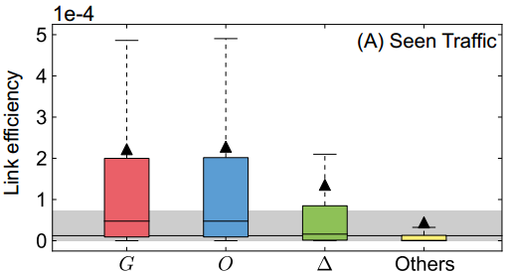
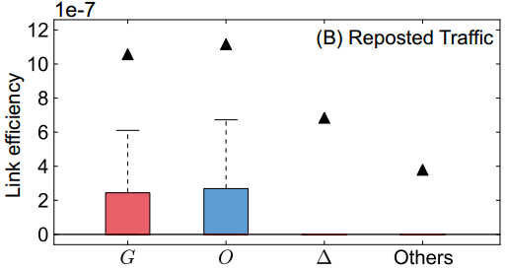
Link Creation Mechanisms
Link efficiency
Convey more information to the follower than others
Efficiency of link l
the average number of posts seen or reposted through l during one time unit after its creation
t(l):
Link l was created
T:
Last action

Slide 10
OUtline
Introduction
Meme Dataset
Link Creation Mechanisms
Rules of Network Evolution
User Behavior
Conclusion

Slide 11
Rules of Network Evolution
Infer the different link creation strategies
Using Maximum-Likelihood Estimation (MLE)
Single strategies
Random (Rand)
Triadic closure (Δ)
Grandparent (G)
Origin (O)
Traffic shortcut (G U O)

Slide 12
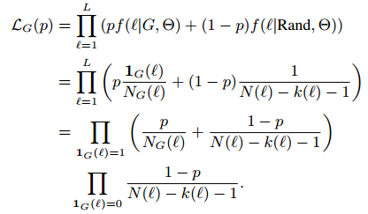
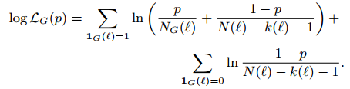
Rules of Network Evolution
Calculation of maximum likelihood (for single strategies)
With the grandparents strategy
For numerically stable computation:

Slide 13
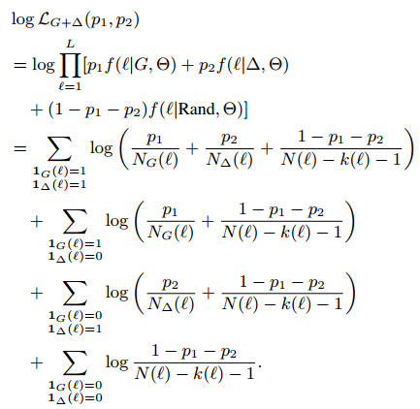
Rules of Network Evolution
Combined strategies
With the grandparents strategy

Slide 14
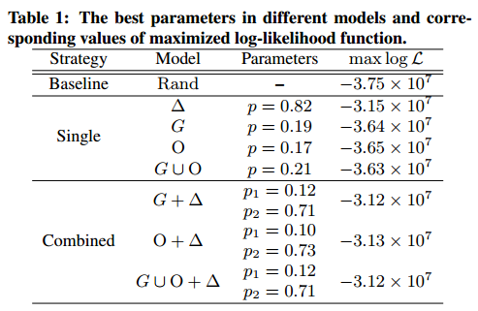
Rules of Network Evolution
Combined strategies (cont.)

Slide 15
OUtline
Introduction
Meme Dataset
Link Creation Mechanisms
Rules of Network Evolution
User Behavior
Conclusion

Slide 16
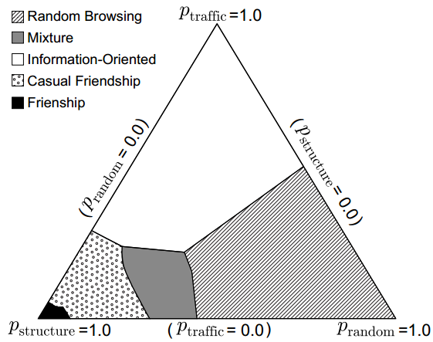
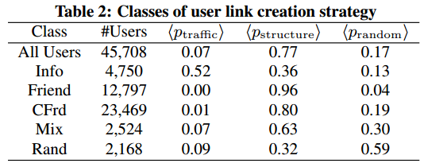
User Behavior
Run MLE to explain the link created by each user independently
Clustering users based on p_{traffic}, p_{structure}, and p_{random} using the EM algorithms
Information-Oriented (Info)
Friend of a Friend (Friend)
Casual Friendship (CFrd)
Mixture (Mix)
Random Browsing (Rand)

Slide 17
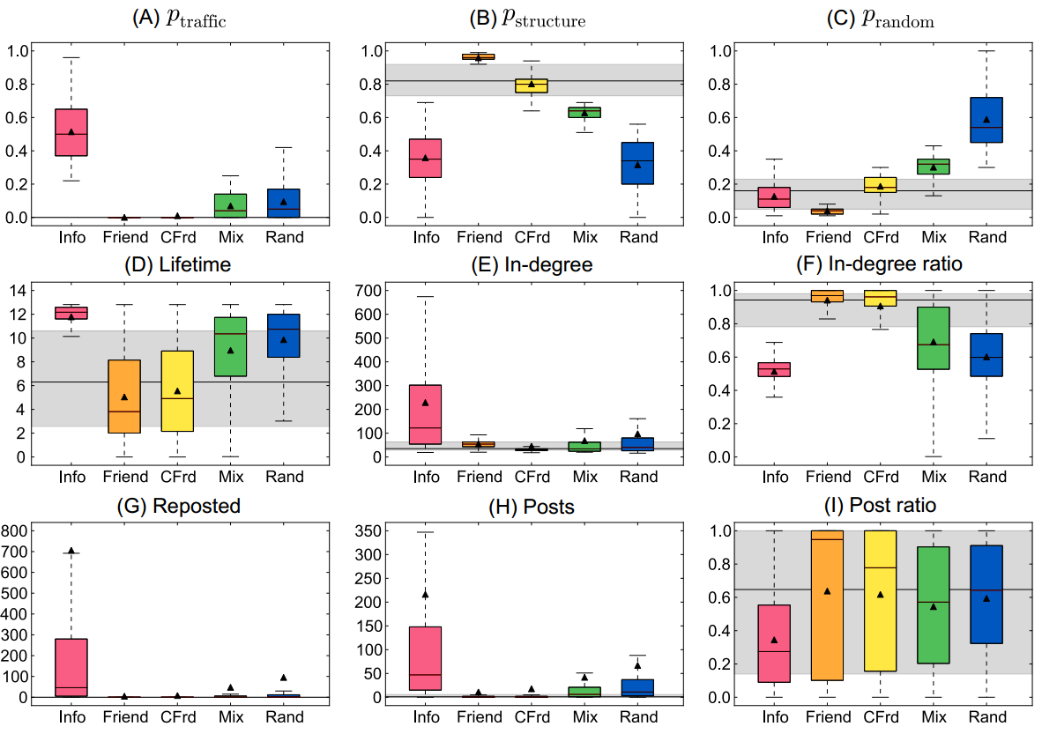
User Behavior
Characterization of user classes

Slide 18
OUtline
Introduction
Meme Dataset
Link Creation Mechanisms
Rules of Network Evolution
User Behavior
Conclusion

Slide 19
Conclusion
The feedback loop between the dynamics of and on the network
Triadic closure: mainly relevant in the early stage of a user’s lifetime
The traffic becomes an indispensable component for user linking behavior
Future work
MLE framework could be used to assess link prediction method by treating the prediction at each step as a link creation strategy

