Slide 1
Tag Clustering and Refinement on Semantic Unity Graph
Yang Liu et al., Zhejiang Univ., China
11th IEEE International Conference on Data Mining (ICDM 2011)
8 November 2012
SNU IDB Lab.
Hyunwoo Kim

Slide 2
Outline
Introduction
Semantic Unity Graph
Tag Clustering and Refinement
Experiments
Conclusions and Future Work
Discussion

Slide 3
Introduction [1/8]
Title: Tag Clustering and Refinement on Semantic Unity Graph

Slide 4

Introduction [2/8]
Title: Tag Clustering and Refinement on Semantic Unity Graph
Ji-Sung Park, QPR, EPL, Football, Window, London, Sky

Slide 5
Introduction [3/8]
Title: Tag Clustering and Refinement on Semantic Unity Graph
Cluster 1
Cluster 2
Store
Orange
Steve Jobs
Pie
Apple
EarPod
iTunes
Tree
iPhone 5
Fruit
iPad
Non-exclusive clustering!!

Slide 6
Introduction [4/8]
Title: Tag Clustering and Refinement on Semantic Unity Graph
EPL, Football, Window, London, Sky, Galaxy S3, iPhone 5
EPL, Football, Window, London, Sky, Galaxy S3, iPhone 5
+ Ji-Sung Park, QPR,

Slide 7

Introduction [5/8]
Title: Tag Clustering and Refinement on Semantic Unity Graph
Tagging information
Imprecise
Incomplete
Ambiguous
Tag clustering
Improving the user experience of current tagging services
Tag refinement
Removing imprecise tags
Adding missing tags to images

Slide 8
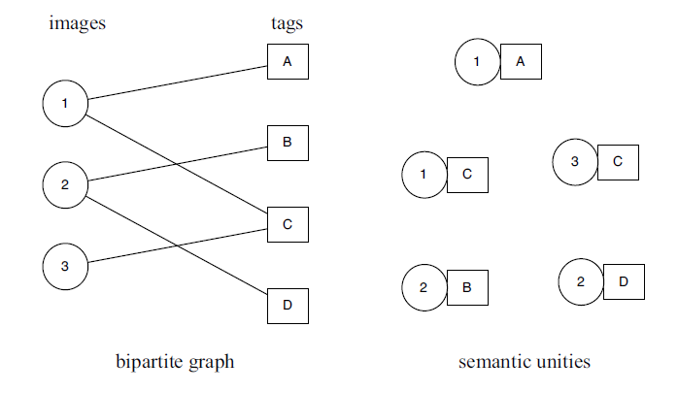

Introduction [6/8]
Title: Tag Clustering and Refinement on Semantic Unity Graph
Park

Slide 9
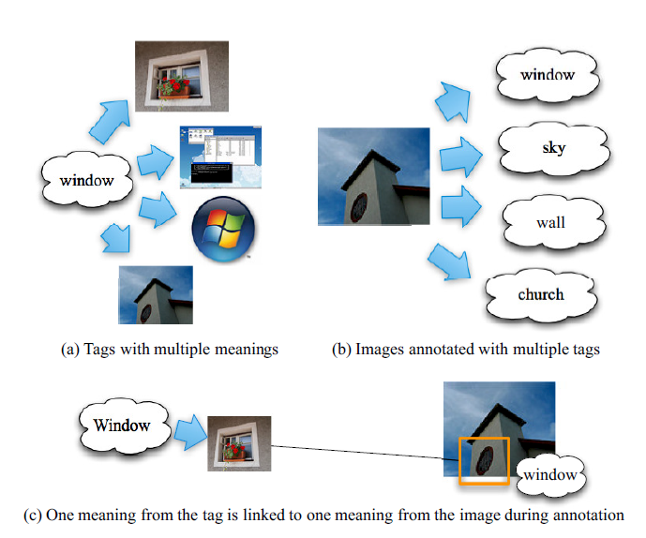
Introduction [7/8]
Title: Tag Clustering and Refinement on Semantic Unity Graph

Slide 10
Introduction [8/8]
Contributions
Image and tag co-clustering on Semantic Unity Graph
Polysemous tags or images can be clustered into different clusters
A novel framework for modeling images and tags
Co-clustering and refinement algorithm based on the representation of Semantic Unity Graph

Slide 11
Outline
Introduction
Semantic Unity Graph
Tag Clustering and Refinement
Experiments
Conclusions and Future Work
Discussion

Slide 12
Semantic Unity Graph [1/3]
Semantic Unity
Tagging activity eliminates the ambiguity of both the images and tags by the image-tag pair which expresses a definite meaning
Semantic Unity
Park

Slide 13
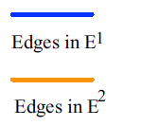
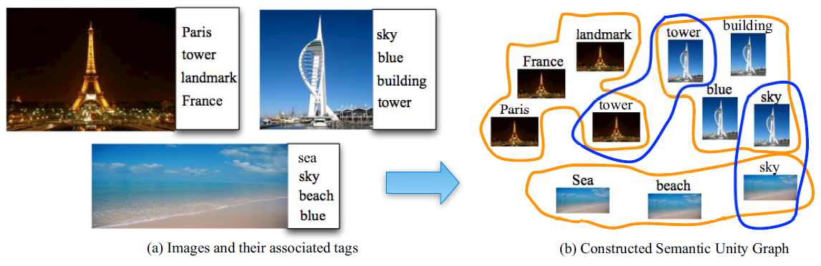
Semantic Unity Graph [2/3]
Semantic Unity Graph (SUG)
Hypergraph of Semantic Unities
E¹: connecting Semantic Unities that are annotated with the same tag
E²: connecting Semantic Unities that are from the same image
E³: connecting visually similar Semantic Unities

Slide 14
Semantic Unity Graph [3/3]
Weight of hyperedges
In edge set E¹ and E²: a constant value
In edge set E³
The average distance between the “centroid” image and its neighbors
High weight when its “centroid” image and neighbor images are close

Slide 15
Outline
Introduction
Semantic Unity Graph
Tag Clustering and Refinement
Experiments
Conclusions and Future Work
Discussion

Slide 16







Tag Clustering and Refinement [1/3]
Each Semantic Unity have a unique semantic meaning
→ Uniquely clustered into one cluster
Clustering method
Normalized hypergraph Laplacian based on spectral hypergraph partitioning problem*
* D. Zhou et al., Learning with hypergraphs: clustering, classification, and embedding, NIPS 2006

Slide 17
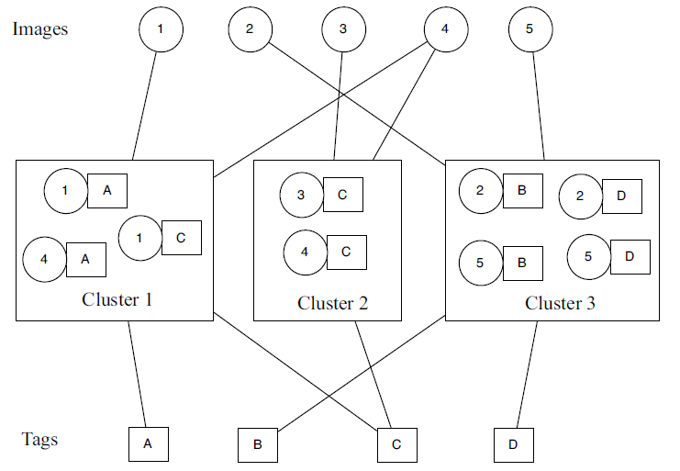
Tag Clustering and Refinement [2/3]
Each Semantic Unity can be assigned a category of topic

Slide 18

Tag Clustering and Refinement [3/3]
Refinement
Embedding the hypergraph into a lower-dimension space by hypergraph Laplacian
Distance between two Semantic Unities can be directly calculated
Ji-Sung Park
QPR
Galaxy S3
iPhone 5

Slide 19
Outline
Introduction
Semantic Unity Graph
Tag Clustering and Refinement
Experiments
Conclusions and Future Work
Discussion

Slide 20
Experiments [1/4]
Datasets
NUS-WIDE
MIRFlickr-25K
Both collected from Flickr
Weight of hyperedges
E¹ = 4 and E² = 1
E³
428-dimensional feature vector for each image
Color moment features
Wavelet texture features
Edge distribution histogram features

Slide 21
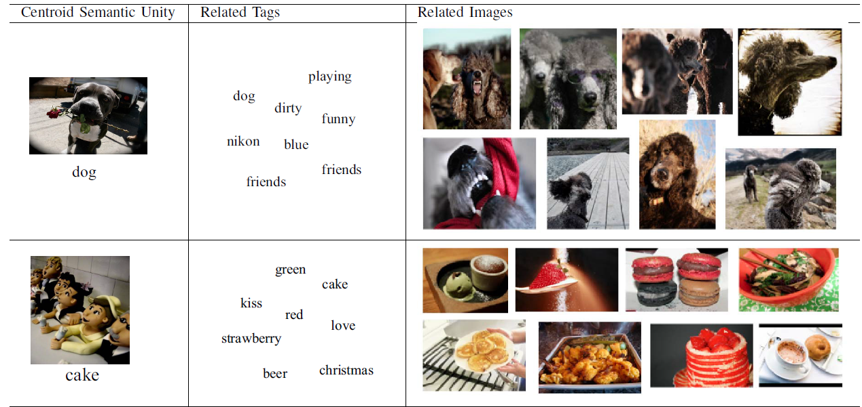
Experiments [2/4]
Image tag co-clustering

Slide 22
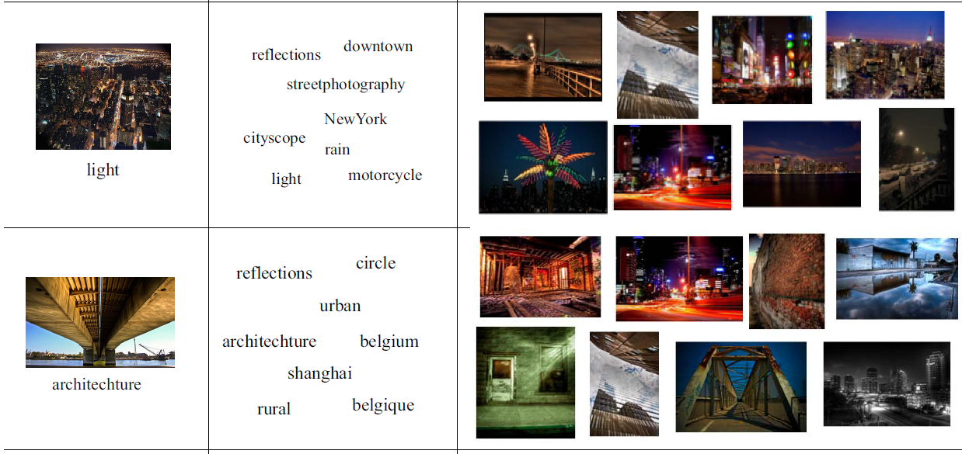
Experiments [3/4]
Image tag co-clustering

Slide 23
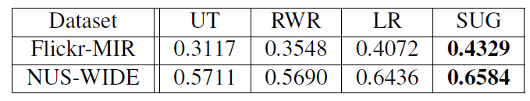
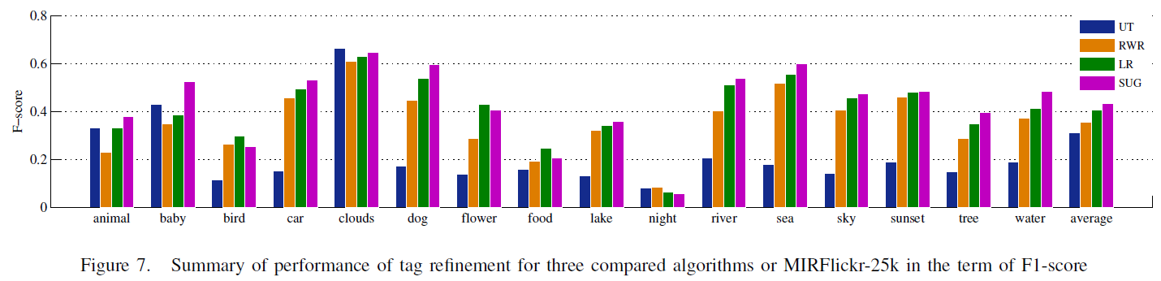
Experiments [4/4]
Tag refinement
Proposed method (SUG)
User-tag matrix (UT)
Random walk with restart (RWR)
Low-rank, error sparsity and content consistency (LR)

Slide 24
Outline
Introduction
Semantic Unity Graph
Tag Clustering and Refinement
Experiments
Conclusions and Future Work
Discussion

Slide 25
Conclusion
A novel framework for modeling images and tags
Polysemy of images and tags are explicitly considered
Future work
Other social media can be integrated into the framework
Geography information
Better ways to set the weights of different hyperedges

Slide 26
Outline
Introduction
Semantic Unity Graph
Tag Clustering and Refinement
Experiments
Conclusions and Future Work
Discussion

Slide 27
Discussion
Strong points
Semantic Unity!!!!!!!!!!!!!!!!!!!!!
Alleviating ambiguity problem in social tagging systems
Weak points
Rationale on the weight of hyperedges
Semantic Unity
Park

Slide 28
Thank you for your attention

