Slide 1
빅데이터 팀 세미나 #맵리듀스 프레임워크 기반 그래프 처리 알고리즘
Adapted from vldb 2012 tutorial slides (prof. Kyuseok shim)

Slide 2
Outline
그래프 알고리즘
Counting Triangles
Graph Analysis using MapReduce

Slide 3
What’s a graph?
G = (V,E), where
V represents the set of vertices (nodes)
E represents the set of edges (links)
Both vertices and edges may contain additional information
Different types of graphs:
Directed vs. undirected edges
Presence or absence of cycles
Graphs are everywhere:
Hyperlink structure of the Web
Physical structure of computers on the Internet
Interstate highway system
Social networks

Slide 4
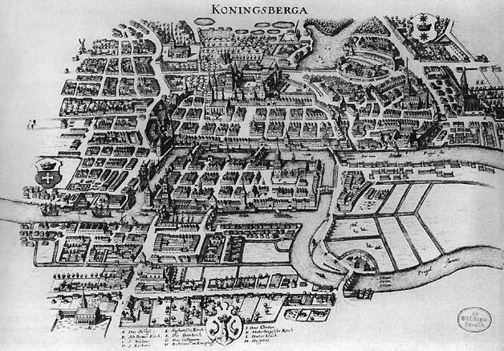
Graph theory

Slide 5
Some Graph Problems
Finding shortest paths
Routing Internet traffic and UPS trucks
Finding minimum spanning trees
Telco laying down fiber
Finding Max Flow
Airline scheduling
Identify “special” nodes and communities
Breaking up terrorist cells, spread of avian flu
Bipartite matching
Monster.com, Match.com
And of course... PageRank

Slide 6
Graphs and MapReduce
Graph algorithms typically involve:
Performing computation at each node
Processing node-specific data, edge-specific data, and link structure
Traversing the graph in some manner
Key questions:
How do you represent graph data in MapReduce?
How do you traverse a graph in MapReduce?

Slide 7
Representation Graphs
G = (V, E)
A poor representation for computational purposes
Two common representations
Adjacency matrix
Adjacency list
 | 1 | 2 | 3 | 4
1 | 0 | 1 | 0 | 1
2 | 1 | 0 | 1 | 1
3 | 0 | 1 | 0 | 0
4 | 1 | 0 | 1 | 0
2
1: 2, 4
2: 1, 3, 4
3: 1
4: 1, 3
1
3
4

Slide 8
Single Source Shortest Path
Problem: find shortest path from a source node to one or more target nodes
First, a refresher: Dijkstra’s Algorithm
∞
∞
1
10
0
2
3
9
4
6
5
7
∞
∞
2

Slide 9
Single Source Shortest Path
10
∞
1
10
0
2
3
9
4
6
5
7
5
∞
2

Slide 10
Single Source Shortest Path
8
14
1
10
0
2
3
9
4
6
5
7
5
7
2

Slide 11
Single Source Shortest Path
8
13
1
10
0
2
3
9
4
6
5
7
5
7
2

Slide 12
Single Source Shortest Path
8
9
1
10
0
2
3
9
4
6
5
7
5
7
2

Slide 13
Single Source Shortest Path
8
9
1
10
0
2
3
9
4
6
5
7
5
7
2

Slide 14
Finding the Shortest Path
First, consider equal edge weights
Solution to the problem can be defined inductively
Here’s the intuition:
DistanceTo(startNode) = 0
For all nodes n directly reachable from startNode, DistanceTo(n) = 1
For all nodes n reachable from some other set of nodes S, DistanceTo(n) = 1 + min(DistanceTo(m), m ∈ S)
d₁
m₁
…
d₂
s
…
n
m₂
…
d₃
m₃

Slide 15
Visualizing Parallel BFS

Slide 16
From Intuition to Algorithm
Data representation
Key: node n
Value: D (distance from start), adjacency list(list of nodes reachable from n)
Initialization : for all nodes except for start node, d = ∞
Mapper
∀m ∈ adjacency : emit (m, d+1)
Sort/Shuffle
Groups distances by reachable nodes
Reducer:
Selects minimum distance path for each reachable node
Additional bookkeeping needed to keep track of actual path

Slide 17
Multiple Iterations Needed
This MapReduce task advances the “known frontier” by one hop
Subsequent iterations include more reachable nodes as frontier advances
Multiple iterations are needed to explore entire graph
Feed output back into the same MapReduce task
Preserving graph structure:
Problem: Where did the points-to list go?
Solution: Mapper emits (n, adjacency list) as well

Slide 18
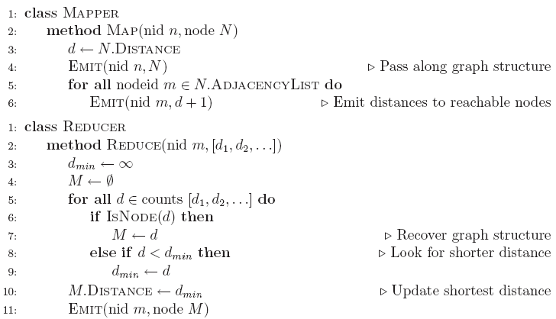
BFS Pseudo-Code

Slide 19
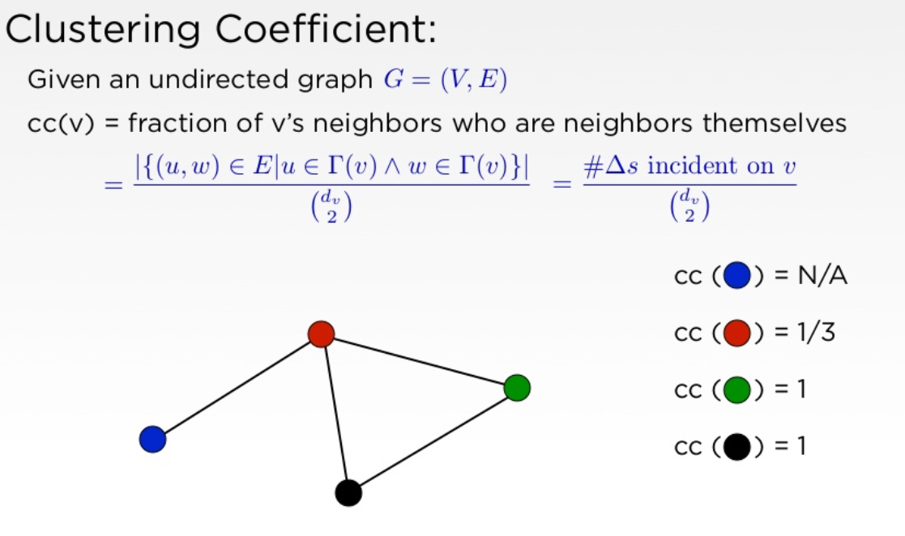
Clustering Coefficient

Slide 20
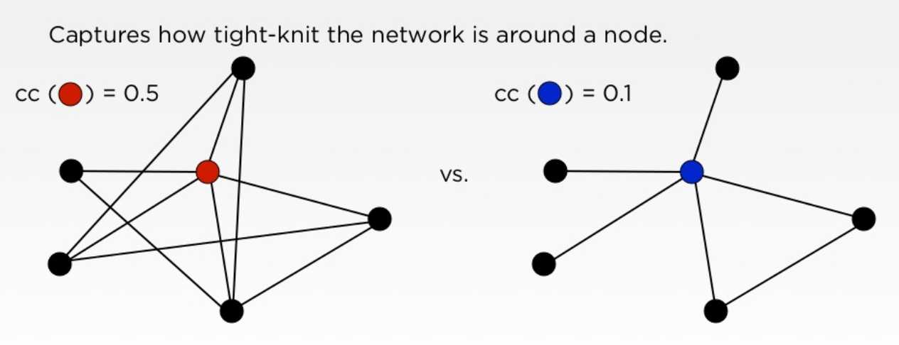
Why?

Slide 21
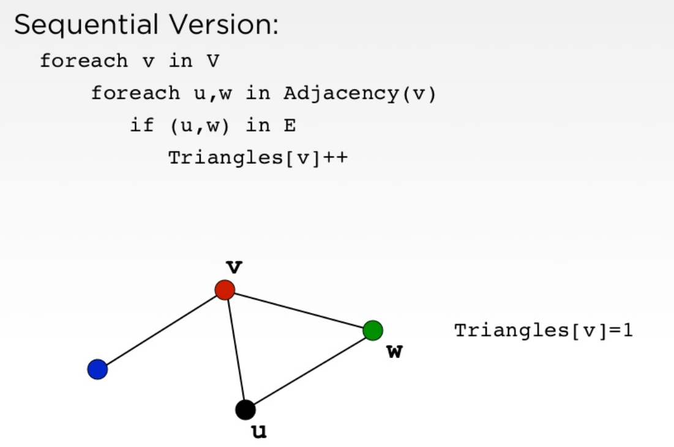
NodeIterator

Slide 22
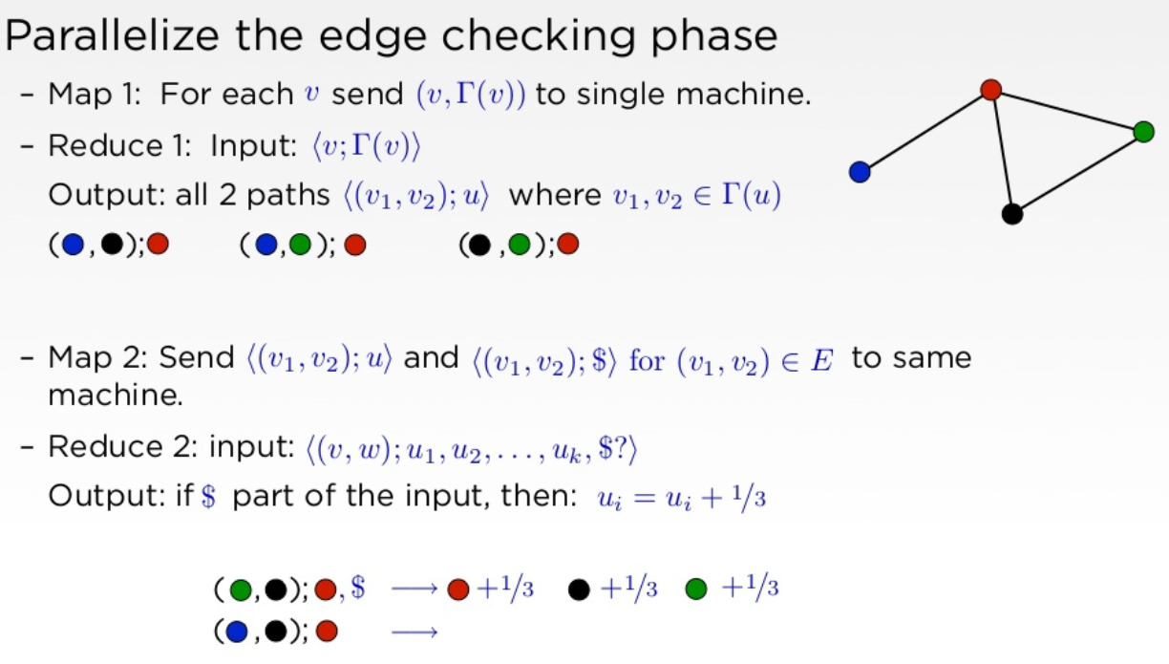
Parallel Version

Slide 23
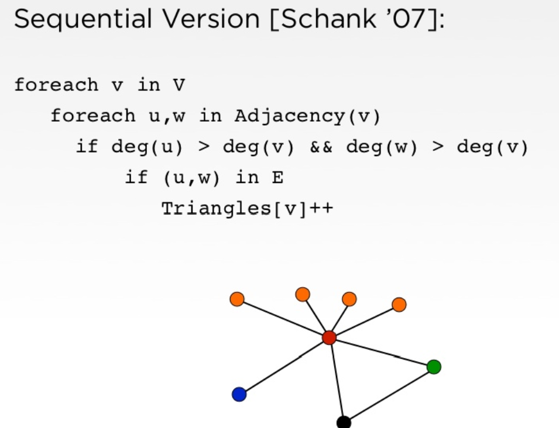
NodeIterator
> : total order on all of the vertices

Slide 24
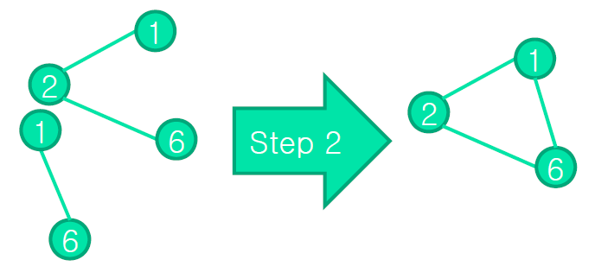
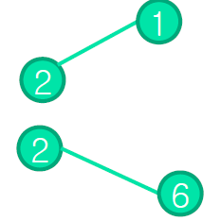

Triangle Counting Algorithm Using MapReduce
Step 1
Generate the possible length two paths in the graph by pivoting on every node in parallel
Step 2
Check which of the length two paths generated in Step1 can be closed by an edge in the graph and count the triangles accordingly

Slide 25
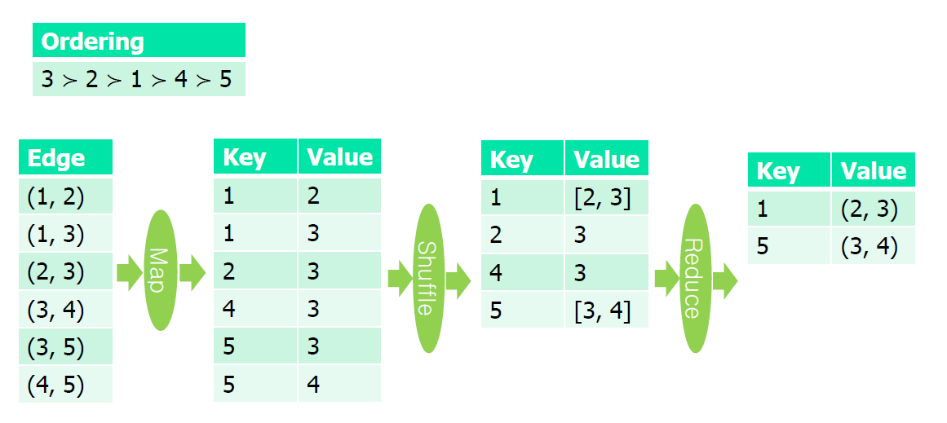
Triangle Counting Algorithm Using MapReduce

Slide 26
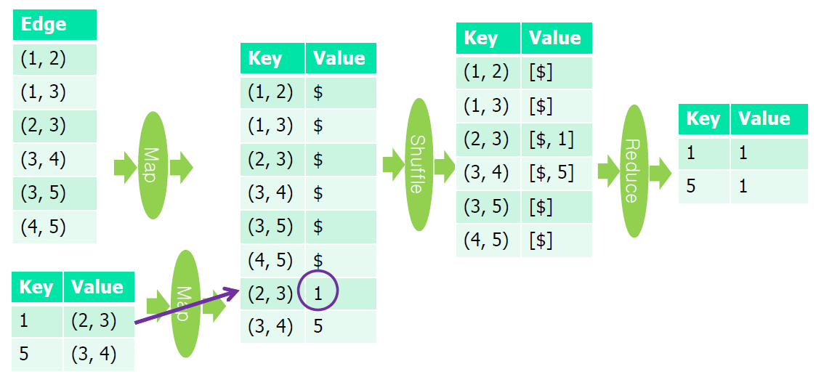
Triangle Counting Algorithm Using MapReduce

Slide 27
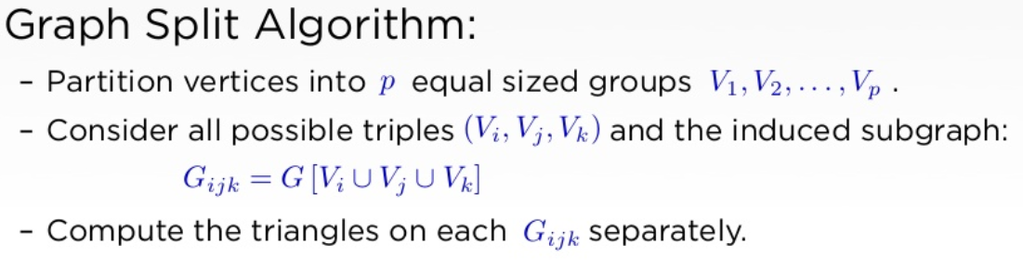
Partition Algorithm [1/2]
V₁
V₂
V₁
V₂
V₃
{V_{1,} V₂, V₃}
{V_{1,} V₂, V₄}
{V_{1,} V₃, V₄}
{V_{2,} V₃, V₄}
V₁
V₂
V₃
V₄
V₄

Slide 28
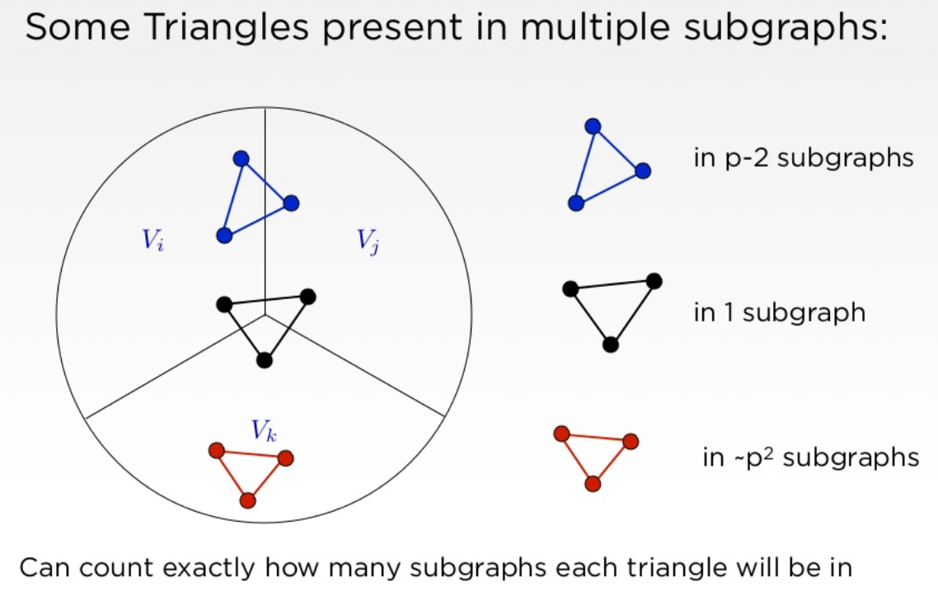
Partitioning Algorithm [2/2]

Slide 29
PEGASUS: Mining Peta-scale Graphs
[Kang, et al: Knowledge and Information Systems 2011]
An open source peta graph mining library
Implemented on the top of the Hadoop
Use a repeated matrix-vector multiplication
Achieve scale-up on the number of machines and linear running time on the number of edges
Perform typical graph mining tasks such as
Computing the diameter of the graph
Computing the radius of each node
Finding the connected components
Computing the importance score of nodes (PageRank, personalized PageRank…)

Slide 30
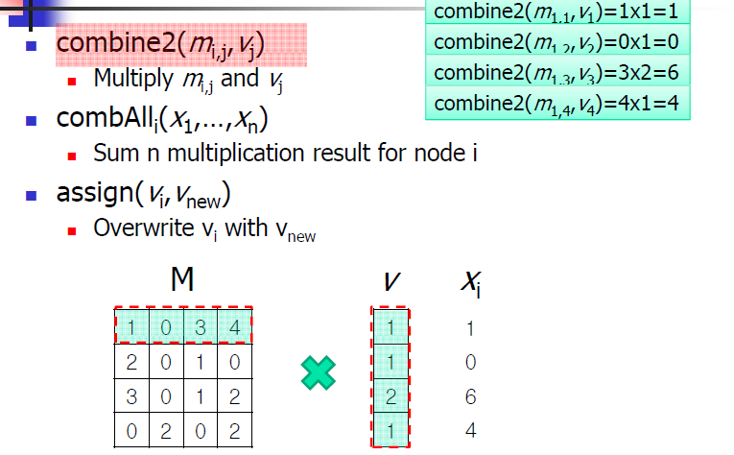
Operations in the usual matrix-vector multiplication

Slide 31
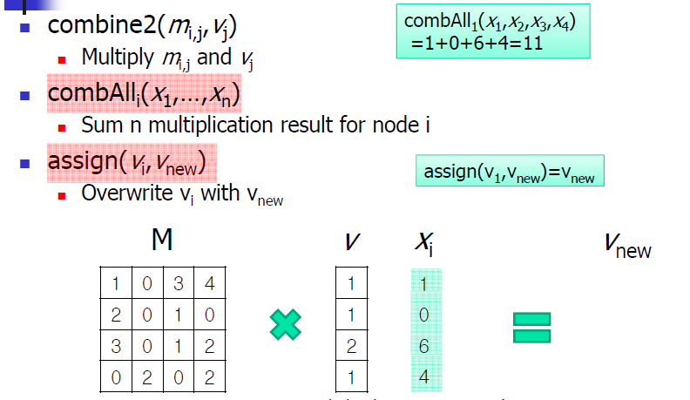
Operations in the usual matrix-vector multiplication

Slide 32
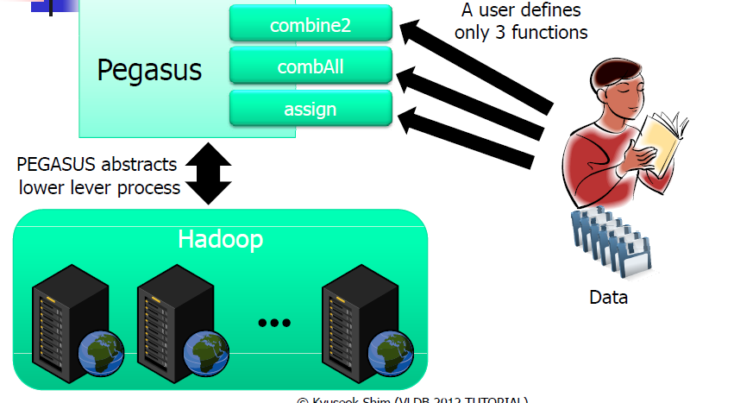
How PEGASUS Works

Slide 33
Challenging Issue: Reachability query
The problem: Given two vertices u and v in
a directed graph G, is there a path from u to v ?
15
14
?Query(1,11)
Yes
?Query(3,9)
No
11
13
10
12
6
7
8
9
3
4
5
1
2
Directed Graph → DAG (directed acyclic graph) by
coalescing the strongly connected components

Slide 34
GRIPP : SIGMOD 2007
Pre- and Postorder Numbering For Trees
Node labeling during depth-first traversal of G.
[ 0, 17 ]
R
w reachable from v iff
v_{pre} < w_{pre} < v_{post}
[ 1, 16]
A
[ 2, 7]
[ 8, 9]
[ 10, 15]
E reachable from A?
E_{pre} = 3
A_{pre} = 1, A_{post} = 16
1 < 3 < 16 ⇨ true
B
C
D
[ 3, 4]
[ 5, 6]
[ 11, 12]
[ 13, 14]
E
F
G
H

Slide 35
GRIPP Index : Non-tree
Depth-first traversal of G
Node | pre | post | inst
R | 0 | 21 | tree
A | 1 | 20 | tree
B | 2 | 7 | tree
E | 3 | 4 | tree
F | 5 | 6 | tree
C | 8 | 9 | tree
D | 10 | 19 | tree
G | 11 | 14 | tree
B | 12 | 13 | Non-tree
H | 15 | 18 | tree
A | 16 | 17 | Non-tree
[0
21 ]
R
[16
17 ]
[1
20 ]
A
[8
9 ]
[10
19 ]
[2
7 ]
B
C
D
[12
13 ]
[3
[5
6 ]
4 ]
[11
14 ]
E
F
[15
18 ]
G
H

Slide 36
Dual Labeling: ICDE 2006
[0, 21 ]
Naïve Dual Labeling:
Tree Interval-Based Labeling
Link Table
[1, 8]
[9, 20]
X
11 → [1, 8]
16 → [10, 15]
[2, 7]
[10, 15]
[16, 19]
Y
[3, 4]
[5, 6]
[13, 14]
[11, 12]
[17, 18]

Slide 37
Dual Labeling
[0, 21 ]
A
Case 1:
Query B → F ?
17 ∈ [9, 20]
[1, 8]
[9, 20]
X
B
Case 2:
Query C → X ?
[2, 7]
[10, 15]
[16, 19]
G
Y
C
16 → [10, 15]
11 ∈ [10, 15]
11 → [1, 8]
YES
[3, 4]
[5, 6]
[13, 14]
H
I
D
E
F
[11, 12]
[17, 18]

Slide 38
2-hop labeling : SODA 02
u₀
u₁
vertex | 2-hop Labeling
u0 | L_{in}(u₀)={} , L_{out}(u₀)={ u₂ , u₃}
u1 | L_{in}(u₁)={}, L_{out}(u₁)={u₂,u₃}
u2 | L_{in}(u₂)={u₂ , u₃}, L_{out}(u₂)={u₂}
u3 | L_{in}(u₃)={u₃}, L_{out}(u₃)={u₂,u₃}
u4 | L_{in}(u₄)={u₂, u₃}, L_{out}(u₄)={}
u₂
u₃
hops
u₄
u₀
u₁
u₃
u₀
u₁
u₂
u₃
u₄
u₂
u₄

Slide 39
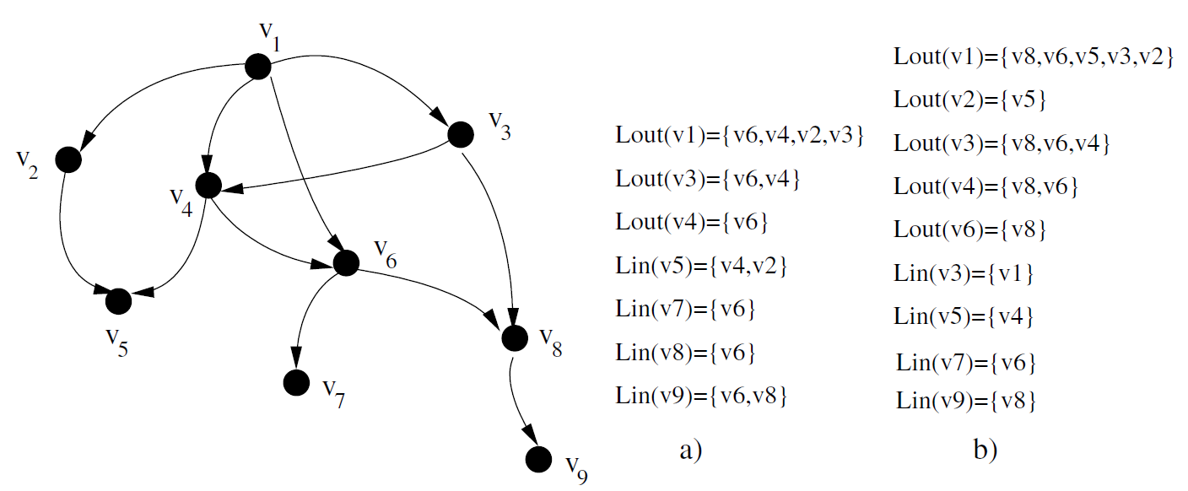
2-hop

Slide 40
Prime Number labeling :DASFAA 2006
1155
1
(1*1)
15
77
2
(1*2)
3
(1*3)
3
5
7
11
10
(2*5)
14
(2*7)
33
(3*11)
39
(3*13)
Bottom-up labeling scheme
Top-down labeling scheme
<from “A Prime Number Labeling Scheme for dynamic ordered XML Trees,
In ICDE 2004>

Slide 41
Prime Number Labeling: DAG
(2 * 1 = 2)
A
C
(17 * 2 = 34)
(3 * 2 * 34 = 204)
(19 * 34 = 646)
B
E
F
(23 * 34 = 782)
(5 * 204 = 1020)
D
G
(11 * 204 * 646 * 782= 1133605968)
H
I
(13 * 1133605968 = 14736877584)
(7 * 1020 * 1133605968 = 8093946611520)

Slide 42
Prime Number Labeling : LCM
(2, 2*1 = 2, 1)
A
C
(17, 17*lcm(2) = 34, 2)
(3, 3*lcm(2,34) = 102, 34)
(19, 19*lcm(34)=646, 17)
B
E
F
(23, 23*lcm(34)=782, 17)
(5, 5*lcm(102)=510, 3)
D
G
(11, 11*lcm(102,646,782)=490314, 1311)
(13, 13*lcm(490314)=6374082, 11)
H
I
(7,7*lcm(510,490314)=17160990, 55)

Slide 43
Prime Number Labeling: Topological Sort
Vertices on the top of the hierarchy should be assigned small prime numbers as early as possible
Topological sort of a DAG provides the character we need
E.g.)
A
C
“A, C, E, F, B, D, G, H, I”
“2, 3, 5, 7, 11, 13, 17, 19, 23”
B
E
F
D
G
H
I

