Slide 1
Google News Personalization: Scalable Online Collaborative Filtering
Abhinandan Das, Mayur Datar, Ashutosh Garg @ Google
Shyam Rajaram @ UIUC
11 Aug. 2014
SNU IDB Lab.
Lee, Inhoe
Notes:
Google News Personalization: Scalable Online Collaborative Filtering

Slide 2
Outline
Background
Introduction
Motivation
Method
System
Algorithms
Result
Conclusions

Slide 3
Background
Information overflow with the advent of technologies like Internet
People are drowning in data pool without getting right information they want
Challenge:
To find right information
Right Information:
Something that will answer users’ query
Something that user would love to read, listen or see
Solution:
Search Engines
Solve the first requirement
What if user does not know what to look for ?

Slide 4
Introduction: Collaborative Filtering
It is a technology that aims to learn user preferences and make recommendations based on user and community data
Example:
Amazon: User’s past shopping history is used to make recommendations for new products
Netflix, movie recommender
Recommendations for clubs, cosmetics, travel locations
Personalized Google News

Slide 5
Motivation
Google News is visited by several millions in a period of few days
There are lots of articles being created each day
Scalability is a big issue for such personalized system
The items cannot be static as the articles are changing very fast
Existing recommender system thus unsuitable for such need
Need for a novel scalable algorithm
Notes:
Moreover, since it is a news based system, the items cannot be static as the articles are changing very fast
Novel: 참신한

Slide 6
Google News System
Google news record
the search queries and clicks on news stories
Makes previously read articles easily accessible
Recommends top stories based on past click history
Recommendations based on:
Click history
Click history of the community
User’s click on an article is treated as positive vote
Could be noisy
No negative votes

Slide 7
Problem statement
Given a click history of N users,
U = {u1, u2, u3, u4, u5,…, uN }
And M items
S = {s1, s2, …, sM }
User u with click history set Cu consisting of stories
{si1, si2, …, si|Cu| }
System is to recommend K stories that user might be interested in
Incorporate user feedback instantly
Notes:
U1 이런 거 고치기
즉각적인 User feedback 포함해야 한다

Slide 8
Related Work: Architectures and algorithm
Algorithms
Memory-based algorithms
Predictions made based on past ratings of the user
Weighted average of ratings given by other users
Weight is the similarity of users
( Pearson correlation coefficient, cosine similarity)
Model-based algorithms
A model of the user developed based on their past ratings
Use the models to predict unseen items
(Bayesian, clustering etc. )

Slide 9
Proposed System
Mixture of
Model based algorithms
Probabilistic Latent Semantic Indexing
MinHash
Memory based algorithms
Item co-visitation
The scores given by each algorithm is combined as
ΣWa Rs
where Wa is the weight given to algorithm ‘a’ and Rs is its rank
Notes:
Wa 이런거 고치기
Ras - is the score given by algorithm ‘a’ to story s

Slide 10
Algorithms
MinHash
A probabilistic clustering method that assigns a pair of users to the same cluster with probability proportional to the overlap between the set of items that these users have voted for
User U is represented by a set of items that she has clicked, Cu
The similarity between their item-sets is given be :
S(ui, uj) = | Cui, ∩ Cuj | (Jaccard Coeffient)
| Cui U Cuj |
Similarity of a user with all other users can be calculated
Not scalable in real time

Slide 11
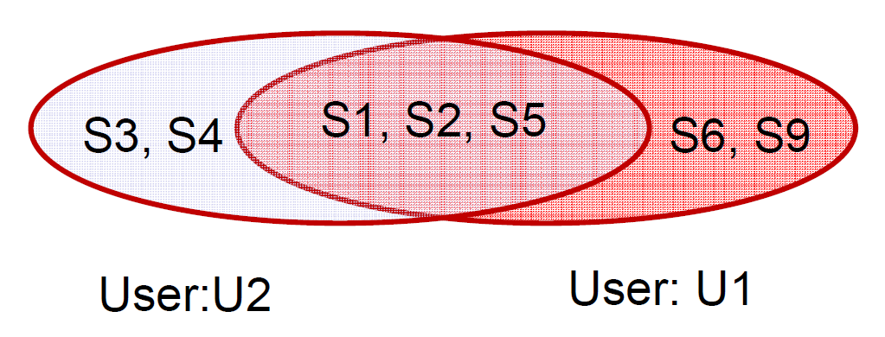
MinHash: Example
User u1 clicks on the items:
S1, S2, S5, S6, S9
Similarly, user u2 clicks on the items:
S1, S2, S3, S4, S5
Jaccard Coefficient : 3/7

Slide 12
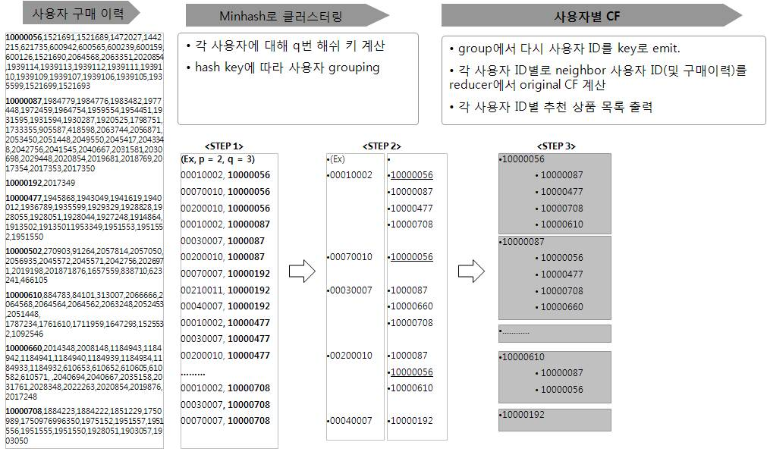
MinHash: Example
Notes:
Cu 이런거 바꿔주기
Minhash는 한 사용자의 구매 기록을 0에서 M사이의 값을 가지는 p개의 hash key의 concatenation으로 바꾸고, 이 값을 특정 사용자의 group ID로 사용합니다. 적용 데이터 형태에 따라 사용해야 할 Minhash 함수가 달라지는데, 0/1 구매기록의 경우에는 h(x)=(ax+b)mod M을 사용합니다. p가 커지면 커질수록 Minhash key로 구한 jaccard 유사도와, 원래의 구매 이력으로 계산한 jaccard 유사도가 비슷해집니다. 하지만 Minhash를 해보면 p값이 작으면 전혀 유사성 없는 사용자들만 모인 그룹이 생기거나, p가 커지면 동일 그룹내에 모이는 사용자가 너무 없기도 한데요, 이걸 보완하기 위해 한 명의 사용자에 대해서 q번 만큼 Minhash key를 생성해 한명의 사용자가 최대 q개의 서로 다른 그룹에 속하게 합니다. 이 때 각 그룹은 어느 정도 확률적으로 서로 구매 이력이 비슷한 사용자들이 모여 있게 되고, 이 그룹에서 다시 각 사용자를 key로 해서, 같은 그룹에 있던 모든 사용자들을 value로 해서 내보내면, 마지막으로 한 명의 사용자에 대해 어느 정도 유사한 구매 이력을 가진 사용자들을 모을 수 있습니다. 이렇게 target 사용자 1명과 이 사용자와 유사한 사용자 k명이 모인 데이터가 있으니, sequential하게 각 사용자와의 유사도를 구하면서 동시에 아이템 별로 가중치도 incremental하게 k명까지 죽 계산하면 해당 target 사용자에 대한 선호도 매트릭스 값이 나옵니다.
- 1st Map: 각 사용자별 구매 로그 기반 Minhash key 계산 - 1st Reduce: Group ID별 사용자 모으기 - 2nd Map: 사용자별 grouping을 위해 다시 각 사용자를 key로 해서 emit. - 2nd Reduce: 각 사용자별로 유사 사용자 그룹 모으고, CF 계산

Slide 13
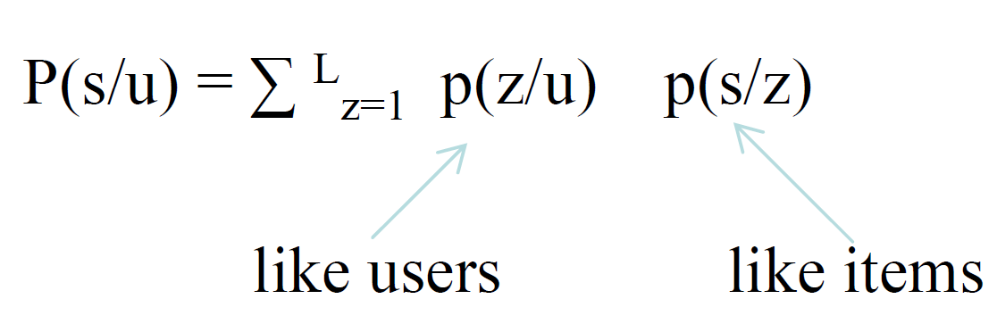
Algorithms
Probabilistic Latent Semantic Indexing[PLSI] *
With users U and items S, the relationship between users and items is learned by modeling the joint distribution of users and items as a mixture distribution
A hidden variable Z is introduced to capture this relationship, which can be thought of as representing user communities(like minded users) and item communities(like items)
Mathematically,
The conditional probabilities p(z/u) and p(s/z) are learned from the training data using Expectation maximization algorithm
* T. Hofmann. Latent Semantic Models for Collaborative Filtering. ACM Transactions on Information Systems, 2004
Notes:
C=UZS
Z=diagonal matrix

Slide 14
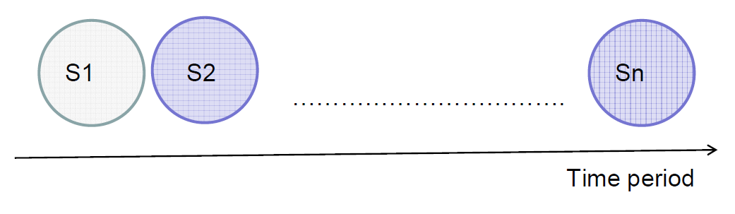
Algorithms
Co-visitation
Two stories are clicked by the same user within a certain time interval
Store as a graph with nodes at stories, edges as age discounted covisitation counts
Update graph (using user history) whenever we receive a click
Notes:
Si 같은 거 고치기
time interval (few hours)
“Users who viewed this item also viewed the following items”

Slide 15
Data stored
User Table:
Cluster information (MinHash and PLSI)
Click history
Story Table:
Cluster Statistics: How many times was the story S clicked on by users from each cluster C
Co-visitation: How many times was story S co-visited with each story S’

Slide 16
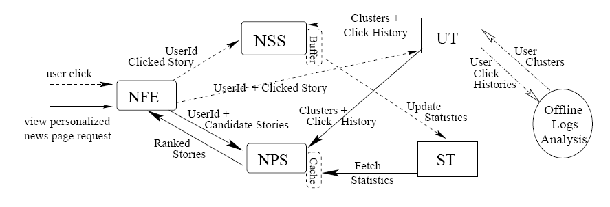
System Components
NFE: News Front End NPS: News Personalization Server
NSS: News Statistics Server UT: User Table ST: Story Table

Slide 17
Evaluation
Train: 80%
Test: 20%
Data | Users | Items | Clicks(ratings)
Movie Lens | 943 | 1,670 | 54,000
NewsSmall | 5,000 | 40,000 | 370,000
NewsBig | 500,000 | 190,000 | 10,000,000
Notes:
Movie Lens: 943 users, 1670 movies, 54,000 ratings
NewsSmall: top 1,000제외한 top 5,000 users, 40,000 items, 370,000 clicks
NewsBig: 500,000 users, 190,000 items, 10,000,000 clicks
80%-20% (train to test)

Slide 18
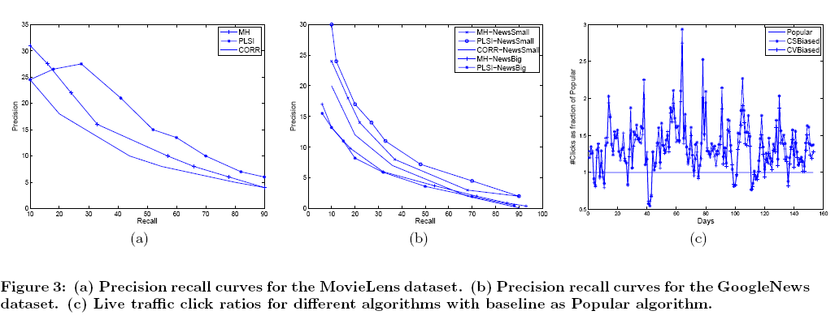
Evaluation Results
Notes:
Movie Lens: 943 users, 1670 movies, 54,000 ratings
NewsSmall: top 1,000제외한 top 5,000 users, 40,000 items, 370,000 clicks
NewsBig: 500,000 users, 190,000 items, 10,000,000 clicks
80%-20% (train to test)
Precision – what fraction of the recommendations were actually clicked in the hold-out or test set)
Recall – what fraction of the clicks in the hold-out set were actually recommended
PLSI 가 가장 좋네
CORR – Big 은 scalable하지 않아서 못함
©는 live traffic
CS Biased: PLSI, MinHash 에 weight
CV Biased: covisitation에 higher weight
Popular보다 CS,CV가 38% 좋다

Slide 19
Conclusion and Future Work
Algorithms for scalable real time recommendation engines presented
The system is content independent and thus easily extendible to other domains
As a future work, suitable algorithm can be explored to determine how to combine scores from different algorithms

Slide 20
Analysis
The paper has successfully addressed the problem of scalability for large recommender systems
Evaluation based on content could be an open research problem
It can be argued that instead of only considering user click for clustering similar users, content based clustering of the stories could open up more similarity metrics for the recommendation system
The precision lies around 30% for the current system showing that more study needs to be done in the field

