Slide 1

Modern Information Retrieval
Ricardo Baeza-Yates and Berthier Ribeiro-Neto
Chapter 8. Indexing & Searching
July 15, 2010
Hyunwoo Kim

Slide 2
Contents
Introduction
Inverted Files
Suffix Trees and Suffix Arrays
Signature Files
Boolean Queries
Sequential Searching
Pattern Matching
Trends and Research Issue

Slide 3
Introduction
Searching
Online text searching (Sequential Searching)
Scan the text sequentially
Indexed searching
Build data structures over the text to speed up the search
Semi-static collections: updated at reasonably regular interval
Indexing techniques
Inverted files
Suffix (PAT) arrays
Signature files

Slide 4
Introduction
n: the size of text databases
m: the length of the search patterns (m<n)
M: the amount of memory available
n’: the size of texts that are modified (n’<n)
Experiments
32bit Sun UltraSparc-1 of 167 MHz with 64 MB of RAM
TREC-2 (WSJ, DOE, FR, ZIFF, AP)

Slide 5
Contents
Introduction
Inverted Files
Suffix Trees and Suffix Arrays
Signature Files
Boolean Queries
Sequential Searching
Pattern Matching
Trends and Research Issue

Slide 6
Inverted Files
Assumption:
Each document is assigned a list of keywords
Word-oriented mechanism
Vocabulary + Occurrences
Vocabulary: set of all different words in the text
Occurrences: position where the word appears
Position i refers to i-th word or i-th character positions

Slide 7
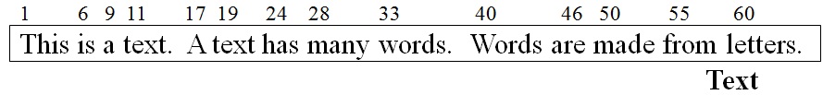
Inverted Files
Vocabulary Occurrences
Letters 60 …
Made 50 …
Many 28 …
Text 11, 19 …
Words 30, 40 …
… …
Addressing granularity:
Inverted list – word positions, character positions
Inverted file – document

Slide 8
Inverted Files
Heaps’ law: the vocabulary grows as O(n^{β}), where β=0.4~0.6
Vocabulary for 1GB of TREC-2 collection: 5MB
Occurrences demand much more space
The extra space O(n)
30% ~ 40% of the text size
Full inverted indices
Point to exact occurrences
Blocking addressing
Point to the blocks where the word appears
Pointers are smaller
5% overhead over the text size

Slide 9
Blocking Addressing
Vocabulary Occurrences
letters 4 …
made 4 …
many 2 …
text 1, 2 …
words 3 …
… …

Slide 10
Inverted Files Structure
Sorted Arrays
Store the list of keywords in a sorted array
Using a standard binary search
Advantage: easy to implement
Disadvantage: updating the index is expensive
B-Trees
Tries
Hashing Structures
Combinations of these structures

Slide 11
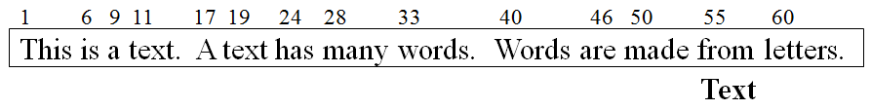
Trie Example
letters: 60
made: 50
‘l’
‘d’
‘a’
‘m’
‘n’
many: 28
‘t’
text: 11, 19
‘w’
< Vocabulary trie >
words: 33, 40

Slide 12
Construction of Inverted Index
1. The input text is parsed into a list of words along with their location in the text
2. This list is inverted from a list of terms in location in order to a list of terms in alphabetical order.
3. Add term weights, or reorganize or compress the files

Slide 13
Contents
Introduction
Inverted Files
Suffix Trees and Suffix Arrays
Signature Files
Boolean Queries
Sequential Searching
Pattern Matching
Trends and Research Issue

Slide 14
Suffix Trees and Suffix Arrays
Problems of inverted index
Keywords must be extracted from the text (indexing)
Queries are restricted to keywords
New indices for text
A text is regarded as a long string.
Each position corresponds to a semi-infinite string (sistring)
Suffix: a string that goes from a text position to the end of the text
Each suffix is uniquely identified by its position
No structures and no keywords

Slide 15
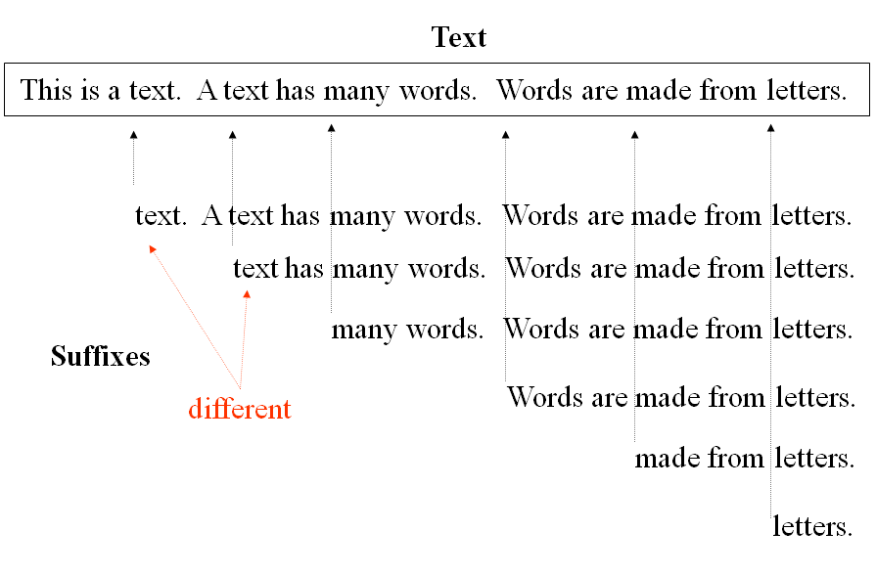
Suffix Trees and Suffix Arrays
words. Words are made from letters.
Index points are selected from the text, which
point to the beginning of the text positions which
are retrievable.

Slide 16
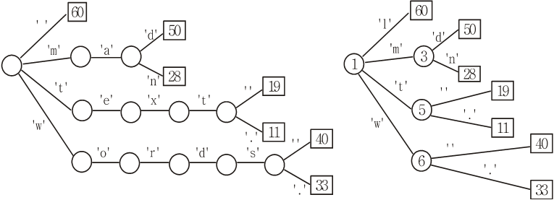
Suffix Trie versus Suffix Tree
< Suffix Trie >
< Suffix Tree >

Slide 17
Suffix Trees and Suffix Arrays
Suffix tree drawback
A space overhead
120% ~ 240% over the text size is produced
Suffix trees represented as arrays (suffix array)
40% overhead over the text size
Suffix array
A space efficient implementation of suffix tree

Slide 18
Suffix Array
60 | 50 | 28 | 19 | 11 | 40 | 33
Suffix Array

Slide 19
Suffix Array
lett |  | text |  | word
Supra-Index
60 | 50 | 28 | 19 | 11 | 40 | 33
Suffix Array

Slide 20
Searching in Suffix Tree
Suffix tree
Searched in O(m)
Fast, but not practical for large text
240% overhead over the text size
Suffix array
Searched in O(log n) by using binary search
Slow, but practical for large text
40% overhead over the text size

Slide 21
Contents
Introduction
Inverted Files
Suffix Trees and Suffix Arrays
Signature Files
Boolean Queries
Sequential Searching
Pattern Matching
Trends and Research Issue

Slide 22
Signature Files
Word-oriented indexing structure based in hashing
A low overhead
10% to 20% over the text size
Suitable for not very large texts
Their signatures (hash-coded bit patterns) are stored in the signature file
Using OR operation
False hits may also happen accidentally

Slide 23
Signature Files
000101 |  | 110101 |  | 100100 |  | 101101
h(text) = 000101
h(many) = 110000
h(words) = 100100
h(made) = 001100
h(letters) = 100001

Slide 24
Contents
Introduction
Inverted Files
Suffix Trees and Suffix Arrays
Signature Files
Boolean Queries
Sequential Searching
Pattern Matching
Trends and Research Issue

Slide 25
Boolean Queries
Optimize the tree using identities
a AND (a or b) = a
(a)
AND
AND
4 6
full evaluation
1 4 6
OR
1 4 6
2 3 4 6 7
2 4 6
2 3 7
(b)
AND
AND
AND
AND
AND 4
AND 6
1
OR 2
4
OR 2
4
OR 3
4
OR 4
6
OR 6
OR 7
lazy evaluation
4
3
4
3
4
7
6
7
7

Slide 26
Contents
Introduction
Inverted Files
Suffix Trees and Suffix Arrays
Signature Files
Boolean Queries
Sequential Searching
Pattern Matching
Trends and Research Issue

Slide 27
Brute Force (BF)
Trying all possible position in the text
Worst case O(mn), average case O(n)
a | b | r | a | c | a | b | r | a | c | a | d | a | b | r | a
a | b | r | a | c | a | d
a
a
a | b
a
a | b | r | a | c | a | d | a | b | r | a
Brute Force search algorithm for the pattern ‘abracadabra’

Slide 28
Knuth-Morris-Pratt (KMP)
Linear worst case behavior
Reusing information from previous search
O(m) for preprocessing
Skipping (j - next[j] + 1) position

Slide 29
Knuth-Morris-Pratt (KMP)
Aho-Corasick algorithm
Extension of KMP

Slide 30
Boyer-Moore Family
Checking inside the window backward
Combining suffix match heuristic and occurrence heuristic
Occurrence heuristic
‘c’ in ‘r’ position -> find the nearest ‘c’
Match heuristic
Found ‘a’ -> largest index of ‘a’ except matched last ‘a’
Choose one which skips more character
a | b | r | a | c | a | b | r | a | c | a | d | a | b | r | a
a | b | r | a | c | a | d | a | b | r | a
Occurrence heuristic
a | b | r | a | c | a | d | a | b | r | a
Match heuristic
 |  |  |  |  |  |  | a | b | r | a

Slide 31
Contents
Introduction
Inverted Files
Suffix Trees and Suffix Arrays
Signature Files
Boolean Queries
Sequential Searching
Pattern Matching
Trends and Research Issue

Slide 32
String Matching Allowing Errors
Problem Definition
Given pattern P and text T, maximum number of errors k
Find all position where pattern occurs with at most k errors
Main approach
Dynamic Programming

Slide 33
String Matching Allowing Errors
Dynamic Programming
Matrix C[0…m, 0…n], where C[i,j] is minimum numbers of errors to match P_{1..i} to text T_{1..j}
Algorithm
C[0,j] = 0
C[i,0] = i
C[i,j] = if (Pi = Tj) then C[i-1, j-1]
else 1 + min(C[i-1,j], C[i, j-1], C[i-1, j-1])
Example of searching ‘survey’ in text ‘surgery’
 |  | s | u | r | g | e | r | y
 | 0 | 0 | 0 | 0 | 0 | 0 | 0 | 0
s | 1 | 0 | 1 | 1 | 1 | 1 | 1 | 1
u | 2 | 1 | 0 | 1 | 2 | 2 | 2 | 2
r | 3 | 2 | 1 | 0 | 1 | 2 | 2 | 3
v | 4 | 3 | 2 | 1 | 1 | 2 | 3 | 3
e | 5 | 4 | 3 | 2 | 2 | 1 | 2 | 3
y | 6 | 5 | 4 | 3 | 3 | 2 | 2 | 2

Slide 34
Contents
Introduction
Inverted Files
Suffix Trees and Suffix Arrays
Signature Files
Boolean Queries
Sequential Searching
Pattern Matching
Trends and Research Issue

Slide 35
Trends and Research Issues
Most adequate indexing technique is the inverted file
The other index technique is needed because specialized queries (genetic database)
The main trends in indexing and searching
Text collection are becoming huge
Searching is becoming more complex
Compression is becoming a star in the field

Slide 36
Thank You

