Slide 1
Who Says What to Whom on Twitter
Shaomei Wu, Jake M. Hofman, Winter A. Mason, Duncan J. Watts
WWW 2011
24 May 2013
SNU IDB Lab.
Namyoon Kim

Slide 2
Outline
Introduction
Data and Methods
Who Listens to Whom
Who Listens to What
Conclusions

Slide 3
Introduction (1/4)
Lasswell’s maxim:
“Who says what to whom in what channel with what effect”
Proven difficult to satisfy for more than 60 years
large populations
Channel differences

Slide 4


Introduction (2/4)
Communication theories
Mass communication
Interpersonal communication

Slide 5
Introduction (3/4)
Recent technology dilutes the mass vs. interpersonal dichotomy
Twitter represents the full spectrum of communications, from private/personal to masspersonal and mass media.
Mass media: CNN NYTimes, organizations
Masspersonal: celebrities
Interpersonals: friends

Slide 6
Introduction (4/4)
Classification of users into “elite” and “ordinary”
Investigate information flow
Emphasis on content, information lifespans

Slide 7
Data and Methods (1/7)
Twitter Follower Graph (http://an.kaist.ac.kr/traces/WWW2010.html)
42M users, 1.5B edges
Directed network graph has highly skewed distributions of in-degree (# followers) and out-degree (# friends)
Out-degree more skewed than in-degree
Low reciprocity (20%)
Twitter: not a typical social network
Resembles more of something between one-way mass communication and reciprocated interpersonal communication

Slide 8
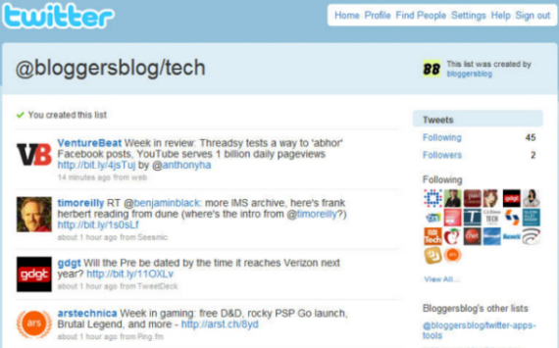
Data and Methods (2/7)
Twitter Firehose: URLs
Complete stream of all tweets
Examined corpus of 5B tweets generated from July 28, 2009 to March 8, 2010
Out of the 5B, focused on 260M shortened bit.ly URLs
Twitter Lists
Helps users organize other users they follow

Slide 9
Data and Methods (3/7)
Interested in relative importance of mass, masspersonal and interpersonal communications
Relationships between different categories of users
Four classes of “elite” users: media, celebrities, organizations, and bloggers
Media: CNN, New York Times
Organizations: Amnesty International, WWF, Yahoo!, Whole Foods
Celebrities: Barack Obama, Lady Gaga, Paris Hilton
Blogs: BoingBoing, mashable, Chrisbrogan, Gizmodo…

Slide 10
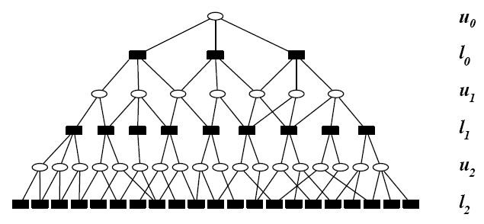
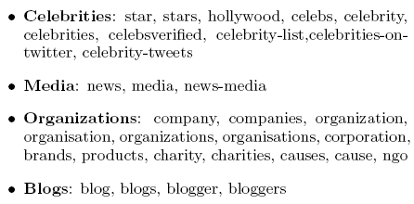
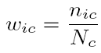
Data and Methods (4/7)
Snowball Sampling: roughly analogous to breadth-first search
Prune with keywords (ex. Lady Gaga in both “faves” and “celeb”)
Membership score for user i, in category c:
n_{ic} = # of lists in category c that contains user i, N_{c} = total # of lists of category in c
Resolves ambiguity (ex. Oprah Winfrey in both “celebrity” and “media)
keywords
Keyword-pruned
lists
seeds

Slide 11
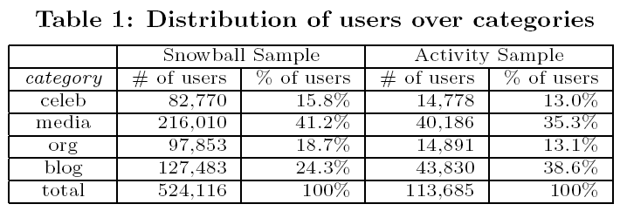
Data and Methods (5/7)
Activity Sample of Twitter Lists
Crawl all lists associated with all users who tweet at least once every week
85% of activity sample also appear in snowball sample

Slide 12
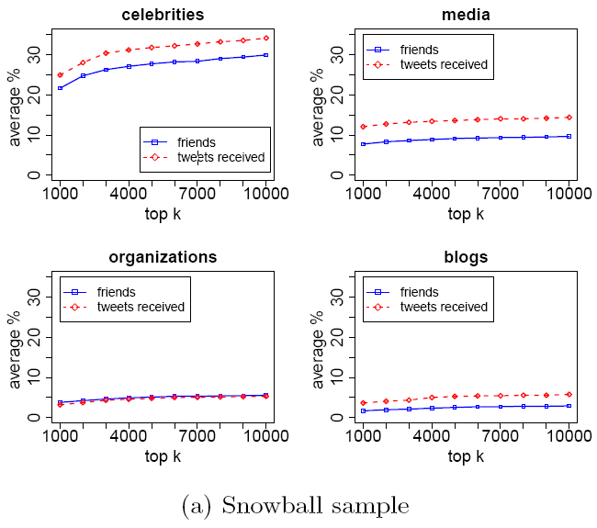
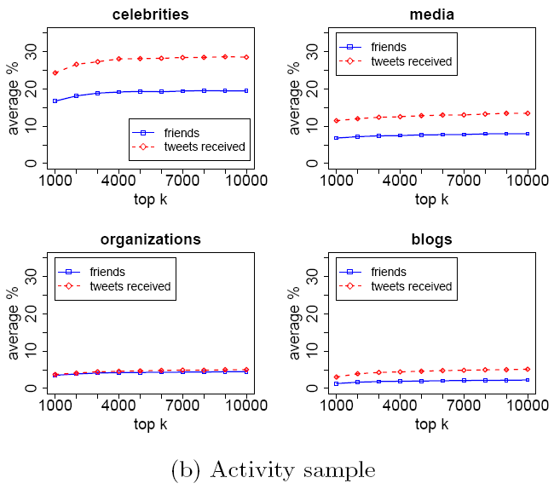
Data and Methods (6/7)
Classifying Elite Users
Rank all users in each of category by how frequently they are listed in that category (x coordinate)
Share of following (blue) and tweets (red) received for average user (random, unclassified sample of 100k users)

Slide 13
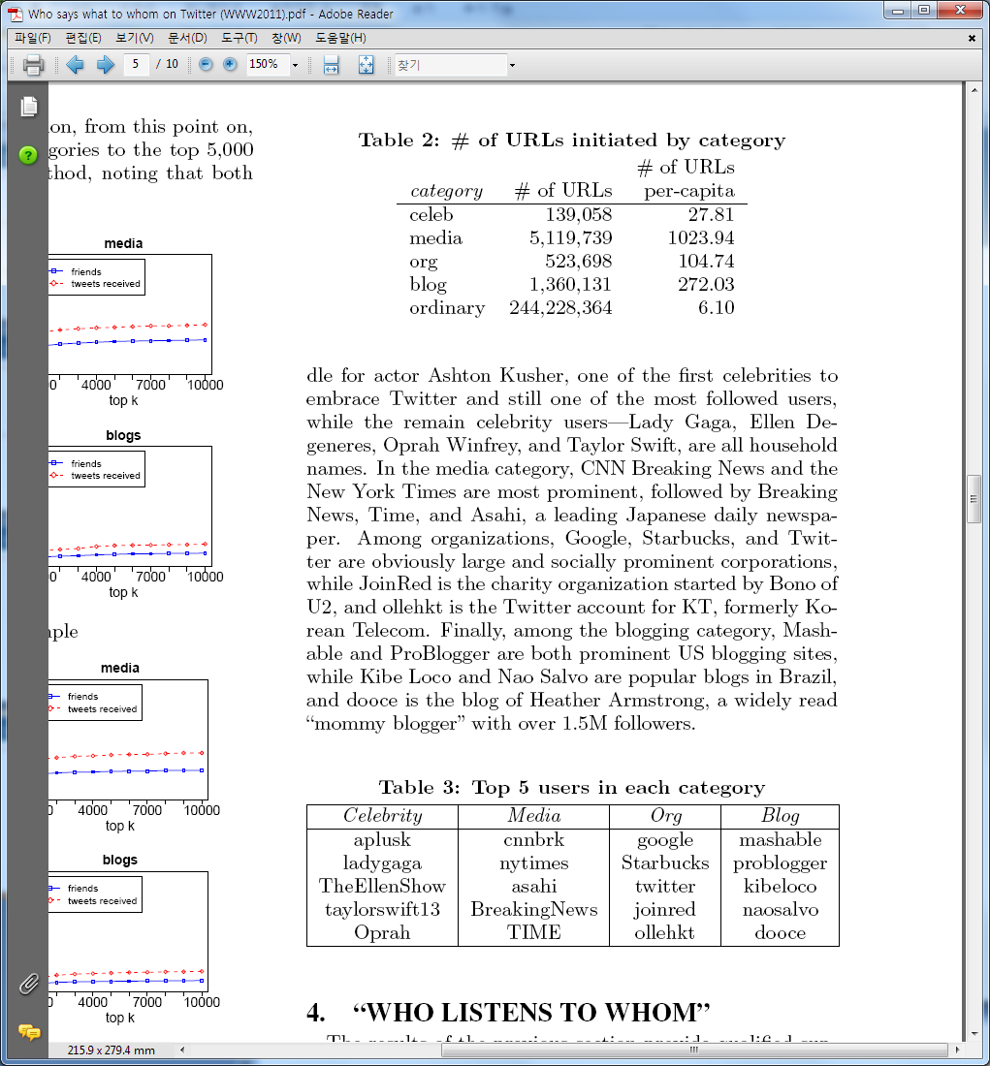
Data and Methods (7/7)
Elite users far more active URL producers
results consistent with identifying prominent users of the target categories

Slide 14
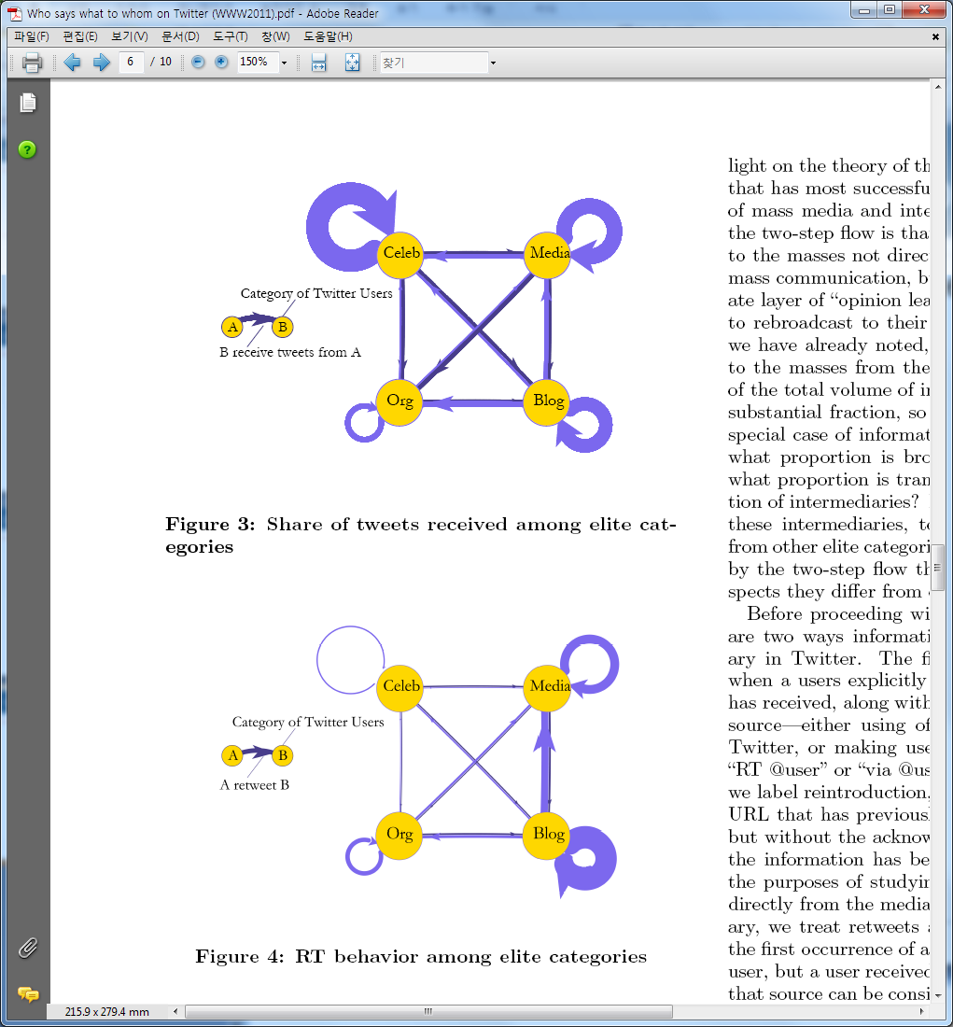
Who Listens to Whom (1/4)
20k elite users, comprising < 0.05% of the user population, attracts almost half of all attention in Twitter.
Strong homophily among elites

Slide 15
Who Listens to Whom (2/4)
Retweeting among elites
Bloggers noticeably more active retweeters; they are the recyclers of information

Slide 16
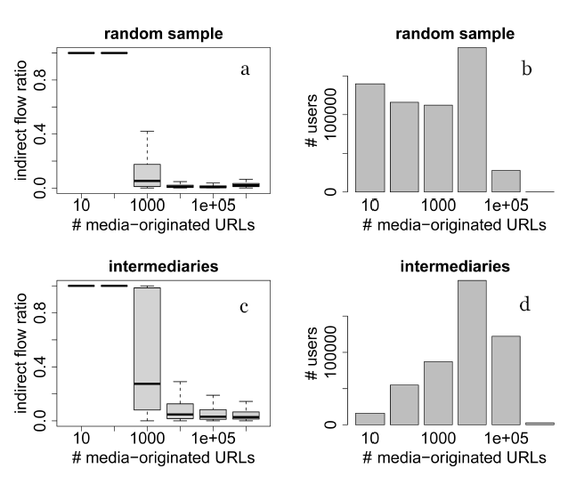
Who Listens to Whom (3/4)
Two-Step Flow of Information
Information passing through an intermediate layer of “opinion leaders”
Retweeting and reintroduction
Intermediaries exposed to much more media than random user

Slide 17
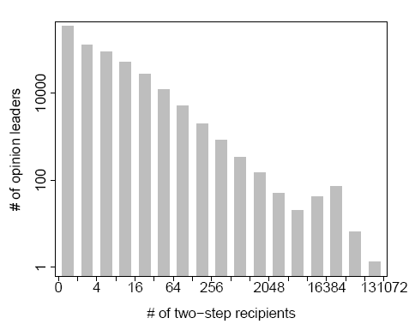
Who Listens to Whom (4/4)
~500k users act as intermediaries for 600k users
96% are ordinary
Most prominent intermediaries are disproportionately from the elite users

Slide 18
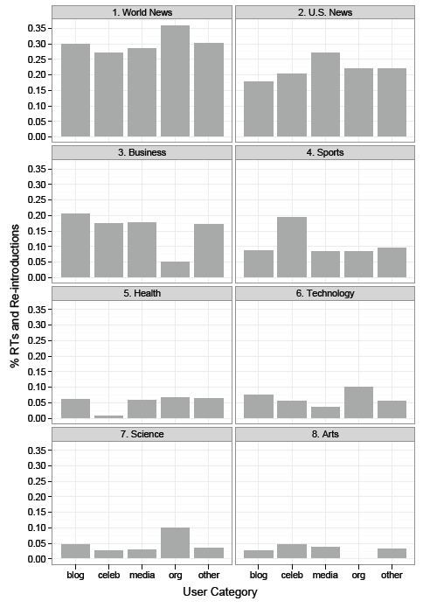
Who Listens to What (1/3)
Content categorization – New York Times

Slide 19
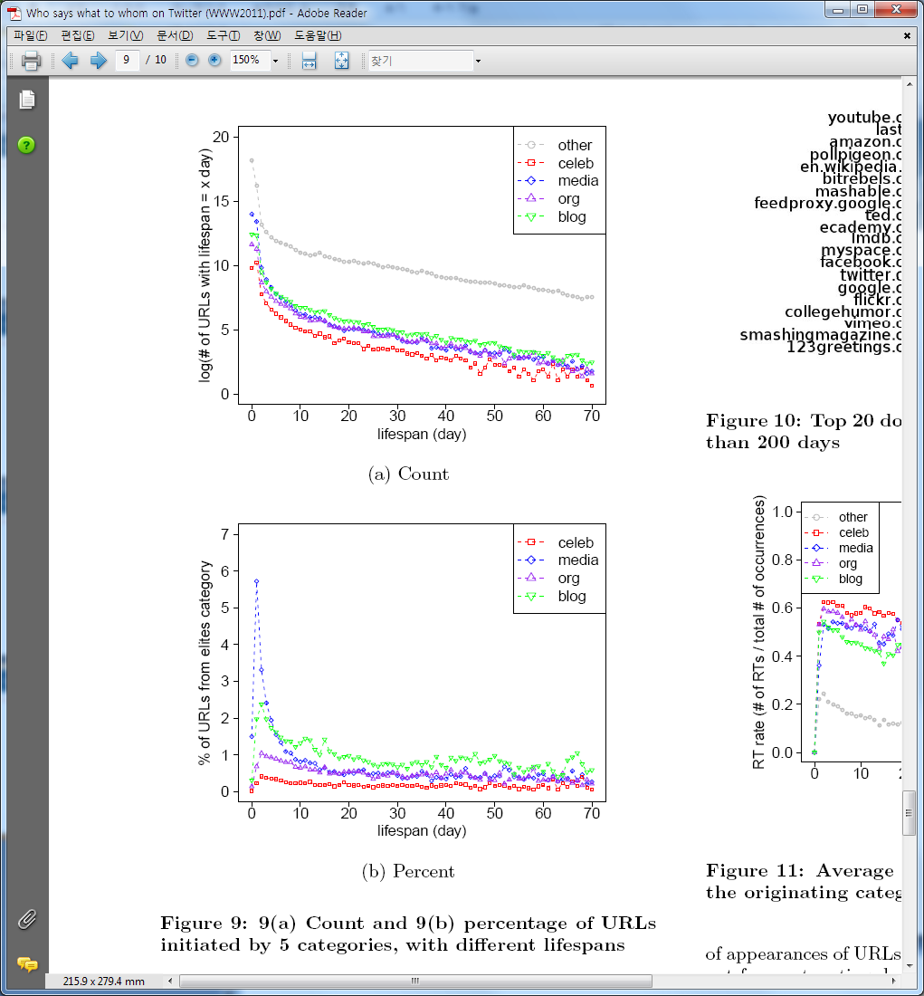
Who Listens to What (2/3)
Lifespan of content
Different categories have URLs of different lifespans
URLs from celebrities usually shortest
URLs from bloggers longer-lived

Slide 20
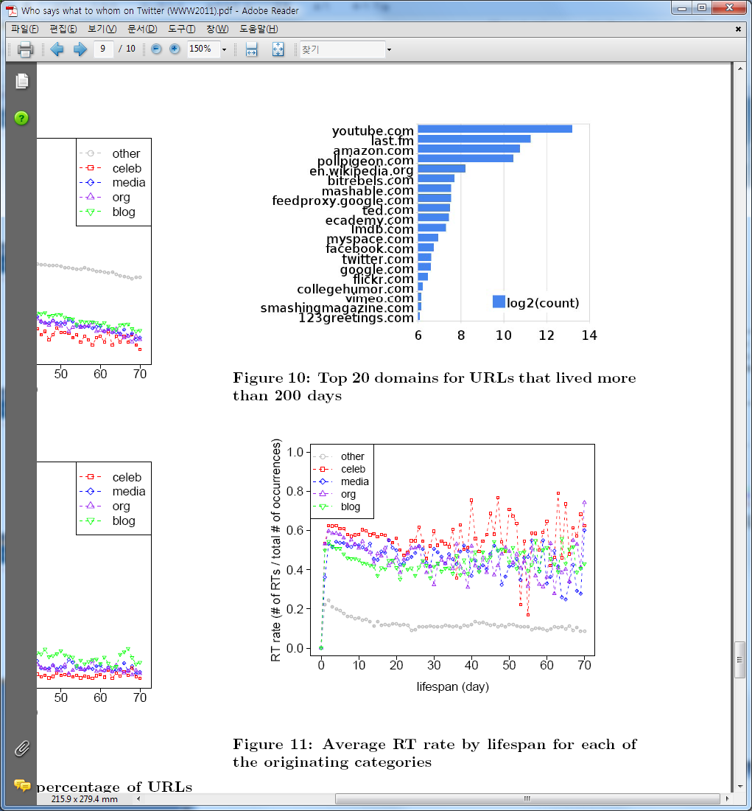
Who Listens to What (3/3)
Population of long lived URLs
Majority are reintroduced rather than retweeted
URLs introduced by elite users tend to be retweeted

Slide 21
Conclusion
Laswell’s maxim in the context of Twitter
Twitter provides unprecedented coverage of who listens to whom
Attention more fragmented than that of classical media, but still highly concentrated
Two-step flow quite apparent
Lifespans of content types differ
Future goals
Explore additional classification schemes
Explore more of the “what” element of Lasswell’s maxim
Merge Twitter information flow with other sources of outcome data (the “effects” component of Lasswell’s maxim)

