Slide 1
LOG ANALYSIS IN CLOUD COMPUTING ENVIRONMENT WITH HADOOP AND SPARK
Xiuqin LIN, Peng WANG, Bin WU
IC-BNMT2013
16 Jan 2015
SNU IDB
Hyesung Oh

Slide 2
Outline
Introduction
Batch analyses with Hadoop/Hive
Analysis capacity extensions
Cloud platform
Log analysis flow
Experiments
Conclusion

Slide 3
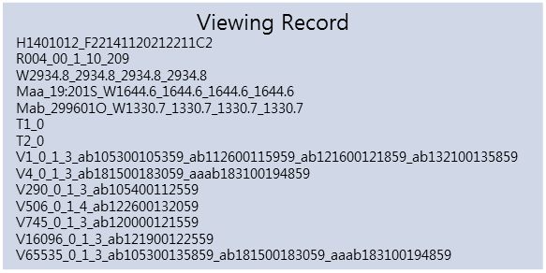
Introduction Problem statement
Log contains valuable information
Free log analysis tools
Webalizer*, Awstats**, and Google Analytics***
Standalone, limitation of data scale
How to deal with large-scale data?
Hadoop / Hive
Spark / Shark
* Webalizer. http://www.webalizer.com/.
** Awstats. http://sourceforge.net/projects/awstats/
*** Google Analytics www.google.com/analytics

Slide 4


Introduction Hive with Hadoop
Hadoop*
Popular open source distributed computing framework
Distributed file system -> HDFS(Hadoop distributed file system)
Map/Reduce
Hive**
Analytical tool of data warehouse based on Hadoop
Converts SQL statement to Map/Reduce job
Hive with Hadoop solved large scale data processing
But, not suitable for interactive query and iterative algorithm
* Hadoop. Hadoop Homepage. http://hadoop.apache.org/.
** THUSOO A, SARMA J S, JAIN N, et al. Hive-a petabyte scale data warehouse using hadoop[C]
Data Engineering (ICDE), 2010 IEEE 26th International Conference on. 2010: 996–1005.

Slide 5


Introduction Spark and Shark
Spark*
Open source in-memory distributed cluster system
Developed in the UC Berkeley AMP Lab
Designed to speed up data analysis operation
Suitable for the treatment of iterative algorithm
Machine learning, graph mining algorithm
Interactive data mining
Shark**
Data analysis tool
Compatible with Hive
Now, subsumed by Spark SQL
* Spark. Spark Homepage http://spark-project.org/.
** http://databricks.com/blog/2014/07/01/shark-spark-sql-hive-on-spark-and-the-future-of-sql-on-spark.html

Slide 6
Batch analyses with Hadoop/Hive
Hive
Provides a complete SQL query function
Converting to Map/Reduce
Hadoop
Scalability
Fault tolerace
High availability
It can be used for the ETL operations
Extract, Transform, Load
Hive
Map/Reduce
HDFS

Slide 7
Analysis capacity extensions
Spark and Shark
Efficient in-memory computation
Map/Reduce -> disk-based system
RDD(Resilient Distributed Datasets) is key concept

Slide 8
Resilient Distributed Datasets(RDD)
Read-only collection of objects partitioned across a set of machines
Can only be created through coarse-grained deterministic operations
Data in stable storage or other RDDs
Transformations(E.g., map and filter) and Actions
Return a value to the application or export data to storage system
User can cache to memory

Slide 9
Shark
Query processing with complex analysis
Can run SQL queries and sophisticated analytics functions
In-memory computing is increasingly important
A study of Facebook’s Hive warehouse
95% of queries in system could be served out of memory using just 64GB/node as a cache, even system manages 100PB of total data

Slide 10
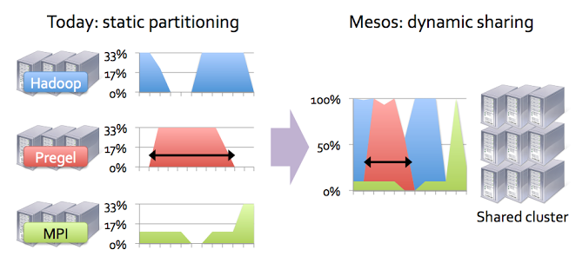
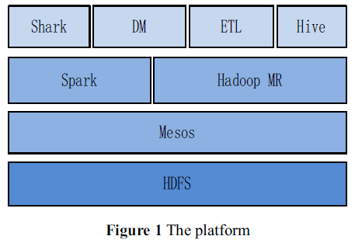
Cloud platform

Slide 11
Hadoop vs. Spark
Spark’s characteristics
Framework based on memory.
Allows user to cache the high value data in memory
Suitable for iterative algorithms and interactive ac-hoc queries
Supports a DAG(Directed Acyclic Graph) type schedule
Avoids materializing the intermediate records
Task scheduling with low latency
Hadoop launch delay : 5 ~ 10 sec
Spark uses event-driven architecture : 5 ms

Slide 12
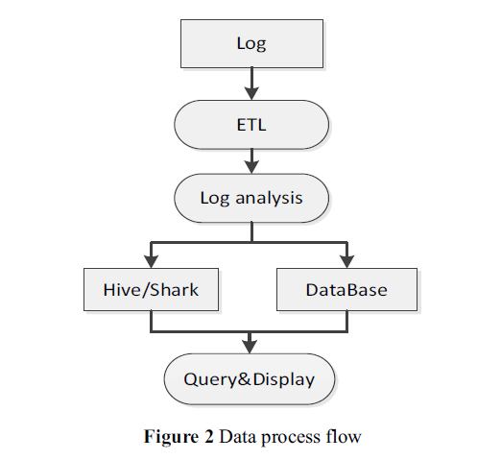
Log analysis flow

Slide 13
Experiments
Implemented Kmeans, PageRank on both Map/Reduce and Spark
Hadoop 0.20.2, Spark 0.6.0
6 nodes with 2 CPU core and 4G memory/node
Kmeans data size : 10 thousands ~ 20 million points of 30 dim
PageRank data size : 1 million to 10 million points of 7 out-degrees
Aggregation query
4 nodes with 16 CPU core, 48G momory/node
Hive 0.9.0, Shark 0.2.1

Slide 14
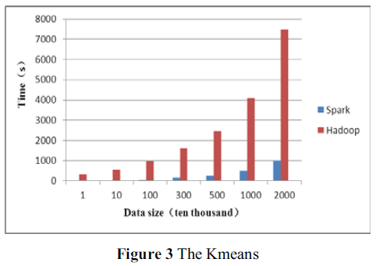
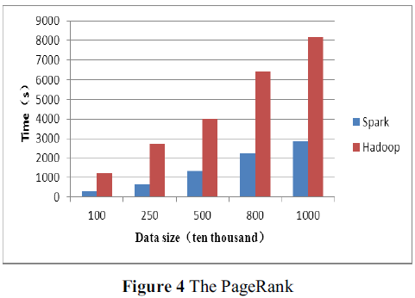
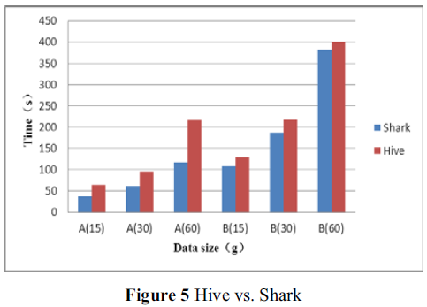
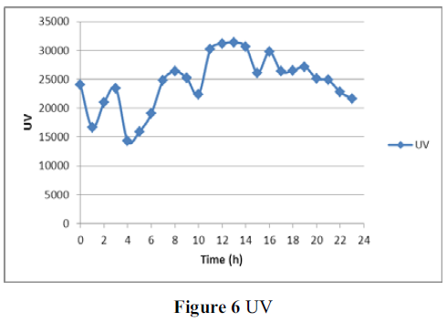
Experimental Results
Notes:
Aggregation A is only based on one field, B has two fields including one that A has
Shark is more suitable for fewer result

Slide 15
Conclusions
Propose a cloud platform analysis model
High stability, availability, and efficiency for batch data analysis
Weak Points?
처음에 설명했던 기존의 standalone 분석 도구들과의 비교가 전혀 없어서 분산 클라우드 환경에서 이런 식으로 구축한 것이 얼마나 좋은지에 대한 감이 잘 잡히지 않는 부분이 좀 아쉽다.

