Slide 1
Predicting Personality from Twitter¹ Predicting Personality with Social Media²
Jennifer Golbeck, Cristina Robles, Michon Edmondson¹, Karen Turner
SocialCom 2011¹, CHI 2011²
29 March 2013
Hyewon Lim

Slide 2
Outline
Introduction
Data Collection
Personality and Profile Correlations
Predicting Personality
Discussion
Conclusion

Slide 3
Introduction
Social networking on the web has grown dramatically
Facebook: over 1 billion members (active Oct 2012)
Twitter: 200M members (active Feb 2013)
Much of a user’s personality comes out through their profile
Self-description
Status updates
Photos
Interests

Slide 4
Introduction
Predicting personality
Personality traits and success
Personality and interfaces
More receptive to and have greater trust in interfaces and information
Online marketing and applications
Personalize their message and its presentation

Slide 5
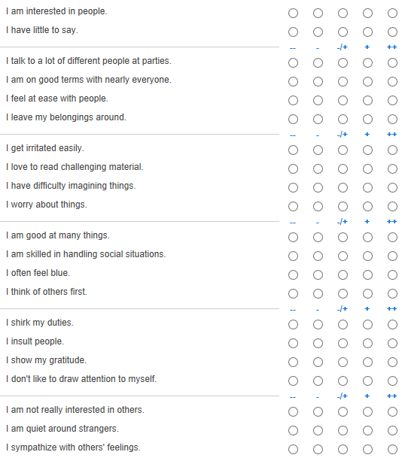
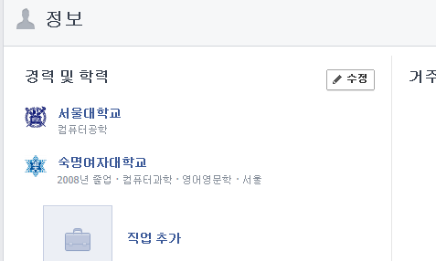
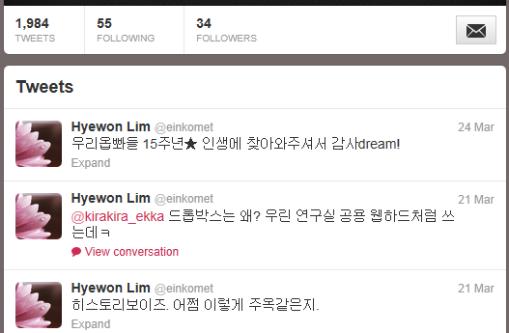
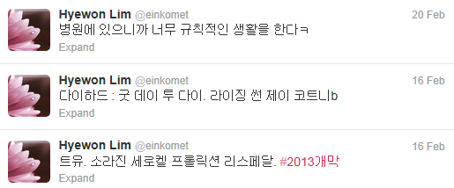
Introduction
Can social media profiles predict personality traits?
Notes:
이전 연구에서 이미 밝혀져있음.
Facebook 프로필이라는 건 idealized version이 아니라 자기 자신의 실제 특성을 반영한다는 연구[3]

Slide 6
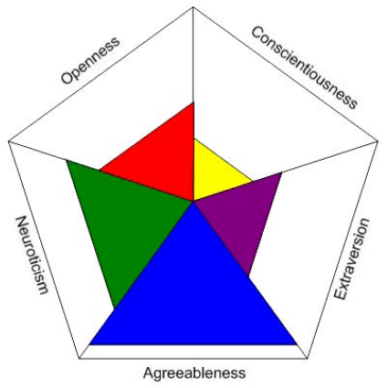
Introduction
Big Five Personality model (OCEAN model)
Openness to experience (경험에 대한 개방성)
Conscientiousness (성실성)
Extroversion (외향성)
Agreeableness (친화성)
Neuroticism (신경성)
Applications of the Big Five
Relationships with others
Preference
Vote, music, interface design
Occupation
Performance, proficiency, counterproductive behaviors, …
Notes:
Openness: 상상력과 호기심, 모험심, 예술적 감각 등으로 보수주의에 반대되는 성향. 개인의 심리 및 경험의 다양성과 관련된 것으로, 지능 상상력,고정관념의 타파, 심미적인 것에 대한 관심, 다양성에 대한 욕구, 품위 등과 관련된 특질을 포함
Conscientiousness: 목표를 성취하기 위해 성실하게 노력하는 경향. 과제 및 목적지향성을 촉진하는 속성과 관련된 것으로, 심사숙고, 규준이나 규칙의 준수, 계획세우기, 조직화, 과제의 준비 등과 같은 특질을 포함
Extroversion: 다른 사람과의 사교, 자극과 활력을 추구하는 성향. 사회와 현실 세계에 대해 의욕적으로 접근하는 속성과 관련된 것으로, 사회성, 활동성, 적극성과 같은 특질을 포함.
Agreeableness: 타인에게 반항적이지 않은 협조적인 태도를 보이는 성향. 사회적 적응성과 타인에 대한 공동체적 속성을 나타내는 것으로, 이타심, 애정, 신뢰 배려, 겸손 등과 같은 특질을 포함.
Neuroticism: 분노, 우울함, 불안감과 같은 불쾌한 정서를 쉽게 느끼는 경향. 걱정, 부정적 감정 등과 같은 바람직하지 못한 행동과 관계된 것으로, 걱정, 두려움, 슬픔, 긴장 등과 같은 특질을 포함.

Slide 7
Outline
Introduction
Data Collection
Personality and Profile Correlations
Predicting Personality
Discussion
Conclusion

Slide 8

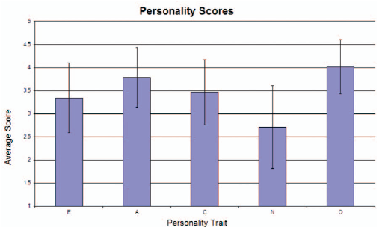
Data Collection
Twitter application
50 subjects, most recent 2,000 tweets from the user
45-question version of the Big Five Inventory

Slide 9
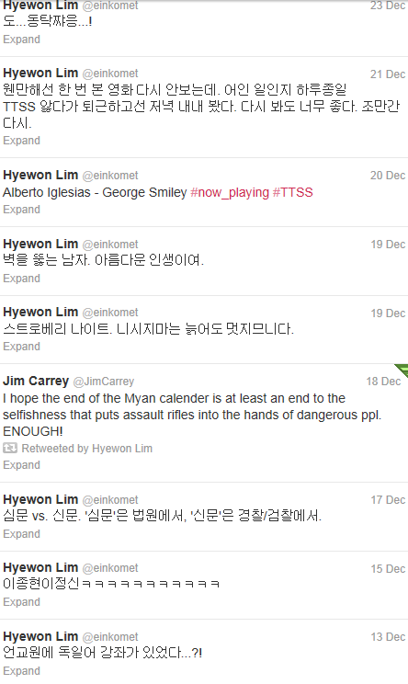
Data Collection
Text processing
Merge the collected tweets into a single document
도…동탁쨔응…! 웬만해선 한 번 본 영화 다시 안보는 데, 어인 일인지 하루종일 TTSS 앓다가 퇴근하고선 저녁 내내 봤다. 다시 봐도 좋다. 조만간 다시. Alberto Iglesias – George Smiley
#now_playing #TTSS 벽을 뚫는 남자. 아름다운 인생이여. 스트로베리 나이트. 니시지마는 늙어도 멋지므니다. I hope the end of the Myan calender is at least an end to the selfishness that puts assault rifles into the hands of dangerous ENOUGH! 심문 vs. 신문. ‘심문’은 법원에서, ‘신문’은 경찰/검찰에서.
More information, but
a stream of disjointed thoughts

Slide 10

Data Collection
Facebook
2,000 unique pairs of friends from a user’s egocentric network
Collected all profile information about the user
Additional features – whether or not the user had included the information
Activities and preferences
Counted the number of characters in the entry
Roughly measuring how much information the user provided in each field
Language features
“About Me” + “blurb” + status update
45-question version of the Big Five Inventory
167 subjects

Slide 11
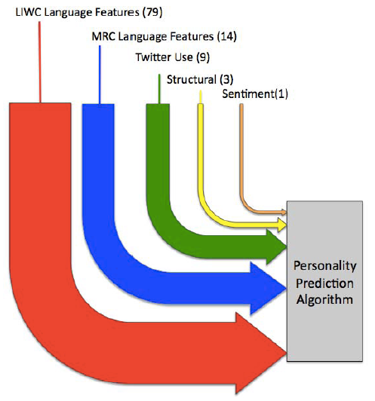


Data Collection
Analyze the content of users’ tweets
Linguistic Inquiry and Word Count (LIWC)
Standard Counts
Psychological Processes
Relativity
Personal Concerns
Other dimensions
MRC Psycholinguistic Database
A list of over 150,000 words with linguistic and psycholinguistic features of each word
Average non-zero score for each feature over all the words from each user
A word by word sentiment analysis of each user’s tweets
Using the General Inquirer dataset
Average sentiment score for all words used in their list of tweets

Slide 12
Outline
Introduction
Data Collection
Personality and Profile Correlations
Predicting Personality
Discussion
Conclusion

Slide 13
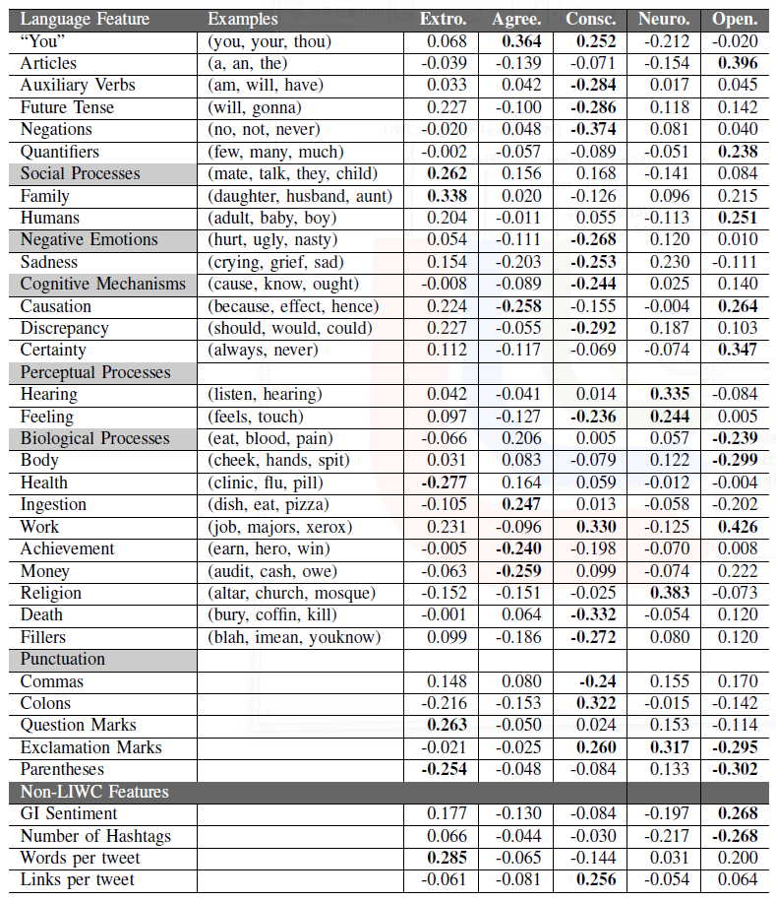
Personality and Profile Correlations: Twitter
Pearson correlation analysis
Between subjects’ personality scores and each of the features
Bold: p < 0.05

Slide 14
Personality and Profile Correlations: Twitter
Intuitive sense
Not intuitive explanations
Words about death
Negative emotions and sadness
Conscientiousness
Use of “you”
Talk about achievements and money
Agreeableness
Use of “you”
Extraversion
The number of parentheses used
Openness
Notes:
그러나 이 논문의 목적은 이런 세부적인 correlation에 일일이 초점을 두는 것이 아니기 때문에
이러한 intuitive하지 않은 관계에 큰 weight을 주지 않았다.
이러한 관계들에 대한 깊은 연구는 다음 논문에서 ㅋㅋㅋㅋㅋㅋㅋㅋ

Slide 15
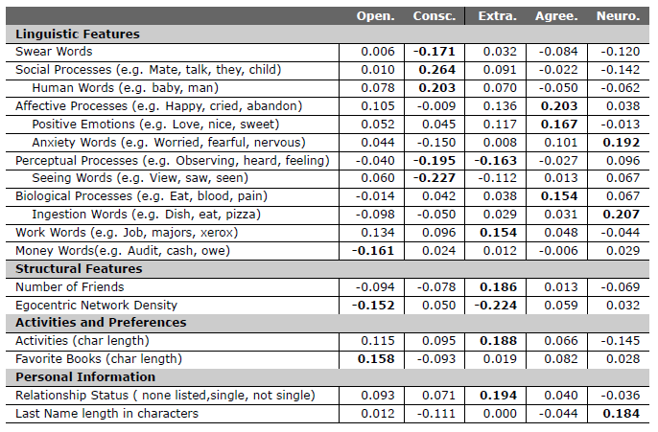
Personality and Profile Correlations: FB
Pearson correlation analysis

Slide 16
Personality and Profile Correlations: FB
Intuitive sense
Unusual correlations
Swear words
Perceptual processes (seeing, hearing, feeling)
Conscientiousness
Social processes
Subset of words that describe people
Agreeableness
Affective process words
Positive emotion words
Neuroticism
Express anxiety
neuroticism
The character length of a subject’s last name
Notes:
그러나 이 논문의 목적은 이런 세부적인 correlation에 일일이 초점을 두는 것이 아니기 때문에
이러한 intuitive하지 않은 관계에 큰 weight을 주지 않았다.
이러한 관계들에 대한 깊은 연구는 다음 논문에서 ㅋㅋㅋㅋㅋㅋㅋㅋ

Slide 17
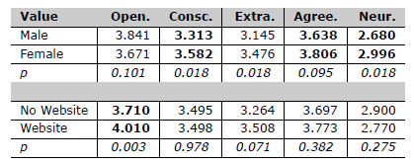
Personality and Profile Correlations: FB
Structure features
Extroverts: more friends, but more sparse
Density Openness
Extraversion & openness reported activities and interests
Groups

Slide 18

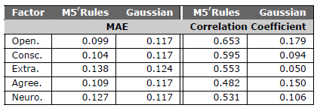
Predicting Personality
Regression analysis in Weka
Twitter
Algorithms: Gaussian Process and ZeroR
MAE on a normalized scale
→ A larger sample size would produce much better results!
Facebook
Algorithms: Gaussian Process and M5’Rules
MAE on a normalized scale

Slide 19
Outline
Introduction
Data Collection
Personality and Profile Correlations
Predicting Personality
Discussion
Conclusion

Slide 20
Discussion
Difference between being 65% vs. 75% extraverted
In many cases: introverted vs. extraverted
Text analysis on Twitter
Misspelling words, missing language features, …
Interfaces and personality
Users preferred interfaces designed to represent personalities
Increase trust and perceived usefulness by the user
Our method provide …
Obtain personality profiles of users w/o the burden of tests
Much easier to create personality-oriented interfaces

Slide 21
Discussion
Advertising
Connections between marketing techniques and consumer personality
Recommendation
Improve their accuracy
In collaborative filtering
Give more weight to users who share similar personality traits
Identify types of items
Liked by individuals with certain personality traits

Slide 22
Outline
Introduction
Data Collection
Personality and Profile Correlations
Predicting Personality
Discussion
Conclusion

Slide 23
Conclusions
Show that a users’ Big Five personality trait can be predicted from the public information they share
With the ability to guess a user’s personality traits
Many opportunities are opened for personalizing interfaces and information
Answer more sophisticated questions (Future work)
Understanding the connections between personality, tie strength, trust, and other related factors

Slide 24
Applicable to other researches
Binary feature
Whether or not the user included the information
Text analysis problem
CHI: Playing well with others
Two similar papers

