Slide 1

Session 10
The Class Diagram: Associations
Written by Thomas A. Pender
Published by Wiley Publishing, Inc.
October 12, 2011
Presented by So-min Kim

Slide 2
Contents
Modeling Basic Association Notations
Modeling Extended Association Notations

Slide 3
Modeling Basic Association Notations (1/6)
Associations between objects
  How objects will be allowed to work together
  Some limitations
    To limit the number of participating objects in the relationship
    To check the qualifications
    To define the roles of participating objects

Slide 4
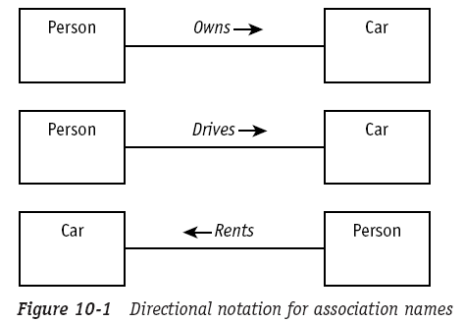

Modeling Basic Association Notations (2/6)
Association name
  The purpose of the association
  A verb or verb phrase that describes how objects of one class relate to objects to another class

Slide 5
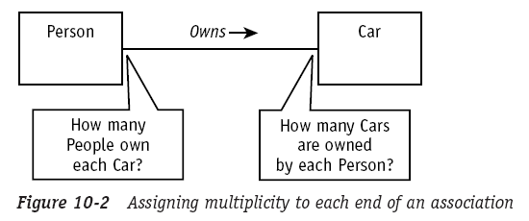
Modeling Basic Association Notations (3/6)
Association multiplicity
  The number of participating objects
  A multiplicity value must be assigned to each of the participating classes in an association

Slide 6
Modeling Basic Association Notations (4/6)
Association multiplicity (cont.)
  Range defining
    Minimum .. Maximum
      Ex. 0..5
    Single value (when the minimum and maximum are the same)
      Ex. 1
  Comma-separated list
    Ex. 4, 6, 8
  Asterisk(*) when used alone means zero or more, no lower or upper limit
  Asterisk(*) when used in a range (1 .. *) means no upper limit

Slide 7
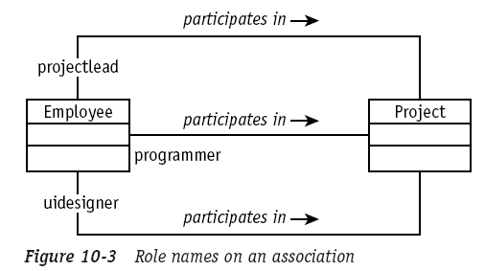
Modeling Basic Association Notations (5/6)
Association roles
  Sometimes the association name is a bit hard to determine
    What English word could you use for the association name between parents and children?
  Role names may be used with or in place of the association name to describe how the objects participate in the relationship

Slide 8
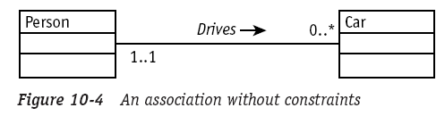
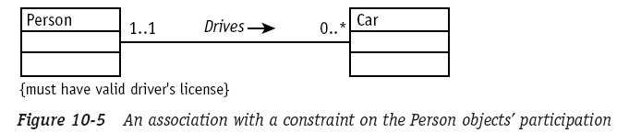
Modeling Basic Association Notations (6/6)
Association constraints
  Rules that must be enforced to ensure the integrity of the relationship
  The constraints may be placed on each end of the association
  Constraints are always enclosed in a single pair of curly brace { }

Slide 9
Contents
Modeling Basic Association Notations
Modeling Extended Association Notations

Slide 10
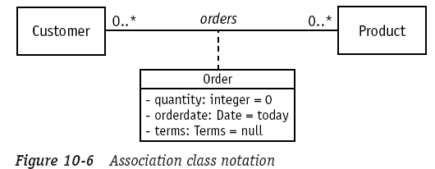
Modeling Extended Association Notations (1/3)
Associations class
  An association class encapsulates information about an association
    When the relationship began
    When it ended
    The current state of the relationship
    Any number of data items …

Slide 11
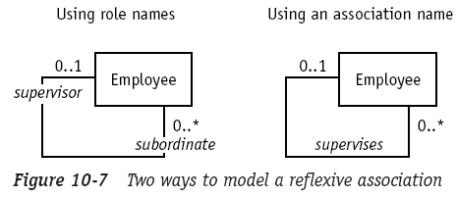
Modeling Extended Association Notations (2/3)
Reflexive association
  An association in which all the participating objects are the same class
    The association line goes out of a class and turns right back to the same class
    All the other notations and rules for defining associations apply to reflexive association
    Ex. Defining hierarchies

Slide 12
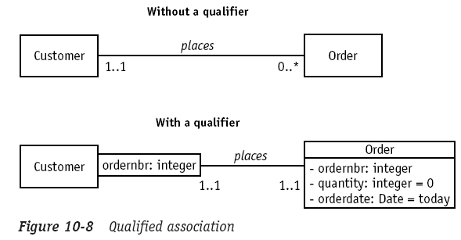
Modeling Extended Association Notations (3/3)
Qualified association
  It simplifies the navigation across complex associations by providing keys to narrow the selection of objects
  It provides approximately the same functionality as indexes

Slide 13
The End

