Slide 1
Multimedia Information Retrieval
Sharif University of Technology
Computer Engineering Department
Modern Information Retrieval Course
Fall 2005

Slide 2
Outline
Support variety of data
Text-Based Retrieval
Problems with Text-based Retrieval
Content-Based Retrieval
Color Histogram Matching
Texture Matching
Problems with CBIR

Slide 3
Support variety of data
Different kinds of media
  Image
    Graph,…
  Audio
    Music, speech,…
  Video

Slide 4
Text-Based Retrieval
based on text associated with the file
  URL:
    http://www.host.com/animals/dogs/poodle.gif
  Alt text:
    <img src=URL alt="picture of poodle">
  Hyperlink text:
    <a href=URL>Sally the poodle</a>

Slide 5



Keyword-based System
User
Video Database
Automatic Annotation
Keyword
Information Need
Including filename, video title, caption, related web page

Slide 6
Text-based Search Engines
Indexing based on text in the container webpage
  Http://www.google.com
  Http://www.ditto.com
  …

Slide 7
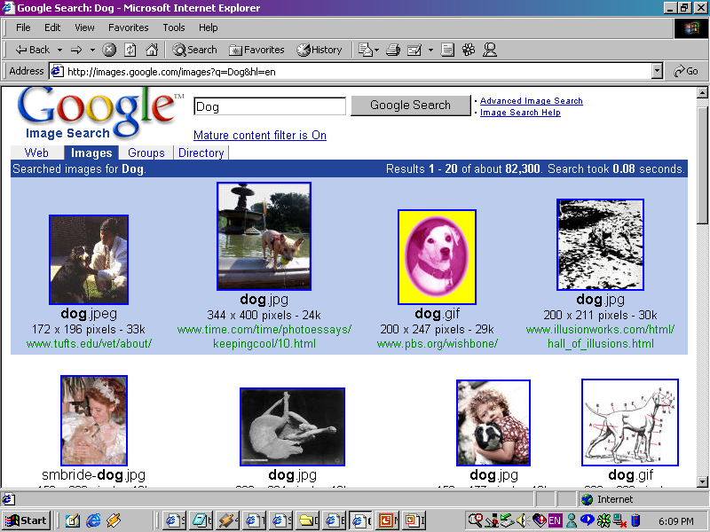
Google image search

Slide 8
Why this happens?
Most of these search engines are keyword based
  Have to represent your idea in keywords
  These keywords are expected to appear in the filename, or corresponding webpage

Slide 9
Problems with Text-Based
The text in the ALT tag has to be done manually
  Expensive
  Time consuming
It is incomplete and subjective
Some features are difficult to define in text such as texture or object shape

Slide 10
Therefore……
  Unable to handle semantic meaning of images
  Unable to handle visual position
  Unable to handle time information
  Unable to use images as query
  ……….

Slide 11
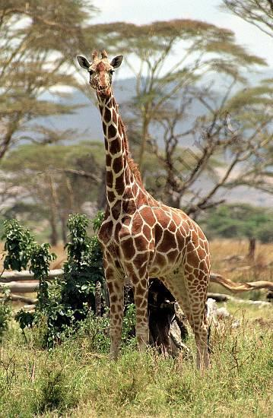
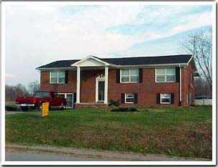
So …
Better for simple concepts
  e.g. A picture of a giraffe
Don’t work for complex queries
  e.g. A picture of a brick home with black shutters and white pillars, with a pickup truck in front of it (image)

Slide 12
Content-Based Image Retrieval
CBIR relies of features such as:
  Colour
  Shape
  Texture
Examples:
  IBM’s Query By Image Content (QBIC)
  Virages’s VIR Image Engine
  Online http://collage.nhil.com/

Slide 13
Video Data Structure
The first step for video retrieval: Video “programmes” are structured into logical scenes, and physical shots
If dealing with text, then the structure is obvious:
  paragraph, section, topic, page, etc.
All text-based indexing, retrieval, linking, etc. builds upon this structure;
shot boundary detection and selection of representative keyframes is usually the first step;

Slide 14
Typical automatic structuring of video
a video document
A set of shots
Keyframe browser combined with transcript or object-based search

Slide 15
Image-based Retrieval
Video Database
User
Text Information
Keyword
Video Structure
Information Need
Image Feature
Query Images

Slide 16
Global Low-level Image Feature
Color-based Feature
  Color Histogram, Color Percentage, Color Correlogram, Color Moments
Texture-based Feature
  Gabor Filter, Wavelet

Slide 17
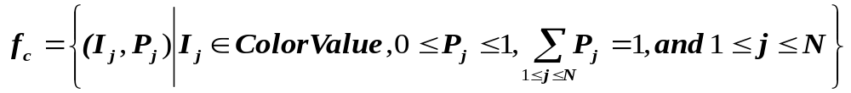

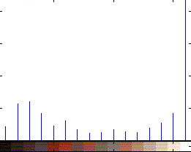
Colour Histogram
Describe the colors and its percentages in an image.

Slide 18
Texture Matching
Texture characterizes small-scale regularity
  Color describes pixels, texture describes regions
Described by several types of features
  e.g., smoothness, periodicity, directionality
Perform weighted vector space matching
Usually in combination with a color histogram

Slide 19
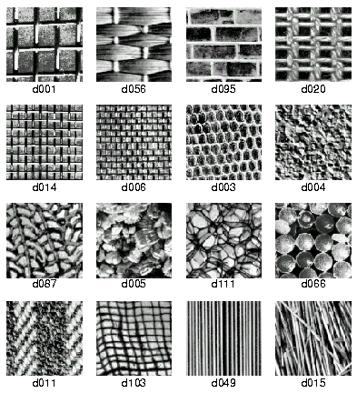
Texture Test Patterns

Slide 20
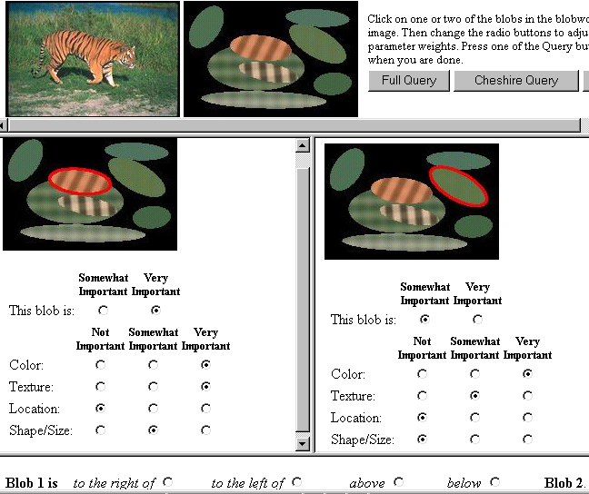
Berkeley Blobworld

Slide 21
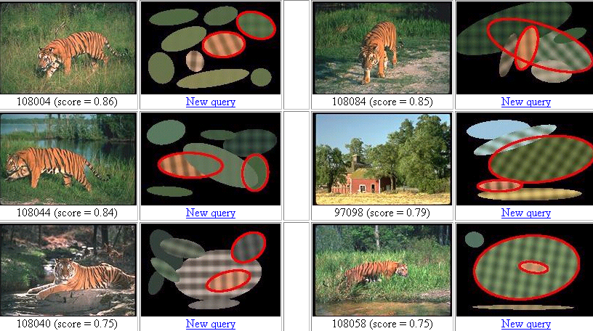
Berkeley Blobworld

Slide 22
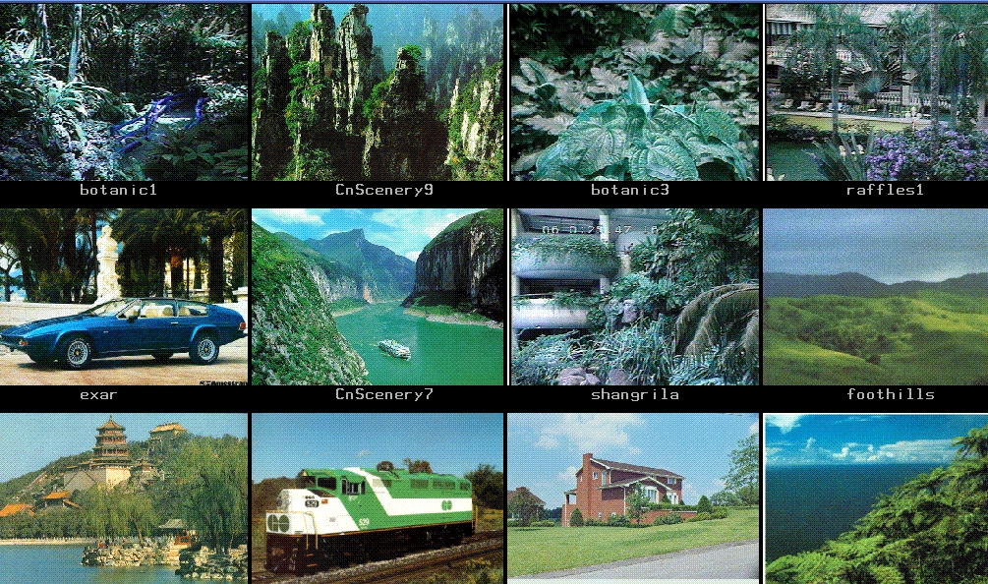
Finding Similar Images

Slide 23
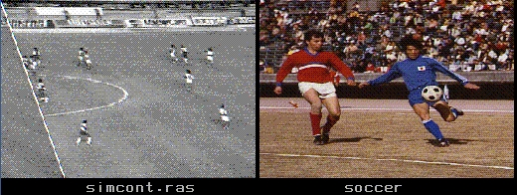
But…..
Low-level feature doesn’t work in all the cases

Slide 24
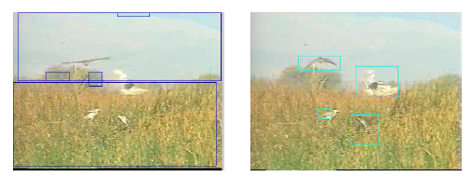
Regional Low-level Image Feature
Segmentation into objects
Extract low-level features from each regions

Slide 25
Image Search
Feature Representation
  Image: represented as a series of real number, or a vector of features, (f1, …., fn)
  Distance Function: The distance between two vectors, typically Euclidean Distance
  We believe “Nearest is relevant”
    The nearest images in the database is relevant to the query images.

Slide 26
More Evidence in Video Retrieval
Video Database
User
Text Information
Keyword
Video Structure
Information Need
Image Information
Query Images
Motion
Information
Motion
Audio Information
Audio

Slide 27
Evidence-based Retrieval System
General framework for current video retrieval system
Video retrieval based on the evidence from both users and database, including
  Text information
  Image information
  Motion information
  Audio information
Return a relevant score for each evidence
Combination of the scores

Slide 28
Problems with CBIR
Must have an example image
Example image is 2-D
  Hence only that view of the object will be returned
Large amount of image data
Similar colour histogram does not equal similar image
Usually the best results come from a combination of both text and content searching
Notes:
For example if we give in a side view image of a horse it will not return images from the front or behind

Slide 29
Manual Search Result
1
Prous Science
0.9
IBM-2
0.8
CMU_MANUAL1
0.7
IBM-3
0.6
LL10_T
0.5
Precision
CLIPS+ASR
0.4
Fudan_Search_Sys4
0.3
CLIPS+ASR+X
0.2
ICMKM-2
0.1
UMDMqtrec
0
0
0.1
0.2
0.3
0.4
0.5
0.6
0.7
0.8
0.9
1
Recall

