Slide 1
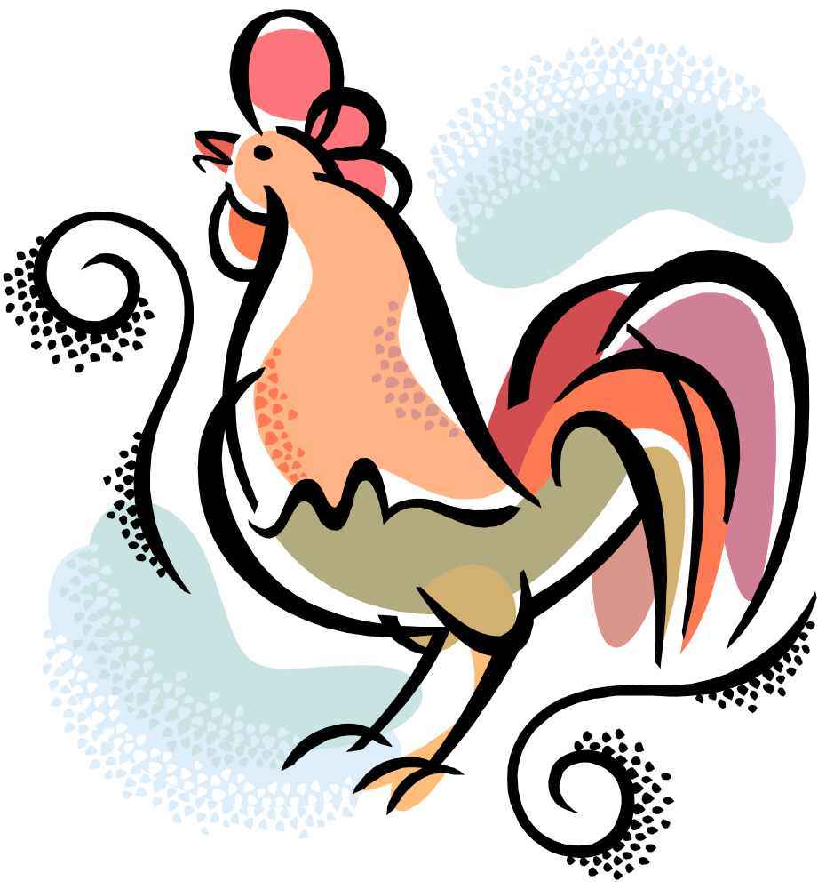
Chapter 8
Using RDFS-Plus in the Wild
Internet Database Lab.
SNU
2009
Presented by Jae-Min Ahn

Slide 2
Contents
Simple Knowledge Organization System (SKOS)
Friend Of A Friend (FOAF)
Summary

Slide 3
SKOS
- SKOS (1/13)
Simple Knowledge Organization System (SKOS)
  A family of formal languages
  Designed for representation of knowledge organization system
    Controlled vacabularies
    Thesauri - similar-word dictionary
    Taxonomies – Science of classification
    Folksonomies – Collaborative tagging
  Being developed by Institute for Learning & Research
  Being built upon RDF and RDFS
  Main objective
    To enable easy publication of controlled structured vocabularies for the Semantic Web

Slide 4
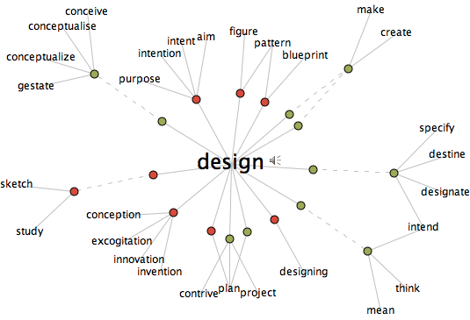
SKOS
- SKOS (2/13)
Thesaurus
  A listing of words with similar, related, or opposite meanings
  Started as similar-word dictionary by Peter Mark Roget, in 1805

Slide 5
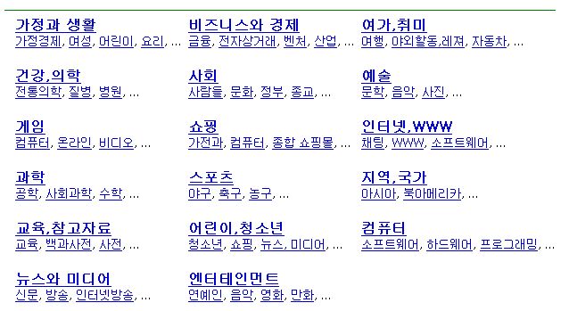
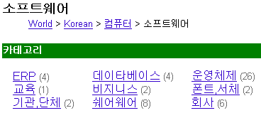
SKOS
- SKOS (3/13)
Taxonomies
*출처 : 부산대학교 인공지능 연구실

Slide 6

SKOS
- SKOS (4/13)
Tag
  A single word or short phrase
  Describing some aspect of contents
Folksonomies(Collaborative tagging)
  “collaboratively creating & managing tags to annotate & categorize content” (from Wikipedia)
girls_generation
Yoona
korean_singer
marine_look

Slide 7
SKOS
- SKOS (5/13)
Why SKOS?
  Given the existence of several thesaurus standards, why create another one?
Unlike thesaurus standards, SKOS
  Basis in the Semantic Web
  Creating modular knowledge organization
    Can be reused
    Referenced across the web

Slide 8
SKOS
- SKOS (6/13)
Layers of SKOS
  SKOS Core, SKOS Mapping, SKOS Extension
SKOS Core
  The most mature
  The part that maps directly to the thesaurus standards
Concentrate on describing the mature SKOS Core
  In terms of
    Usage of RDFS-Plus
    Inferences
[8-1] is a sample from a SKOS thesaurus, in which a small fragment of the UK Archival Thesaurus

Slide 9
SKOS
- SKOS (7/13)
[8-1]
EconomicPolicy
owl:versionInfo=
core:prefLabel = Economic policy
Interdependence
owl:versionInfo=
core:prefLabel = Interpendence
core:broader
core:related
EconomicCooperation
owl:versionInfo=
core:altLabel = Economic co-operation…
core:prefLabel = Economic cooperation
core:scopeNote = Includes cooperative…
IndustrialCooperation
owl:versionInfo=
core:prefLabel = Industrial cooperatio…
core:narrower
core:narrower
core:narrower
EconomicIntegration
EuropeanEconomicCooperation
owl:versionInfo=
core:prefLabel = Economic integration
owl:versionInfo=
core:prefLabel = European Economic co…
core:narrower
EuropeanIndustrialCooperation
owl:versionInfo=
core:prefLabel = European industrial…

Slide 10
SKOS
- SKOS (8/13)
Example of SKOS thesaurus
    @prefix rdf: <http://www.w3.org/1999/02/22-rdf-syntax-nx#> .
    @prefix rdf: <http://www.w3.org/2000/01/rdf-schema#> .
    @prefix rdf: <http://www.w3.org/2002/07/owl#> .
    @prefix rdf: <http://www.w3.org/2004/02/skos/core#> .
    @prefix rdf: <http://www.workingontologist.com/Ch8/UKAT.owl#/>
      UKAT:EconomicCooperation a core:Concept;
      core:altLabel “Economic co-operation”;
      core:broader UKAT:EconomicPolicy;
      core:narrower UKAT:IndustrialCooperation,
      UKAT:EconomicIntegration,
      UKAT:EuropeanIndustrialCooperation
      UKAT:EuropeanEconomicCooperation

Slide 11
SKOS
- SKOS (9/13)
      core:prefLabel “Economic cooperation”;
      core:related UKAT:Interdependence;
      core:scopeNote “Includes cooperative measures in banking, trade, industry etc., between and among countries..”
      UKAT:EconomicIntegration a core:Concept;
      core:prefLabel “Economic integration.”
      UKAT:EconomicPolicy a core:Concept;
      core:prefLabel “Economic policy.”
      UKAT:EuropeanEconomicCooperation a core:Concept;
      core:prefLabel “European Economic cooperation.”
      UKAT:EuropeanIndustrialCooperation a core:Concept;
      core:prefLabel “European industrial cooperation.”
      UKAT:Interdependence a core:Concept;
      core:prefLabel “interdependence.”

Slide 12
SKOS
- SKOS (10/13)
Label resource
  Already defined in RDFS (rdfs:label)
  Having informal meaning
    The printable or human readable name of resource
  SKOS define tree different kinds of label
      skos:prefLabel
      a rdf:Property;
      rdfs:label “preferred label”;
      rdfs:subPropertyOf rdfs:label .
      skos:altLabel
      a rdf:Property;
      rdfs:label “alternative label”;
      rdfs:subPropertyOf rdfs:label .
      skos:hiddenLabel
      a rdf:Property;
      rdfs:label “hidden label”;
      rdfs:subPropertyOf rdfs:label .

Slide 13
SKOS
- SKOS (11/13)
EconomicPolicy
owl:versionInfo=
core:prefLabel = Economic policy
Interdependence
owl:versionInfo=
core:prefLabel = Interpendence
core:broader
core:related
EconomicCooperation
owl:versionInfo=
core:altLabel = Economic co-operation…
core:prefLabel = Economic cooperation
core:scopeNote = Includes cooperative…
IndustrialCooperation
owl:versionInfo=
core:prefLabel = Industrial cooperatio…
core:narrower
core:narrower
core:narrower
EconomicIntegration
EuropeanEconomicCooperation
owl:versionInfo=
core:prefLabel = Economic integration
owl:versionInfo=
core:prefLabel = European Economic co…
core:narrower
EuropeanIndustrialCooperation
owl:versionInfo=
core:prefLabel = European industrial…

Slide 14
SKOS
- SKOS (12/13)
      UKAT:EconomicCooperation a core:Concept;
      core:altLabel “Economic co-operation”;
UKAT:EconomicCooperation core:altLabel “Economic co-operation”.
      skos:altLabel
      a rdf:Property;
      rdfs:label “alternative label”;
      rdfs:subPropertyOf rdfs:label .
skos:altLabel rdfs:subPropertyOf rdfs:label .
UKAT:EconomicCooperation rdfs:label “Economic co-operation”.
pg 6
pg 8
inference

Slide 15
SKOS
- SKOS (13/13)
      UKAT:EconomicCooperation
      rdfs:label “Economic co-operation”.
      UKAT:EconomicCooperation
      rdfs:label “Economic cooperation”.
      UKAT:EconomicIntegration
      rdfs:label “Economic integration”.
      UKAT:EuropeanEconomicCooperation
      rdfs:label “European economic cooperation”.
      UKAT:IndustrialCooperation
      rdfs:label “Industrial cooperation”.
      UKAT:Interdependence
      rdfs:label “interdependence”
inference

Slide 16
SKOS
- Semantic Relations in SKOS (1/5)
Semantic Properties
  Relating concepts to one another
  “broader, narrower, related” from thesaurus standards
      skos:broader
      a owl:TransitiveProperty;
      owl:inverseOf skos:narrower;
      rdfs:comment “Broader concepts are typically
      rendered parents in a concept hierarchy(tree).”;
      rdfs:label “has broader” .
      skos:narrower
      a owl:TransitiveProperty;
      owl:inverseOf skos:broader;
      rdfs:comment “Narrower concepts are typically
      rendered as children in a concept hierarchy(tree).”;
      rdfs:label “has narrower” .
      skos:related
      a owl:SymmetricProperty;
      rdfs:label “related to”;
      rdfs:subPropertyOf rdfs:seeAlso .

Slide 17
SKOS
- Semantic Relations in SKOS (2/5)
FIGURE [8-1]
EconomicPolicy
owl:versionInfo=
core:prefLabel = Economic policy
Interdependence
owl:versionInfo=
core:prefLabel = Interpendence
core:broader
core:related
EconomicCooperation
owl:versionInfo=
core:altLabel = Economic co-operation…
core:prefLabel = Economic cooperation
core:scopeNote = Includes cooperative…
IndustrialCooperation
owl:versionInfo=
core:prefLabel = Industrial cooperatio…
core:narrower
core:narrower
core:narrower
EconomicIntegration
EuropeanEconomicCooperation
owl:versionInfo=
core:prefLabel = Economic integration
owl:versionInfo=
core:prefLabel = European Economic co…
core:narrower
EuropeanIndustrialCooperation
owl:versionInfo=
core:prefLabel = European industrial…

Slide 18
SKOS
- Semantic Relations in SKOS (3/5)
      UKAT:EconomicCooperation a core:Concept;
      core:altLabel “Economic co-operation”;
      core:broader UKAT:EconomicPolicy;
      core:narrower UKAT:IndustrialCooperation,
UKAT:EconomicCooperation core:narrower UKAT:IndustrialCooperation
      skos:broader
      a owl:TransitiveProperty;
      owl:inverseOf skos:narrower;
skos:broader owl:inverseOf skos:narrower;
UKAT:IndustrilCoopertaion core:broader UKAT:EconomicCooperation
pg 6
pg 12
inference

Slide 19
SKOS
- Semantic Relations in SKOS (4/5)
UKAT:EconomicPolicy
core:narrower UKAT:EconomicCooperation.
UKAT:IndustrialCooperation
core:broader UKAT:EconomicCooperation.
UKAT:EconomicIntegration
core:broader UKAT:EconomicCooperation.
UKAT:EuropeanIndustrialCooperation
core:broader UKAT:EconomicCooperation.
UKAT:EuropeanEconomicCooperation
core:broader UKAT:EconomicCooperation.
inference

Slide 20
SKOS
- Semantic Relations in SKOS (5/5)
  Each of core:narrower is a owl:transitiveProperty
  Every concept in this example is narrower than the item at the “top” of the tree, UKAT:EconomicPolicy
UKAT:EconomicPolicy core:narrower
UKAT:IndustrialCooperation,
UKAT:EconomicIntegration,
UKAT:EuropeanIndustrialCooperation,
UKAT:EuropeanEconomicCooperation .
inference

Slide 21
SKOS
- Meaning of Semantic Relations
Similarity between the definitions in
  SKOS of skos:narrower and skos:broader and the definitions of rdfs:subClassOf and rdfs:superClassOf
  Both of these are intended for modeling hierarchies
  Definition for subclassOf
      B rdfs:subClassOf C .
      X rdf:type B .
      X rdf:type C .
  No such rule in SKOS
      UKAT:EconomicCooperation skos:broader UKAT:EconomicPolicy
    “Economic Cooperation has broader category Economic Policy”
    “Economic Cooperation is broader than Economic Policy”
    The relationship is expressed informally in the annotations
inference

Slide 22
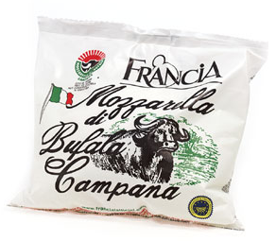
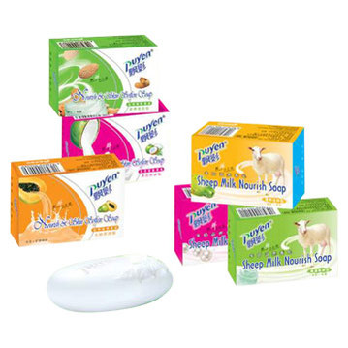
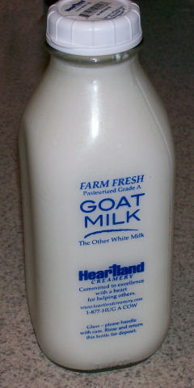
SKOS
- Special Purpose Inference (1/3)
Special provision for implementing Collection of concepts
  Common in thesaurus and indexing standards
  “Milk by source animals”
    Not a concept in its own right
    A grouping for concepts
      argo:MilkBySourceAnimal a skos:Collection;
      rdfs:label “Milk by source animal” ;
      core:member agro:CowMilk,
      agro:BuffaloMilk,
      agro:GoatMilk,
      agro:SheepMilk .
      agro:BuffaloMilk a skos:Concept;
      skos:prefLabel “buffalo Milk” .
      agro:CowMilk a skos:Concept;
      skos:prefLabel “Cow Milk” .
      agro:GoatMilk a skos:Concept;
      skos:prefLabel “Goat Milk” .
      agro:SheepMilk a skos:Concept;
      skos:prefLabel “Sheep Milk” .

Slide 23
SKOS
- Special Purpose Inference (2/3)
FIGURE [8-2]
CowMilk
rdf:type
MilkBySourceAnimal
skos:member
skos:member
skos:member
CowMilk
skos:member
SheepMilk
BuffaloMilk
GoatMilk

Slide 24
SKOS
- Special Purpose Inference (3/3)
  Skos:narrower to describe the relationship between a term and a collection
      Agro:Milk skos:narrower agro:MilkBySourceAnimal
      X skos:narrower C.
      C skos:member Y.
      X skos:narrower Y.
      Agro:Milk skos:narrower agro:BuffaloMilk .
      Agro:Milk skos:narrower agro:CowMilk .
      Agro:Milk skow:narrower agro:SheepMilk .
      Agro:Milk skos:narrower agro:GoatMilk .
inference

Slide 25
SKOS
- Published Subject Indicators
PSI (Published Subject Indicators)
  Making unique identifier for a certain concept
  Skos:subjectIndicator
    To link a skos:Concept to a published document
  Not be possible for two different concepts to share the same skos:subjectIndicator
    Policy:Privacy a skos:Concept;
    skos:subjectIndicator http://www.usdoj.gov/foia/privstat.htm
    gov:InfoAccess a skos:Concept;
    skos:subjectIndicator http://www.usdoj.gov/foia/privstat.htm
    Gov:InfoAccess owl:sameAs policy:Privacy
inference

Slide 26
SKOS
- SKOS in Action
SKOS in Action
  AGROVOC
    Provides multilingual indexing for materials concerning any aspect of agriculture
  NAL
    Extensive thesaurus for indexing agricultural materials
  When a project to map these thesauri together
  Needed a representation that would allow for terms from multiple sources to be distinguished in a global way

Slide 27
Contents
Simple Knowledge Organization System (SKOS)
Friend Of A Friend (FOAF)
Summary

Slide 28

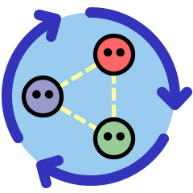
FOAF
- FOAF
Friend Of A Friend (FOAF)
  A format for supporting distributed descriptions of people and their relationships
FOAF works in the spirit of the AAA principle
  Things that are related to say about people
    Organizations(that people belong)
    Projects(that people work on)
    Documents(that people have create)
    Images(that depict people)

Slide 29
FOAF
- People and Agents
FOAF
  Primarily about people
  Many things we might say about a foaf:Person can hold for any foaf:Agent
  Most of the properties for people hold for agents in general
    Groups, companies, etc
      foaf:Person rdfs:subClassOf foaf:Agent .
      foaf:Group rdfs:subClassOf foaf:Agent .
      foaf:Organization rdfs:subClassOf foaf:Agent .

Slide 30
FOAF
- Names in FOAF
Names in FOAF
  The most essential thing we know about a person
      foaf:name rdfs:domain owl:Thing .
      foaf:name rdfs:subPropertyOf rdfs:label .
  Anything in the world can have a name
  Used as the Printable label for that thing
  Parts of a person’s name are also needed
    Foaf:firstName, foaf:givenname, foaf:family_name, foaf:surname
  If two properties are used in the same way,
      foaf:surname owl:equivalentProperty foaf:family_name

Slide 31
FOAF
- Nicknames and Online Names (1/2)
Nicknames and Online Names
  Since FOAF is used on the Web,
  Many people will be used to describe internet communities
    Foaf:aimChatID, foaf:icqChatID, foaf:msnChatID, and foaf:yahooChatID
  In the spirit of extensibility of FOAF, new ID properties can be added
    Foaf:jabberID

Slide 32
FOAF
- Nicknames and Online Names (2/2)
  FOAF makes a formal connection between these properties
    All of them are subproperties of a single property, foaf:nick
      foaf:aimChatID rdfs:subPropertyOf foaf:nick .
      foaf:icqChatID rdfs:subPropertyOf foaf:nick .
      foaf:msnChatID rdfs:subPropertyOf foaf:nick .
      foaf:yahooChatID rdfs:subPropertyOf foaf:nick .
      foaf:jabberID rdfs:subPropertyOf foaf:nick.
      Lit:Shakespeare foaf:aimChatID “Willie1564” .
      Lit:Shakespeare foaf:msnChatID “TempestMan” .
      Lit:Shakespeare foaf:nick “Willie1564” .
      Lit:Shakespeare foaf:nick “TempesetMan” .

Slide 33
FOAF
- Online Persona
Online Persona
  Foaf:homepage
    Relates a person to their homepage
  Foaf:wolkplaceHomepage
    The homepage of the woklplace of a person
  Foaf:workInfoHomepage
    The homepage of a person at their workplace
  Foaf:schoolHomepage
    The school that a foaf:Person attended
  Foaf:weblog
    The address of the web blog of a person

Slide 34
FOAF
- Groups of People (1/2)
Groups of People
  Where they belong to
  Connected a property called, foaf:member
  Define a group called English Monarchy
      :English_Monarchy
      a foaf:Group ;
      foaf:name “English Monarchy” ;
      foaf:homepage “http://www.monarchy.com/” ;
      foaf:member :William_I, :Henry_I, :Henry_II,
      :Elizabeth_I, :Elizabeth_II .

Slide 35
FOAF
- Groups of People (2/2)
  A number of properties that can describe foaf:Group
    Chat ID, a nickname, and e-mail box, a homepage, or even a blog
  Group members to instance of a class
    consider the members of a group as instances of a class
    FOAF provides a link from a group to a Class, called foaf:membershipClass
      :English_Monarchy foaf:membershipClass :Monarch .
    The members of the group English_Monarchy all have type Monarch
      :William_I a :Monarch .
      :Henry_I a :Monarch .
      :Henry_II a :Monarch .
      :Elizabeth_I a :Monarch .
      :Elizabeth_II a :Monarch .

Slide 36
FOAF
- Things People Make and Do
Things People Make and Do
  FOAF provides two properties
    foaf:made and foaf:maker
      foaf:made rdfs:domain foaf:Agent .
      foaf:made rdfs:range owl:Thing .
      foaf:maker rdfs:domain owl:Thing .
      foaf:maker rdfs:range foaf:Agent .
      foaf:made owl:inverseOf foaf:maker .

Slide 37
FOAF
- Identity in FOAF (1/3)
Identity in FOAF
  If someone else wants to contribution information about me, how will that person refer to me?
    RDF uses URIs
    I should have URI that denotes me, and anyone who wants to make a comment about me using that URI
  Is there any identifying marker that everyone on the Internet already has?
    E-mail address

Slide 38
FOAF
- Identity in FOAF (2/3)
  When a property uniquely identifies an individual, we say that property is an owl:InverseFunctionalProperty
      foaf:aimChatID rdf:type owl:InverseFunctionalProperty.
      foaf:homepage rdf:type owl:InverseFunctionalProperty.
      foaf:icqChatID rdf:type owl:InverseFunctionalProperty.
      foaf:jabberID rdf:type owl:InverseFunctionalProperty.
      foaf:mbox rdf:type owl:InverseFunctionalProperty.
      foaf:msnChatID rdf:type owl:InverseFunctionalProperty.
      foaf:weblog rdf:type owl:InverseFunctionalProperty.
      foaf:yahooChatID rdf:type owl:InverseFunctionalProperty.

Slide 39
FOAF
- Identity in FOAF (3/3)
  Using the foaf:mbox as identifiers of individuals solves the technical problem
  Publishing someone’s e-mail address is considered a violation of privacy
      [foaf:mbox “Shakespeare@gmail.com”]
    Using hash function
      [foaf:mbox_sha1sum “f964f2dfd4784fe9d68ada960099e0b592e16a95”]
    But, FOAF does not provide a standard way to identify properties such as foaf:aimChatID, foaf:yahooChatID

Slide 40
FOAF
- It’s Not What You Know, It’s Who You Know
It’s Not What You Know, It’s Who You Know
  The ability to link one person to another
  FOAF provides a single property for this relationship Foaf:knows
      foaf:knows rdfs:domain foaf:Person.
      foaf:knows rdfs:range foaf:Person.

Slide 41
SUMMARY
SKOS and FOAF demonstrate how a fairly simple set of modeling constructs can be used to create extensible, distributed information network
Both of them rely on the inferencing structure of RDFS-Plus to add commpleteness to their information structure
Both of them us owl:inverseFunctionalProperty to determine identity of key elements
FOAF and SKOS are organized very differently in terms of how they support extension by their expected user communities
FOAF takes something of an evolutionary approach to information extension
SKOS, in contrast, takes a much more orderly approach to extension

