Slide 1
PPI team Progress Report
PPI team, IDB Lab.
Sangwon Yoo, Hoyoung Jeong, Taewhi Lee
Mar 2006

Slide 2
Contents
Introduction
Roles and schedule
Work completed
Work in progress
Work remains to be done
References
Paper work schedule

Slide 3
Introduction(1/2)
Protein Protein Interaction (PPI)
  단백질 상호작용
  Proteins working on the same pathway
  Proteins forming a protein complex
  Detection of protein interaction
    Experiments
    Computational methods
      Gene Context Analysis
  Gene Context Analysis
    Utilizing the information of gene location, co-occurrence and fusion events

Slide 4
Introduction(2/2)
Issues
  How to improve the quality of prediction database
    Modeling the gene context with the probability
    Scoring the interactions
  How to interpret the prediction result
    Visualization of the interaction network
    Mapping proteins to functions

Slide 5
Roles and schedule(1/3)
Roles of members
  Sangwon Yoo
    Analysis of the existing models and algorithms
    Designing a new interpretation method
  Hoyoung Jeong
    Implementation of the system
    Focus on the efficiency of the processing
  Taewhi Lee
    Preprocessing of the data
    BLAST management
    User interface

Slide 6
Roles and schedule(2/3)
Scheduled Task | Status
Data preprocessing | delayed
Algorithm analysis | done
Algorithm implementation | done
User interface | delayed
Total | 80%

Slide 7
Roles and schedule(3/3)
Problems
  BLAST search
    Time consuming jobs
    From 486 sequences to 58794 sequences per organism
    in 168 species
    3 or 4 species a day for blast search
  Examinations
    TOEFL, 전문연구요원선발시험

Slide 8
Work completed(1/4)
Implemented algorithms
  Phylogenetic profiles method
  Using the co-occurrences of the genes
  Hypergeometric distribution
 | Genome 1 | Genome 2 | Genome 3 | Genome 4
Gene a | 1 | 1 | 0 | 0
Gene b | 1 | 1 | 0 | 0
Gene c | 0 | 1 | 0 | 1

Slide 9
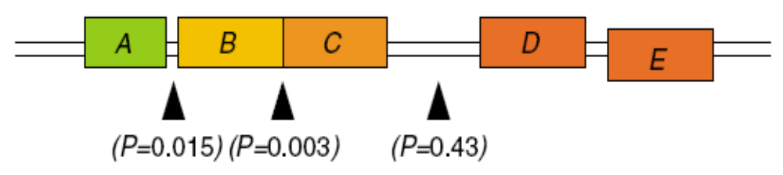
Work completed(2/4)
Gene cluster method
  Using the distance between genes in a genome
  Finding an operon structure in a microbial organism
  Poisson distribution
†Operon: An operon is a collection of inter-related genes including one which acts as a switch that governs the expression of the structural genes in the collection.

Slide 10
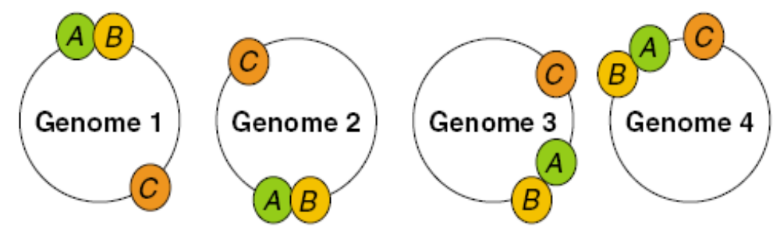
Work completed(3/4)
Gene Neighbor method
  Using the order of genes
  Finding the conserved ‘close’
†Close: a set of genes occurring on a prokaryotic chromosome if and only if they all occur on the same strand and the gaps between adjacent genes are 300 bp or less

Slide 11
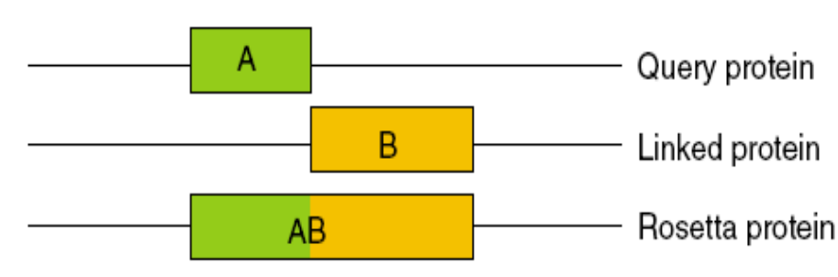
Work completed(4/4)
Gene Fusion method
  Analysis of gene fusion events
  Detecting proteins carrying out consecutive metabolic steps
  Detecting proteins being components of molecular complexes
  Hypergeometric distribution

Slide 12
Work in progress(1/3)
User Interface
  Input: NCBI ids, protein name
  Output
    Make a list of interacting proteins
    Drawing the interaction network
      Utilizing the public graph drawing API

Slide 13
Work in progress(2/3)
public database
identifiers
gene name, protein name
Query protein
GI:12168078
PP
GN
GC
RS
confidence | 0.7
Methods
1. Select methods
2. Set confidence value

Slide 14
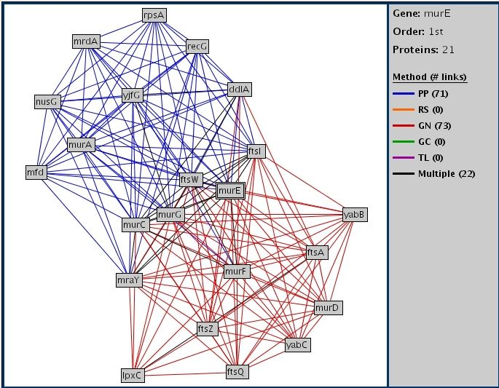
Work in progress(3/3)
Functional Links
method | identifier | confidence | name
PP | 685507 | 0.91 | mfd
PP | 283507 | 0.87 | recG
GN | 545861 | 0.79 | murG
… | … | … | …

Slide 15
Work remains to be done(1/2)
MAR~APR
  Input: sequence, other ids
  Output
    Detailed information
    Integration of other application information
      Pathway maps
      Localization information

Slide 16
Work remains to be done(2/2)
MAY~JUN
  Input: keyword
  Output
    Predicted functions
    Go terms for molecular function, biological process
    and cellular component
Research
  Improvement of the phylogenetic profile method
  Interpretation of the interaction network
  Integration of other applications

Slide 17
References(1/2)
Prolinks
  Institute for Genomics and Proteomics, UCLA
  Prolinks : a database of protein functional linkages derived from coevolution
  Bowers PM, Pellegrini M, Thompson MJ, Fierro J, Yeates TO, Eisenberg D
  Genome Biology 2004, 5(5):R35
  Assigning protein functions by comparative genome analysis: Protein phylogenetic profiles
  Pellegrini M, Marcotte EM, Thompson MJ, Eisenberg D, Yeates TO
  PNAS 1999, 96(8):4285-4288
  A combined algorithm for genome-wide prediction of protein function
  Marcotte EM, Pellegrini M, Thompson MJ, Yeates TO, Eisenberg D
  Nature 1999, 402:83-86
  Providing the appropriate probability models
  More prediction links, higher accuracy

Slide 18
References(2/2)
String
  Search Tool for the Retrieval of Interacting Genes/Proteins
  European Molecular Biology Laboratory, Germany
  STRING: known and predicted protein-protein associations, integrated and transferred across organisms
  von Mering C, Jensen LJ, Snel B, Hooper SD, Krupp M, Foglierini M, Jouffre N, Huynen MA, Bork P.
  Nucleic Acids Res. 2005 Jan 1;33(Database issue):D433-7.
  STRING: a database of predicted functional associations between proteins
  von Mering C, Huynen M, Jaeggi D, Schmidt S, Bork P, Snel B.
  Nucleic Acids Res. 2003 Jan 1;31(1):258-61.
  STRING: a web-server to retrieve and display the repeatedly occurring neighbourhood of a gene
  Snel B, Lehmann G, Bork P, Huynen MA
  Nucleic Acids Res. 2000 Sep 15;28(18):3442-4.
  Using experimental data and expression data
  Providing many links to additional information

Slide 19
Paperwork schedule
Domestic journal
  This semester
  Topic: Interaction interpretation method
  Author: Sangwon Yoo, Hoyoung Jeong, Taewhi Lee, Mikyoung Lee, Cheolgoo Hur, Hyoung-Joo Kim
  Topic: Efficient processing of phylogenetic profile method
  Author: Hoyoung Jeong, Sangwon Yoo, Taewhi Lee, Cheolgoo Hur, Hyoung-Joo Kim

