Slide 1
Less Talk, More Rock: Automated Organization of Community-Contributed Collections of Concert Videos
Lyndon Kennedy, Yahoo! Research, Santa Clara, CA
Mor Naaman ,Dept. of Library and Information Science ,Rutgers University, New Brunswick, NJ
2009.12.30
Presented by Seong-yun Lee, IDB

Slide 2
Outline
Introduction
Aligning Video Clips with Audio Fingerprints
Generating Fingerprints
Matching Clips
Synchronization
Linking and Clustering
Several Applications
Evaluation
Conclusion

Slide 3
Outline
Introduction
Aligning Video Clips with Audio Fingerprints
Generating Fingerprints
Matching Clips
Synchronization
Linking and Clustering
Several Applications
Evaluation
Conclusion

Slide 4
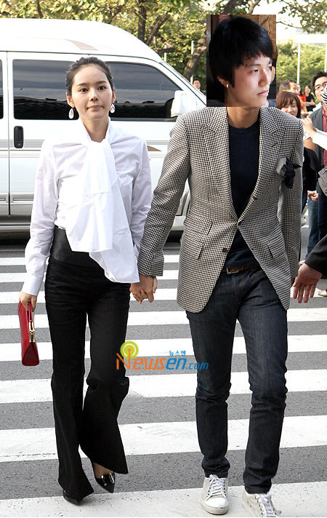
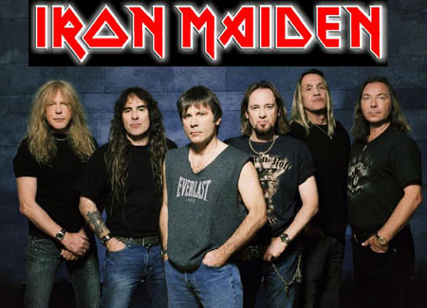
Introduction – User Scenario
Seong-yun and His girl friend attended Iron Maiden’s show.

Slide 5
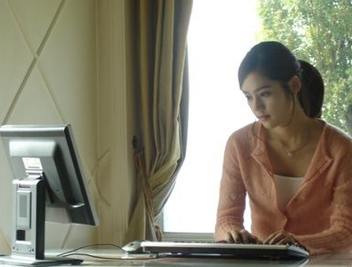
Introduction – User Scenario
I want to re-live some of the best moments from last night.
Seong-yun’s girl friend searched ‘The Number of the Beast’ on Youtube.

Slide 6
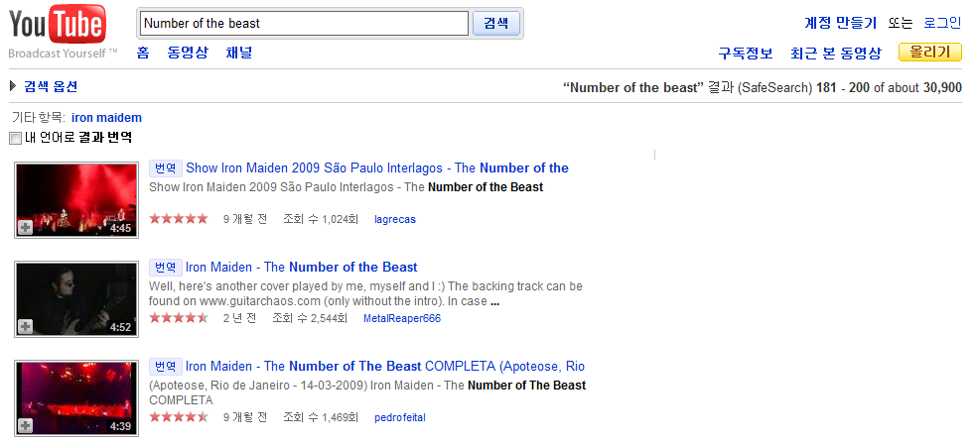
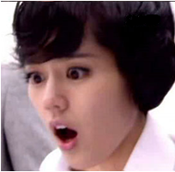
Introduction – User Scenario
There are too many clips!!!

Slide 7
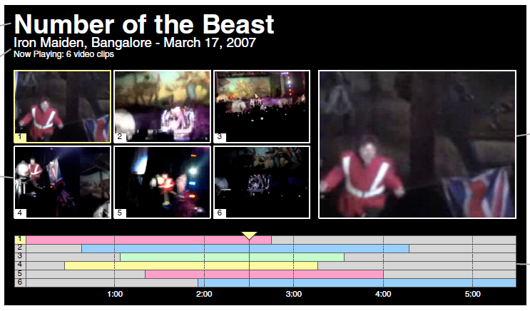
Introduction – Sample Interface

Slide 8
Introduction
Main Contributions are
A framework for identifying and synchronizing video clips taken at the same event
An initial analysis of the audio synchronization
An approach to extract meaningful metadata about the event
An approach to find the higher quality audio content using synchronization links

Slide 9
Outline
Introduction
Aligning Video Clips with Audio Fingerprints
Generating Fingerprints
Matching Clips
Synchronization
Linking and Clustering
Several Applications
Evaluation
Conclusion

Slide 10
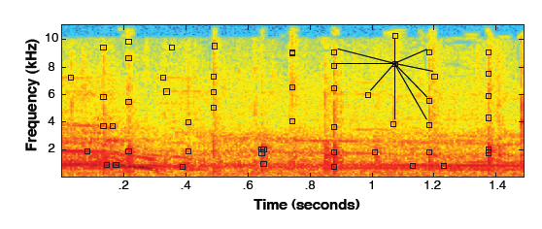
Aligning Video Clips – Generating Fingerprints
Proposed by A. Wang
An Industrial Strength Audio Search Algorithm. In Proceedings of the International Conference on Music Information Retrieval, 2003.
Taking the short-time Fourier transform of a given audio segment
<Spectrogram of a segment of audio>
Black square : landmark
Local frequency peak
The fingerprints are determined by constructing hash values
Using the time and frequency differences between the landmark and a few landmarks

Slide 11
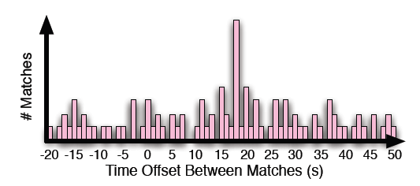
Aligning Video Clips – Matching Clips
Determine the two clips are a match
By checking whether any of the bins exceeds the threshold
* (Threshold : based on the computed mean and standard deviation)
Successful detection needs
The less noise in a clip
The longer clip

Slide 12
Aligning Video Clips – Synchronization
Typical Audio fingerprinting applications : focused on the detection of matches between two clips
But, the detection process can yield the actual offset between two clips.
Setting the bins’ span to 50ms
=> Sufficient to synchronize the video stream (typically have a low frame rate)

Slide 13
Outline
Introduction
Aligning Video Clips with Audio Fingerprints
Generating Fingerprints
Matching Clips
Synchronization
Linking and Clustering
Several Applications
Evaluation
Conclusion

Slide 14
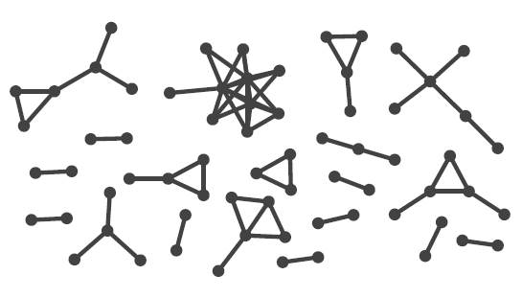
Linking and Clustering
Create a graph structure, linking between overlapping video clips
It is possible that system generate a undesirable single connected component
Eg.) There is a clip of recording of the whole show.
But authors did not encounter this in their experiments and dataset.

Slide 15
Outline
Introduction
Aligning Video Clips with Audio Fingerprints
Generating Fingerprints
Matching Clips
Synchronization
Linking and Clustering
Several Applications
Evaluation
Conclusion

Slide 16
Several Applications
Extracting Level of Interest
Larger clusters are more interesting
Selection of Higher Quality Audio
Low-quality audio tracks cause the audio fingerprinting method to fail
If sources are highly noisy, they are filtered automatically.
Extracting Themes from Media Descriptions
If overlapping videos are related, users may choose similar terms to annotate
A score for each term is calculated as
( : the number of videos for which the term x is used in a cluster C
: the count of video clips in the entire collection where the term x appears)

Slide 17
Outline
Introduction
Aligning Video Clips with Audio Fingerprints
Generating Fingerprints
Matching Clips
Synchronization
Linking and Clustering
Several Applications
Evaluation
Conclusion

Slide 18
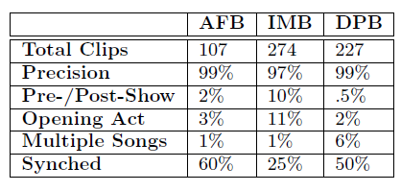
Evaluation – Experimental Data
<Summary of the characteristics of the online vidoes>
Arcade Fire in Berkeley(AFB) , Iron Maiden in Bangalore(IMB),
Daft Punk in Berkeley(DFB)

Slide 19
Evaluation – Experimental Data
Precision : Percentage of the retrieved videos that were indeed captured at the concert
Pre- / Post-Show : The proportion of social interactions between the concert-goers before and after the show.
Opening Act : The opening act performing before the main show.
Multiple Songs : Single Clips have the different portions of the show.
Synched : the proportion of clips for which the audio processing framework has found a matching clip

Slide 20
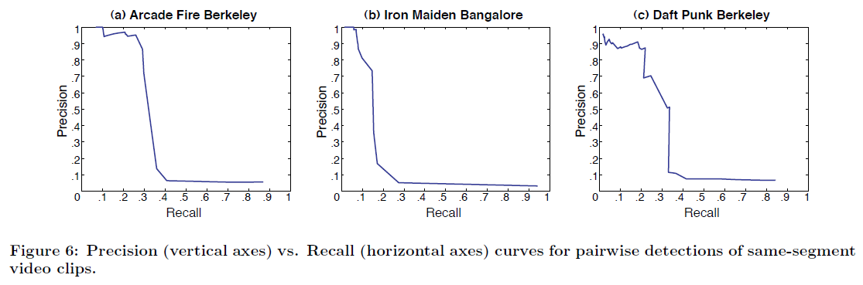
Evaluation – Matching Clips
Near-perfect precision is maintained up to recall of 20~30%, after which point the precision drops off dramatically.
Low recall value may not be critical for this paper’s application
The exclusion of too short clips and low quality clips.
Use the high precision threshold!!

Slide 21
Evaluation – Finding Important Segments
The larger clusters are subjectively most interesting.
Eg.) the largest Daft Punk clusters contain videos of “One more time”, and “Around the World” which are two of the group’s most popular singles.
Comparing the size of the cluster against the number of times that the song has been played by Last.fm users.
There is a statistically significant correlation!

Slide 22
Evaluation – Higher Quality Audio
To evaluate this topic, authors conducted a study with human subjects.
Comparing the quality score as generated by the system against audio-quality scores by human.
There is a significant correlation!!
This approach is successfully detecting higher-quality audio segments.

Slide 23
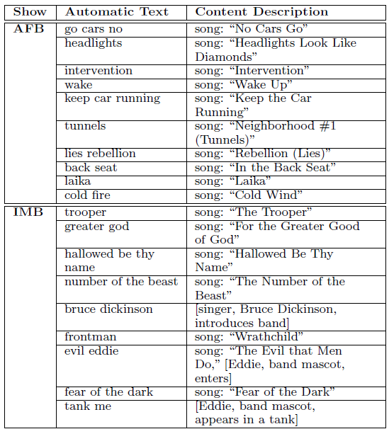
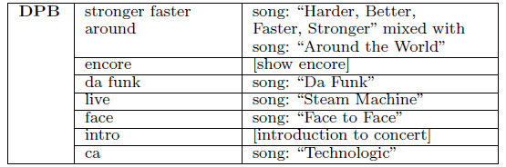
Evaluation – Extracting Textual Themes

Slide 24
Evaluation – Extracting Textual Themes
There are many terrible Automatic Text
“No Cars Go” => “go cars no” , “Cold Wind” => “Cold fire”
“Steam machine” => “live” , “Technologic” => “ca”
But, Some text are reflective of the moments
Encore, intro
evil eddie, tank me : reflect theatrics portions of concert (Band mascot eddie enters)

Slide 25
Outline
Introduction
Aligning Video Clips with Audio Fingerprints
Generating Fingerprints
Matching Clips
Synchronization
Linking and Clustering
Extracting Level of Interest
Selection of Higher Quality Audio
Extracting Themes from Media Descriptions
Towards a Better Presentation of Concert Clips
Evaluation
Conclusion

Slide 26
Conclusion
The authors set
the grounds for an application that enhances the presentation and findability of content in live music concert
Key problem
Authors did not have proper crawling algorithm
This approach will lead to change the way we consume and share media online.

