Slide 1

Chapter 1
What Is the Semantic Web?
Internet Database Lab.
SNU
2009 Winter
Presented by Jae-Min Ahn

Slide 2
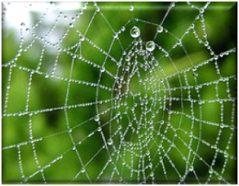
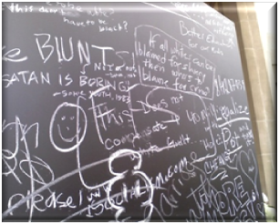
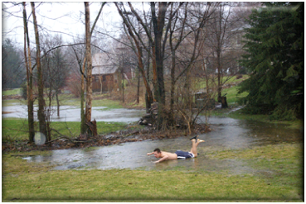
WHAT IS A WEB?
Web of information
  Traditional - Accessible only to highly trained
  After adoption of the WWW - Anyone to be familiar with
Open community
  Anyone can contribute their ideas for anyone to see
  Openness
    Resulting in the astonishing comprehensiveness of topics covered by the Web
A mile wide but an inch deep

Slide 3
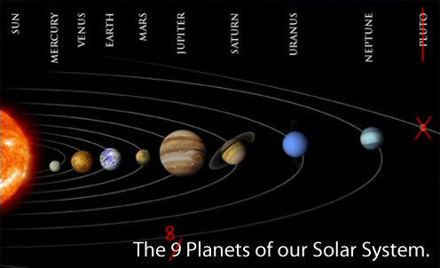
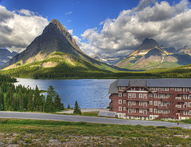
SMART WEB, DUMB WEB
- SMART WEB, DUMB WEB
“Dumb”
  Means inconsistent, out of synch, and disconnected
  Ex> Pluto
    Which up until 2006 was considered a planet
    IAU(International Astronomical Union) has decided
    it should be considered a member of a new
    category called a “dwarf planet!”
    In Pluto web page, the update has been made
    But, others didn’t
  Ex> Mongotel
    A branch of Mongotel in National Park Website
    But in Mongotel Website, you can’t find
    that branch

Slide 4
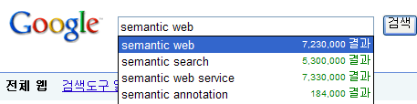
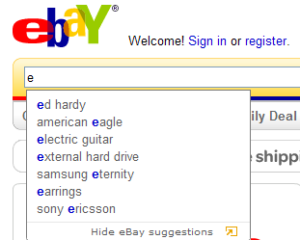
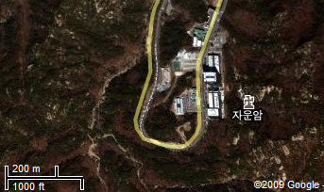
SMART WEB, DUMB WEB
- Smart Web Applications (1/2)
The web
  Full of intelligent applications
    Search engines make matches that seem deep and intuitive
    Commerce sites make smart recommendations
    Mapping sites include detailed information about world geography

Slide 5
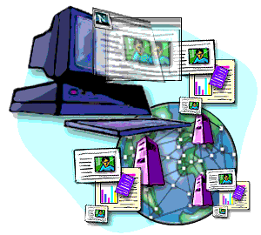
SMART WEB, DUMB WEB
- Smart Web Applications (2/2)
Web infrastructure
  To allow smart applications to perform to their potential
  Intelligent application
    Only as smart as the data that is available it
    Inconsistent input will still result in confusing
  The Semantic Web
    Not to make a web infrastructure that is as smart as possible
    To make an infrastructure that is most appropriate to the job of integrating information on the web
    Doesn’t make data smart
    Just needs to get the right data
    to the right place
World Wide Web Infrastructure

Slide 6
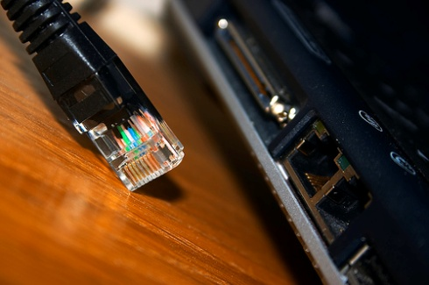
SMART WEB, DUMB WEB
- A Connected Web Is a Smarter Web
Disconnected data
  Result in dumb behavior
The Web seems smarter
  Because smart applications can get the data they need
  Ex> Pluto Example
    Astronomy website to update consistently
  Ex> Mongotel Example
    Coordination between the two webpages
    An update to the location of hotels would be reflected
    Two sources to stay synchronized

Slide 7
SEMANTIC DATA
- A Distributed Web of Data
To support a distributed network
  The current Web infrastructure
    Webpages can refer to one another with global links
    URL(Uniform Resource Locators) – One web page point to another
  The Semantic Web infrastructure
    At the level of the data
    URI(Uniform Resource Identifiers) - One data can point to another
    RDF(Resource Description Framework) – Data model
    This single, distributed model of information is the contribution that the Semantic Web infrastructure brings to smarter web

Slide 8
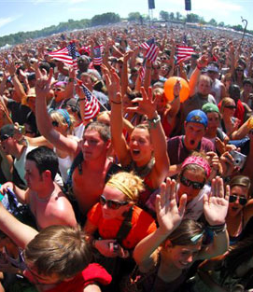
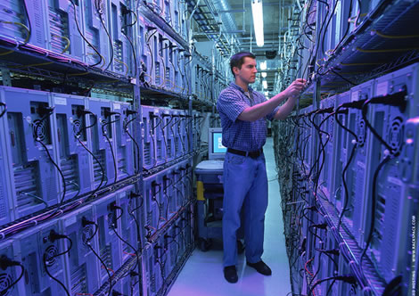
SEMANTIC DATA
- Features of a Semantic Web (1/2)
The AAA slogan
  Anyone can say, Anything about, Any topic
  Data infrastructure allow any individual
    to express a piece of data about some entity
    to combine with information from other sources
  Information is not managed for a large, corporate data center
    Data center : one database administrator rules with an iron hand over any addition or modification to the database
  A distributed web of data
    An organic system
    Contribution coming from all sources
Notes:
문서들의 웹에서의 의미는 누구나 자신이 웹페이지를 만드는 것이었고
시멘틱 웹에서는 어떤 개인이라도 다른 소스에서 나온 정보들과 결합할 수 있으며 어느 엔티티에 대한 데이터라도 표현할 수 있어야 한다.
Document Web
Semantic Web

Slide 9
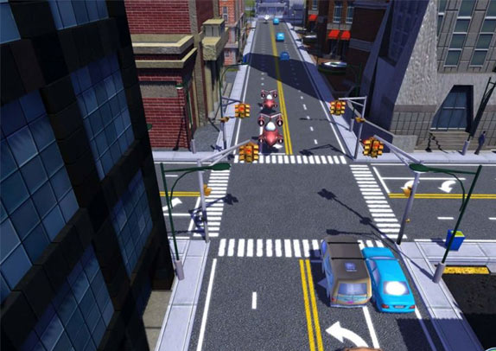
SEMANTIC DATA
- Features of a Semantic Web (2/2)
The network effort
  The document Web
    In the early days Skeptics, “Who is going to create all that content? Someone has to write those webpages!”
    Once the Web infrastructure was in place, people came out of the woodwork to do just that
    Growing because of a virtuous cycle
  Virtuous cycle
    A few people did have Web servers
    And a few more got Web browsers
    become more attractive
  Semantic Web
    “Who convert data to RDF for distribute access?”
    Being designed to benefit from the Same network effect
    that drove the document Web
Notes:
너무 걱정하지 말아라
Document web이 virtuous cycle 에 의해 성장했듯이 Semantic Web도 성장할 것이다~~~ 이런것이죠

Slide 10
SEMANTIC DATA
- What about the Round-Worlders?
What about the Round-Worlders?
  Someone say world is round, while others insist flat
  Speakers on the Web may disagree
    They may fundamentally disagree on some topic
      While the IAU has changed its definition of planet in such a way that Pluto is no longer include, many astrologers have decided to continue to consider Pluto as a planet
    Someone might want to intentionally deceive
      Someone who markets posters, models, or other works that depict nine planets has a good reason to delay reporting the result from the IAU
    Someone might simply be mistaken
      Some website might erroneously list Pluto as a planet
    Some information may be out of date
      It does take effort to update them

Slide 11
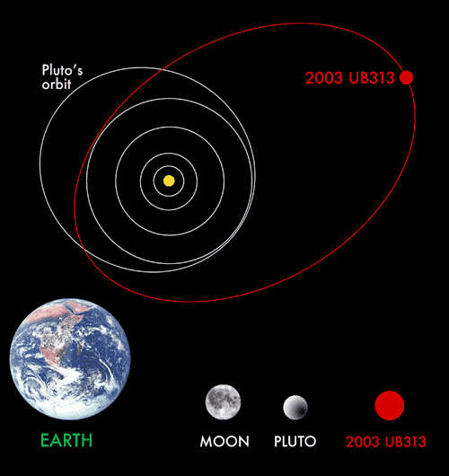
SEMANTIC DATA
- To Each Their Own
Non-unique naming assumption
  Since the speakers on the Web won’t necessarily coordinate their naming efforts, the same entity could be known by more than one name.
  UB313 versus Xena

Slide 12
SEMANTIC DATA
- There’s Always One More
Open World assumption
  A consequence of the AAA slogan is that there could always be something new that someone will say
  Assuming that there is always more information
  Ex> UB313
  The fact that Mogetel might have more hotels in Boston
    Not invalidating the fact that it has the ones it already lists
  When we want to draw conclusions based on distributed data, the openness of the Web becomes an issue
    Not assuming that just because we haven’t found a Mongotel listing in Boston, no such hotel exists

Slide 13
SUMMARY(1/2)
The aspects of the Web we have outlined here – the AAA slogan, the network effect, non-unique naming and the open world assumption – already hold for the document Web.
As a result, the Web today is something of an unruly place
For the Semantic Web, which operates at the finer level of individual statement about data, the situation is even wilder.
If the document Web is unruly, then surely the Semantic Web is a jungle.
How can such a mess become something useful? That is the challenge that faces the working ontologist.
Their medium is the distributed web of data.
Their tools are the Semantic Web languages RDF, RDFS, and OWL.
Their craft is to make sensible, usable, and durable information resources from this medium.

Slide 14
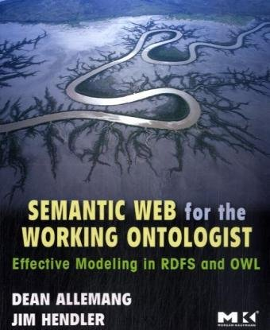
SUMMARY(2/2)
The cover of this book shows a system of channels with water coursing through them.
If we think of the water as the data that are on the Web, the channels are the model. If not for the model, the water would not flow in any systematic way.

