Slide 1

Modern Information Retrieval
Ricardo Baeza-Yates and Berthier Ribeiro-Neto
Chapter 2. Modeling (2.6-2.10)
June 28, 2010
Kangpyo Lee

Slide 2
Contents
Alternative Set Theoretic Models
Fuzzy Set Model
Extended Boolean Model
Alternative Algebraic Model
Generalized Vector Space Model
Latent Semantic Indexing Model
Neural Network Model
Alternative Probabilistic Models
Bayesian Networks
Inference Network Model
Belief Network Model
Structured Text Retrieval Models
Models for Browsing

Slide 3
Fuzzy Set Model (1)
Representing documents & queries through set of keywords
Only partially related to the real semantic contents
An approximate (or vague) matching of a document to the query
Alternative
Each query term defines a fuzzy set
Each document has a degree of membership (usually < 1) in this set
Proposed in 1991 by Ogawa, Morita, & Kobayashi [616]

Slide 4
Fuzzy Set Model (2)
Fuzzy Set Theory
The representation of classes whose boundaries are not well defined
Key idea
to associate a membership function with the elements of the class
This function takes values in the interval [0,1]
0: no membership in the class
1: full membership
Definition
μ_{A}(u): U → [0,1]
A membership function which associates with each element u of U a number in the interval [0,1]
μ_{¬A}(u) = 1 - μ_{A}(u)
μ_{A∪B}(u) = max(μ_{A}(u), μ_{B}(u))
μ_{A∩B}(u) = min(μ_{A}(u), μ_{B}(u))
Fuzzy sets are useful for representing vagueness & imprecision

Slide 5
Fuzzy Set Model (3)
Fuzzy Information Retrieval
Basic idea: to expand the set of index terms in the query with related terms
Defining a term-term correlation matrix c (i.e. keyword connection matrix)
A normalized correlation factor c_{i,l} between two terms k_{i} & k_{l}
n_{i}: the # of documents which contain the term k_{i}
n_{i,l}: the # of documents which contain both terms k_{i} & k_{l}
A document d_{j} has a degree of membership μ_{i,j}
Computes an algebraic sum over all terms in the document d_{j}
1) Whenever there is at least one index term k_{l} of d_{j} which is strongly related to the index k_{i} , then μ_{i,j} ~ 1 (-> the index k_{i} is a good fuzzy index for d_{j})
2) When all index terms of d_{j} are only loosely related to k_{i}, then μ_{i,j} ~ 0

Slide 6
Fuzzy Set Model (4)
Fuzzy Information Retrieval
Converting a Boolean-like query expression to its disjunctive normal form
E.g. [q = k_{a} ∧ (k_{b} ∨ ¬k_{c})] -> [q_{dnf} = (1,1,1) ∨ (1,1,0) ∨ (1,0,0)]
q_{dnf} = cc₁ ∨ cc₂ ∨ ... ∨ cc_{p}
cc_{i}: a reference to the i-th conjunctive component
p: the # of conjunctive components of q_{dnf}
D_{a}
D_{b}
cc₃
cc₂
cc₁
D_{c}
D_{q}= cc₁ + cc₂ + cc₃

Slide 7
Fuzzy Set Model (5)
Evaluation
Fuzzy set models for IR have been
Discussed mainly in the literature
Not popular among the IR community
The vast majority of the experiments has considered only small collections

Slide 8
Extended Boolean Model (1)
Consider a conjunctive Boolean query q = k_{x} ∧ k_{y}
According to the Boolean model, a document which contains either the term k_{x} or the term k_{y} is as irrelevant as another document which contains neither of them
Extending the Boolean model with the functionality of partial matching & term weighting of the vector model
Introduced in 1983 by Salton, Fox, & Wu [703]

Slide 9
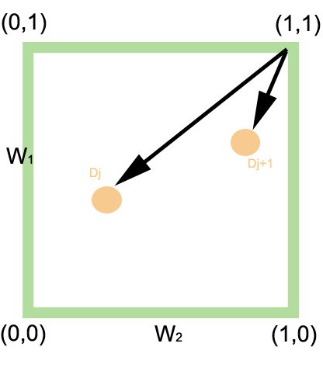
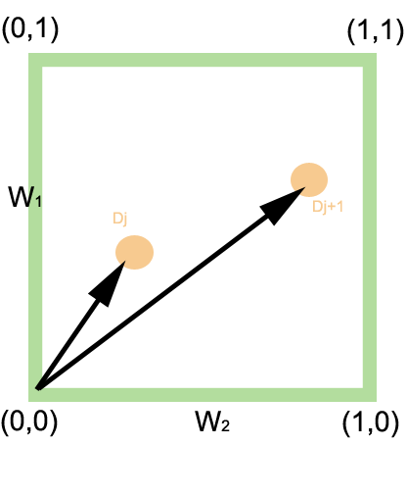
Extended Boolean Model (2)
When only two terms are considered, we can plot queries & documents in a two-dimensional map
f_{x,j}: the normalized frequency of term k_{x} in the document d_{j}
idf_{i}: the inverse document frequency for a generic term k_{i}
The similarities of q = (k_{x} ∧ k_{y})
with documents d_{j} & d_{j+1}
The similarities of q = (k_{x} ∨ k_{y})
with documents d_{j} & d_{j+1}

Slide 10
Extended Boolean Model (3)
When only two terms are considered, we can plot queries & documents in a two-dimensional map
If the # of index terms in a document collection is t, the model can be naturally extended to consider Euclidean distance in a t-dimensional space or p-norm model
The similarities of q = (k_{x} ∧ k_{y})
with documents d_{j} & d_{j+1}
The similarities of q = (k_{x} ∨ k_{y})
with documents d_{j} & d_{j+1}

Slide 11
Extended Boolean Model (4)
Evaluation
Really a hybrid model which includes properties of both the set theoretic models & the algebraic models
Has not been used extensively
Does provides a neat framework & might reveal itself useful in the future

Slide 12
Contents
Alternative Set Theoretic Models
Fuzzy Set Model
Extended Boolean Model
Alternative Algebraic Model
Generalized Vector Space Model
Latent Semantic Indexing Model
Neural Network Model
Alternative Probabilistic Models
Bayesian Networks
Inference Network Model
Belief Network Model
Structured Text Retrieval Models
Models for Browsing

Slide 13
Generalized Vector Space Model (1)
Motivation
The three classic models assume independence of index terms
I.e. Pairwise orthogonality among the index term vectors (k_{i} • k_{j} = 0)
In the generalized vector space model, the index term vectors are assumed linearly independent but are not pairwise orthogonal
Limitations
There is no consensus that incorporation of term dependencies yields effective improvement with general collections
The generalized vector space model is more complex & computationally more expensive

Slide 14
Generalized Vector Space Model (2)
Definition
Given the set {k₁, k₂, …, k_{t}} of index terms in a collections
w_{i,j}: the weight associated with the term-document pair [k_{i}, d_{j}]
All binary
All possible patterns of term co-occurrence (inside documents) can be represented by a set of 2^{t} minterms
m₁ = (0, 0, …, 0), m₂ = (1, 0, …, 0), m₃ = (0, 1, …, 0), m₄ = (1, 1, …, 0), …, m₂^{t} = (1, 1, …, 1)
g_{i}(m_{j}): the weight {0, 1} of the index term k_{i} in the minterm m_{j}
The central idea
To introduce a set of pairwise orthogonal vectors associated with set of minterms
To adopt this set of vectors as the basis

Slide 15
Generalized Vector Space Model (3)
Definition 1, 2, …, 2^{t}
…
where each vector is associated with the respective minterm m_{i}
Example
is associated with the minterm m₄ = (1, 1, …, 0) which points to the documents in the collection containing the index terms k₁, k₂, and no others
If such documents do exist in the collection then we say
that the minterm m₄ is active
that a dependence between the index terms k₁ & k₂ is induced

Slide 16
Generalized Vector Space Model (4)
To determine the index term vector associated with the index term k_{i}
Simply sum up the vectors for all minterms m_{r} in which the term k_{i} is in state 1 & normalize
To quantify a degree of correlation between the index terms k_{i} & k_{j}

Slide 17
Latent Semantic Indexing Model (1)
Motivation
The inherent vagueness associated with a retrieval process which is based on keyword sets
The process of matching documents to a given query based on concept matching instead of index term matching
E.g. a document could be retrieved because it shares concepts with another document which is relevant to the given query
The main idea
To map each document & query vector into a lower dimensional space which is associated with concepts
Accomplished by mapping the index term vectors into this lower dimensional space

Slide 18
Latent Semantic Indexing Model (2)
Definition
t: the total # of index terms
N: the # of documents
= (M_{ij}): a term-document matrix with t rows & N columns
To each element of this matrix is assigned a weight w_{ij} associated with the pair [k_{i}, d_{j}]
The weight w_{ij} could be generated using the tf-idf weighting technique
To compute the correlation matrix
Term-to-term correlation matrix = AA^{t}
Document-to-document correlation matrix = A^{t}A
 | d₁ | d₂ | d₃
k₁
k₂
k₃
A =

Slide 19
Latent Semantic Indexing Model (3)
Decompose the association matrix in three components using singular value decomposion
: the matrix of eigenvectors derived from the term-to-term correlation matrix
: the matrix of eigenvectors derived from the document-to-document correlation matrix
: an r x r digornal matrix of singular values where r = min(t, N) is the rank of

Slide 20
Latent Semantic Indexing Model (4)
Only the s largest singular values of are kept along with their corresponding columns in &
s: the dimensionality of a reduced concept space ( < r)
should be large enough to allow fitting all the structure
should be small enough to allow filtering out all the non-relevant representational details
The relationship between any two documents in the reduced space

Slide 21
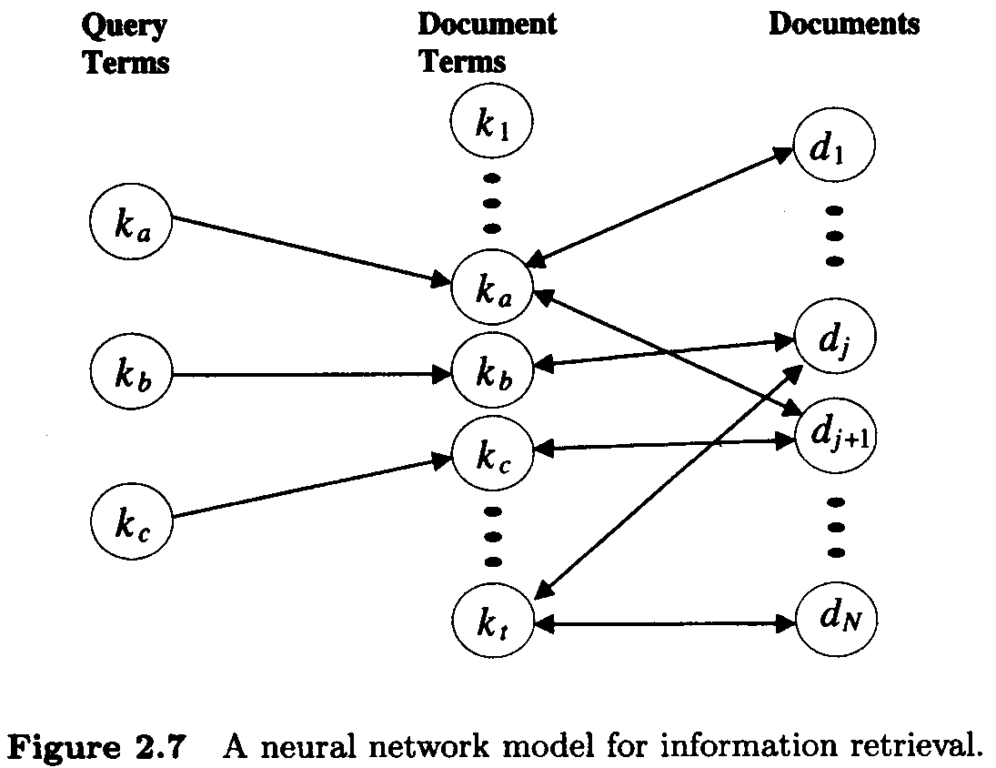
Neural Network Model (1)
Motivation
Index terms in documents & queries should be matched & weighted
Neural networks are known to be good pattern matchers
Three layers
Query terms
Documents terms
Documents

Slide 22
Neural Network Model (2)
First phase of propagation
Query term nodes initiate the process by sending signals to the document term nodes
The document term nodes might themselves generate signals to the document nodes
Next phase of propagation
The document nodes might generate new signals which are directed back to the document term nodes (-> the bidirectional edges)
The document term nodes might again fire new signals directed to the document nodes, repeating the process

Slide 23
Neural Network Model (3)
Normalize signal strength (MAX = 1)
Query terms emit initial signal equal to 1
Weight associated with an edge from a query term node k_{i} to a document term node k_{i}
Weight associated with an edge from a document term node k_{i} to a document node d_{j}

Slide 24
Neural Network Model (4)
After the first round of signal propagation, the activation level of the document node associated to the document d_{j}
-> Exactly the ranking of the Vector model
New signals might be exchanged among document term nodes & document nodes in a process analogous to a feedback cycle
A minimum threshold should be enforced to avoid spurious signal generation

Slide 25
Contents
Alternative Set Theoretic Models
Fuzzy Set Model
Extended Boolean Model
Alternative Algebraic Model
Generalized Vector Space Model
Latent Semantic Indexing Model
Neural Network Model
Alternative Probabilistic Models
Bayesian Networks
Inference Network Model
Belief Network Model
Structured Text Retrieval Models
Models for Browsing

Slide 26
Alternative Probabilistic Models
Probability theory for quantifying document relevance
One stream concerning Bayesian belief network
Why Bayesian Networks?
Clear formalism to combine evidences
Combining distinct evidences leading better performance
Bayesian Network Models for IR
Inference Network (Turtle & Croft, 1991)
Prior successful model
Belief Network (Ribeiro-Neto & Muntz, 1996)
Generalized model

Slide 27
Bayesian Networks (1)
Motivation
Bayesian (belief) networks are useful
Provide a clean formalism for combining distinct sources of evidence (past queries, past feedback cycles, & distinct query formulations) in support of the rank for a given document
The combination of distinct evidential sources can be used to improve retrieval performance
Bayesian Network Models for IR
Inference Network (Turtle & Croft, 1991)
Prior successful model
Belief Network (Ribeiro-Neto & Muntz, 1996)
Generalized model

Slide 28
Bayesian Networks (2)
Bayesian networks
Directed acyclic graphs (DAGs)
Nodes: random variables
Arcs: causal relationships between these variables
If x → y, x is a direct cause for y & x is a parent of y
The strengths of these causal influences: conditional probabilities
Bayes’ Rule: the heart of Bayesian techniques

Slide 29
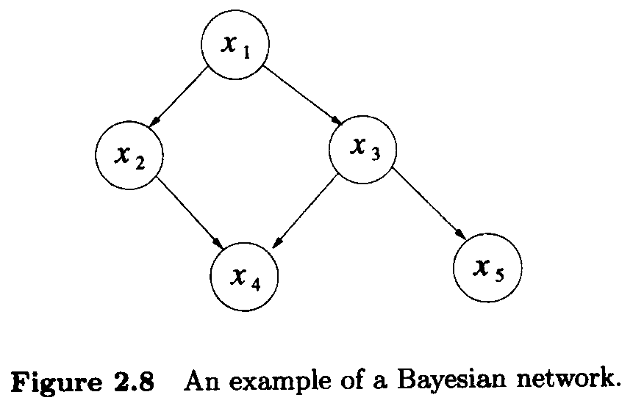
Bayesian Networks (3)
Example
A Bayesian network for a joint probability distribution
P(x₁): the prior probability (used to model previous knowledge about the semantics of the application)

Slide 30
Inference Network Model (1)
Two most traditional schools of thought in probability
Frequentist view
Probability as a statistical notion related to the laws of chance
Epistemological view
Probability as a degree of belief without statistical experimentation
Inference network model
Takes an epistemological view of the IR problem
Associates random variables with the index terms, documents, & user queries
A random variable associated with a document d_{j} represents the event of observing that document

Slide 31
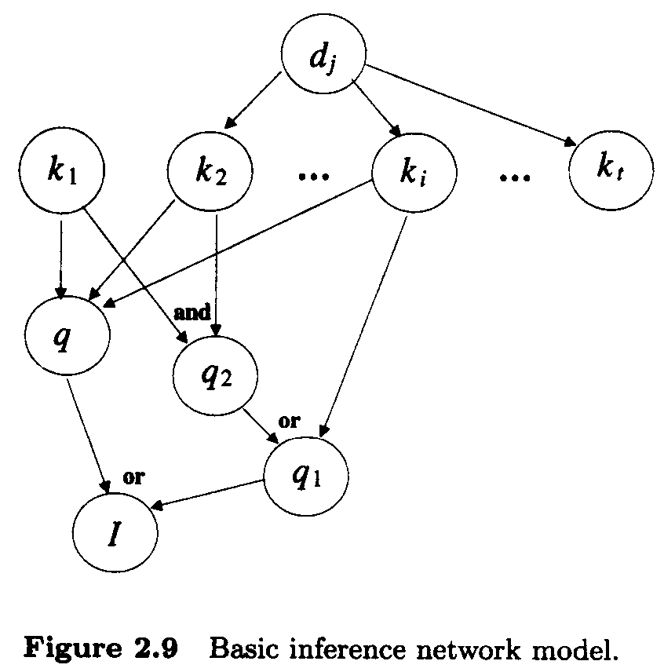
Inference Network Model (2)
Nodes
Documents (d_{j})
Index terms (k_{i})
Queries (q, q₁, & q₂)
User information need (I)
Edges
An edge from d_{j} to its index term nodes k_{i} indicate that the observation of d_{j} increase the belief in the variables k_{i}
Example
d_{j} has index terms k₂, k_{i}, & k_{t}
q has index terms k₁, k₂, & k_{i}
q₂ & q₁ model a Boolean formulation
q₁ = ((k₁ Λ k₂) V k_{i})
I = (q V q₁)

Slide 32
Inference Network Model (3)
Definition
k = (k₁, k₂, ..., k_{t}): a t-dimensional vector
k_{i} ∈{0, 1} is a binary random variable
k has 2^{t} possible states for k
d_{j} ∈ {0, 1}: a binary random variable associated with a document d_{j}
q ∈ {0, 1}: a binary random variable associated with the user query q
The ranking of a document d_{j} with respect to a query q is computed as P(q Λ d_{j})
q & d_{j} are short representations for q = 1 & d_{j} = 1

Slide 33
Inference Network Model (4)
Computing P(q Λ d_{j})
P(q Λ d_{j}) = Σ_{∀k} P(q Λ d_{j} | k) P(k)
= Σ_{∀k} P(q Λ d_{j} Λ k) (Product Rule)
= Σ_{∀k} P(q | d_{j} Λ k) P(d_{j} Λ k) (Product Rule)
= Σ_{∀k} P(q | d_{j} Λ k) P(k | d_{j} ) P(d_{j}) (Product Rule)
= Σ_{∀k} P(q | k) P(k | d_{j}) P(d_{j}) (k_{i} separates q from d_{j})
P(¬(q Λ d_{j})) = 1 - P(q Λ d_{j})

Slide 34
Belief Network Model (1)
As the inference network model
Takes an epistemological view of the IR problem
Contrary to the inference network model
Adopting a clearly defined sample space (K = {k₁, k₂, ...,k_{t}})
A set-theoretic view
A slightly different network topology which provides a separation between the documents & the query portions of the network

Slide 35
Belief Network Model (2)
Definition of the probability space
K = {k₁, k₂, ...,k_{t}}: the sample space (a concept space)
u ⊂ K: a subset of K (a concept)
A probability distribution P over K
c: a generic concept in the space K representing a document or user query
P(c) = Σ_{∀u} P(c|u) P(u)
P(u)=(1/2)^{t}

Slide 36
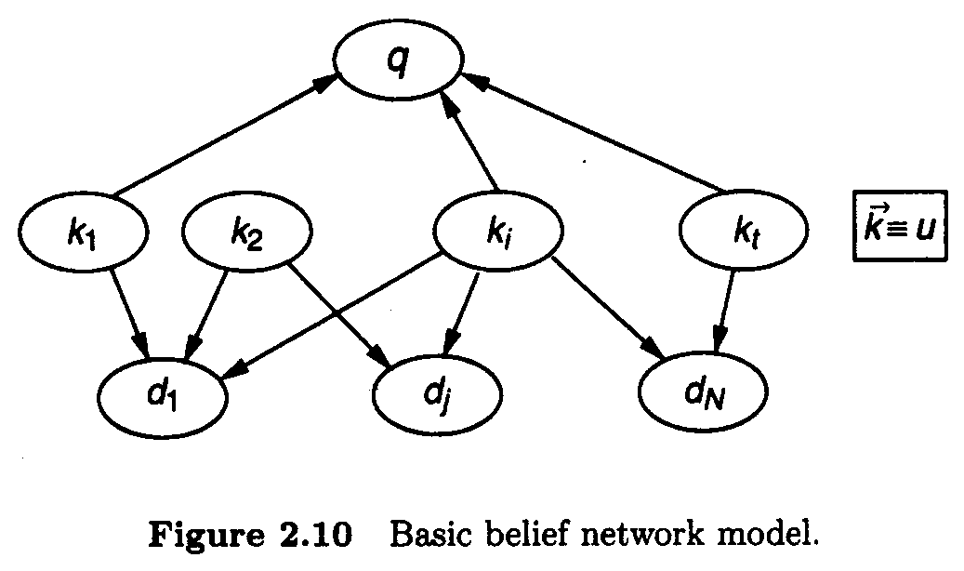
Belief Network Model (3)
The rank of d_{j}
P(d_{j} | q) = P(d_{j} Λ q) / P(q)
~ P(d_{j} Λ q) (P(q) is constant for every document)
~ Σ_{∀u} P(d_{j} Λ q | u) P(u) (P(c)=Σ_{∀u}P(c|u) P(u))
~ Σ_{∀u} P(d_{j} | u) P(q | u) P(u) (Instantiation of index term variables make d & q independent)
~ Σ_{∀k} P(d_{j} | k) P(q | k) P(k) (u can be converted to vector k)

Slide 37
Contents
Alternative Set Theoretic Models
Fuzzy Set Model
Extended Boolean Model
Alternative Algebraic Model
Generalized Vector Space Model
Latent Semantic Indexing Model
Neural Network Model
Alternative Probabilistic Models
Bayesian Networks
Inference Network Model
Belief Network Model
Structured Text Retrieval Models
Models for Browsing

Slide 38
Structured Text Retrieval Models (1)
Motivation
Keyword-based query answering considers that the documents are flat
A word in the title has the same weight as a word in the body of the document
But, the document structure is one additional piece of information which can be taken advantage of
Words appearing in the title or in sub-titles within the document could receive higher
E.g. Consider the following information need
Retrieve all documents which contain a page in which the string ‘atomic holocaust’ appears in italic in the text surrounding a Figure whose label contains the word ‘earth’
The corresponding query could be: same-page(near(‘atomic holocaust’, Figure( label(‘earth’))))

Slide 39
Structured Text Retrieval Models (2)
Advanced interfaces that facilitate the specification of the structure are also highly desirable
Structured text models
Allow combining information on text content with information on document structure
Include no ranking (open research problem)
Trade-off between the expressiveness & efficiency
Definitions
Match point: the position in the text of a sequence of words that match the query
Query: [‘atomic holocaust in Hiroshima’]
Document d_{j}: contains three lines with this string
Then, the document d_{j} contains three match points
Region: a contiguous portion of the text
Node: a structural component of the text such as a chapter, a section, etc

Slide 40
Structured Text Retrieval Models (3)
Model Based on Non-Overlapping Lists
Proposed by Burkowski [132, 133]
Dividing the text in non-overlapping regions which are collected in a list
Multiple ways to divide the text in non-overlapping parts yield multiple lists:
a list for chapters
a list for sections
a list for subsections
Text regions from distinct lists might overlap
L₀
Chapter
L₁
Sections
L₂
SubSections
L₃
SubSubSections

Slide 41
Structured Text Retrieval Models (4)
Model Based on Non-Overlapping Lists
A single inverted file that combines keywords and text regions
To each entry in this inverted file is associated a list of text regions
Lists of text regions can be merged with lists of keywords
Types of queries:
(a) select a region that contains a given word
(b) select a region A that does not contain a region B (regions A and B belong to distinct lists)
(c) select a region not contained within any other region
Vocabulary
Occurrences
beautiful
flowers
garden
house
70
45, 58
18, 29
6

Slide 42
Structured Text Retrieval Models (5)
Model Based on Non-Overlapping Lists
The non-overlapping lists model is simple and allows efficient implementation
But, types of queries that can be asked are limited
No provision for ranking the documents by degree of similarity to the query

Slide 43
Structured Text Retrieval Models (6)
Model Based on Proximal Nodes
Proposed by Navarro & Baeza-Yates [41, 589, 590]
Defining indepedent hierarchical indexing structures over the text
Multiple index hierarchies might be defined
Chapter
Sections
SubSections
SubSubSections
holocaust
10
256
48,324

Slide 44
Structured Text Retrieval Models (7)
Model Based on Proximal Nodes
Each indexing structure is a strict hierarchy composed of chapters, sections, subsections, paragraphs, & lines which are called nodes
To each node is associated a text region
Two distinct hierarchies might refer to overlapping text regions
Queries are now
regular expressions (search for strings)
references to structural components by name (search for chapters)
combination of these
Queries are simple, but can be processed efficiently
More expressive than non-overlapping lists

Slide 45
Structured Text Retrieval Models (8)
Model Based on Proximal Nodes
Given a user query which refers to distinct hierarchies,
The compiled answer is formed by nodes which all coming from only one of them
This is for faster query processing at the expense of less expressiveness
A compromise between expressiveness and efficiency
Query: find the sections, the subsections, and the subsubsections that contain the word “holocaust”
[(*section) with (‘holocaust’)]
A simple query processing:
Traverse the inverted list for “holocaust” and determine all match points
Use the match points to search in the hierarchical index for the structural components

Slide 46
Structured Text Retrieval Models (9)
Model Based on Proximal Nodes
A sophisticated query processing:
Get the first entry in the inverted list for ‘holocaust’
Use this match point as a starting point to search in the hierarchical index
Traverse down until the innermost matching component is found
Verify if innermost matching component includes the second entry in the inverted list for ‘holocaust’
If it does, we conclude that the larger structural components above it also do
Proceed to the third entry and so on
This allows matching efficiently the nearby (or proximal) nodes

Slide 47
Structured Text Retrieval Models (10)
Model Based on Proximal Nodes
Allows formulating queries that are more sophisticated than those allowed by non-overlapping lists
To speed up query processing, only nearby nodes are inspected
Types of queries that can be asked are somewhat limited
All nodes in the answer must come from a same index hierarchy!
A compromise between efficiency and expressiveness

Slide 48
Contents
Alternative Set Theoretic Models
Fuzzy Set Model
Extended Boolean Model
Alternative Algebraic Model
Generalized Vector Space Model
Latent Semantic Indexing Model
Neural Network Model
Alternative Probabilistic Models
Bayesian Networks
Inference Network Model
Belief Network Model
Structured Text Retrieval Models
Models for Browsing

Slide 49
Models for Browsing
Browsing
Exploring the documents space looking for interesting references
Three types
Flat browsing
Structure guided browsing
The hypertext model

Slide 50
Thank You

