Slide 1
Ch. 3: XPath Patterns and Expressions
Seoul National University, Internet Database Laboratory
July, 2011
In Seok An

Slide 2
Contents
XPath
Locating Nodes
Determining the Current Node
Referring to the Current Node
Selecting a Node’s Children
Conditionally Selecting Nodes
Creating Absolute Location Paths
Selecting All the Descendants

Slide 3
Locating Nodes [1/4]
XPath
A language for selecting nodes and node sets by specifying their location paths in the XML document
XPath language
Ability to use location paths
To refer to a node or node set
Node
An individual piece of the XML document
Element, attribute or some text content
Location path
Uses relationships to describe the location of a node or set of nodes relative to a given node

Slide 4
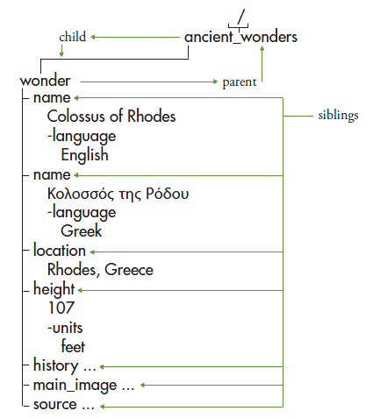
Locating Nodes [2/4]
Everything in the tree is a node
Root node
The top of the node tree
Child node
Parent node
Sibling node
Descendant node
Ancestor node

Slide 5
Locating Nodes [3/4]
Location Paths
Relative location path
Consists of a sequence of location steps separated by “ / “
Each step selects a node or node set relative to the current node
Absolute location path
Relative location path starting at the root node
“ / ” : selects the root node of the XML document
Relative location paths are most commonly used
They generate the resulting node set relative to the current node
This is typically the context in which you are working

Slide 6
Locating Nodes [4/4]
Actual XML source
<?xml version=“1.0”?>
<ancient_wonders>
<wonder>
<name language=“English”>
Colossus of Rhodes</name>
<name language=“Greek”>
Κολοσσός της Ρόδου</name>
<location>Rhodes, Greece</location>
<height units="feet">107</height>
<history> ... </history>
<main_image ... />
<source ... />
</wonder>
</ancient_wonders>

Slide 7
Determining the Current Node [1/2]
Developing an XSLT style sheet
Specify what to process next
with respect to what is being processed now
Current node
Node currently being processed

Slide 8
Determining the Current Node [2/2]
(1)
<xsl:template match="/">
...
<h2>Overview</h2>
<xsl:apply-templates select=
"ancient_wonders/wonder">
<xsl:sort select="height" order=
"descending" data-type="number" />
</xsl:apply-templates>
...
</xsl:template>
<xsl:template match="wonder">
<tr><td><a>...
<strong><xsl:value-of select=
"name[@language='English']"/>
</strong></a><br/>
<xsl:apply-templates select="
name[@language!='English']"/>
...
</xsl:template>
<xsl:template match=
"name[@language!='English']">
(<em>
<xsl:value-of select="."/></em>)
</xsl:template>
To determine the current node
<xsl:template> identified by the template’s match attribute
<xsl:apply-templates> the node that is matched by the corresponding template
<xsl:for-each > the one specified by its select attribute
(1a)
(2)
(2a)
(3)
Notes:
Template의 match attribute에 쓰여 있는 것이 current node
Xsl : apply –templates 라는 instruction이 있다면 그 노드로 이동..
Xsl :for – each instruction이 있다면 해
Back to
the node that is matched by the
corresponding template

Slide 9
Referring to the Current Node [1/2]
“.”
To refer to the current node
...
<xsl:template match="wonder">
<tr><td><a>...
<strong><xsl:value-of select=
"name[@language='English']"/>
</strong></a><br/>
<xsl:apply-templates select="name[@
language!='English']"/>
...
</xsl:template>
<xsl:template match=
"name[@language!='English']">
(<em><xsl:value-of select="."/>
</em>)
</xsl:template>
...

Slide 10
Referring to the Current Node [2/2]
Result
...
<tr><td><a href="#Great Pyramid of
Giza"><strong>Great Pyramid of
Giza</strong></a><br/></td>
<td>Giza, Egypt</td>
<td>455</td></tr>
<tr><td><a href="#Lighthouse of
Alexandria"><strong>Lighthouse of
Alexandria</strong></a><br/>
(<em>o Φάρος τ˜ης ’Aλεξανδρείας</em>)
</td><td>Alexandria, Egypt</td>
<td>384</td></tr>
<tr><td><a href="#Mausoleum at
Halicarnassus">
<strong>Mausoleum at Halicarnassus
</strong></a><br/>
(<em>Μαυσωλε˜ιον ’Aλικαρνασσεύς</em>)
</td><td>Bodrum, Turkey</td>
<td>135</td></tr>
...

Slide 11
Selecting a Node’s Children [1/2]
To get a node’s children
child ( the name of the child node )
To refer to the name of the child element(s)
child/grandchild
To refer to a node or node set contained in the child set
...
<xsl:template match="history">
...
was built in
<xsl:value-of select="year_built"/>
<xsl:text> </xsl:text>
<xsl:value-of
select="year_built/@era"/>
<xsl:choose>
<xsl:when
test="year_destroyed != 0">
and was destroyed by
<xsl:value-of
select="how_destroyed"/> in
<xsl:value-of
select="year_destroyed"/>
<xsl:text> </xsl:text>
<xsl:value-of
select="year_destroyed/@era"/>.
</xsl:when>
<xsl:otherwise>
is still standing today.
</xsl:otherwise>
</xsl:choose>
<br \><br \>
</xsl:template>
...
<history>
<year_built era="BC">282
</year_built>
<year_destroyed era="BC">226
</year_destroyed>
<how_destroyed>earthquake
</how_destroyed>
<story>In 294 BC, the people of
the island of Rhodes began
building a colossal statue of the sun god Helios. They believed ...
</story>
</history>
...

Slide 12
Selecting a Node’s Children [2/2]
Tips
It’s important to know which is the current node
“*”
to select all the current node’s children
“xsl:text” element
To add literal text to the output
Cannot contain any other elements
Often used to handle special characters
Such as “&” or “>”
White space

Slide 13
Selecting a Node’s Parent or Siblings [1/3]
To select a node’s parent
Make sure you know what the current node
Type “..”
To select the current node’s parent
To select a node’s siblings
../ sibling
Child of the current node’s parent
../sibling/ niece
A node that is the child of the sibling of the current node
Tip
Attribute of the parent node
../@attribute
All the child elements of the parent of the current node
../*
Including the current node itself

Slide 14
Selecting a Node’s Parent or Siblings [2/3]
Siblings and Parent
...
<wonder>
<name language="English">
Colossus of Rhodes</name>
<name language="Greek">
Κολοσσός της Ρόδου</name>
...
<history>
<year_built era="BC">
282</year_built>
<year_destroyed era="BC">
226</year_destroyed>
<how_destroyed>
earthquake</how_destroyed>
<story>In 294 BC, ...</story>
</history>
...
...
<xsl:template match="history">
...
The <xsl:value-of select=
"../name[@language='English']"/>
<xsl:apply-templates select=
"../name[@language!='English']"/>
was built in <xsl:value-of select=
"year_built"/>
...
Notes:
Sibling 이다.

Slide 15
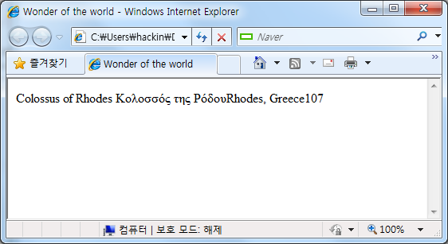
Selecting a Node’s Parent or Siblings [3/3]
Result

Slide 16
Selecting a Node’s Attributes [1/2]
Type “/@”
“*”
wildcard to select all the node’s attributes
Attribute
specify the name of the attribute
...
<xsl:template match="history">
...
The <xsl:value-of select=
"../name[@language='English']"/>
<xsl:apply-templates select=
"../name[@language!='English']"/>
was built in <xsl:value-of
select="year_built"/>
<xsl:text> </xsl:text>
<xsl:value-of
select="year_built/@era"/>
...
...
<h2>History</h2>
<a name="Great Pyramid of Giza"/>
The Great Pyramid of Giza was built
in 2570 BC and is still standing
today.<br/><br/>
<a name="Hanging Gardens of
Babylon"/>The Hanging Gardens of
Babylon was built in 600 BC
...
Notes:
옆에 era 라는 attribute가 있고, 오른쪽에 해당 attribute가 출력되어 있다

Slide 17
Selecting a Node’s Attributes [2/2]
Tip
“@*” symbol
Sometimes referred to as the attribute axis
12 other axes
Ancestor
Ancestor-or self
Child
Descendant
Descendant-or-self
Following
Following-sibling
Namespace
Parent
Preceding
Preceding-sibling
self

Slide 18
Conditionally Selecting Nodes [1/3]
Predicates
Boolean expression
to test a condition
Select a specific subset of the node set
Boolean expression
Compare values
Test for existence
Do math
XPath Function
More…
To conditionally select nodes
Type “[“
Write the expression that identifies the subset
Type “]”

Slide 19
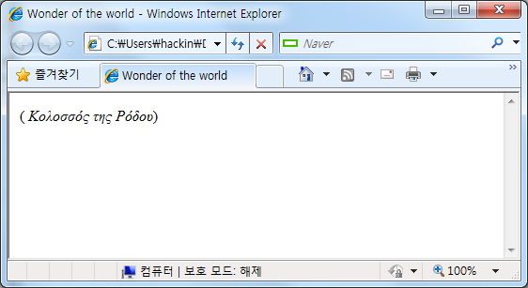
Conditionally Selecting Nodes [2/3]
Conditionally select nodes
...
<wonder>
<name language="English">
Statue of Zeus at Olympia</name>
<name language="Greek">
Κολοσσός της Ρόδου</name>
<location>Olympia, Greece</location>
<height units="feet">39</height>
<history>
...
</wonder>
...
...
<xsl:template match=
"name[@language!='English']">
(<em><xsl:value-of select="."/>
</em>)
</xsl:template>
...

Slide 20
Conditionally Selecting Nodes [3/3]
Tips
[@language]
Select all the current node’s elements that have a language attribute
Multiple predicates
Name[@language=‘English’][position()=last()]
Select the name elements that have a language attribute equal to “English” and that are the last node in the set
[last()]/@*
All the attributes of the last element of the current node set
Make sure you type square brackets
Not curly ones
Not parentheses

Slide 21
Creating Absolute Location Paths [1/3]
Absolute location paths
One that do not rely on the current node
To create an absolute location path
Relative location from root node

Slide 22
Creating Absolute Location Paths [2/3]
Absolute location path
...
<xsl:template match="wonder">
<tr><td>
<a><xsl:attribute name=
"href">#<xsl:value-of select=
"name[@language='English']"/>
</xsl:attribute>
<strong>
<xsl:value-of select=
"/ancient_wonders/wonder/name
[@language='English']"/>
</strong></a><br/>
...
...
<a href="#Great Pyramid of
Giza"><strong>Colossus of Rhodes
</strong></a><br/></td>
<td>Giza, Egypt</td><td>455</td>
...
<a href="#Lighthouse of
Alexandria"><strong>Colossus of
Rhodes</strong></a>
...

Slide 23
Creating Absolute Location Paths [3/3]
Tips
All location path ideas and shortcuts discussed so far can also be used
.. , .
You can use “*”
To specify all the elements at that level
Pay careful attention
Disregarding the current node may cause unforeseen consequences

Slide 24
Selecting All the Descendants [1/2]
Type “ // “
Two forward slashes
To select all the descendants of the root node
Type “ .// ”
A period followed by two forward slashes
To select all the descendants of the current node
“ //*/@file “
All nodes that have an attribute named file

Slide 25
Selecting All the Descendants [2/2]
Selecting All the Descendants
...
<wonder>
<name language="English">
Lighthouse of Alexandria</name>
...
<main_image file="lighthouse.jpg"
w="528" h="349"/>
<source sectionid="112"
newspaperid="53"/>
</wonder>
...
...
<xsl:template match="/">
<html><head><title>Wonders of the
World</title></head>
<body>
<xsl:apply-templates
select="//*/@file" />
</body></html>
</xsl:template>
<xsl:template match="//*/@file" >
<xsl:value-of select="."/><br />
</xsl:template>
...

