Slide 1
Chapter 21: Information Retrieval

Slide 2
Database System Concepts
Chapter 1: Introduction
Part 1: Relational databases
  Chapter 2: Introduction to the Relational Model
  Chapter 3: Introduction to SQL
  Chapter 4: Intermediate SQL
  Chapter 5: Advanced SQL
  Chapter 6: Formal Relational Query Languages
Part 2: Database Design
  Chapter 7: Database Design: The E-R Approach
  Chapter 8: Relational Database Design
  Chapter 9: Application Design
Part 3: Data storage and querying
  Chapter 10: Storage and File Structure
  Chapter 11: Indexing and Hashing
  Chapter 12: Query Processing
  Chapter 13: Query Optimization
Part 4: Transaction management
  Chapter 14: Transactions
  Chapter 15: Concurrency control
  Chapter 16: Recovery System
Part 5: System Architecture
  Chapter 17: Database System Architectures
  Chapter 18: Parallel Databases
  Chapter 19: Distributed Databases
Part 6: Data Warehousing, Mining, and IR
  Chapter 20: Data Mining
  Chapter 21: Information Retrieval
Part 7: Specialty Databases
  Chapter 22: Object-Based Databases
  Chapter 23: XML
Part 8: Advanced Topics
  Chapter 24: Advanced Application Development
  Chapter 25: Advanced Data Types
  Chapter 26: Advanced Transaction Processing
Part 9: Case studies
  Chapter 27: PostgreSQL
  Chapter 28: Oracle
  Chapter 29: IBM DB2 Universal Database
  Chapter 30: Microsoft SQL Server
Online Appendices
  Appendix A: Detailed University Schema
  Appendix B: Advanced Relational Database Model
  Appendix C: Other Relational Query Languages
  Appendix D: Network Model
  Appendix E: Hierarchical Model

Slide 3
Chapter 21: Information Retrieval
21.1 Overview
21.2 Relevance Ranking Using Terms
21.3 Relevance Using Hyperlinks
21.4 Synonyms, Homonyms, and Ontologies
21.5 Indexing of Documents
21.6 Measuring Retrieval Effectiveness
21.7 Crawling and Indexing the Web
21.8 Information Retrieval: Beyond Ranking of Pages
21.9 Directories and Categories

Slide 4
Information Retrieval Systems
Information retrieval (IR) systems use a simpler data model than database systems
  Information organized as a collection of documents
  Documents are unstructured, no schema
Information retrieval locates relevant documents, on the basis of user input such as keywords or example documents
  e.g., find documents containing the words “database systems”
Can be used even on textual descriptions provided with non-textual data such as images
Web search engines are the most familiar example of IR systems

Slide 5
Information Retrieval Systems (Cont.)
Differences from database systems
  IR systems don’t deal with transactional updates (including concurrency control and recovery)
  Database systems deal with structured data, with schemas that define the data organization
  IR systems deal with some querying issues not generally addressed by database systems
    Approximate searching by keywords
    Ranking of retrieved answers by estimated degree of relevance

Slide 6
Keyword Search
In full text retrieval, all the words in each document are considered to be keywords.
  We use the word term to refer to the words in a document
Information-retrieval systems typically allow query expressions formed using keywords and the logical connectives and, or, and not
  “Ands” are implicit, even if not explicitly specified
Ranking of documents on the basis of estimated relevance to a query is critical
  Relevance ranking is based on factors such as
    Term frequency (TF)
      Frequency of occurrence of query keyword in document
    Inverse document frequency (IDF)
      How many documents the query keyword occurs in
        Fewer ➔ give more importance to keyword
    Hyperlinks to documents
      More links to a document ➔ document is more important

Slide 7
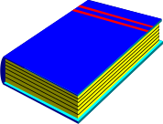

Original
Texts
Text-Based
Full Text Retrieval System
Digitization
Information
Retrieval
System
User Query
.......
..........
........
.........
...
..........
........
.........
...
..........
........
.........
Digitized
Full Texts
Relevant
Digitized Full Texts

Slide 8
Chapter 21: Information Retrieval
21.1 Overview
21.2 Relevance Ranking Using Terms
21.3 Relevance Using Hyperlinks
21.4 Synonyms, Homonyms, and Ontologies
21.5 Indexing of Documents
21.6 Measuring Retrieval Effectiveness
21.7 Crawling and Indexing the Web
21.8 Information Retrieval: Beyond Ranking of Pages
21.9 Directories and Categories

Slide 9
Relevance Ranking using Terms
TF-IDF (Term Frequency / Inverse Document Frequency) ranking:
  Let n(d) = number of terms in the document d
  n(d, t) = number of occurrences of term t in the document d.
  Relevance of a document d to a term t
    One naïve way of defining TF: Just count the number of occurrences
    The number of occurrences depends on the length of the document
    A document containing 10 occurrences of a term may not be 10 times as relevant as a document containing one word
n(d, t)
TF (d, t) =
n(d)

Slide 10
Relevance Ranking using Terms (cont.)
  Applying log factor is to avoid excessive weight to frequent terms
  IDF
    n(t) is number of documents containing term t
  Relevance of a document d to a query Q
n(d, t)
1 +
TF (d, t) = log
n(d)
IDF(t) = 1 / n(t)
∑
∑
TF (d, t)
r (d, Q) =
TF (d, t) * IDF(t)
=
t∈Q
n(t)
t∈Q

Slide 11
Relevance Ranking Using Terms (Cont.)
Most systems add to the above model
  Words that occur in title, author list, section headings, etc. are given greater importance
  Words whose first occurrence is late in the document are given lower importance
  Very common words such as “a”, “an”, “the”, “it” etc. are eliminated
    Called stop words
  Proximity: if keywords in query occur close together in the document, the document has higher importance than if they occur far apart
Documents are returned in decreasing order of relevance score
  Usually only top few documents are returned, not all

Slide 12
Similarity Based Retrieval
Similarity based retrieval - retrieve documents similar to a given document
  Similarity may be defined on the basis of common words
    E.g., find k terms in A with highest values of TF (d, t ) / n (t ) and use these terms to find relevance of other documents.
Relevance feedback: Similarity can be used to refine answer set to keyword query
  User selects a few relevant documents from those retrieved by keyword query, and system finds other documents similar to these
Vector space model: define an n-dimensional space, where n is the number of words in the document set.
  Vector for document d having terms t1, t2, … tn goes from origin to a point
    i ^{th} coordinate of the point is r(d, ti) = TF (d, ti ) * IDF (ti )
  The cosine of the angle between the vectors of two documents is used as a measure of their similarity.

Slide 13
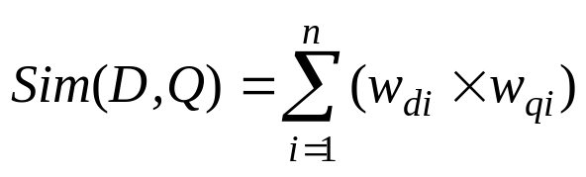
Vector Space Model
문서와 질의를 가중치가 부여된 색인어들의 벡터로 표현
  D = {(t₁, w_{d1}), (t₂, w_{d2}), ... , (t_{n}, w_{dn})} w_{di} : 문서 D 에서 i번째 색인어 t_{i} 의 가중치
  Q = {(t₁, w_{q1}), (t₂, w_{q2}), ... , (t_{n}, w_{qn})} w_{ti} : 질의 Q 에서 i번째 색인어 t_{i} 의 가중치
문서D 와 질의 Q 의 유사도
예제) 다음 문서 D 와 Q의 유사도 계산
D = {(정보, 0.3), (검색, 0.5), (시스템, 0.2)}
Q = {(정보, 0.4), (검색, 0.7)}
Sim (D,Q) = 0.3*0.4 + 0.5*0.7 = 0.47
D
t₂
θ
Q
t₁
t₃

Slide 14
Chapter 21: Information Retrieval
21.1 Overview
21.2 Relevance Ranking Using Terms
21.3 Relevance Using Hyperlinks
21.4 Synonyms, Homonyms, and Ontologies
21.5 Indexing of Documents
21.6 Measuring Retrieval Effectiveness
21.7 Crawling and Indexing the Web
21.8 Information Retrieval: Beyond Ranking of Pages
21.9 Directories and Categories

Slide 15
Relevance Using Hyperlinks
If only term frequencies are taken into account
  Number of documents relevant to a query can be enormous
  Using high term frequencies makes “spamming” easy
    E.g. a travel agency can add many occurrences of the words “travel” to its page to make its rank very high
The advent of WWW
  Observation: Most of the time people are looking for pages from popular sites
  Idea: use popularity of Web site (e.g. how many people visit it) to rank site pages that match given keywords
  Problem: hard to find actual popularity of site
    Solution: next slide

Slide 16
Relevance Using Hyperlinks (Cont.)
Solution: use number of hyperlinks to a site as a measure of the popularity or prestige of the site
  Count only one hyperlink from each site (why? - see previous slide)
  Popularity measure is for site, not for individual page
    But, most hyperlinks are to root of site
    Also, concept of “site” difficult to define since a URL prefix like cs.yale.edu contains many unrelated pages of varying popularity
Refinements
  When computing prestige based on links to a site, give more weight to links from sites that themselves have higher prestige
    Definition is circular
    Set up and solve system of simultaneous linear equations
  Above idea is basis of the Google PageRank ranking mechanism

Slide 17
Relevance Using Hyperlinks (Cont.)
Connections to social networking theories that ranked prestige of people
  E.g., the president of the U.S.A has a high prestige since many people know him
  Someone known by multiple prestigious people has high prestige
Hub and authority based ranking
  A hub is a page that stores links to many pages (on a topic)
  An authority is a page that contains actual information on a topic
  Each page gets a hub prestige based on prestige of authorities that it points to
  Each page gets an authority prestige based on prestige of hubs that point to it
  Again, prestige definitions are cyclic, and can be got by
  solving linear equations
  Use authority prestige when ranking answers to a query

Slide 18
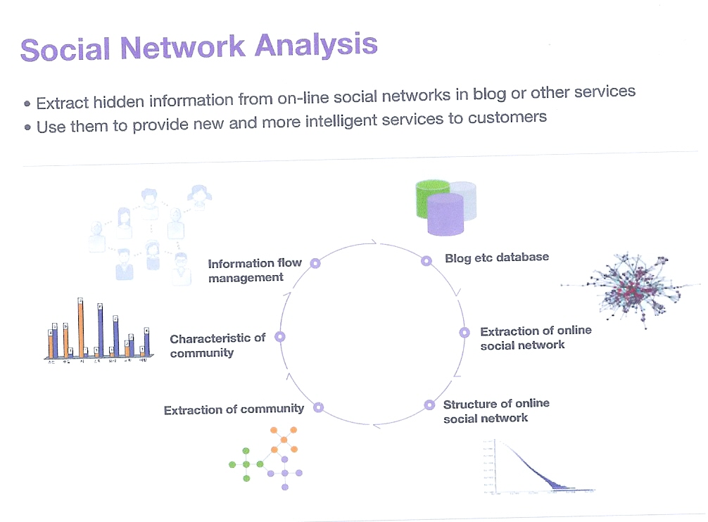
Social Network Analysis

Slide 19
Chapter 21: Information Retrieval
21.1 Overview
21.2 Relevance Ranking Using Terms
21.3 Relevance Using Hyperlinks
21.4 Synonyms, Homonyms, and Ontologies
21.5 Indexing of Documents
21.6 Measuring Retrieval Effectiveness
21.7 Crawling and Indexing the Web
21.8 Information Retrieval: Beyond Ranking of Pages
21.9 Directories and Categories

Slide 20
Synonyms and Homonyms
Synonyms
  E.g., document: “motorcycle repair”, query: “motorcycle maintenance”
    Need to realize that “maintenance” and “repair” are synonyms
  System can extend query as “motorcycle and (repair or maintenance)”
Homonyms
  E.g., “object” has different meanings as noun/verb
  Can disambiguate meanings (to some extent) from the context
Extending queries automatically using synonyms can be problematic
  Need to understand intended meaning in order to infer synonyms
    Or verify synonyms with user
  Synonyms may have other meanings as well

Slide 21
Concept-Based Querying
Approach
  For each word, determine the concept it represents from context
  Use one or more ontologies:
    Hierarchical structure showing relationship between concepts
    E.g., the ISA relationship that we saw in the E-R model
This approach can be used to standardize terminology in a specific field
  Gene Ontology
  Ontology for home appliances
Ontologies can link multiple languages
  WordNet for English
  WordNet for Korean
Foundation of the Semantic Web (not covered here)

Slide 22
Chapter 21: Information Retrieval
21.1 Overview
21.2 Relevance Ranking Using Terms
21.3 Relevance Using Hyperlinks
21.4 Synonyms, Homonyms, and Ontologies
21.5 Indexing of Documents
21.6 Measuring Retrieval Effectiveness
21.7 Crawling and Indexing the Web
21.8 Information Retrieval: Beyond Ranking of Pages
21.9 Directories and Categories

Slide 23
Indexing of Documents
An inverted index maps each keyword K_{i} to a set of documents S_{i} that contain the keyword
  Documents identified by identifiers
Inverted index may record
  Keyword locations within document to allow proximity based ranking
  Counts of number of occurrences of keyword to compute TF
and operation: Finds documents that contain all of K₁, K₂, ..., K_{n}.
  Intersection S₁∩ S₂ ∩..... ∩ S_{n}
or operation: documents that contain at least one of K₁, K₂, …, K_{n}
  union, S₁∩ S₂ ∩..... ∩ S_{n},.
Each S_{i} is kept sorted to allow efficient intersection/union by merging
  “not” can also be efficiently implemented by merging of sorted lists

Slide 24
Chapter 21: Information Retrieval
21.1 Overview
21.2 Relevance Ranking Using Terms
21.3 Relevance Using Hyperlinks
21.4 Synonyms, Homonyms, and Ontologies
21.5 Indexing of Documents
21.6 Measuring Retrieval Effectiveness
21.7 Crawling and Indexing the Web
21.8 Information Retrieval: Beyond Ranking of Pages
21.9 Directories and Categories

Slide 25
Measuring Retrieval Effectiveness
Information-retrieval systems save space by using index structures that support only approximate retrieval. May result in:
  false negative (false drop) - some relevant documents may not be retrieved.
  false positive - some irrelevant documents may be retrieved.
  For many applications a good index should not permit any false drops, but may permit a few false positives.
Relevant performance metrics:
  precision - what percentage of the retrieved documents are relevant to the query = C / A
  recall - what percentage of the documents relevant to the query were retrieved = C / B
Document pool
A: Retrieved
documents
B: Relevant
documents
C

Slide 26
Measuring Retrieval Effectiveness (Cont.)
Recall vs. precision tradeoff:
    Can increase recall by retrieving many documents (down to a low level of relevance ranking), but many irrelevant documents would be fetched, reducing precision
Measures of retrieval effectiveness:
  Recall as a function of number of documents fetched, or
  Precision as a function of recall
    Equivalently, as a function of number of documents fetched
  E.g., “precision of 75% at recall of 50%, and 60% at a recall of 75%”
Problem: which documents are actually relevant, and which are not

Slide 27
Chapter 21: Information Retrieval
21.1 Overview
21.2 Relevance Ranking Using Terms
21.3 Relevance Using Hyperlinks
21.4 Synonyms, Homonyms, and Ontologies
21.5 Indexing of Documents
21.6 Measuring Retrieval Effectiveness
21.7 Crawling and Indexing the Web
21.8 Information Retrieval: Beyond Ranking of Pages
21.9 Directories and Categories

Slide 28
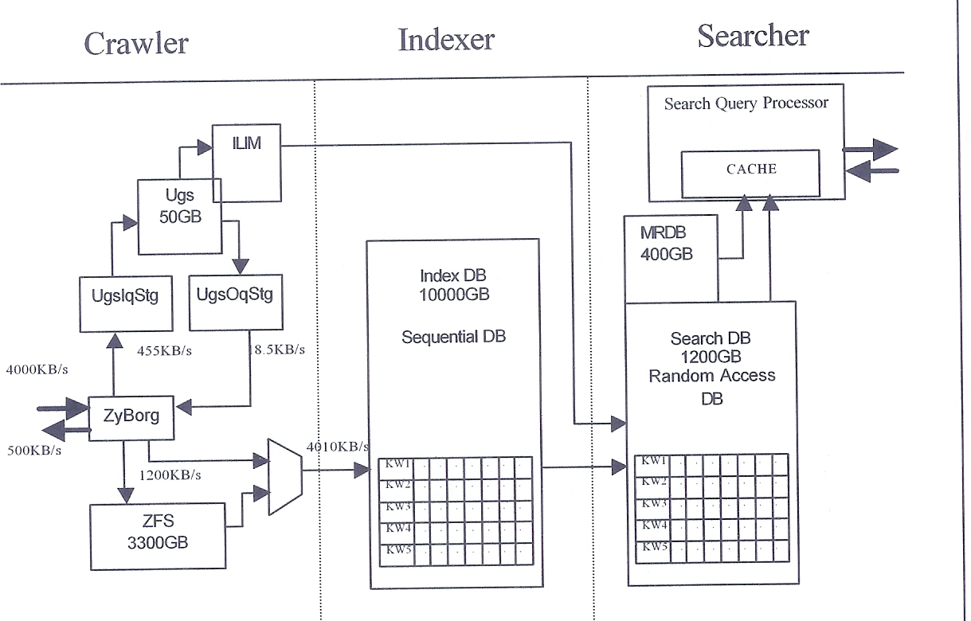
Web Search Engine Architecture
NAVER: more than 3000 servers
Google: more than 20,000 servers

Slide 29
Web Search Engines
Web crawlers are programs that locate and gather information on the Web
  Recursively follow hyperlinks present in known documents, to find other documents
    Starting from a seed set of documents
  Fetched documents
    Handed over to an indexing system
    Can be discarded after indexing, or store as a cached copy
Crawling the entire Web would take a very large amount of time
  Search engines typically cover only a part of the Web, not all of it
  Take months to perform a single crawl

Slide 30
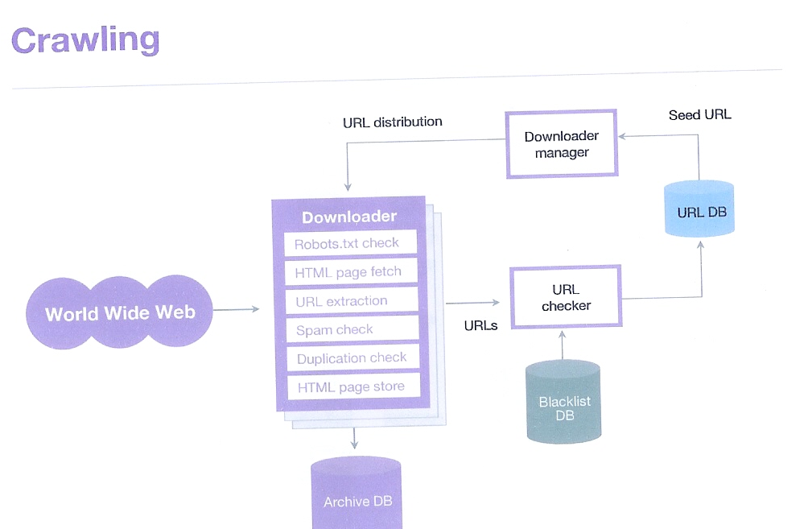
Web Crawler

Slide 31
Web Crawling (Cont.)
Crawling is done by multiple processes on multiple machines, running in parallel
  Set of links to be crawled stored in a database
  New links found in crawled pages added to this set, to be crawled later
Indexing process also runs on multiple machines
  Creates a new copy of index instead of modifying old index
  Old index is used to answer queries
  After a crawl is “completed” new index becomes “old” index
Multiple machines used to answer queries
  Indices may be kept in memory
  Queries may be routed to different machines for load balancing

Slide 32
Chapter 21: Information Retrieval
21.1 Overview
21.2 Relevance Ranking Using Terms
21.3 Relevance Using Hyperlinks
21.4 Synonyms, Homonyms, and Ontologies
21.5 Indexing of Documents
21.6 Measuring Retrieval Effectiveness
21.7 Crawling and Indexing the Web
21.8 Information Retrieval: Beyond Ranking of Pages
21.9 Directories and Categories

Slide 33
Information Retrieval and Structured Data
Information retrieval systems originally treated documents as a collection of words
Information extraction systems infer structure from documents, e.g.:
  Extraction of house attributes (size, address, number of bedrooms, etc.) from a text advertisement
  Extraction of topic and people named from a new article
Relations or XML structures used to store extracted data
  System seeks connections among data to answer queries
  Question answering systems

Slide 34
Information Retrieval and Structured Data
Querying Structured Data (Keyword search in relational data and XML data)
  Keyword “Smith Queens” may be “Smith” in customer tuple or “Queens” in branch tuple
    Don’t care schema / Don’t care SQL
  Techniques using connections among keywords or assigning popularity to keywords

Slide 35
Doc
1
...
XML-Based
Full Text Retrieval System
Doc
2
Doc
n
Information
Processing
XML
Query
Documents
Information
Retrieval
XML
System
Parser
Verified
Verified
XML
XML
XML
Viewer
Documents
Documents
XML-Text
Converter
Plain Text
There are lots of issues !!!!

Slide 36
IR and Question Answering System
Question answering in web search engine
  Question ➔ “Who killed Lincoln?”
  Answer ➔ “Abraham Lincoln was shot by John Wilkes Booth in 1865”
  Steps of QA system
    Extract some keywords from the submitted question
    Execute keyword searching against Web search engine
    Parse the returned documents and generate the answer
      A number of linguistic techniques and heuristics from AI Natural Language Processing

Slide 37
Original
Texts
Passage-Based
Full Text Retrieval System
Digitization
.......
..........
........
.........
...
..........
........
.........
...
..........
........
.........
Digitized
Full Texts
User Query
Information
Retrieval
System
Relevant
Passages
Passage
Generation
Relevant Passage
Generated Passages

Slide 38
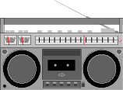

Original Information Items
Advanced
Information
Systems
Digitization
Text Summ.
OCR
Color Ext.
Feature Ext.
Voice Rec.
Text
SGML
Tiff
JPEG
MPEG
WAV
et al.
Manual
Information
Processing
Digitized
Information
Automatic
Information
Processing
Query
Information
Retrieval
System
Secondary
Information
Relevant
Secondary
Information
Relevant
Digitized
Information

Slide 39
Chapter 21: Information Retrieval
21.1 Overview
21.2 Relevance Ranking Using Terms
21.3 Relevance Using Hyperlinks
21.4 Synonyms, Homonyms, and Ontologies
21.5 Indexing of Documents
21.6 Measuring Retrieval Effectiveness
21.7 Crawling and Indexing the Web
21.8 Information Retrieval: Beyond Ranking of Pages
21.9 Directories and Categories

Slide 40
Directory in IR System (1)
Storing related documents together in a library facilitates browsing
  users can see not only requested document but also related ones.
Browsing is facilitated by classification system that organizes logically related documents together.
Organization is hierarchical: classification hierarchy

Slide 41
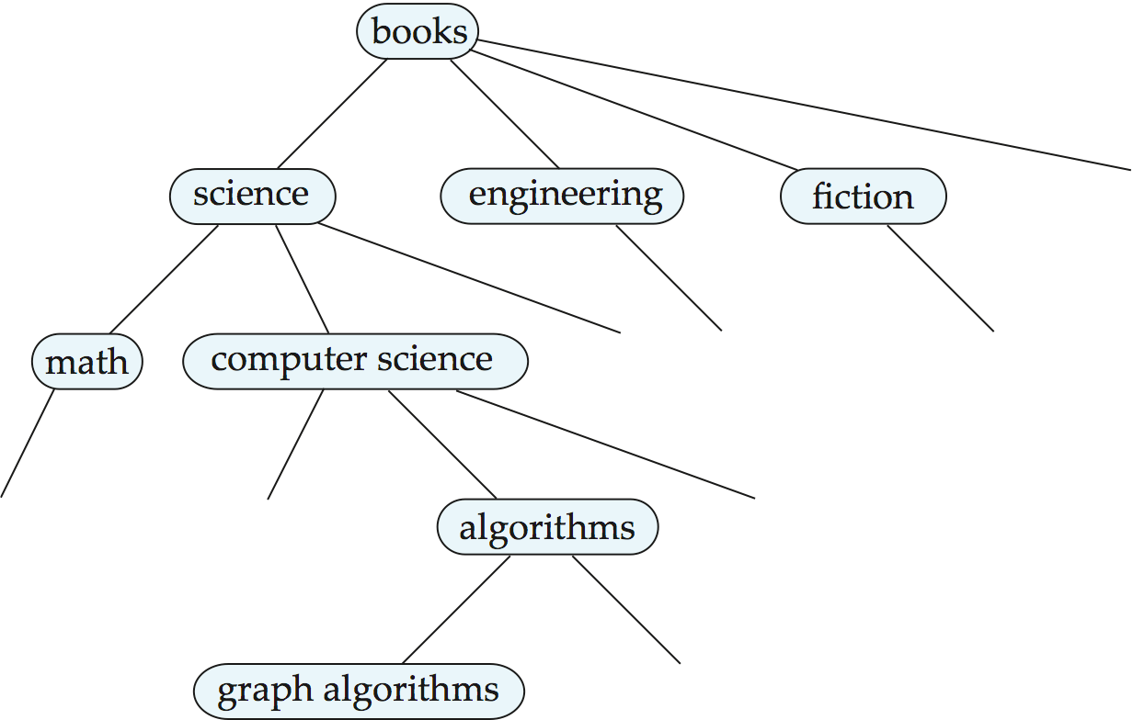
A Classification Hierarchy For A Library System

Slide 42
Directory in IR System (2)
Directed Acyclic Graph (DAG)
Documents can reside in multiple places in a hierarchy in an information retrieval system, since physical location is not important.

Slide 43

A Classification DAG For A Library Information Retrieval System

Slide 44
Web Directories
A Web directory is just a classification directory on Web pages
  E.g., Yahoo! Directory, Open Directory project
  Issues:
    What should the directory hierarchy be?
    Given a document, which nodes of the directory are categories relevant to the document
  Often done manually: Yahoo’s Open Directory project
    Classification of documents into a hierarchy may be done based on term similarity in an automatic tool
Tagging vs. Directory

Slide 45
End of Chapter

