Slide 1

Session 23
Applying the Extended Statechart
Features to the Case Study
Written by Thomas A. Pender
Published by Wiley Publishing, Inc.
October 27, 2011
Presented by Kang-Pyo Lee

Slide 2
Deriving a Statechart from Sequence Diagrams (1/13)
Those who use the UML diagrams often miss the benefit of building and comparing the different diagrams
Each diagram provides a unique view of the same problem
Comparing and contrasting these views can function much like reconciling your checkbook
Given multiple sources of the same information, it is much easier to find and correct errors

Slide 3
Deriving a Statechart from Sequence Diagrams (2/13)
The dynamic model provides two diagrams that model changes over time: the Statechart diagram and the Sequence diagram
The key to understanding the relationship between these diagrams is in understanding states and events
  Events trigger transitions between states
  States capture the condition of an object during the period of time between transitions

Slide 4
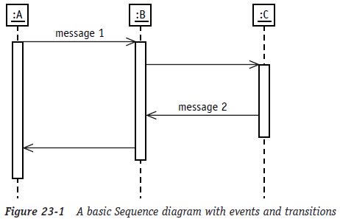
Deriving a Statechart from Sequence Diagrams (3/13)
Each vertical column represents the lifeline for one object
Each event directed at a lifeline represents an event that may trigger a change in that object
The space between events on the lifeline represents a period of time when the object remains in the same condition or state
Because not every event causes a state transition, these periods are referred to as candidate states until it’s proven that a change, in fact, occurs

Slide 5
Deriving a Statechart from Sequence Diagrams (4/13)
The challenging part of mapping the Sequence diagram to the Statechart diagram is to determine the condition of the object between the events and name it as accurately as possible
To choose an accurate name
  Remember that the state of an object is defined by its attribute values
  Describe the object in terms of its attributes (for example, open, closed, open and overdrawn, or filled and not shipped)
  Adjectives make very good state names, but you might need more than one adjective to fully describe the current condition of the object

Slide 6
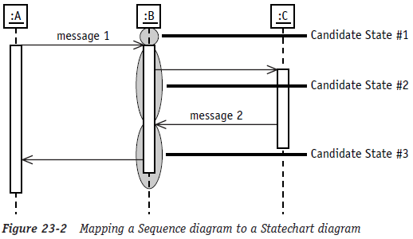
Deriving a Statechart from Sequence Diagrams (5/13)
How to map the events and corresponding gaps on the lifeline of the Sequence diagram to candidate states and events on the Statechart diagram

Slide 7
Deriving a Statechart from Sequence Diagrams (6/13)
To derive a Statechart diagram for the Product object:
  1. Identify the events directed at the lifeline of the Product object
  2. Identify candidate states by isolating the gaps of the lifeline between the incoming events
  3. Name the candidate states using adjectives that describe the condition of the object during the period of time represented by the gap
  4. Add the new states and events to the Product Statechart
I’ll work through the same series of steps for each scenario

Slide 8
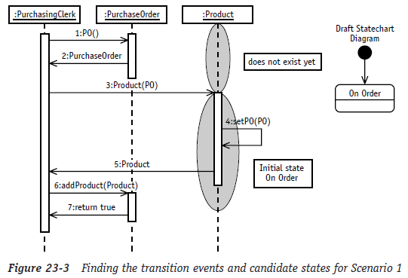
Deriving a Statechart from Sequence Diagrams (7/13)
The first scenario
  There is one incoming event called Product(PO)
    This is the constructor operation that creates the object
  Before this event, this particular Product object didn’t exist, so you have discovered the initial state
    I’ll name it “On Order” to show that a record of the Product object is created when the Product is first ordered

Slide 9
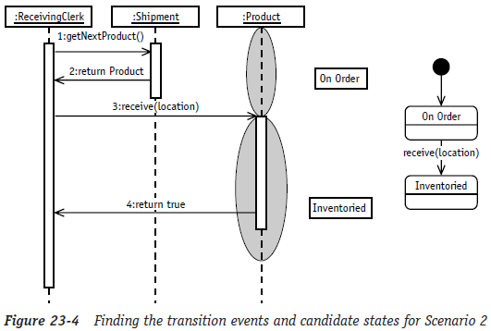
Deriving a Statechart from Sequence Diagrams (8/13)
The second scenario
  Shows the receiving event
  There is only one event hitting the Product life line, so I identify two candidate states: the one before the event and the one after
  The event receive(location) becomes the reason for the transition from On Order to Inventoried

Slide 10
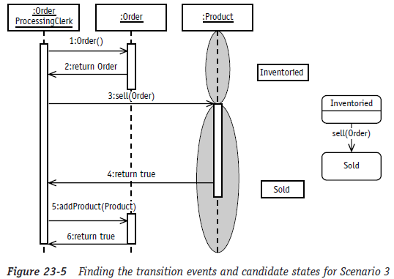
Deriving a Statechart from Sequence Diagrams (9/13)
The third scenario
  Shows the Product being sold
  Before the sell event, the Product was sitting in inventory
  In fact, if it were not in inventory, I could not sell it
  So again, I identify two states and use the incoming event sell as the transition event between the two states

Slide 11
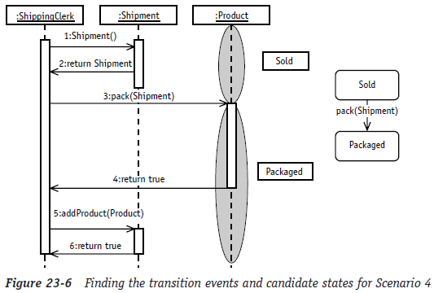
Deriving a Statechart from Sequence Diagrams (10/13)
The fourth scenario
  The product is packed for shipment
  Before the product may be packed for shipping it must have been sold
  The pack event requires the shipment to update the product with the Shipment information so that we can track it
  To show the change, I model a transition from the sold state to a new state labeled Packaged

Slide 12
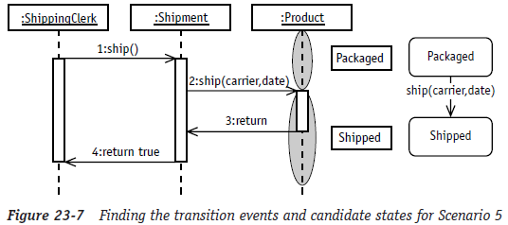
Deriving a Statechart from Sequence Diagrams (11/13)
The fifth scenario
  Tells me to ship the product
  Before the product may be shipped it must have been packaged for shipment
  The ship event requires me to update the product with the carrier and ship date
  Based on this information, I modeled a transition from the Packaged state to a new state labeled Shipped

Slide 13
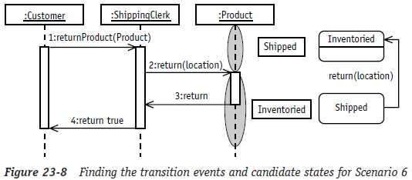
Deriving a Statechart from Sequence Diagrams (12/13)
The sixth scenario
  Illustrates bringing a return back into inventory
  Before the product may be returned, it must have been shipped
  The return event requires the location in inventory where the Product will be placed
  When the product is returned to a stock location, it is returned to the previous state called Inventoried

Slide 14
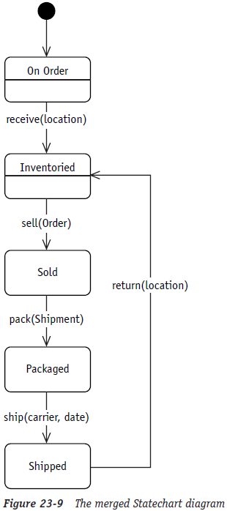
Deriving a Statechart from Sequence Diagrams (13/13)
When you put all the little Statechart diagrams together, you get a final Statechart diagram
The Statechart and Sequence diagrams can help you a great deal when you’re trying to design the behavior of your objects
  especially those few objects that are at the heart of your application

Slide 15
The End

