Slide 1
Window Interfaces Using Swing
Chapter 13

Slide 2
Objectives
Describe the basics of event-driven programming
Design and code a simple GUI that includes buttons and text
Use the standard classes

Slide 3
Graphical User Interfaces
Referred to as GUI (pronounced "gooey")
Elements of a GUI
  Window – portion of the screen
  Menu – list of choices
  Button – click to choose an item

Slide 4
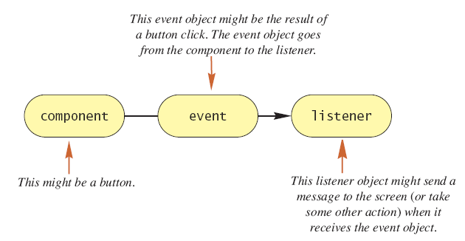
Event Driven Programming
An event is an object that represents an action
  An object "fires" an event
Figure 13.1
Event Firing
And An
Event
Listener

Slide 5
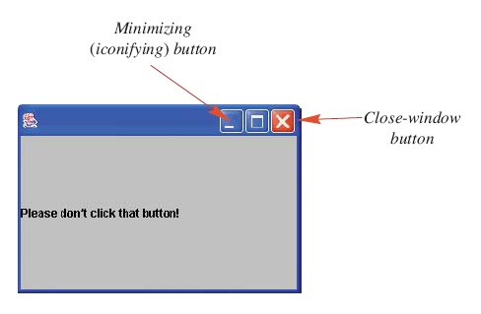
Programming Example
Note example program, listing 13.1
class FirstSwingDemo
Window appears on screen with message
Uses JFrame
object
Sample
screen output

Slide 6
Programming Example
Note use of
  JLabel object
  Content pane, the inside of the window
  Registering a listener
  Setting the window to be visible

Slide 7

Programming Example
Figure 13.2 Clicking the Close-Window button
View listener class, listing 13.2
class WindowDestroyer

Slide 8
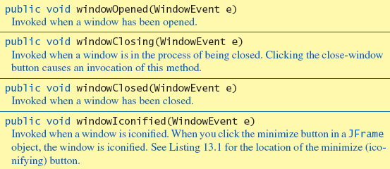
More About Window Listeners
Derived from class WindowAdapter
Figure 13.3 Methods in the Class WindowAdapter

Slide 9
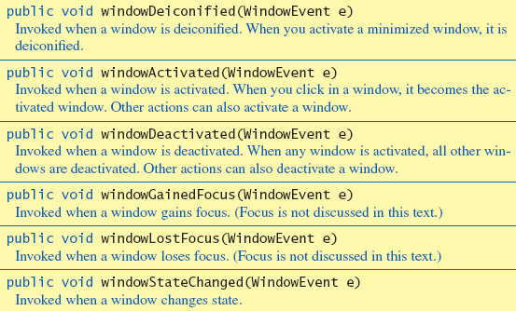
More About Window Listeners
Figure 13.3 ctd.

Slide 10
Size Units for Screen Objects
Smallest screen area displayed is a pixel
With Swing,
  Both size and position of objects on screen measured in pixels.
A screen’s resolution is a measure of the number of pixels it can display

Slide 11

The setVisible Method
Takes one argument of type boolean
Other objects besides windows can be made visible or invisible
  The object calls the method

Slide 12
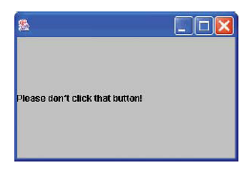
Programming Example
A better version of first Swing program,
listing 13.3 class FirstWindow
A program that uses class FirstWindow
listing 13.4 class FirstWindowDemo
Sample
screen output

Slide 13
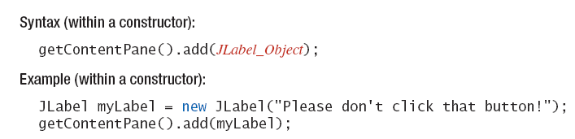
Adding Items to a JFrame Window
Requires the following syntax:

Slide 14
Programming Example
View new sample window, listing 13.5
class SecondWindow
Note new elements
  A title, Second Window
  A local variable named contentPane to reference the content pane of the window
  A background color, blue
  A new way to add the window listener

Slide 15
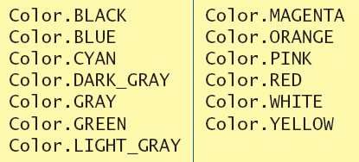
A Window with Color
Note color constants
Figure 13.4 , the color constants
View demo program, listing 13.6
class SecondWindowDemo

Slide 16
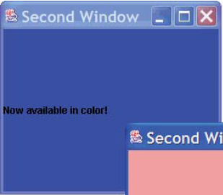
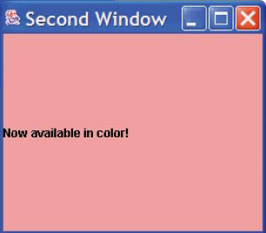
A Window with Color
Run of demo program
Sample
screen output

Slide 17
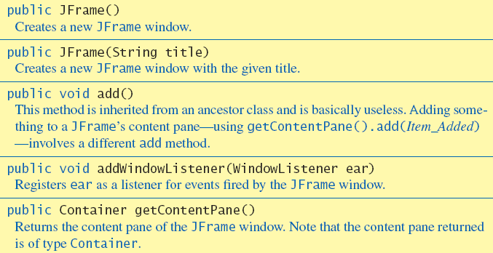
Methods in Class JFrame
Figure 13.5

Slide 18
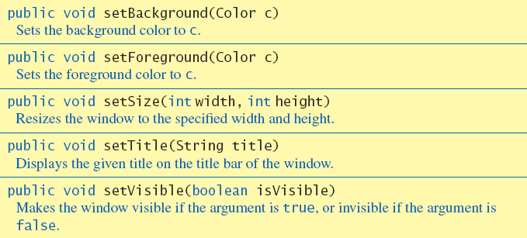
Methods in Class JFrame
Figure 13.5 ctd.

Slide 19
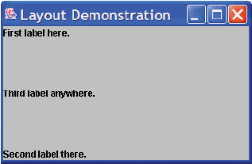
Layout Managers
A layout manager arranges objects
View example using BorderLayout
listing 13.7 class BorderLayoutDemo
Sample
screen output

Slide 20
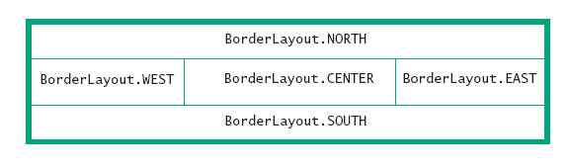
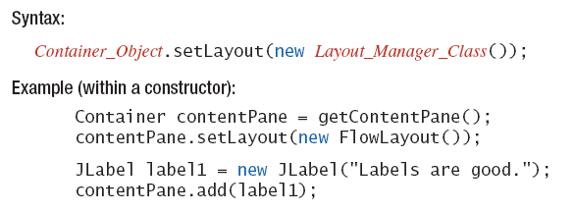
Layout Managers
Figure 13.6 Five regions of a BorderLayout manager
Syntax

Slide 21
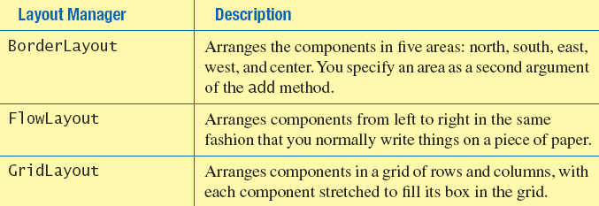
Layout Managers
Figure 13.7, some layout managers

Slide 22
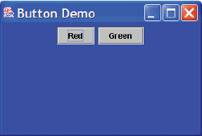
Button and Action Listeners
Note sample program, listing 13.8
class ButtonDemo
Sample
screen output

Slide 23
Buttons
Adding buttons to a GUI
  Create the instance of the button
  Use the .add method
Remember that the Close-Window button is not an object of the class JButton

Slide 24
Action Listeners, Action Events
Swing, GUI class definition should:
  Register a listener for each button
  Define a method to be invoked when the event is sent to the listener
A button "fires" action events
Action events are handled by action listeners

Slide 25
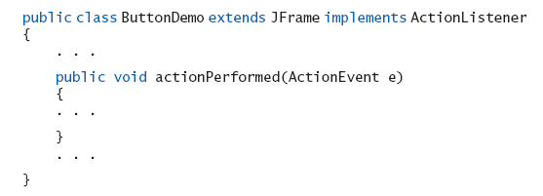
Action Listeners, Action Events
To make a class into an action-listener class you must:
  Add the phrase implements ActionListener to the heading of the class definition.
  Define a method named actionPerformed.

Slide 26
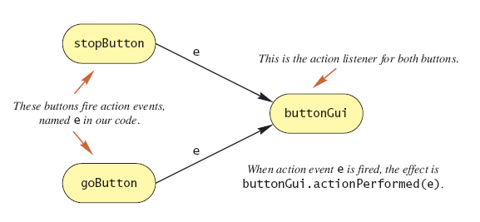
Action Listeners, Action Events
Figure 13.8 buttons and an action listener

Slide 27
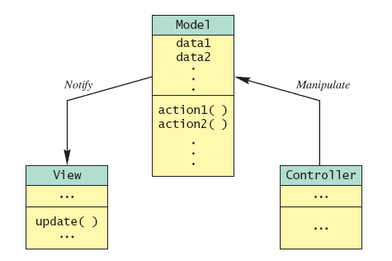
Model–View–Controller Pattern
Figure 13.9 the model–view–controller pattern

Slide 28
Container Classes
Building a Swing GUI uses inheritance and containment
Inheritance
  Use the Swing class JFrame and make your window a derived class of JFrame
Containment
  Use one of the Swing classes as a container and to place elements in the container.

Slide 29
Class JPanel
A panel is a container
Panels can have a color
To add a button to a panel
  Use add to place the button in the panel
  buttonPanel.add(stopButton);
  Use add to place the panel in the frame’s content pane
  contentPane.add(buttonPanel, BorderLayout.SOUTH);

Slide 30
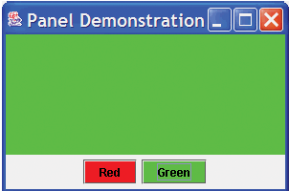
Putting Buttons into a Panel
View sample program, listing 13.9
class PanelDemo
Sample
screen output

Slide 31
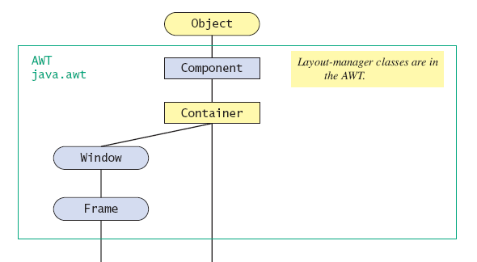
Class Container
A container class is a descendant of the class Container
A component class is a descendant of the class JComponent
Figure 13.10 hierarchy of swing classes
. . .

Slide 32
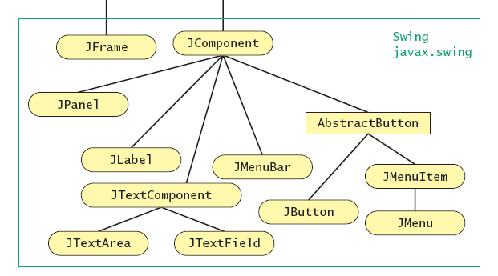
Class Container
Figure 13.10 hierarchy of swing classes, ctd.
. . .

Slide 33
Three Kinds of Objects
When using a Swing container class, you have three kinds of objects to deal with
  The container class itself
  The components you add to the container
  A layout manager, which positions components inside container

Slide 34
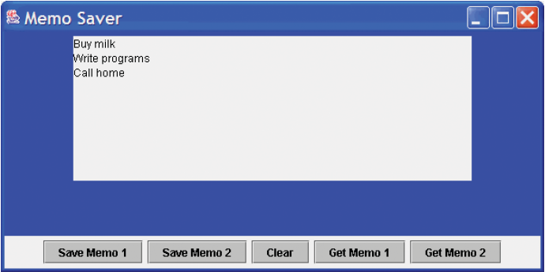
Text Areas, Text Fields
A text area contains user input or program output
View example program, listing 13.10
class MemoSaver
Sample
screen output

Slide 35
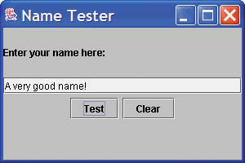
Programming Example
Labeling a text field
Note sample program, listing 13.11
class LabelDemo
Sample
screen output
A label

Slide 36
Numbers as Input, Output
With Swing
  All input from, output to the screen is of type string
  If input is meant to be numeric, programmer must convert from string
  Similarly numeric values for output must be converted to string

Slide 37
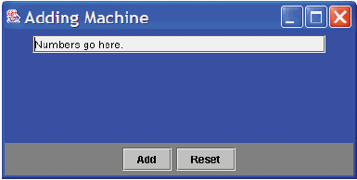
Programming Example
A GUI adding machine
View program, listing 13.12
class Adder
Sample
screen output

Slide 38
Catching NumberFormatException
Problem with previous program
  What happens if user enters non-numeric value in the text field?
Program should catch that situation and throw an exception
View improved program, listing 13.13
class ImprovedAdder

Slide 39
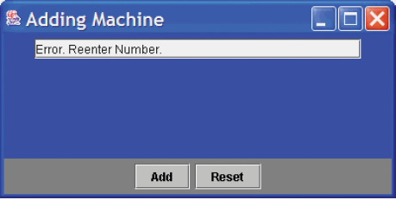
Catching NumberFormatException
Program gives warning for invalid input
Sample
screen output

Slide 40
Summary
GUIs require event driven programming
Use Swing with inheritance or add components to a container class
Define windowing GUI as a derived class of the Swing class JFrame.
Add string of text to GUI as a JLabel object

Slide 41
Summary
Click an object of type JButton to fire an event
Event handled by actionlistener
Use .add method to place elements in a container object
For an object of the class JFrame use the method getContentPane

Slide 42
Summary
A panel is a container object that is used to group elements inside of a larger container.
TextField and TextArea objects are used for text input, output

