Slide 1
Short Text Understanding Through Lexical-Semantic Analysis
Wen Hua, Zhongyuan Wang, Haixun Wang, Kai Zheng, and Xiaofang Zhou
ICDE 2015
21 April 2015
Hyewon Lim

Slide 2
Outline
Introduction
Problem Statement
Methodology
Experiment
Conclusion

Slide 3
Introduction
Characteristics of short texts
Do not always observe the syntax of a written language
Cannot always apply to the traditional NLP techniques
Have limited context
The most search queries contain <5 words
Tweets have <140 characters
Do not possess sufficient signals to support statistical text processing techniques

Slide 4
Introduction
Challenges of short text understanding
Segmentation ambiguity
Incorrect segmentation of short texts leads to incorrect semantic similarity
April in paris lyrics
vs.
Vacation april in paris
{april paris lyrics}
{april in paris lyrics}
{vacation april paris}
{vacation april in paris}
Book hotel california
vs.
Hotel California eagles

Slide 5
Introduction
Type ambiguity
Traditional approaches to POS tagging consider only lexical features
Surface features are insufficient to determine types of terms in short texts
pink songs
vs.
pink shoes
instance
adjective
watch free movie
vs.
watch omega
verb
concept

Slide 6


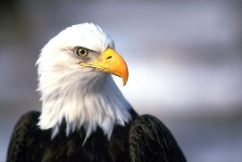



Introduction
Entity ambiguity
watch harry potter
vs.
read harry potter
Hotel California eagles
vs.
Jaguar cars

Slide 7
Outline
Introduction
Problem Statement
Methodology
Experiment
Conclusion

Slide 8
Problem Statement
Problem definition
Does a query “book Disneyland hotel california” mean that “user is searching for hotels close to Disneyland Theme Park in California”?
Book Disneyland hotel california
1) Detect all candidate terms
{“book”, “disneyland”, “hotel california”, “hotel”, “california”}
2) Two possible segmentations:
{book disneyland hotel california}
{book disneyland hotel california}
Book Disneyland hotel california
Book_{[v]} Disneyland_{[e]} hotel_{[c]} california_{[e]}
“Disneyland” has multiple senses:
Theme park and Company
Book_{[v]} Disneyland_{[e](park)} hotel_{[c]} california_{[e](state)}

Slide 9
Problem Statement
Short text understanding = Semantic labeling
Text segmentation
Divide text into a sequence of terms in vocabulary
Type detection
Determine the best type of each term
Concept labeling
Infer the best concept of each entity within context

Slide 10
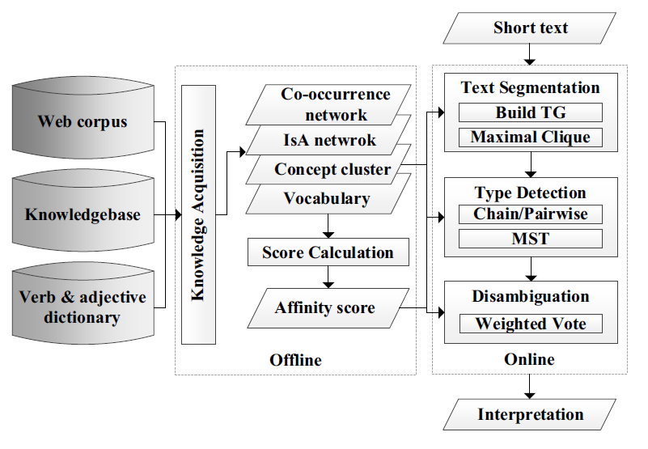
Problem Statement
Framework

Slide 11
Outline
Introduction
Problem Statement
Methodology
Experiment
Conclusion

Slide 12
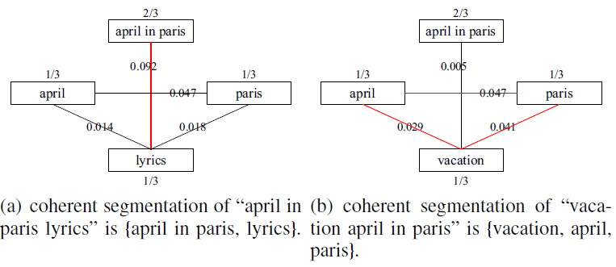
Methodology
Online inference
Text segmentation
How to obtain a coherent segmentation from the set of terms?
Mutual exclusion
Mutual reinforce

Slide 13
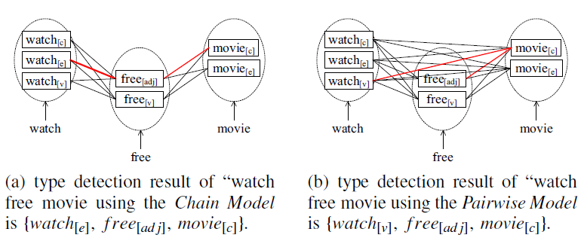
Methodology
Online inference (cont.)
Type detection
Chain Model
Consider relatedness between consecutive terms
Maximize total score of consecutive terms
Pairwise Model
Most related terms might not always be adjacent
Find the best type for each term so that the Maximum Spanning Tree of the resulting sub-graph between typed-terms has the largest weight

Slide 14
Methodology
Online inference (cont.)
Instance disambiguation
Infer the best concept of each entity within context
Filtering/re-rank of the original concept cluster vector
Weighted-Vote
The final score of each concept cluster is a combination of its original score and the support from other terms
hotel california eagles
eagles
hotel california
After normalization:
<animal, 0.2379>
<band, 0.1277>
<bird, 0.1101>
<celebrity, 0.0463>
…
<singer, 0.0237>
<band, 0.0181>
<celebrity, 0.0137>
<album, 0.0132>
…
WV
<band, 0.4562>
<celebrity, 0.1583>
<animal, 0.1317>
<singer, 0.0911>
…

Slide 15
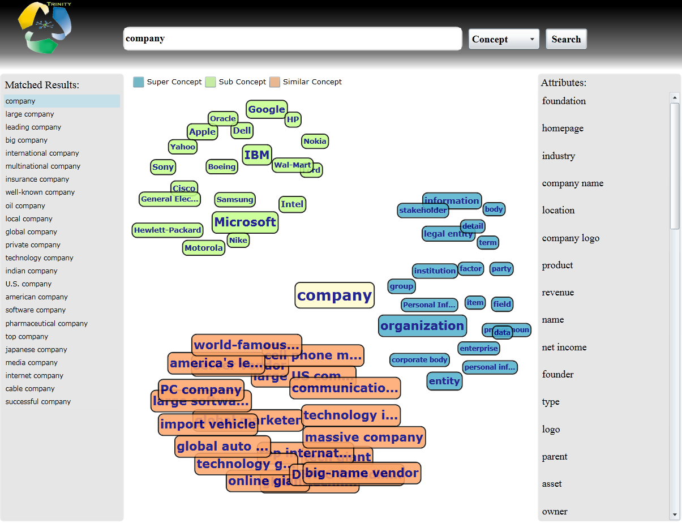
Methodology
Offline knowledge acquisition
Harvesting IS-A network from Probase
http://research.microsoft.com/en-us/projects/probase/browser.aspx

Slide 16
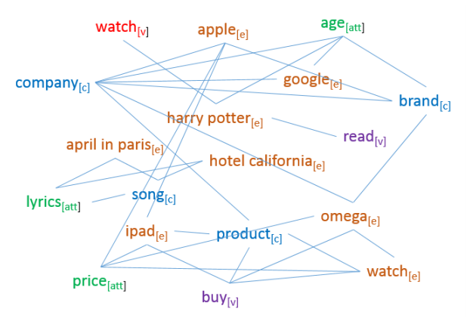
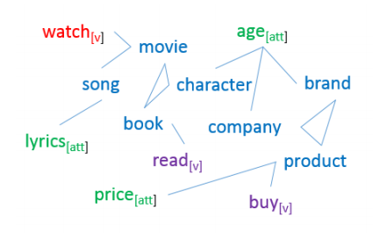
Methodology
Offline knowledge acquisition (cont.)
Constructing co-occurrence network
Between typed-terms; common terms are penalized
Compress network
Reduce cardinality
Improve inference accuracy

Slide 17
Methodology
Offline knowledge acquisition (cont.)
Concept clustering by k-Mediods
Cluster similar concepts contained in Probase
Represent the semantics of an instance in a more compact manner
Reduce the size of the original co-occurrence network
Disneyland
<theme park, 0.0351>, <amusement park, 0.0336>,
<company, 0.0179>, <park, 0.0178>, <big company, 0.0178>
<{theme park, amusement park, park}, 0.0865>,
<{company, big company}, 0.0357>

Slide 18



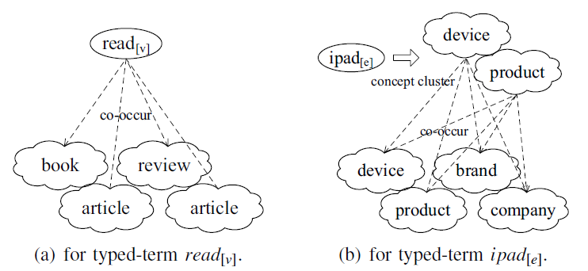
Methodology
Offline knowledge acquisition (cont.)
Scoring semantic coherence
Affinity Score
Measure semantic coherence between typed-terms
Two types of coherence: similarity, relatedness (co-occurrence)

Slide 19
Outline
Introduction
Problem Statement
Methodology
Experiment
Conclusion

Slide 20
Experiment
Benchmark
Manually picked 11 terms
April in paris, hotel california, watch, book, pink, blue, orange, population, birthday, apple fox
Randomly selected 1,100 queries containing one of above terms from one day’s query log
Randomly sampled another 400 queries without any restriction
Invited 15 colleagues ☺

Slide 21
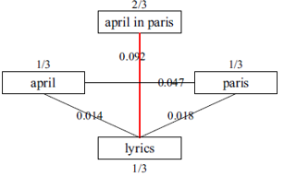
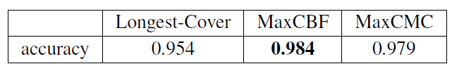
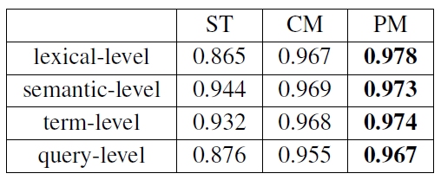
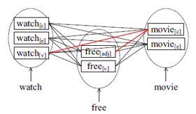
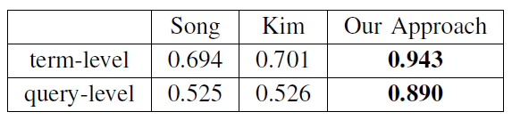
Experiment
Effectiveness of text segmentation
Effectiveness of type detection
Effectiveness of short text understanding
Verb, adjective, …
Attribute, concept and instance

Slide 22
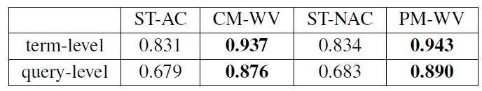
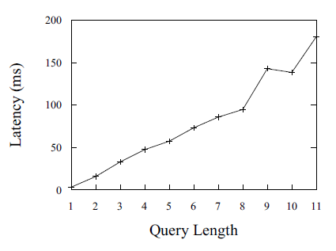
Experiment
Accuracy of concept labeling
AC: adjacent context; WV: weighted-vote
Efficiency of short text understanding

Slide 23
Outline
Introduction
Problem Statement
Methodology
Experiment
Conclusion

Slide 24
Conclusion
Short text understanding
Text segmentation: a randomized approximation algorithm
Type detection: a Chain Model and a Pairwise Model
Concept labeling: a Weighted-Vote algorithm
A framework with feedback
The three steps of short text understanding are related with each other
Quality of text segmentation > Quality of other steps
Disambiguation > accuracy of measuring semantic coherence > performance of text segmentation and type detection

