Slide 1
Ch. 1: Writing XML
Seoul National University, Internet Database Laboratory
July, 2011
Hyunwoo Kim

Slide 2
Contents
An XML Sample
Rules for Writing XML
Elements, Attributes, and Values
Writing XML
Predefined Entities
Displaying Elements as Text

Slide 3
An XML Sample
An XML document describing one of the Sever Wonders of the World: the Colossus of Rhodes
XML declaration
root element
<?xml version=“1.0”?>
<wonder>
<name>Colossus of Rhodes</name>
<location>Rhodes, Greece</location>
<height units=“feet”>107</height>
</wonder>
child elements
attribute

Slide 4
Rules for Writing XML [1/2]
1. A root element is required
2. Closing tags are required
<?xml version=“1.0”?>
<wonder>
<name>Colossus of Rhodes</name>
</wonder>
<?xml version=“1.0”?>
<wonder>
<name>Colossus of Rhodes</name>
<main_image file=“colossus.jpg”/>
</wonder>

Slide 5
Rules for Writing XML [2/2]
3. Elements must be properly nested
4. Case matters
5. Values must be enclosed in quotation marks
<wonder>
<name>Colossus of Rhodes</wonder>
</name>
<name>Colossus of Rhodes</name>
<Name>Colossus of Rhodes</Name>
<name>Colossus of Rhodes</Name>
<main_image file=“colossus.jpg”/>

Slide 6
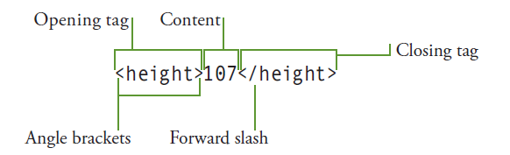
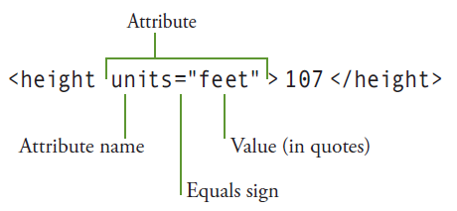
Elements, Attributes, and Values
XML element
Attributes and values

Slide 7
Writing XML [1/5]
1. To declare the version of XML
2. Every XML document must have one, and only one root element
3. Writing child elements
<?xml version=“1.0”?>
<?xml version=“1.0”?>
<ancient_wonders>
</ancient_wonders>
<?xml version=“1.0”?>
<ancient_wonders>
<wonder>Colossus of Rhodes</wonder>
</ancient_wonders>

Slide 8
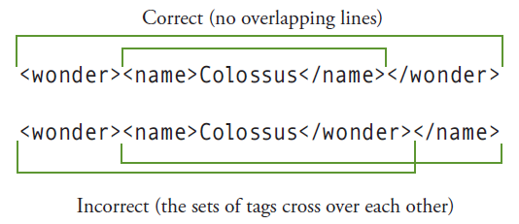
Writing XML [2/5]
4. Nesting Elements
<?xml version=“1.0”?>
<ancient_wonders>
<wonder>
<name>Colossus of Rhodes</name>
<location>Rhodes, Greece</location>
<height units=“feet”>107</height>
</wonder>
</ancient_wonders>

Slide 9
Writing XML [3/5]
5. Adding attributes
Attribute values must be in quotes
If an attribute’s value contains double quotes, use single quotes to contain the value (and vice versa)
ex) comment=‘She said, “The Colossus has fallen!”’
<?xml version=“1.0”?>
<ancient_wonders>
<wonder>
<name language=“English”>Colossus of Rhodes</name>
<name language=“Greek”>Κολοσσός της Ρόδου</name>
<location>Rhodes, Greece</location>
<height units=“feet”>107</height>
</wonder>
</ancient_wonders>

Slide 10
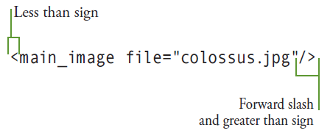
Writing XML [4/5]
6. Using empty elements
<?xml version=“1.0”?>
<ancient_wonders>
<wonder>
<name language=“English”>Colossus of Rhodes</name>
<name language=“Greek”>Κολοσσός της Ρόδου</name>
<location>Rhodes, Greece</location>
<height units=“feet”>107</height>
<main_image file=“colossus.jpg” w=“528 h=“349”/>
<source sectionid=“101” newspaperid=“21”></source>
</wonder>
</ancient_wonders>

Slide 11
Writing XML [5/5]
7. Writing comments
<?xml version=“1.0”?>
<ancient_wonders>
<wonder>
<name language=“English”>Colossus of Rhodes</name>
<name language=“Greek”>Κολοσσός της Ρόδου</name>
<location>Rhodes, Greece</location>
<height units=“feet”>107</height>
<main_image file=“colossus.jpg” w=“528 h=“349”/>
<!–- the research on this wonder of the world came in part from the sectionid of the newspaper (identified by newspaperid) in the source tag below -->
<source sectionid=“101” newspaperid=“21”></source>
</wonder>
</ancient_wonders>

Slide 12
Predefined Entities – Five Special Symbols
Type &amp; to create an ampersand sign (&)
Type &lt; to create a less than sign (<)
Type &gt; to create a less than sign (>)
Type &quot; to create a less than sign (“)
Type &apos; to create a less than sign (‘)
<height units=“feet”>&lt; 107</height>
< 107

Slide 13
Displaying Elements as Text [1/4]
Displaying elements
<?xml version=“1.0”?>
<xml_book>
<tags>
<appearance>
<ancient_wonders>
<wonder>
<name language=“English”>Colossus of Rhodes</name>
<name language=“Greek”>Κολοσσός της Ρόδου</name>
<location>Rhodes, Greece</location>
<height units=“feet”>107</height>
<main_image file=“colossus.jpg” w=“528 h=“349”/>
<source sectionid=“101” newspaperid=“21”></source>
</wonder>
</ancient_wonders>
</appearance>
</tags>
</xml_book>

Slide 14
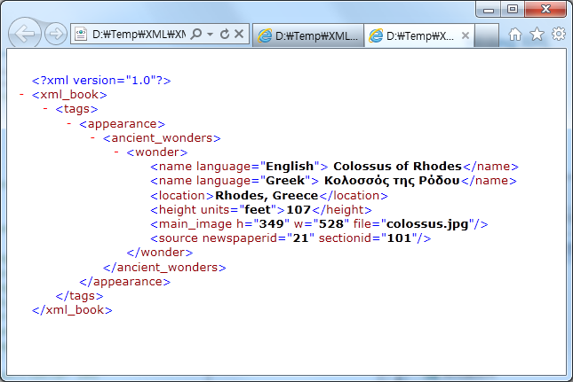
Displaying Elements as Text [2/4]
Displaying elements

Slide 15
Displaying Elements as Text [3/4]
Displaying elements as text
<![CDATA[ text ]]>
<?xml version=“1.0”?>
<xml_book>
<tags>
<appearance>
<![CDATA[
<ancient_wonders>
<wonder>
<name language=“English”>Colossus of Rhodes</name>
<name language=“Greek”>Κολοσσός της Ρόδου</name>
<location>Rhodes, Greece</location>
<height units=“feet”>107</height>
<main_image file=“colossus.jpg” w=“528 h=“349”/>
<source sectionid=“101” newspaperid=“21”></source>
</wonder>
</ancient_wonders>
]]>
</appearance>
</tags>
</xml_book>

Slide 16
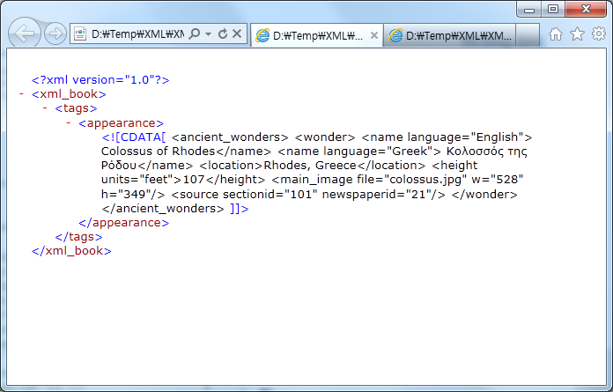
Displaying Elements as Text [4/4]
Displaying elements as text
<![CDATA[ text ]]>

