Slide 1
RP-Filter: A Path-based Triple Filtering Method for Efficient SPARQL Query Processing
Seoul National University
Internet Database Lab.
Kisung Kim
2011. 10. 6

Slide 2
Outline
Introduction
Related work
Preliminary
Our approaches
Experimental results
Conclusions and future work

Slide 3
Introduction
RDF(Resource Description Language)
Standard data model recommended by W3C
A set of triples (subject, predicate, object)
Graph structured data: RDF graph
<paper1, reference, paper2>
<paper1, hasAuthor, person1>
<paper1, year, 2011>
<paper2, hasAuthor, person2>
<paper2, year, 2010>
<paper2, wonPrize, prize1>
reference
paper1
paper2
hasAuthor
hasAuthor
wonPrize
year
year
person1
person2
prize1
2011
2010
RDF Triples
RDF Graph

Slide 4

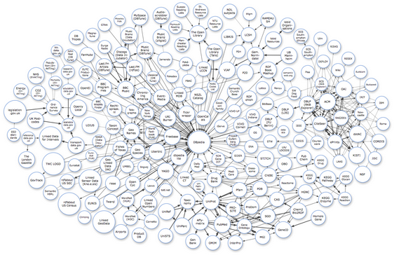
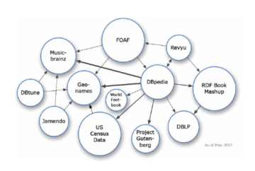
Introduction
RDF has gained popularity rapidly
Data integration, publishing and exchanging data on the Web
Area: Life science, open government, social network, multimedia,…
Linking Open Data(LOD) project¹
Enables data from different sources to be connected and queried
Open data: Wikipedia, MusicBrainz, WordNet, DBLP, Uniprot,….
LOD cloud diagram²
Show RDF data sources and there relationships
2007
1 Billion Triples
12 Data Sources
2010
25 Billion Triples
203 Data Sources
¹http://www.w3.org/wiki/SweoIG/TaskForces/CommunityProjects/LinkingOpenData
²http://lod-cloud.net

Slide 5
Introduction
SPARQL(SPARQL Protocol And RDF Query Language)
Standard query language for RDF
Query by a graph pattern
Subgraph pattern matching
SPARQL Query
SPARQL Graph Pattern
SELECT ?paper1 ?paper2 ?prize
WHERE {?paper1 <reference> ?paper2.
?paper2 <year> <2010>.
?paper2 <wonPrize> ?prize.
?paper1 <year> <2011>.}
?paper1
reference
year
?paper2
2011
year
wonPrize
RDF Graph
2010
?prize
reference
paper1
paper2
paper1
paper2
Results
hasAuthor
hasAuthor
wonPrize
year
year
?paper1 | ?paper2 | ?prize
paper1 | paper2 | prize1
prize1
person1
person2
prize1
2011
2011
2010
2010

Slide 6
Storage Model of RDF Data
Triple table
Store all triples in a 3-column(S, P, O) table
Dictionary table
Store mapping information between resources and their IDs
ID | URL(literal)
1 | paper1
2 | hasAuthor
3 | year
4 | reference
5 | wonPrize
6 | person1
7 | 2011
8 | paper2
9 | person2
10 | 2010
11 | prize1
reference
S | P | O
1 | 2 | 6
1 | 3 | 7
1 | 4 | 8
8 | 2 | 9
8 | 3 | 10
8 | 5 | 11
paper1
paper2
hasAuthor
hasAuthor
wonPrize
year
year
person1
person2
prize1
2011
2010
RDF Graph
Triple Table
Dictionary Table

Slide 7
SPARQL Query Processing
Execution plan consists of
Scan operator: retrieve triples matching one triple pattern
Join operator: combine triples from different triple patterns
More join operators than usual RDBMS queries
Each operator produces a partially matching fragments for the query graph pattern
Join
O2=S4
Join
O2=S4
?paper1
?paper1
reference
reference
year
Join
O2=S3
year
Join
O2=S3
Table Scan
P4 = year
O4 = 2010
Table Scan
P4 = year
O4 = 2010
?paper2
2011
?paper2
2011
Table Scan
P3 = wonPrize
Join
S1=S2
Table Scan
P3 = wonPrize
year
wonPrize
Join
S1=S2
2010
2010
?prize
?prize
Table Scan
P2 = year
O2 = 2011
Table Scan
P1 = reference
Table Scan
P2 = year
O2 = 2011
Table Scan
P1 = reference
SPARQL Graph Pattern
Query Execution Plan

Slide 8
Challenges in SPARQL Query Processing
Useless intermediate results
Results of operators which are not included in the final results
Slow down the query execution time
How can we avoid producing useless intermediate results?
Execution Plan
Query
RDF Graph
1 row
p1
1M rows
p1
p1
p1
p2
Join
p3
p2
p2
p2
p2
p2
Join
Scan
p1
p3
p3
p3
Scan
p2
Scan
p3
Useless Intermediate Results

Slide 9
Idea: Triple Filtering
Prune scanned triples which would be useless before join operators
Information for triple filtering
We use incoming path information
If a node in a query graph has an incoming path pattern, the matching data node also has the same incoming path pattern
Query
Incoming path pattern
<p1, p2>
Execution Plan
p1
Join
p2
Join
Scan
p1
p3
Filter triples
whose object
does not have
incoming path pattern <p1,p2>
Scan
p2
Scan
p3

Slide 10
Outline
Introduction
Related work
Preliminary
Our approaches
Experimental results
Conclusions and future work

Slide 11
Related Work
RDF3x [Neumann et al., VLDB’08]
One of the state-of-the-art RDF stores
Store RDF triples in six indexes(SPO,SOP,PSO,POS,OSP,OPS) redundantly
Use fast merge joins extensively
Triple Table (not sorted)
Triple Index(PSO) Sorted by (P, S, O)
Triple Index(SPO) Sorted by (S, P, O)
S | P | O
1 | 10 | 5
6 | 3 | 6
40 | 4 | 9
16 | 10 | 8
6 | 3 | 10
90 | 2 | 11
6 | 10 | 12
P | S | O
2 | 90 | 11
3 | 6 | 6
3 | 6 | 10
4 | 40 | 9
10 | 1 | 5
10 | 16 | 12
10 | 16 | 8
S | P | O
1 | 10 | 5
6 | 3 | 6
6 | 3 | 8
6 | 10 | 12
16 | 10 | 8
40 | 4 | 9
90 | 2 | 11
Triple Pattern
<?, 10, ?>
Triple Pattern
<6, ?, ?>
Totally ordered by S
Totally ordered by P

Slide 12
Related Work
U-SIP [Neumann et al., SIGMOD’09]
RDF-specific sideway information passing method
To reduce the intermediate results and the overhead of index scans
Build a sort of filters while processing of an operator and to pass the filters to other operators
Not transfer the filter information reverse direction to the data flow of the execution plan
Not very effective for long path queries

Slide 13
Related Work
U-SIP [Neumann et al., SIGMOD’09]
Merge Join
[S2=S3]
S1=S2=S3
Next Information
S1=S2=S3
S1
S2
S3
Merge Join
[S1=S2]
Scan PSO
[P=wonPrize,
S3, O3]
5
10
100
Scan PSO
[P=hasTitle, S1, O1]
Scan PSO
[P=hasAuthor, S2, O2]
S3
O3
100
100
502
S1
O1
S2
O2
803
1
1
2
2
2
2
3
3
Skip using B+tree index
3
3
4
4
4
4
10
10
5
5
100
99
101
103
102
104
103
105

Slide 14
Outline
Introduction
Related work
Preliminary
Our approaches
Experimental results
Conclusions and future work

Slide 15
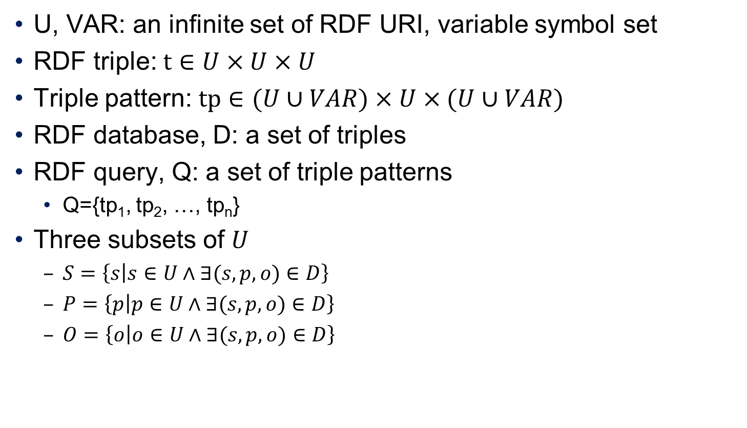
Preliminary: RDF Data Model
U, VAR: an infinite set of RDF URI, variable symbol set
RDF triple: $t∈U×U×U$
Triple pattern: $tp∈(U∪VAR)×U×(U∪VAR)$
RDF database, D: a set of triples
RDF query, Q: a set of triple patterns
Q={tp₁, tp₂, …, tp_{n}}
Three subsets of $U$
$S=\left\{s | s∈U∧∃(s, p, o)∈D\right\}$
$P=\left\{p | p∈U∧∃(s, p, o)∈D\right\}$
$O=\left\{o | o∈U∧∃(s, p, o)∈D\right\}$

Slide 16
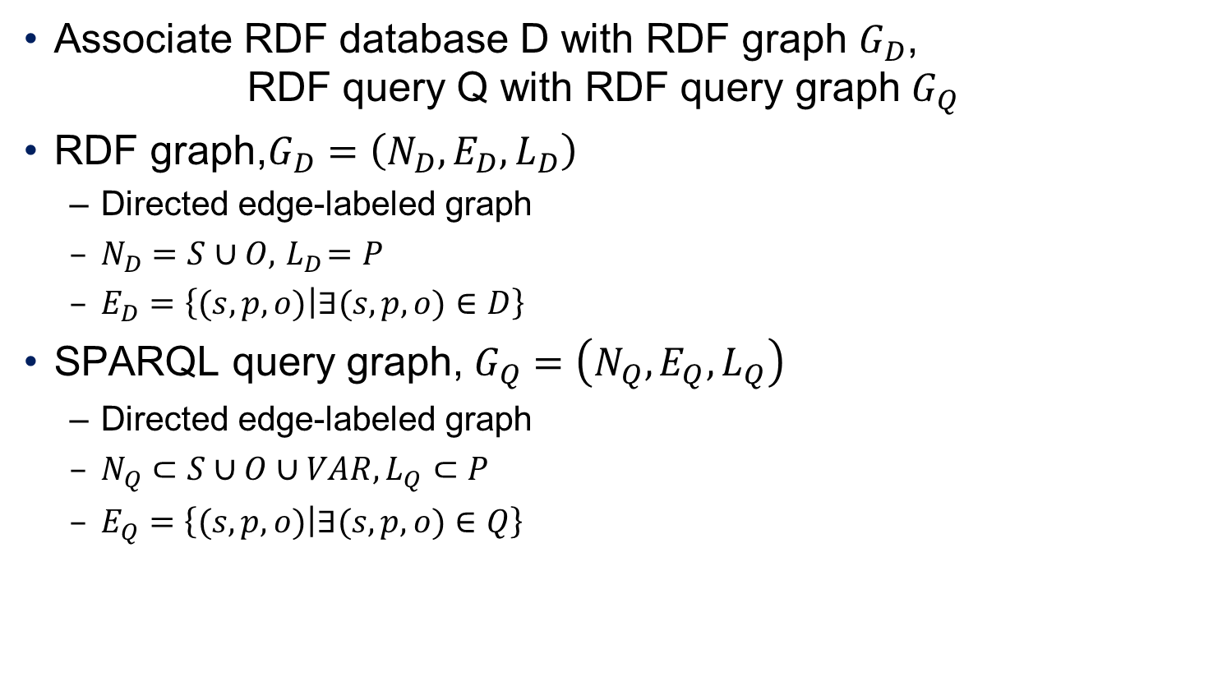
Preliminary: RDF Data Model
Associate RDF database D with RDF graph $G_{D}$, RDF query Q with RDF query graph $G_{Q}$
RDF graph,$G_{D}=\left(N_{D},E_{D},L_{D}\right)$
Directed edge-labeled graph
$N_{D}=S∪O, { L}_{D}=P$
$E_{D}=\left\{(s,p,o) | ∃(s, p, o)∈D\right\}$
SPARQL query graph, $G_{Q}=\left(N_{Q},E_{Q},L_{Q}\right)$
Directed edge-labeled graph
$N_{Q}⊂S∪O∪VAR, L_{Q}⊂P$
$E_{Q}=\left\{(s,p,o) | ∃(s, p, o)∈Q\right\}$

Slide 17

Preliminary: Predicate Path
Path
A sequence of connected edges
Predicate path
A sequence of predicates
Incoming predicate path set, $InPPath(n,l)$
A set of the predicate paths for all incoming paths of v whose $length ≤l$
v₁
p₁
v₂
$$InPPath\left(v_{4},3\right)=\{<p_{3}>,<p_{2},p_{3}>,<p_{1},p_{2},p_{3}>\}$$
p₂
v₃
p₃
v₄

Slide 18
Outline
Introduction
Related work
Preliminary
Our approaches
Experimental results
Conclusions and future work

Slide 19
Triple Filtering
We need
Node list which provides nodes having a specific incoming predicate path ➔ RP-Filter
Operator to perform the triple filtering ➔ RPFLT operator
Execution Plan
Query
Incoming path pattern
<p1, p2>
Join
p1
Join
Scan
p1
p2
Filtering
Filtering
p3
Node List
Having <p1,p2>
Scan
p2
Scan
p3

Slide 20
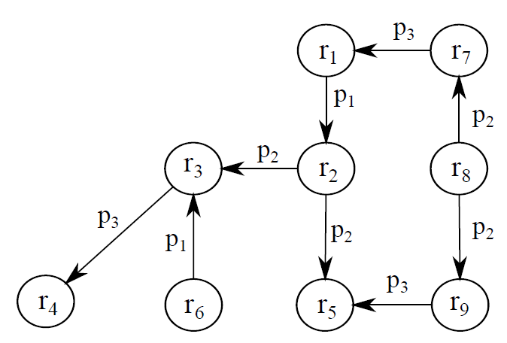
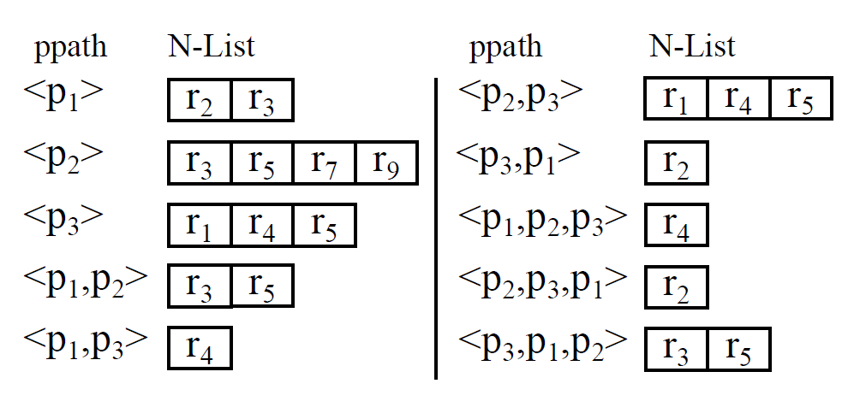
RP-Filter
Node list: N-List(ppath)
Sorted list of node IDs which have ppath as its incoming predicate path
RP-Filter of RDF database D
MaxL: maximum length of predicate paths
A set of all pairs <ppath, N-List(ppath)>, for all ppaths which exist in D and whose lengths are less than or equal to MaxL
RDF Graph
RP-Filter(D, MaxL=3)

Slide 21
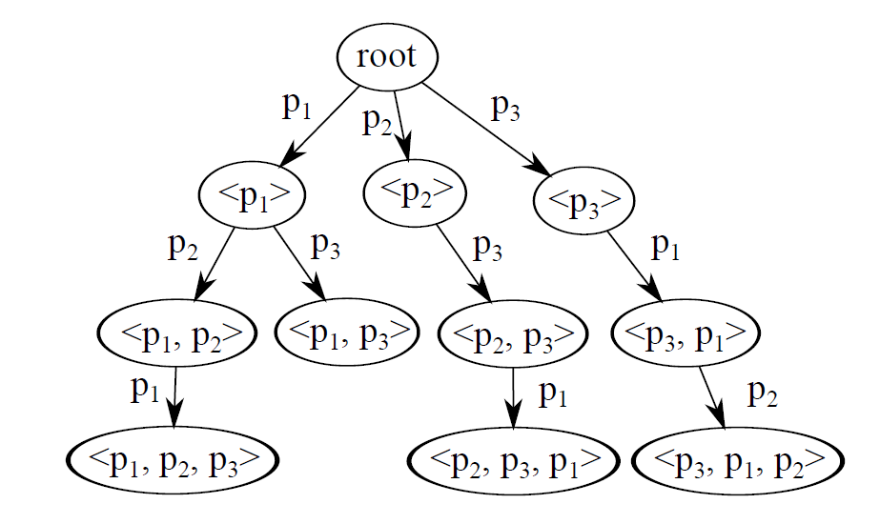

RP-Trie
RP-Trie is a trie(or prefix tree) which organize all the predicate paths in RP-Filter
To search the N-List of a predicate path easily
Each node in RP-Trie points the N-List of the associated predicate path
Space complexity
$O\left(\sum_{i=1}^{MaxL}{{\left|P\right|}^{i}}\right)$
For real-life dataset and small MaxL, the size of RP-Trie is small
RP-Filter(D, MaxL=3)
RP-Trie

Slide 22
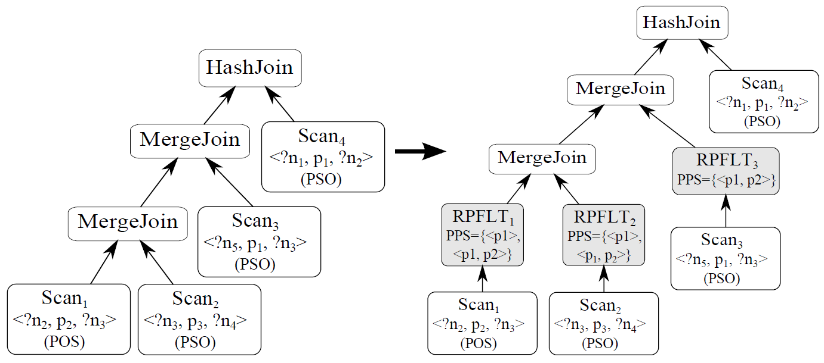
RPFLT Operator
Filter input triples from a scan operator using RP-Filter
Query compiler adds RPFLT operators as parents of scan operators
PPS(Predicate Path Set)
Predicate paths assigned by query compiler
RPFLT uses the N-Lists of ppaths in PPS

Slide 23
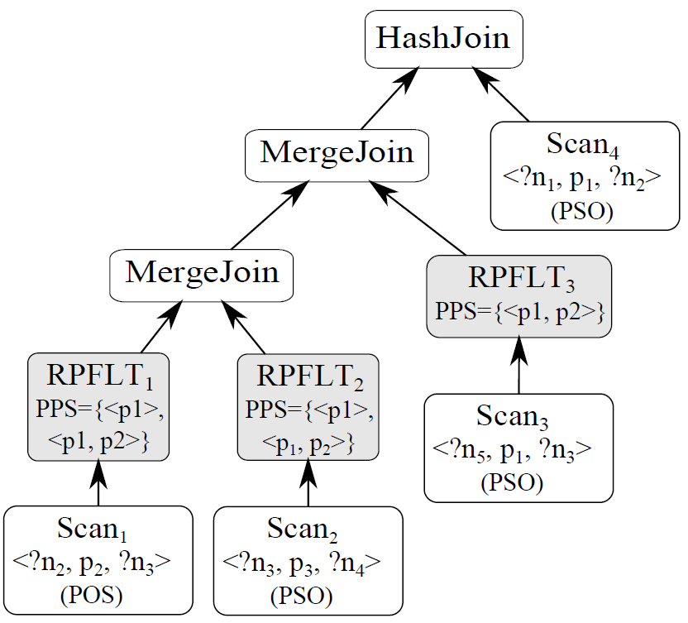
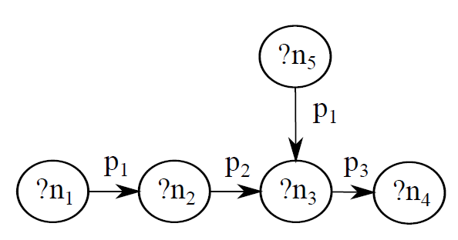

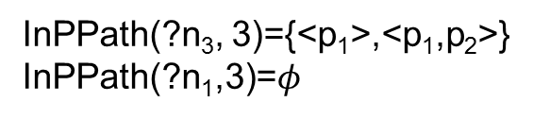
RPFLT Operator
Which N-Lists does a RPFLT operator use?
Sortkey of a scan operator
By which column the results of a scan operator sorted
PPS of ${Scan}_{i}⊂InPPath({Scan}_{i}.sortkey, MaxL)$
Scan₁.sortkey=Scan₂.sortkey= Scan₃.sortkey=?n₃ Scan₄.sortkey=?n₁
InPPath(?n₃, 3)={<p₁>,<p₁,p₂>}
InPPath(?n₁,3)=$φ$

Slide 24
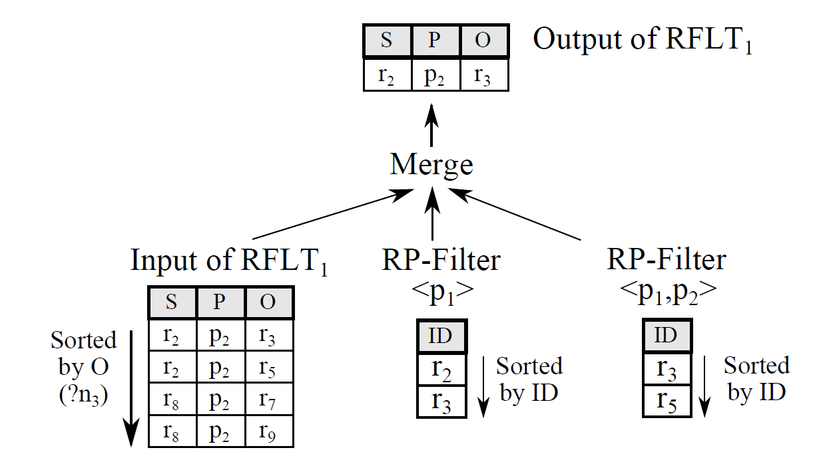
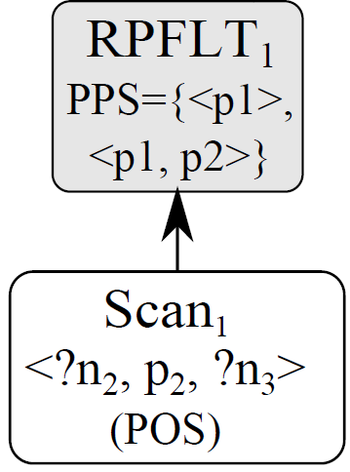
Filtering in RPFLT Operator
Merge the input triples with N-list(ppath), for all ppath in PPS
The inputs share the same ordering

Slide 25
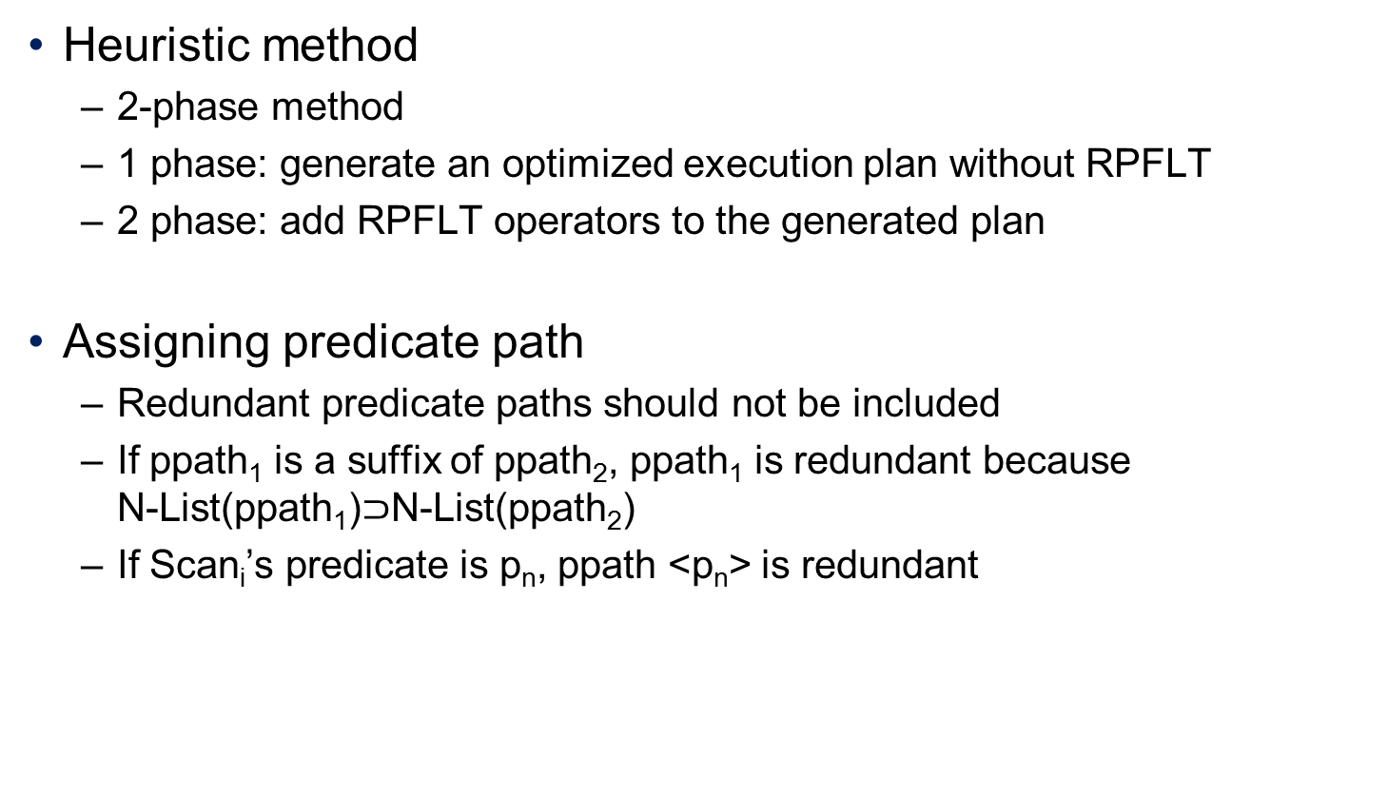
Generating Execution Plan with RPFLT
Heuristic method
2-phase method
1 phase: generate an optimized execution plan without RPFLT
2 phase: add RPFLT operators to the generated plan
Assigning predicate path
Redundant predicate paths should not be included
If ppath₁ is a suffix of ppath₂, ppath₁ is redundant because N-List(ppath₁)$⊃$N-List(ppath₂)
If Scan_{i}’s predicate is p_{n}, ppath <p_{n}> is redundant

Slide 26
Generating Execution Plan with RPFLT
Redundant predicate path
Scan₁.sortkey=Scan₂.sortkey= Scan₃.sortkey=?n₃
InPPath(?n₃, 3)={<p₁>, <p₂>,<p₁,p₂>}
RPFLT₁.PPS=RPFLT₂.PPS={<p₁>, <p₁,p₂>}
RPFLT₃.PPS={<p₁,p₂>}

Slide 27
Outline
Introduction
Related work
Preliminary
Our approaches
Experimental results
Conclusions and future work

Slide 28
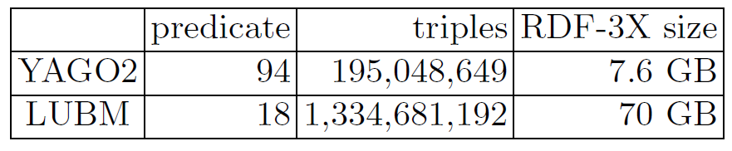
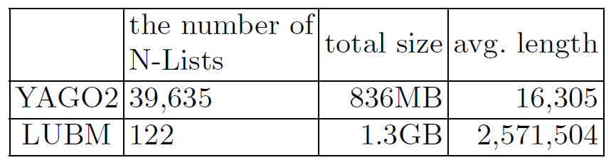
Experimental Results
Experimental environment
We implemented RP-Filter on RDF-3X(0.3.5)
IBM machine having 8 Intel Xeon 3.0GHz cores, 16GB memory
Datasets
YAGO2: small real-life dataset
LUBM: large synthetic dataset
RP-Filter size(MaxL=3)

Slide 29
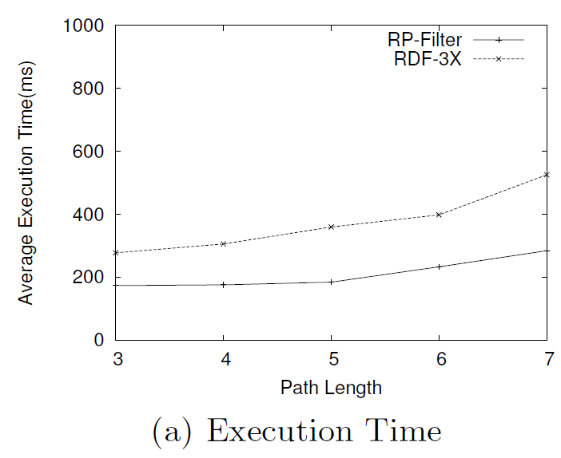
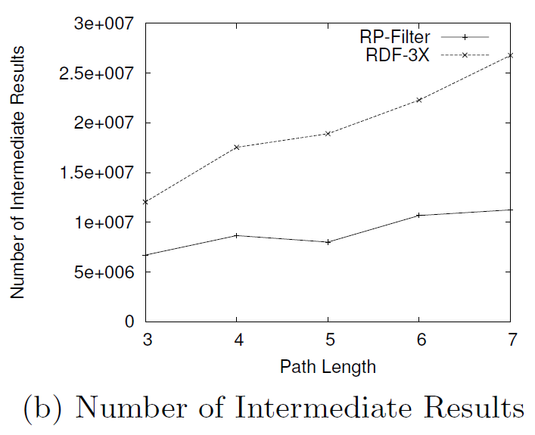
Experimental Results
v₁
p₁
v₂
p₂
v₃
YAGO2 dataset
Generate n-length single path queries
The execution time and the number of intermediate results of RP-Filter are lower than those of RDF-3X
p₃
Example Single Path Query (length=3)
v₄

Slide 30
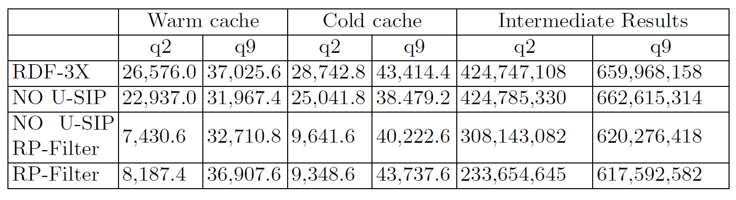
Experimental Results
LUBM dataset
We use q2 and q9 queries
U-SIP is not very effective in q2 and q9
U-SIP is not effective for queries with long paths
RP-Filter is very effective in q2 but not in q9
q2 has a very selective path in the query pattern
Execution time (ms)

Slide 31
Outline
Introduction
Related work
Preliminary
Our approaches
Experimental results
Conclusions and future work

Slide 32
Conclusions and Future Work
We propose a novel triple filtering method to reduce the useless intermediate results
RP-Filter is a path-based filter structure
Experimental results show RP-Filter is very effective for complex queries to reduce the intermediate results
Future work
How to reduce the overhead of filtering process
How to increase the applicability of RP-Filter
How to generate the execution plan using RP-Filter based on the cost model

Slide 33
Journal Version
Title
RP-filter: Triple Filtering Framework using a Graph Index for Efficient SPARQL Query Processing
Added topics
Totally rewritten
Size problem of RP-index
Building and updating RP-index
Increasing applicability of RP-filter
RPFLT&MJ operator
Comprehensive evaluation using more datasets: UNIPROT, BTC, …
Plan
Complete draft version until October 31

