Slide 1
Frequent Subgraph Mining
2015. 01. 09.
Hyun Geun Soo
FSG : Frequent subgraph discovery,
M.Kuramochi and G. Karypis , In ICDM’01
gSpan : Graph-Based Substructure Pattern Mining,
Yan, X. and Han, J. , In ICDM’02

Slide 2
Outline
Introduction
Apriori-based
Pattern growth based

Slide 3
Introduction
Frequent subgraph
A (sub)graph is frequent if its support (occurrence frequency) in a given dataset is no less than a minimum support threshold
A
A
C
C
A
B
B
B
A
B
C
A
A
C
A
Support
1
3
3
subgraph

Slide 4
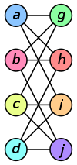
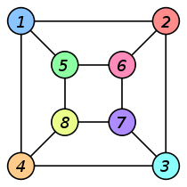
Introduction
Graph isomorphism
to detect if two graphs are identical in structure

Slide 5
Introduction
Graph representation (Canonical Labeling)
A canonical label is a unique code of a given graph.
same topological structure and the same labeling of edges and vertices.
Subgraph candidate generation
generate candidate frequent subgraphs from datasets

Slide 6
Introduction
Apriori-based
FSG : Frequent subgraph discovery, ICDM’01, M.Kuramochi and G. Karypis.
Pattern growth based
gSpan : Graph-Based Substructure Pattern Mining, ICDM’02 , Yan. X. and Han. J.

Slide 7
Outline
Introduction
Apriori-based
Pattern growth based

Slide 8
FSG : Frequent subgraph discovery
Canonical Labeling
Flattened Representation
Generate subgraph candidate
FSG(Apriori-based algorithm)

Slide 9
Flattened Representation
Using vertex invariant
Vertex degree, label

Slide 10
Flattened Representation
Lexicographic order or dictionary order

Slide 11
Apriori-algorithm
Ck: Candidate itemset of size k
Lk: frequent itemset of size k
Frequent: count >= min_support
Find frequent set Lk−1.
Join Step
Ck is generated by joining Lk−1 with itself
Prune Step
Any (k−1)-itemset that is not frequent cannot be a subset of a frequent k -itemset, hence should be removed.

Slide 12
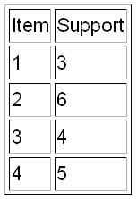
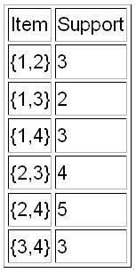
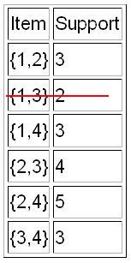
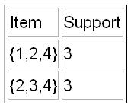
Apriori-algorithm
Set of transactions : { {1,2,3,4}, {2,3,4}, {2,3}, {1,2,4}, {1,2,3,4}, {2,4} }
min_support: 3
L₁
C₂
L₂
L₃
{1,2,3} and {1,3,4} were pruned as {1,3} is not frequent.
{1,2,3,4} not generated since {1,2,3} is not frequent. Hence algo terminates.

Slide 13
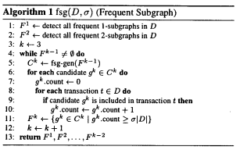
Candidate Generation
Apriori Property
If a graph is frequent, all of its subgraphs are frequent

Slide 14
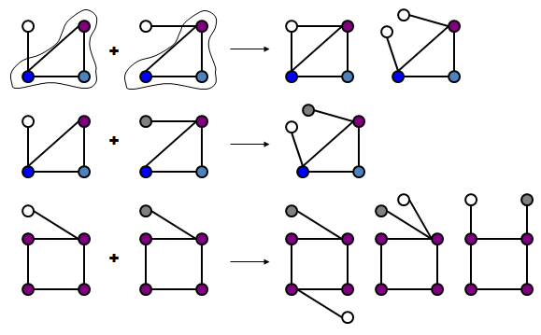
Candidate Generation
Candidate Generation Based On Core Detection

Slide 15
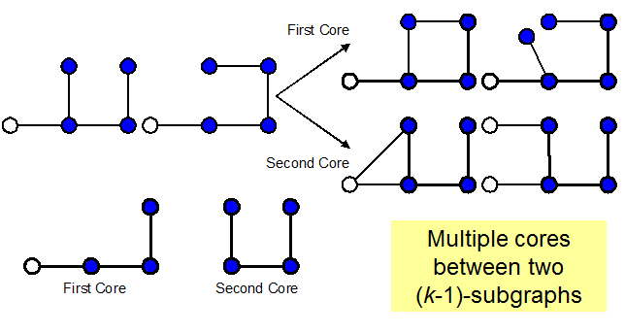
Candidate Generation
Candidate Generation Based On Core Detection

Slide 16
Experiment Result
Chemical Compound Dataset, which contains 340 compounds,24 different atoms (vertices)

Slide 17
Weakness of Apriori-based approach
The generation of size (k+1) subgraph candidates from size k frequent subgraph too complicated and complex.
subgraph isomorphism is an NP complete problem which is costly.

Slide 18
Outline
Introduction
Apriori-based
Pattern growth based

Slide 19
gSpan: Graph-Based Substructure Pattern Mining
Canonical Labeling
DFS(Depth First Search)
Generate subgraph candidate
Path growth

Slide 20
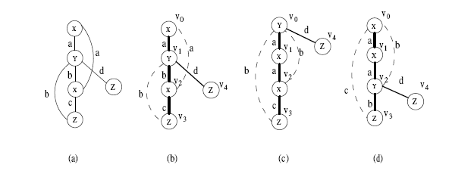
DFS(Depth First Search)
First Step: DFS the graph and use edges on the path to represent the graph.
Second Step: DFS Lexicographic Order
An edge is presented by 5 tuples.

Slide 21
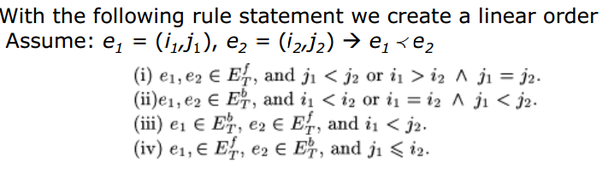
DFS(Depth First Search)

Slide 22
DFS(Depth First Search)
Second Step: DFS Lexicographic Order

Slide 23
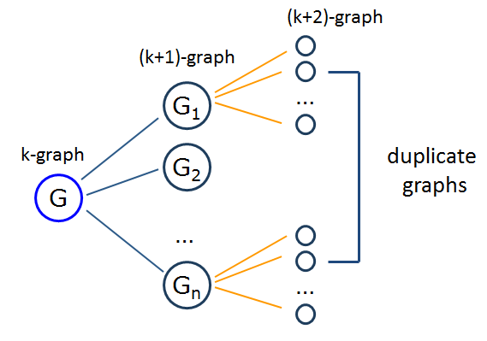
Pattern Growth
Candidate Generation

Slide 24
Pattern Growth
Free extension

Slide 25
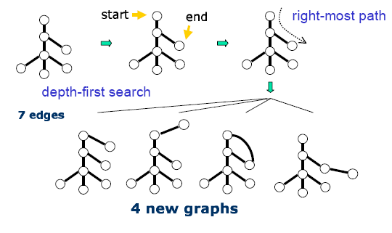
Pattern Growth
Right most extension
Vertex can be extended from the right-most vertex connecting to any other vertices on the right-most path(backward extension)
Vertex can be extended from vertices on the right-most path an introduces a new vertex (forward extension)

Slide 26
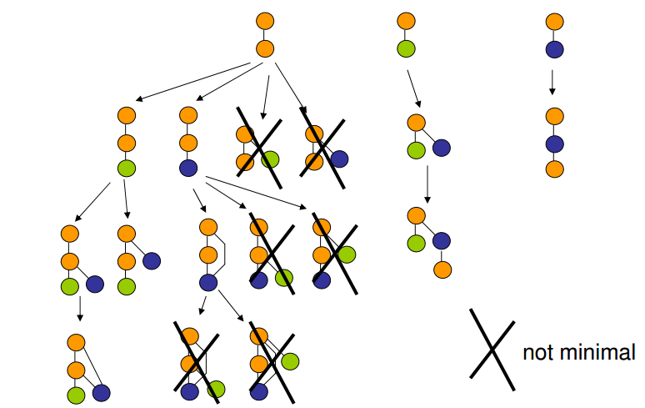
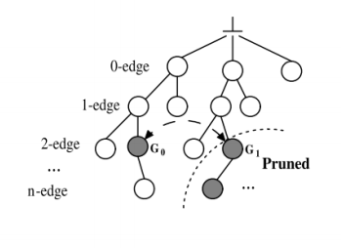
Pattern Growth
Pruning

Slide 27
gSpan
Pros
It reduces the generation of duplicate graphs
No need to search previous discovered frequent graphs in order to detect duplicates
Con
Still inefficient with large size graph
It is impossible to mine frequent large subgrahs with exponential growth

Slide 28
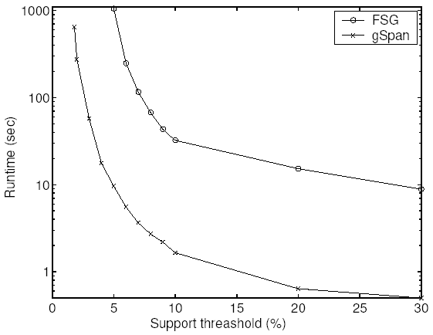
Experiment
Experimental result using Chemical data
340 molecules , 66 atom types and 4 bond types as labels
On average only 27 vertices with 28 edges

Slide 29
Summary
Graph representation
Flatten representation vs DFS code
Generation of Candidate Patterns
Apriori vs pattern growth

