Slide 1
Do Social Explanations Work? Studying and Modeling the Effects of Social Explanations in Recommender Systems
Amit Sharma and Dan Cosley, Cornell Univ.
WWW 2013
3 May 2013
Hyunwoo Kim

Slide 2
Outline
Introduction
Related Work
Social Explanations
ExploreMusic
Phase I: likelihood
Phase II: consumption
Discussion
Conclusion

Slide 3


Introduction [1/3]
Social explanation
Alice, Bob, and 56 other friends like this.
Charlie, Dave, and 35 other friends like this.
Alice, Bob, Charlie, Dave, and one other person +1’d this.
82,504 people +1’d this.

Slide 4


Introduction [2/3]
Do social explanations work?
A study of the effects of these social explanations in a recommendation
Distinguish between 2 key decisions
Likelihood of checking out the artist
Consumption rating of the artist
Likelihood
Consumption rating

Slide 5

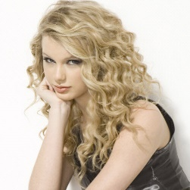
Introduction [3/3]
1. Explanation strategies
Along with an artist’s name and profile picture
5 different strategies used in the experiment
2. Modeling likelihood ratings
3. Relation between likelihood and ratings
Bruno Mars
Taylor Swift

Slide 6
Outline
Introduction
Related Work
Social Explanations
ExploreMusic
Phase I: likelihood
Phase II: consumption
Discussion
Conclusion

Slide 7
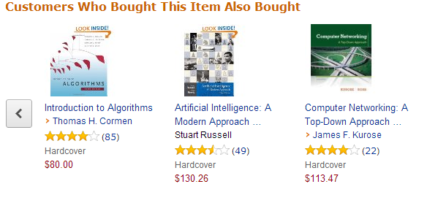

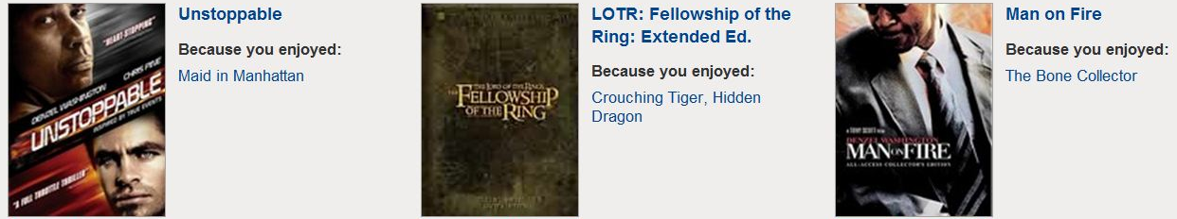
Related Work [1/2]
Amazon’s explanation
Netflix’s explanation

Slide 8
Related Work [2/2]
Explanation interfaces
Histogram showing the ratings of similar users
Social information for recommendation
People prefer the user of known friends to explain recommendations

Slide 9
Outline
Introduction
Related Work
Social Explanations
ExploreMusic
Phase I: likelihood
Phase II: consumption
Discussion
Conclusion

Slide 10
Social Explanation [1/11]
Fundamental question
How social explanations influence user decisions
Research questions
How do different social explanation strategies influence likelihood?
How do explanations interact with a person’s preferences?
How can we model the effect of explanations on likelihood?
How effective are explanations in directing people to items that receive high consumption ratings?

Slide 11

Social Explanation [2/11] ExploreMusic
Music
Easy to acquire consumption ratings
3 minutes per song
Facebook
Like button
Social network and music preference information available
Using Facebook data to explain a series of music recommendations
Data preparation
To minimize the effects of prior knowledge → 30 unknown artists
To minimize position bias → randomly ordered artists

Slide 12
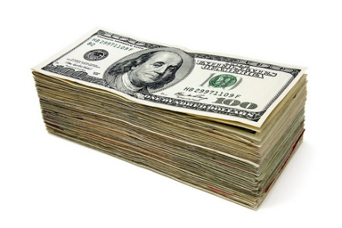

Social Explanation [3/11] ExploreMusic
Phase I
Users see the artist
Users rate how likely are they to check out the recommended artist
Phase II
Users listen to songs by a randomly chosen artists they had rated in Phase I
Users rate how much they liked the artist
Participants
237 users
Compensation
Money or experiment participation credits required by some courses

Slide 13
Social Explanation [4/11] ExploreMusic
5 explanation strategies (phase I)
Overall popularity
Friend popularity
Random Friend
Good Friend
Good Friend & Count

Slide 14
Social Explanation [5/11] Phase I: likelihood
RQ1: Are different social explanations more persuasive on average?
Showing the right friends matters
Popularity only matters if people identify with the crowd

Slide 15
Social Explanation [6/11] Phase I: likelihood
RQ2: How important are social explanations in decision making?
People are differently susceptible to social explanation
Social explanation is only part of the story
Explanations are a second order effect

Slide 16
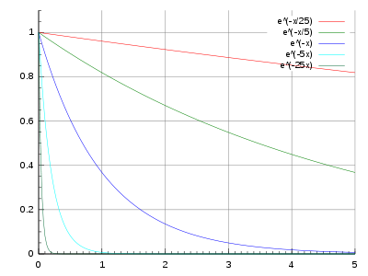
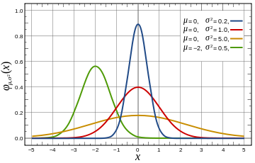
Social Explanation [7/11] Phase I: likelihood
RQ3: How can we model the effect of explanations on likelihood?
Inherent likelihood estimate
Effect of social explanation
Exponentially decaying function
Gaussian function

Slide 17
Social Explanation [8/11] Phase I: likelihood
RQ3: How can we model the effect of explanations on likelihood?
Inherent likelihood estimate
Effect of social explanation
a=1, inherent likelihood estimated
a=0, social explanation

Slide 18
Social Explanation [9/11] Phase I: likelihood
RQ3: How can we model the effect of explanations on likelihood?

Slide 19
Social Explanation [10/11] Phase I: likelihood
User clustering
Standard k-means algorithm
Representing users by their mean and variance of ratings
Cluster 1: “no use or influence”
Cluster 2: “useful information”
Cluster 3: “helped make decision”

Slide 20
Social Explanation [11/11] Phase II: consumption
RQ4: Do explanations affect ratings?

Slide 21
Outline
Introduction
Related Work
Social Explanations
ExploreMusic
Phase I: likelihood
Phase II: consumption
Discussion
Conclusion

Slide 22
Discussion [1/2]
Social explanations
Persuasive, especially ones involving close friends
Secondary effects
Not informative
Balancing persuasiveness and informativeness
Click-through/purchase distinction in customer behavior
Interface elements
Tokens of the item itself (genres, music clips)
Data that people attach to the item (ratings, tags, reviews)
Metadata about those people (similarity information, their ratings)
Information about the recommendation systems algorithms (confidence)

Slide 23
Discussion [2/2]
Acceptability of social explanation
Violating privacy expectations
Disclosing personal information
“No, I was not totally comfortable. Since it could take my friends’ information, it could take mine and share it. It felt like a breach of privacy”
Participants did not view privacy as a major issue
It is acceptable thing to do at least in music domain

Slide 24
Outline
Introduction
Related Work
Social Explanations
ExploreMusic
Phase I: likelihood
Phase II: consumption
Discussion
Conclusion

Slide 25
Conclusion
Adding to knowledge around the effect of social explanations on user preferences
Low correlation between likelihood and consumption ratings
A generative model that explains much of the variation in likelihood ratings

Slide 26
Thank you

