Slide 1
Snowball: Extracting Relations from Large Plain-Text Collections
Eugene Agichtein, Luis Gravano
Department of Computer Science
Columbia University
ACM DigitalLibrary 2000
Nov 10, 2011
Heegook Jun

Slide 2
Outline
Introduction
Related Work
The Snowball System
Experiments
Conclusion

Slide 3
Information Extraction
Information extraction (IE) is originally the task of locating specific information from a natural language document
IE systems have been developed both for structured text with tabular information and for free text such as new stories.
A key element of IE systems is a set of text extraction rules or extraction patterns that identify relevant information to be extracted.

Slide 4
IR and IE
IE is different from the more mature technology of information retrieval (IR)
IR retrieves relevant documents from collections
Probability theory and statistics have influenced
IE extracts relevant information from documents
Rule-based systems in computational linguistics and natural language processing

Slide 5
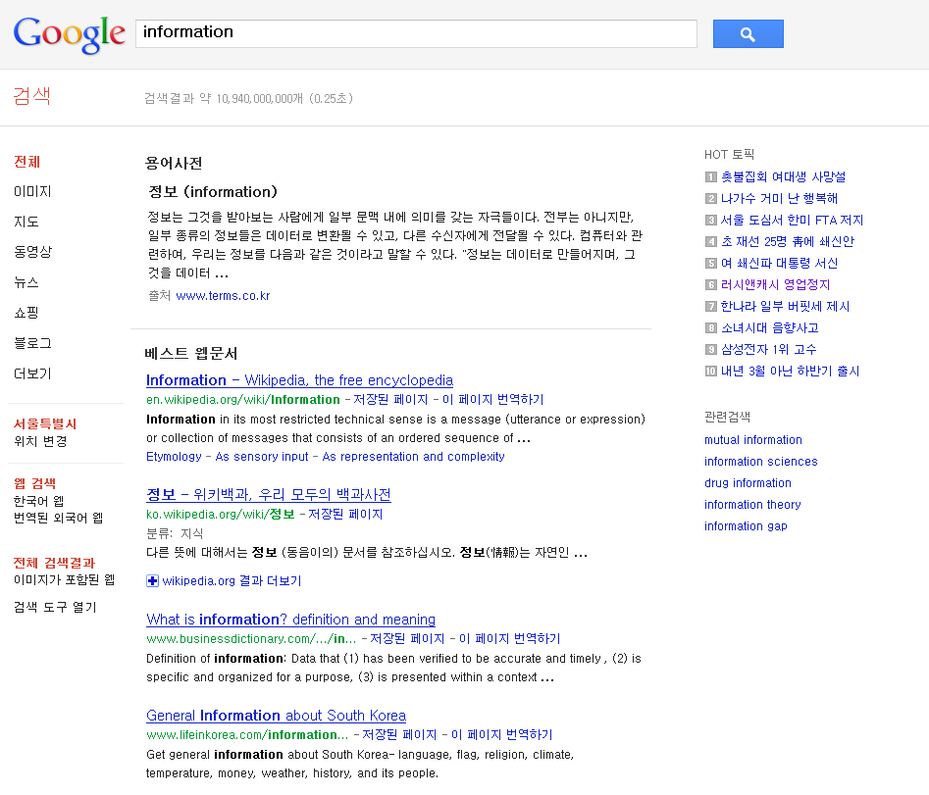
Information Retrieval

Slide 6


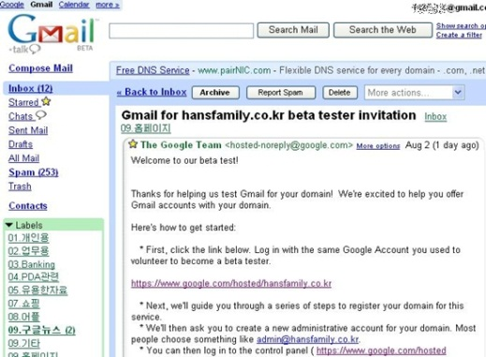
Information Extraction
<Name, Job>
Name | Job
Tom | Actor
Joe | Singer
Kim | Teacher
… | …

Slide 7
Outline
Introduction
Related Work
The Snowball System
Experiments
Conclusion

Slide 8
Traditional IE
One of the major challenges in IE is the necessary amount of manual labor involved in training the system for each new task
These systems still require substantial expert manual labor to port the system to each new domain
In contrast, Snowball and DIPRE require only a handful of example tuples for each new scenario

Slide 9
DIPRE
DIPRE(Dual Iterative Pattern Expansion), Sergey Brin
It was proposed as an approach for extracting a structured relation(table) from a collection of HTML documents.
It exploits this redundancy and inherent structure in the collection to extract the target relation with minimal training from a user

Slide 10
DIPRE
Seed Tuples
Org | Location
MICROSOFT | REDMOND
Context
“Computer servers at Microsoft’s headquarters in Redmond”
Construct Pattern
<String1> | ‘s headquarters in | <String2>

Slide 11
Traditional IE
Another approach is to train the system over a large manually tagged corpus, where the system can apply machine learning techniques to generate extraction patterns.
Need for a large tagged corpus!
According to Robert Callahan, president of Eastern’s flight attendants union, the past practice of Eastern’s parent, Houston-based Texas Air Corp., has involved ultimatums to unions to accept the carrier’s terms
The Unstructured Source

Slide 12
Traditional IE
Another approach is to train the system over a large manually tagged corpus, where the system can apply machine learning techniques to generate extraction patterns.
Need for a large tagged corpus!
According to <Person>Robert Callahan</Person>, president of <Org>Eastern’s</Org> flight attendants union, the past practice of Eastern’s parent, <Location>Houston</Location>-based <Org>Texas Air Corp.</Org>, has involved ultimatums to unions to accept the carrier’s terms
Annotated Entities

Slide 13
Using unlabeled examples for training
Bootstrapping has been an attractive in automatic text processing
To extract patterns to recognize and classify named entities in text
Snowball uses named-entity tagger, The MITRE Copration’s Alembic Workbench
Alembic can identify entities (PERSON, LOCATION, ORG..)
According to <Person>Robert Callahan</Person>, president of <Org>Eastern’s</Org> flight attendants union, the past practice of Eastern’s parent, <Location>Houston</Location>-based <Org>Texas Air Corp.</Org>, has involved ultimatums to unions to accept the carrier’s terms

Slide 14
Using unlabeled examples for training
Bootstrapping has been an attractive in automatic text processing
To extract patterns to recognize and classify named entities in text
Snowball uses named-entity tagger, The MITRE Copration’s Alembic Workbench
Alembic can identify entities (PERSON, LOCATION, ORG..)
According to Robert Callahan, president of Eastern’s flight attendants union, the past practice of Eastern’s parent, Houston-based Texas Air Corp., has involved ultimatums to unions to accept the carrier’s terms

Slide 15
Contribution
Techniques for generating patterns and extracting tuples
Capture most of the tuples that are hidden in the text
Strategies for evaluating patterns and tuples
Estimating the reliability of the extracted patterns and tuples
Amount of training is minimal
Need only handful set of tuples

Slide 16
Outline
Introduction
Related Work
The Snowball System
Experiments
Conclusion

Slide 17
The Snowball System
Snowball presents a novel technique to generate patterns and extract tuples from text documents
Snowball introduces a strategy for evaluating the quality of the patterns and the tuples that are generated in each iteration of the extraction process

Slide 18
Iterative Information Extraction
Find Occurrences of Seed Tuples
Seed tuples
Append to seed tuples
Tag Entities
Augment Table
Generate Extraction Patterns

Slide 19
1. Generating Patterns
A Crucial step in the table extraction process
Snowball is initially given a handful of example tuples
Seed Tuples
Org | Location
MICROSOFT | REDMOND
EXXON | IRVING
IBM | ARMONK
BOEING | SEATTLE
INTEL | SANTA CLARA

Slide 20
1. Generating Patterns
Snowball pattern is a 5-tuple
<left, tag1, midddle, tag2, right>
Tag1 and tag2 are named-entity tags
Left, middle, and right are vectors associating weights with terms
Seed Tuple
MICROSOFT | REDMOND
Context
“the Redmond-based Microsoft corporation”
Generate Pattern
{<the, 0.2>}, | LOCATION | {<-, 0.5>, <based, 0.5>} | ORGANIZATION | { }

Slide 21
Minimum similarity threshold Ƭ_{sim}
In order to generate a pattern, Snowball groups occurrences of known tuples in documents, if the contexts surrounding the tuples are similar enough
< {<the, 0.2>}, LOCATION, {<-, 0.5>, <based, 0.5>}, ORGANIZATION, { } >
< { }, LOCATION, { <based, 0.3>}, ORGANIZATION, {<corp., 0.4>} >
< {<the, 0.1>}, LOCATION, {<, , 0.5>, <based, 0.3>}, ORGANIZATION, { } >
…
Notes:
정성적인 factor도 고려

Slide 22
Minimum similarity threshold Ƭ_{sim}
< {<the, 0.2>}, LOCATION, {<-, 0.5>, <based, 0.5>}, ORGANIZATION, { } >
< { }, LOCATION, { <based, 0.3>}, ORGANIZATION, { <corp., 0.4> } >
Match (Tp, Ts) = ( l_{p} x l_{s} ) + ( m_{p} x m_{s} ) + ( r_{p} x r_{s} )
Clusters these 5-tuples using a simple singlepass clustering algorithm
Using the Match function to compute the similarity between the vectors and some minimum similarity threshold Ƭ_{sim}

Slide 23
2. Generating Tuples
After generating patterns, Snowball scans the collection to discover new tuples.
Snowball first identifies sentences that include an organization and a location, as determined by the named-entity tagger
According to Robert Callahan, president of Eastern’s flight attendants union, the past practice of Eastern’s parent, the Houston-based Texas Air, has involved ultimatums to unions to accept the carrier’s terms

Slide 24
2. Generating Tuples
Generates the 5-tuple t = <lc, t1, mc, t2, rc >
According to Robert Callahan, president of Eastern’s flight attendants union, the past practice of Eastern’s parent, Houston-based Texas Air, has involved ultimatums to unions to accept the carrier’s terms
< { }, Houston, {<-, 0.5>, <based, 0.5>}, Texas Air, { } >

Slide 25
2. Generating Tuples
Match pattern: Match (Tp, Ts) = ( l_{p} x l_{s} ) + ( m_{p} x m_{s} ) + ( r_{p} x r_{s} )
Patterns
< {<at, 0.2>}, ORGANIZATION, {<’s, 0.5>, <headquarters, 0.5>, <in, 0.5>}, LOCATION, { } >
< {<the, 0.2>}, LOCATION, {<-, 0.5>, <based, 0.5>}, ORGANIZATION, { } >
Candidate 5-tuple
< { }, Houston, {<-, 0.5>, <based, 0.5>}, Texas Air, { } >

Slide 26
2. Generating Tuples
Match pattern: Match (Tp, Ts) = ( l_{p} x l_{s} ) + ( m_{p} x m_{s} ) + ( r_{p} x r_{s} )
Patterns
< { }, Houston, {<-, 0.5>, <based, 0.5>}, Texas Air, { } >
< {<at, 0.2>}, ORGANIZATION, {<’s, 0.5>, <headquarters, 0.5>, <in, 0.5>}, LOCATION, { } >
< {<the, 0.2>}, LOCATION, {<-, 0.5>, <based, 0.5>}, ORGANIZATION, { } >

Slide 27
2. Generating Tuples
Match pattern: Match (Tp, Ts) = ( l_{p} x l_{s} ) + ( m_{p} x m_{s} ) + ( r_{p} x r_{s} )
Patterns
< {<at, 0.2>}, ORGANIZATION, {<’s, 0.5>, <headquarters, 0.5>, <in, 0.5>}, LOCATION, { } >
< { }, Houston, {<-, 0.5>, <based, 0.5>}, Texas Air, { } >
< {<the, 0.2>}, LOCATION, {<-, 0.5>, <based, 0.5>}, ORGANIZATION, { } >
Match(t, t_{p}) >= T_{sim}

Slide 28
2. Generating Tuples
Match pattern: Match (Tp, Ts) = ( l_{p} x l_{s} ) + ( m_{p} x m_{s} ) + ( r_{p} x r_{s} )
Patterns
< {<at, 0.2>}, ORGANIZATION, {<’s, 0.5>, <headquarters, 0.5>, <in, 0.5>}, LOCATION, { } >
< { }, Houston, {<-, 0.5>, <based, 0.5>}, Texas Air, { } >
< {<the, 0.2>}, LOCATION, {<-, 0.5>, <based, 0.5>}, ORGANIZATION, { } >
Match(t, t_{p}) >= T_{sim}
Augment table
Org | Location
Texas Air | Houston

Slide 29
3. Evaluating Patterns and Tuples
The pattern and tuple evaluation is the key part of our system
Estimating the confidence of the patterns, so that we do not trust patterns that tend to generate wrong tuples
We can weigh the Snowball patterns based on their selectivity, and trust the tuples that they generate accordingly
Thus, a pattern that is not selective will have a low weight

Slide 30

The confidence of a pattern P
$Conf\left(P\right)= \frac{P.positive}{(P.positive+P.negative)}$
1st iteration
Find Occurrences of Seed Tuples
Seed tuples
Append to seed tuples
Tag Entities
Org | Location
MICROSOFT | REDMOND
EXXON | IRVING
Generate Extraction Patterns

Slide 31
The confidence of a pattern P
$Conf\left(P\right)= \frac{P.positive}{(P.positive+P.negative)}$
2nd iteration
Find Occurrences of Seed Tuples
Seed tuples
Append to seed tuples
Tag Entities
Generate Extraction Patterns
< { }, ORGANIZATION, {<“,”, 1>}, LOCATION, { } >

Slide 32
The confidence of a pattern P
$Conf\left(P\right)= \frac{P.positive}{(P.positive+P.negative)}$
2nd iteration
“..Exxon, Irving, said..”
“..Intel, Santa Clara, cut prices..”
“..invest in Microsoft, New York-based analyst Jane Smith said..”
<Exxon, Irving>
<Intel, Santa Clara>
<MS, NY>
< { }, ORGANIZATION, {<“,”, 1>}, LOCATION, { } >

Slide 33
The confidence of a pattern P
$Conf\left(P\right)= \frac{P.positive}{(P.positive+P.negative)}$
1st iteration
2nd iteration
<Exxon, Irving>
<Intel, Santa Clara>
<MS, NY>
Org | Location
MICROSOFT | REDMOND
EXXON | IRVING

Slide 34
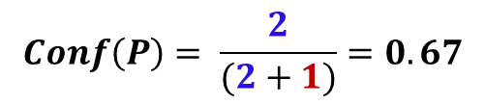
The confidence of a pattern P
$Conf\left(P\right)= \frac{P.positive}{(P.positive+P.negative)}$
1st iteration
2nd iteration
<Exxon, Irving>
<Intel, Santa Clara>
<MS, NY>
Org | Location
MICROSOFT | REDMOND
EXXON | IRVING
$$Conf\left(P\right)= \frac{2}{(2+1)}=0.67$$

Slide 35
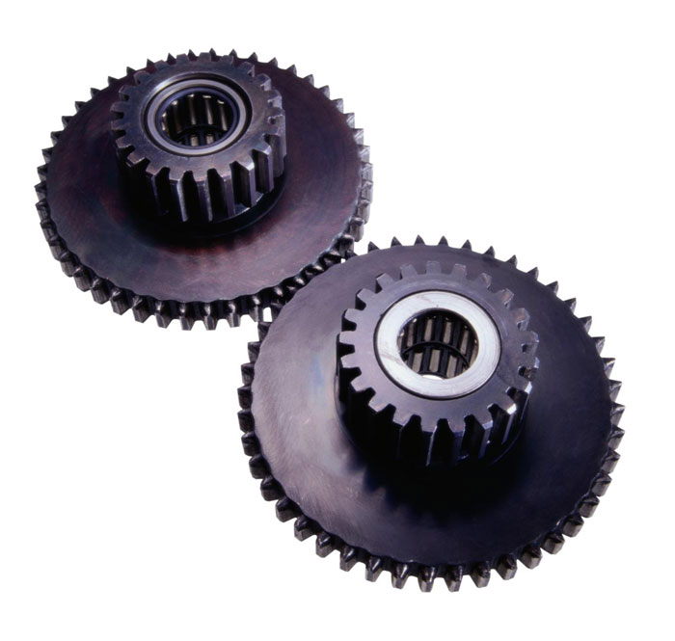



The confidence of a tuple T
$$Conf\left(P\right)$$
$$Match\left(Ci, Pi\right)$$
$$Conf\left(T\right)$$

Slide 36
3. Evaluating Patterns and Tuples
After determining the confidence of the candidate patterns and tuples,
Snowball discards all patterns and tuples with low confidence
F_{p}(p₁) = 1
P_{p}
F_{p}(p₂) = 0.6
Threshold
Ƭp = 0.5
F_{p}(p₃) = 0.8
F_{p}(p₄) = 0.2

Slide 37
3. Evaluating Patterns and Tuples
After determining the confidence of the candidate patterns and tuples,
Snowball discards all patterns and tuples with low confidence
F_{p}(t₁) = 1
T_{p}
F_{p}(t₂) = 0.7
Threshold
Ƭt = 0.6
F_{p}(t₃) = 0.3
F_{p}(t₄) = 0.8

Slide 38
Outline
Introduction
Related Work
The Snowball System
Experiments
Conclusion

Slide 39
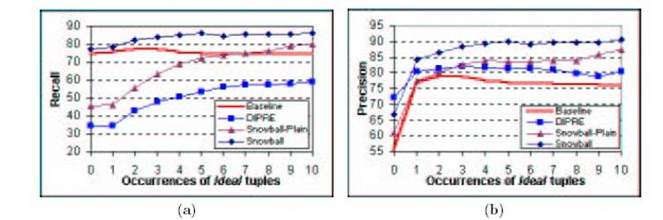
Experimental Evaluation
This experiments involved over 300,000 newspaper articles
(a) Recall
(b) precision of Baseline, DIPRE, Snowball and Snowball-Plain

Slide 40
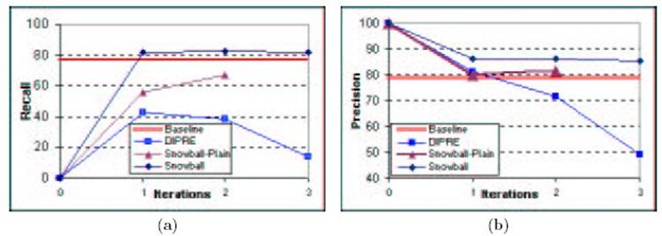
Experimental Evaluation
(a) Recall
(b) Precision of Baseline, DIPRE, Snowball, and Snowball-Plain as a function of the number of iterations

Slide 41
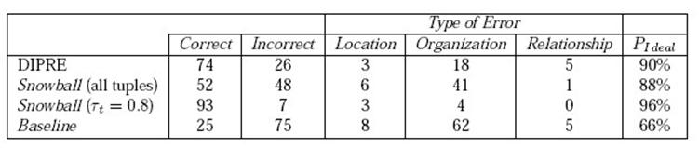
Experimental Evaluation
Manually computed precision estimate, derived from a random sample of 100 tuples from each extracted table

Slide 42
Conclusion
We presents Snowball, a system for extracting relations from large collections of plain-text documents that requires minimal training for each new scenario
It shows that the new techniques produce high-quality tables, according to the scalable evaluation methodology
In the future, we will also generalize Snowball to relations of more than two attributes.

Slide 43
Thank You!
Any Questions or Comments?

