Slide 1
Chapter 13: Query Optimization

Slide 2
Database System Concepts
Chapter 1: Introduction
Part 1: Relational databases
  Chapter 2: Introduction to the Relational Model
  Chapter 3: Introduction to SQL
  Chapter 4: Intermediate SQL
  Chapter 5: Advanced SQL
  Chapter 6: Formal Relational Query Languages
Part 2: Database Design
  Chapter 7: Database Design: The E-R Approach
  Chapter 8: Relational Database Design
  Chapter 9: Application Design
Part 3: Data storage and querying
  Chapter 10: Storage and File Structure
  Chapter 11: Indexing and Hashing
  Chapter 12: Query Processing
  Chapter 13: Query Optimization
Part 4: Transaction management
  Chapter 14: Transactions
  Chapter 15: Concurrency control
  Chapter 16: Recovery System
Part 5: System Architecture
  Chapter 17: Database System Architectures
  Chapter 18: Parallel Databases
  Chapter 19: Distributed Databases
Part 6: Data Warehousing, Mining, and IR
  Chapter 20: Data Mining
  Chapter 21: Information Retrieval
Part 7: Specialty Databases
  Chapter 22: Object-Based Databases
  Chapter 23: XML
Part 8: Advanced Topics
  Chapter 24: Advanced Application Development
  Chapter 25: Advanced Data Types
  Chapter 26: Advanced Transaction Processing
Part 9: Case studies
  Chapter 27: PostgreSQL
  Chapter 28: Oracle
  Chapter 29: IBM DB2 Universal Database
  Chapter 30: Microsoft SQL Server
Online Appendices
  Appendix A: Detailed University Schema
  Appendix B: Advanced Relational Database Model
  Appendix C: Other Relational Query Languages
  Appendix D: Network Model
  Appendix E: Hierarchical Model

Slide 3
Chapter 13: Query Optimization
13.1 Overview
13.2 Transformation of Relational Expressions
13.3 Estimating Statistics of Expression
13.4 Choice of Evaluation Plans
13.5 Materialized views**
13.6 Advanced Topics in Query Optimization**

Slide 4

Introduction
Alternative ways of evaluating a given query
  Equivalent expressions
  Different algorithms for each operation
Relations generated by two equivalent expressions have the same set of attributes and contain the same set of tuples, although their attributes may be ordered differently.

Slide 5

Introduction (Cont.)
An evaluation plan defines exactly what algorithm is used for each operation, and how the execution of the operations is coordinated.
Find out how to view query execution plans on your favorite database

Slide 6
Introduction (Cont.)
Cost difference between evaluation plans for a query can be enormous
  E.g. seconds vs. days in some cases
Steps in cost-based query optimization
  Generate logically equivalent expressions using equivalence rules
  Annotate resultant expressions to get alternative query plans
  Choose the cheapest plan based on estimated cost
Estimation of plan cost based on:
  Statistical information about relations. Examples:
    number of tuples, number of distinct values for an attribute
  Statistics estimation for intermediate results
    to compute cost of complex expressions
  Cost formulae for algorithms, computed using statistics

Slide 7
Generating Equivalent Expressions

Slide 8
Transformation of Relational Expressions
Two relational algebra expressions are said to be equivalent if the two expressions generate the same set of tuples on every legal database instance
  Note: order of tuples is irrelevant
  we don’t care if they generate different results on databases that violate integrity constraints
In SQL, inputs and outputs are multisets of tuples
  Two expressions in the multiset version of the relational algebra are said to be equivalent if the two expressions generate the same multiset of tuples on every legal database instance.
An equivalence rule says that expressions of two forms are equivalent
  Can replace expression of first form by second, or vice versa

Slide 9



Equivalence Rules
1. Conjunctive selection operations can be deconstructed into a sequence of individual selections.
2. Selection operations are commutative.
3. Only the last in a sequence of projection operations is needed, the others can be omitted.
Selections can be combined with Cartesian products and theta joins.
  σ_{θ}(E₁ X E₂) = E₁ _{θ} E₂
  σ_{θ1}(E₁ _{θ2} E₂) = E₁ _{θ1∧ θ2} E₂

Slide 10
Equivalence Rules (Cont.)
5. Theta-join operations (and natural joins) are commutative.
E_{1 θ} E₂ = E₂ _{θ} E₁
6. (a) Natural join operations are associative:
(E₁ E₂) E₃ = E₁ (E₂ E₃)
(b) Theta joins are associative in the following manner:
(E_{1 θ1} E₂) _{θ2∧ θ3} E₃ = E_{1 θ1∧ θ3} (E₂ _{θ2} E₃)
where θ₂ involves attributes from only E₂ and E₃.

Slide 11

Pictorial Depiction of Equivalence Rules

Slide 12
Equivalence Rules (Cont.)
7. The selection operation distributes over the theta join operation under the following two conditions:
(a) When all the attributes in θ₀ involve only the attributes of one
of the expressions (E₁) being joined.
σ_{θ0}(E₁ _{θ} E₂) = (σ_{θ0}(E₁)) _{θ} E₂
(b) When θ ₁ involves only the attributes of E₁ and θ₂ involves
only the attributes of E₂.
σ_{θ1}∧_{θ2} (E₁ _{θ} E₂) = (σ_{θ1}(E₁)) _{θ} (σ_{θ2} (E₂))

Slide 13
Equivalence Rule 7-a (1)
보조자료
θ₀의 모든 속성들이 조인되는 expression(E₁) 의 한 쪽의 속성들로만 이루어져 있을 때
  1) σ_{θ0}(E1 _{θ} E2)
branch-city | branch-name | assets | loan-number | amount
Brighton | Perryridge | 7100000 | L-15 | 1500
Brighton | Perryridge | 7100000 | L-16 | 1300
σ_{assets > 2000000}
branch-city | branch-name | assets | loan-number | amount
Bennington | Pownal | 300000 | L-23 | 2000
Horseneck | Mianus | 400000 | L-11 | 900
Brighton | Perryridge | 7100000 | L-15 | 1500
Brighton | Perryridge | 7100000 | L-16 | 1300
branch
loan
branch-name | branch-city | assets
Brighton | Perryridge | 7100000
Downtown | Brooklyn | 9000000
Mianus | Horseneck | 400000
North Town | Rye | 3700000
Perryridge | Horseneck | 1700000
Pownal | Bennington | 300000
Redwood | Palo Alto | 2100000
Round Hill | Horseneck | 8000000
loan-number | branch-name | amount
L-11 | Horseneck | 900
L-14 | Downtown | 1500
L-15 | Perryridge | 1500
L-16 | Perryridge | 1300
L-17 | Downtown | 1000
L-23 | Pownal | 2000
L-93 | Mianus | 500

Slide 14
Equivalence Rule 7-a (2)
보조자료
2) (σ_{θ0}(E₁)) _{θ} E₂
branch-city | branch-name | assets | loan-number | amount
Brighton | Perryridge | 7100000 | L-15 | 1500
Brighton | Perryridge | 7100000 | L-16 | 1300
Result
branch-name | branch-city | assets
Brighton | Perryridge | 7100000
Downtown | Brooklyn | 9000000
North Town | Rye | 3700000
Redwood | Palo Alto | 2100000
Round Hill | Horseneck | 8000000
loan
loan-number | branch-name | amount
L-11 | Horseneck | 900
L-14 | Downtown | 1500
L-15 | Perryridge | 1500
L-16 | Perryridge | 1300
L-17 | Downtown | 1000
L-23 | Pownal | 2000
L-93 | Mianus | 500
σ_{assets > 2000000}
branch
branch-name | branch-city | assets
Brighton | Perryridge | 7100000
Downtown | Brooklyn | 9000000
Mianus | Horseneck | 400000
North Town | Rye | 3700000
Perryridge | Horseneck | 1700000
Pownal | Bennington | 300000
Redwood | Palo Alto | 2100000
Round Hill | Horseneck | 8000000
So, σ_{θ0}(E1 _{θ} E2) = (σ_{θ0}(E1)) _{θ} E2

Slide 15
Equivalence Rule 7-b (1)
보조자료
θ ₁이 E₁ 의 속성들에만 관여되고, θ₂가 E₂의 속성들에만 관여될 때
1) σ_{θ1}∧_{θ2} (E₁ _{θ} E₂)
branch-city | branch-name | assets | loan-number | amount
Brighton | Perryridge | 7100000 | L-15 | 1500
σassets > 2000000 and amount > 1300
branch-city | branch-name | assets | loan-number | amount
Bennington | Pownal | 300000 | L-23 | 2000
Horseneck | Mianus | 400000 | L-11 | 900
Brighton | Perryridge | 7100000 | L-15 | 1500
Brighton | Perryridge | 7100000 | L-16 | 1300
branch
loan
branch-name | branch-city | assets
Brighton | Perryridge | 7100000
Downtown | Brooklyn | 9000000
Mianus | Horseneck | 400000
North Town | Rye | 3700000
Perryridge | Horseneck | 1700000
Pownal | Bennington | 300000
Redwood | Palo Alto | 2100000
Round Hill | Horseneck | 8000000
loan-number | branch-name | amount
L-11 | Horseneck | 900
L-14 | Downtown | 1500
L-15 | Perryridge | 1500
L-16 | Perryridge | 1300
L-17 | Downtown | 1000
L-23 | Pownal | 2000
L-93 | Mianus | 500

Slide 16
Equivalence Rule 7-b (2)
보조자료
2) (σ_{θ1}(E₁)) _{θ} (σ_{θ2} (E₂))
branch-city | branch-name | assets | loan-number | amount
Brighton | Perryridge | 7100000 | L-15 | 1500
Result
branch-name | branch-city | assets
Brighton | Perryridge | 7100000
Downtown | Brooklyn | 9000000
North Town | Rye | 3700000
Redwood | Palo Alto | 2100000
Round Hill | Horseneck | 8000000
loan-number Horseneck | branch-name | amount
L-14 | Downtown | 1500
L-15 | Perryridge | 1500
L-23 | Pownal | 2000
σ_{assets > 2000000}
σ_{amount > 1500}
branch
loan
branch-name | branch-city | assets
Brighton | Perryridge | 7100000
Downtown | Brooklyn | 9000000
Mianus | Horseneck | 400000
North Town | Rye | 3700000
Perryridge | Horseneck | 1700000
Pownal | Bennington | 300000
Redwood | Palo Alto | 2100000
Round Hill | Horseneck | 8000000
loan-number | branch-name | amount
L-11 | Horseneck | 900
L-14 | Downtown | 1500
L-15 | Perryridge | 1500
L-16 | Perryridge | 1300
L-17 | Downtown | 1000
L-23 | Pownal | 2000
L-93 | Mianus | 500
So, σ_{θ1∧θ2} (E1 _{θ} E2) = (σ_{θ1}(E1)) _{θ} (σ_{θ2} (E2))

Slide 17
Equivalence Rules (Cont.)
8. The projection operation distributes over the theta join operation as follows:
(a) if θ involves only attributes from L₁ ∪ L₂:
(b) Consider a join E_{1 θ} E₂.
  Let L₁ and L₂ be sets of attributes from E₁ and E₂, respectively.
  Let L₃ be attributes of E₁ that are involved in join condition θ, but are not in L₁ ∪ L₂, and
  let L₄ be attributes of E₂ that are involved in join condition θ, but are not in L₁ ∪ L₂.
∏
(
E
E
)
=
(
∏
(
E
))
(
∏
(
E
))
L
1
∪
L
2
1
θ
2
L
1
1
θ
L
2
2
∏
(
E
E
)
=
∏
((
∏
(
E
))
(
∏
(
E
)))
L
1
∪
L
2
1
θ
2
L
1
∪
L
2
L
1
∪
L
3
1
θ
L
2
∪
L
4
2

Slide 18




The Equivalence Rule 8-a
보조자료
E1 = loan, E2 = branch
L1 = {loan-number, branch-name}, L2 = {branch-name, assets}
= branch.assets > 75000
In this condition, join condition involves only attributes in

Slide 19


Equivalence Rule 8-a: left-hand side
보조자료
loan-number | branch-name | amount | branch-city | assets
L-11 | Round-Hill | 900 | Horse-neck | 8000000
L-14 | Downtown | 1500 | Brook-lyn | 9000000
L-17 | Downtown | 1000 | Brook-lyn | 9000000
loan-number | branch-name | assets
L-11 | Round-Hill | 8000000
L-14 | Downtown | 9000000
L-17 | Downtown | 9000000

Slide 20
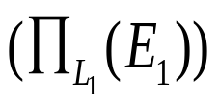


Equivalence Rule 8-a: right-hand side
보조자료
loan-number | branch-name | assets
L-11 | Round-Hill | 8000000
L-14 | Downtown | 9000000
L-17 | Downtown | 9000000

Slide 21
Equivalence Rule 8-b:
보조자료
E1 = loan, E2 = branch
L1 = {branch-name}, L2 = {branch-name}
= loan.amount > 950 and branch.branch-city = ‘Brooklyn’
L3 = {amount}, L4 = {branch-city}

Slide 22
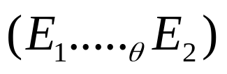
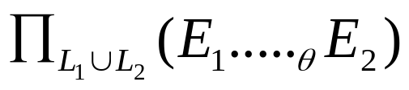
Equivalence Rule 8-b: left-hand side
보조자료
loan-number | branch-name | amount | branch-city | assets
L-14 | Downtown | 1500 | Brook-lyn | 9000000
L-17 | Downtown | 1000 | Brook-lyn | 9000000
branch-name
Downtown

Slide 23




Equivalence Rule 8-b: right-hand side
보조자료
branch-name | amount | branch-city
Downtown | 1500 | Brook-lyn
Downtown | 1000 | Brook-lyn
branch-name
Downtown

Slide 24
Equivalence Rules (Cont.)
The set operations union and intersection are commutative
E₁ ∪ E₂ = E₂ ∪ E₁
E₁ ∩ E₂ = E₂ ∩ E₁
  (set difference is not commutative).
Set union and intersection are associative.
(E₁ ∪ E₂) ∪ E₃ = E₁ ∪ (E₂ ∪ E₃)
(E₁ ∩ E₂) ∩ E₃ = E₁ ∩ (E₂ ∩ E₃)
The selection operation distributes over ∪, ∩ and –.
σ_{θ} (E₁ – E₂) = σ_{θ} (E₁) – σ_{θ}(E₂)
and similarly for ∪ and ∩ in place of –
Also: σ_{θ} (E₁ – E₂) = σ_{θ}(E₁) – E₂
and similarly for ∩ in place of –, but not for ∪
12. The projection operation distributes over union
Π_{L}(E₁ ∪ E₂) = (Π_{L}(E₁)) ∪ (Π_{L}(E₂))

Slide 25
Transformation Example: Pushing Selections
Query: Find the names of all instructors in the Music department, along with the titles of the courses that they teach
  Π_{name, title}(σ_{dept_name= “Music”}
  (instructor (teaches Π_{course_id, title} (course))))
Transformation using rule 7a.
  Π_{name, title}((σ_{dept_name= “Music”}(instructor))
  (teaches Π_{course_id, title} (course)))
Performing the selection as early as possible reduces the size of the relation to be joined.

Slide 26
Example with Multiple Transformations
Query: Find the names of all instructors in the Music department who have taught a course in 2009, along with the titles of the courses that they taught
  Π_{name, title}(σ_{dept_name= “Music”∧gear = 2009}
  (instructor (teaches Π_{course_id, title} (course))))
Transformation using join associatively (Rule 6a):
  Π_{name, title}(σ_{dept_name= “Music”∧gear = 2009}
  ((instructor teaches) Π_{course_id, title} (course)))
Second form provides an opportunity to apply the “perform selections early” rule, resulting in the subexpression
σ_{dept_name = “Music”} (instructor) σ _{year = 2009} (teaches)

Slide 27

Multiple Transformations (Cont.)

Slide 28
Transformation Example: Pushing Projections
Consider: Π_{name, title}(σ_{dept_name= “Music”} (instructor) teaches)
Π_{course_id, title} (course))))
When we compute
(σ_{dept_name = “Music”} (instructor teaches)
we obtain a relation whose schema is:
(ID, name, dept_name, salary, course_id, sec_id, semester, year)
Push projections using equivalence rules 8a and 8b; eliminate unneeded attributes from intermediate results to get:
Π_{name, title}(Π_{name, course_id} (
σ_{dept_name= “Music”} (instructor) teaches))
Π_{course_id, title} (course))))
Performing the projection as early as possible reduces the size of the relation to be joined.

Slide 29
Join Ordering Example
For all relations r_{1,} r_{2,} and r₃,
(r₁ r₂) r₃ = r₁ (r₂ r₃ )
(Join Associativity)
If r₂ r₃ is quite large and r₁ r₂ is small, we choose
(r₁ r₂) r₃
so that we compute and store a smaller temporary relation.

Slide 30
Join Ordering Example (Cont.)
Consider the expression
Π_{name, title}(σ_{dept_name= “Music”} (instructor) teaches)
Π_{course_id, title} (course))))
Could compute teaches Π_{course_id, title} (course) first, and join result with
σ_{dept_name= “Music”} (instructor)
but the result of the first join is likely to be a large relation.
Only a small fraction of the university’s instructors are likely to be from the Music department
  it is better to compute
σ_{dept_name= “Music”} (instructor) teaches
first.

Slide 31
Enumeration of Equivalent Expressions
Query optimizers use equivalence rules to systematically generate expressions equivalent to the given expression
Can generate all equivalent expressions as follows:
  Repeat
    apply all applicable equivalence rules on every subexpression of every equivalent expression found so far
    add newly generated expressions to the set of equivalent expressions
    Until no new equivalent expressions are generated above
The above approach is very expensive in space and time
  Two approaches
    Optimized plan generation based on transformation rules
    Special case approach for queries with only selections, projections and joins

Slide 32
Implementing Transformation Based Optimization
Space requirements reduced by sharing common sub-expressions:
  when E1 is generated from E2 by an equivalence rule, usually only the top level of the two are different, subtrees below are the same and can be shared using pointers
    E.g. when applying join commutativity
  Same sub-expression may get generated multiple times
    Detect duplicate sub-expressions and share one copy
Time requirements are reduced by not generating all expressions
  Dynamic programming
    We will study only the special case of dynamic programming for join order optimization
E1
E2

Slide 33
Cost Estimation
Cost of each operator computer as described in Chapter 12
  Need statistics of input relations
    E.g. number of tuples, sizes of tuples
Inputs can be results of sub-expressions
  Need to estimate statistics of expression results
  To do so, we require additional statistics
    E.g. number of distinct values for an attribute
More on cost estimation later

Slide 34
Choice of Evaluation Plans
Must consider the interaction of evaluation techniques when choosing evaluation plans
  choosing the cheapest algorithm for each operation independently may not yield best overall algorithm. E.g.
    merge-join may be costlier than hash-join, but may provide a sorted output which reduces the cost for an outer level aggregation.
    nested-loop join may provide opportunity for pipelining
Practical query optimizers incorporate elements of the following two broad approaches:
  1. Search all the plans and choose the best plan in a cost-based fashion.
  2. Uses heuristics to choose a plan.

Slide 35
Cost-Based Optimization
Consider finding the best join-order for r₁ r₂ . . . r_{n}.
There are (2(n – 1))!/(n – 1)! different join orders for above expression.
  With n = 7, the number is 665280, with n = 10, the number is greater than 176 billion!
  The number of complete binary trees with n leaf nodes ( n-1 internal nodes)
    1/n X 2(n-1) C (n-1) ➔ (2(n-1))! / ( n! * (n-1)!)
  Multiply this by n! (permutations of n leaves)
No need to generate all the join orders.
Using dynamic programming, the least-cost join order for any subset of
{r₁, r₂, . . . r_{n}} is computed only once and stored for future use.

Slide 36
Dynamic Programming in Optimization
To find best join tree for a set of n relations:
  To find best plan for a set S of n relations, consider all possible plans of the form: S₁ (S – S₁) where S₁ is any non-empty subset of S.
  Recursively compute costs for joining subsets of S to find the cost of each plan.
    nC1 + nC2 + …. nCn = 2^{n}
    Choose the cheapest of the 2^{n} – 2 alternatives.
    Space overhead for storing 2^{n} cost ➔ O(2^{n})
  Base case for recursion: single relation access plan
    Apply all selections on R_{i} using best choice of indices on R_{i}
  When plan for any subset is computed, store it and reuse it when it is required again, instead of recomputing it
    Dynamic programming O(3^{n})
    O(3^{n}) by solving the recurrence relation of the next slide

Slide 37
Join Order Optimization Algorithm
procedure findbestplan(S)
if (bestplan[S].cost ≠ ∞)
return bestplan[S]
// else bestplan[S] has not been computed earlier, compute it now
if (S contains only 1 relation)
set bestplan[S].plan and bestplan[S].cost based on the best way
of accessing S /* Using selections on S and indices on S */
else for each non-empty subset S1 of S such that S1 ≠ S
P1= findbestplan(S1)
P2= findbestplan(S - S1)
A = best algorithm for joining results of P1 and P2
cost = P1.cost + P2.cost + cost of A
if cost < bestplan[S].cost
bestplan[S].cost = cost
bestplan[S].plan = “execute P1.plan; execute P2.plan;
join results of P1 and P2 using A”
return bestplan[S]
* Some modifications to allow indexed nested loops joins on relations that have
selections (see book)

Slide 38

Left Deep Join Trees
In left-deep join trees, the right-hand-side input for each join is a relation, not the result of an intermediate join.
Left-deep join orders are convenient for pipelined evaluation: the right operand is a stored relation and only one input to each join is pipelined
Figure (a) would enjoy pipelining while pipelining may not be possible in Figure (b)
All left-deep join orders is O(n!) while all join orders is O(3^{n}).

Slide 39
Cost of Optimization
With dynamic programming time complexity of optimization with bushy trees is O(3^{n}).
  With n = 10, this number is 59000 instead of 176 billion!
Space complexity is O(2^{n})
To find best left-deep join tree for a set of n relations:
  Consider n alternatives with one relation as right-hand side input and the other relations as left-hand side input.
  Modify optimization algorithm:
    Replace “for each non-empty subset S1 of S such that S1 ≠ S”
    By: for each relation r in S
    let S1 = S – r .
If only left-deep trees are considered, time complexity of finding best join order is O(n 2^{n})
  Space complexity remains at O(2^{n})
Cost-based optimization is expensive, but worthwhile for queries on large datasets (typical queries have small n, generally < 10)

Slide 40
Interesting Sort Orders
Consider the expression (r₁ r₂) r₃ (with A as common attribute)
An interesting sort order is a particular sort order of tuples that could be useful for a later operation
  Using merge-join to compute r₁ r₂ may be costlier than hash join but generates result sorted on A
  Which in turn may make merge-join with r₃ cheaper, which may reduce cost of join with r₃ and minimizing overall cost
  Sort order may also be useful for order by and for grouping
Not sufficient to find the best join order for each subset of the set of n given relations
  must find the best join order for each subset, for each interesting sort order
  Simple extension of earlier dynamic programming algorithms O(3^{n})
  Usually, number of interesting orders is quite small and doesn’t affect time/space complexity significantly

Slide 41
Cost Based Optimization with Equivalence Rules
Physical equivalence rules allow logical query plan to be converted to physical query plan specifying what algorithms are used for each operation.
Efficient optimizer based on equivalent rules depends on
  A space efficient representation of expressions which avoids making multiple copies of subexpressions
  Efficient techniques for detecting duplicate derivations of expressions
  A form of dynamic programming based on memoization, which stores the best plan for a subexpression the first time it is optimized, and reuses in on repeated optimization calls on same subexpression
  Cost-based pruning techniques that avoid generating all plans
Pioneered by the Volcano project and implemented in the SQL Server optimizer

Slide 42
Heuristic Optimization
Cost-based optimization is expensive, even with dynamic programming.
Systems may use heuristics to reduce the number of choices that must be made in a cost-based fashion.
Heuristic optimization transforms the query-tree by using a set of rules that typically (but not in all cases) improve execution performance:
  Perform selection early (reduces the number of tuples)
  Perform projection early (reduces the number of attributes)
  Perform most restrictive selection and join operations (i.e. with smallest result size) before other similar operations.
  Some systems use only heuristics, others combine heuristics with partial cost-based optimization.
Direction in heuristics ➔ reduce the size of intermediate results!

Slide 43
Structure of Query Optimizers
Many optimizers considers only left-deep join orders.
  Plus heuristics to push selections and projections down the query tree
  Reduces optimization complexity and generates plans amenable to pipelined evaluation.
Heuristic optimization used in some versions of Oracle:
  Repeatedly pick “best” relation to join next
    Starting from each of n starting points. Pick best among these
Intricacies of SQL complicate query optimization
  E.g. nested subqueries

Slide 44
Structure of Query Optimizers (Cont.)
Some query optimizers integrate heuristic selection and the generation of alternative access plans.
  Frequently used approach
    heuristic rewriting of nested block structure and aggregation
    followed by cost-based join-order optimization for each block
  Some optimizers (e.g. SQL Server) apply transformations to entire query and do not depend on block structure
  Optimization cost budget to stop optimization early (if cost of plan is less than cost of optimization)
  Plan caching to reuse previously computed plan if query is resubmitted
    Even with different constants in query
Even with the use of heuristics, cost-based query optimization imposes a substantial overhead.
  But is worth it for expensive queries
  Optimizers often use simple heuristics for very cheap queries, and perform exhaustive enumeration for more expensive queries

Slide 45
Statistics for Cost Estimation

Slide 46
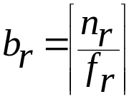
Statistical Information for Cost Estimation
n_{r}: number of tuples in a relation r.
b_{r}: number of blocks containing tuples of r.
l_{r}: size of a tuple of r.
f_{r}: blocking factor of r — i.e., the number of tuples of r that fit into one block.
V(A, r): number of distinct values that appear in r for attribute A
  same as the size of ∏_{A}(r).
If tuples of r are stored together physically in a file, then:
SC(A, r): selection cardinality of attribute A of relation r
  average number of records that satisfy equality on A.
f_{i}: average fan-out of internal nodes of index i, for B+-trees.
HT_{i}: number of levels in index i ( i.e., the height of i & on attribute A of relation r)
  For a B+-tree HT_{i} = ⎡log_{fi}(V(A,r))⎤
  For a hash index, HT_{i} = 1
LB_{i}: number of lowest-level index blocks in i (i.e, the # of blocks at the leaf level)

Slide 47
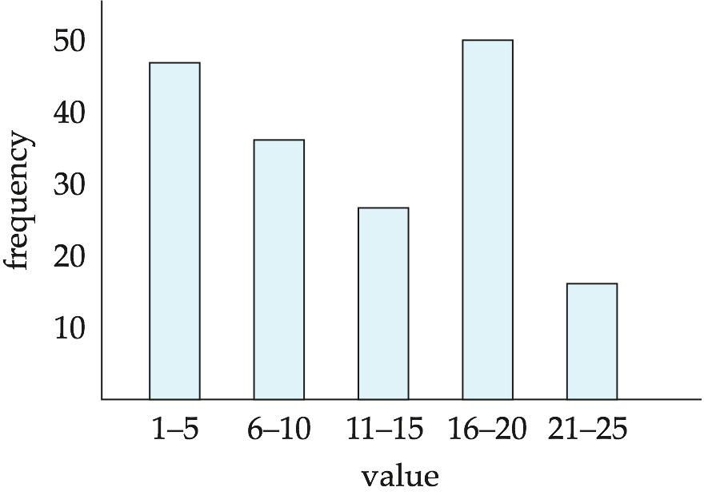
Histograms
Histogram on attribute age of relation person
Equi-width histograms
Equi-depth histograms

Slide 48
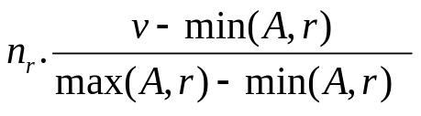
Selection Size Estimation
Equality selection σ_{A=v}(r)
  n_{r} / V(A,r) : number of records that will satisfy the selection
  Equality condition on a key attribute: size estimate = 1
σ_{A≤V}(r) (case of σ_{A ≥ V}(r) is symmetric)
  Let c denote the estimated number of tuples satisfying the condition.
  If min(A,r) and max(A,r) are available in catalog
    c = 0 if v < min(A,r)
    c =
  If histograms available, can refine above estimate
  In absence of statistical information c is assumed to be n_{r} / 2.

Slide 49
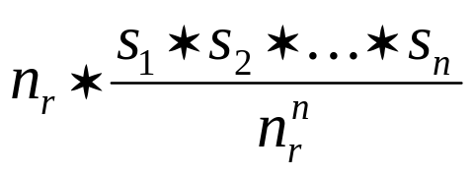
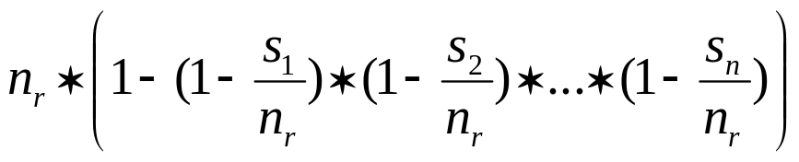
Size Estimation of Complex Selections
The selectivity of a condition θ_{i} is the probability that a tuple in the relation r satisfies θ_{i} .
  If s_{i} is the number of satisfying tuples in r, the selectivity of θ_{i} is given by s_{i} /n_{r}.
Conjunction: σ_{θ1∧ θ2∧. . . ∧ θn} (r). Assuming indepdence, estimate of
tuples in the result is:
Disjunction:σ_{θ1∨} _{θ2 ∨. . . ∨} _{θn} (r). Estimated number of tuples:
Negation: σ_{¬θ}(r).
Estimated number of tuples: n_{r} – size(σ_{θ}(r))

Slide 50
Join Operation: Running Example
Running example:
student takes
Catalog information for join examples:
n_{student} = 5,000.
f_{student} = 50, which implies that
b_{student} =5000/50 = 100.
n_{takes} = 10000.
f_{takes} = 25, which implies that
b_{takes} = 10000/25 = 400.
V(ID, takes) = 2500, which implies that on average, each student who has taken a course has taken 4 courses.
  Attribute ID in takes is a foreign key referencing student.
  V(ID, student) = 5000 (primary key!)

Slide 51
Estimation of the Size of Joins
The Cartesian product r x s contains n_{r} .n_{s} tuples; each tuple occupies s_{r} + s_{s} bytes.
If R ∩ S = ∅, then r s is the same as r x s.
If R ∩ S is a key for R, then a tuple of s will join with at most one tuple from r
  therefore, the number of tuples in r s is no greater than the number of tuples in s.
If R ∩ S in S is a foreign key in S referencing R, then the number of tuples in r s is exactly the same as the number of tuples in s.
    The case for R ∩ S being a foreign key referencing S is symmetric.
In the example query student takes, ID in takes is a foreign key referencing student
  hence, the result has exactly n_{takes} tuples, which is 10000

Slide 52


Estimation of the Size of Joins (Cont.)
If R ∩ S = {A} is not a key for R or S.
If we assume that every tuple t in R produces tuples in R S, the number of tuples in R S is estimated to be:
If the reverse is true, the estimate obtained will be:
The lower of these two estimates is probably the more accurate one.
Can improve on above if histograms are available
  Use formula similar to above, for each cell of histograms on the two relations

Slide 53
Estimation of the Size of Joins (Cont.)
Compute the size estimates for depositor customer without using information about foreign keys:
  V(ID, takes) = 2500, and
  V(ID, student) = 5000
  The two estimates are 5000 * 10000/2500 = 20,000 and 5000 * 10000/5000 = 10000
  We choose the lower estimate, which in this case, is the same as our earlier computation using foreign keys.

Slide 54
Size Estimation for Other Operations
Projection: estimated size of ∏_{A}(r) = V(A,r)
Aggregation : estimated size of _{A}g_{F}(r) = V(A,r)
Set operations
  For unions/intersections of selections on the same relation: rewrite and use size estimate for selections
    E.g. σ_{θ1} (r) ∪ σ_{θ2} (r) can be rewritten as σ_{θ1} σ_{θ2} (r)
  For operations on different relations:
    estimated size of r ∪ s = size of r + size of s.
    estimated size of r ∩ s = minimum size of r and size of s.
    estimated size of r – s = r.
    All the three estimates may be quite inaccurate, but provide upper bounds on the sizes.
Outer join:
  Estimated size of r s = size of r s + size of r
    Case of right outer join is symmetric
  Estimated size of r s = size of r s + size of r + size of s

Slide 55
Estimation of Number of Distinct Values
Selections: σ_{θ} (r)
If θ forces A to take a specified value: V(A,σ_{θ} (r)) = 1.
    e.g., A = 3
If θ forces A to take on one of a specified set of values:
V(A,σ_{θ} (r)) = number of specified values.
    (e.g., (A = 1 V A = 3 V A = 4 )),
If the selection condition θ is of the form A op r
estimated V(A,σ_{θ} (r)) = V(A.r) * s
    where s is the selectivity of the selection.
In all the other cases: use approximate estimate of
min(V(A,r), n_{σθ (r)} )
  More accurate estimate can be got using probability theory, but this one works fine generally

Slide 56
Estimation of Distinct Values (Cont.)
Joins: r s
If all attributes in A are from r
estimated V(A, r s) = min (V(A,r), n _{r s})
If A contains attributes A1 from r and A2 from s, then estimated
V(A,r s) =
min(V(A1,r)*V(A2 – A1,s), V(A1 – A2,r)*V(A2,s), n_{r s})
  More accurate estimate can be got using probability theory, but this one works fine generally
Projection: Estimation of distinct values are straightforward for projections.
  They are the same in ∏_{A (r)} as in r.
Aggregation: The same holds for grouping attributes of aggregation.
  For aggregated values
    For min(A) and max(A), the number of distinct values can be estimated as min(V(A,r), V(G,r)) where G denotes grouping attributes
    For other aggregates, assume all values are distinct, and use V(G,r)

Slide 57
Estimation of Distinct Values in Join (1)
보조자료
A의 모든 속성이 r에 있을때의 estimated V(A, r s) = min (V(A,r), n _{r s})
Example A = (B)
s (case 1)
s (case 2)
r
C | D
C1 | D1
C2 | D1
C3 | D2
C4 | D3
C5 | D4
C | D
C1 | D1
C5 | D2
C12 | D3
C5 | D4
C6 | D5
K | B | C
A1 | B1 | C1
A1 | B2 | C2
A2 | B3 | C1
A2 | B1 | C1
A3 | B5 | C4
r s (case 1)
∏_{B}(r s) (case 1)
K | B | C | D
A1 | B1 | C1 | D1
A2 | B3 | C1 | D1
A2 | B1 | C1 | D1
A1 | B2 | C2 | D1
B
B1
B3
B2
V(A, r s) = V(A,r)
r s (case 2)
∏_{B}(r s) (case 2)
K | B | C | D
A1 | B1 | C1 | D1
A2 | B3 | C1 | D1
B
B1
B3
V(A, r s) = n _{r s}

Slide 58
Estimation of Distinct Values in Join (2)
보조자료
A의 속성 A1은 r에, A2는 s에 있을때의 estimated V(A, r s) =
  min(V(A1,r) * V(A2 – A1,s), V(A1 – A2,r) * V(A2,s), n_{r s})
Example A = (B, D), 처음 두 개의 경우는 대칭적이므로 처음과 세번째 경우만 고려
r
s (case 1)
s (case 3)
K | B | C
A1 | B1 | C1
A1 | B2 | C2
A2 | B2 | C1
A2 | B1 | C1
A3 | B2 | C4
C | D
C1 | D1
C1 | D1
C2 | D2
C2 | D1
C | D
C2 | D1
C5 | D2
C12 | D3
C5 | D4
C6 | D5
r s (case 1)
∏_{A}(r s) (case 1)
K | B | C | D
A1 | B1 | C1 | D1
…
A2 | B1 | C1 | D1
A1 | B2 | C2 | D1
V(A, r s) =
V(A1,r) * V(A2-A1,s)
(4 = 2 X 2)
(Join의 결과가 큰 경우)
B | D
B1 | D1
B1 | D2
B2 | D1
B2 | D2
r s (case 3)
∏_{A}(r s) (case 3)
K | B | C | D
A1 | B2 | C2 | D1
B | D
B2 | D1
V(A, r s) = n _{r s}
(1 = 1)

Slide 59
Additional Optimization Techniques
Nested Subqueries
Materialized Views

Slide 60
Optimizing Nested Subqueries**
Nested query example:
select name
from instructor
where exists (select *
from teaches
where instructor.ID = teaches.ID and teaches.year = 2007)
SQL conceptually treats nested subqueries in the where clause as functions that take parameters and return a single value or set of values
  Parameters are variables from outer level query that are used in the nested subquery; such variables are called correlation variables
Conceptually, nested subquery is executed once for each tuple in the cross-product generated by the outer level from clause
  Such evaluation is called correlated evaluation
  Note: other conditions in where clause may be used to compute a join (instead of a cross-product) before executing the nested subquery

Slide 61
Optimizing Nested Subqueries (Cont.)
Correlated evaluation may be quite inefficient since
  a large number of calls may be made to the nested query
  there may be unnecessary random I/O as a result
SQL optimizers attempt to transform nested subqueries to joins where possible, enabling use of efficient join techniques
E.g.: earlier nested query can be rewritten as
select name
from instructor, teaches
where instructor.ID = teaches.ID and teaches.year = 2007
  Note: the two queries generate different numbers of duplicates (why?)
    teaches can have duplicate IDs
    Can be modified to handle duplicates correctly as we will see
In general, it is not possible/straightforward to move the entire nested subquery from clause into the outer level query from clause
  A temporary relation is created instead, and used in body of outer level query

Slide 62
Optimizing Nested Subqueries (Cont.)
In general, SQL queries of the form below can be rewritten as shown
Rewrite: select …
from L₁
where P₁ and exists (select *
from L₂
where P₂)
To: create table t₁ as
select distinct V
from L₂
where P₂¹
select …
from L₁, t₁
where P₁ and P₂²
  P₂¹ contains predicates in P₂ that do not involve any correlation variables
  P₂² reintroduces predicates involving correlation variables, with
  relations renamed appropriately
  V contains all attributes used in predicates with correlation variables

Slide 63
Optimizing Nested Subqueries (Cont.)
In our example, the original nested query would be transformed to
create table t₁ as
select distinct ID
from teaches
where year = 2007
select name
from instructor, t₁
where t₁.ID = instructor.ID
The process of replacing a nested query by a query with a join (possibly with a temporary relation) is called decorrelation.
Decorrelation is more complicated when
  the nested subquery uses aggregation, or
  when the result of the nested subquery is used to test for equality, or
  when the condition linking the nested subquery to the other query is not exists,
  and so on.

Slide 64
Materialized Views**
A materialized view is a view whose contents are computed and stored.
Consider the view
create view department_total_salary(dept_name, total_salary) as
select dept_name, sum(salary)
from instructor
group by dept_name
Materializing the above view would be very useful if the total salary by department is required frequently
  Saves the effort of finding multiple tuples and adding up their amounts

Slide 65
Materialized View Maintenance
The task of keeping a materialized view up-to-date with the underlying data is known as materialized view maintenance
Materialized views can be maintained by recomputation on every update
A better option is to use incremental view maintenance
  Changes to database relations are used to compute changes to the materialized view, which is then updated
View maintenance can be done by
  Manually defining triggers on insert, delete, and update of each relation in the view definition
  Manually written code to update the view whenever database relations are updated
  Periodic recomputation (e.g. nightly)
  Above methods are directly supported by many database systems
    Avoids manual effort/correctness issues

Slide 66
Incremental View Maintenance
The changes (inserts and deletes) to a relation or expressions are referred to as its differential
  Set of tuples inserted to and deleted from r are denoted i_{r} and d_{r}
To simplify our description, we only consider inserts and deletes
  We replace updates to a tuple by deletion of the tuple followed by insertion of the update tuple
We describe how to compute the change to the result of each relational operation, given changes to its inputs
We then outline how to handle relational algebra expressions

Slide 67
Join Operation
Consider the materialized view v = r s and an update to r
Let r^{old} and r^{new} denote the old and new states of relation r
Consider the case of an insert to r:
  We can write r^{new} s as (r^{old} ∪ i_{r}) s
  And rewrite the above to (r^{old} s) ∪ (i_{r} s)
  But (r^{old} s) is simply the old value of the materialized view, so the incremental change to the view is just i_{r} s
Thus, for inserts v^{new} = v^{old} ∪(i_{r} s)
Similarly for deletes v^{new} = v^{old} – (d_{r} s)
A, 1
B, 2
1, p
2, r
2, s
A, 1, p
B, 2, r
B, 2, s
C,2
C, 2, r
C, 2, s

Slide 68
Incremental View Maintenance
보조자료
r = loan, s = branch
The materialized view v = r s
loan-number | branch-name | amount | branch-city | assets
L-11 | Round-Hill | 900 | Horseneck | 8000000
L-14 | Downtown | 1500 | Brooklyn | 9000000
L-15 | Perryridge | 1500 | Horseneck | 1700000
L-16 | Perryridge | 1300 | Horseneck | 1700000
L-17 | Downtown | 1000 | Brooklyn | 9000000
L-23 | Redwood | 2000 | Palo Alto | 2100000
L-93 | Mianus | 500 | Horseneck | 400000

Slide 69
Incremental Deletion
보조자료
dr = (L-11, Round Hill, 900)
dr s
vnew = vold – (dr s)
loan-number | branch-name | amount | branch-city | assets
L-11 | Round-Hill | 900 | Horseneck | 8000000
loan-number | branch-name | amount | branch-city | assets
L-14 | Downtown | 1500 | Brooklyn | 9000000
L-15 | Perryridge | 1500 | Horseneck | 1700000
L-16 | Perryridge | 1300 | Horseneck | 1700000
L-17 | Downtown | 1000 | Brooklyn | 9000000
L-23 | Redwood | 2000 | Palo Alto | 2100000
L-93 | Mianus | 500 | Horseneck | 400000

Slide 70
Incremental Insertion
보조자료
ir = (L-11, Round Hill, 900)
ir s
vnew = vold ∪ (ir s)
loan-number | branch-name | amount | branch-city | assets
L-11 | Round-Hill | 900 | Horseneck | 8000000
loan-number | branch-name | amount | branch-city | assets
L-11 | Round-Hill | 900 | Horseneck | 8000000
L-14 | Downtown | 1500 | Brooklyn | 9000000
L-15 | Perryridge | 1500 | Horseneck | 1700000
L-16 | Perryridge | 1300 | Horseneck | 1700000
L-17 | Downtown | 1000 | Brooklyn | 9000000
L-23 | Redwood | 2000 | Palo Alto | 2100000
L-93 | Mianus | 500 | Horseneck | 400000

Slide 71
Selection and Projection Operations
Selection: Consider a view v = σ_{θ}(r).
  v^{new} = v^{old} ∪σ_{θ}(i_{r})
  v^{new} = v^{old} - σ_{θ}(d_{r})
Projection is a more difficult operation
  R = (A,B), and r(R) = { (a,2), (a,3)}
  ∏_{A}(r) has a single tuple (a).
  If we delete the tuple (a,2) from r, we should not delete the tuple (a) from ∏_{A}(r), but if we then delete (a,3) as well, we should delete the tuple
For each tuple in a projection ∏_{A}(r) , we will keep a count of how many times it was derived
  On insert of a tuple to r, if the resultant tuple is already in ∏_{A}(r) we increment its count, else we add a new tuple with count = 1
  On delete of a tuple from r, we decrement the count of the corresponding tuple in ∏_{A}(r)
    if the count becomes 0, we delete the tuple from ∏_{A}(r)

Slide 72
Aggregation Operations
count : v = _{A}g_{count(B)}^{(r)}.
  When a set of tuples i_{r} is inserted
    For each tuple r in i_{r}, if the corresponding group is already present in v, we increment its count, else we add a new tuple with count = 1
  When a set of tuples d_{r} is deleted
    for each tuple t in i_{r.}we look for the group t.A in v, and subtract 1 from the count for the group.
      If the count becomes 0, we delete from v the tuple for the group t.A
sum: v = _{A}g_{sum (B)}^{(r)}
  We maintain the sum in a manner similar to count, except we add/subtract the B value instead of adding/subtracting 1 for the count
  Additionally we maintain the count in order to detect groups with no tuples. Such groups are deleted from v
    Cannot simply test for sum = 0 (why?)
To handle the case of avg, we maintain the sum and count aggregate values separately, and divide at the end

Slide 73
Incremental View Maintenance
보조자료
Count
  v = _{branch-name}g_{count(loan-number)} ^{(loan)}
Sum
  v = _{branch-name}g_{sum(amount)} ^{(loan)}
Avg
  v = _{branch-name}g_{avg(amount)} ^{(loan)}

Slide 74
Incremental View Maintenance
보조자료
Materialized View (Count) Materialized View (Sum)
Materialized View (Avg)
branch-name | count
Round Hill | 1
Downtown | 2
Perryridge | 2
Red Wood | 1
Mianus | 1
branch-name | sum
Round Hill | 900
Downtown | 2500
Perryridge | 2800
Red Wood | 2000
Mianus | 500
branch-name | avg
Round Hill | 900
Downtown | 1250
Perryridge | 1400
Red Wood | 2000
Mianus | 500

Slide 75
Insertion to Base Relation
보조자료
Base relation loan에 tuple (L-30, Round Hill, 1300) 이 삽입된 경우
  Count: Materialized View Count 에 Round Hill 이 있는가? ➔ Yes
    Update the tuple (Round Hill, 1) ➔ (Round Hill, 2)
  Sum: Materialized View Sum 에 RoundHill 이 있는가? ➔ Yes
    Update the tuple (RoundHill, 900) ➔ (RoundHill, 2200) // 900+1300
  Avg: Materialized View Sum 에 RoundHill 이 있는가? ➔ Yes
    Update the tuple (RoundHill, 900) ➔ (RoundHill, 1100) // (900 + 1300) / 2
Base relation loan에 tuple (L-70, Seoul, 1000) 이 삽입된 경우
  Count: Materialized View Count 에 Seoul 이 있는가? ➔ No
    Insert a new tuple (Seoul, 1) to Count
  Sum: Materialized View Sum 에 Seoul 이 있는가? ➔ No
    Insert a new tuple (Seoul, 1000) to Sum
  Avg: Materialized View Sum 에 Seoul 이 있는가? ➔ No
    Insert a new tuple (Seoul, 1000) to Sum

Slide 76
Delete from Base Relation
보조자료
Base relation loan에 tuple (L-11, Round Hill, 900)이 삭제된 경우
  Count: Attribute ‘count’ value를 1감소. 0인가?
    If so, Tuple (Round Hill, 1)을 Count에서 삭제
  Sum: 구릅별 count 에서 1감소. 0인가?
    If so, Tuple (Round Hill, 900)을 Sum에서 삭제
  Avg: 구릅별 count 에서 1감소. 0인가?
    If so, Tuple (Round Hill, 900)을 Avg에서 삭제
Base relation loan에 tuple (L-15, Downtown, 1500) 삭제된 경우
  Count: Attribute ‘count’ value를 1감소. 0인가?
    If not, update (Downtown, 2) ➔ (Downtown, 1)
  Sum: . Group별 count에서 1감소. 0인가?
    If not, update Tuple (Downtown, 2500) ➔ (Downtown, 1000) // 2500 - 1500
  Avg: Group별 count에서 1감소. 0인가?
    If not, update Tuple (Downtown, 2500) ➔ (Downtown, 1000) // (2500 – 1500)/ (2 -1)

Slide 77
Aggregate Operations (Cont.)
min, max: v = _{A}g_{min (B)} (r).
  Handling insertions on r is straightforward.
  Maintaining the aggregate values min and max on deletions may be more expensive.
    We have to look at the other tuples of r that are in the same group to find the new minimum

Slide 78
Other Operations
Set intersection: v = r ∩ s
  when a tuple is inserted in r we check if it is present in s, and if so we add it to v.
  If the tuple is deleted from r, we delete it from the intersection if it is present.
  Updates to s are symmetric
  The other set operations, union and set difference are handled in a similar fashion.
Outer joins are handled in much the same way as joins but with some extra work
  we leave details to you.

Slide 79
Handling Expressions
To handle an entire expression, we derive expressions for computing the incremental change to the result of each sub-expressions, starting from the smallest sub-expressions.
E.g. consider E₁ E₂ where each of E₁ and E₂ may be a complex expression
  Suppose the set of tuples to be inserted into E₁ is given by D₁
    Computed earlier, since smaller sub-expressions are handled first
  Then the set of tuples to be inserted into E₁ E₂ is given by
  D₁ E₂
    This is just the usual way of maintaining joins

Slide 80
Query Optimization and Materialized Views
Rewriting queries to use materialized views:
  A materialized view v = r s is available
  A user submits a query r s t
  We can rewrite the query as v t
    Whether to do so depends on cost estimates for the two alternative
Replacing a use of a materialized view by the view definition:
  A materialized view v = r s is available, but without any index on it
  User submits a query σ_{A=10}(v).
  Suppose also that s has an index on the common attribute B, and r has an index on attribute A.
  The best plan for this query may be to replace v by r s, which can lead to the query plan σ_{A=10}(r) s
Query optimizer should be extended to consider all above alternatives and choose the best overall plan

Slide 81
Materialized View Selection
Materialized view selection: “What is the best set of views to materialize?”.
Index selection: “what is the best set of indices to create”
  closely related, to materialized view selection
    but simpler
Materialized view selection and index selection based on typical system workload (queries and updates)
  Typical goal: minimize time to execute workload , subject to constraints on space and time taken for some critical queries/updates
  One of the steps in database tuning
    more on tuning in later chapters
Commercial database systems provide tools (called “tuning assistants” or “wizards”) to help the database administrator choose what indices and materialized views to create

Slide 82
Additional Optimization Techniques

Slide 83
Top-K Queries
Top-K queries
  select *
  from r, s
  where r.B = s.B
  order by r.A ascending
  limit 10
  Alternative 1: Indexed nested loops join with r as outer
  Alternative 2: estimate highest r.A value in result and add selection (and r.A <= H) to where clause
    If < 10 results, retry with larger H

Slide 84
Optimization of Updates
Halloween problem
  update R set A = 5 * A
  where A > 10
  If index on A is used to find tuples satisfying A > 10, and tuples updated immediately, same tuple may be found (and updated) multiple times
  Solution 1: Always defer updates
    collect the updates (old and new values of tuples) and update relation and indices in second pass
    Drawback: extra overhead even if e.g. update is only on R.B, not on attributes in selection condition
  Solution 2: Defer only if required
    Perform immediate update if update does not affect attributes in where clause, and deferred updates otherwise.

Slide 85
Join Minimization
Join minimization
  select r.A, r.B
  from r, s
  where r.B = s.B
Check if join with s is redundant, drop it
  E.g. join condition is on foreign key from r to s, no selection on s
  Other sufficient conditions possible
  select r.A, s1.B
  from r, s as s1, s as s2
  where r.B=s1.B and r.B = s2.B and s1.A < 20 and s2.A < 10
    join with s2 is redundant and can be dropped (along with selection on s2)
  Lots of research in this area since 70s/80s!

Slide 86
Multiquery Optimization
Example
Q1: select * from (r natural join t) natural join s
Q2: select * from (r natural join u) natural join s
  Both queries share common subexpression (r natural join s)
  May be useful to compute (r natural join s) once and use it in both queries
    But this may be more expensive in some situations
      e.g. (r natural join s) may be expensive, plans as shown in queries may be cheaper
Multiquery optimization: find best overall plan for a set of queries, expoiting sharing of common subexpressions between queries where it is useful

Slide 87
Multiquery Optimization (Cont.)
Simple heuristic used in some database systems:
  optimize each query separately
  detect and exploiting common subexpressions in the individual optimal query plans
    May not always give best plan, but is cheap to implement
  Shared scans: widely used special case of multiquery optimization
Set of materialized views may share common subexpressions
  As a result, view maintenance plans may share subexpressions
  Multiquery optimization can be useful in such situations

Slide 88
Parametric Query Optimization
Example
select *
from r natural join s
where r.a < $1
  value of parameter $1 not known at compile time
    known only at run time
  different plans may be optimal for different values of $1
Solution 1: optimize at run time, each time query is submitted
    can be expensive
Solution 2: Parametric Query Optimization:
  optimizer generates a set of plans, optimal for different values of $1
    Set of optimal plans usually small for 1 to 3 parameters
    Key issue: how to do find set of optimal plans efficiently
  best one from this set is chosen at run time when $1 is known
Solution 3: Query Plan Caching
  If optimizer decides that same plan is likely to be optimal for all parameter values, it caches plan and reuses it, else reoptimize each time
  Implemented in many database systems

Slide 89
End of Chapter

Slide 90
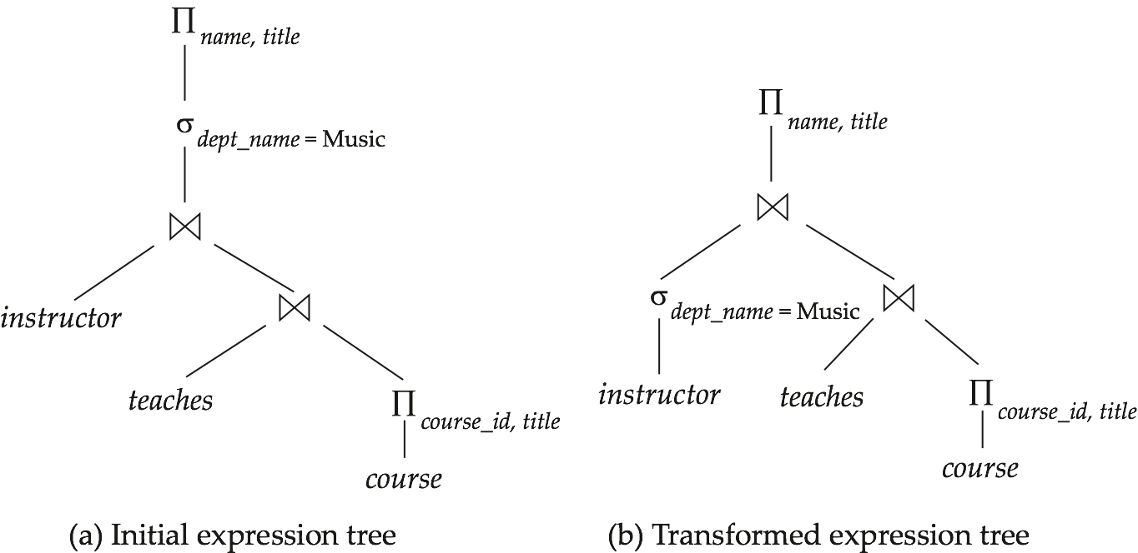
Figure 13.01

Slide 91
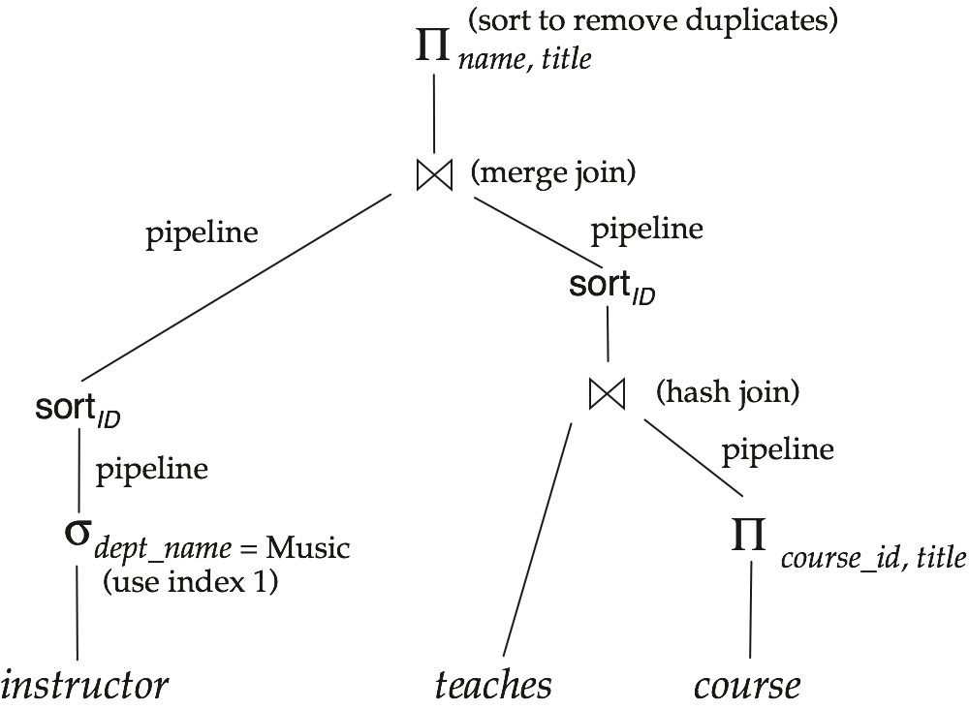
Figure 13.02

Slide 92
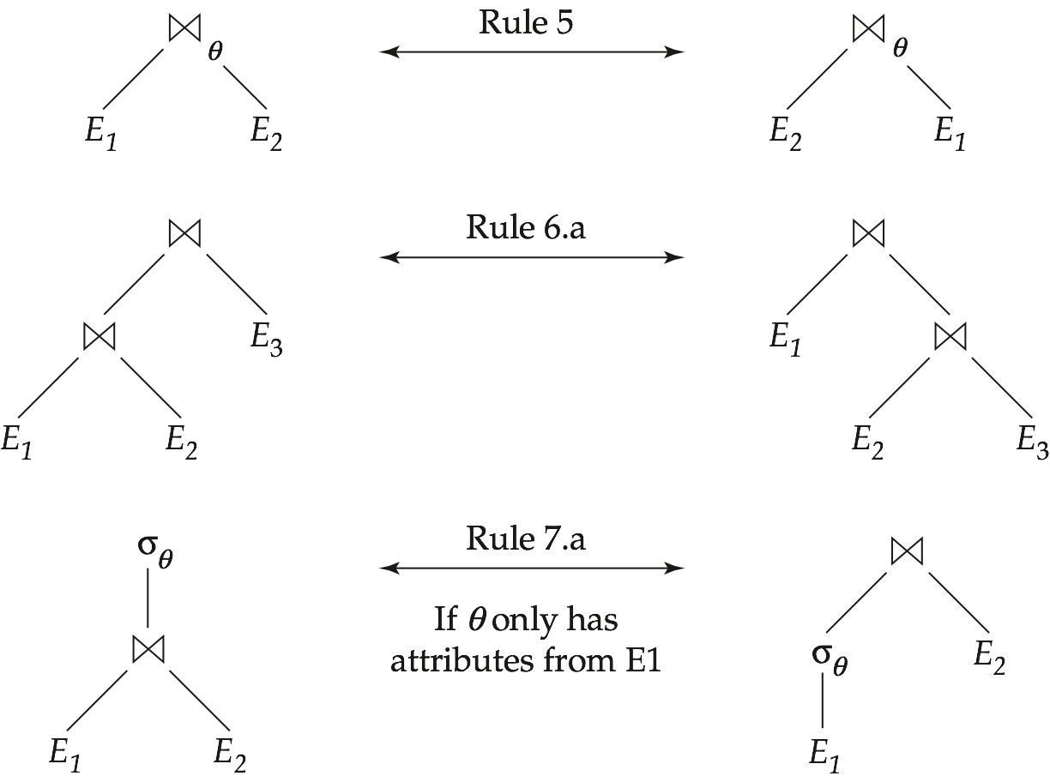
Figure 13.03

Slide 93
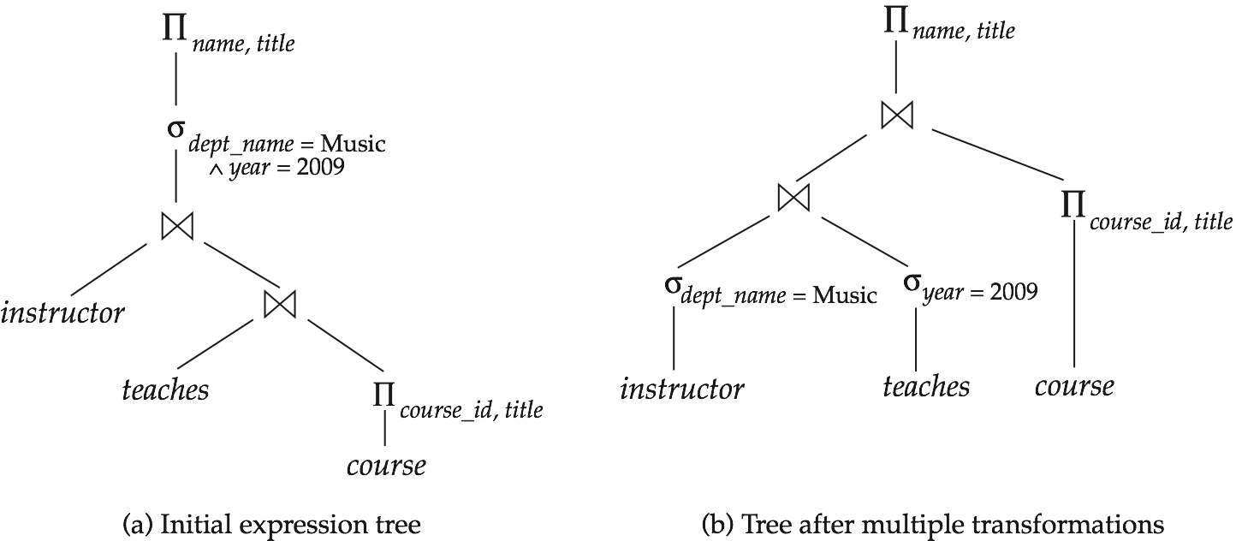
Figure 13.04

Slide 94
Figure 13.06

Slide 95
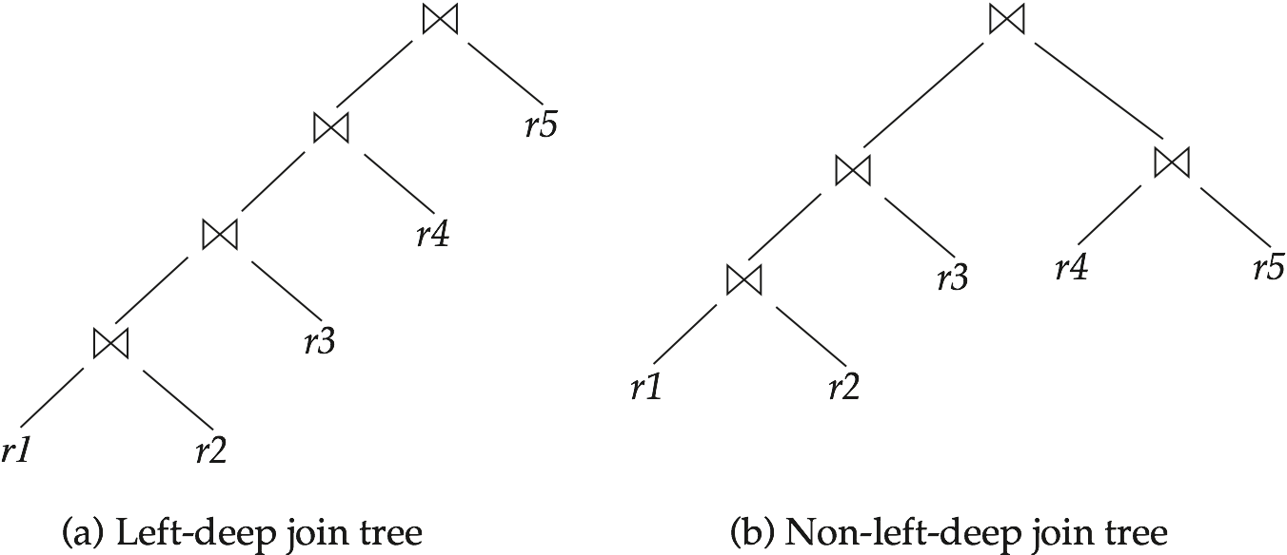
Figure 13.08

