Slide 1
Modeling and Comparing the Influence of Neighbors on the Behavior of Users in Social and Similarity Networks
Mohsen Jamali and Martin Ester
ICDMW 2010
12 Feb 2015
Hyewon Lim

Slide 2
Outline
Introduction
Datasets
Analyzing the Behavior of K-exposed Users
Modeling User Behavior
A Simple Recommender based on the Influence Coefficient
Social Authority of Users
Conclusion

Slide 3
Introduction
Social rating network
A social network in which users can express and share ratings on products or services
Two types of user behavior
adopting an item to rate
adopting a rating value for that item
Previous research issues on social network
Static analysis of social network structures
Models of the evolution of the structures over time
The analysis of the detailed dynamics of social processes
Influence and social selection

Slide 4
Introduction
Social influence
Adopt behaviors of their neighbors
Correlational influence
Adopt the behavior of users who have expressed similar behavior in the past
Similarity network
A graph among the same users in which users are connected to the most similar users
Correlational influence: the influence of neighbors in this network

Slide 5




Introduction
k-exposed users
E.g., 2-exposed user at time t

Slide 6


Introduction
Two approaches to analyze user behavior
Given that a user is k-exposed to an item, what is the probability that he will rate the item (or rate the item similar to the values expressed by his direct neighbors)?
Given that a user rates an item and some direct neighbors have already rated this item, what is the probability that he rates the item with a particular value?
✓
✓

Slide 7
Introduction
Local differences
Certain users have a stronger social influence than others
Social authority of individual users
Goal
To analyze, model, and compare social and correlational influence
Implicit feedback
on the influence

Slide 8
Outline
Introduction
Datasets
Analyzing the Behavior of K-exposed Users
Modeling User Behavior
A Simple Recommender based on the Influence Coefficient
Social Authority of Users
Conclusion

Slide 9
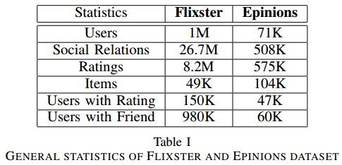
Datasets
Epinions and Flixster
Epinions: Nov 2005 – Nov 2009
Flixster: Jan 2000 – Feb 2002

Slide 10
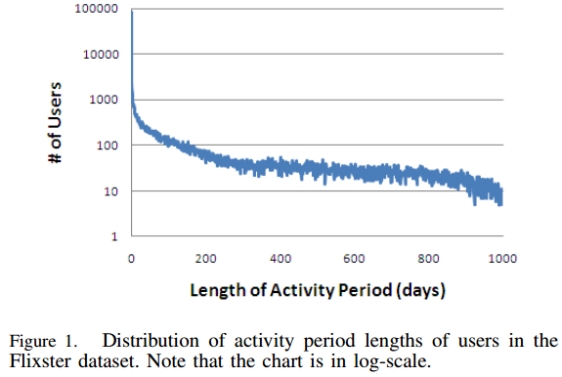
Datasets
Activity period for a users
The time interval between the first and the last rating expressed by the user
Notes:
Flixster dataset에서는 대부분의 user가 굉장히 짧은 주기를 가짐. Mean이 106 days 인데 median은 0(…)
Epinions datasets에서는 activity period가 0인 애들이 1/3 이하, median은 20 days, average는 137 days

Slide 11
Outline
Introduction
Datasets
Analyzing the Behavior of K-exposed Users
Modeling User Behavior
A Simple Recommender based on the Influence Coefficient
Social Authority of Users
Conclusion

Slide 12
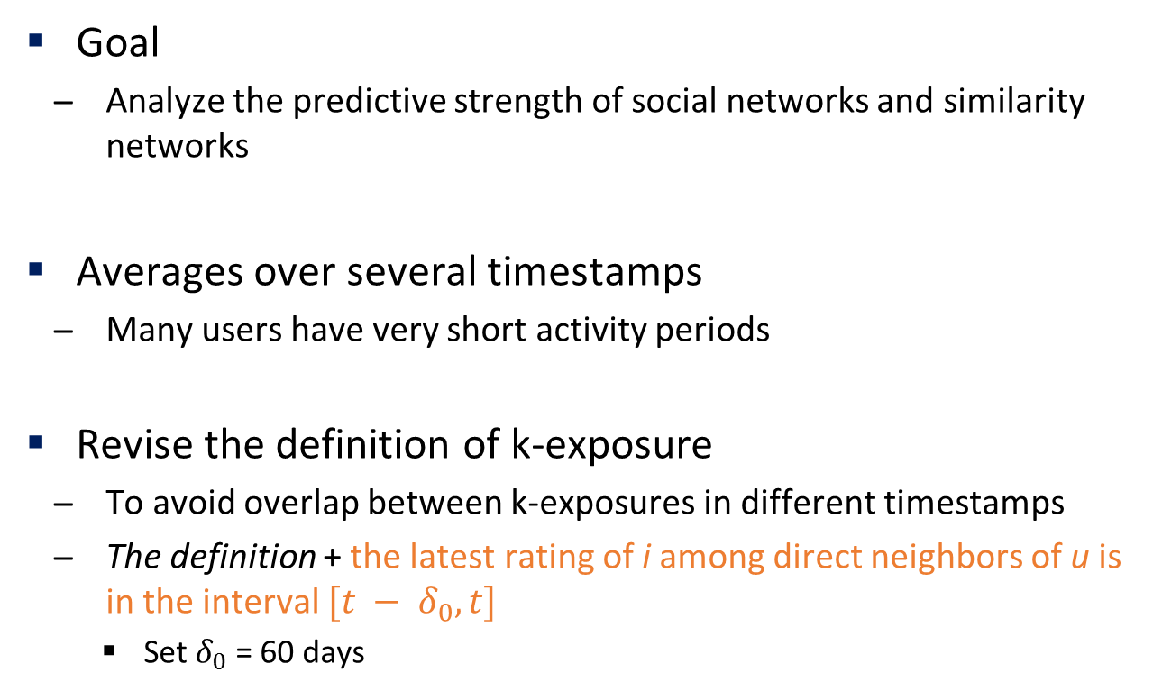
Analyzing the Behavior of K-exposed Users
Goal
Analyze the predictive strength of social networks and similarity networks
Averages over several timestamps
Many users have very short activity periods
Revise the definition of k-exposure
To avoid overlap between k-exposures in different timestamps
The definition + the latest rating of i among direct neighbors of u is in the interval $[t − δ_{0}, t]$
Set $δ_{0}$ = 60 days

Slide 13
Analyzing the Behavior of K-exposed Users Item adoption behavior of k-exposed users
Item adoption ratio p(k)
Compute the fraction of k-exposed users to any item i who have rated that item in a time window from t_{j} to t_{j}+𝛿
Flixster dataset: t₁ – t₁₀ (18/1/2009, 18/2/2009, … 18/10/2009)
Epinions dataset: t₁ – t₅ (1/1/2001, 1/3/2001, …, 1/9/2001)
t - 𝛿₀
t
t + 𝛿
60 days
30 days

Slide 14
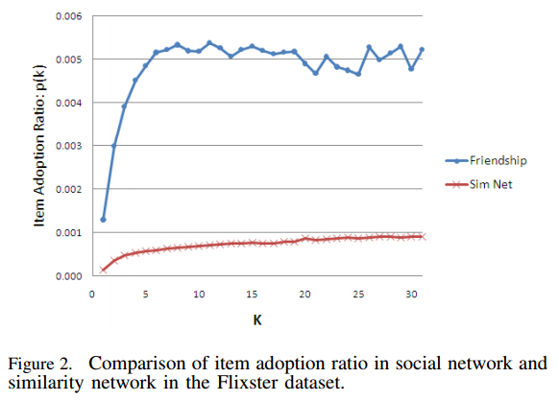
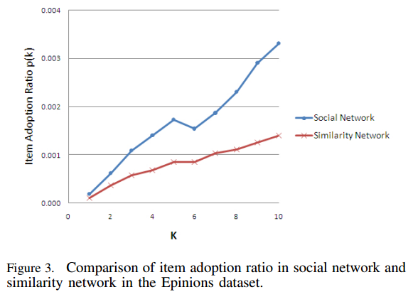
Analyzing the Behavior of K-exposed Users Item adoption behavior of k-exposed users
Social network vs. similarity network

Slide 15
Analyzing the Behavior of K-exposed Users Rating adoption behavior of k-exposed users
Rating adoption ratio p(k)
Compute the percentage of users being k-exposed to an item who rate the item within a distance of 0.5 of the average of their neighbors’ ratings
From
to
?

Slide 16
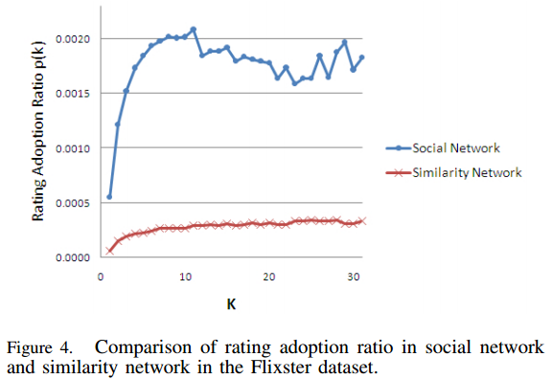
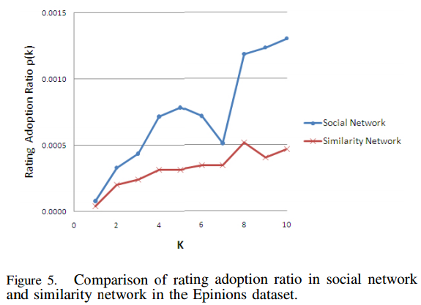
Analyzing the Behavior of K-exposed Users Rating adoption behavior of k-exposed users
Social network vs. similarity network

Slide 17
Outline
Introduction
Datasets
Analyzing the Behavior of K-exposed Users
Modeling User Behavior
A Simple Recommender based on the Influence Coefficient
Social Authority of Users
Conclusion

Slide 18

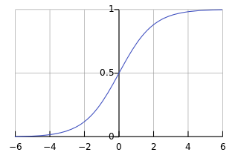



Modeling User Behavior Measuring the degree of influence on item & rating adoption
Model item adoption using a model in [1]*
“For most tags in the Flicker data set, a logistic function with the logarithm of the number of friends as the explanatory variable provides a good fit for the probability.”
: estimate the probability p(a) of activation for an agent with a already-active friends
: compute the value of α and β using maximum likelihood logistic regression
* [1] A. Anagnostopoulos et al., “Influence and correlation in social networks,” KDD’08

Slide 19
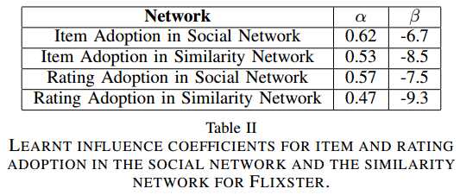
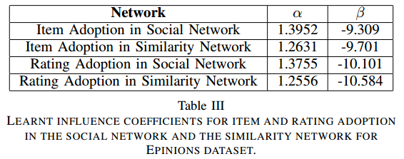
Modeling User Behavior Measuring the degree of influence on item & rating adoption
Influence coefficients for item and rating adoption
Notes:
α in social network: the measure of social influence
α in similarity network: the measure of correlational influence
Β controls the constant part of P(u, i, t)
- Rating adopation의 값이 item adoptio의 값보다 작은 것은 rating adoption probability가 더 낮기 때문.

Slide 20
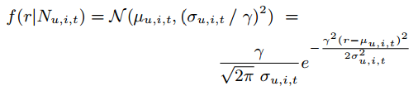

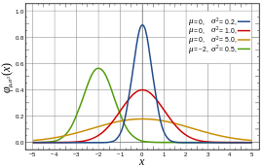

Modeling User Behavior Modeling the rating behavior of users
Q. What is the probability that he rates the item with a particular rating value?
Assumption
A normal distribution for the distribution of ratings
with mean (μ_{u, i, t})
The probability density function of the rating values
Models the influence on ratings from the ratings of direct neighbors
σ₀ = Default, 0.25
σ_{obs} = SD of the observed ratings by direct neighbors

Slide 21
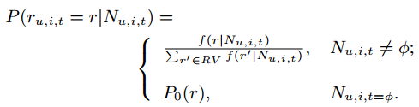

Modeling User Behavior Modeling the rating behavior of users
Normal distribution is a continuous distribution!
Our datasets have discrete rating values
Convert density function into a discrete probability function
The likelihood of the observed dataset D
Assuming the independence of the observed rating
A default normal distribution with
- mean = average of all ratings in the datasets
- SD = SD of all ratings in the datasets

Slide 22
Modeling User Behavior Modeling the rating behavior of users
The maximum likelihood
using gradient descent
learnt γ:
Results
The Social influence is a stronger predictor for future rating behavior of users in Flixster and Epinions
 | Social network | Similarity network
Flixster | 0.237 | 0.153
Epinions | 0.194 | 0.175

Slide 23
Modeling User Behavior Modeling the rating behavior of users
A stronger predictor
Depends on the characteristics of the network
In the LiveJournal, the similarity network is a better predictor
Edge overlap between the social network and similarity networks
Flixster: Less than 1%
Epinions: 4%
→ Using both networks together improves the quality of mining a social rating network

Slide 24
Outline
Introduction
Datasets
Analyzing the Behavior of K-exposed Users
Modeling User Behavior
A Simple Recommender based on the Influence Coefficient
Social Authority of Users
Conclusion

Slide 25

A Simple Recommender based on the Influence Coefficient
The predicted rating
Compute the expected value of ratings
At least one direct neighbor rating the target item
For most of the ratings, there is no direct neighbor who has already rated the item
The recommender cannot compute μ and σ
Notes:
RMSE: 추정 값 또는 모델이 예측한 값과 실제 환경에서 관찰되는 값의 차이를 다룰 때 흔히 사용하는 측도. 정밀도(precision)를 표현하는데 적합하다.

Slide 26

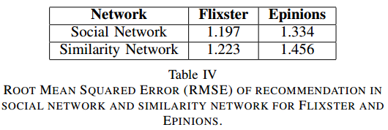
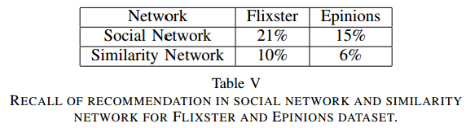
A Simple Recommender based on the Influence Coefficient
RMSE (Root-mean-squared error) for recommendation
To compare the social network and the similarity network
Recall of recommendation
Notes:
** RMSE: 추정 값 또는 모델이 예측한 값과 실제 환경에서 관찰되는 값의 차이를 다룰 때 흔히 사용하는 측도. 정밀도(precision)를 표현하는데 적합하다.
** recall 값들이 작은 이유 : direct neighbors만 고려했기 때문

Slide 27
Outline
Introduction
Datasets
Analyzing the Behavior of K-exposed Users
Modeling User Behavior
A Simple Recommender based on the Influence Coefficient
Social Authority of Users
Conclusion

Slide 28

Social Authority of Users
Analyze the influence of individual users separately
Idea
Social authority ↑
Social authority ↑

Slide 29




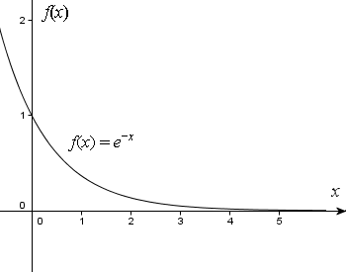
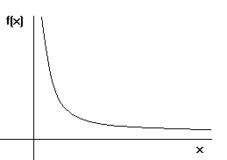
Social Authority of Users
Factors of the increase in social authority
The time difference δt of ratings expressed by u and v
The difference of ratings expressed by u and v
Number of ratings expressed by v
Social authority of a user u

Slide 30
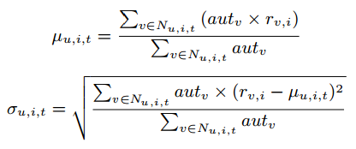
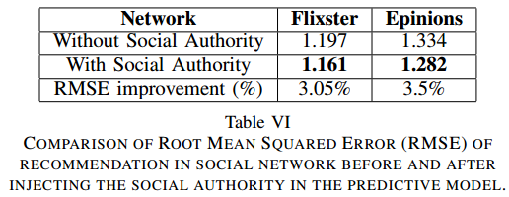
Social Authority of Users
Evaluating the social authority values
How these social authority values affect the predictive model
Comparing the RMSE

Slide 31
Outline
Introduction
Datasets
Analyzing the Behavior of K-exposed Users
Modeling User Behavior
A Simple Recommender based on the Influence Coefficient
Social Authority of Users
Conclusion

Slide 32
Conclusion
Analyzed and modeled the item adoption and rating adoption behavior in social and similarity networks
Social influence is a stronger predictor of both item and rating adoption than correlational influence
Inject the social authority (local effect)
Future work
Explore multi-model normal distributions for more flexible models
Consider the effect of the authorities of users and the number of neighbors they have

